Slide 1

COMPANION GRAPHS

Slide 2
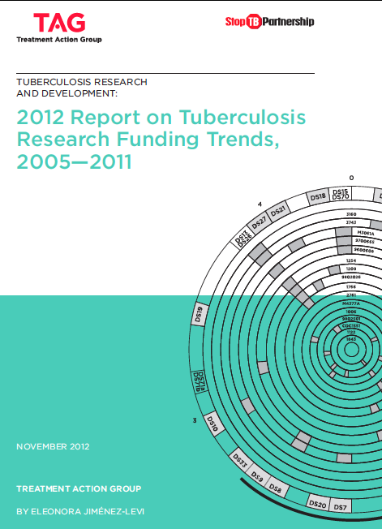

Slide 3
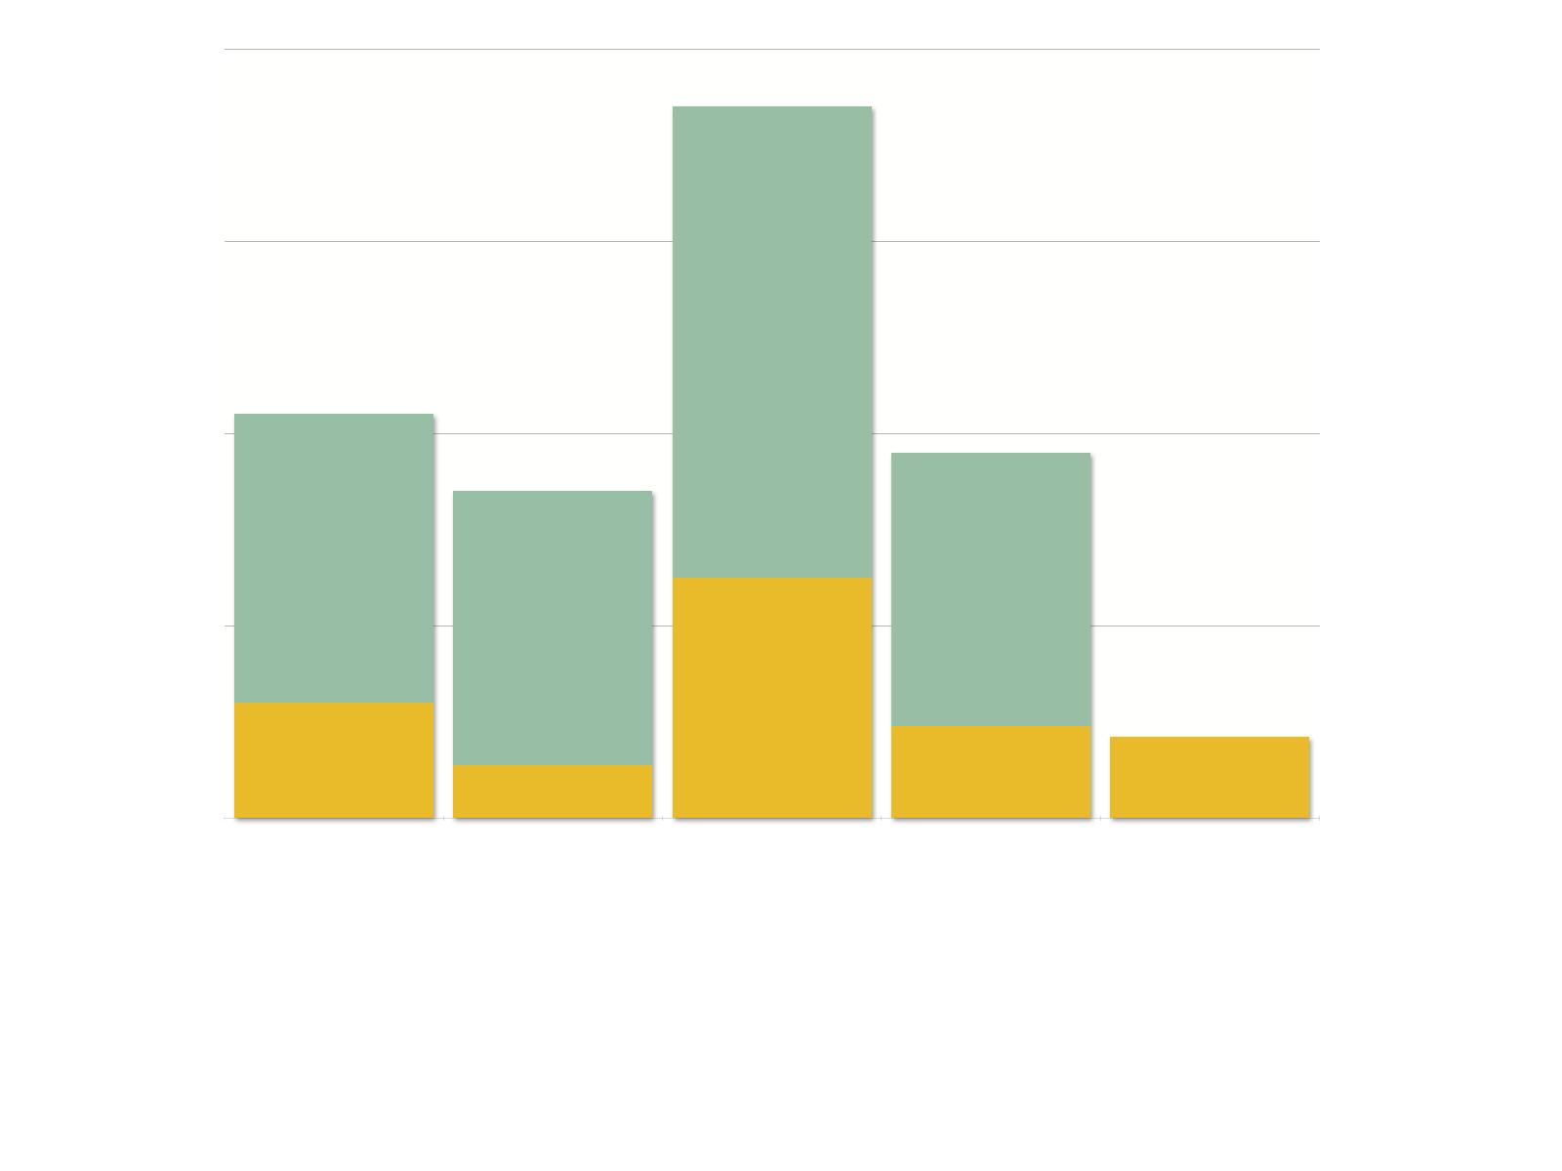
Annual Global Plan Research Funding Targets
vs. 2011 Investments
$800,000,000
$740,000,000
$600,000,000
$400,000,000
$420,000,000
$380,000,000
$340,000,000
$200,000,000
$250,038,877
$120,361,419
$80,000,000
$95,446,326
$84,140,175
$0
$55,043,541
Fundamental
research
New
diagnostics
New drugs
New
vaccines
Operational
research
Global Plan Annual Targets
2011 Investments
Notes:
2011 Funding Gaps that must be addressed to meet the Global Plan annual funding targets:
Fundamental Science: $300 million
New Diagnostics: $285 million
New Drugs: $490 million
New Vaccines: $285 million
Operational Research: None- the only research area to meet and exceed it’s funding target

Slide 4
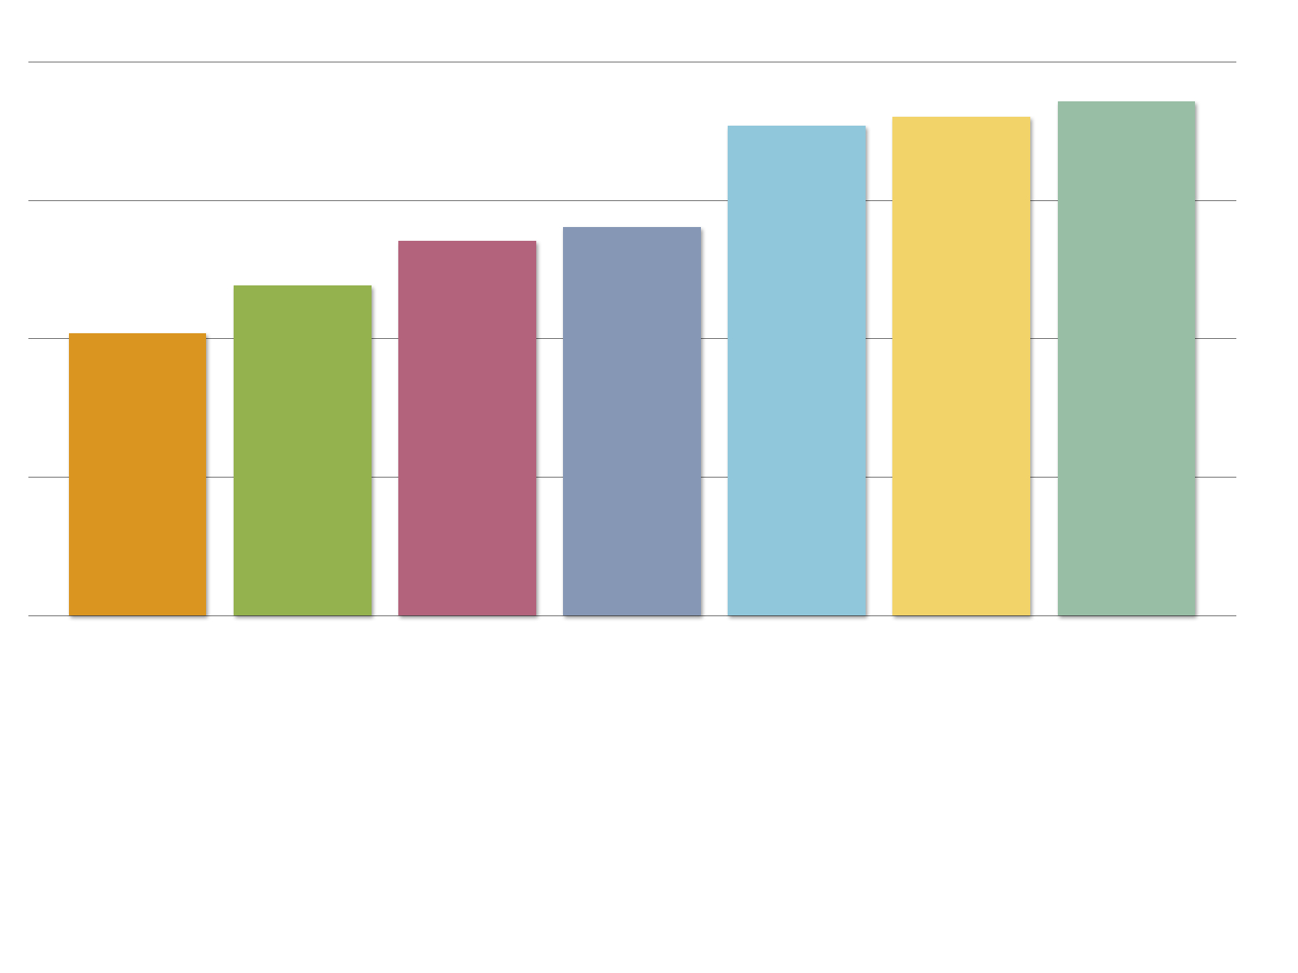
Total TB R&D Funding: 2005-2011
$700,000,000
$649,648,183
$619,209,536
$630,446,462
$525,000,000
$491,476,917
$473,920,682
$417,824,708
$357,426,170
$350,000,000
$175,000,000
$0
2005
2006
2007
2008
2009
2010
2011
2011 TB R&D investments witnessed an 82% increase
over 2005 levels, but only 3% growth since 2010.

Slide 5
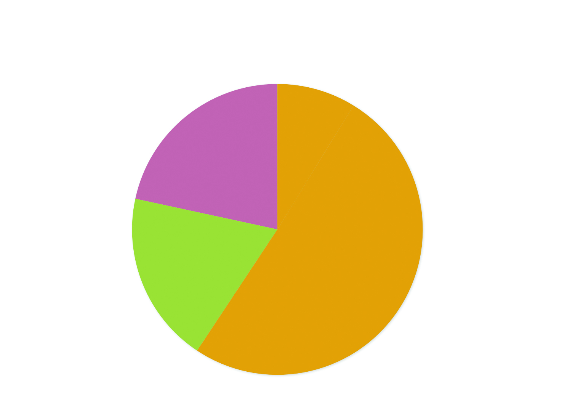
Total TB R&D Funding: by Donor Sector: 2011
Total: $649,648,183
International
Development Agencies
9%
Philanthropy
19%
Public
[Overall]
59%
Private
22%
Notes:
Public sector agencies including international development agencies invested the most to TB R&D, making up 59% of the total global spend.

Slide 6
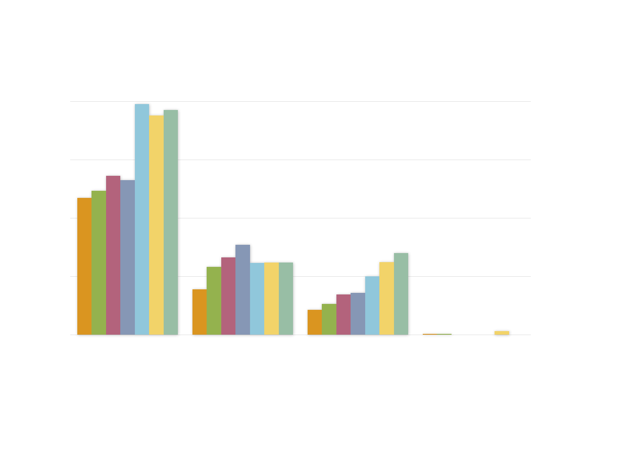
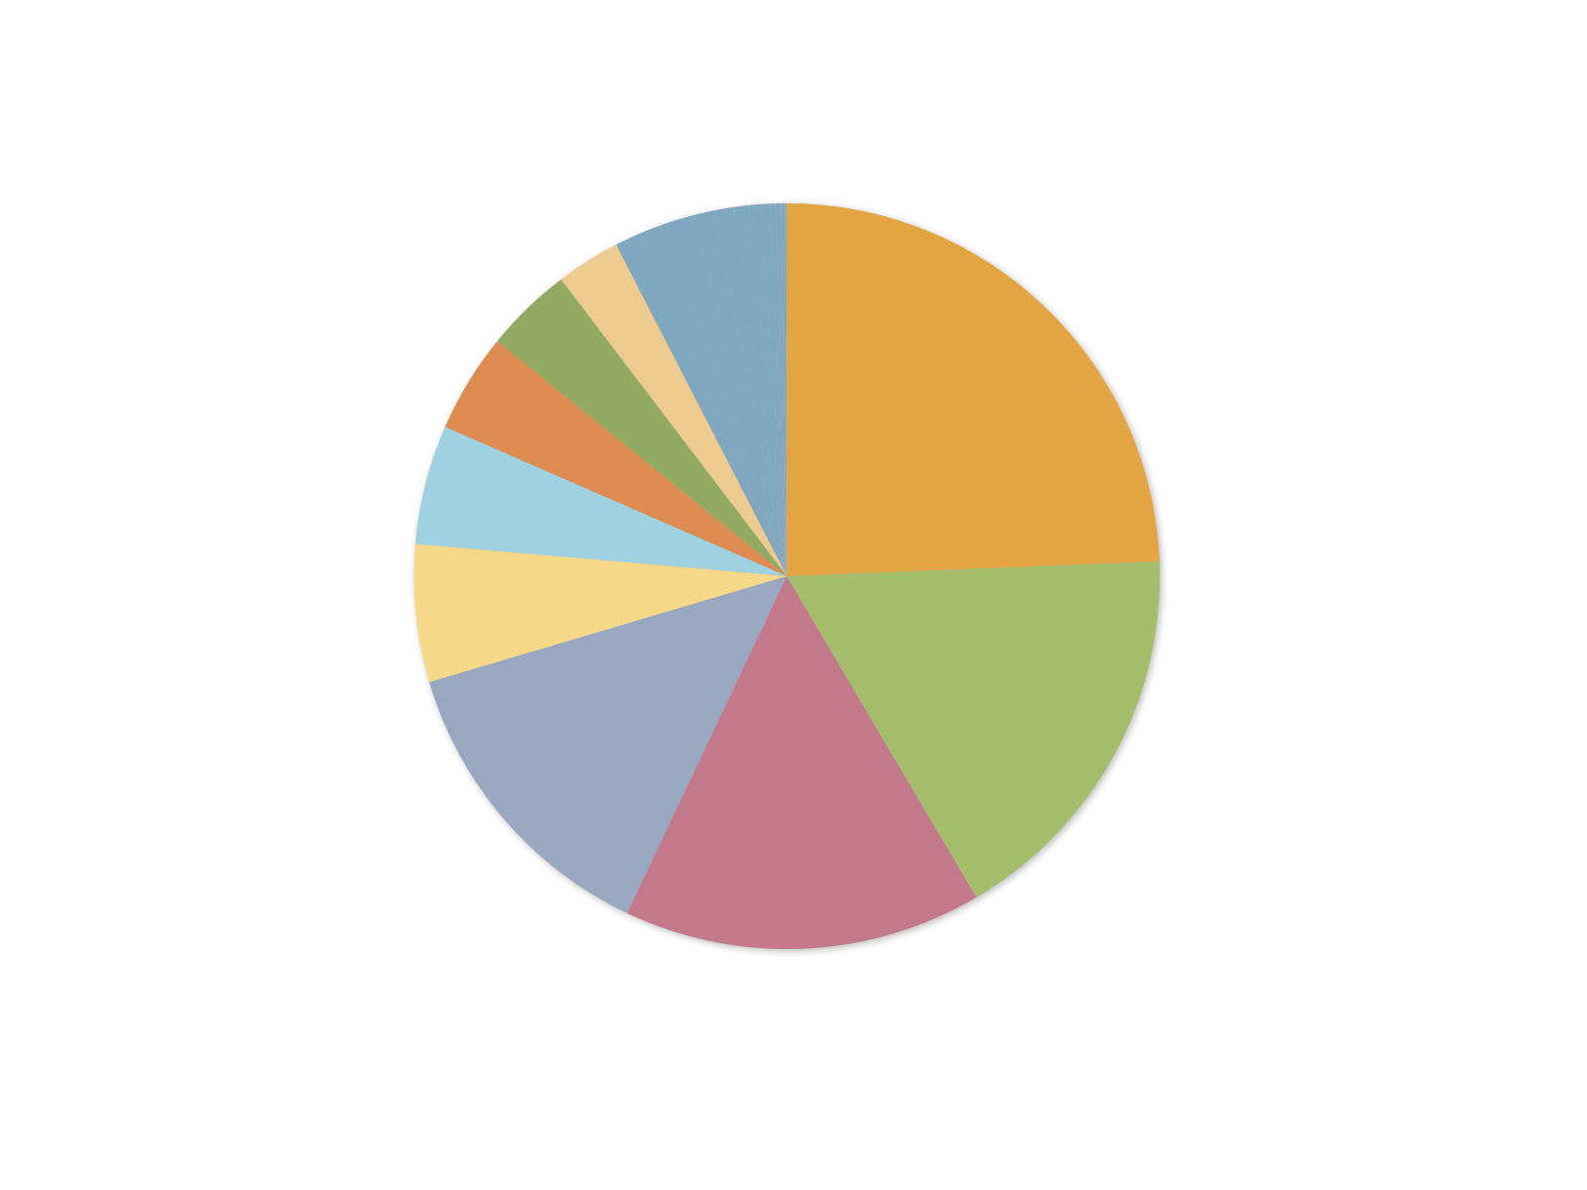
Total TB R&D Funding by Donor Sector: 2005-2011
$400,000,000
$300,000,000
$200,000,000
$100,000,000
$0
Public*
Philanthropy
Private
Multilateral
2005
$234,503,645
$78,178,708
$43,095,353
$1,648,083
2006
$246,862,858
$116,289,274
$53,138,347
$1,534,259
2007
$272,404,317
$132,326,981
$69,387,383
N/A
2008
$264,944,215
$154,513,987
$72,018,715
N/A
2009
$395,326,911
$123,383,703
$99,973,537
$525,385
2010
$376,189,816
$123,974,117
$124,249,938
$6,022,590
2011
$385,343,785
$123,889,768
$140,168,565
$246,064
* Includes funding from International Development Agencies
Notes:
Between 2010 and 2011:
The private sector grew the most out of all the donor sectors, at 13%
Public-sector funding increased slightly by 2.5% and philanthropic investments remained flat.
Multi-lateral investments fell 96%, though TAG predicts this donor sector is significantly under-reported

Slide 7
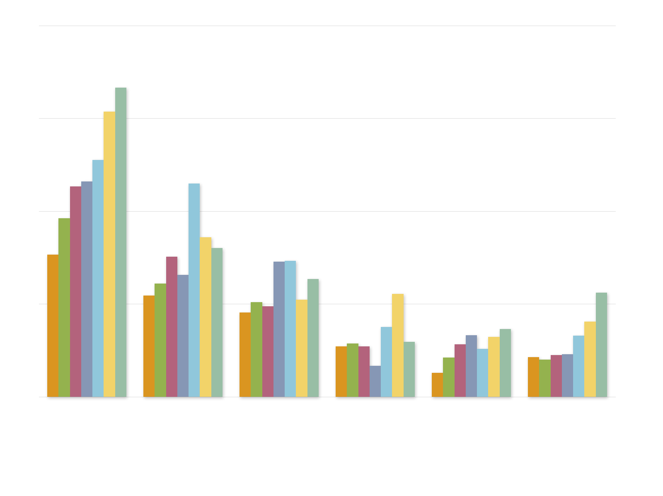
Investments in TB R&D by Research Category: 2005-2011
$225,000,000
$150,000,000
$75,000,000
$0
Infrastructure/
Unspecified
Operational
Research
Drugs
Basic Science
Vaccines
Diagnostics
2005
$114,862,738
$81,892,167
$68,351,530
$40,741,527
$19,408,124
$32,170,084
2006
$144,336,532
$91,643,009
$76,555,111
$43,205,600
$31,890,329
$30,194,127
2007
$170,233,497
$113,325,202
$73,225,383
$40,734,199
$42,435,113
$33,967,288
2008
$174,178,052
$98,728,019
$109,337,224
$25,032,930
$49,788,950
$34,411,742
2009
$191,483,304
$172,447,841
$110,133,485
$56,686,918
$38,921,229
$49,536,760
2010
$230,540,443
$129,008,413
$78,446,298
$83,145,063
$48,410,889
$60,895,355
2011
$250,038,877
$120,361,419
$95,446,326
$44,617,845
$55,043,541
$84,140,175
Notes:
Between 2010 and 2011:
Basic science funding fell 7%
Vaccines funding increased 22%
Drugs research funding increased 9%, infrastructure/unspecified and diagnostics 14%
Infrastructure/unspecified witness the largest funding drop at 46%
The largest year-to-year increase was in operational research, which grew 38% and surpassed the annual $80 million Global Plan funding target.

Slide 8
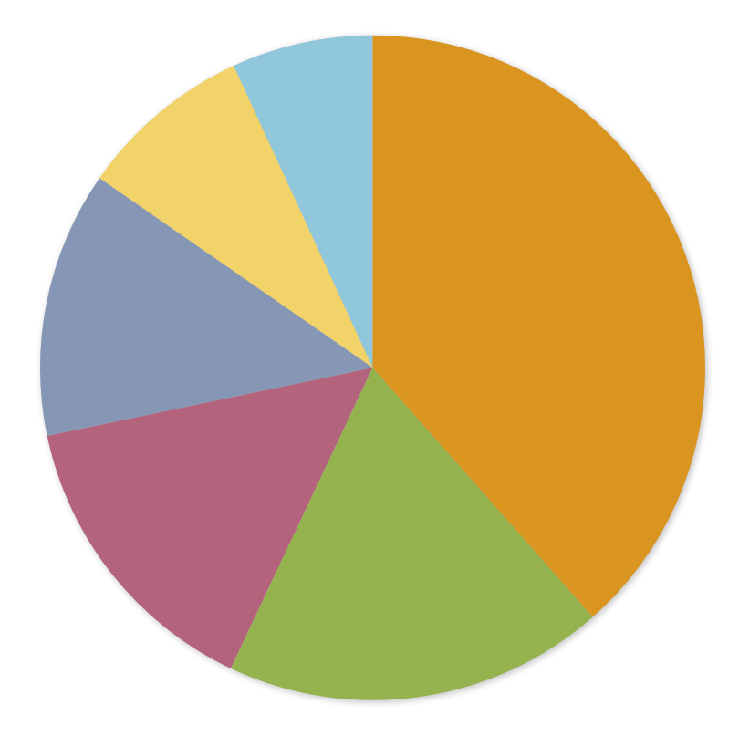
Total TB Investments by Research Category: 2011
Total: $649,648,183
Infrastructure/
Unspecified
$44,617,845 (7%)
Diagnostics
$55,043,541 (8%)
Drugs
$250,038,877 (38%)
Operational Research
$84,140,175 (13%)
Vaccines
$95,446,326 (15%)
Basic Science
$120,361,419 (19%)
Notes:
TB Drugs was the most well-funded research area for a seventh year in a row
Basic science received the second largest portion of funding though funding between 2010 and 2011 declined by 7%

Slide 9
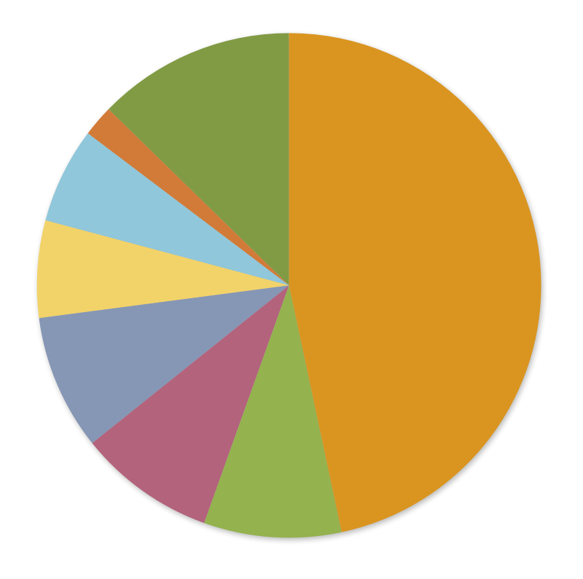
Basic Science: $120,361,419
Funders under 2%
$15,283,956 (12%)
Institut Pasteur
$2,413,982 (2%)
EC
$7,392,381 (6%)
US NHLBI NIH
$7,493,040 (6%)
US NIAID, NIIH
$56,152,399 (47%)
BMGF
$10,445,925 (9%)
MRC
$10,577,128 (9%)
US Other NIH ICs
$10,602,608 (9%)

Slide 10
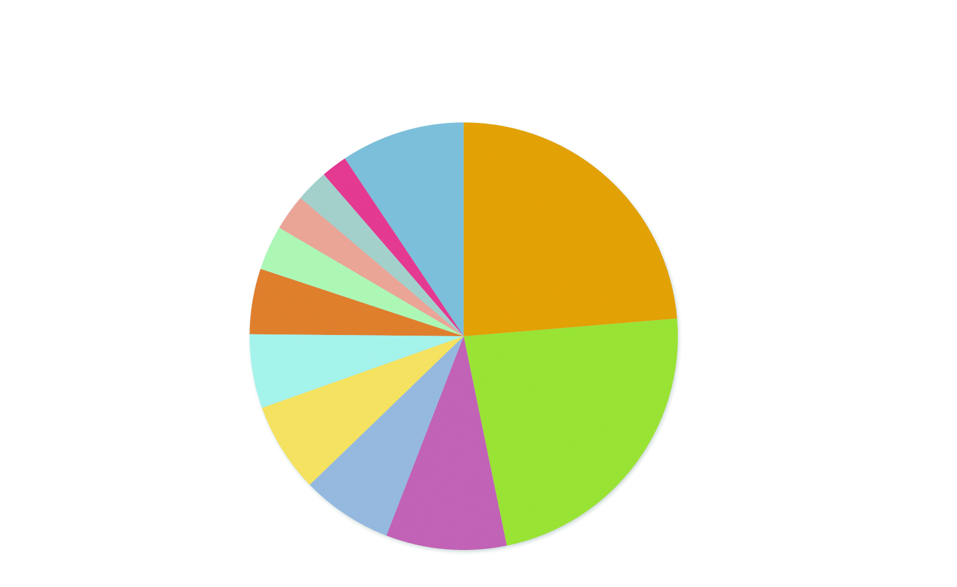
TB Diagnostics: $55,043,541
Funders under 2%
$5,166,472 (9%)
Japan
$1,086,750 (2%)
BMFG
$13,052,604 (24%)
CDC
$1,361,520 (2%)
US Other NIH ICs
$1,400,547 (3%)
EC
$1,859,696 (3%)
DFID
$2,729,656 (5%)
MRC
$3,086,584 (6%)
DGIS
$3,741,546 (7%)
USAID
$12,735,889 (23%)
COMPANY Y
$3,800,000 (7%)
USAID
$5,022,277 (9%)

Slide 11
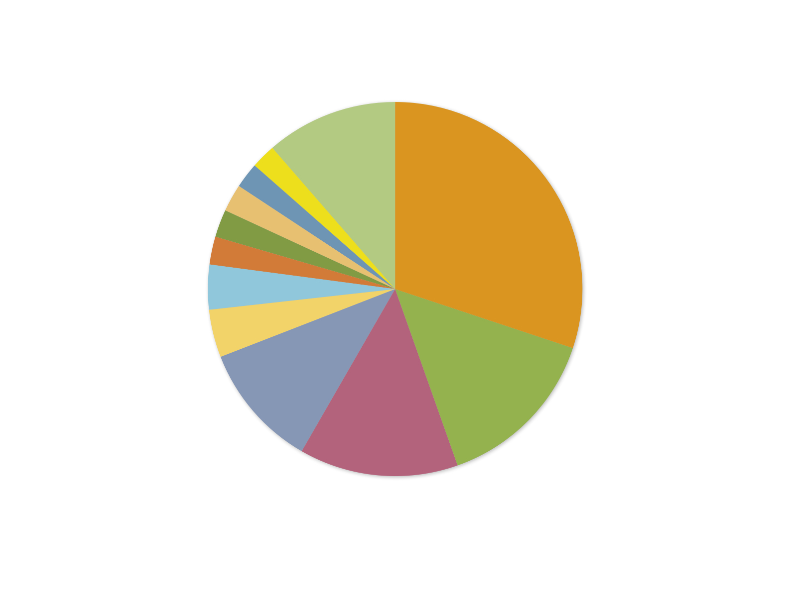
TB Drugs: $250,038,877
Funders under 2%
$31,487,936 (13%)
USAID
$6,049,692 (2%)
Pfizer
$6,323,901 (3%)
Otsuka
$65,124,407 (26%)
EC
$7,079,430 (3%)
US Other NIH ICs
$8,661,953 (4%)
CDC
$9,827,883 (4%)
DFID
$10,436,920 (4%)
AstraZeneca
$13,235,259 (5%)
US NIAID NIH
$35,612,879 (14%)
BMGF
$25,327,763 (10%)
Company X
$30,870,854 (12%)

Slide 12
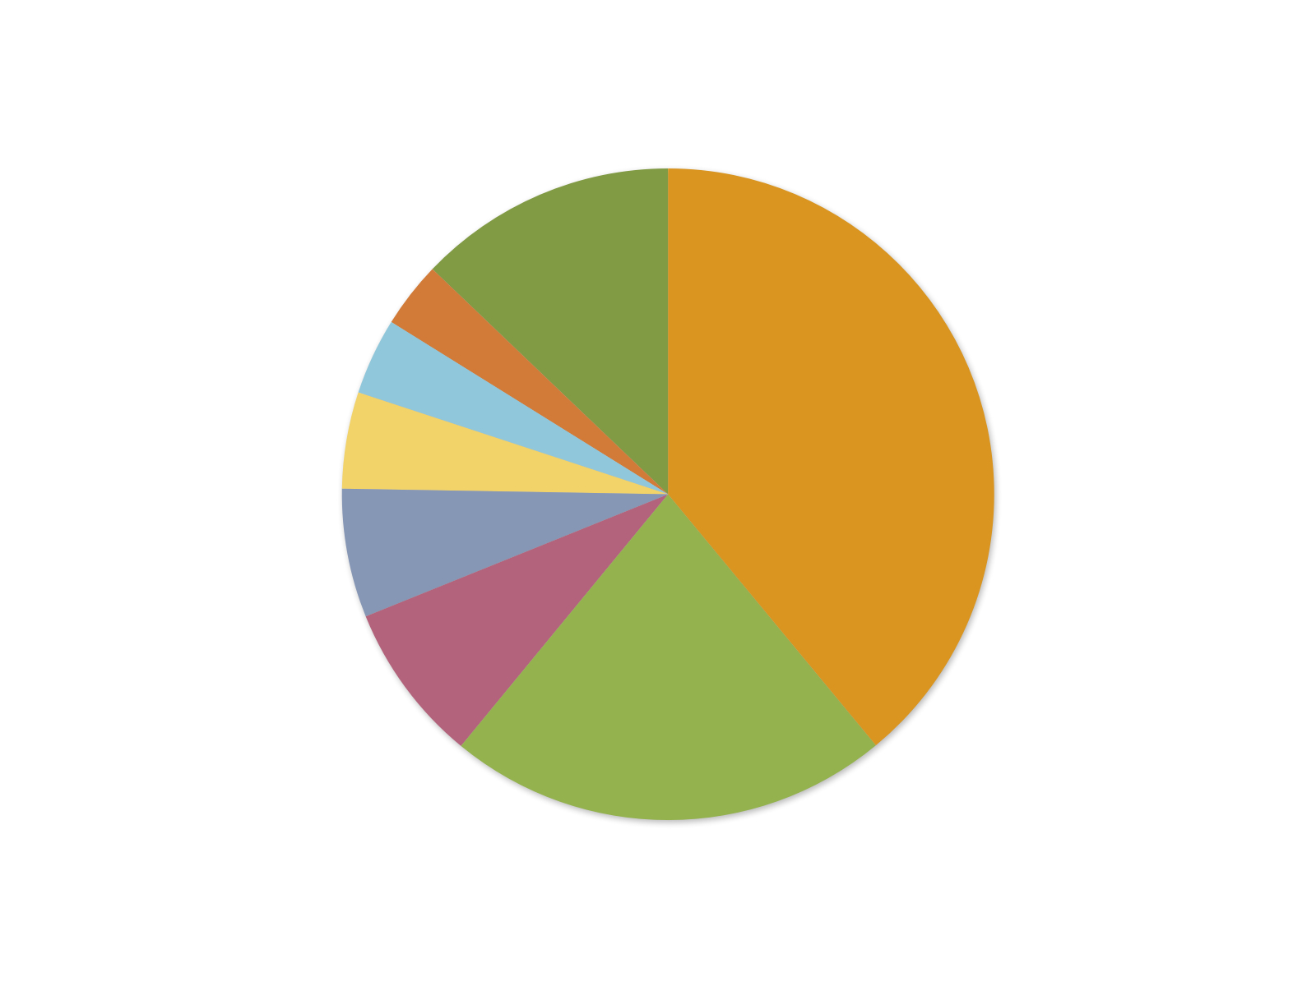
TB Vaccines: $95,446,326
Funders under 2%
$12,269,516 (13%)
Company Z
$3,129,753 (3%)
DGIS
$3,632,072 (4%)
BMGF
$37,225,976 (39%)
Emergent Biosolutions
$4,568,160 (5%)
DFID
$6,101,584 (6%)
EC
$7,573,500 (8%)
US NIAID, NIIH
$20,945,767 (22%)

Slide 13
Operational Research: $84,140,175
Funders under 2%
$9,577,605 (11%)
Switzerland
$1,790,567 (2%)
CIDA
$1,853,250 (2%)
Bloomberg Philanthropies
$2,000,000 (2%)
BMFG
$25,336,167 (30%)
US NHLBI, NIH
$2,013,879 (2%)
Japan
$2,030,757 (3%)
Wellcome Trust
$3,259,892 (4%)
US PEPFAR
$3,478,567 (4%)
US Other NIH ICs
$12,178,454 (15%)
USAID
$9,073,683 (11%)
US NIAID, NIH
$11,547,354 (14%)

Slide 14
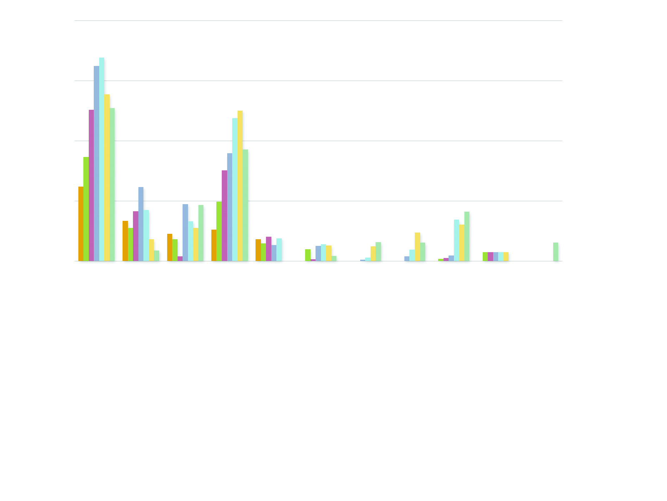
TB R&D PDPs and Research Consortia: 2005-2011
$60,000,000
$45,000,000
$30,000,000
$15,000,000
$0
Aeras
CREATE
FIND
TB Alliance
TBVAC
TDR
TBVI
OETC
EDCTP
NM4TB
MM4TB
2005
$18,580,139
$10,000,000
$6,778,239
$7,874,983
$5,445,450
N/A
N/A
N/A
N/A
N/A
N/A
2006
$25,923,809
$8,298,826
$5,492,942
$14,808,362
$4,451,895
$2,995,748
N/A
N/A
$580,039
$2,214,000
N/A
2007
$37,704,051
$12,375,000
$1,145,409
$22,624,182
$6,091,335
$453,382
N/A
N/A
$805,625
$2,214,000
N/A
2008
$48,679,266
$18,493,585
$14,177,202
$26,885,734
$3,944,425
$3,817,352
$339,741
$1,196,000
$1,416,064
$2,214,000
N/A
2009
$50,792,515
$12,786,985
$9,975,320
$35,643,490
$5,634,040
$4,243,264
$841,333
$2,851,000
$10,343,479
$2,214,000
N/A
2010
$41,572,980
$5,410,545
$8,212,896
$37,538,794
Concluded
$3,900,000
$3,700,914
$7,142,159
$9,081,799
$2,214,000
N/A
2011
$38,166,117
$2,657,411
$13,938,587
$27,824,033
Concluded
$1,315,700
$4,731,422
$4,568,160
$12,313,115
Concluded
$4,644,099
Notes:
In 2010, PDPs and research consortia reported spending a total of $116.6 million in TB R&D, a 12% decline from 2009 levels and a 140% increase since 2005.
PDPs and research consortia are non-profit institutions that bring together public, private, and philanthropic sector partners and resources to accelerate research for neglected global diseases.
PDPs and research consortia are not original source funders but rather receive and disburse funding. Therefore the PDP amounts are not included in the global R&D total.

Slide 15
Notes:
Though funding increased slightly in 2011, the $649.6 million total still falls $1.35 billion short of the annual $2 billion funding target defined by the Global Plan.

Slide 16
In 2011, 81 donors invested $649.6 million on TB R&D, an 82% increase over 2005 levels, but only 3% growth since 2010.
The top 10 TB R&D donors spent $506.7 million in 2010, or 78% of the total global spend.
PDPs and research consortia disbursed $110.2 million in TB R&D in 2011, 7% less than 2010 spending levels.
Across the five Global Plan research areas, operational research was the only research area to meet and surpass its annual target.
For a seventh consecutive year, TB drug development funding increased and made up the largest share of the global TB R&D spend. However, it has the largest funding gap of all the research areas—at $490 million.
The 2011 $649.6 million total still falls $1.35 billion short of the annual $2 billion funding target defined by the Global Plan.

Slide 17
Research to accelerate global TB R&D is gravely underfunded. More resources are needed to see new TB tools come to fruition, particularly in:
Biomarker discovery to modernize TB drug and vaccine development by demonstrating the progress and effects of treatment or immunity early on, which in turn radically reduces the time and costs of the clinical trials;
Biomarker discovery for the development of a POC diagnostic test that can identify people with latent TB at risk of developing active TB, as well as biomarkers associated with infection, treatment response, cure, and drug susceptibility or resistance;

Slide 18
TB sample banks that support biomarker discovery with well-characterized specimens;
Late-stage drug and vaccine clinical trials, many of which will take place in high-burden countries with limited laboratory capacity or infrastructure that meet Good Clinical Practice standards; and
Basic science research to enhance our scientific understanding of TB disease and the M. tuberculosis pathogen.

