Slide 1
www.sentinel-project.org sentinel_project@hms.harvard.edu
Happy 1st birthday! (Launched 28 Oct 2011)

Slide 2
DR-TB

Slide 3
To find and treat more children with TB, we need to apply widely a “family-centered approach”…
Prof. Jeff Starke
Baylor College of Medicine
Houston, Texas, USA

Slide 4
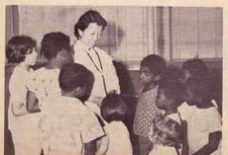
JOURNAL OF PEDIATRICS 1956

Slide 5
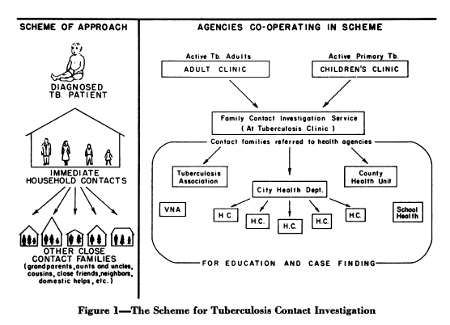
Hsu KHK. Contact investigation: A practical approach to tuberculosis eradication. AJPH 1963.
“Children with TB may be compared to sensitive Geiger counters…
TB exists today in ‘pools’ …
An enormous number of cases of TB are to be found in these ‘pools’…
A dual approach is necessary by which cases are traced from child patients to adult contacts, and from adult patients to child contacts.”

Slide 7
Household
contact
investigation
?
?
?
?
?
?

Slide 8
Household
contact
investigation
?
?
?
?
?
?

Slide 9
Household
contact
investigation

Slide 10
Household
contact
investigation

Slide 12
Source
case
investigation
?
?
?

Slide 13
Source
case
investigation
?
?
?

Slide 14
Source
case
investigation

Slide 15
Source
case
investigation

Slide 16
FAMILY-CENTERED
APPROACH
Source
case
investigation
Household
contact
investigation

Slide 17
FAMILY-CENTERED
APPROACH
Source
case
investigation
Household
contact
investigation

Slide 18
FAMILY-CENTERED
APPROACH
Source
case
investigation
Household
contact
investigation
Preventive therapy

Slide 19
FAMILY-CENTERED
APPROACH
Source
case
investigation
Household
contact
investigation
Preventive therapy
Treatment of disease

Slide 20
FAMILY-CENTERED
APPROACH
Source
case
investigation
Household
contact
investigation
DR-TB
DR-TB
Preventive therapy
Treatment of disease

