Slide 1
Setting the Stage for TB Elimination: Lessons from Smallpox Eradication
Reaching Zero TB Deaths and Zero New TB Infections
Kuala Lumpur, Malaysia
November 13, 2012
Kenneth G. Castro, M.D.
RADM, U.S. Public Health Service
Director
Division of Tuberculosis Elimination
National Center for HIV/AIDS, Viral Hepatitis, STD & TB Prevention

Slide 2
Overview
Smallpox eradication and its lessons
TB resurgence in U.S., response and recovery
Challenges to TB elimination must bridge three gaps in:
Implementation
Knowledge
Ambition

Slide 4
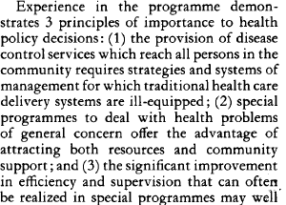
Smallpox Eradication Lessons
Political commitment, coordination, and implementation
Decision by 1959 WHA, ratified in 1966 WHA with new resources
Special program
Specifically targeted and time-limited
Adapted to local epidemiology and different local conditions
Identify and address set-backs
Defined objectives and goals
Complete disease reporting and nil incidence
Discover cases and contain outbreaks within 2 weeks
Quality control and program management
Network of professional staff: “many thousands of health staff received training in the execution of vaccination programmes and in field epidemiology”
Research
Better methods for quality vaccine production and targeted delivery
Certification, Costs

Slide 5
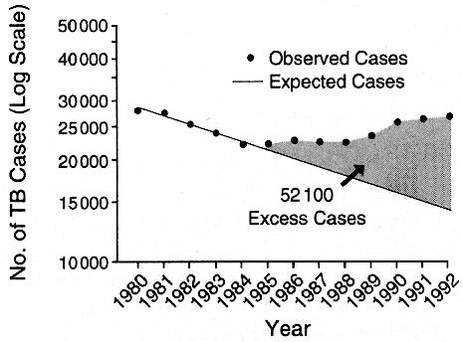
Resurgent TB in U.S. Trends reversal, excess morbidity, 1985-1992
Associated
Conditions
Deficient
infrastructure
HIV epidemic
Immigration
Institutional
transmission
MDR-TB
Cantwell MF, et al. JAMA 1994; 272:535-539
Notes:
After more than three decades of a steady decline in TB morbidity, averaging 5-6% annual decrease, our nation experienced a resurgence of tuberculosis from 1985 through 1992, with an estimated excess of 52,100 persons who should have never developed this disease had previous morbidity trends continued. To add insult to injury, there was a concurrent widespread occurrence of multidrug-resistant TB
Several factors were associated with this resurgence, and have been documented in previous publications. Perhaps the single most important factor that set the stage for this mess consisted of the dismantling of TB clinical services during the disappearance of categorical funds in the late 1970s and early 1980s.

Slide 6
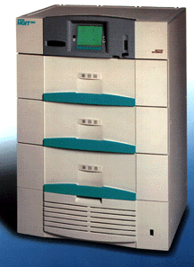
U.S. Response to TB Resurgence
National MDR-TB Action Plan,
Political Will & New Resources
Rebuilt Infrastructure & Training to
Improve Case
Identification
Focus on DOT, Outreach,
Improved Rx Completion
Updated Diagnostic Labs,
Real-time DST & Fingerprinting
Rebuilt Research Capacity
Updated Infection Control &
Treatment Recommendations
Notes:
In response to the resurgent tuberculosis, the Federal Government developed and published the ‘National Action Plan to Combat Multidrug-resistant TB,’ and received new resources to begin the implementation of several action steps outlined in that plan. These new resources were quickly mobilized to improve the identification of TB cases, to upgrade state laboratories for early diagnosis and prompt recognition of drug resistance via routine and systematic drug susceptibility testing (DST), updated treatment recommendations, paid for the broad-scale use of directly-observed therapy as a tool to improve treatment completion, and emphasized the need for ongoing program evaluation.

Slide 7
Reported TB Cases United States, 1982–2011*
2011 Data
10,528 Cases
(Rate 3.4/100,000)
No. of Cases
Resurgence
Associated w/
Deficient
infrastructure
HIV epidemic
Immigration
Institutional
transmission
MDR TB
Year
Updated July 2012

Slide 8
CDC TB Appropriations, FY1967–FY2000 and Reported TB Case Rates, 1967–1999
Response to
Resurgent TB
Categorical TB Grants Ceased
1972-1982*
* Categorical funding reappeared via emergency grants in 1980, but amounted to only $3.6M
in 1980 and $3.7M in 1981. “It was not until 1989 that funding reached the level at which it had
peaked in 1969, before the institution of block grants.”
IOM. Ending Neglect: the elimination of tuberculosis in the United States. Natl Acad Press, 2000

Slide 9
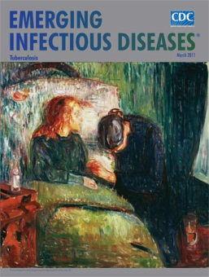
TB Elimination Requires Bridging 3 Gaps
(≤ 1 case/ million population)
Implementation
Knowledge
Ambition
Castro KG, LoBue P. Emerg Infect Dis 2011;17:337-342

Slide 10
Bridging the Implementation Gap in TB
W. Fox, London (1963): “little attempt to adapt present knowledge to their specific problems”
NR Fendall, New York (1972): refers to medicine in 20th century as “…superb in technological breakthroughs, but woefully inept in its application of knowledge to those most in need.” Further suggests “the ‘implementation gap’ must be closed”
WHO 2012 Global TB report:
51 million cured; 20 million lives saved, 1995 –2011
8.4 million new cases; 1.4 million deaths in 2011
48% of HIV-infected TB patients on ARVs
19% of MDR TB reported/notified
Castro KG, LoBue P. Emerg Infect Dis 2011;17:337-342

Slide 11
Bridging the Knowledge Gap in TB
Research, develop, and implement:
Understanding local epidemiology and drivers
Rapid (i.e., same-day) diagnosis of TB and drug resistance to guide optimal therapeutic regimen use
Safe and effective new drugs, and short effective regimens. Aim for cure with 2-3 months of therapy
Understanding of genetic markers of bacterial virulence to enable targeted interventions
Understanding of host defense correlates of protection for effective vaccine, and surrogate markers of disease progression for targeted prevention efforts in people with latent TB
Castro KG, LoBue P. Emerg Infect Dis 2011;17:337-342

Slide 12
Bridging the Ambition Gap in TB
Overcome impoverishment of will common to resource-limited settings
Acknowledge that TB elimination and eradication are the ultimate goals (for present or future generation)
Mobilize political resolve and commitment
Develop solidarity of effort behind global elimination plan
Develop “status of intolerability” by authorities and public
Bold ambition, expectations, and sustained actions (no room for premature declarations of victory or complacency)
Castro KG, LoBue P. Emerg Infect Dis 2011;17:337-342

Slide 13
Bridging 3 Gaps for Global TB Elimination
Implement/
Universal
Access
Learn/
Knowledge
Commitment/
Ambition
Mutually reinforcing

Slide 14
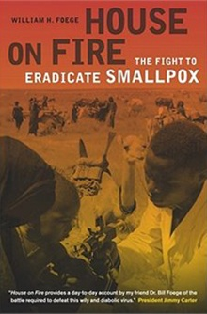
Foege’s Observations on Smallpox Eradication
“Thousands of people participated in the smallpox global eradication effort…they were optimists…they were risk takers; there was no shortage of people telling them that the effort was futile…”
“It wasn't science that threatened to stop us. It wasn't even nature per se. Rather, it was human nature: the human factors that involve strikes, job security, political concerns, turf.”
Foege WH. House on Fire. University of California Press. 2011

Slide 15
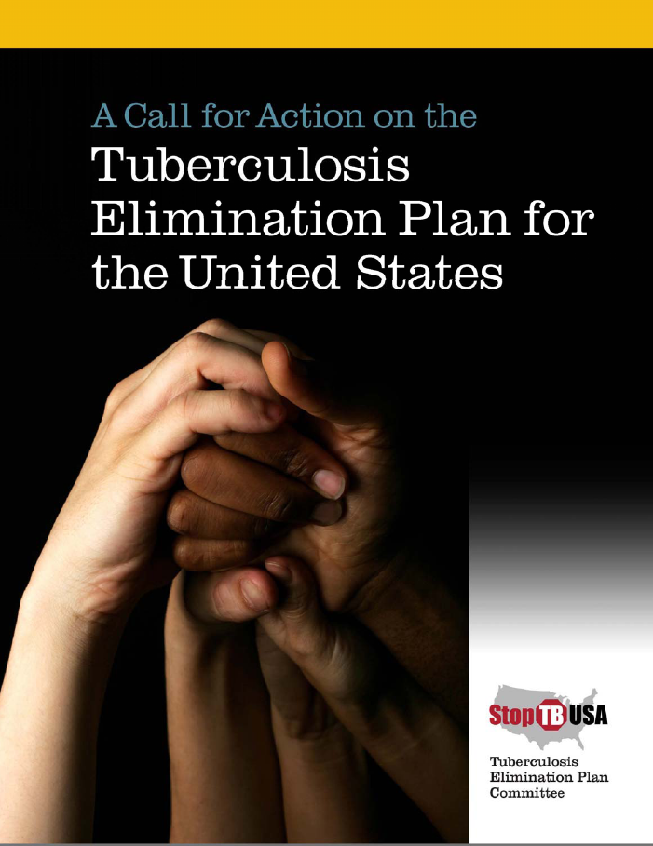
≤ 1 TB case per million by 2035 would yield
253,000 fewer TB cases
15,200 fewer TB-related deaths
$1.3 billion less in treatment costs (in 2006 dollars)

Slide 16
2011-2015 Returns on Global Stop TB Plan Investment
 | Cost/Returns
Total investment in TB control | US$36.9 billion
Lives saved | ~14 million
Life years gained | ~ 280 million
Cost per life year gained | ~ US$130
NB: in HIV 2011-2020 investment framework, 7.4 million lives saved, 29.4 million life years gained over 10 years, for additional investment of US$46.5 billion and cost per life year gained of about US$ 1,000
Source: Floyd K. WHO Stop TB Department, Jan 2012
Notes:
Assume 50% cases sm+, 50% sm-/EP; mortality rate among HIV-negative TB cases without treatment based on up-to-date literature reviews 70% in sm+ and 20% in other cases; assume 100% mortality in HIV+ TB cases without treatment.
Gains from IPT not included

Slide 17
Thank You The findings and conclusions presented here do not necessarily represent the official position of the Centers for Disease Control and Prevention

