Slide 1
Rationale for New Drugs for Tuberculosis
500,000 cases annually of MDR TB
Second line treatment toxic and weak
15% of TB is HIV-related
Drug-drug interactions problematic
15% of TB is in children
Formulations inadequate, dosages poorly understood
5-20% of TB patients experience adverse effects
Safer agents needed
6-month regimen is miraculous, but not miraculous enough
Faster cures are essential

Slide 2
Challenges in Developing New Drugs for TB
Need for new regimens, not just drugs
Toxicity, e.g., Q-Tc prolongation
Drug-drug interactions
Especially antiretrovirals
Lack of robust surrogate endpoints
Need for large Phase 3 trials
Low incidence of endpoints (relapse)
Lack of ambition

Slide 3
Timeline for Development of Moxifloxacin for Shortening TB Treatment
1996 1998 2000 2002 2004 2006 2008 2010 2012 2014
Activity of Moxi shown in Mice
JHU/Brazil trial
OfloTub trial
Study 26
Study 28
ReMox TB
OfloTub II

Slide 4
The Context: Approach to TB Drug/Regimen Development
Discovery and Development Process
Single Compound
Preclinical Development
→ Phase I → EBA
Phase II → Phase III
Compound 1
Drug Candidate Pool
Compound 2
Regimen A
Compound 3
Regimen B
Compound 4
Compound 5
Regimen C
Regimen Identification in Mice
Identification of New Drug
Candidates
Selection of Potential New Regimens

Slide 5
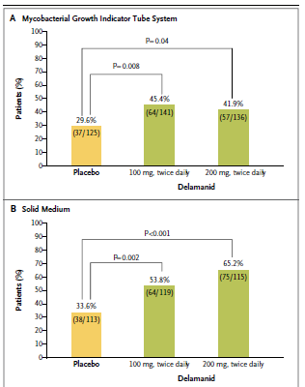
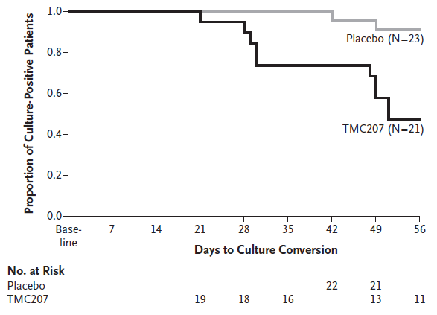
Bedaquiline (TMC207) and Delamanid Placebo-Controlled Trials with OBR in MDR-TB
9%
48%
Diacon et al., NEJM 2009;360:2397-405
Gler et al., NEJM 2012;366:2151-60

Slide 6
Early Bactericidal Activity of PNU 100480 (Sutezolid)
Both PNU dosing schedules resulted in significant log CFU reductions from baseline over the 14 day period of treatment.
600 mg BID: -0.09 log/d, 90% CI -0.06 to -0.11
1200 mg QD: -0.07 log/d, 90% CI -0.04 to -0.09
A trend was apparent toward superior responses with BID dosing
Shading indicates 90% confidence interval by mixed effects model repeated measures analysis
Wallis et al., AIDS 2012

Slide 7
A novel regimen (PaMZ) is more active than RHZ in mice
Relapse rate after 4 months
RHZ 10/20 (50%)
PaMZ 0/20 (0%)
*
*p<0.01 vs. RHZ and RMZ
Nuermberger et al, AAC (2008); 52:1522

Slide 8
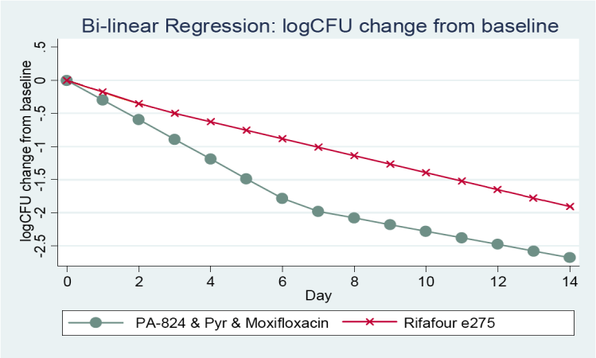
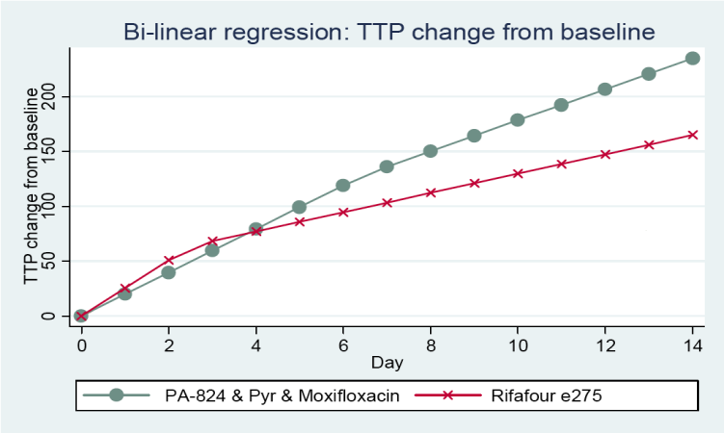
Extended EBA of the novel PaMZ combo The NC-001 study
Diacon et al, Lancet, July 23, 2012

Slide 9
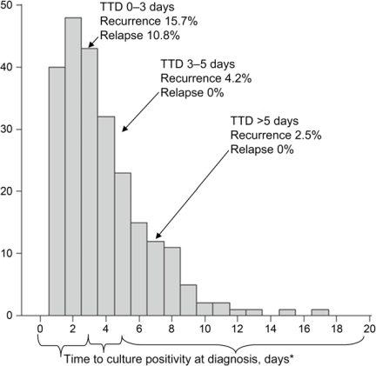
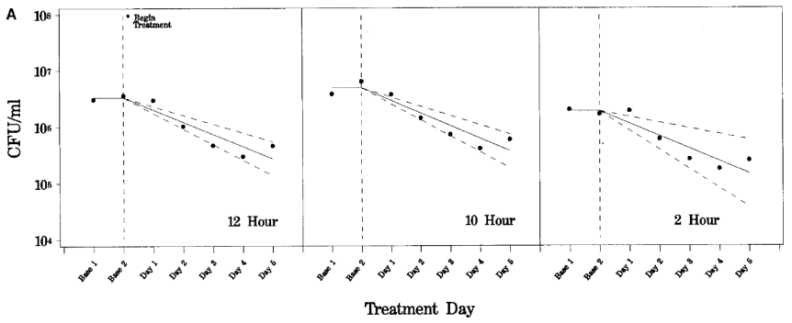
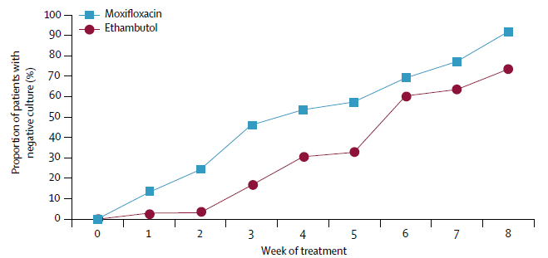
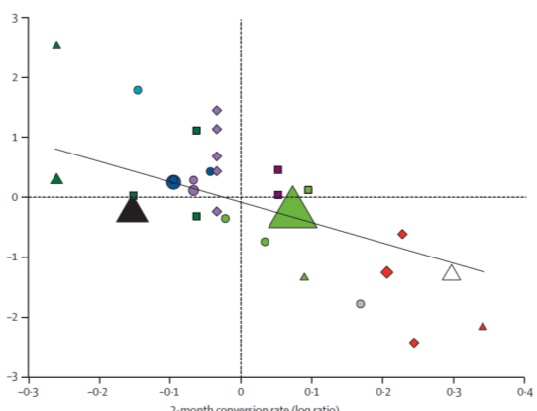
Surrogate endpoints in TB clinical trials
EBA
TTP
2-mo conversion
Hafner et al. AJRCCM 1996; Hesseling et al. IJTLD 2010; Conde et al. Lancet 2009; Wallis, Lancet ID 2010

Slide 10
Treatment Priority #1 – Fund the Pipeline
Development of more new TB drugs
Identification of optimal regimens for
Susceptible TB (shortening)
MDR and XDR
HIV+
Children
Development of methods to evaluate combinations
Identification of relevant biomarkers

Slide 11
Change the Paradigm: No more second rate, second line drugs
Develop potent regimens that can treat all forms of TB
MDR/XDR
HIV on ART
Children
A menu of options for different patient populations
Alternatives for specific clinical needs

Slide 12
Getting to Zero
Let’s ADD another zero to the level of funding for TB drugs, diagnostics, vaccines and elimination!
→ $6,300,000,000

Slide 13
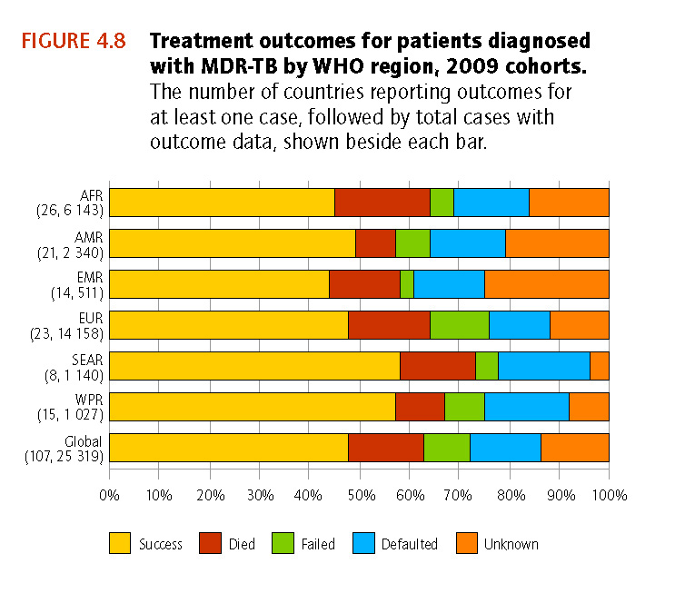
Global MDR-TB treatment outcomes
Estimated 650,000 prevalent MDR-TB cases
~30,000 enrolled on treatment in 2009
Less than 50% treatment success globally
High rates of death, failure and default throughout
WHO TB Report. Oct 2012
Notes:
Most recent data, scale up is occurring (allbeit way too slowly), but global treatment success is less than 50%

Slide 14
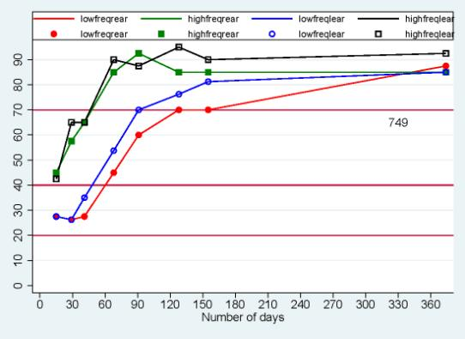
Side effects of treatment
Painful injections
Hearing loss due to the injectable drugs (~30% of patients in some settings)
Nausea and vomiting
Kidney failure
Psychiatric side effects (depression, paranoia)
Hepatitis
Peripheral neuropathy (tingling, numbness, pain)
Side effects often additive with HIV drugs
Hearing loss with treatment

Slide 15
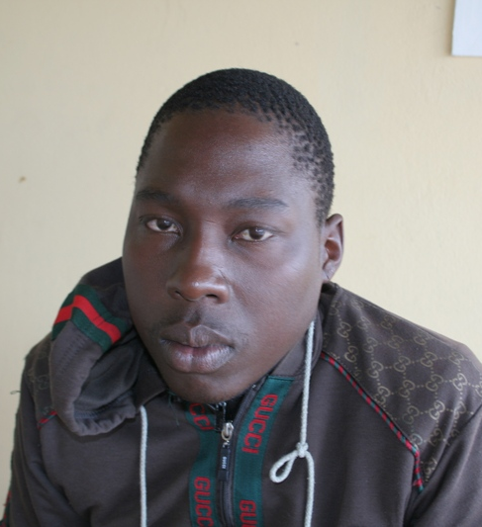
We need a new regimen!
Some new drugs are close to approval
Do we wait for an entirely new regimen?
Conventional approach 20+ years
Drug combination approach – half this, but still too long
Or use combination of new, existing and re-purposed drugs to develop new regimens that can be used to scale up treatment
Both short term and long term goals are needed

Slide 16
Key principles for a new regimen
At least one new class of drug
Minimum 3 effective drugs
Not combining drugs of the same class
No injectables
Broad backbone that can be used for MDR and XDR
Simple dosing
Limited side effects
Shorter duration (6-9 months?)
Minimal interaction with ART

Slide 17
Potential trade-offs?
 | Benefits | Trade-offs
Shorter duration | Reduced default Easier monitoring Decreased cost | Reduced efficacy Increased relapse
No injectable | Improved tolerability and default Less adverse events Easier health service implementation Decreased cost | Reduced efficacy?
More than one potentially cardiotoxic drug | Increased efficacy Overall improved survival | Potential risk of sudden death in a few

Slide 18
Concurrent approaches required
Rational incorporation of new drugs into current treatment
New drugs and combination testing
Pragmatic clinical trials

Slide 19
Compassionate access /Extended access program/ Named patient program
Granting access to drugs prior to approval for patients who have exhausted all alternative treatment options and do not match clinical trial entry criteria.
Previous examples- Kaletra EAP, Tipranavir EAP, intravenous oseltamivir, chemotherapeutic agents.

Slide 20
Falls in the grey zone between treatment and research
When is the development of a drug should this be contemplated?
Obtaining an IRB and other regulatory review
Protecting doctors against liability risk
Paying for the drug
Assessing the potential impact of adverse events on drug development

Slide 21
Advantages of providing access
Replication of similar outcomes as in the trial
Provision of medication to an individual who almost certainly dies
Prevention of morbidity and mortality

Slide 22
Disadvantages of providing access
Unknown cumulative toxicities e.g. Qtc prolongation with the compassionate use drug and approved drug e.g. Clofazimine and Bedaquiline
Adding a single drug to a failing regimen.
Development of resistance to the newer agents.

Slide 23
Way forward
Set up regulatory precedents for IRBs and MCC/FDA/EMA
Autonomy – informed consent
Develop a mechanism of insurance to the health care worker
Clinical oversight teams to ensure that the new drugs are use appropriately

