Slide 1
Zero TB deaths among PLHIV: what are the gaps and what is missing?
Reaching Zero TB Deaths and Zero New TB infections, November 13, 2012.
Haileyesus Getahun
Stop TB Department
World Health Organisation, Geneva.

Slide 2
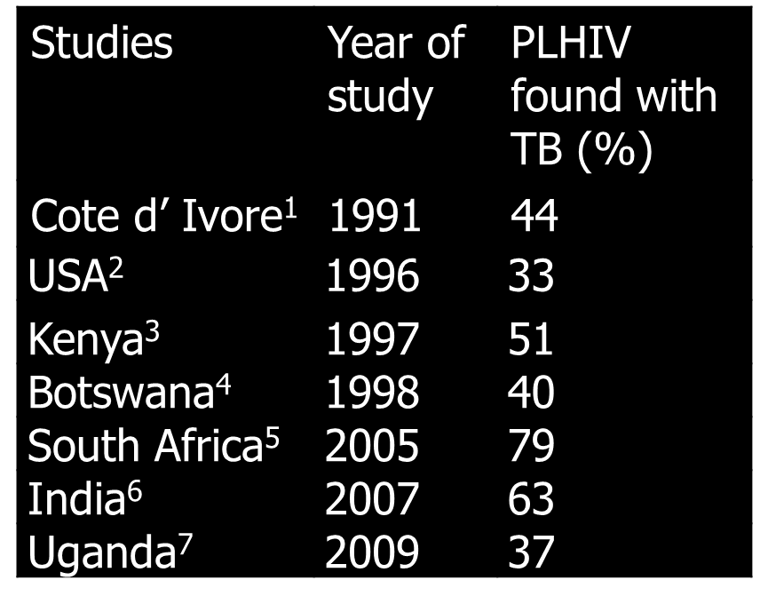
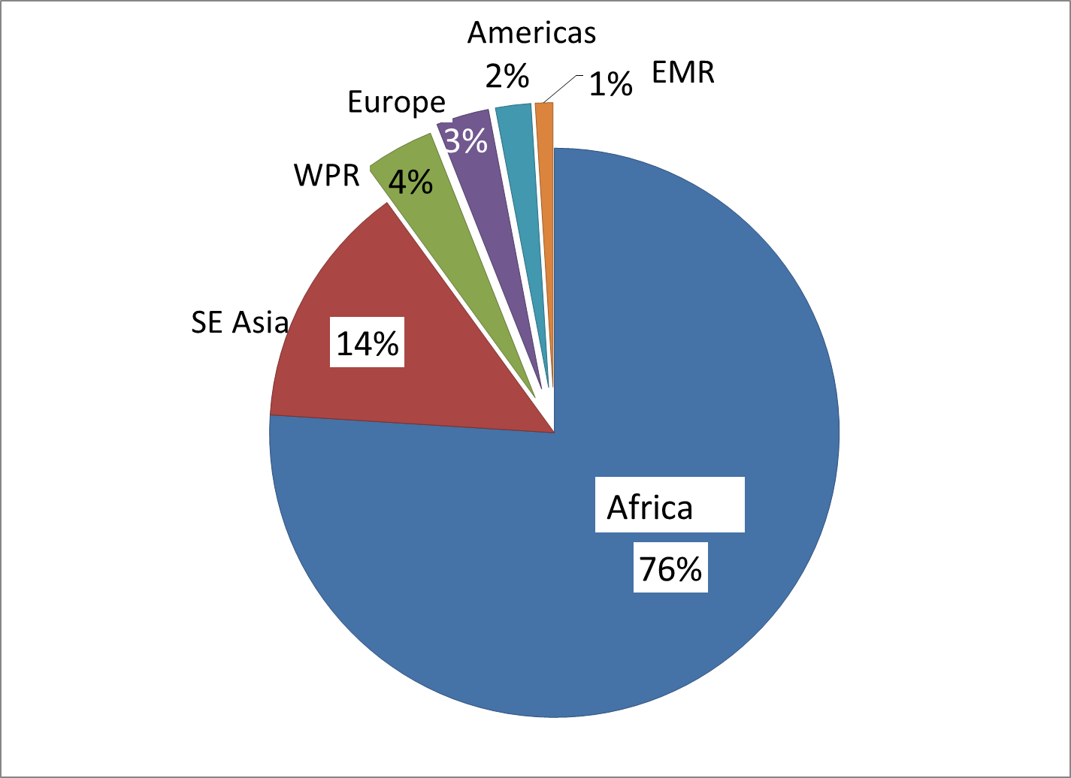
430,000 HIV associated TB deaths in 2011
1. Lucas 1994; 2. Afessa et al, 1998; 3.Ranna et al, 2000; 4.Ansari et al, 2002; 5. Martinson et al, 2007;6. Lanjewar, 2011; 7. Cox et al, 2012
25% of AIDS and 30% of TB deaths; majority in Africa

Slide 3
Percent of death according to HIV status, 2009 cohort

Slide 4
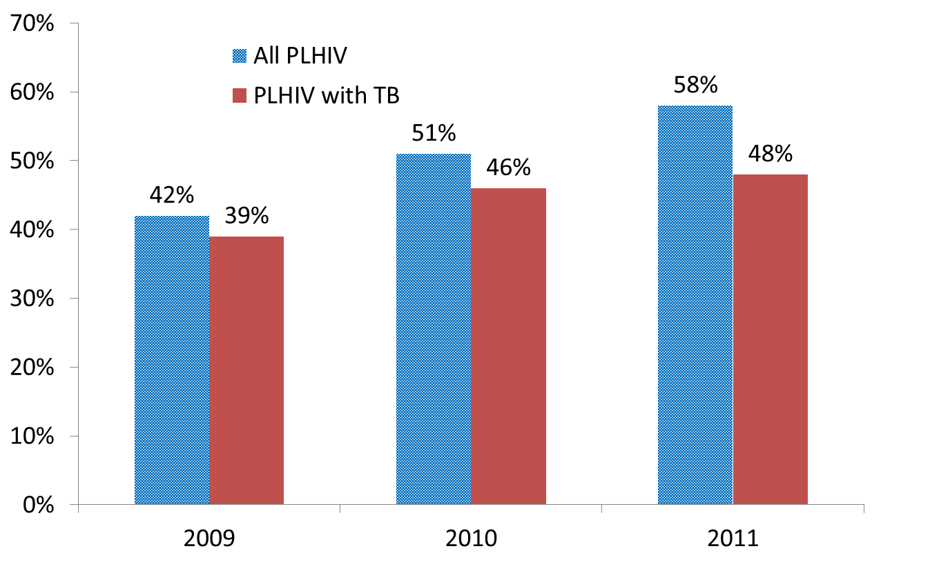
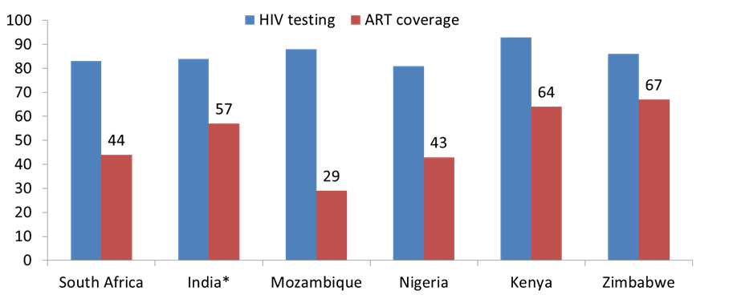
Inequity of ART provision to TB patients
* Six high HIV prevalent states in India

Slide 5
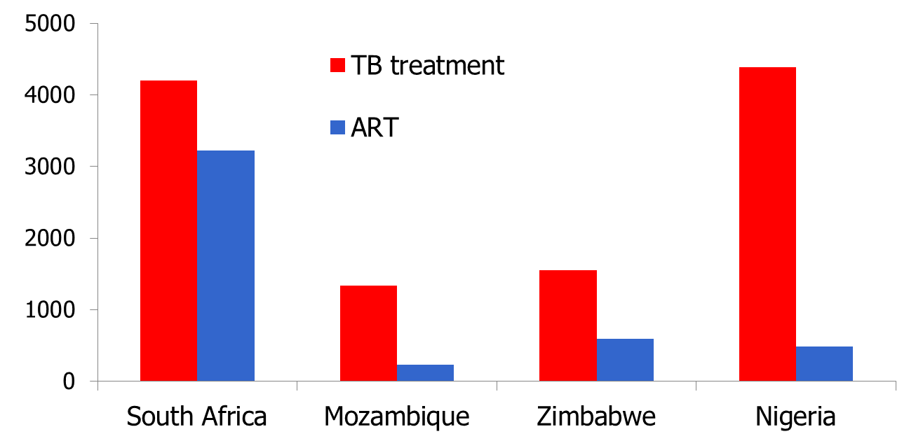
Number of facilities providing TB and ART, 2011
ART services are still too centralized and too few

Slide 6
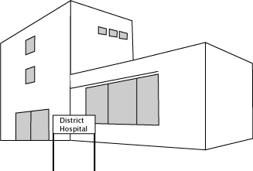
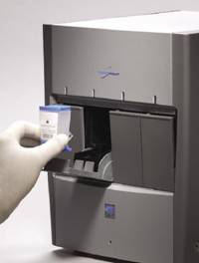
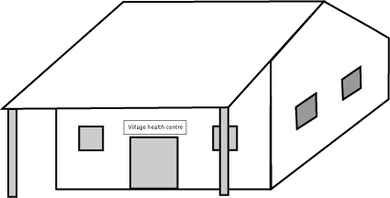
Delay in TB diagnosis-a key factor!
Delay
Xpert MTB/RIF should be used as the initial diagnostic test in individuals suspected of having MDR-TB or HIV-associated TB
Results in 90 minutes!
Referral hospital
8 (0-45) days*
District hospital
18 (0-191) days*
35 (21-56) days**
Health centres
Health post/clinic
35(21-56) days**
Community/ home
21 (7-49) days**
POC (Dipstick TB test) is needed!
* IJTLD 2008 : 392-396
** IJTLD 2006; 10:422-28
Notes:
World Health Organization
6

Slide 7
Too few research, drugs and champions
Multi-disciplinary implementation research
Inclusion of PLHIV in new TB drug trials
Inclusion of TB patients in new ART trials
Address conservative opinion leaders
TB champions for post-2015 TB target setting

Slide 8
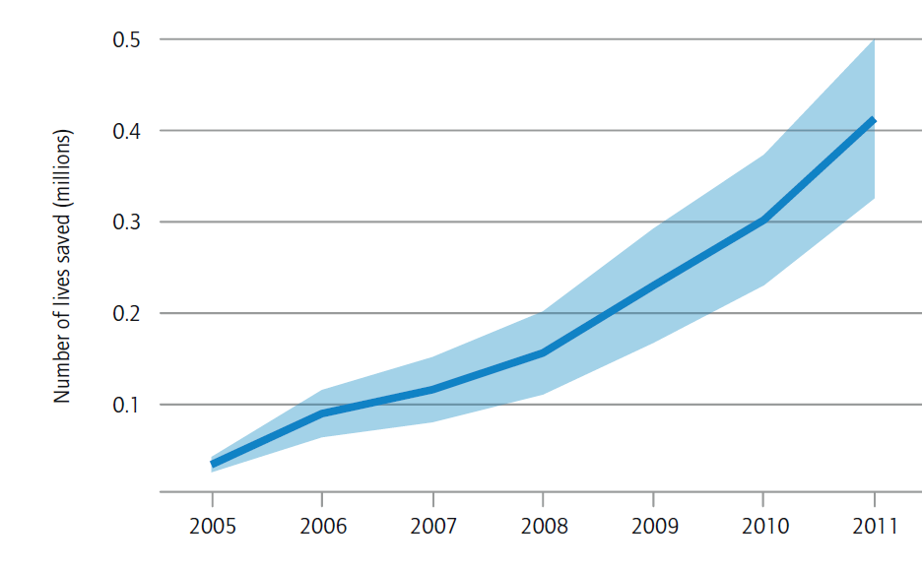
Conclusion: We can eliminate TB deaths in PLHIV
1.3 million lives saved by WHO’s TB/HIV policy (2005-2011)

