Slide 1
TB Political Will in SSA: The “Tuk Tuk” Syndrome
Khairunisa Suleiman
43rd Union World Conference,
Malaysia,
November 2012.
Notes:
“It is useful to be acquainted with history… it keeps repeating itself, as if we liked it”-Linn Hansen. “Knowledge about TB is not lacking but the will to use it appropriately is”-Roland Maes. It is critical that the orphan disease (TB) grows to a parent!-Khairunisa Suleiman. If you’ve been inside a tuk tuk you know that there are no seat belts, you’re exposed to the elements, you can’t travel long distances and certainly not fast even at short distances-this is how we have been operating in the TB field-exposed, inefficient and certainly not moving at the pace we should be since there are alternative and better vehicles.

Slide 2
Table of Contents
Political will: The Past and the Current!
Playing yoyo
What we must do?

Slide 3
Political Will: TB Response

Slide 4
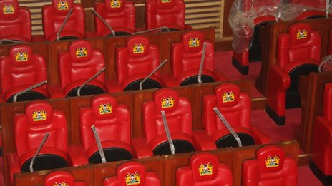
Political Will: Funding commitments-are we serious?
Government spent US$ 1.05 million for 350 Parliament chairs in 2012 in Kenya!
2012: TB funding shortfall in Kenya is US$ 32 million, only 41% of total TB budget was funded!
US$ 53 million lost to National Hospital Insurance Fund (NHIF) Scandal!
Notes:
Ref: Nation newspaper, WHO TB country profile and http://allafrica.com/stories/201208120068.html

Slide 5
Political Will: The past and current: Are we committed?
TB is Preventable
Infection Control (IC)
Health Facilities (HF); breeding grounds of TB transmission
IC guidelines still in draft format in some countries
Nurses go on strike in Swaziland at Moneni Hospital because of their colleagues contracting TB (May 2012)
Simple renovation is needed
Provision of N-95 respirators
Public Transport; limited involvement of minibus drivers- “open windows” campaign
Homes; Community TB care-limited PPE for treatment supporters (who may be HIV positive; vulnerability and further spread of TB)
Factories; TB breeding hubs in esp. developing countries
Notes:
HF seen in Botswana, Swaziland and Kenya as examples of breeding grounds for TB transmission; no infrastructural measures in place (crowded waiting areas, no windows) administration measures in place, shortage of N-95 respirators in HF (perpetuating laxity of wearing N-95 respirators) yet importance of PPE takes precedence in settings where infrastructural and administrative controls are limited. TB Programmes are still not documenting the number of HCW who contract TB; a critical indicator of IC-hence there is always the defence statement that HCW are not contracting TB at HF.
Public Transport: there is anecdotal evidence that there are high rates of TB transmission during public transportations such as buses and mini-buses. In recognition of this the National TB Programme in Swaziland agreed to partner with a SWAPOL (civil society NGO) and the mini-bus drivers-a welcome move, however implementation of the open windows campaign has been sluggish and has been implemented in only one out of four regions. Communities and some HCW still do not understand the tenets of infection control

Slide 6
Political Will: The Past and Current
Notes:
Yet data on the number of HCW who contract TB is not collected and HCW live near the hospital. So did the HCW lie, demonisation of HCW ought to cease.

Slide 7
Political Will: The Past and Current
TB is Preventable-cont…
Infection Control (IC)
“Fuelled by new drug-resistant strains and the HIV/AIDS pandemic, TB is spreading like wildfire through South Africa’s mines and to the world beyond” –Desmond Tutu, Nov 2012
Mines; SADC Declaration-
SA, Madagascar, Namibia, Zimbabwe heads of state have not signed!
Prisons:
Overcrowding e.g. SA, Malawi.
No policies in place to monitor TB status of inmates, (i) entering into prison (ii) during sentence and (iii) prior to release.
Limited referral system into public HF upon release from prison.
No enablers (food and transport money) provided for recently released persons, who may be financially unstable
Notes:
SADC Declaration comes 110 years late. Mine; heads of state that have not signed; Madagascar, SA, Namibia and Zimbabwe. The TB incidence rate in South African miners is between 3000-7000 cases per 100,000 population (between 24x and 55x higher than global TB rates of 128 per 100,000). No Head of State signed the code. SADC MoH’s will review SADC declaration code for mines

Slide 8
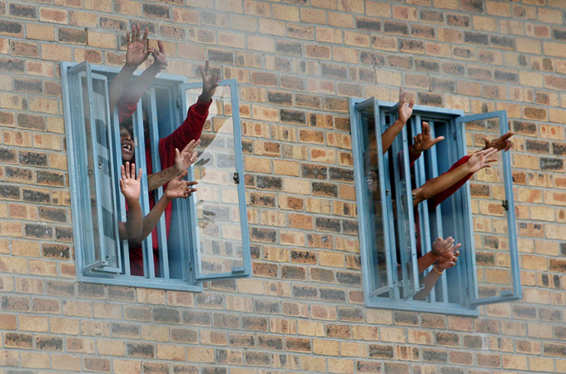
Political Will: The Past and Current
Pollsmoor Prison in SA has a TB transmission rate of 90%!- Robin Wood
SA prisons are overcrowded by 136% on average; 78 prisoners died of TB in 2011!
Notes:
Prison image: http://www.aljazeera.com/indepth/features/2012/10/201210315250776426.html

Slide 9
Political will: The Past and the Current: Are we committed?
TB is Preventable-cont…
Awareness within communities
Little knowledge on TB in certain communities
Communities want to be actively involved
Vaccines
Why BCG?
Commitment to develop new vaccines was low
Notes:
It is critical that we incorporate community involvement in the TB response and use simple messaging on TB that is relevant to the communities. Countries like the USA have never used the BCG vaccine, yet do not have spiked TB disease. ‘The history of immunisation against tuberculosis is a story of setback, controversy and surprise’- Bad News for India, Lancent-1980. Evidence states that there was a better vaccine than BCG (excellent vaccine based on M. chelonei) developed by Friedman yet WHO endorsed it in 1950, after donation from of USD 3 million by Debré (brother of then French Prime Minister) in 1950. “The quality of Friedman's vaccine was recognized in Germany in 1919, in Italy in 1922 and in France in 1958. Nevertheless, it was abandoned. The lack of efficacy and the residual infectiousness of BCG were known in 1927, well before BCG vaccination became mandatory in 68 countries. The Chingleput disaster was published in 1986 but given no heed”-Roland Maes. It cannot be emphasised enough that Governments need to commit financially to the development of a TB vaccine.

Slide 10
Political will: The Past and the Current
Failure of the Mycobacterium bovis BCG Vaccine: Some Species of Environmental Mycobacteria Block Multiplication of BCG and Induction of Protective Immunity to Tuberculosis
Lise Brandt,^{1,†} Joana Feino Cunha,² Anja Weinreich Olsen,¹ Ben Chilima,^{3,4} Penny Hirsch,⁴ Rui Appelberg,² and Peter Andersen^{1,*}
Infect Immun. 2002 February; 70(2): 672–678.
PMCID: PMC127715
BCG elicits only a transient immune response with a low frequency of mycobacterium-specific cells and no protective immunity against TB in tested mice!
The success and failure of BCG - implications for a novel tuberculosis vaccine.
Andersen P, Doherty TM.
Nat Rev Microbiol. 2005 Aug;3(8):656-62.
BCG vaccine against tuberculosis (TB) has maintained its position as the world's most widely used vaccine, despite showing highly variable efficacy (0-80%) in different trials.
Notes:
“It seems that, as long as the TB problem remains the responsibility of international institutions and organizations that thrive in autarky without accounting for their responsibilities, the TB situation will change only at the pace that preserves their interests”-Roland Maes

Slide 11
Political will: The Past and the Current: Are we breeding TB?
TB is Preventable- cont…
Intensified Case Finding
Diagnosis esp. in children, PLHIV and latent TB
Sustainable TB/HIV integration of services (national to grass-root)
Isoniazid Preventative Therapy
Ambiguous initial WHO guidelines 6- 36 months of IPT
Lack of (e.g. Kenya) or recently adopted (e.g. Swaziland) IPT guidelines in NTP’s; sluggish implementation of IPT programme
Failure of IPT programme in Botswana
Weak data reporting tools
Limited buy in from HCW-does resistance arise? Is it really effective if there are short-lasting effects after prophylaxis Rx-what is the cost benefit?
Notes:
DR-TB diagnosis takes too long, patients die waiting for results, delay in duration of diagnosis and centralised diagnosis; delivery of results back to PHC takes long

Slide 12
Political will: The Past and the Current
TB is curable
Diagnosis
No POC diagnosis which is cheap
No diagnostic machine that can diagnose TB strains that are resistant to pyrazinamide
Issues: long time to diagnose and initiation of the correct TB regimen in most settings
Screening for TB in PLHIV; often ad-hoc basis reporting tools is an issue too!
Treatment
Immediate initiation of ART for PLHIV with active TB-often not done
Drug stock outs e.g. Kenya-first line drug stock outs
CTBC
unclear operational guidelines e.g. Botswana
Slow implementation of CTBC-yet has been shown to work for over a decade!
CHW not paid on time if ever paid or compensated
Notes:
CTBC; a rights based approach which has been proven to be efficacious and cost effective in the response to TB; countries with unclear community TB care guidelines in for example Botswana.

Slide 13
Playing yoyo
WHO
Frequent updating guidelines-instead of bold targets-Developing countries simply do not have the resources to frequently update their guidelines, these are resources that could be used in TB and overall public health system!
Global Fund
Delay in fund disbursement in Swaziland induced high attrition rates of CHW who play a critical in CTBC
Cancellation of Round 11
Huge impact on Most at risk populations (MARP)
Proposed reduction in already underfunded TB budget of GF: 16% instead of about 30%
Notes:
Delay in fund disbursement rumoured to be because of delay in reporting by Swazi government. Cancellation of Round 11 had a huge impact on MARP (CSW, OVC and MSM), building community systems in SSA, community awareness, buffer stock of ART in Swaziland, Malawi and Zimbabwe. The community cannot continue to absorb these insults.

Slide 14
What we must do?
Embrace and implement the ZERO TB declaration
Zero TB deaths, Zero New Infections, Zero TB suffering (Zero TB stigma)! Zero tolerance to TB thriving!-
E.g. SA (Strategic plan includes Zero TB deaths, Zero TB stigma). KZN-management of MDR-TB treatment from 2007 to date.
US: lowest TB levels in 20 years
Ensure patient and community driven solutions to TB response adapted to setting
Each Government (particularly those with high TB burden) must have ambitious targets and guidelines and sufficient committed domestic funding
Multi-sectorial response: various stakeholders: increase domestic funding-sensitise Ministry of Finance so as to increase domestic funding
Must have fully integrated TB/HIV response; reporting tools (surveillance), governance, treatment and prevention
Need committed resources from public and private sector to improve diagnostics, treatment and vaccines (for all types of TB in all groups) Improve country policies so as to rapidly adopt/register new TB drugs and ensure ease of compassionate access to newly discovered treatment regimens
Notes:
Each Government (particularly those with high TB burden) must have bold targets and guidelines and avoid over-reliance on the ever-changing, often compromised WHO guidelines, altering policies is costly for National TB programmes. Stakeholders (sponsors, NTP, prisons department, transport department, mines ministry, R&D and community) from various sectors must have a blueprint of working together and account for targets

Slide 15
What we must do?
Infection Control and Intensified Case Finding are needed: we must go to war for with TB transmission!
Develop better Preventative Therapy therapies with long lasting effects and shorter course duration
Awareness within communities is needed! Eliminate low TB knowledge in esp. HB settings!
NTP in Zambia has endorsed the Three I’s TB toolkit-easy messaging for TB prevention and treatment for communities
Treatment
Drug supply: countries should avoid drug stock outs at all costs
Countries and preferably regions (pooled system; decrease pricing due to economies of scale) should take ownership in procuring TB drugs
SADC countries that are short of MDR-TB drugs source from each other
Notes:
Infection control is heavily underinvested in most Nat. TB programmes, a trend which needs to be reversed, increased awareness on infection control knowledge in communities is needed!

Slide 16
Sign the Zero TB Declaration! www.treatmentactiongroup.org/tb/advocacy/zero-declaration THE END khairunisa.suleiman@gmail.com TB activist

