Slide 1
Occupational MDR-TB & me
Reaching Zero TB Deaths and Zero New TB Infections
Satellite Symposium, Kuala Lumpur, Malaysia
Dalene and Arne von Delft
13 November 2012

Slide 2
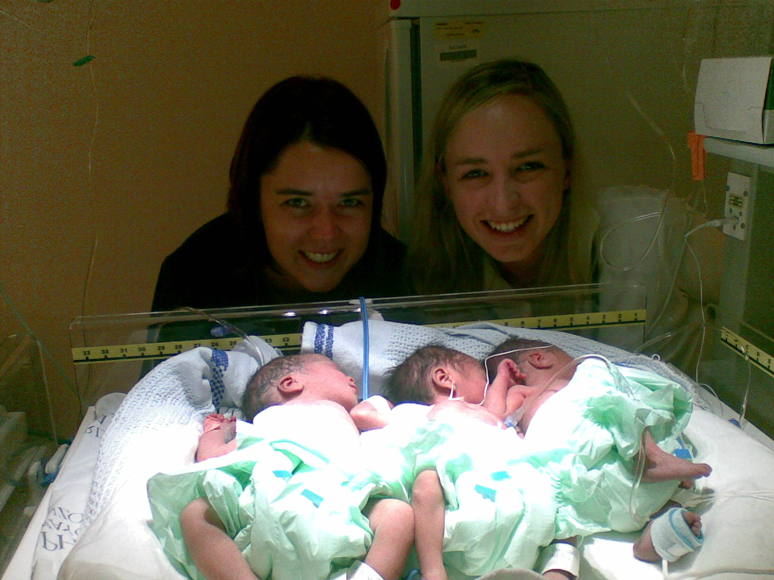
Not TB proof after all?
Dalene von Delft
MB.ChB South Africa, 2006
Completed 2 years internship and 1 year community service, 2007-2009
2010 – Medical Officer - Pediatrics

Slide 3
Estimated TB incidence rates annually
WHO, 2009

Slide 4
Estimated HIV prevalence in new TB cases
WHO, 2009

Slide 5
2 Days before Christmas, 2010
Difficult decision – Sputum microscopy negative (ZN negative)
Options:
Occupational health specialist - Start empiric TB treatment and assess response
Private pulmonologist - CT with Bronchoscopy to find the organism

Slide 6
Results
Test | Result | Sensitivities
Sputum microscopy | ZN negative
Bronchoscopy specimen (bronchial washings) | ZN positive | PCR: Rifampicin Resistance
 |  | PCR: Isoniazide Intermediate resistance 83% chance of Ethionamide resistance too
 |  | PCR: Ethambutol Resistance
 |  | PCR: Fluoroquinolones Sensitive
 |  | PCR: Aminoglycosides Sensitive
Saline induced sputum culture | Positive after 27 days incubation only | Same results as above plus: Ethionamide Sensitive (?) PZA: sensitive (initially reported as resistant?)

Slide 7
Genotyping (done on own initiative)
Spoligotyping results: Beijing strain
Predominant drug resistant strain in the Western Cape
Also one of the dominant strains in susceptible TB
rpoB S531L – most common mutation causing rifampicin resistance
katG Wildtype, inhA promotor -15C→T – low level resistance against INH and most probably resistance to Ethionamide too.
embB M306V – causes ethambutol resistance
controversy regarding the embB306 mutations in the literature
resident expert: does result in resistance, although the level unknown
pncA wildtype (no mutation) – no resistance to pyrazinamide
rpsL and rrs500 wildtype – no resistance to streptomycin
gyrA wildtype – no resistance to fluoroquinolones
rrs1400 wildtype – no resistance to Amikacin, Kanamycin or Capreomycin

Slide 8
Treatment Regime
Isoniazide, 600mg daily (high dose)
Amikacin, 1g daily IV
Moxifloxacin, 400mg daily
Pyrazinamide, 1.5 g daily
Ethionamide, 750mg daily
Ethambutol, 800 mg daily
Terizidone, 750mg daily
IM
Sens
Sens
Sens (?)
??
Res (?)
?

Slide 9
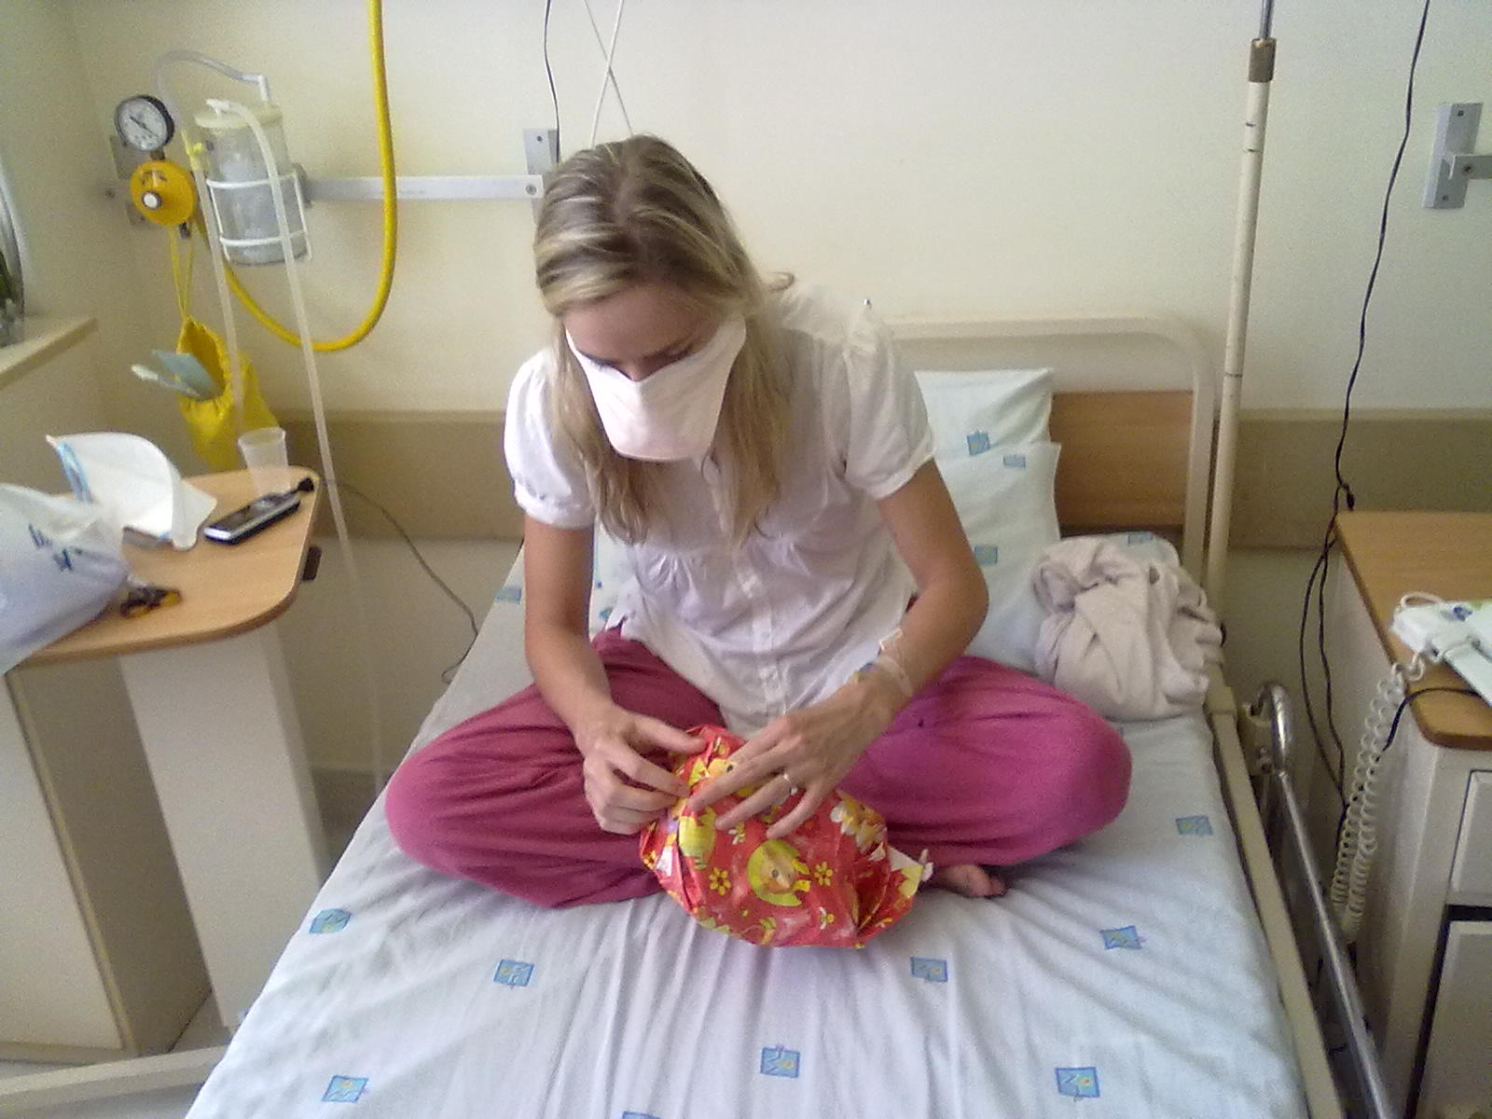
Adverse effects
Christmas in isolation

Slide 10
Adverse effects
Adverse effect | Management
Nausea and vomiting, loss of appetite - Day 1 | Initially Metoclopramide Later changed to Ondansetron* Started taking treatment at night after 2 weeks to try and sleep through the nausea
Diarrhea – Day 1 | Probiotics
Peripheral Neuropathy – week 4 | High dose Pyridoxine (75mg daily)
Vertigo and dizziness, extreme tiredness – 1st week | Refrained from driving and working while symptoms present
Insomnia – week 2 Depressed mood – week 4 | After 4 months of no sleep at night, started Zolpidem 2,5mg nocte – great improvement in sleep and daily functioning (caution: suicide risk)
Hypothyroidism ( hair loss) – w17 | Eltroxin
Abdominal pain – w52 | Mildly raised liver enzymes
Hyperuricaemia with arthralgia – w55 | Dietary adjustment Stopped Ethambutol after 14 months

Slide 11
Audiogram at baseline

Slide 12
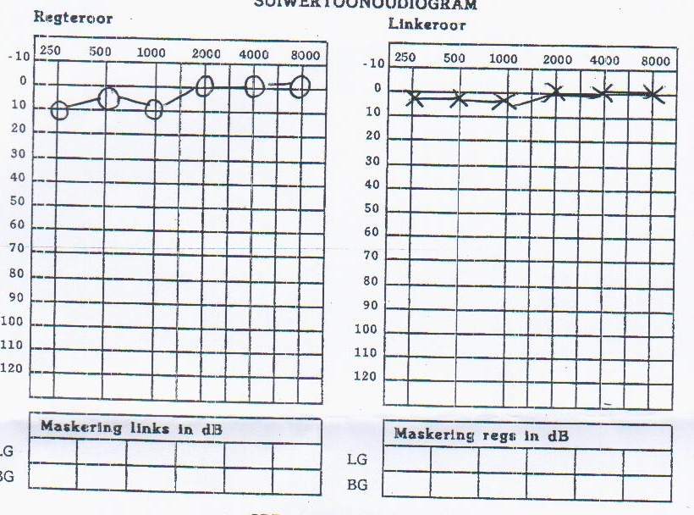
Audiogram at 8 weeks

Slide 13
Audiogram at 10 weeks

Slide 14
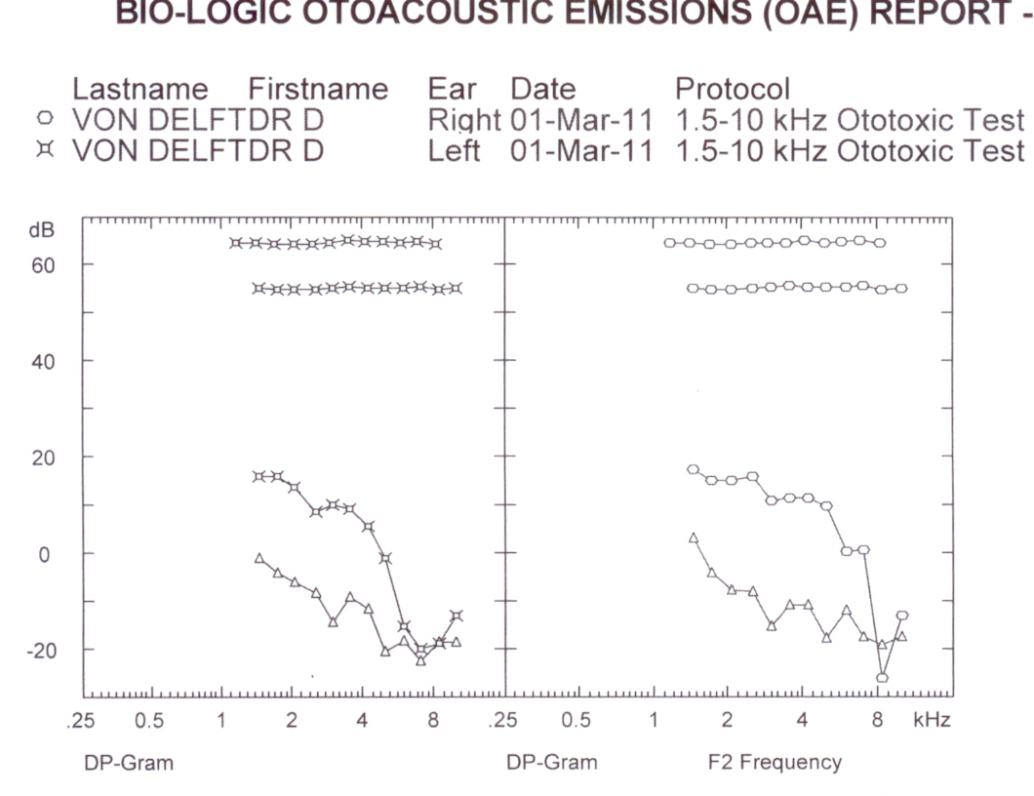

Slide 15
Difficult decision – rather deaf than dead? “Un-informed consent”
18 – 61.5 % ototoxicity but differing methodology

Slide 16
Can anybody hear me?
Occupational health nurse also had MDR TB – deaf overnight; one of two recent examples
Unable to use stethoscope despite bilateral cochlear implants
Music sounds like ‘tin’
I listened to music non-stop for days…
Will I ever be able to practice as a clinician without a stethoscope?
Peak and trough level monitoring – value?
Genetic screening: susceptibility to aminoglycoside induced ototoxicity
MT-RNR1 gene: negative for following mutations:
A827G, 961delT, T1095C, T1291C, C1494T and A1555G
Also of limited value - patients who screen negative still develop hearing loss, just not as rapidly

Slide 17
No real options to choose from
Why screen for hearing loss if no alternatives in any case?
Drug Holiday? Contentious: ?delaying the inevitable
Reduced dosing interval: no proven benefit *
Surgery: not for 1st infection
Capreomycin: kept in “reserve” (but rrs1400 mutation affects kanamycin, amikacin and capreomycin?)
Stop at own risk…what a “choice”!
Culture conversion within 2 weeks of treatment initiation with consecutive negative cultures
CXR improved rapidly – only fibrovascular scarring
Excellent compliance and support
Hope of a back-up plan?

Slide 18
MDR-TB timeline - DvD
Pleuritis
Arne
6
12
18
3
9
15
21
w0-w10, Isolation
Admission – Rx started
Neg cult: w2
Dx 48h
Hearing loss:
w8
Ad
IV Amikacin
Coughing
Ethambutol
INH (high)
Ethionamide
Terizidone
Moxifloxacin
PZA
Exposure?
Resp unit
Infective?
-16w, Aug 2010
-6w
0w, 24 Dec
w10…WHAT NOW?
11/04/11 Submitted
18 Feb

Slide 19
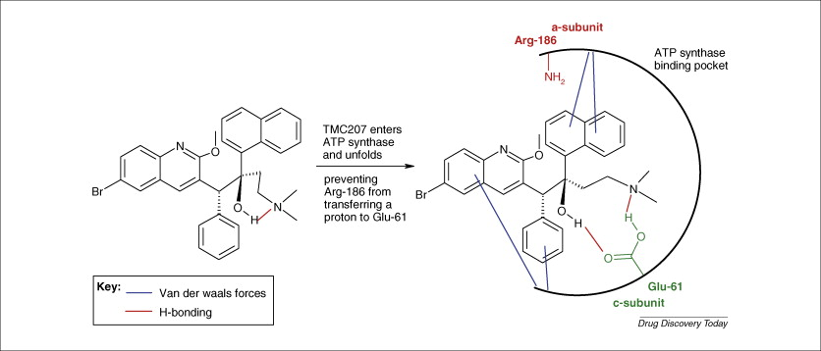
The Diarylquinolone TMC207 (Bedaquiline) for MDR TB*
Mechanism:
inhibits mycobacterial ATP synthase
in drug-sensitive and drug-resistant TB

Slide 20
Results of clinical trial – 24 weeks
Significantly reduced the time to culture conversion over 24 weeks (hazard ratio, 2.253; 95% confidence interval, 1.08 to 4.71; P = 0.031)

Slide 21
MDR-TB timeline – unchartered territory
Pleuritis
Arne
6
12
18
3
9
15
21
w0-w10, Isolation
Admission – Rx started
Neg cult: w2
IGRA’s normal
w81
Dx 48h
Hearing loss:
w8
Hypothyroidism:
w17
CXR unchanged
w34
Gout: Ethambutol stopped
w54
Ad
IV Amikacin
Coughing
Ethambutol
INH (high)
Ethionamide
Terizidone
Moxifloxacin
PZA
Exposure?
Mox, INH, Ethion,
PZA, Teriz
Resp unit
Infective?
w10…WHAT NOW?
-16w, Aug 2010
-6w
0w, 24 Dec
w10, Amikacin
stopped
w28 – Bedaquiline started
w54,Bedaquiline completed
w81, Rx stopped,
18 m post-conv.
Loading 2wks
X
TMC 207/Bedaquiline application
Bedaquiline duration
28/12/10, d4 1st enquiry
w8, only
XDR
w18, CUP app’s open
w21 APPROVED
w46, MCC
revokes CU
Total treatment duration – 18.5 months
11/04/11 Submitted
18 Feb

Slide 22
Adverse events
QT prolongation? Patients received Ofloxacin.
Increases in the mean corrected QT interval were observed in both treatment groups but were more pronounced in the TMC207 group, with intergroup differences ranging from 1.0 to 10.8 msec (P>0.05).
None of the absolute values for corrected QT interval were greater than 500 msec, and no adverse events were associated with ECG changes.*
Janssen 2010: Moxifloxacin use with bedaquiline was not advised pending more results
*Andreas Diacon et al, NEJM June 2009

Slide 23
Average terminal elimination half-life of TMC207 is estimated as 132 days
ECG not done at the same time or on same machine every day
Moxifloxacin peak and trough levels contributing to variability?

Slide 25
Compassionate use
‘Compassionate use’ allows for potentially lifesaving investigational drugs or experimental treatments (with good efficacy and safety in trials, but which haven’t been registered for market use) to be made available for patients suffering from a disease for which no satisfactory authorised therapy exists and/or who cannot enter a clinical trial.

Slide 26
MSF (and SA) vs. MCC
July 2011: After discussions with MSF, Janssen submits request to the MCC for Section 21 compassionate use permission to use bedaquiline in the Khayelitsha DR-TB program for 6 month period
August 2011: The MCC gives written approval for 6 month renewable Section 21 compassionate use in the Khayelitsha project
November 2011: The MCC, in verbal communication to Janssen, revokes compassionate use permission
Reason?
Dec 2011 – current: various attempts to regain access
MSF, SA HIV Clinicians Society, individual clinicians, Global Tuberculosis Community Advisory Board, AIDS & Rights Alliance for Southern Africa and TAC
Rejected two more times by MCC

