Slide 1
With support from the TB Alliance

Slide 2
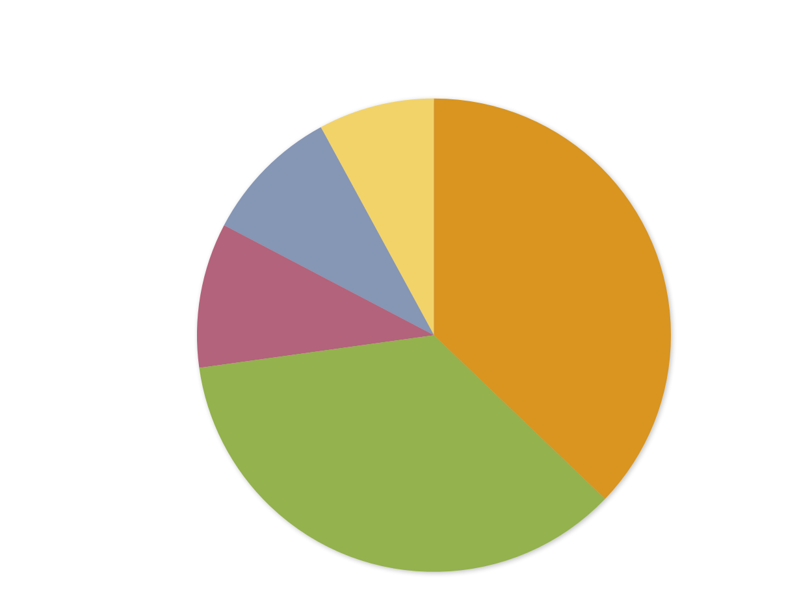
Pediatric TB R&D Investments by Research Category 2012 Total: $10,278,875
Basic Science$814,356 (8%)
Operational Research
$965,185 (9%)
Diagnostics
$1,017,160 (10%)
Drugs
$3,819,102 (37%)
Vaccines
$3,663,074 (36%)

Slide 3
2012 Pediatric TB R&D Funders by Rank and Compared with Prior Years
Percentage of 2012 Total R&D Funding Allocated to Pediatrics
2012
Pediatric TB R&D
Funding
2011 Pediatric TB R&D
Funding
2010
Pediatric TB R&D
Funding
2012
Total TB R&D
Funding
2012
Rank
Funding Organization
Funder Type
1 U.K. Medical Research Council P $2,644,610 $3,111,533 $408,718 $14,790,087 17.9
Other National Institutes of Health P $2,624,745 $1,917,849 $1,772,537 $36,646,883 7.2 Institutes and Centers*
3 Company X C $1,718,595 N/A N/A $22,844,099 7.5
4 U.S. National Institute of Allergy and Infectious Diseases* P $954,061 $532,394 $554,003 $169,092,971 0.6
5 Wellcome Trust F $551,017 $2,606,924 $322,682 $13,418,817 4.1
6 Company V C $481,080 N/A N/A $4,297,934 11.2
U.S. President’s Emergency P $450,000 $0 $0 $6,606,609 6.8 Plan for AIDS Relief
P= public-sector R&D agency; C= Corporation/private sector; M= Multilateral; F=Foundation/philanthropy; P-D= Public-sector development agency
*TAG reports National Institutes of Health investments in three categories: 1) National Institute of Allergy and Infectious Diseases—the largest investor in TB R&D overall; 2) the National Health, Lung and Blood Institute—which did not document investments in pediatric TB R&D; and 3) other NIH institutes and centers.
Note: This table records contributions made only by funders investing in pediatric TB R&D in 2012.

Slide 4
2012 Pediatric TB R&D Funders by Rank and Compared with Prior Years (continued)
Percentage of 2012 Total R&D Funding Allocated to Pediatrics
2012
Pediatric TB R&D
Funding
2011 Pediatric TB R&D
Funding
2010
Pediatric TB R&D
Funding
2012
Total TB R&D
Funding
2012
Rank
Funding Organization
Funder Type
8 Canadian Institutes P $326,268 $661,616 N/A $6,017,561 5.4 of Health Research
9 Australian National Health P $166,738 $295,363 $153,590 $4,060,791 4.1 and Medical Research Council
10 Danish International P-D $154,993 N/A N/A $323,250 47.9 Development Agency
11 World Health Organization M $85,260 $0 $0 $1,707,923 5.0
12 U.S. Agency for P-D $50,000 N/A N/A $12,174,064 0.4 International Development
13 Norwegian Knowledge Centre P $48,460 N/A N/A $48,460 100.0 for the Health Services
14 Indian Council of Medical Research P $23,047 N/A N/A $7,131,390 0.3
Grand Total $10,278,875
P= public-sector R&D agency; C= Corporation/private sector; M= Multilateral; F=Foundation/philanthropy; P-D= Public-sector development agency
*TAG reports National Institutes of Health investments in three categories: 1) National Institute of Allergy and Infectious Diseases—the largest investor in TB R&D overall; 2) the National Health, Lung and Blood Institute—which did not document investments in pediatric TB R&D; and 3) other NIH institutes and centers.
Note: This table records contributions made only by funders investing in pediatric TB R&D in 2012.

