Slide 1
What is the State of Our National HIV Prevention Efforts?

Slide 2
Objectives for Module 2
Our Mission(s) Today:
Discuss what HEALTH INDICATORS are, what they are not, and why they are important
Look at some of the current indicators and relevant research to see how well we’re doing with HIV prevention in key populations in America
Identify current opportunities for advocacy to improve our current indicators and how well we know the state of our HIV prevention efforts

Slide 3
We have a lot of work to do on HIV PREVENTION in America!

Slide 4
How Do We Know This?
There are several numbers that people might toss around:
An estimated 37,600 new HIV infections occurred in the United States in 2014
1.1 million Americans are estimated to be living with HIV as of 2014
About 3 in 20 people living with HIV do not know they have the virus
In 2014, an estimated 20,896 individuals in the United States were diagnosed with AIDS
Notes:
Key Points
Historically, “HIV Prevention” has been frequently used as an umbrella term for testing and services to keep HIV negative people from getting the virus (primary prevention). Following HPTN 052 and the advent of treatment as prevention, it has come to typically include services that keep HIV positive people from passing on the virus (secondary prevention).
Primary prevention, secondary prevention, and testing services are three different types of services with different targets and outcomes. One part does not replace the others- all three require investment in order to improve outcomes on individual and societal levels.

Slide 5
The Importance of Numbers
An estimated 37,600 new HIV infections occurred in the United States in 2014
1.1 million Americans are estimated to be living with HIV as of 2014
About 3 in 20 people living with HIV do not know they have the virus
In 2014, an estimated 20,896 individuals in the United States were diagnosed with AIDS
Each of these numbers is a type of HEALTH INDICATOR we use as a way of measuring our progress
Notes:
Key Points
Historically, “HIV Prevention” has been frequently used as an umbrella term for testing and services to keep HIV negative people from getting the virus (primary prevention). Following HPTN 052 and the advent of treatment as prevention, it has come to typically include services that keep HIV positive people from passing on the virus (secondary prevention).
Primary prevention, secondary prevention, and testing services are three different types of services with different targets and outcomes. One part does not replace the others- all three require investment in order to improve outcomes on individual and societal levels.

Slide 6
Indicators are QUANTIFIABLE CHARACTERISTICS that describe the health of a population They help gauge the EFFICACY of prevention/treatment efforts and steer advocacy

Slide 7
Looking Ahead: National HIV/AIDS Strategy Indicators for 2020
Image Source: AIDS.gov
Notes:
Additional Info
The period during which antibodies are first produced is called “seroconversion”. It is frequently, but not always, accompanied by a set of symptoms commonly called a seroconversion illness, which may be misdiagnosed as flu or glandular fever (or ignored). The most common symptoms are fever, rash, sore throat, swollen lymph nodes, muscle aches and joint pains. When these symptoms appear, they normally do so within six weeks of the HIV exposure.
The typical time before a third-generation laboratory test can detect infection is thought to be between 20 and 25 days, although it can be longer in some cases. For 4th generation tests, some experts believe that combined tests usually detect infection approximately 15 to 25 days after exposure, but occasionally this period will be a little longer.
With the exception of the Determine HIV-1/2 Ag/Ab Combo test, all point-of-care tests look for antibodies only. The window periods of these tests are usually a few days longer than those of antibody laboratory tests. In most but not all studies of the Determine HIV 1/2, INSTI and the Vikia HIV 1/2 tests, they performed well, usually with sensitivities (no false HIV negative results) and specificities (no false positive results) in the range of 99-100%. Performance of the OraQuick test with fingerprick blood samples has generally been good, with sensitivity and specificity in the range of 99-100%. However, performance is slightly poorer when testing samples of oral fluid – some people with HIV may receive a false negative result. This may be because quantities of antibodies are lower in oral fluid than in blood.
The Alere Determine point of care 4th generation rapid test: Because it detects p24 antigen (a key protein in HIV) as well as antibodies, the window period should be reduced. The manufacturer says the window period is an average of five days shorter than for the previous Determine test, but this varies from individual to individual (range: 2 to 20 days). The manufacturer also reports that on tests with 1179 positive and 2343 negative samples, sensitivity was 100% and specificity was 99.2%.
At home testing: the OraQuick test has been simplified for use by non-professionals, so that it can only test oral fluid (rather than fingerprick blood). A trial found that specificity was 99.98% and sensitivity was 93.0% – lower than for the professional version, probably due to more user errors. Moreover, this is an antibody test and so it is unable to detect recent infection. However, these limitations may be counter-balanced by the potential of self-testing to improve the uptake of HIV testing.
7. For more information on testing technologies, AIDSMAP has a useful summary: http://www.aidsmap.com/HIV-testing-technologies/page/2928294/

Slide 8
But indicators can be SUBJECTIVE and OPEN TO INTERPRETATION

Slide 9
Example 1: Incidence vs. New Diagnoses
NHAS uses “new diagnoses,” not “incidence,” as a key indicator
HIV incidence is the number of new infections within a given time. (~37,600 people in 2014)
New diagnoses are the number of people newly diagnosed within a given time, regardless of when they were infected. (39,513 in 2015)
Increase in new diagnoses could be due to increased testing and awareness efforts
Depending on other factors, an increase in this indicator could be a good thing or a bad thing

Slide 10
Example 2: Transgender Women
Transgender women are being miscategorized in CDC surveillance data
Transgender women are not men who have sex with men
HIV incidence and new diagnosis is uniquely disproportionate among transgender women
Image Source: CDC.gov

Slide 11
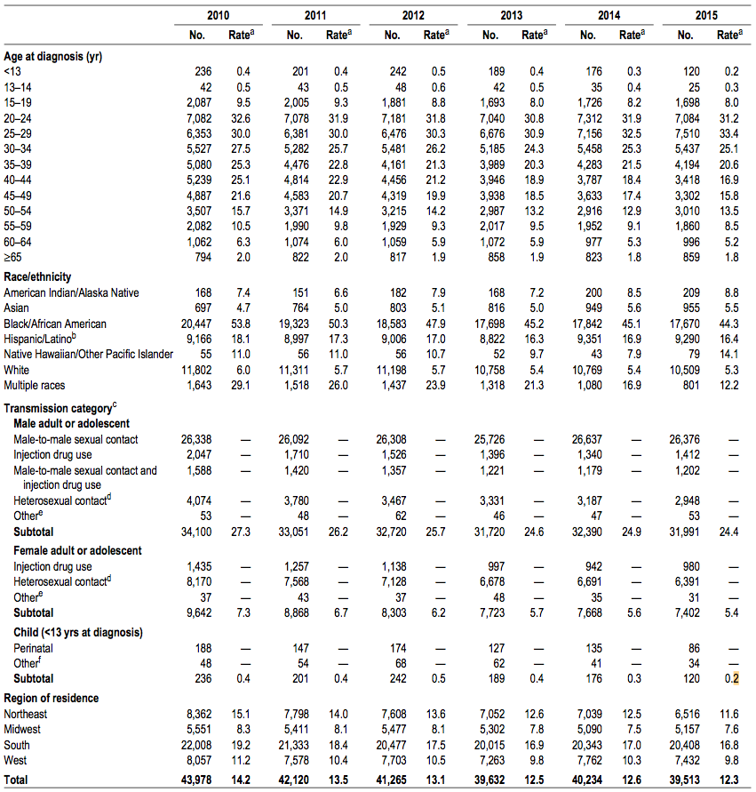
Example 3: Other Key Populations
Who else is missing?
Transgender men
Sex workers
People who are/have been incarcerated
Undocumented immigrants
People who are homeless or transitionally housed
All are dependent on unique protections and policies based on accurate CDC data
Image Source: CDC.gov

Slide 12
Question:
Why do you think indicators are important to the HIV response? Why is it important that we have indicators for transgender women and other populations?

Slide 13
OTHER TERMS you may need to know

Slide 14
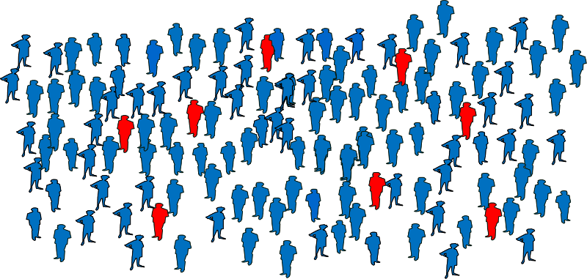
Prevalence
Prevalence is the estimated number of people who are currently living with an infection or disease at a given time
Different than incidence, which is the estimated rate of new infections that occur during a set period of time (e.g., annually)
In 2014, an estimated 1.1 million persons aged 13 and older were living with HIV infection in the United States
Image source: Boston University School of Public Health
Notes:
Additional Info:
For more news on the HPTN 052 study: http://www.hptn.org/research_studies/hptn052.asp
For more news about the PARTNER study: http://www.chip.dk/PARTNER
For more news about the START study and benefits of early treatment for HIV positive individuals: http://www.aidsmap.com/START-trial-finds-that-early-treatment-improves-outcomes/page/2972328/

Slide 15
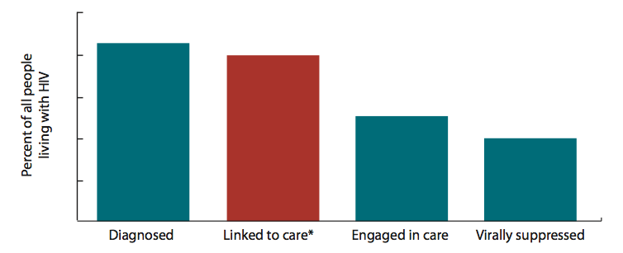
Care Continuum
A series of steps from the time a person is diagnosed with HIV through the successful treatment of their infection with antiretrovirals
Uses different data sources to determine % of all people living with HIV in the United States: diagnosed, linked to care, engaged in care, and who have undetectable virus loads
Significant differences between populations
Prevention continuums also being tested and used
Image Source: CDC.gov
Notes:
Additional Info:
For more news on the HPTN 052 study: http://www.hptn.org/research_studies/hptn052.asp
For more news about the PARTNER study: http://www.chip.dk/PARTNER
For more news about the START study and benefits of early treatment for HIV positive individuals: http://www.aidsmap.com/START-trial-finds-that-early-treatment-improves-outcomes/page/2972328/

Slide 16
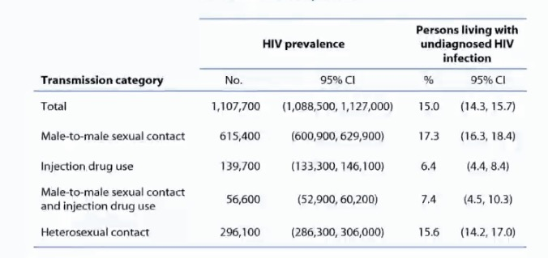
Confidence Intervals
Many studies only use samples of the overall population to look for things like incidence, prevalence, and treatment effect
Example: CDC conducts an analysis of data every year to determine the estimated number of people living with HIV, whether their diagnosis is known or not (1.1 million in 2014)
But if many analyses were conducted, a range of estimates would be generated, with 95% of the analyses indicating that the true U.S. population prevalence is between 1,088,500 and 1,127,000. This is known as the 95% confidence interval (95% CI)
Watch out for very wide ranges and overlapping ranges when one estimate is being compared to others (if they overlap, any observed differences are likely due to chance)
Notes:
Additional Info:
For more news on the HPTN 052 study: http://www.hptn.org/research_studies/hptn052.asp
For more news about the PARTNER study: http://www.chip.dk/PARTNER
For more news about the START study and benefits of early treatment for HIV positive individuals: http://www.aidsmap.com/START-trial-finds-that-early-treatment-improves-outcomes/page/2972328/

Slide 17
Surveillance
The ongoing collection, analysis, interpretation and dissemination of data used to plan and implement public health practices (including HIV prevention)
Used to estimate HIV incidence, new diagnoses, prevalence, viral load suppression rates in the United States
Can use many difference data sources
Reports from physicians, hospitals, laboratories, etc.
Surveys, registries, cohort studies, etc.
Image Source: CDC.gov
Notes:
Additional Info:
For more news on the HPTN 052 study: http://www.hptn.org/research_studies/hptn052.asp
For more news about the PARTNER study: http://www.chip.dk/PARTNER
For more news about the START study and benefits of early treatment for HIV positive individuals: http://www.aidsmap.com/START-trial-finds-that-early-treatment-improves-outcomes/page/2972328/

Slide 18
HIV Surveillance
HIV surveillance uses surveys to measure specific indicators
National HIV Surveillance System (NHSS)
State and local health departments send de-identified HIV data to CDC in exchange for funding
National HIV Behavioral Surveillance (NHBS)
Collects data on sexual behaviors, drug use, testing behaviors, and prevention strategies
Youth Risk Behavior Surveillance System (YRBSS)
Highlights lack of sexual education, comprehensive health services, and supportive environments
Image Source: CDC.gov
Notes:
Additional Info:
For more news on the HPTN 052 study: http://www.hptn.org/research_studies/hptn052.asp
For more news about the PARTNER study: http://www.chip.dk/PARTNER
For more news about the START study and benefits of early treatment for HIV positive individuals: http://www.aidsmap.com/START-trial-finds-that-early-treatment-improves-outcomes/page/2972328/

Slide 19
Questions:
What is the difference between prevalence and incidence?
Why are confidence intervals important?

Slide 20
Indicators and surveillance are imperfect. But existing figures do give us some idea on where we are with different KEY POPULATIONS

Slide 21
Key Populations
In the context of HIV, groups most likely to be impacted by the virus are most likely have less access to services to prevent or successfully manage the infection
U.S. examples include:
Gay, bisexual, and other men who have sex with men (MSM), particularly young, African American, gay, bisexual, and other MSM
Transgender women
Sex workers
People who inject drugs

Slide 22
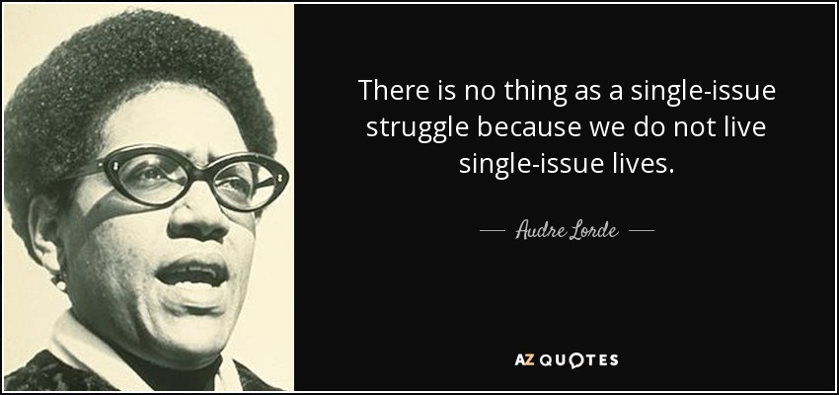
Intersectionality
“The interconnected nature of social categorizations such as race, class, and gender as they apply to a given individual or group, regarded as creating overlapping and interdependent systems of discrimination or disadvantage.” –Oxford Living Dictionaries
Image source: azquotes.com
Notes:
https://en.oxforddictionaries.com/definition/intersectionality
Audre Lorde, “Learning from the 60s,” in Sister Outsider: Essays & Speeches by Audre Lorde (Berkeley, CA: Crossing Press, 2007), 138.

Slide 23
Gay, Bisexual, and Other MSM
(Remember the problems with the MSM category)
Since the epidemic began, nearly 371,000 MSM with an AIDS diagnosis have died
According to new 2014 incidence estimates, in the United States, 70% of new infections occur among MSM despite their making up only 2% to 5% of the population
Around 26,000 MSM are estimated to get HIV each year–that figure has remained stagnant between 2008 and 2014

Slide 24
Don’t Forget Intersectionality and Subpopulations
Estimated Incidence Trends Between 2008 and 2014:
MSM + Race/Ethnicity
⬇Down 18% for White MSM
Stagnant for Black MSM
⬆Up 20% for Latino MSM
MSM + Age
⬇Down 18% for MSM 13 – 24
⬆Up 35% for MSM 25 – 34

Slide 25
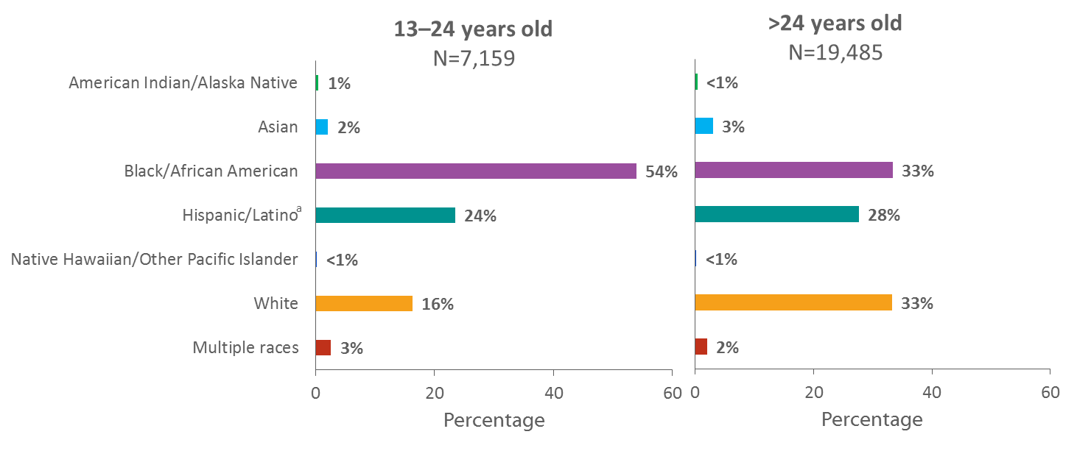
Diagnoses of HIV Infection among Men Who Have Sex with Men, by Age Group and Race/Ethnicity, 2015—United States and 6 Dependent Areas
Note. Data include persons with a diagnosis of HIV infection regardless of stage of disease at diagnosis. Data for the year 2015 are preliminary and based on 6 months reporting delay.
ª Hispanics/Latinos can be of any race.
Notes:
The racial/ethnic distribution of diagnoses of HIV infection among men who have sex with men (MSM) varied by age group in the United States and 6 dependent areas. Among young MSM (aged 13–24 years) with diagnosed HIV infection, 54% were black and 16% were white. But among MSM aged 25 years and older, 33% were black and 33% were white.
Data include persons with a diagnosis of HIV infection regardless of stage of disease at diagnosis. Data for the year 2015 are preliminary and based on 6 months reporting delay. Data have been statistically adjusted to account for missing transmission category.
Data on men who have sex with men do not include men with HIV infection attributed to male-to-male sexual contact and injection drug use.
Hispanics/Latinos can be of any race.

Slide 26
Transgender Women and Men
Understanding HIV-related risks among transgender men is limited by a lack of research. A CDC analysis of 29 studies involving transgender people found only 5 collected data on transgender men specifically
Transgender women in the United States are 34 times more likely to have HIV than their cisgender male and female counterparts
The quality of data is terrible, but according to one meta-analysis, 1 in 2 black transgender women in the United States could be living with HIV¹
By one estimate, 28% of transgender women in the United States could have HIV¹
¹ Herbst JH, Jacobs ED, Finlayson TJ, et al. Estimating HIV prevalence and risk behaviors of transgender persons in the United States: a systematic review. AIDS Behav 2008;12(1):1-17.

Slide 27
HIV by Geography
Southern states account for an estimated 44% of all people living with HIV in the United States and 50% of new 2014 infections despite only having about 1/3 of the US population
Eight of the 10 states with the highest rates of new diagnoses are in the South as are the 10 metropolitan areas with the highest rates
In 2014, the South accounted for 52% of the estimated 20,896 new AIDS diagnoses, as well as 52% of deaths attributed to HIV/AIDS
Rural residents are less likely to have health insurance, good access to care, and may face more stigma and discrimination than their urban counterparts

Slide 28
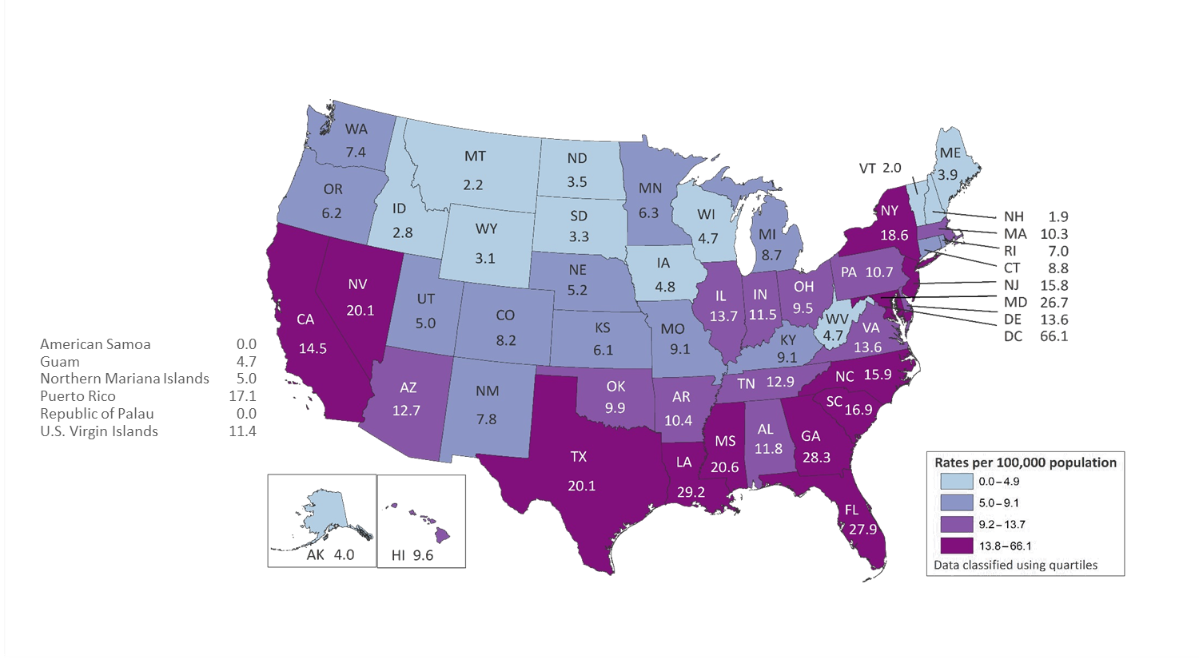
Rates of Diagnoses of HIV Infection among Adults and Adolescents 2015—United States and 6 Dependent Areas N = 39,920 Total Rate = 14.7
Note. Data include persons with a diagnosis of HIV infection regardless of stage of disease at diagnosis. Data for the year 2015 are preliminary and based on 6 months reporting delay.
Notes:
In the United States and 6 dependent areas, the rate of diagnoses of HIV infection among adults and adolescents was 14.7 per 100,000 population in 2015. The rate of diagnoses of HIV infection for adults and adolescents ranged from zero per 100,000 in American Samoa and the Republic of Palau to 66.1 per 100,000 in the District of Columbia.
The District of Columbia (i.e., Washington, DC) is a city; use caution when comparing the HIV diagnosis rate in DC with the rates in states.
Data include persons with a diagnosis of HIV infection regardless of stage of disease at diagnosis. Data for the year 2015 are preliminary and based on 6 months reporting delay.

Slide 29
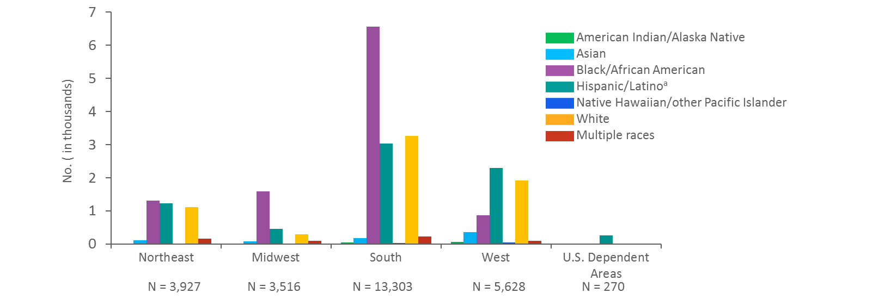
Diagnoses of HIV Infection among Men Who Have Sex with Men, by Region of Residence and Race/Ethnicity, 2015—United States and 6 Dependent Areas
Note. Data include persons with a diagnosis of HIV infection regardless of stage of disease at diagnosis. Data for the year 2015 are preliminary and based on 6 months reporting delay. Data have been statistically adjusted to account for missing transmission category. Data on men who have sex with men do not include men with HIV infection attributed to male-to-male sexual contact and injection drug use.
Numbers less than 12, and trends based on these numbers, should be interpreted with caution.
ª Hispanics/Latinos can be of any race
Notes:
This slide presents the number of diagnoses of HIV infection in 2015 among men who have sex with men (MSM) by race/ethnicity and the region of the United States where they were living at the time of diagnosis. Diagnoses of HIV infection among MSM in the 6 U.S. dependent areas are also shown by race/ethnicity.
The South had more diagnoses of HIV infection among MSM — 13,303 diagnoses in 2015 — than any other region. The largest group of MSM with diagnosed HIV infection in the South were blacks/African Americans, followed by whites, Hispanics/Latinos, persons of multiple races, Asians, American Indians/Alaska Natives, and Native Hawaiians/other Pacific Islanders.
In the West, the number of diagnoses of HIV infection among MSM was 5,628. The racial/ethnic group with the largest number of diagnoses were Hispanics/Latinos, followed by whites, blacks/African Americans, Asians, persons of multiple races, American Indians/Alaska Natives, and Native Hawaiians/other Pacific Islanders.
In the Northeast the number of diagnoses of HIV infection among MSM was 3,927. The racial/ethnic group with the largest number of diagnoses were blacks/African Americans, followed by Hispanics/Latinos, whites, persons of multiple races, Asians, American Indians/Alaska Natives, and Native Hawaiians/other Pacific Islanders.
In the Midwest, the number of diagnoses of HIV infection among MSM was 3,516. The racial/ethnic group with the largest number of diagnoses were blacks/African Americans, followed by Hispanics/Latinos, whites, persons of multiple races, Asians, American Indians/Alaska Natives, and Native Hawaiians/other Pacific Islanders.
In the dependent areas, 96% of diagnoses of HIV infection among MSM in 2015 were in Hispanics/Latinos.
Inter-region comparisons of numbers of diagnosed HIV infections should be made cautiously because the four regions and the dependent areas vary by number of jurisdictions and by population size.
Regions of residence are defined as follows: Northeast—Connecticut, Maine, Massachusetts, New Hampshire, New Jersey, New York, Pennsylvania, Rhode Island, and Vermont; Midwest—Illinois, Indiana, Iowa, Kansas, Michigan, Minnesota, Missouri, Nebraska, North Dakota, Ohio, South Dakota, and Wisconsin; South—Alabama, Arkansas, Delaware, District of Columbia, Florida, Georgia, Kentucky, Louisiana, Maryland, Mississippi, North Carolina, Oklahoma, South Carolina, Tennessee, Texas, Virginia, and West Virginia; West—Alaska, Arizona, California, Colorado, Hawaii, Idaho, Montana, Nevada, New Mexico, Oregon, Utah, Washington, and Wyoming. The 6 U.S. dependent areas include American Samoa, Guam, the Northern Mariana Islands, Puerto Rico, the Republic of Palau, and the U.S. Virgin Islands.
Data include persons with a diagnosis of HIV infection regardless of stage of disease at diagnosis. Data for the year 2015 are preliminary and based on 6 months reporting delay. Data have been statistically adjusted to account for missing transmission category.
Data on men who have sex with men do not include men with HIV infection attributed to male-to-male sexual contact and injection drug use.
Hispanics/Latinos can be of any race.

Slide 30
Cisgender Women
Between 2005 and 2014, the number of new HIV diagnoses among women declined 40%. New incidence estimates show a 30% decline in new infections between 2008 and 2013
Many women remain vulnerable to infection, particularly those with a history of trauma and those who have access to fewer resources.
As of 2014, around 1/5 of new US diagnoses still occur in women

Slide 31
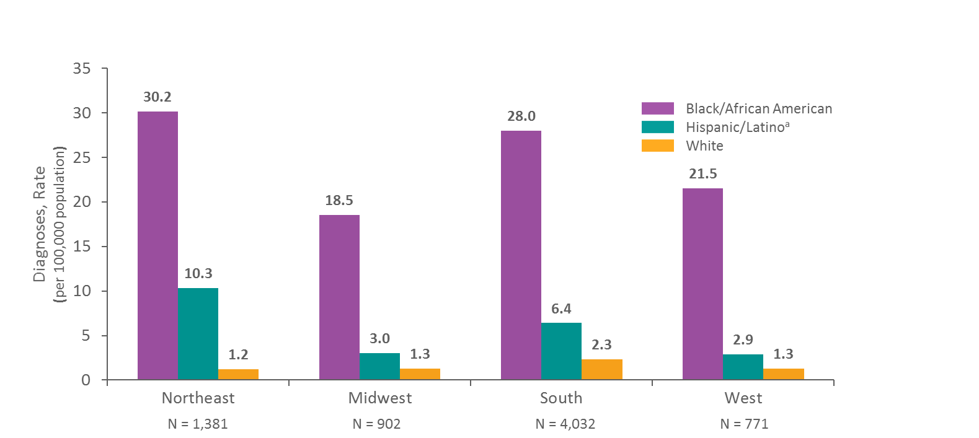
Diagnoses of HIV Infection among Female Adults and Adolescents by Region and Race/Ethnicity, 2015—United States
Note. Data include persons with a diagnosis of HIV infection regardless of stage of disease at diagnosis. Data for the year 2015 are preliminary and based on 6 months reporting delay.
ª Hispanics/Latinos can be of any race.
Notes:
This slide presents the rates (per 100,000 population) of diagnoses of HIV infection in 2015 among adult and adolescent black/African American, Hispanic/Latino, and white females by region of residence in the United States. Most diagnoses of HIV infection among female adults and adolescents were among those who resided in the Northeast and the South.
The highest rates of diagnoses of HIV infection were among black/African American females in the Northeast (30.2) and in the South (28.0).
The highest rate of diagnoses of HIV infection among Hispanic/Latino females was in the Northeast (10.3).
The highest rate of diagnoses of HIV infection among white females was in the South (2.3).
Data are not shown for Asian, American Indian/Alaska Native and Native Hawaiian/other Pacific Islander females or females of multiple races because the numbers when stratified by region of residence are small.
Regions of residence are defined as follows:
Northeast—Connecticut, Maine, Massachusetts, New Hampshire, New Jersey, New York, Pennsylvania, Rhode Island, Vermont Midwest—Illinois, Indiana, Iowa, Kansas, Michigan, Minnesota, Missouri, Nebraska, North Dakota, Ohio, South Dakota, Wisconsin South—Alabama, Arkansas, Delaware, District of Columbia, Florida, Georgia, Kentucky, Louisiana, Maryland, Mississippi, North Carolina, Oklahoma, South Carolina, Tennessee, Texas, Virginia, West Virginia West—Alaska, Arizona, California, Colorado, Hawaii, Idaho, Montana, Nevada, New Mexico, Oregon, Utah, Washington, Wyoming
Data include persons with a diagnosis of HIV infection regardless of stage of disease at diagnosis. Data for the year 2015 are preliminary and based on 6 months reporting delay.
Hispanics/Latinos can be of any race.

Slide 32
People Who Use Drugs
Significant progress has been made to reduce works-related transmission risk among people who inject drugs
Sexual transmission is inadequately addressed among people who use drugs
New outbreaks in Indiana highlight the urgency of addressing barriers to effective prevention. We saw over 200 new diagnoses in a small Indiana town of 4000 people in 2015
Sterile injecting equipment substantially reduces HIV infection

Slide 33
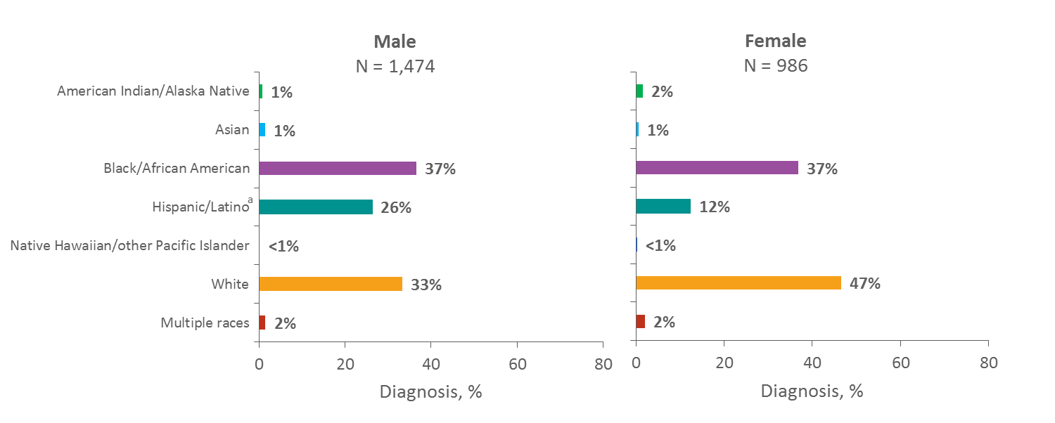
Diagnoses of HIV Infection among Persons Who Inject Drugs, by Sex and Race/Ethnicity, 2015—United States and 6 Dependent Areas
Note. Data include persons with a diagnosis of HIV infection regardless of stage of disease at diagnosis. Data for the year 2015 are preliminary and based on 6 months reporting delay. Data have been statistically adjusted to account for missing transmission category.
ª Hispanics/Latinos can be of any race.
Notes:
In 2015 in the United States and 6 dependent areas, among male adults and adolescents with diagnosed HIV infection attributed to injection drug use (IDU), approximately 37% were among blacks/African Americans, 33% among whites, and 26% among Hispanics/Latinos. Among female adults and adolescents with diagnosed HIV infection attributed to IDU, 47% were among whites, 37% among blacks/African Americans, and 12% among Hispanics/Latinos.
Among both sexes, American Indian/Alaska Native, Asian, Native Hawaiian/other Pacific Islander, and persons of multiple races each comprised 2% or less of persons with HIV infection attributed to IDU.
Data include persons with a diagnosis of HIV infection regardless of stage of disease at diagnosis. Data for the year 2015 are preliminary and based on 6 months reporting delay. Data have been statistically adjusted to account for missing transmission category.
Data on injection drug use among males do not include men with HIV infection attributed to male-to-male sexual contact and injection drug use.
Hispanics/Latinos can be of any race.

Slide 34
Youth
In 2014, youth aged 13 to 24 accounted for 22% (9,731) of all new HIV diagnoses. 80% of these cases were gay and bisexual males
In 2012, an estimated 44% of youth aged 18-24 were living with undiagnosed HIV. Only 16% had a suppressed viral load, the lowest of any age group
Inadequate sex education, stigma, and high-risk behaviors all contribute

Slide 35
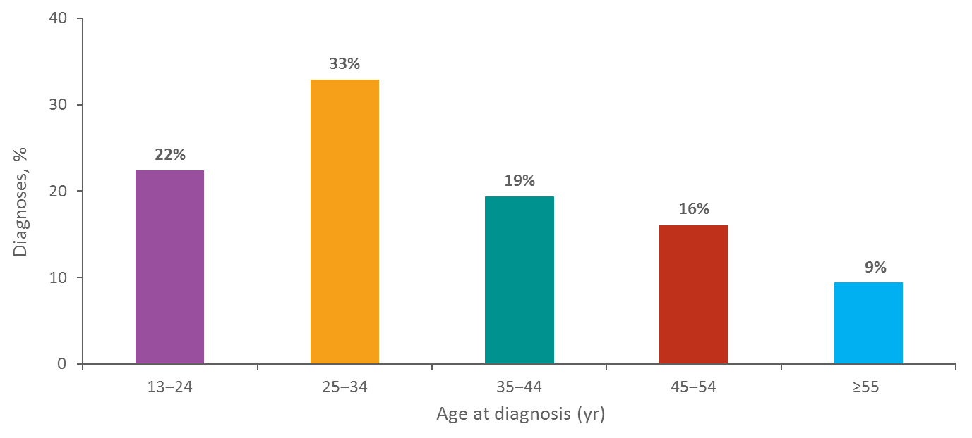
Diagnoses of HIV Infection among Adults and Adolescents by Age at Diagnosis, 2015—United States N = 39,393
Note. Data include persons with a diagnosis of HIV infection regardless of stage of disease at diagnosis. Data for the year 2015 are preliminary and based on 6 months reporting delay.
Notes:
This slide presents percentages of diagnoses of HIV infection by age group for 2015 in the United States. Of the 39,393 diagnoses of HIV infection among adults and adolescents, 33% were among persons aged 25–34 years, 22% among persons aged 13–24 years, 19% among persons aged 35–44 years, 16% among persons aged 45–54 years, and 9% among persons aged ≥55 years.
Data include persons with a diagnosis of HIV infection regardless of stage of disease at diagnosis. Data for the year 2015 are preliminary and based on 6 months reporting delay.

Slide 36
Black and African Americans
In 2015, 45% (17,670) of estimated new HIV diagnoses in the United States were among Black and African Americans, who comprise 12% of the U.S. population
58% of those were gay or bisexual men
From 2005 to 2014, the number of new HIV diagnoses among young Black gay and bisexual men (aged 13 to 24) increased 87%
However, new incidence estimates were seen as stable/stagnant between 2008 and 2014
Only 49% of Black and African Americans living with HIV at the end of 2012 had achieved viral suppression

Slide 37
Latinos and Latinas
Latinos and Latinas account for 1 in 4 new HIV diagnoses in the United States
Only 54% of Latinos and Latinas living with HIV at the end of 2012 had achieved viral suppression
Men who have sex with men accounted for 84% of the new HIV diagnoses among the Latino population in 2014
New infections are estimated to be going up for Latino MSM–by 20% between 2008 and 2014

Slide 38
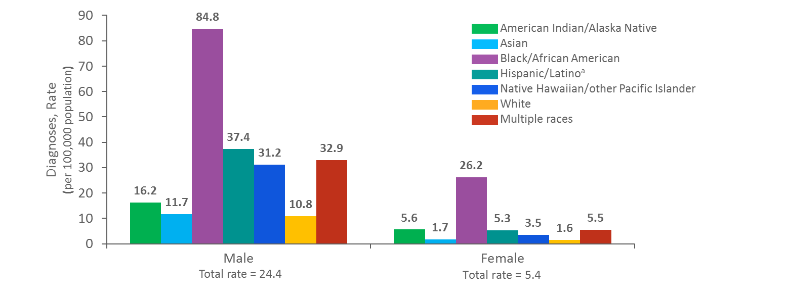
Rates of Diagnoses of HIV Infection among Adults and Adolescents by Sex and Race/Ethnicity, 2015—United States
Note. Data include persons with a diagnosis of HIV infection regardless of stage of disease at diagnosis. Data for the year 2015 are preliminary and based on 6 months reporting delay.
ª Hispanics/Latinos can be of any race.
Notes:
This slide presents a comparison of the rates of diagnoses of HIV infection between males and females by race/ethnicity in the United States. In 2015, blacks/African Americans accounted for the highest rates of diagnoses of HIV infection for males (84.8 per 100,000 population) and for females (26.2 per 100,000 population).
Data include persons with a diagnosis of HIV infection regardless of stage of disease at diagnosis. Data for the year 2015 are preliminary and based on 6 months reporting delay.
Hispanics/Latinos can be of any race.

Slide 39
Question:
What are the “key populations” in your city and state? Where can you find local epidemiological data?

Slide 40
Key Points From Module 2
Indicators are quantifiable characteristics that describe the health of a population. They help gauge the efficacy of prevention/treatment efforts and steer advocacy
Advocacy on indicators and surveillance to address problems such as misuse of new diagnoses, miscategorization of transgender women, and omission of other potential key populations is frequently needed at local, state, and national levels
We reviewed several numbers for a number of key populations. Numbers are evolving and subjective, but this is the best information we currently have on how we’re doing

Slide 41
Check Out Our Other HIV Prevention Policy Modules:
Module 1: What Is in Our HIV Prevention Toolbox?
Module 2: What Is the State of Our National HIV Prevention Efforts?
Module 3: Why Is HIV Still a Problem? A Discussion on Structural and Social Determinants of Health
Module 4: Using Policy Advocacy to Remove Barriers to Comprehensive HIV Prevention

Slide 42
For More Information About TAG and Our Work on HIV Prevention:
Visit: www.treatmentactiongroup.org
Like: Treatment Action Group on Facebook
Follow: @TAGTeam_Tweets on Twitter
Email: jeremiah.johnson@treatmentactiongroup.org

Slide 43
THANK YOU!

