Slide 1
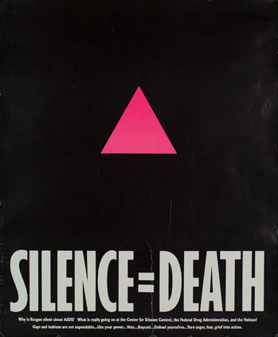
Using Policy Advocacy to Remove Barriers to Comprehensive HIV Prevention
Notes:
Image Source: ACTUPNY.org

Slide 2
Objectives for Module 4
Our Mission(s) Today:
Review a Brief history of HIV/AIDS policy advocacy
Understand basic tactics for policy advocacy and how it differs from other kinds of advocacy
Go over suggestions for developing an advocacy agenda and action plan
Discuss some of the primary options in our “advocacy toolbox”

Slide 3
What is Policy Advocacy?
“Public support for or recommendation of a particular cause or policy.” (OxfordDictionaries.com)
“Advocacy is a political process by an individual or group which aims to influence decisions within political, economic, and social systems and institutions.” (Wikipedia)
“Advocacy's end goal always is to change policy.” (Advancing Women's Leadership and Advocacy for AIDS Action)
“Advocacy is a process that brings about change in laws, policies and practices by persuading individuals, groups or institutions.” (USAID)

Slide 4
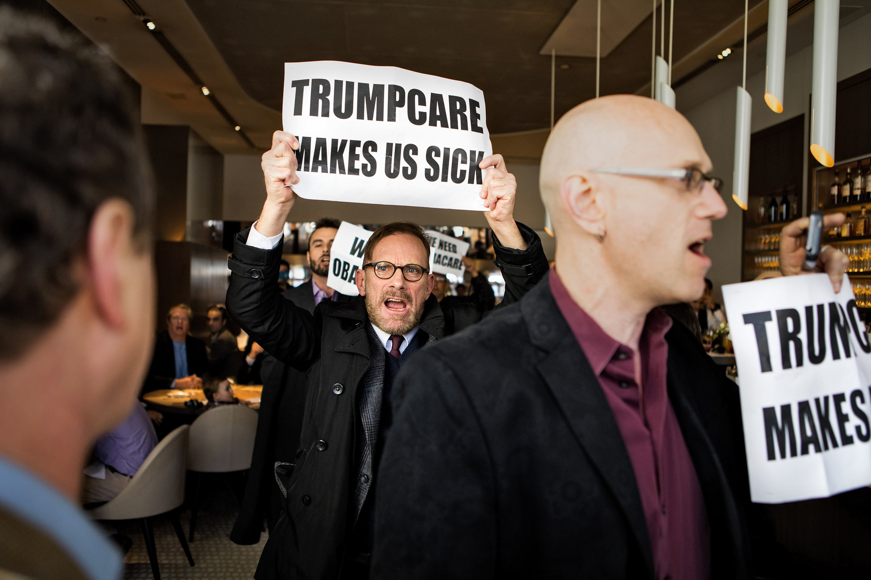
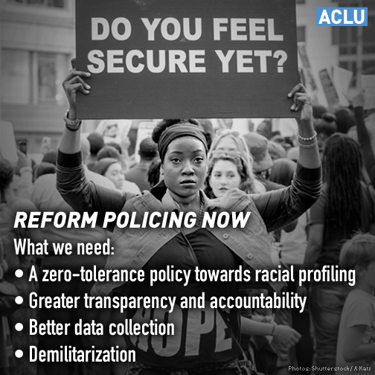
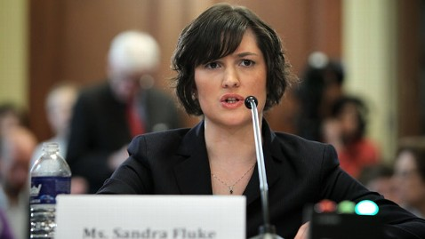
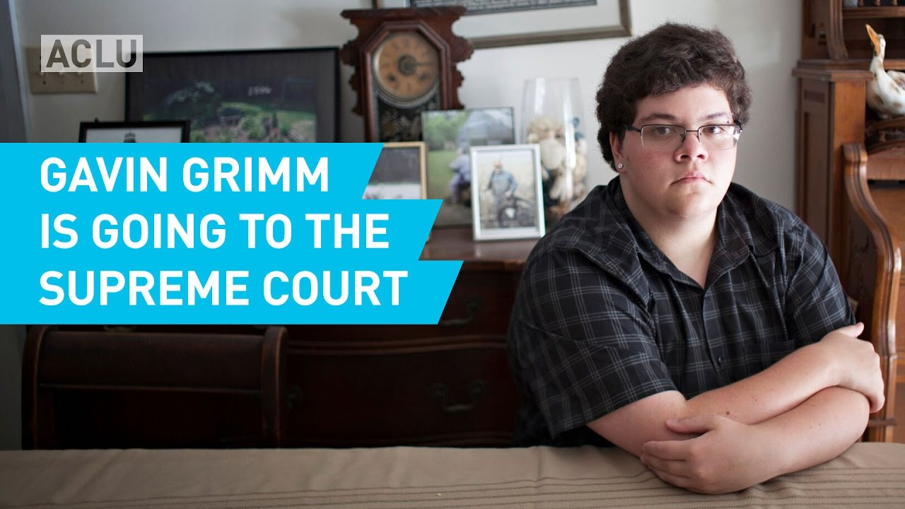

Slide 5
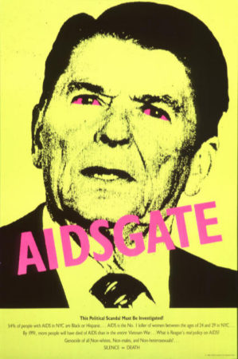
Key U.S. Policy Advocacy Victories in HIV/AIDS History
1988: Congress passes the first comprehensive AIDS legislation—the Hope Act of 1988
1990: Congress passes the Americans with Disabilities Act, which protects individuals with disabilities, including both people with HIV/AIDS and those suspected of being infected, from discrimination
1990: Passage of the Ryan White Comprehensive AIDS Resources Emergency (CARE) Act
1991: Congress enacts the Housing Opportunities for People with AIDS (HOPWA) Act to provide housing assistance to people with HIV/AIDS
Image source: ACTUPNY.org

Slide 6
Key U.S. Policy Advocacy Victories in HIV/AIDS History
1993: The CDC's decision to revise its definition of AIDS to include new opportunistic infections, cervical cancer and HIV-positive people with T-cell counts under 200 results in an 111% increase in the number of U.S. AIDS cases. Many of these new cases are among women
2003: President George W. Bush announces his Emergency Plan for AIDS Relief (PEPFAR), a five-year, $15 billion initiative to fight HIV/AIDS, primarily in Africa and the Caribbean
2009: The United States ends travel ban on HIV-positive visitors and immigrants. The ban had been in place since 1987
2015: Congress ends ban on federal funding for needle exchanges
Image source: amfAR.org

Slide 7
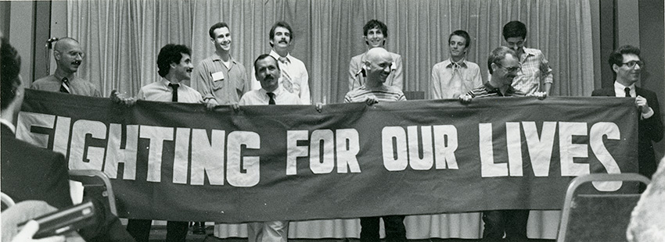
The Denver Principles (1983)
We condemn attempts to label us as "victims," a term which implies defeat, and we are only occasionally "patients," a term which implies passivity, helplessness, and dependence upon the care of others.
We are "People With AIDS."
Image source: nlm.nih.gov

Slide 8
The Denver Principles
Recommendations for All People
Support us in our struggle against those who would fire us from our jobs, evict us from our homes, refuse to touch us or separate us from our loved ones, our community or our peers, since available evidence does not support the view that AIDS can be spread by casual, social contact
Not scapegoat people with AIDS, blame us for the epidemic or generalize about our lifestyles

Slide 9
The Denver Principles
Recommendations for People Living With AIDS
Form caucuses to choose their own representatives, to deal with the media, to choose their own agenda and to plan their own strategies
Be involved at every level of decision-making and specifically serve on the boards of directors of provider organizations
Be included in all AIDS forums with equal credibility as other participants, to share their own experiences and knowledge
Substitute low-risk sexual behaviors for those which could endanger themselves or their partners; we feel people with AIDS have an ethical responsibility to inform their potential sexual partners of their health status

Slide 10
The Denver Principles
Rights of People With AIDS
To as full and satisfying sexual and emotional lives as anyone else
To quality medical treatment and quality social service provision without discrimination of any form, including sexual orientation, gender, diagnosis, economic status, or race
To full explanations of all medical procedures and risks, to choose or refuse their treatment modalities, to refuse to participate in research without jeopardizing their treatment, and to make informed decisions about their lives
To privacy, to confidentiality of medical records, to human respect, and to choose who their significant others are
The right to die—but most importantly, TO LIVE, in dignity

Slide 11
Question:
What does community involvement look like in HIV prevention in your community? Which communities most need to be involved?

Slide 12
Getting Prepared for Policy Advocacy (A Few Suggestions)
Self-care
Keep the focus on the cause as much as possible
Be confident: speak truth to power
Be aware of internalized shaming (“Who do you think you are?” and “Why didn’t you speak up?”)
Maintain a strong support network
Accept what you cannot change (while working to change what you cannot accept)
Image source: Keepcalm-o-matic.co.uk

Slide 13
Getting Informed
Know who the decision makers are
Understand relevant policies
Get familiar with trusted and accessible science-based sources
Seek expert guidance
Develop working coalitions with organizations with different areas of expertise
Have five or six strong and clear talking points ready for legislators or media

Slide 14
Developing an Advocacy Agenda
What are we advocating for? (Select issue/problem to address)
What do we know? What is the evidence? (Analyze and research issue/problem/desired outcomes)
What do we hope to achieve? (Develop specific proactive—rather than reactive—objectives for advocacy work)
Identify targets, resources, and allies
Create an action plan
Implement, monitor, and evaluate— quantitative and qualitative metrics
Adapted from Alliance - Advocacy in Action: iasociety.org/

Slide 15
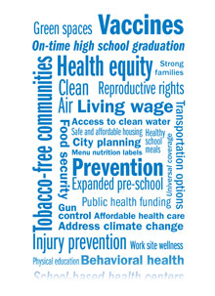
Developing and Prioritizing Policy Advocacy Objectives
Have specific policies in mind that you’d like to create, change, or remove (federal/state/local laws, institutional policies, organizational policies, etc.)
Map out the power players
Create SMART objectives (more on this later)
Prioritize multiple objectives in terms of interest and feasibility. Don’t forget winnable battles while you’re shooting for the moon
Image source: APHA.org

Slide 16
Raising Awareness vs. Policy Advocacy
Community Education | Policy Advocacy
Designing social media-based comprehensive sex education tools for students | Pressure a school board to officially endorse evidence-based comprehensive sex education for all students in the district
Design a campaign to educate physicians about pre-exposure prophylaxis (PrEP) and post-exposure prophylaxis (PEP) | Pressure state medical boards and associations to officially support greater access to PrEP and PEP and mandate HIV prevention education as part of license renewal

Slide 17
Question:
What is a barrier to HIV prevention that concerns you? What kinds of laws and policies are related to that barrier?

Slide 18
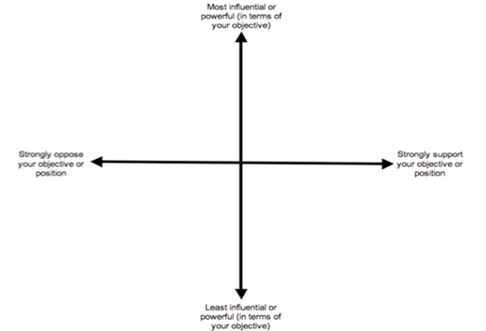
Power Mapping
Useful method for intimately understanding who has power on an issue, what their interests are, and how to persuade them
Key questions:
Who are the power players for your issue?
What is the mission/purpose for these players?
In what ways do these players have influence over your issue?
What law, higher authority, or community constituency is this player accountable to? Who does it purport to serve?
What legal authority (if any) does this player operate under? What is their mandate?
How is this player funded?
In what manner does this player make decisions and what policies and authorities guide their decision-making processes?
Image Source: thechangeagency.org

Slide 19
SMART Objectives
Specific
Measurable
Attainable (but ambitious)
Relevant
Time-bound
Example: Work with state legislators to draft a bill by the end of 2017 that would reform outdated laws requiring abstinence-only education in schools Not SMART example: Get rid of abstinence-only education in the state
Image source: useablehome.ri.umt.edu

Slide 20
Building an Advocacy Toolbox
Voting!
Get your message to law makers/key decision makers
Lobbying/direct negotiation
Providing public testimony
Work from inside the system
Join community advisory boards
Community mobilization
Build coalitions/networks
Start an organization that fills a gap
Write Letters/petitions, etc.
Conduct and attend trainings
Information, education, and communication
Publications
Media coverage
Press releases
Social media
Litigation/Protesting
Litigation/Protest
Research & Planning
Mobilization
Lobbying
Networks & Coalitions
Media
Image Source: Slideshare.net

Slide 21
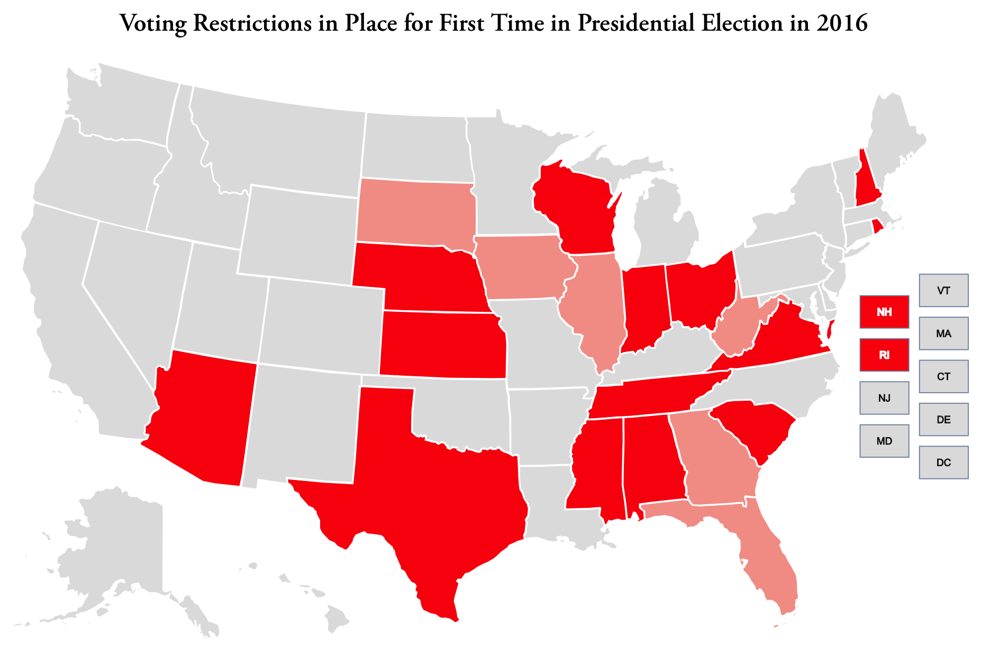
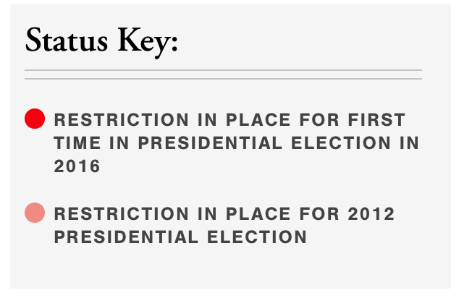
Voting
Register
Know the candidates
Know the issues
Ballotpedia.org
Know WHEN to vote
Most local elections determined in the primary
Be aware of laws and policies suppressing voter turnout
Image source: www.brennancenter.org

Slide 22
Tips for Influencing Key Decision Makers
Two simple rules for influencing public policy
Elected and appointed officials make different decisions when watched by the affected constituency
Get the right information to the right person at the right time
Communicating with elected officials
Write letters
Send e-mails
Call your elected officials
Provide public testimony
Meet with elected officials
Know who they are: https://www.usa.gov/elected-officials
Image source: abcnews.go.com

Slide 23
Key Elements of Effective Communication
Identify the issue
Cite a personal connection OR describe the local impact
Use key facts to support your case
Make a specific “ask”
Say “thank you” and request an opportunity to follow up
The more prepared you are the better
Consider your appearance and how you
dress
Make the message as accessible as possible
Clear messaging
Offer it visually or in writing when possible
Consider tone
Consider length
Follow up, be repetitive
Image source: ACLU.org

Slide 24
Mobilizing Communities
Build coalitions/networks
Leadership structure/Diversity
In person vs. online
Sharing resources
One-time vs. extended partnerships
Start an organization that fills a gap
Letters/petitions, etc.
Trainings
Protests and civil disobedience
Image source: NYTimes.com

Slide 25
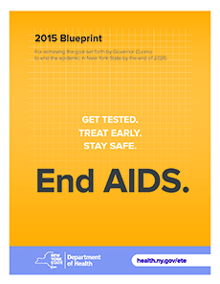
Community Mobilization: Ending the Epidemic in New York State
On June 29, 2014, Governor Cuomo detailed a three-point plan to move us closer to the end of the AIDS epidemic in New York State. The goal is to reduce the number of new HIV infections to just 750 (from an estimated 3,000) by 2020 and achieve the first ever decrease in HIV prevalence in New York State.
The three-point plan:
Identifies persons with HIV who remain undiagnosed and link them to health care
Links and retains persons diagnosed with HIV in health care to maximize virus suppression so they remain healthy and prevent further transmission
Facilitates access to PrEP for high-risk persons to keep them HIV negative
Image source: health.ny.gov

Slide 26
Community Mobilization: Ending the Epidemic in New York State
The result of at least two key components:
Close collaboration between state, city, and community
Massive community mobilization; partnership between community based organizations
Before the plan:
Proposed by Housing Works and TAG
Several large community town hall gatherings and conference calls
Several discussions with legislative partners and allies close to governor
Image source: health.ny.gov

Slide 27
Key Points From Module 4
Policy advocacy and direct involvement of affected communities has been essential over the course of the epidemic. It is our responsibility to maintain our victories and expand them into HIV prevention
Self care and getting informed are key parts of preparing for policy advocacy
Clear policy objectives are necessary for policy advocacy. We need more than educational campaigns
The more people in power know they are being watched, the more likely they are to prioritize our needs. Different “inside” and “outside” advocacy tools and strategies work in different situations and with different targets

Slide 28
Check Out Our Other HIV Prevention Policy Modules:
Module 1: What Is in Our HIV Prevention Toolbox?
Module 2: What Is the State of Our National HIV Prevention Efforts?
Module 3: Why Is HIV Still a Problem? A Discussion on Structural and Social Determinants of Health
Module 4: Using Policy Advocacy to Remove Barriers to Comprehensive HIV Prevention

Slide 29
For More Information About TAG and Our Work on HIV Prevention:
Visit: www.treatmentactiongroup.org
Like: Treatment Action Group on Facebook
Follow: @TAGTeam_Tweets on Twitter
Email: jeremiah.johnson@treatmentactiongroup.org

Slide 30
THANK YOU!

