Slide 1
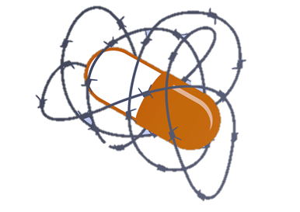
Why Is HIV Still a Problem?
A discussion on Structural and Social Determinants of Health
Notes:
Image source: Aidsmap.com

Slide 2
Objectives for Module 3
Our Mission(s) Today:
Discuss the difference between individual, structural, and social interventions
Discuss examples of “structural determinants” and “social determinants” of health that drive the HIV epidemic
Look at examples of structural and social interventions for HIV prevention

Slide 3
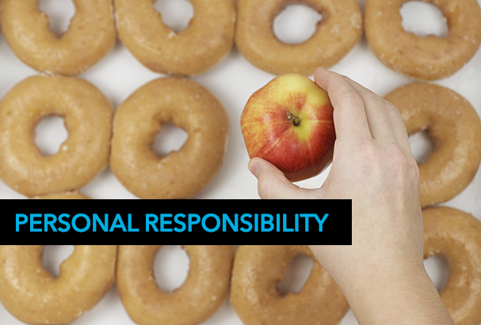
Individual Responsibility and HIV
Primary way we discuss HIV prevention (and preventive health in general)
Every individual mostly (or solely) responsible for (not) getting HIV
Leads to prevention interventions that focus on changing individual knowledge, behaviors, or habits
Image source: LinkedIn.com

Slide 4
Individual Responsibility and Going to the Gym
Objective: Getting someone to go to the gym more
If we believe the individual is mostly (solely) responsible, we can choose:
To do nothing
Positive messaging (Michele Obama’s Let’s Move Campaign)
Negative messaging (scare them about diseases, shame their current body shape)
Increase knowledge (info on accessing the gym, how to exercise, the effects on health)
Offer benefits (free training services, financial incentives)
Create consequences (insurance penalties)
Image Source: Clipartkid.com

Slide 5
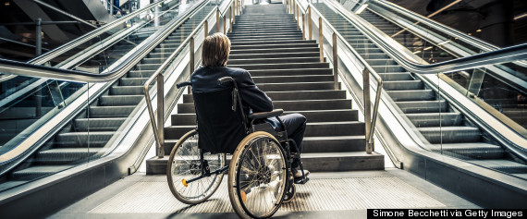
But What If There Are…
Structural barriers
The gym is very far and there’s no public transit
The gym is really expensive
The gym equipment is old and dangerous
Signs/services are all in a foreign language
Gym hours are too early/late
Social barriers
The gym staff is bitter and mean
Other gym members are judgmental or insulting
Uncomfortable social environment
Image source: Huffingtonpost.com

Slide 6
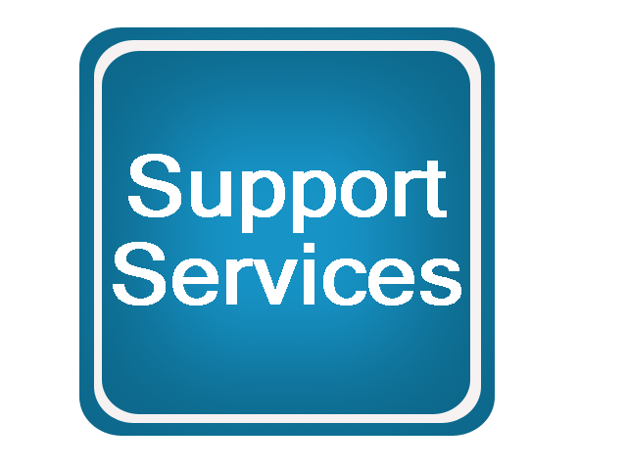
Other Personal Barriers/Deterrents
Joint pain and no insurance/doctor to help
Need assistance with mental health issues (depression, anxiety disorder, history of trauma)
Need help addressing alcohol or drug use
Too busy just trying to meet basic needs (housing, food, safety)
Image source: umkc.edu

Slide 7
Structural and Social Barriers Defined
“The complex, integrated, and overlapping social structures and economic systems that are responsible for most health inequities. These social structures and economic systems include the social environment, physical environment, health services, and structural and societal factors. Social determinants of health are shaped by the distribution of money, power, and resources throughout local communities, nations, and the world.”
https://www.cdc.gov/nchhstp/socialdeterminants/definitions.html

Slide 8
More Than Just Individual Responsibility
Image source: Jiasociety.org

Slide 9
Question:
In our gym example: what are some solutions to the STRUCTURAL and SOCIAL barriers listed?

Slide 10
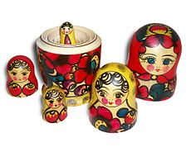
We Need Multilevel Interventions
Example: getting someone to the gym
Individual
Positive messaging campaigns
Structural
Extend gym hours
Open a gym closer to their home
Social
Teach them strategies to handle uncomfortable social situations (e.g., work out with a friend)
Give gym staff the training/resources they need to be more welcoming
Other personal needs
Help link them to good health insurance that also covers mental health
Improve their income and access to resources
Image source: Wiktionary.org

Slide 11
Question:
What are some common structural and social barriers to
HIV PREVENTION?

Slide 12
Examples of Major Structural Barriers to HIV Prevention Services
Housing
Transportation
Employment
Healthcare coverage and complex systems
Access to adequately trained healthcare providers
System-wide barriers to comprehensive education on HIV, sex, and drug use
Declining media coverage/inaccurate media coverage
Fewer schools teaching sexual education
Image source: healthjournalism.org

Slide 13
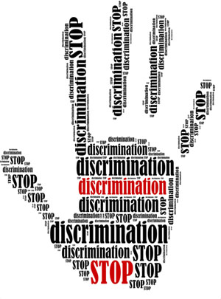
Examples of Social Barriers
HIV-specific stigma
Sex negativity
Drug-related stigma
Stigma associated with different
personal characteristics (RACISM,
misogyny, transphobia, etc.)
Image Source: covenanthousebc.org

Slide 14
Accepting the Limitations of Individual Autonomy
Even with all our individual/community creativity and determination, individuals alone cannot easily overcome:
So little money spent on prevention (only 3% of domestic HIV/AIDS budget)
Lack of comprehensive (LGBT) sex education for youth
Complicated, uncomfortable, inaccessible health care systems
Inadequate support for mental health, housing, jobs, etc.
Many forms of sex, drug, HIV stigma that exist
We have to keep fighting to end structural and social barriers

Slide 15
HIV Prevention Example: Syringe Access
Individual
Educational campaigns
Structural
Decriminalize syringe-exchange programs, allow pharmacies to provide syringes
Social
Anti-stigma campaigns, resilience training for individuals
Other personal needs
Services for housing, jobs, mental health
Image Source: Clipartkid.com
Notes:
(Photo: Getty Images/iStockphoto)

Slide 16
What Interventions Are Funded?

Slide 17
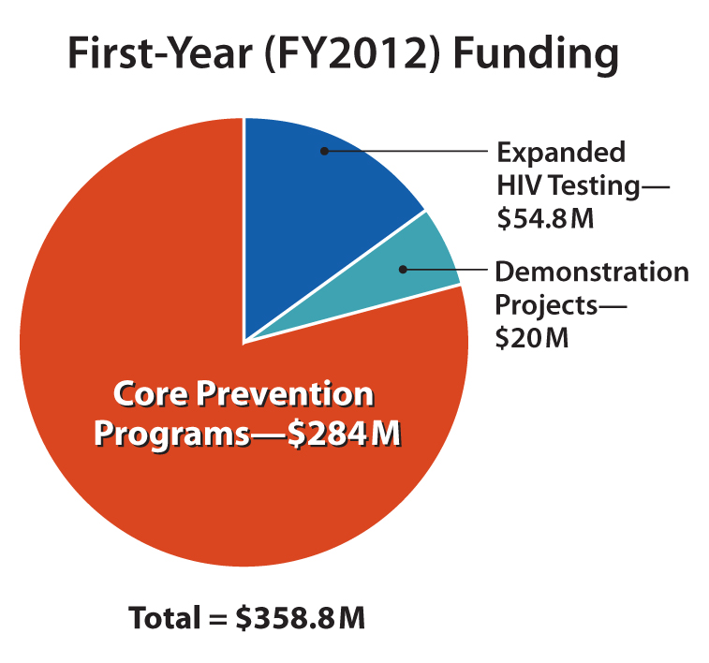
What Interventions Are Funded?
Prior to 2012: Mostly testing and individually focused interventions (counseling, testing, and referral (CTR); condoms; EBIs/DEBIs); educational campaigns
After 2012: Increased focus on addressing structural and social barriers—particularly for treatment as prevention. More focus on PrEP in recent years
https://www.cdc.gov/hiv/funding/
More on High Impact Prevention: https://www.cdc.gov/hiv/funding/announcements/ps12-1201/factsheet.html

Slide 18
Hopeful State and Local Approaches
Ending the Epidemic in New York
Fulton County Task Force
Houston
Pittsburgh
San Francisco
Washington, D.C.
Image source: health.ny.gov

Slide 19
Question:
What opportunities exist in your community or your state for a push to END THE EPIDEMIC?

Slide 20
Key Points From Module 3
While individual-level interventions are always necessary, they are not enough. Media campaigns can be useful, but they are also not enough
Social and structural barriers must be addressed by all key stakeholders in order for comprehensive HIV prevention to be available to all communities
New state/local approaches and even some federal funding may provide some directions and resources to address structural and social barriers

Slide 21
Check Out Our Other HIV Prevention Policy Modules:
Module 1: What Is in Our HIV Prevention Toolbox?
Module 2: What Is the State of Our National HIV Prevention Efforts?
Module 3: Why Is HIV Still a Problem? A Discussion on Structural and Social Determinants of Health
Module 4: Using Policy Advocacy to Remove Barriers to Comprehensive HIV Prevention

Slide 22
For More Information About TAG and Our Work on HIV Prevention:
Visit: www.treatmentactiongroup.org
Like: Treatment Action Group on Facebook
Follow: @TAGTeam_Tweets on Twitter
Email: jeremiah.johnson@treatmentactiongroup.org

Slide 23
THANK YOU!

