Slide 1

What Is in Our HIV Prevention Toolbox?

Slide 2
Objectives for Module 1
Our Mission(s) Today:
Discuss the difference between HIV prevention for HIV-negative people, HIV prevention for people living with HIV, and HIV testing
Discuss the evidence-based HIV prevention options we have available in 2017
Provide an overview of new tools in development

Slide 3
What is
HIV PREVENTION?
(It’s not always as simple as it seems)

Slide 4
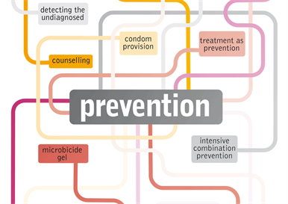
“HIV Prevention” Can Refer to:
HIV testing services (not really prevention, just detection)
HIV prevention for people who are HIV-positive (stop transmission/passing)
HIV prevention for people who are HIV-negative (stop acquisition/getting)
All three parts are necessary!
Image source: Aidsmap.com
Notes:
Key Points
Historically, “HIV Prevention” has been frequently used as an umbrella term for testing and services to keep HIV negative people from getting the virus (primary prevention). Following HPTN 052 and the advent of treatment as prevention, it has come to typically include services that keep HIV positive people from passing on the virus (secondary prevention).
Primary prevention, secondary prevention, and testing services are three different types of services with different targets and outcomes. One part does not replace the others- all three require investment in order to improve outcomes on individual and societal levels.

Slide 5
Things to know about
HIV TESTING

Slide 6
Did You Know?
Testing is for (just about) everyone:
  The CDC recommends HIV testing for all people ages 13 through 64 (some people think the upper age limit should be removed). More vulnerable individuals from key populations may benefit from getting tested annually (or even 2 to 3 times a year)
Not your grandparents’ HIV test:
  Fourth Generation (Antibody/Antigen) testing can pick up a new infection faster than Third Generation (Antibody only/ELISA) tests
  At-home testing has been available in the United States since 2012
  Laboratory/Confirmatory tests (should be Fourth Generation)
Notes:
Additional Info
The period during which antibodies are first produced is called “seroconversion”. It is frequently, but not always, accompanied by a set of symptoms commonly called a seroconversion illness, which may be misdiagnosed as flu or glandular fever (or ignored). The most common symptoms are fever, rash, sore throat, swollen lymph nodes, muscle aches and joint pains. When these symptoms appear, they normally do so within six weeks of the HIV exposure.
The typical time before a third-generation laboratory test can detect infection is thought to be between 20 and 25 days, although it can be longer in some cases. For 4th generation tests, some experts believe that combined tests usually detect infection approximately 15 to 25 days after exposure, but occasionally this period will be a little longer.
With the exception of the Determine HIV-1/2 Ag/Ab Combo test, all point-of-care tests look for antibodies only. The window periods of these tests are usually a few days longer than those of antibody laboratory tests. In most but not all studies of the Determine HIV 1/2, INSTI and the Vikia HIV 1/2 tests, they performed well, usually with sensitivities (no false HIV negative results) and specificities (no false positive results) in the range of 99-100%. Performance of the OraQuick test with fingerprick blood samples has generally been good, with sensitivity and specificity in the range of 99-100%. However, performance is slightly poorer when testing samples of oral fluid – some people with HIV may receive a false negative result. This may be because quantities of antibodies are lower in oral fluid than in blood.
The Alere Determine point of care 4th generation rapid test: Because it detects p24 antigen (a key protein in HIV) as well as antibodies, the window period should be reduced. The manufacturer says the window period is an average of five days shorter than for the previous Determine test, but this varies from individual to individual (range: 2 to 20 days). The manufacturer also reports that on tests with 1179 positive and 2343 negative samples, sensitivity was 100% and specificity was 99.2%.
At home testing: the OraQuick test has been simplified for use by non-professionals, so that it can only test oral fluid (rather than fingerprick blood). A trial found that specificity was 99.98% and sensitivity was 93.0% – lower than for the professional version, probably due to more user errors. Moreover, this is an antibody test and so it is unable to detect recent infection. However, these limitations may be counter-balanced by the potential of self-testing to improve the uptake of HIV testing.
7. For more information on testing technologies, AIDSMAP has a useful summary: http://www.aidsmap.com/HIV-testing-technologies/page/2928294/

Slide 7
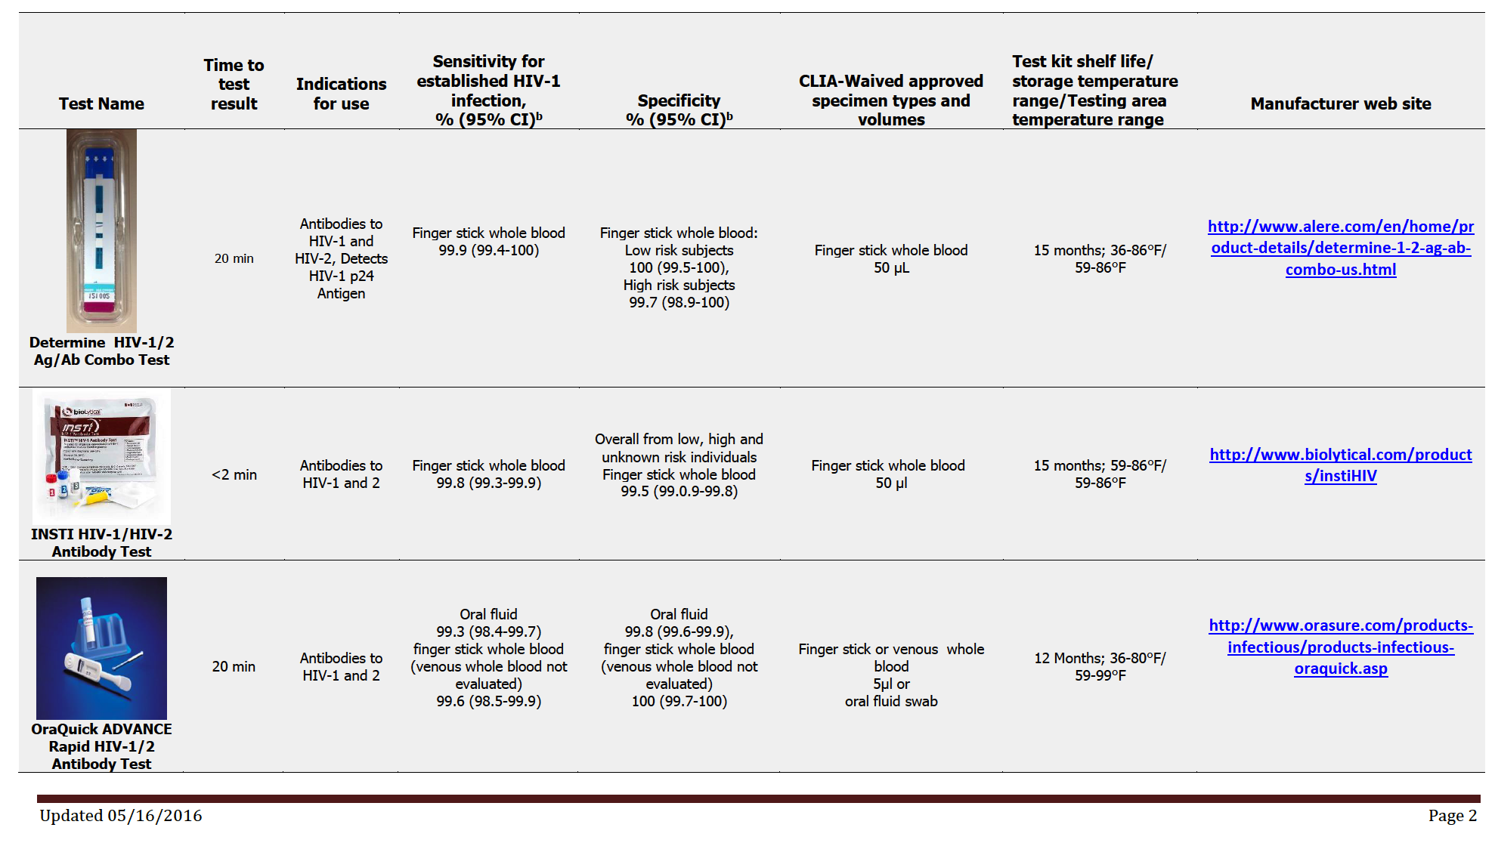
Know Your Rapid Test Options
Image source: CDC.gov

Slide 8
Spotting Recent (Acute) HIV Infection
Key opportunity to offer a test and possibly prevent onward transmission
Shows up 2 to 4 weeks after HIV infection
Many, but not all, people develop flu-like symptoms, often described as “the worst flu ever”
Symptoms can include fever, swollen glands, sore throat, rash, muscle and joint aches and pains, fatigue, and headache

Slide 9
Question:
What testing options are available in your community? What opportunities are being missed?

Slide 10
Options for Stopping HIV TRANSMISSION

Slide 11
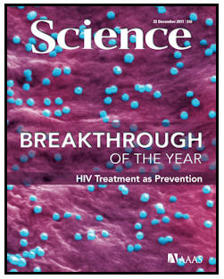
Treatment as Prevention
Treatment as Prevention (TasP)
  Starting treatment early has health
  benefits for people living with HIV
  (SMART)
  It also stops HIV from being passed on
    There was not a single case of HIV transmission by an “undetectable” HIV-positive partner in the HPTN 052 or PARTNER studies. TasP works
  We still have a lot of work to do
    Recent estimates of people living with HIV who are “undetectable” in the United States range between 30% and 55%
Image source: Sciencemag.org
Notes:
Additional Info:
For more news on the HPTN 052 study: http://www.hptn.org/research_studies/hptn052.asp
For more news about the PARTNER study: http://www.chip.dk/PARTNER
For more news about the START study and benefits of early treatment for HIV positive individuals: http://www.aidsmap.com/START-trial-finds-that-early-treatment-improves-outcomes/page/2972328/

Slide 12
More Than Treatment and Transmission
Never forget the human living with the human immunodeficiency virus; living with HIV is emotional as much as it is intellectual
Treatment was about survival, now it provides so much more:
  The hope for increased pleasure and intimacy with sexual partners
  The relief from fear of passing HIV on to someone else
But remember: starting treatment is still a deeply personal choice

Slide 13
QUESTION
How well do people in your community know that HIV treatment stops transmission? What opportunities are being missed?

Slide 14
Options for Stopping HIV
ACQUISITION

Slide 15
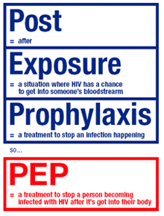
Post-Exposure Prophylaxis (PEP)
Emergency 28-day course of antiretroviral drugs (ARVs) that should be started immediately after possible exposure—no later than 72 hours
In use for “occupational” exposure (oPEP) since 1988. CDC guidance for “non-occupational” exposure (nPEP) didn’t come out until 2005. New nPEP guidelines were released in April 2016
PEP is vastly underused
Image source: Rainbow-project.org
Notes:
Additional Info
The preferred regimen for PEP is Truvada (TDF/FTC) and Raltegravir (Isentress) or Dolutegravir (Tivicay). Isentress requires an additional pill in the evening which has been harder for some individuals to remember while on PEP- as such, once a day Truvada plus Tivicay may have an adherence advantage.
Existing evidence shows that PEP is highly effective, though we don’t have a randomized control trial (RCT)– it would be unethical to run a study with a control arm that is denied PEP. An observational study of hospital workers published in 1987 found that zidovudine as PEP led to an 81% reduction in incidence. A 2-year prospective study of MSM in Brazil estimated that PEP reduced seroconversion by 83%. In a meta-analysis of primate studies, PEP led to an 89% lower risk.
PEP users are an excellent group for PrEP. In an Amsterdam cohort study, MSM who had taken PEP were 4 times as likely to seroconvert as a reference cohort.

Slide 16
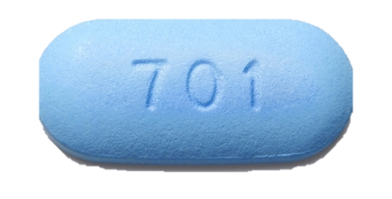
Pre-Exposure Prophylaxis (PrEP)
PrEP works if you use it
  One documented case of an individual getting HIV while on PrEP
PrEP is forgiving
  In iPrEx results, MSM participants were fully protected with 4 doses a week—84% reduction in risk with 2 to 3 doses a week
PrEP is safe
Challenges with paying for PrEP
Notes:
Additional Info:
In clinical trials, PrEP has been shown to be 92% effective when Truvada was detected in someone’s blood. Mathematical modeling shows that PrEP could even be up to 99% effective. There is one case in which a man from Toronto, Canada acquired HIV despite being adherent to PrEP because he came into contact with an extremely rare version of HIV that was resistant to Truvada. While PrEP is still the most effective real-world HIV intervention we have for HIV negative individuals, the incident shows us that nothing is perfect. If this rare outcome is concerning to someone who believes they are vulnerable to HIV infection, it is recommended that they pair PrEP with condoms.
We have seen terrific examples of high adherence and effectiveness of PrEP from San Francisco, UK, and France- with reductions in the number of new infections of over 86% in the PROUD and Ipergay studies.
A recent study found Truvada to be an extremely safe medication, even comparing it to aspirin in safety. For some individuals there may be some “start up” side effects that mostly include headache and nausea- these symptoms typically resolve within a month. There is the potential for rare kidney complications that are completely reversible when PrEP is discontinued, so doctors are advised to monitor kidney function. Clinically insignificant decreases in bone mineral density have been detected for Truvada users.
PrEP is, unfortunately, a very expensive medication- costing an average retail reimbursement price of over $1700 for a 30 day supply in 2015. So far, insurance companies and state Medicaids have been covering the costs of PrEP- although many insurers make it challenging to obtain coverage with prior authorizations and other hoops. Unfortunately, persistence is key in these cases. For uninsured or underinsured (many Bronze plans available through the Affordable Care Act don’t cover PrEP very well), it gets even more complicated. Gilead’s medication assistance program (MAP) and co-pay assistance program (CAP) may be able to help in most cases for covering the cost of Truvada (https://start.truvada.com/paying-for-truvada). Patients may also work with the PAN Foundation to cover the cost of the drug (www.panfoundation.org). For uninsured individuals, the final and more problematic hurdle is paying for quarterly labs and doctor visits for which there are few programs to help- which underscores the importance of linking vulnerable individuals to insurance and expanding Medicaid in all states.
For a more thorough overview of PrEP you can watch this video: www.whatisprep.org

Slide 17
QUESTION
Where in your community can people access PrEP? Where can they access PEP?

Slide 18
Future PrEPs?
Long-acting injectable PrEP
  Cabotegravir in phase 3 clinical trial (HPTN 083)
  Intramuscular injections every eight weeks
  Requires long (approximately 12 months) oral PrEP once injections are discontinued
Oral PrEP 2.0
  Descovy® vs. Truvada® – DISCOVER trial results in 2 to 3 years

Slide 19

Other New Tools for HIV-Negative People?
Microbicide gels
  A gel containing medications that can be used vaginally or rectally to stop HIV
  Some progress for rectal gels; less promising news for vaginal
Intravaginal microbicide rings
  Ring inserted vaginally and replaced monthly
  Ring Study and Aspire: Twin trials showed reductions in new HIV infections for women over age 25
Films, vaginal tablets, and rectal douches
  Other insertable products
  In early-stage development
Image from: People.com

Slide 20
More Than PEP and PrEPs
Lesson from contraception: human beings need options
PrEP isn’t just about stopping HIV acquisition:
  Mental health: peace of mind, reduction of fear
  Anti-stigma: PrEP helps HIV-negative people see the human and not the HIV
  Possibility for increased sexual intimacy
PEP isn’t just another option for stopping an infection:
  Imagine you believe you’ve been exposed to HIV and you’re not on PrEP: PEP is your last prevention option
  Every time that someone can’t access PEP after a possible exposure is an inexcusable injustice and major societal failure

Slide 21
Options for Stopping HIV TRANSMISSION OR ACQUISITION

Slide 22

Needle and Syringe Programs (NSPs or SAPs)
Expert opinion, as well as some studies, strongly support NSPs/SAPs for HIV prevention
NSPs partner well with other prevention and wellness services
  NSPs that connect people who inject heroin with opioid substitution therapies may be most successful at preventing infection
  Access/education for naloxone
Urgent need for greater access to
NSPs
  Think: Indiana
Image from: Housingworks.org
Notes:
Additional Information:
NSPs and SAPs are a bit of a no brainer in HIV prevention. While more research linking NSPs to a reduction in new infections would be welcome, they are most likely very impactful in addressing transmission via intravenous injection of substances (drugs, steroids, hormones, etc.) and there are very few drawbacks to this intervention. When operated effectively, NSPs can help with syringe disposal which has benefits for the community, and link people who inject to vital services related to their wellbeing. Furthermore, unlike condoms, new syringes are a tool that is in demand by the affected population because it feels better.
NSPs are a very good use of funding. In an older study in New York, researchers estimated a cost-effectiveness ratio of $20,947 per HIV infection averted by syringe access (Laufer 2001). Naloxone provision has a cost-effectiveness ratio of $438- $14,000 depending on variables used (Coffin 2013).

Slide 23
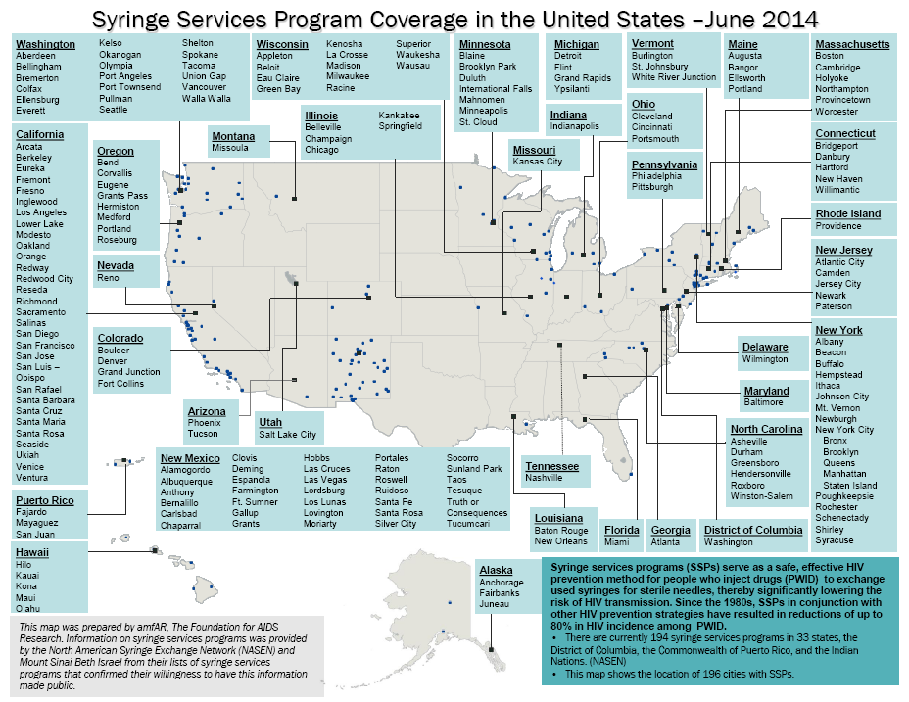
Notes:
Slide courtesy of The Foundation for AIDS Research (amfAR)- most recent map, but out of date

Slide 24

Condoms and Lube
Condoms (both insertive and receptive)
work if used correctly and consistently
  Also estimated to reduce risk of syphilis infection by about 50% to 66%
An option that works for some individuals, but not on a population level
  CDC data: majority of men who have sex with men have had sex without a condom at least once in the past year with a partner of unknown HIV status
  One night stand: the protective benefits do not translate to future sexual acts
Notes:
Additional Info:
1. For a more in-depth discussion of the evidence base behind condoms, AIDSMAP provides another useful discussion: http://www.aidsmap.com/Condoms-and-lubricants/page/1065704/

Slide 25
Behavioral Interventions
All prevention options require behavioral change
Effective Behavioral Interventions (EBIs)
  Some encouraging data for some interventions, but largely inconclusive
New approaches needed
  Incorporating PrEP and PEP
  Adherence interventions
  Interventions for transgender women and gay and bisexual
    men of color
Notes:
Additional Information:
Recent meta-analyses of existing EBIs and DEBIs have shown little rigorous evidence that any intervention has been capable of changing sexual behaviors and increasing condom usage in the long term. Of 7 randomized control trials for behavioral interventions supported by the CDC, only one has been shown to show any efficacy (I need to find this citation) The data that do exist that are more supportive of interventions typically come from self reporting which is notoriously impacted by social desirability bias (aka: saying what we think others want to hear).
Given the tremendous challenges and potential ethical considerations of only seeking to alter sexual behavior within marginalized populations in the post-PrEP era, modifying EBIs and DEBIs to focus on increasing the ability of vulnerable individuals to access comprehensive prevention services and adhere to them is highly recommended.

Slide 26
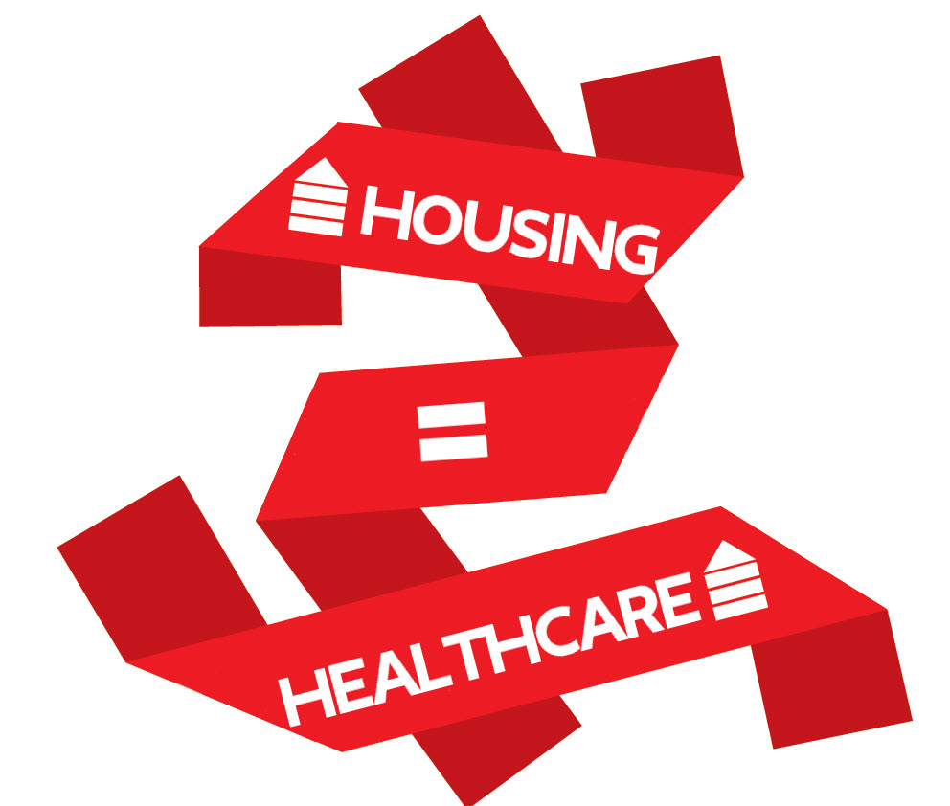
Housing, Case Management, and Other Support Services
Support services have been essential in the care and treatment of people living with HIV
Do we need prevention case management?
Meeting more than HIV prevention needs: housing, mental health, job training, other health needs that make us vulnerable
Image from: Housingworks.org

Slide 27
QUESTION
What prevention options are easily accessible in your community? What are some of the main barriers to access?

Slide 28
Visualizing Comprehensive Prevention

Slide 29
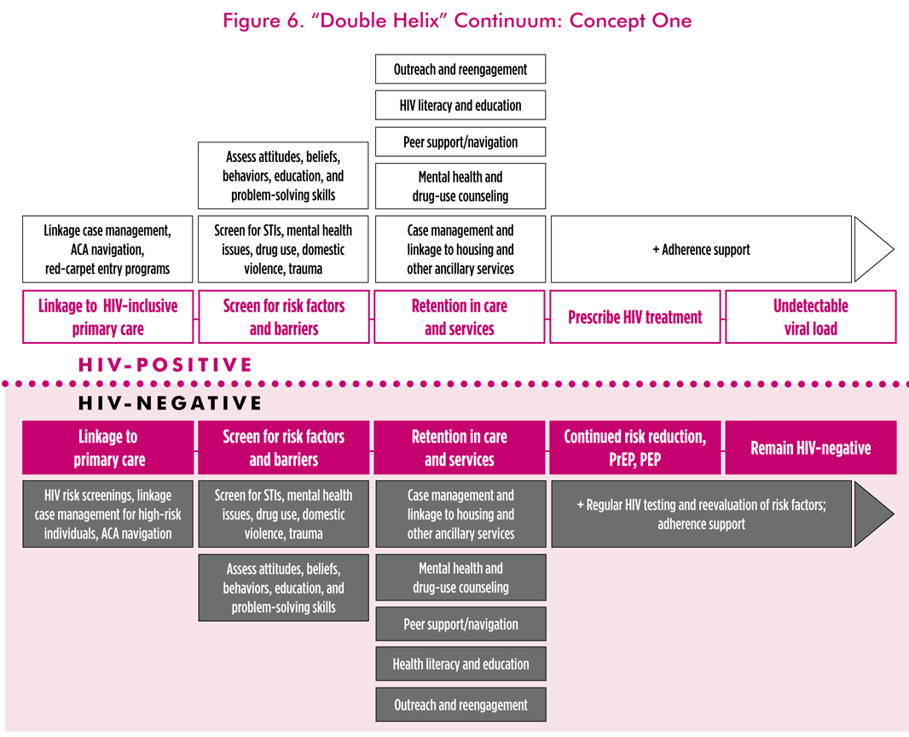
Notes:
Key Points
Secondary prevention, Primary Prevention, and Testing are all essential parts of the same HIV puzzle, but it can be difficult to visualize how they fit together.
TAG, in collaboration with The Foundation for AIDS Research (amfAR), has developed a comprehensive HIV prevention model to help key stakeholders visualize how primary prevention, secondary prevention, and testing fit together. A few specifics about the model:
The model starts with HIV testing in the center where the wheel and the bar graphs meet. This is the primary screening point that determines what should happen next.
If the test is negative, then the individual should go through the steps in the “Primary HIV Prevention Cycle.” This means that they receive a risk and needs assessment, linkage to services, engagement/adherence support, and HIV retesting at an appropriate time. It is a cycle because there is no definitive intervention- primary prevention service needs change over time for different individuals. Ultimately the real-world next steps might look different for different people- but they should always come back to getting tested and hopefully receive an HIV negative result.
If the person is HIV positive, then they enter the orange “HIV Care and Secondary Prevention Continuum” and go through the familiar steps of getting diagnosed, linked to care, retained in care, and virally suppressed.

Slide 30
An Integrated Primary and Secondary HIV Prevention Continuum:
Conceptual Framework
Horn T, Sherwood J, Remien RH, Nash D, Auerbach JD, et al. Towards an integrated primary and secondary HIV prevention continuum for the United States: a cyclical process model. J Int AIDS Soc. 2016 Nov 17;19(1):21263. doi: 10.7448/IAS.19.1.21263.
Notes:
Conceptual framework illustrating the interplay between processes to halt both the acquisition and transmission of HIV. The primary HIV prevention cycle, left, begins with HIV testing. Risk and needs assessments, linkage to services, engagement in risk-reduction prevention interventions and HIV testing are repeated for as long as an individual remains at risk for HIV acquisition.

Slide 31
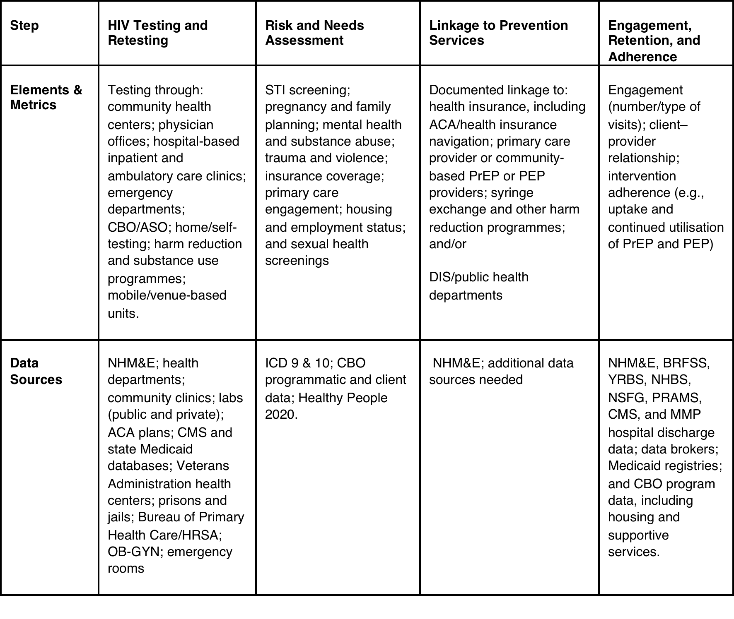
An Integrated Primary and Secondary HIV Prevention Continuum:
Potential Elements, Metrics, and Data Sources
Horn T, Sherwood J, Remien RH, Nash D, Auerbach JD, et al. Towards an integrated primary and secondary HIV prevention continuum for the United States: a cyclical process model. J Int AIDS Soc. 2016 Nov 17;19(1):21263. doi: 10.7448/IAS.19.1.21263.
Notes:
In contrast to the relatively straightforward data elements used to assess outcomes along the HIV care continuum, the metrics required to populate a primary HIV prevention continuum involving different systems of service delivery, interventions, and outcome measures are incredibly complex and often without adequate or complete population-based data sources.
Two potential approaches to address the gaps in data required for programmatic planning, implementation, and evaluation across the elements of the prevention cycle:
Develop primary HIV prevention continuum metrics
Identifying “missed opportunities” and primary HIV prevention continuum gaps (Denis can speak to this with great clarity)

Slide 32
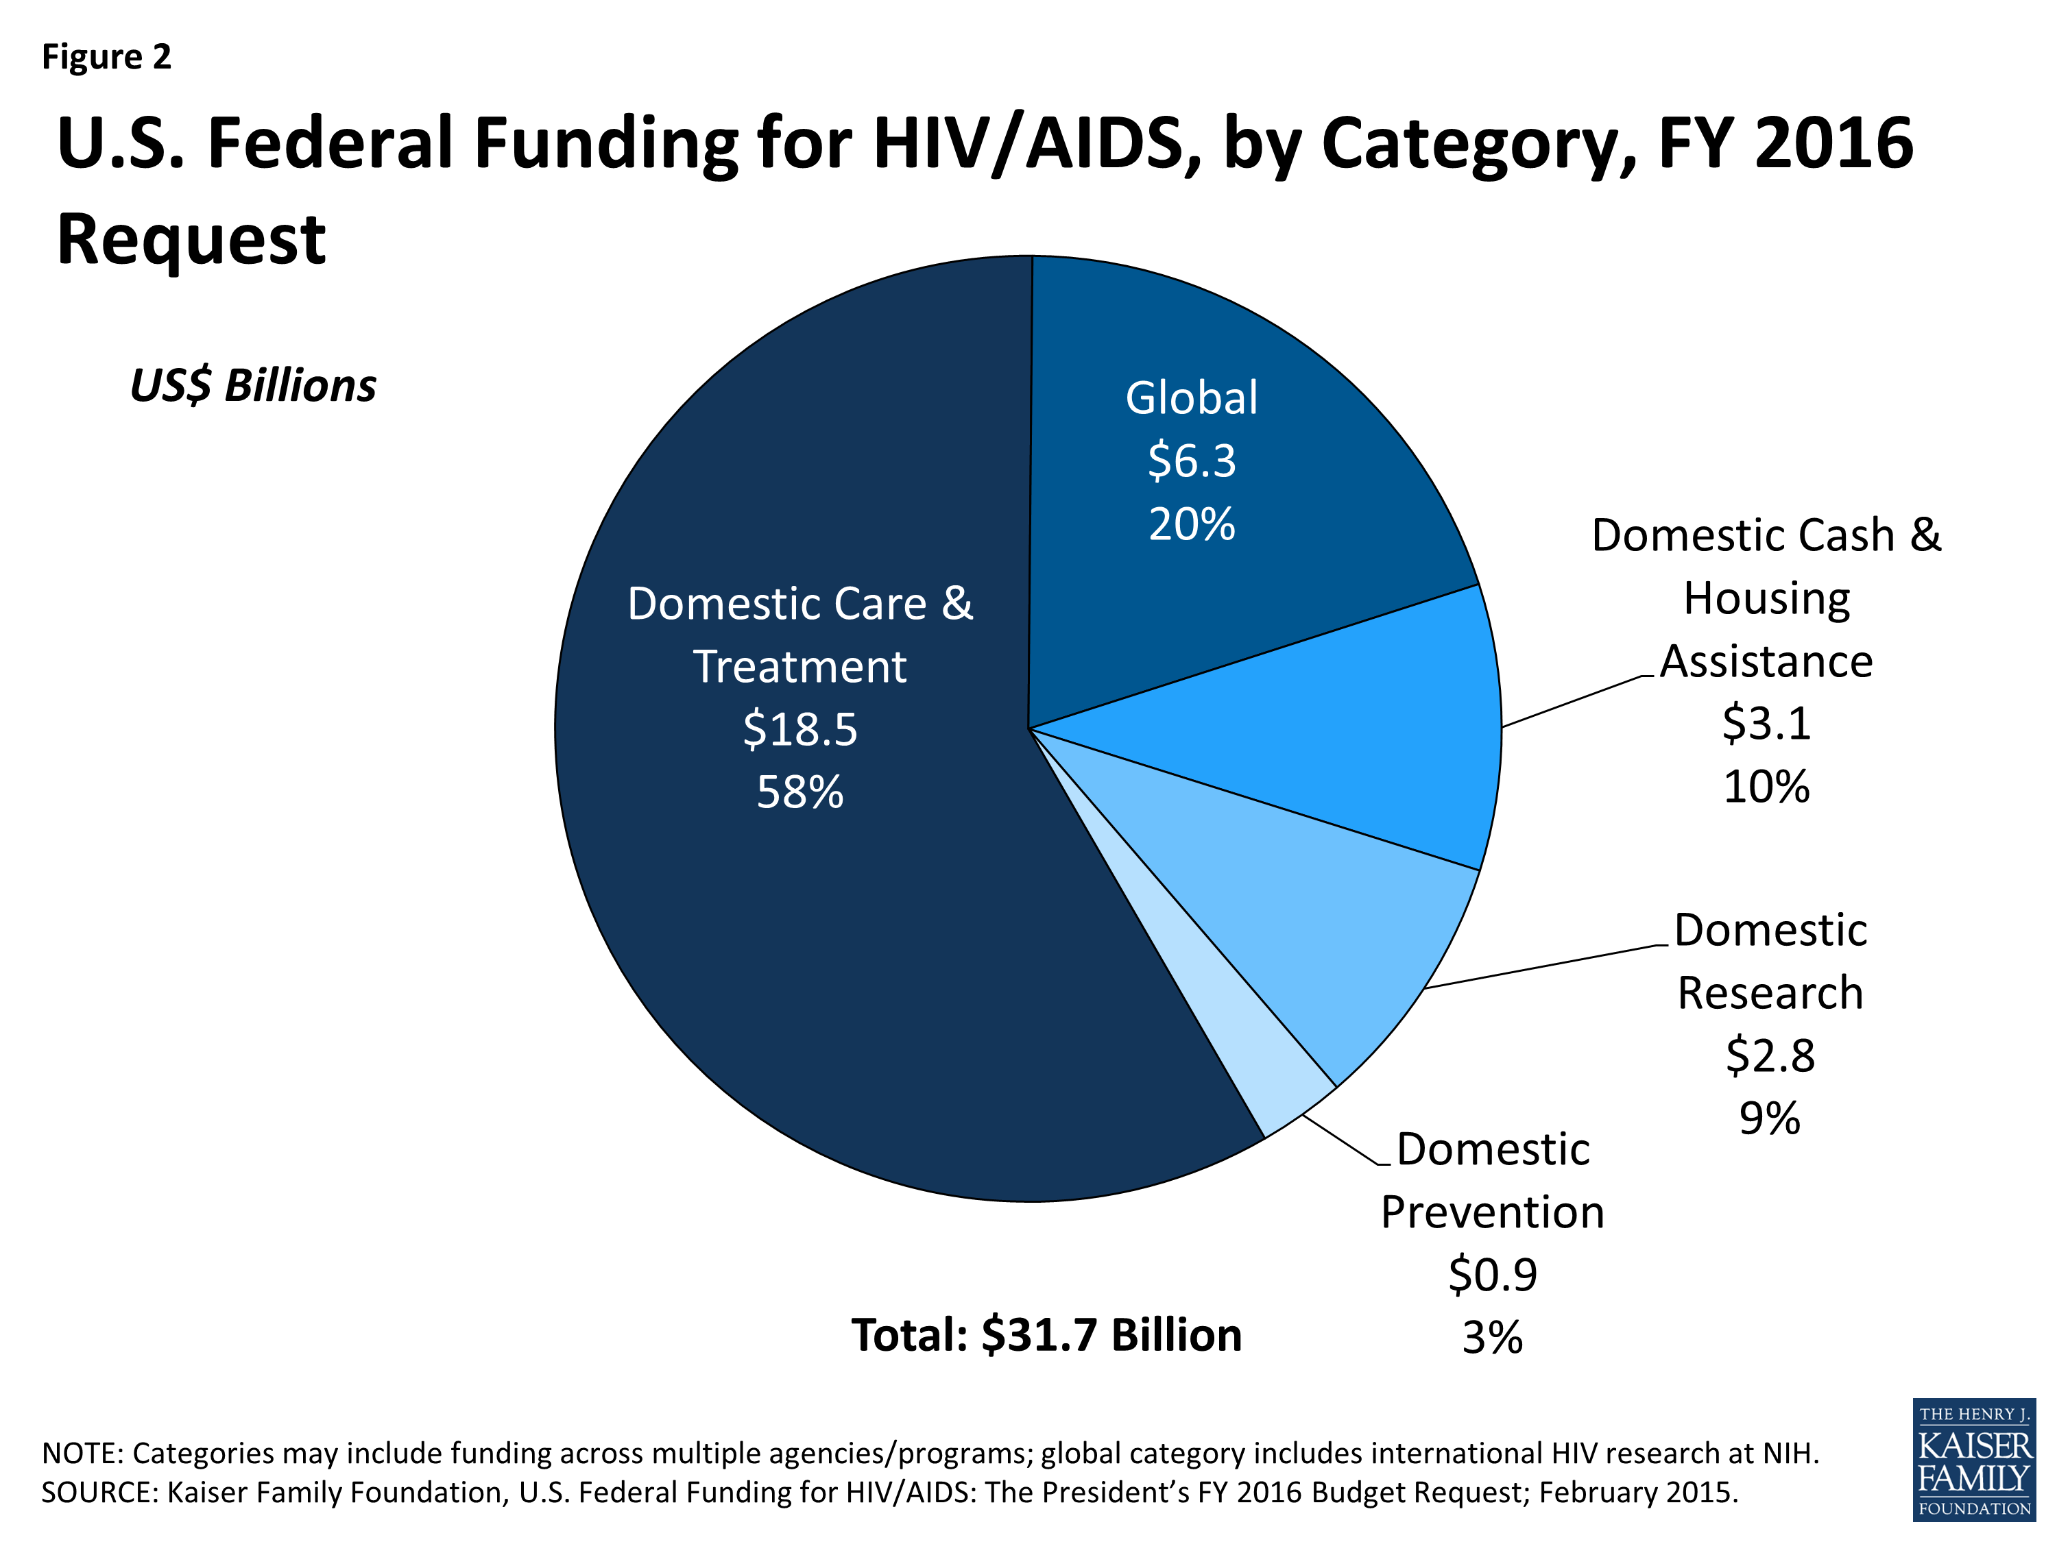
Spending on Primary vs. Secondary Prevention
Notes:
Key Points:
1. Although testing, secondary, and primary prevention are likely necessary for individual and population-level impact, primary prevention receives significantly less funding than secondary prevention within the US.
2. This graph was created by the Kaiser Family Foundation to outline President Obama’s FY 2016 budget request for HIV/AIDS. It largely follows the spending patterns of previous years. http://kff.org/global-health-policy/fact-sheet/u-s-federal-funding-for-hivaids-the-presidents-fy-2016-budget-request/
3. As can be seen, domestic prevention funding, primarily administered by the Centers for Disease Control and Prevention, makes up around 3% of the budget. This is the largest source of grant funding for primary prevention activities in the US. Domestic care and treatment, which is largely an investment in “secondary prevention” makes up 58% of the budget. Domestic case and housing assistance also primarily goes to HIV positive individuals.
4. Since 2011, as part of the CDC’s High Impact Prevention (HIP) approach, the majority of domestic prevention dollars have also gone to secondary prevention and testing. A very very small percentage of the national HIV/AIDS budget goes to PrEP, PEP, clean syringes, and other highly effective interventions for HIV negative individuals.

Slide 33
Primary Prevention is (Still) Essential
Nationally we tend to focus the most on HIV testing and prevention for PLWHA, but this isn’t enough
  Population level: We might not be able to end HIV/AIDS as an epidemic through only focusing on people living with HIV
  Individual level: A highly vulnerable HIV negative individual deserves access to all available tools to avoid infection
Notes:
Image courtesy of The Stigma Project
Additional Info:
The argument that “test and treat” or “treatment as prevention” strategies can end an HIV epidemic remains controversial. In theory, if we were able to test every single person living with HIV tomorrow and get them onto treatment, we could stop the epidemic- TasP is just that good. However, in a real world context, that is very challenging and potentially impossible. For that option to work, we would most likely need perfect testing, perfect treatment, and no loss of follow up to care.
A major limitation of TasP when it comes to ending an HIV epidemic is the role of acute HIV infection (AHI). Newly infected people in AHI are less likely to benefit from TasP right away- so if this group makes up a substantial part of new infections, it might be challenging/impossible to end the epidemic with TasP alone. Estimates of the percent of new infections coming from people in AHI vary a great deal- from 3% to 50% depending on the model. If higher AHI transmission estimates are correct, then TasP may only be able to get us so far.
Even if TasP were able to end the epidemic eventually, there is a human rights argument to be made for continuing to scale up and focus on primary prevention, particularly within the era of PrEP.

Slide 34
Key Points From Module 1
Primary prevention, secondary prevention, and testing are all vital parts of a comprehensive HIV prevention response
Newer laboratory, rapid, and at-home options have made testing more convenient and accessible
HPTN 052 and PARTNERS have shown the value of TasP as secondary prevention. SMART showed us the health benefits of early treatment
More primary prevention options than ever
Keep up-to-date on new prevention options with TAG’s annual Pipeline Report (www.treatmentactiongroup.org)
Support/ancillary services are essential

Slide 35
Check Out Our Other HIV Prevention Policy Modules:
Module 1: What Is in Our HIV Prevention Toolbox?
Module 2: What Is the State of Our National HIV Prevention Efforts?
Module 3: Why Is HIV Still a Problem? A Discussion on Structural and Social Determinants of Health
Module 4: Using Policy Advocacy to Remove Barriers to Comprehensive HIV Prevention

Slide 36

For More Information About TAG and Our Work on HIV Prevention:
Visit: www.treatmentactiongroup.org
Like: Treatment Action Group on Facebook
Follow: @TAGTeam_Tweets on Twitter
Email: jeremiah.johnson@treatmentactiongroup.org

Slide 37
THANK YOU!

