Slide 1
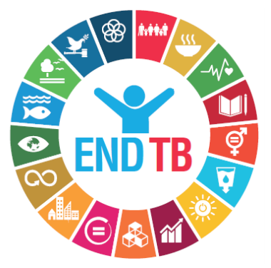
Funding for TB Research
Rand
Real
Renminbi
Rubles
Rupees
For tb R&D
Mike Watson Frick
Senior Project Officer
Treatment Action Group

Slide 2
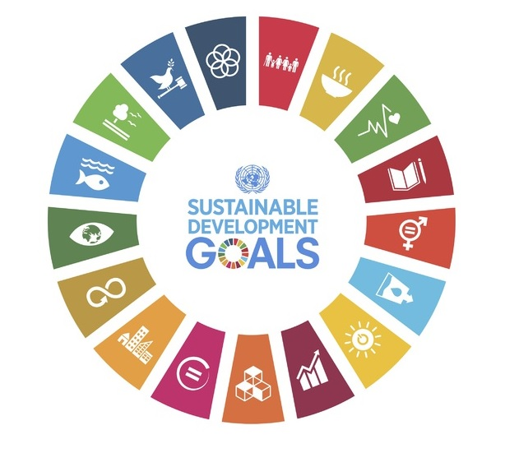
TB Sits at the Heart of the SDGs
SDG 1: End Poverty in All its Forms
SDG 3: Good Health & Wellbeing
TB is implicated by many of the targets and indicators
Reduce maternal mortality
End preventable newborn + child deaths
End epidemics of AIDS, TB, malaria, NTDs
Achieve universal health coverage
Support R&D of new medicines + vaccines
TB
SDG 10: Reduce Inequalities within and among Countries

Slide 3
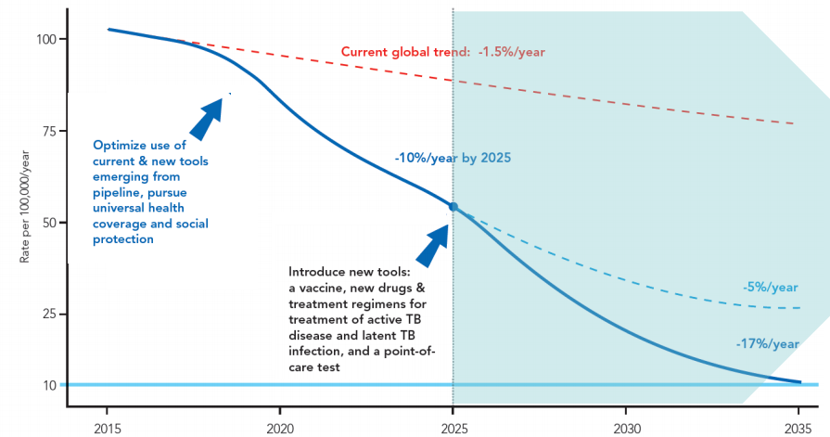
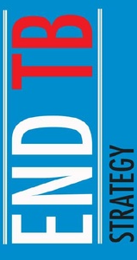
Research sits at the heart of the End TB Strategy
By 2035…
95% reduction in TB deaths
90% reduction in TB incidence
Zero catastrophic spending due to TB
New Tools must be introduced by 2025 in order to reach the SDG and End TB Strategy Targets
The Strategy highlights the need for 1) a vaccine that is effective pre- and post-exposure; 2) better diagnostics; 3) safer and easier treatment for latent TB infection; 4) safer and shorter treatment for DS- and DR-TB.

Slide 4
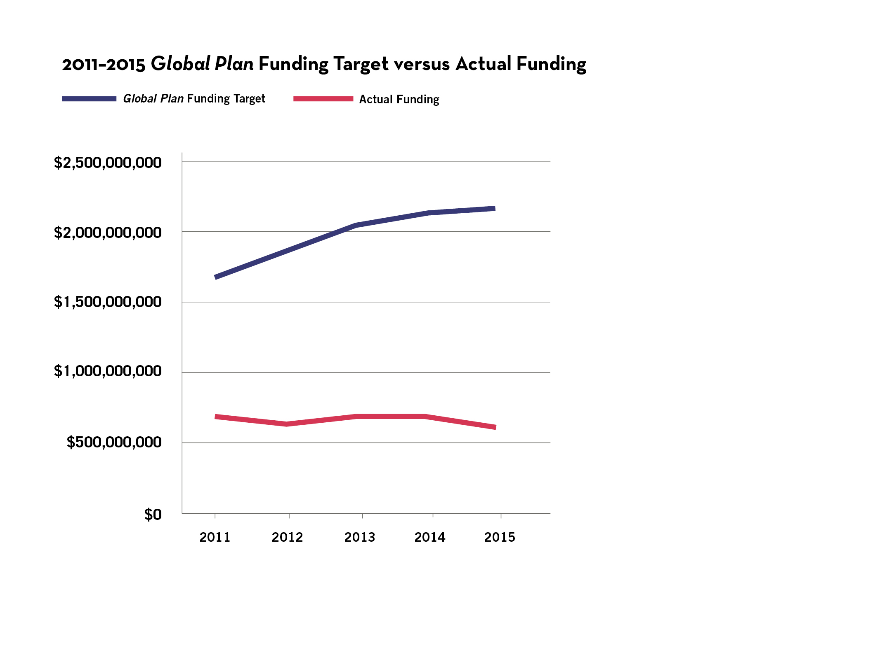
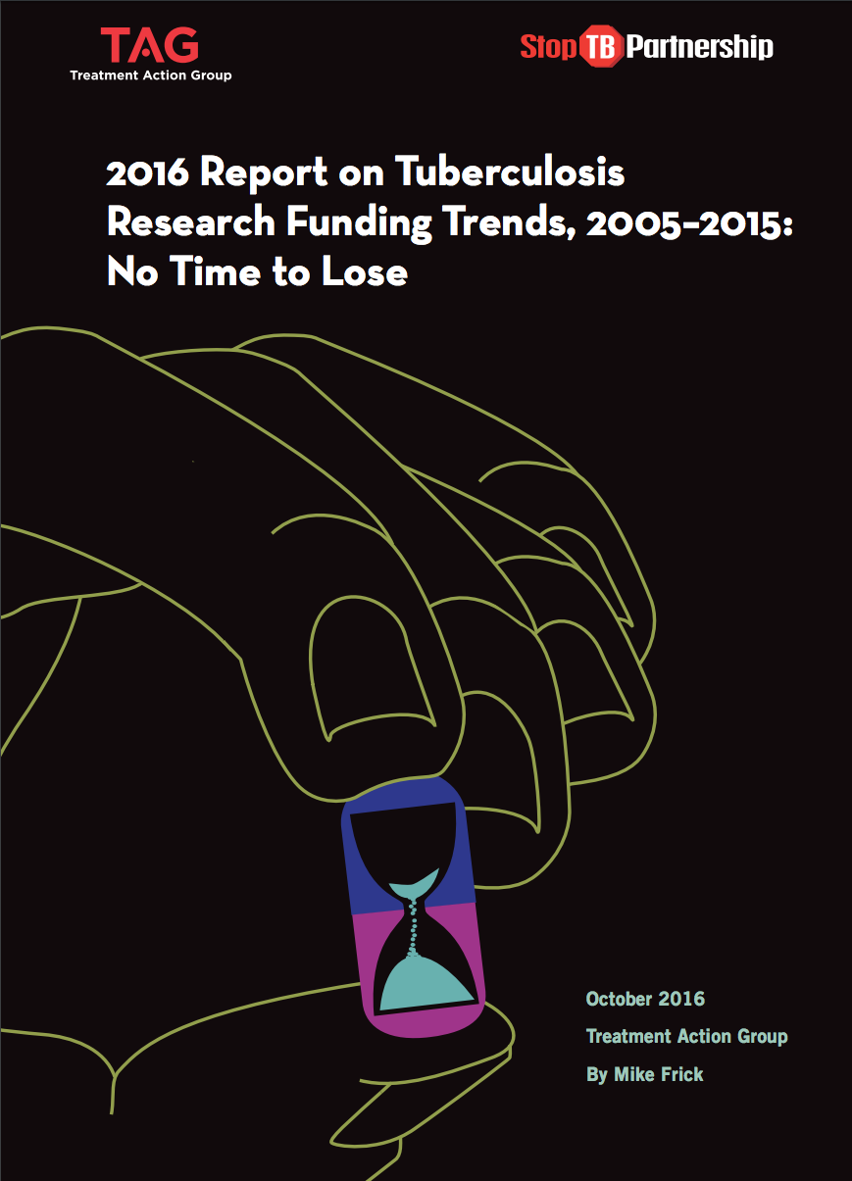
TB Research is Gravely underfunded
The 2011–2015 Global Plan called for $9.84 billion for TB R&D over five years; instead, the world spent $3.29 billion, one-third of the target.

Slide 5
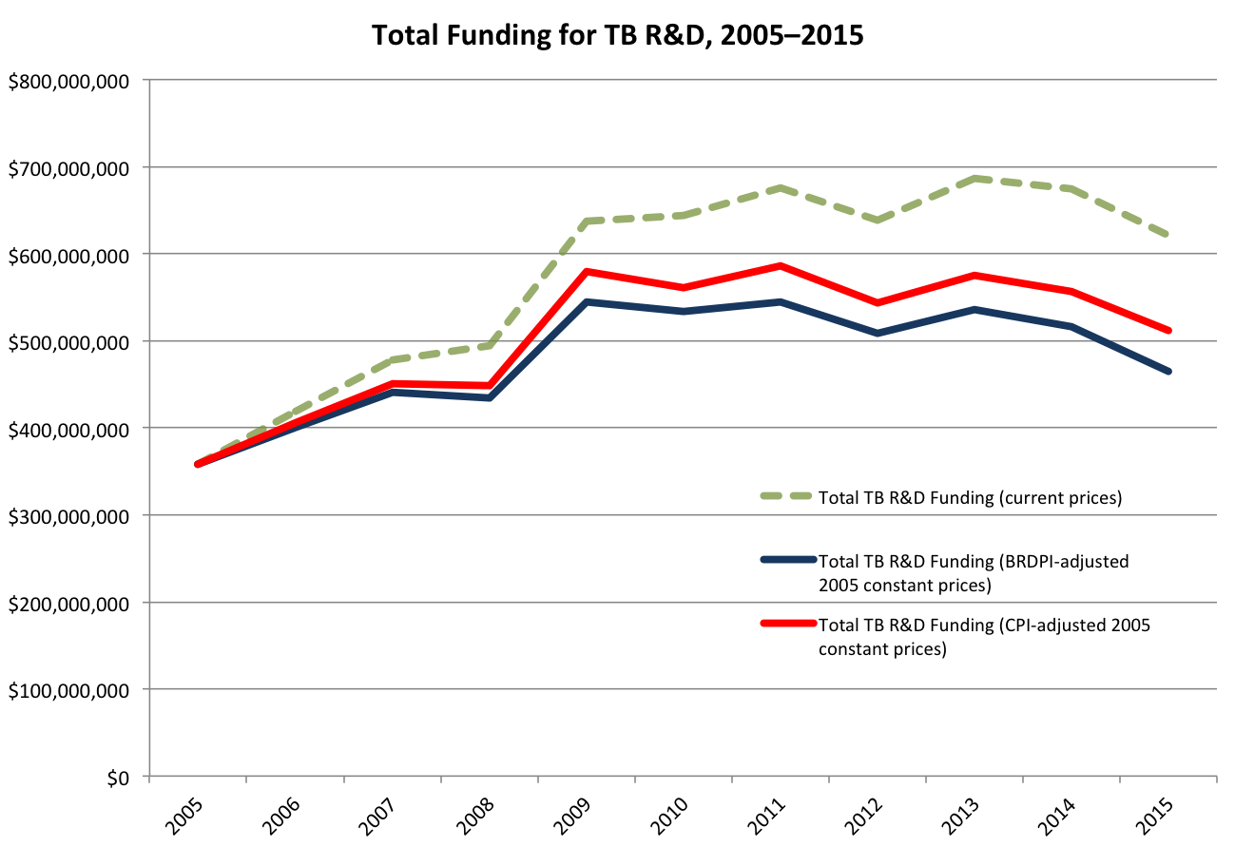
Funding for TB R&D has Stagnated and Lost Ground to Inflation

Slide 6
funding For tb R&D is highly concentrated
“We are sitting with the U.S. taxpayer.” —Valerie Mizrahi
1. US National Institutes of Health | $213,606,591
2. Bill & Melinda Gates Foundation | $110,985,743
3. U.S. Agency for International Development | $34,053,650
4. Otsuka Pharmaceuticals | $29,042,414
5. U.K. Department for International Development | $23,034,975
…
30. French National Agency for Research | $2,362,871
52%
66%
93%

Slide 7
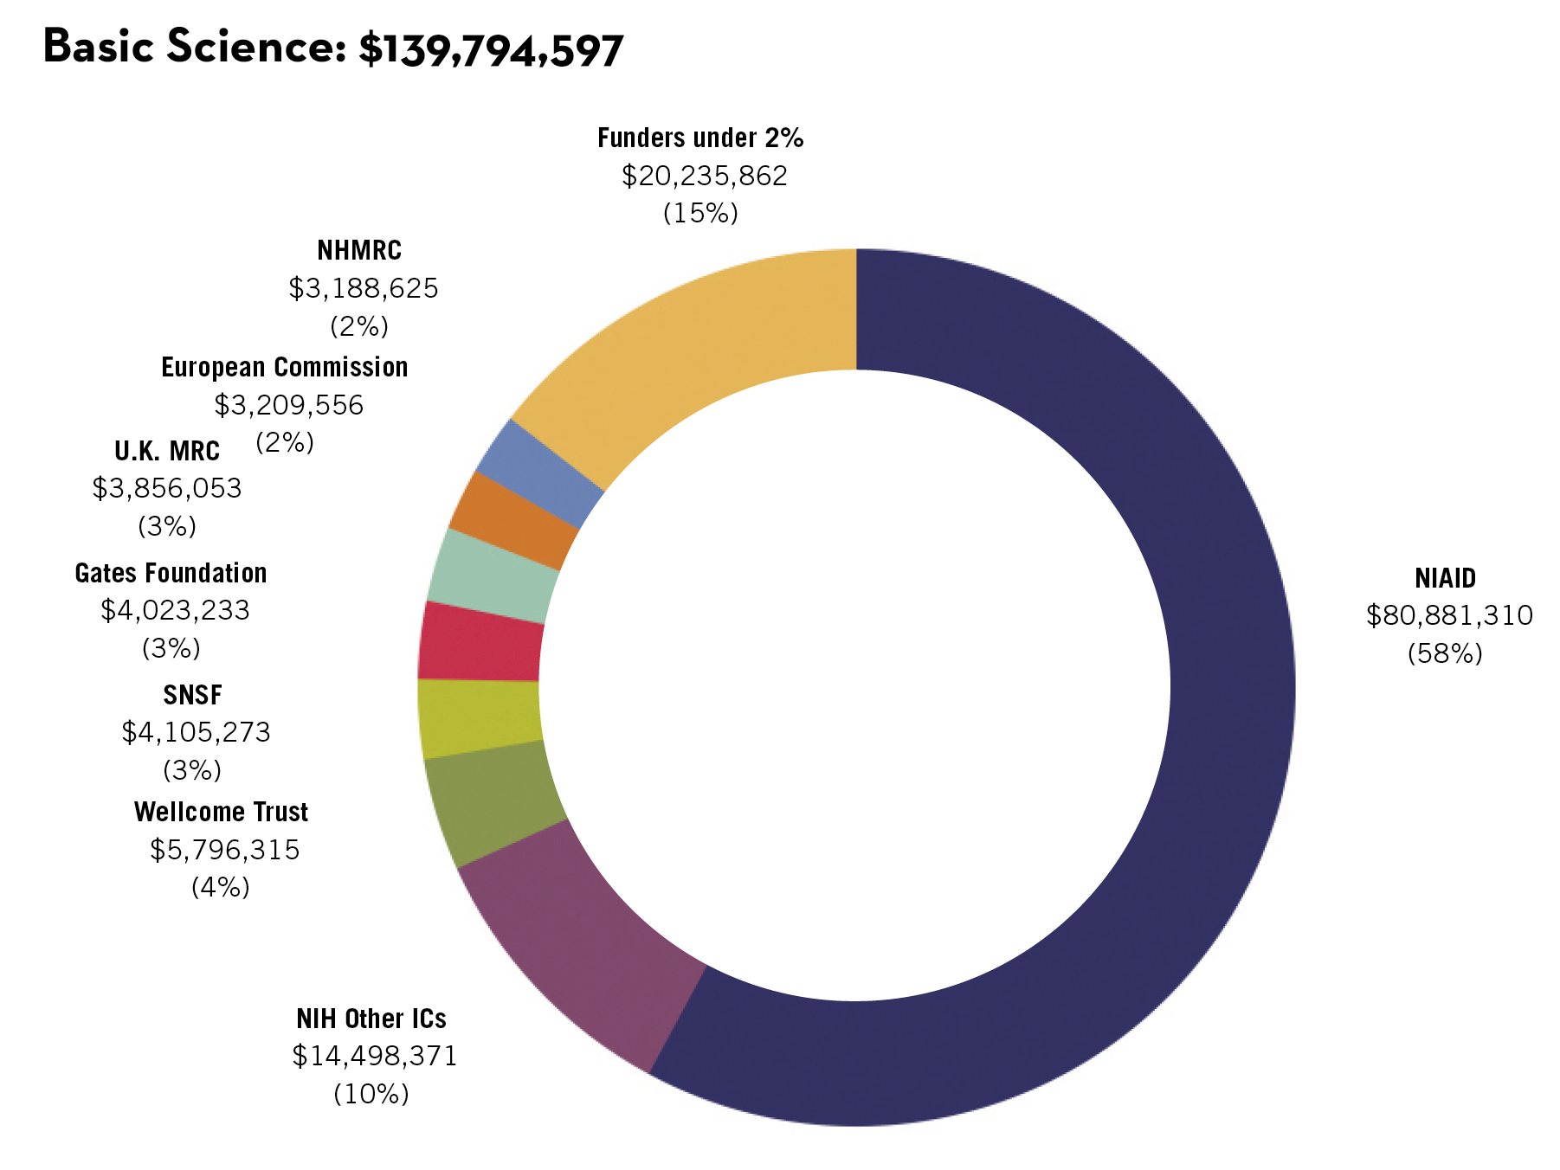
The most concentrated side of the TB R&D Pipeline is its beginning: basic discovery
“…the likelihood of any of this research being translated into drugs that reach the clinic is steadily diminishing.”—Stewart Cole

Slide 8
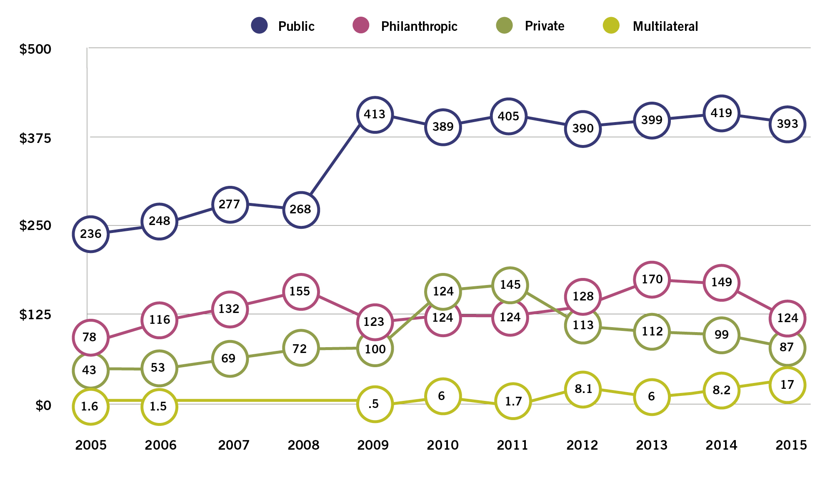
The Public Sector Accounted for 60% of TB R&D Funding since 2009 Private sector support decreased by 44% from 2011–2015

Slide 9
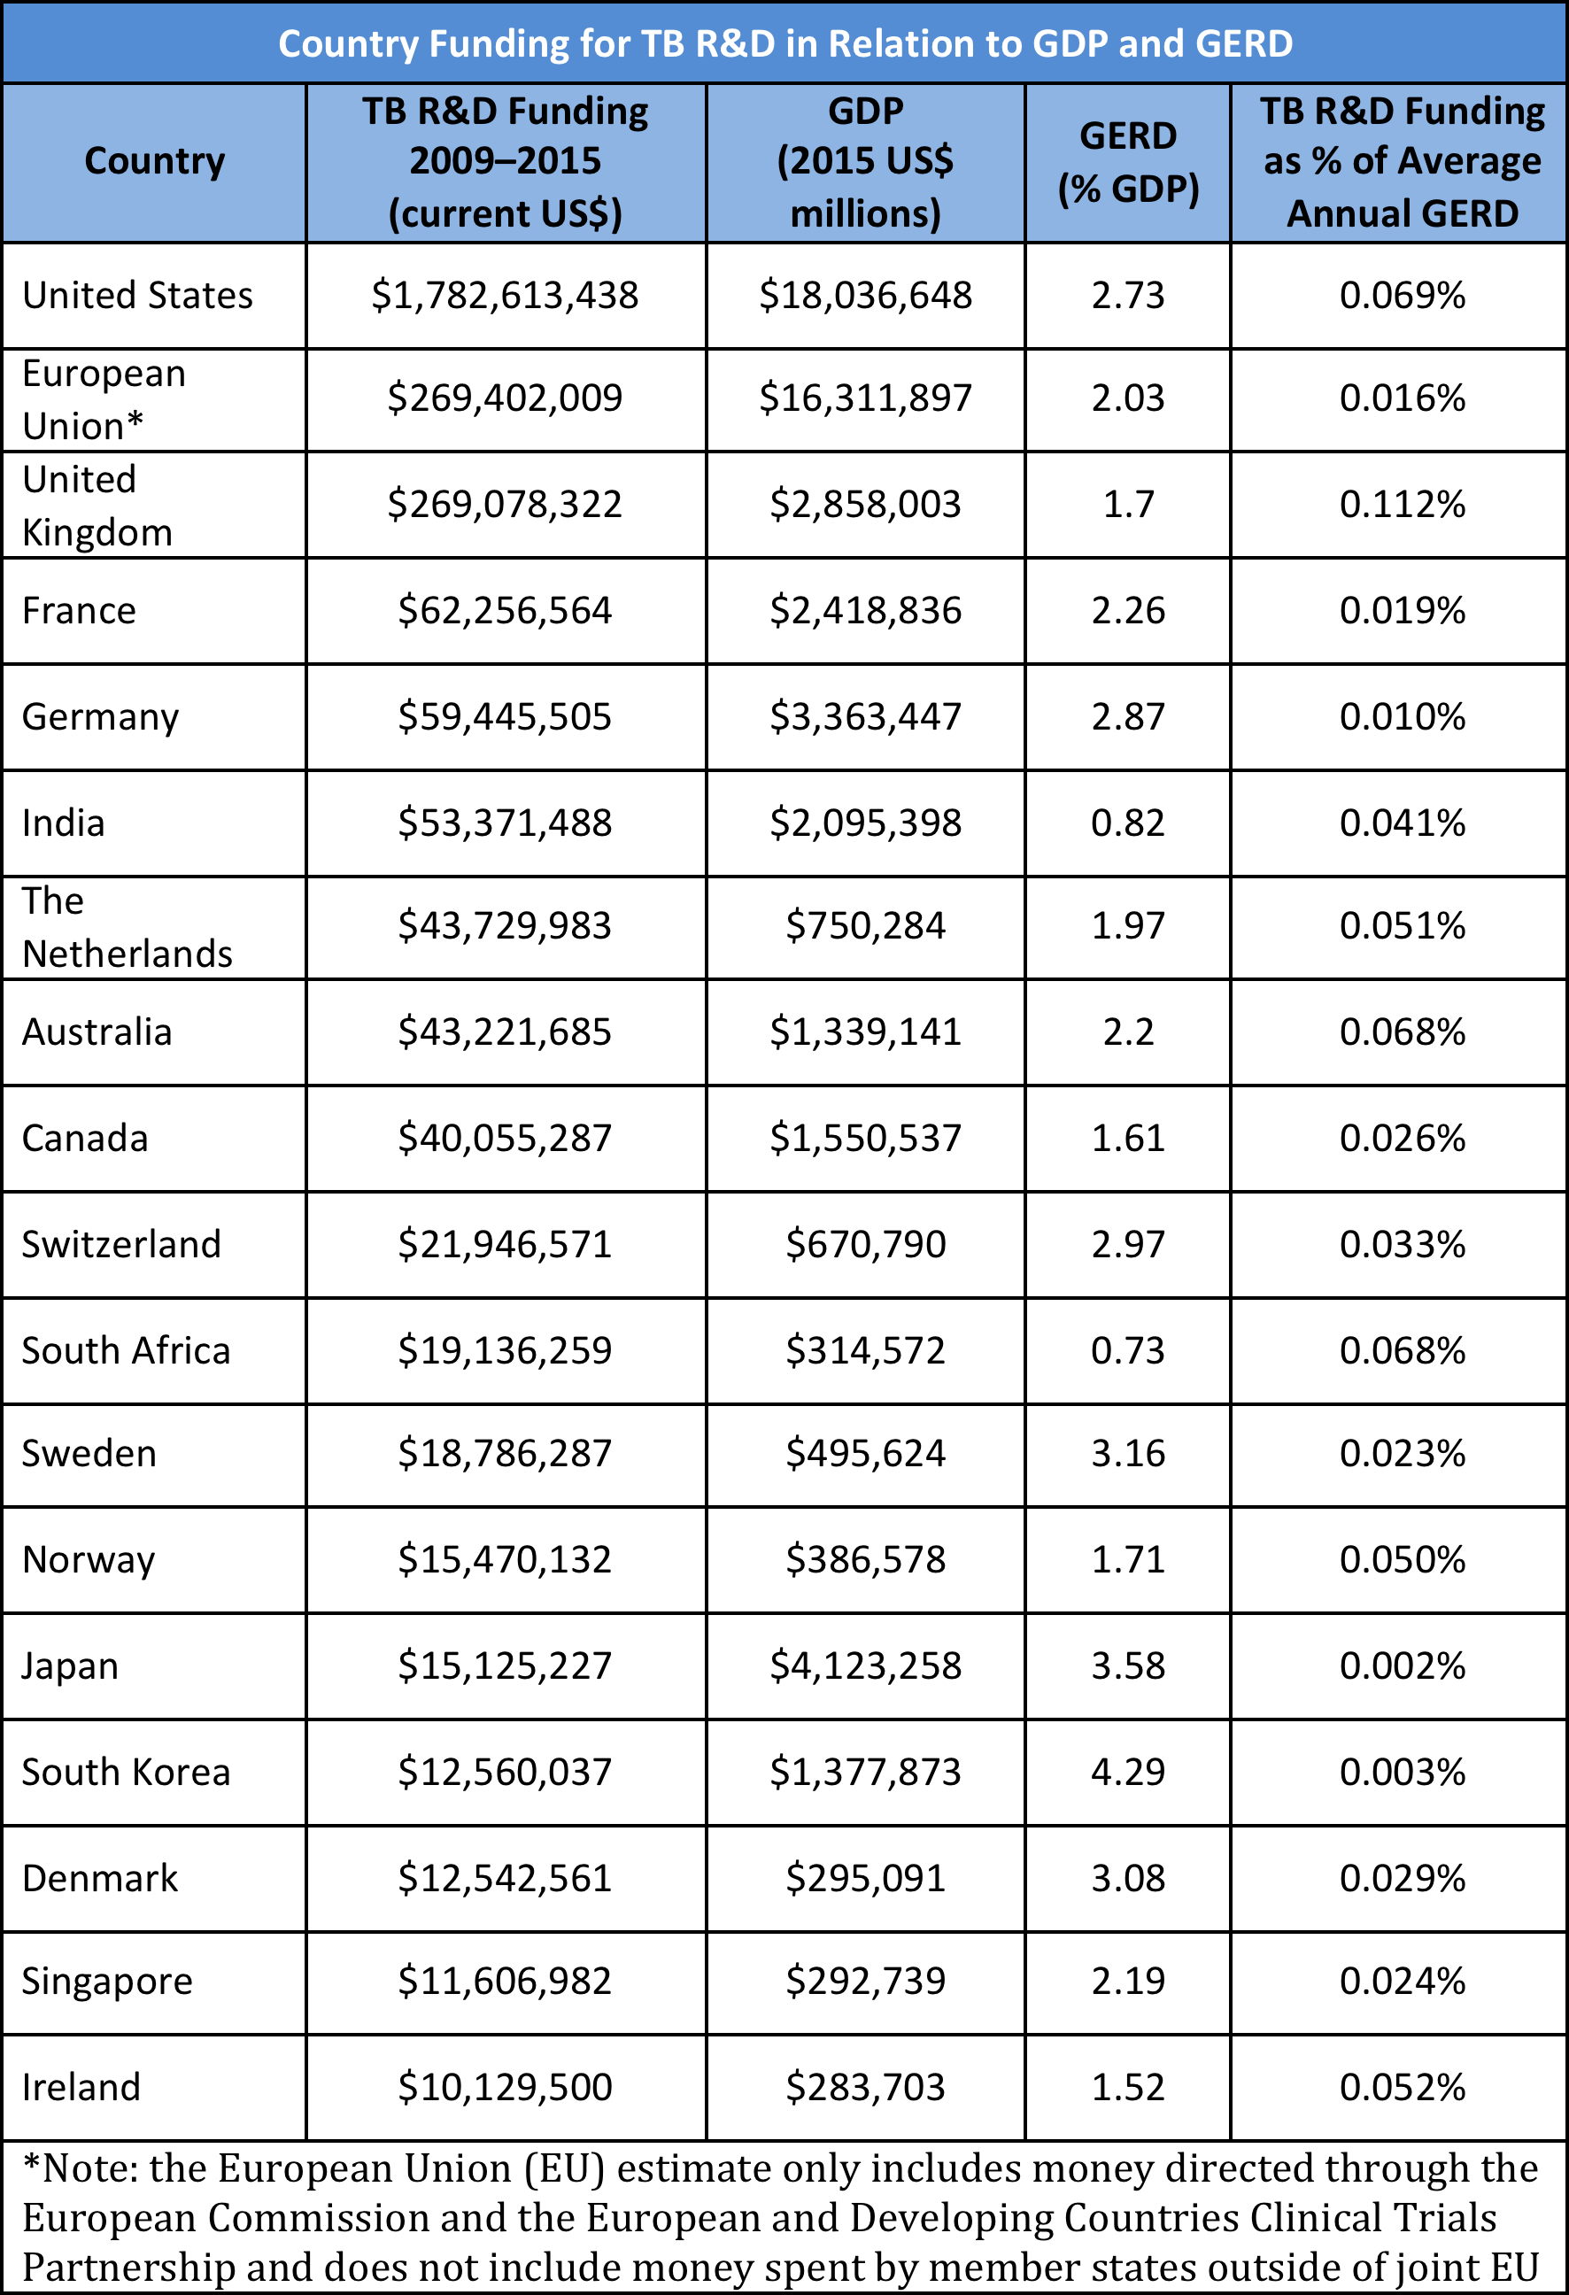
63% of Public Funding came from the USG
Some countries spend a large proportion of their GDP on R&D, generally, but little on TB R&D, specifically.
Some countries with lower spending on R&D as a percentage of GDP spend more on TB R&D than wealthier countries.
Countries at all levels of income and R&D capacity can do more on TB R&D.

Slide 10
The result: Funding for TB R&D is… 1) inadequate measured against the ambitions of the SDGs and End TB Strategy 2) incommensurate with the global burden of TB
TB is responsible for nearly 2% of disability-adjusted life-years (DALYs) and 2% of deaths globally, but only receives 0.25% of the estimated $265 billion spent on medical research annually.
TB R&D Funding per TB DALY and Fatal Case
 | 2010 | 2015
R&D $ / DALY | $12 | $12
R&D $ / Fatal Case | $475 | $469
“There has been a tendency over the years to take R&D for granted, as though the medicines and diagnostics somehow miraculously appear when necessary. But in truth, ignoring R&D is disastrous when combatting an infectious disease like TB. We’ve learned in HIV that R&D, once unleashed, has saved millions of lives. The same can and must be true of TB.”
—Stephen Lewis

Slide 11
How can Governments Support TB R&D? There are Many points of Entry and reasons to invest
In 2015, it only took $10 million to be a top 10 funder of TB research. Investment in a flagship TB research program, or a grants program earmarked for TB within a larger science funding envelope, could make a meaningful difference for the field.
Public money is like yeast, it makes the dough rise. Public investments often attract co-funding from other sectors.
The TB community has started to organize collaborative research platforms (e.g., the 3P Project) that provide opportunities to invest in joint initiatives, pool resources, and leverage money across sectors.
Despite limited investment, TB R&D is a good investment. Investments made over the last 10 years have yielded high returns:
New drugs to treat MDR-TB (bedaquiline, delamanid)
Shorter preventive therapy (3HP)
Improved diagnostics (GeneXpert, TB LAM)
First efficacy trial of a TB vaccine in 60 years (MVA85A)
A true paradigm shift in understandings of the basic biology of TB

Slide 12
The costs of Research are nothing compared to the costs of inaction
“There can be no end to TB without an end to political indifference in this R&D agenda.” —Lynette Mabote
According to the Stop TB Partnership, a 5-year delay in funding R&D at the targeted level of $9 billion between 2016 and 2020 could result in an additional:
8.4 million TB cases
1.4 million TB deaths
$5.3 billion in treatment costs
$181 billion in lost productivity
Let the past be our guide: the MDR-TB outbreak in New York City in the early 1990s cost over $1 billion to control.
In 2015 dollars, that’s >$1.8 billion, or more than what the world spent on TB research in the last three years combined.
Given the scale of these costs, the least expensive option for governments is to act!

Slide 13
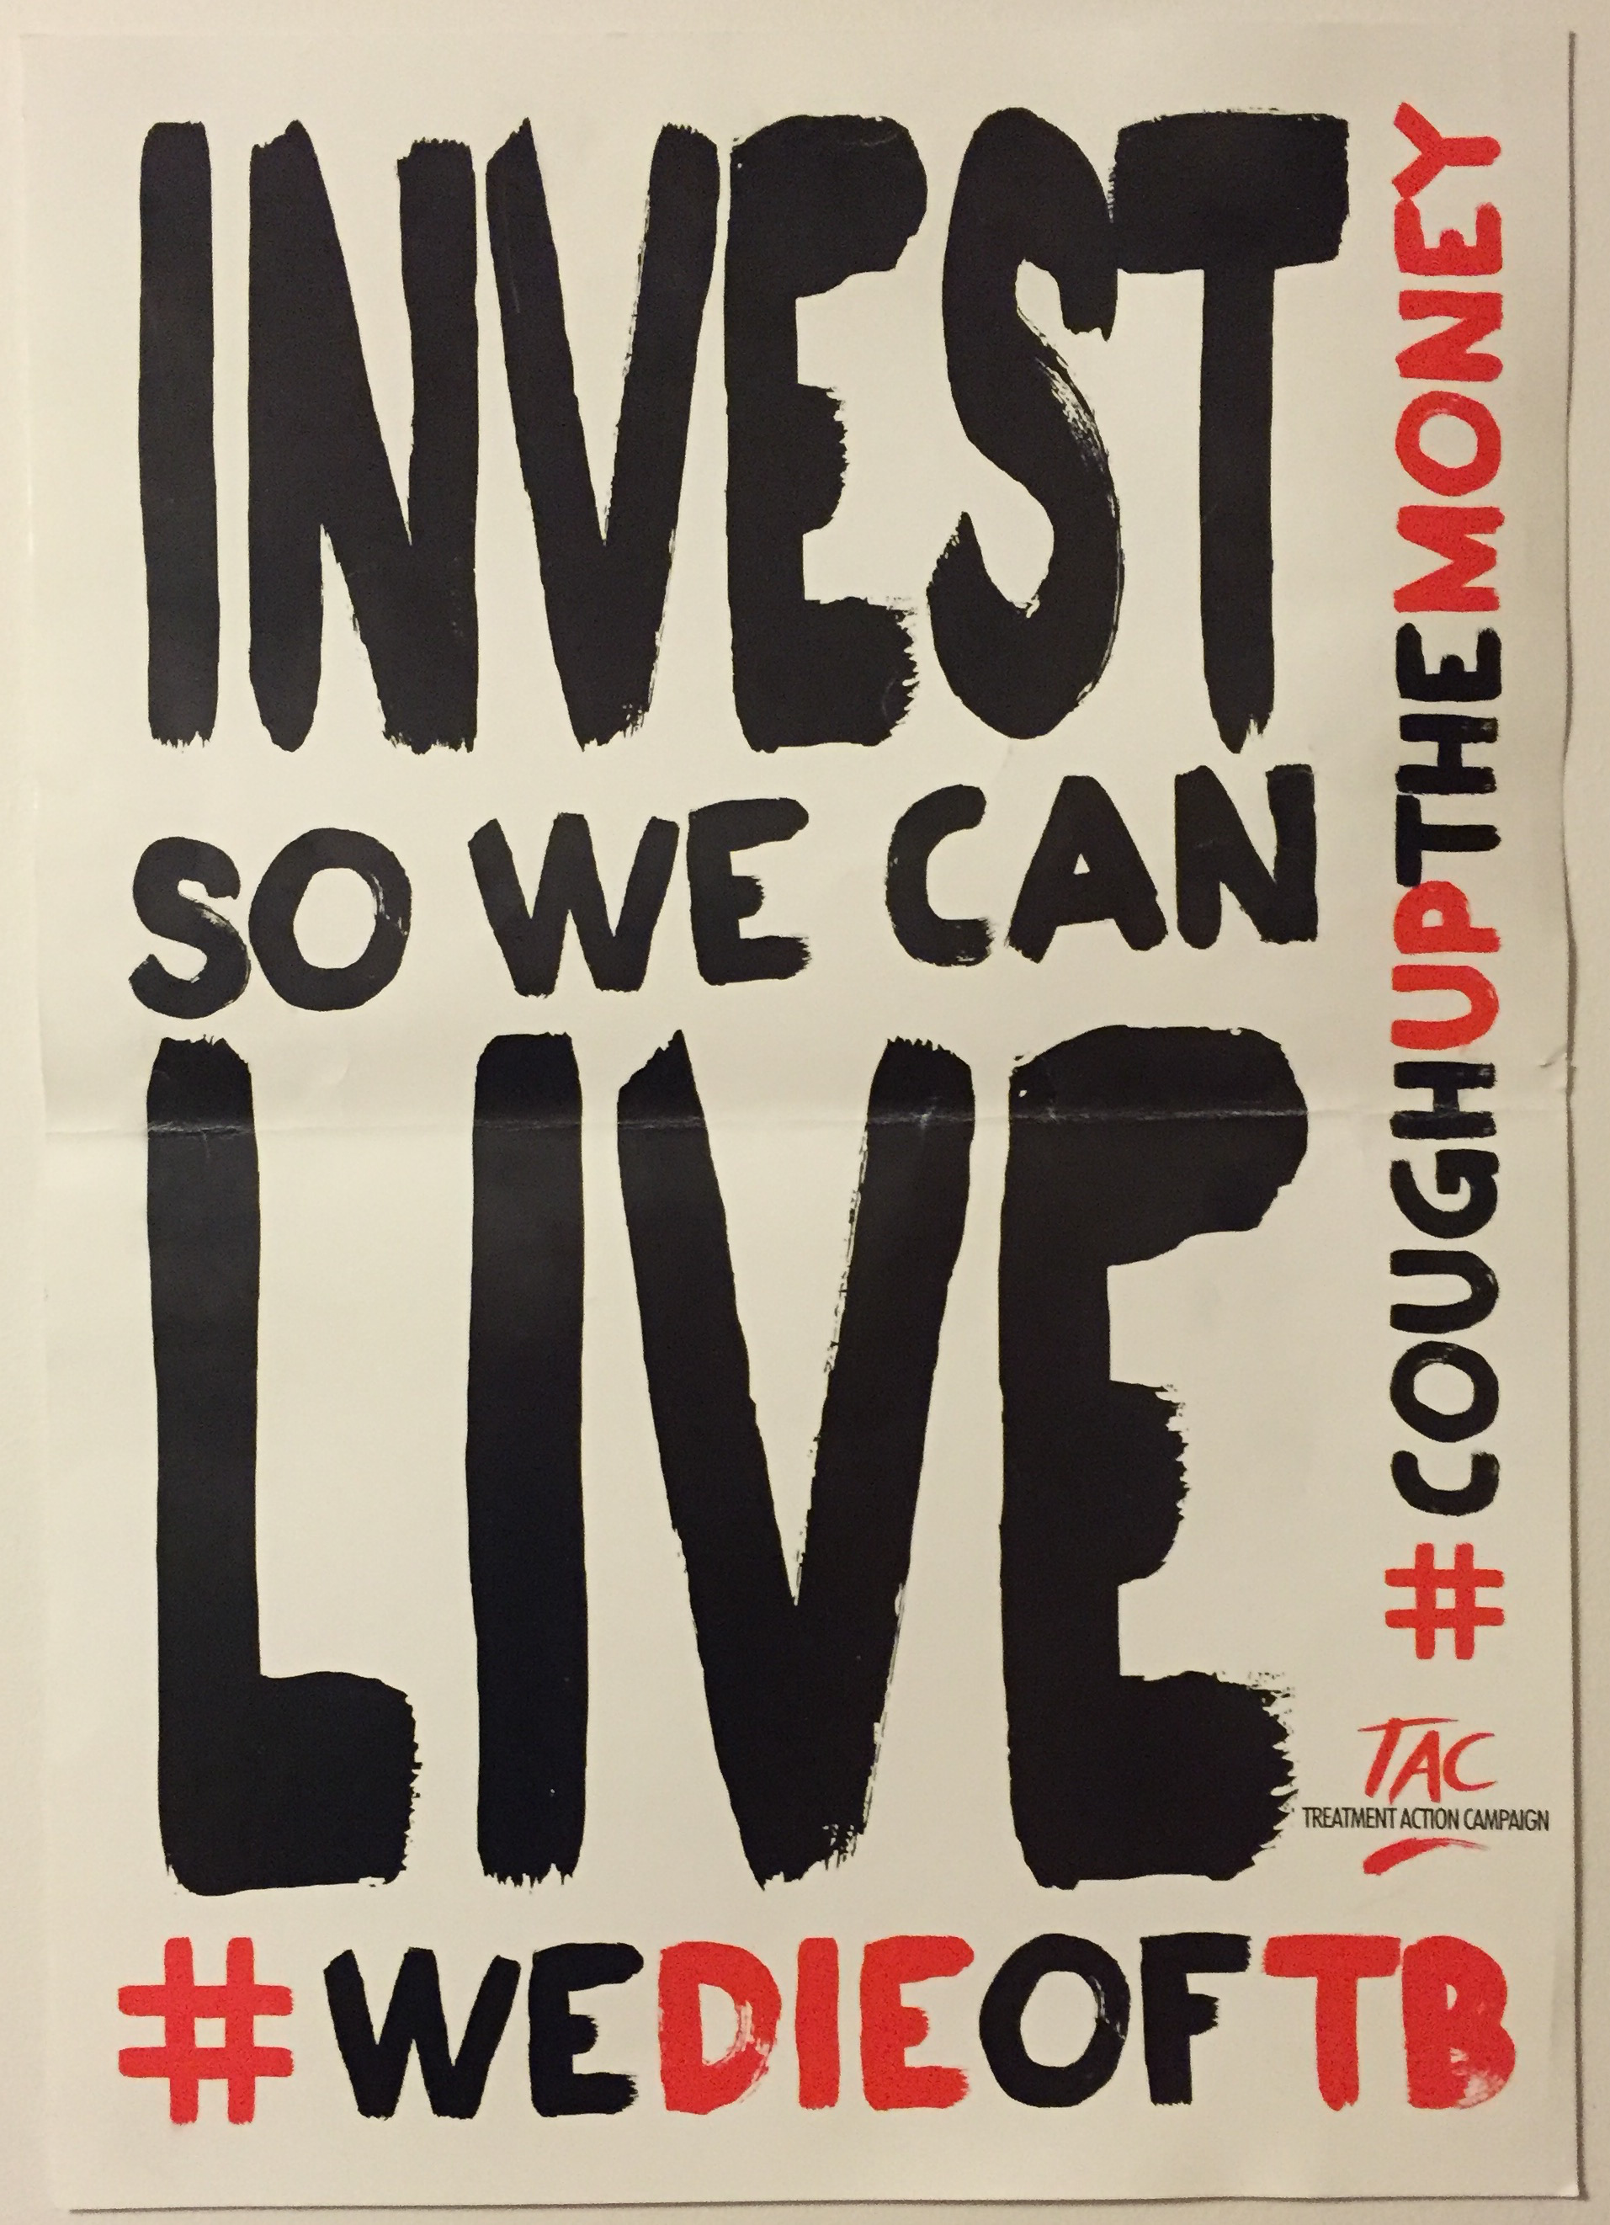
Thank yoU!
Questions?
mike.frick@treatementactiongroup.org
@mwfrick

