Slide 1
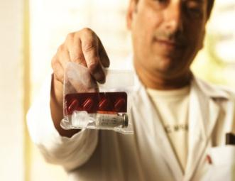
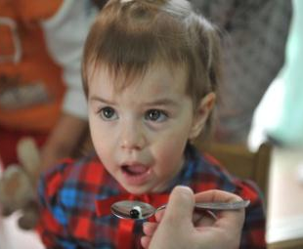
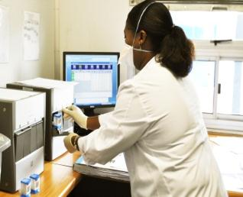
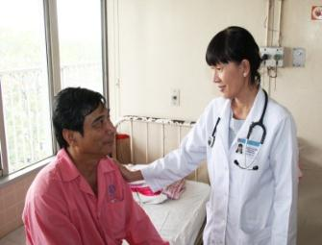
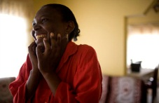
TB R&D goals of the WHO Ministerial Conference 2017 and HLM on TB at UNGA 2018
Dr Mario RAVIGLIONE
Director GTB, WHO
TAG/ACTION Webinars
30 May 2017

Slide 2
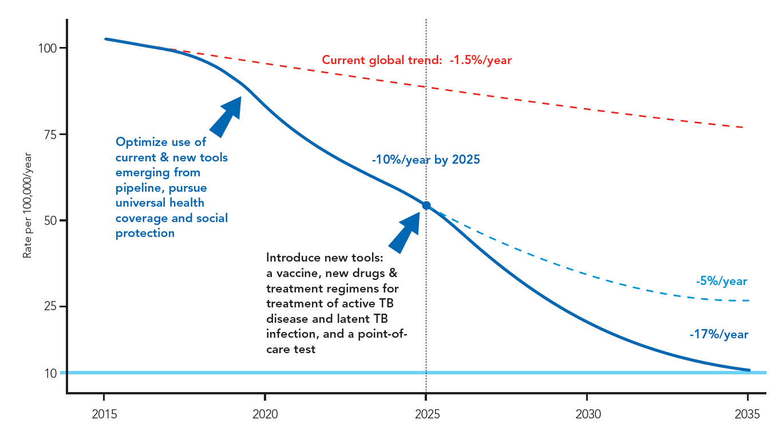
Second steering committee meeting
FIRST WHO GLOBAL MINISTERIAL CONFERENCE
ENDING TB IN THE SUSTAINABLE DEVELOPMENT ERA: A MULTISECTORAL RESPONSE
ACCELERATING TO REACH WHO & SDG END TB TARGETS
Accelerate scaled up use of current and new tools, pursue universal health coverage and social protection

Slide 3
Second steering committee meeting
FIRST WHO GLOBAL MINISTERIAL CONFERENCE
ENDING TB IN THE SUSTAINABLE DEVELOPMENT ERA: A MULTISECTORAL RESPONSE
CRITICAL FUNDING GAPS IN R&D
RESEARCH –
at least US$ 2 billion per year needed
$1.7 billion
funding gap
$621 million available in 2015
$1.3 billion
funding gap
TAG TB R&D report 2016

Slide 4
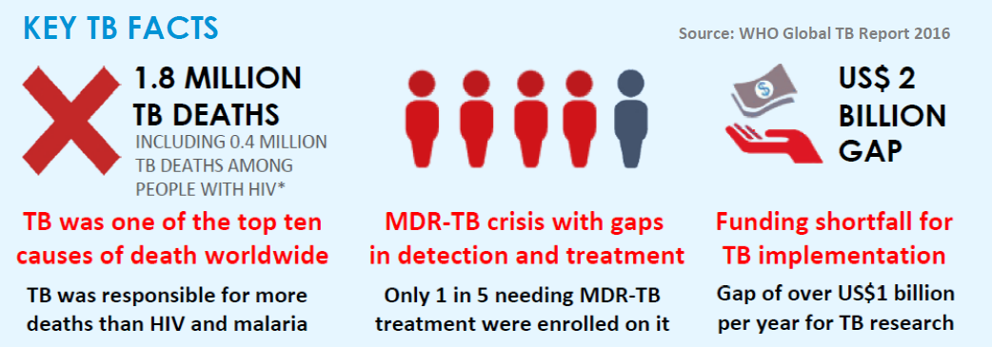
Second steering committee meeting
FIRST WHO GLOBAL MINISTERIAL CONFERENCE
ENDING TB IN THE SUSTAINABLE DEVELOPMENT ERA: A MULTISECTORAL RESPONSE
Tuberculosis is the leading infectious killer
CURRENT ACTIONS AND INVESTMENTS
ARE FALLING FAR SHORT

Slide 5
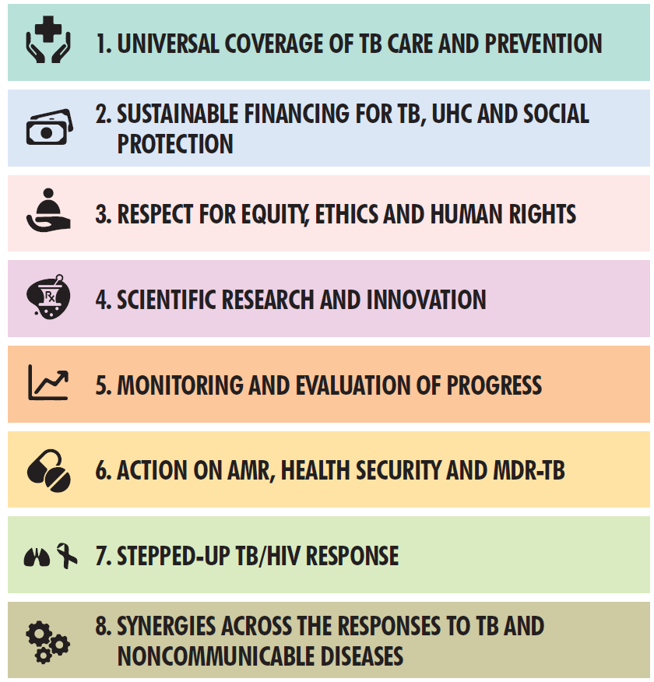
Second steering committee meeting
FIRST WHO GLOBAL MINISTERIAL CONFERENCE
ENDING TB IN THE SUSTAINABLE DEVELOPMENT ERA: A MULTISECTORAL RESPONSE
EIGHT THEMATIC TRACKS
Leading up to the United Nations General Assembly High-Level Meeting on TB in 2018, Ministerial commitment for:
MULTISECTORAL ACCOUNTABILITY

Slide 6
Second steering committee meeting
FIRST WHO GLOBAL MINISTERIAL CONFERENCE
ENDING TB IN THE SUSTAINABLE DEVELOPMENT ERA: A MULTISECTORAL RESPONSE
TOP OUTCOME AREAS
MULTISECTORAL ACCOUNTABILITY
SUSTAINABLE FINANCING
UNIVERSAL COVERAGE
RESEARCH

Slide 7
NEW FUNDING MECHANISM FOR GLOBAL TB RESEARCH AND DEVELOPMENT
PARTNERS GROUP CONSULTATION
FIRST WHO GLOBAL MINISTERIAL CONFERENCE
ENDING TUBERCULOSIS IN THE SUSTAINABLE DEVELOPMENT ERA: A MULTISECTORAL RESPONSE
16 - 17 November 2017, Moscow, Russian federation

Slide 8
PARTNERS GROUP CONSULTATION
FIRST WHO GLOBAL MINISTERIAL CONFERENCE
ENDING TB IN THE SUSTAINABLE DEVELOPMENT ERA: A MULTISECTORAL RESPONSE
THE ISSUE
Context:
The 2030 global targets will not be achieved unless all existing interventions are optimally implemented and new transformational tools are developed and in use in all high- and medium-TB burden countries.
Issue:
Despite some progress in the pipeline of new diagnostics, drugs and vaccines, TB research and development (R&D) remains severely underfunded.
Aim:
Strong commitment is needed from high- and medium-TB burden countries to step up their TB response efforts, including investments in health R&D, to guarantee success of the End TB Strategy.

Slide 9
PARTNERS GROUP CONSULTATION
FIRST WHO GLOBAL MINISTERIAL CONFERENCE
ENDING TB IN THE SUSTAINABLE DEVELOPMENT ERA: A MULTISECTORAL RESPONSE
CHALLENGES AND OPPORTUNITIES
With a global figure of $620,600,596 in 2015, funding for TB R&D has not grown since 2009 and has even lost ground in the face of inflation. The TB R&D pipeline is lagging behind those, for instance, of HIV and malaria.
Funding is mainly coming from a few donors from a few countries: the United States Government and the Bill & Melinda Gates Foundation together accounted for almost 60 percent of TB R&D funding over the last 10 years, proof an insufficient solidarity underpinning the TB research cause .
A Global Action Framework for TB Research has been developed by the WHO as a blueprint for the promotion of research both at the national and global levels, to support the 3rd Pillar of the End TB Strategy.
As awareness on the global TB burden increases, research implementation & investments have the potential to progressively shift from high-income, low TB burden countries to middle and lower-middle income countries with high TB burden.

Slide 10
PARTNERS GROUP CONSULTATION
FIRST WHO GLOBAL MINISTERIAL CONFERENCE
ENDING TB IN THE SUSTAINABLE DEVELOPMENT ERA: A MULTISECTORAL RESPONSE
ACTIONS
National Level – Countries commit to:
Pursue A SOLID RESEARCH ENABLING ENVIRONMENT. Country level research is critical in developing and evaluating tools and approaches that most appropriately match context-specific TB prevention and control needs. This needs to be backed by national research investments, multisectoral collaboration and reduced regulatory and structural impediments.
Global Level – Countries call for the:
Establishment of a Global Coalition for TB Research FINANCING FOR TOP PRIORITIES to act as an engagement platform at the forefront of efforts to raise resources, and stimulate, harmonize and unite for R&D to End TB in the context of SDGs.
ADOPT A NEW PROACTIVE APPROACH TO GLOBAL TB R&D FUNDING to develop the knowledge base and tools necessary to identify, adopt and scale up innovative, cost-effective and sustainable best practices needed to end TB.

Slide 11
Second steering committee meeting
FIRST WHO GLOBAL MINISTERIAL CONFERENCE
ENDING TB IN THE SUSTAINABLE DEVELOPMENT ERA: A MULTISECTORAL RESPONSE
Pooled vs joint funding mechanism for TB R&D
Pooled funding |  | Joint funding
Pros | Cons | Pros | Cons
Tangible resources can be secured for research aligned with global TB R&D priorities. | Most state and non-state funders of TB research may not have the flexibility to contribute | State and non-state funders of TB research jointly prioritize and fund proposals within the scope of their own funding strategies. | Functions based on voluntary contributions and collaboration between funders.
 | Requires dedicated governance and administration, with transaction costs and fund raising efforts. | Not very time-consuming and managerially costly. | Dedicated convening body to sustain success.
 |  | Flexible and collaborative, so an attractive platform for additional TB R&D supportive activities.

Slide 12
FIRST WHO GLOBAL MINISTERIAL CONFERENCE
ENDING TB IN THE SUSTAINABLE DEVELOPMENT ERA: A MULTISECTORAL RESPONSE
ROADMAP
2017
Research and Innovation
2018
2016
2016
Jan -Mar
Apr-
-----May-----
--Jun--
Jul
Aug
Sep
Oct
Nov
Dec
2018
Today
Date TBC
Apr 5-6
Jun 1
Aug 1
Finalization of the Policy Paper and Brief
Production of advocacy materials
Jan-Mar
Second Funders’ Forum on TB Research
Discussion of policy paper outline and content
May 1
1st draft of PHI assessment
2nd draft of public health impact assessment
Ministerial Conference
Moscow
Commissioning TAG to conduct TB R&D funding trend analysis for policy paper
1st draft of TB R&D trend analysis (TAG)
Nov 16-17
Second Meeting of Global TB Research Task Force
Commissioning Imperial College London to conduct public health impact (PHI) assessment of TB R&D funding
First full draft of the policy paper
May 12
Link the two reports
1st draft of policy brief
May 21-22
Editing and publication
Request for case studies from partners on R&D for new tools (FIND, Alliance, Aeras, TBVI, STP research WGs ) + OR/IR (UCSF)
PAG & Steering Committee
meetings
Jun 12-14
July 1
UN
High-level Meeting on TB
Presentation of Policy Paper and Brief at STAG
Revised draft of TB R&D trend analysis
Revised draft of Policy paper circulated to WHO Task Force on Global TB R&D and other partners
May 31
2nd draft of TB R&D trend analysis (TAG)
Circulation of draft Policy Paper to WHO Task Force on Global TB R&D and other partners
Prepare advocacy materials

Slide 13
FIRST who GLOBAL MINISTERIAL CONFERENCE
ENDING TB IN THE SUSTAINABLE DEVELOPMENT ERA: A MULTISECTORAL RESPONSE
PARTNERSS ENGAGED IN THE PROCESS
Ministries of Health/National TB Programmes
Armauer Hansen Research Institute, Ministry of Health (Ethiopia)
Ministry of Health of Russian Federation
National Tuberculosis Programmes (Brazil, Tanzania and Vietnam)
Universities
Amsterdam Institute for Global Health and Development
Federal University of Rio de Janeiro-Brazil
Imperial college, London, UK
London School of Hygiene and Tropical Medicine, UK
McGill University, Montreal, Canada
University College London, UK
University of California San Francisco
Partners
Aeras, FIND, KNCV, Stop TB Partnership, TB Alliance, TBVI, The Union
Funders
Bill and Melinda Gates Foundation, CDC, European Commission, EDCTP, ICMR-India, US NIH/NIAID, MRC-South Africa, UNITAID, USAID
Advocacy
TAG

Slide 14
Second steering committee meeting
FIRST WHO GLOBAL MINISTERIAL CONFERENCE
ENDING TB IN THE SUSTAINABLE DEVELOPMENT ERA: A MULTISECTORAL RESPONSE
What is the role of civil society?
Support necessary to advocate for bold outcome at national and global levels
Make the TB coalition an achievable goal
Convince traditional funders to engage and increase commitments
Identify new potential funders and advocate for contributions
Support countries to invest in establishing a research-enabling environment – develop national plans & strategies
Push G7, BRICS and G20 members to contribute to the Global Coalition on TB Research

Slide 15
THANK YOU

