Slide 1
Tuberculosis prevention
Treatment Action Group
TB/HIV Advocacy Toolkit
July 2019
With thanks to Adam Almeida, Andolyn Medina, and Dr. Jennifer Furin

Slide 2
Topics to be covered
Vaccination Fundamentals
Current Vaccine
Vaccine Research
Preventive Therapy
Other aspects of TB prevention
The Main Points

Slide 3
Vaccination fundamentals

Slide 4
VOCABULARY
Primary Prevention: to block infection
Secondary Prevention: to stop infection from progressing to disease
Immunity: the ability to resist the onset or progression of a disease
Vaccine: a substance that is introduced into the body to create immunity against infection or prevent disease progression
FUNDAMENTALS

Slide 5
TYPES OF VACCINES
Live, attenuated vaccine: contains germs that are alive and have been weakened so they have lowered disease-causing ability
Inactivated vaccine: contains germs that have been killed
Toxoid vaccine: contains toxins produced by germs
Component vaccine: contains part of germ
FUNDAMENTALS

Slide 6
Current Vaccine FOR TB

Slide 7
Current Vaccine
Bacille Calmette-Guérin (BCG) is currently the only approved TB vaccine
BCG is the world’s most widely administered vaccine
The WHO estimates that it saves the lives of over 40,000 children each year
BCG is a live, attenuated strain of M. bovis
It protects infants and young children against severe forms of TB, including:
Miliary TB: throughout the body
Meningeal TB: in the lining of the brain
VACCINE

Slide 8
LIMITATIONS OF BCG VACCINE
BCG offers limited protection against TB in adolescents and adults
The durability of its protection (how long its protective effects last) decreases in early adolescence
Whether repeated BCG vaccination can boost protection at different time points over the life course is currently being studied
It should not be given to people (including infants) with HIV
Because HIV suppresses or weakens the immune system, the live, attenuated vaccine can cause TB disease in these people
Target stages/populations for vaccination and where BCG vaccine fits
Target stage | Target population
 | Infants | Adolescents | Adults | People with HIV (all ages)
Active disease
Latent infection
Pre-infection | BCG
VACCINE

Slide 9
Research

Slide 10
VACCINE DEVELOPMENT PIPELINE
Costs associated with the development of a portfolio of TB vaccine candidates
Field Site Preparation ($2-4 million per year, per site)
Manufacturing ($310 million to build and upgrade facilities; $10 million per year)
Vaccine Discovery
Preclinical Testing
Phase I
(4 trials per candidate)
Phase II
(3 trials per candidate)
Phase IIb (1 trial per candidate)
Phase III (1 trial per candidate)
Licensure
1 - 2 years
8 – 10 years
4 years
Costs related to the development of one TB vaccine candidate
$3.5 million
$3 million
$18 million
$24 million
up to $265 million
Direct costs to develop one TB vaccine candidate for one target population could be as much as $315 million
Phase III licensure trials are complex and costly
Infant trial — between $70 and $140 million
Adolescent and adult trial — between $130 and $265 million
RESEARCH

Slide 11
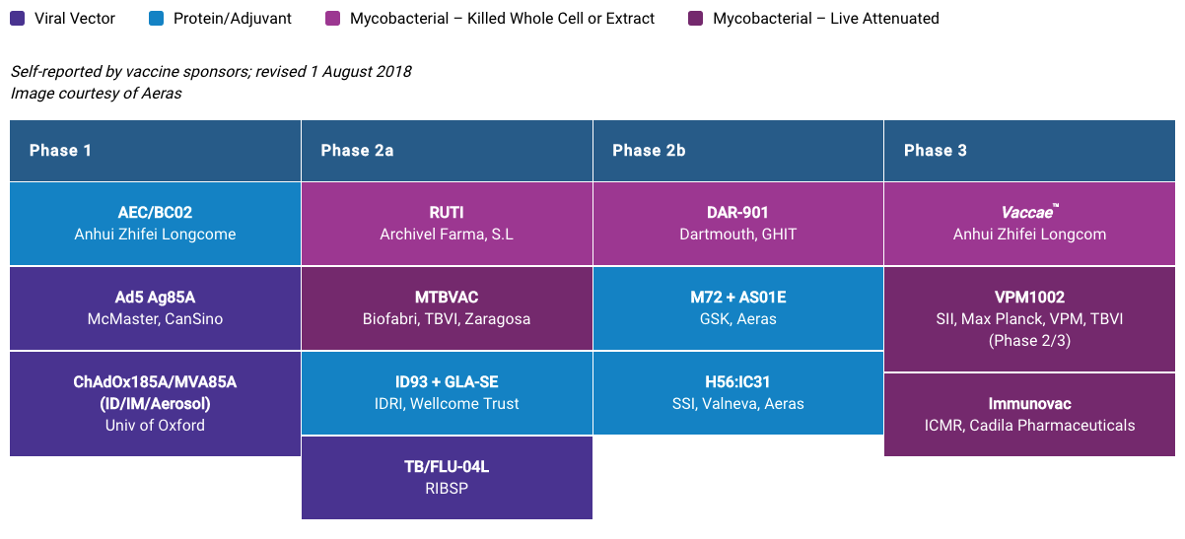
VACCINE PIPELINE
Current TB vaccine candidates fall into three categories:
Priming vaccine: induces an initial immune response
Boosting vaccine: strengthens the induced immune response, may be given months or years after the primer
Immunotherapeutic vaccine: strengthens the immune response after infection
Courtesy of STBP New TB Vaccines Working Group
RESEARCH
Notes:
For more information on the Vaccine pipeline go to the website of the Working Group on New vaccines at: www.newtbvaccines.org and TAG’s Pipeline Report which can be found at: pipelinereport.org

Slide 12
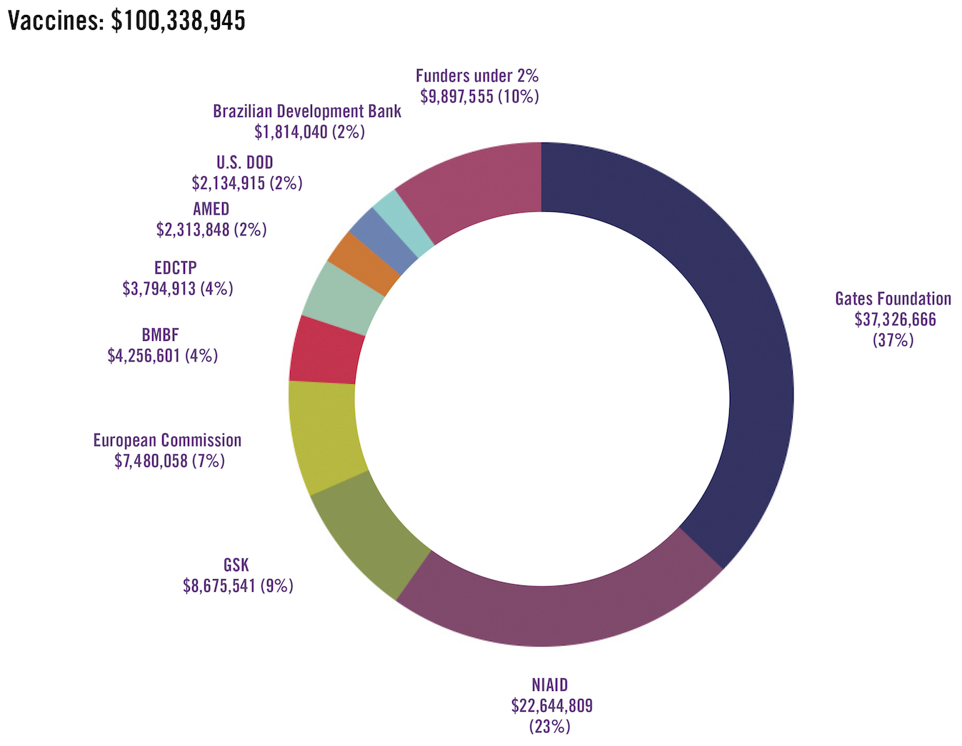
VACCINE FUNDING, 2017
Source: www.treatmentactiongroup.org/TBRD2018
RESEARCH
Notes:
12

Slide 13
CHALLENGES OF TB VACCINE RESEARCH
Lack of understanding of BCG
Limited understanding of how TB infection and disease occur in the body
Difficulty in assessing immunity
Limited research capacity
Few options for HIV-exposed infants
Not enough resources
Poor animal models
RESEARCH
Notes:
Note to facilitator: this list is not exhaustive and should be used as a guide based on the information discussed in this module.

Slide 14
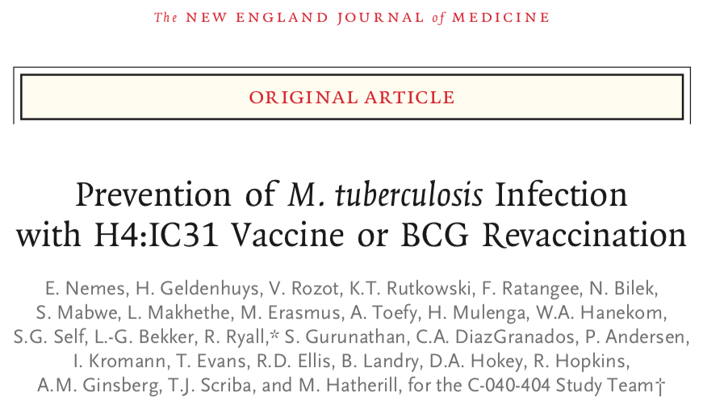
Promising Vaccine Candidates
Re-vaccination with BCG may offer some additional immunity. The benefits of this are that the vaccine is widely available, its safety profile in all ages has been assessed, and its cost is reasonable. The protection, however, does not appear to be complete.
Notes:
For full text use: doi: 10.1056/NEJMoa1714021
For additional information on these study results see: http://pipelinereport.org/sites/default/files/pipeline_2018_tb_prevent_mf_web2.pdf

Slide 15
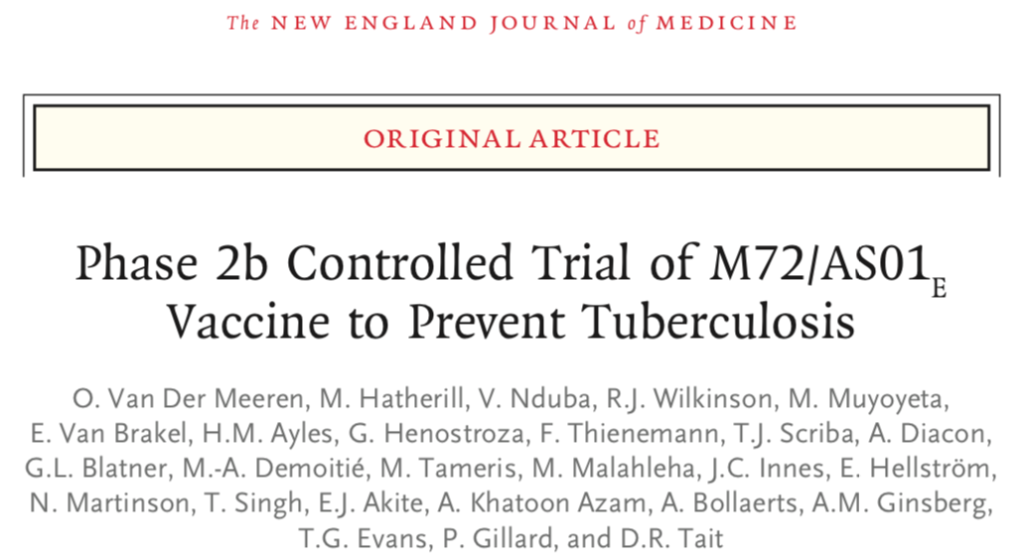
Promising Vaccine CAndidates
The M72/ASO1_{E} vaccine provided 54% protection from the development of TB when tested in a phase IIB trial in HIV-negative individuals in Kenya, South Africa, and Zambia who were living with TB infection. The vaccine appeared safe and will be tested in phase III trials if funding is available.
Notes:
For full text use: doi: 10.1056/NEJMoa1803484
For additional information on these study results see: http://pipelinereport.org/sites/default/files/pipeline_2018_tb_prevent_mf_web2.pdf

Slide 16
Preventive therapy

Slide 17
Preventive therapy
Especially in the absence of a broadly effective vaccine, preventive therapy is extremely important in TB prevention
Much like PrEP/PEP in HIV
Currently, WHO recommends preventive therapy in all:
Childhood household contacts (under 5 years) of someone diagnosed with active TB disease
People with HIV as long as active TB disease has been ruled out
The most common form of preventive therapy is Isoniazid Preventive Therapy (IPT)
Uptake of preventive therapy is too low
Only 7% of those who should receive preventive therapy do
PREVENTION

Slide 18
Treatment REGIMENS For LTBI
The WHO recommends one of the following treatment regimens for latent TB infection based on drug sensitivity, drug availability, and TB incidence and prevalence:
6-month isoniazid (daily)*
9-month isoniazid (daily)*
3-month rifapentine + isoniazid (weekly)
1-month of rifapentine+ isoniazid (daily)
3-4 months isoniazid + rifampicin (daily)
4 months rifampicin (daily), recommended for people who cannot tolerate or whose TB is resistant to isoniazid
Note: none of these regimens would work on drug-resistant strains. Research is underway to see if levofloxacin or delamanid are good options for contacts of people with MDR-TB
*the ideal length of IPT is unknown; IPT also comes in a co-formulation with cotrimoxazole to prevent other bacterial conditions
Source: WHO Guidelines on the management of latent tuberculosis infection, 2015 http://www.who.int/tb/publications/ltbi_document_page/en/
PREVENTION

Slide 19
Other aspects of TB prevention

Slide 20
How else to prevent TB?
Finding and treating active disease quickly and with the right drugs
This is the best way to prevent TB
On the right treatment, TB very quickly (<2 weeks) becomes non-infectious
This includes active case finding and contact tracing (finding and testing close contacts of known TB cases and other people at high risk)
Environmental protections
Sunlight or other UltraViolet (UV) light
Good ventilation (airflow)—fans, open windows
In hospitals, negative pressure rooms (if resources allow)
In clinics, separating people with cough
PREVENTION

Slide 21
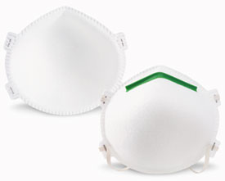
How else to prevent TB?
Other personal, health, and social protections
For TB-negative people, wearing an N-95 respirator (N-95 mask)
For persons with TB, wearing a surgical mask when coughing may reduce the spread of TB in the first weeks of treatment, but this should not be a requirement and could increase stigma.
Improved living conditions (avoid overcrowding)
Improved air quality: pollution- and smoke-free
Healthy nutrition (both malnutrition and diabetes predispose people to develop active TB)
Early initiation of antiretroviral therapy in people with HIV
N-95 respirator
PREVENTION

Slide 22
interventions from infection through transmission
Primary prevention vaccine
Preventive therapy
Improved air quality
Reduce overcrowding
Exposure
Infection
Early initiation of antiretroviral therapy
UV light
Mask
Secondary prevention vaccine
Transmission
Disease
Preventive therapy
Nutrition
Early diagnosis and good treatment of TB
Therapeutic vaccine
PREVENTION

Slide 23
The main points

Slide 24
There are many ways to prevent TB—none perfect—so we need to use them all
BCG vaccine protects children against the worst forms of TB
Preventive therapy is very important for contacts of people with TB
Early detection and treatment of TB and HIV is the best way to prevent TB transmission
Personal and environmental controls also help prevent TB transmission
More research into TB vaccines, basic science, and best strategies for preventive therapy is needed
MAIN POINTS

Slide 25
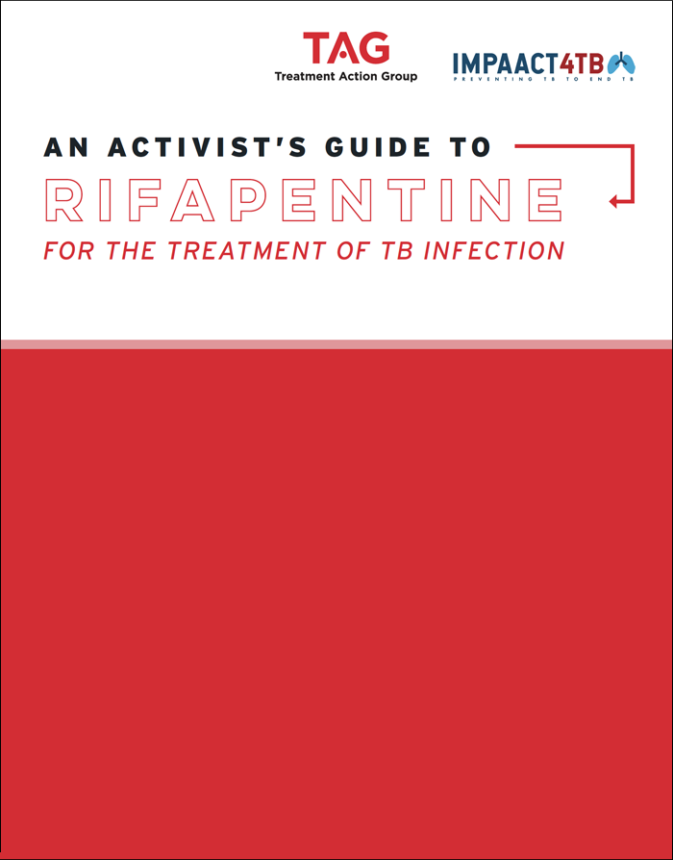
ADDITIONAL RESOURCES
Treatment Action Group (TAG) has developed An Activist’s Guide to Rifapentine for the Treatment of TB Infection: treatmentactiongroup.org/content/activists-guide-rifapentine-treatment-tb-infection

