Slide 1
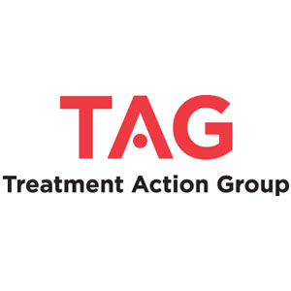
TB AND HIV
Treatment Action Group
TB/HIV Advocacy Toolkit
July 2019
With thanks to Adam Almeida, Andolyn Medina, and Dr. Jennifer Furin

Slide 2
overview
TB and HIV
Challenges to TB/HIV
Integrating the TB/HIV response to improve care
Advocacy priorities
Main Points

Slide 3
TB AND HIV

Slide 4

TB/HIV
The presence of HIV or TB causes the accelerated progression of the other disease
    HIV increases the risk of developing TB disease due to a weakened immune system
    TB causes the acceleration of HIV through an unknown mechanism
  TB is the most common co-infection in people with HIV
  In people with HIV, extrapulmonary TB (TB outside the lungs) is more common
  People with HIV tend to have worse
  outcomes from TB than HIV-negative
  people
Image from Médecins Sans Frontières
TB/HIV

Slide 5
TB AND HIV COMPARISON
TB
HIV
MTB is a large bacterium made of a fatty cell wall and many proteins
Genetic material is stored as DNA, which is stable because of its ability to proofread and regulate mutations
TB is a complex organism and has approx. 4,000 genes
TB has around throughout human history
HIV is a tiny retrovirus made of a few proteins and a glycoprotein envelope
Genetic material is stored as RNA, which has no regulating mechanism and its copies often contain changes or mutations
HIV is a relatively simple organism and has 9 genes
HIV has been around for about 70 years
FUNDAMENTALS
Notes:
TB and HIV are two of the most important infectious diseases in the world today. While they overlap in many important ways, they are also quite different.
TB is a large and complex bacteria that has been infecting humans since early civilization. HIV however is a tiny, relatively simple virus that has been infecting humans for less than a century.

Slide 6
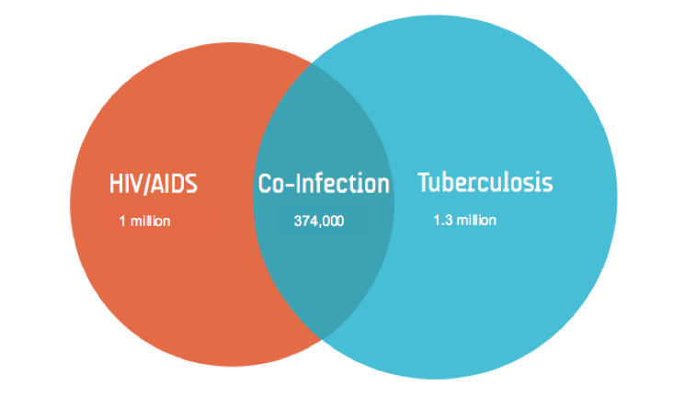
TB/HIV Statistics
People with HIV are 21 times more likely to develop TB
There were 10 million new cases of TB worldwide in 2017, of which 920,000 million cases arose in people with HIV
TB is the number one killer of people with HIV
  23% of HIV deaths were due to TB disease (300,000 TB deaths among people with HIV in 2017)
However, under drug treatment regimens, TB/HIV co-infection is manageable and allows for long, healthy lives
Number of deaths worldwide in 2016, according to the 2017 WHO Global TB Report and 2017 UNAIDS Factsheet
Concept courtesy of ACTION
TB/HIV

Slide 7
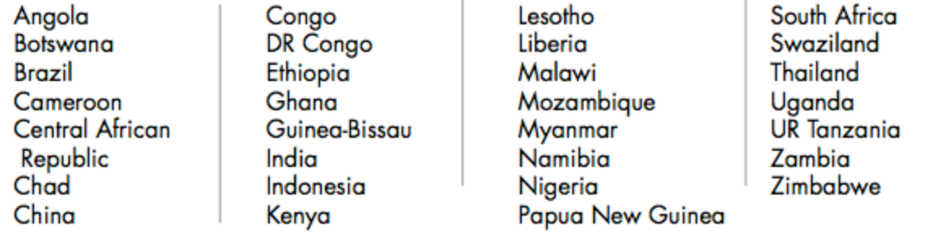
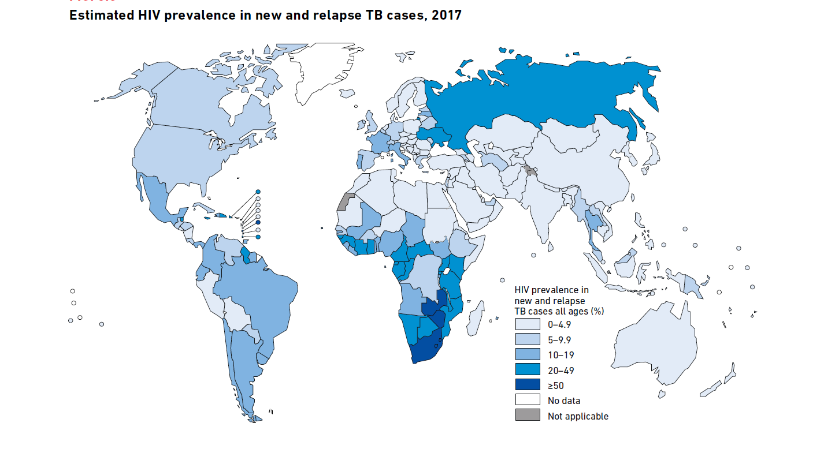
TB/HIV Global Burden of Disease
  Countries with the highest burden of TB/HIV co-infection*:
*The HBC list is defined as the top 20 countries in terms of absolute number of incident cases and the top 10 countries with the most severe burden in terms of incidence rates per capita not captured by the top 20 and meet a minimum threshold of the absolute number of incident cases (1,000 per year for TB/HIV).
Source: https://www.who.int/tb/publications/global_report/en/
TB/HIV

Slide 8
Challenges in tb/hiv coinfection

Slide 9
challenges in preventing, diagnosing, and treating TB/HIV
Vaccination
  The BCG (bacille Calmette-Guerin) vaccine, used to protect against TB, is not recommended for infants with HIV
    it can cause a potentially fatal inflammatory immune reaction
Diagnostics
  The most commonly used TB diagnostic tools lack the sensitivity to detect smear-negative and extrapulmonary TB
Treatment
  Pill burden of taking TB treatment and anti-retroviral treatment at the same time
  Coordination of timing of both treatments, due to immune reconstitution inflammatory syndrome (IRIS)
  Drug-drug interactions between HIV and TB medications, such as rifampicin and bedaquiline
*see other modules for more information on preventing, diagnosing, and treating TB in people with HIV
Challenges

Slide 10
Integrating TB/HIV response to improve care

Slide 11
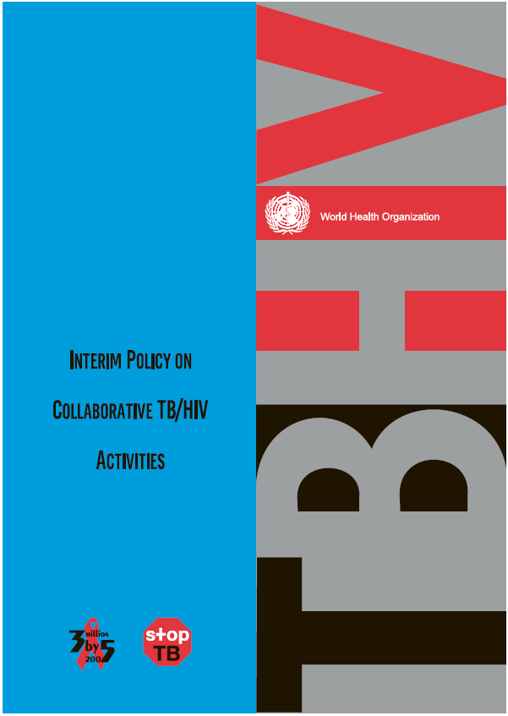
WHO Policy on TB/HIV
Collaborative Activities
A. Establish NTP-NACP collaborative mechanisms
  Set up coordinating bodies for effective TB/HIV activities
  at all levels
  Conduct surveillance of HIV prevalence among TB cases
  Carry out joint TB/HIV planning
  Monitor and evaluate collaborative TB/HIV activities
B. Decrease the burden of TB among PLHIV (Three I’s)
  Establish intensified TB case finding
  Introduce isoniazid preventive therapy
  Ensure TB infection control in health care and congregate settings
C. Decrease the burden of HIV among TB patients
  Provide HIV testing and counselling
  Introduce HIV prevention methods
  Introduce co-trimoxazole preventive therapy
  Ensure HIV/AIDS care and support
  Introduce ARVs
INTEGRATION
Notes:
11

Slide 12
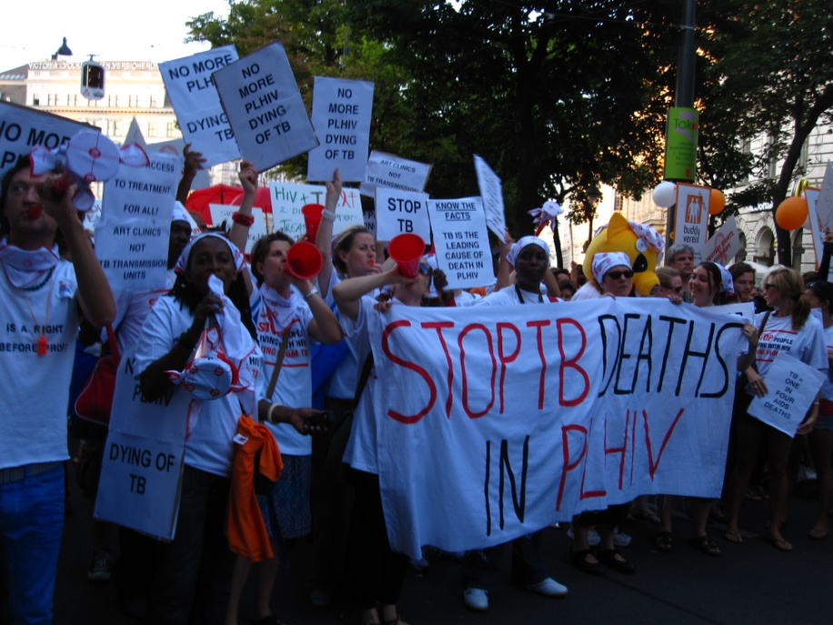
What are the Three I’s?
Intensified case finding (ICF): the regular screening of all people at high risk of HIV, and their close contacts, for the symptoms and signs of TB.
Isoniazid preventive therapy (IPT): the provision of daily isoniazid (or other recommended regimens) to people with HIV who are latently infected with TB to prevent progression to TB disease.
Infection control (IC): strategies that minimize the risk of TB transmission, particularly in HIV-prevalent settings.
Notes:
The Three Is are the elements of the policy under section B designed to decrease the burden of tuberculosis in people living with HIV/AIDS.

Slide 13
What is the “fourth I”?
Initiation of antiretroviral therapy in people with HIV—specifically
  earlier initiation of ART by increasing the minimum to start to 350 CD4 cells/mm³
  provide ART to all HIV-positive people who have TB regardless of CD4 count
The Temprano Study (2015) showed that starting ART immediately reduced risk of death and serious HIV related illnesses, including TB, by 44%.
Source: Danel C, Gabillard D, Carrou JL, et al. Early ART and IPT in HIV-infected African adults with high CD4 count (Temprano trial). Paper presented at: 22nd Conference on Retroviruses and Opportunistic Infections; 2015 February 23–26; Seattle, WA.
Notes:
These recommendations can be found in the 2009 WHO’s Rapid Advice: Antiretroviral therapy for HIV in adults and adolescents which can be found at www.who.int/hiv/pub/arv/rapid_advice_art.pdf

Slide 14
INTEGRATIVE TOOLS
Diagnostics that can work on both HIV and TB, or work well in people with TB/HIV, can help forge integration:
  GeneXpert contains a cartridge for detection of TB (MTB/RIF Ultra) and a cartridge for detection of HIV viral load and early infant diagnosis, as well as other diagnostic cartridges
  Centralized high throughput assays can be used to test for TB drug susceptibility as well as viral loading testing, such assays include Abbott’s Real Time Platform
  LAM test is a point-of-care diagnostic tool, which is able to test for TB in people living with HIV who have CD4 levels <100 cells/m³ or who are very sick
Preventive therapy, recommended in all people with HIV without TB, also offers a path for integration:
  Several options now (see prevention module)
  Fixed dose formulation of isoniazid/co-trimoxazole/B6
INTEGRATION
Source: http://www.treatmentactiongroup.org/pipeline-report/2017

Slide 15
Advocacy Priorities

Slide 16
Advocacy Priorities
  People with HIV need to be routinely screened for TB and given appropriate treatment or preventive therapy
  People with TB or at risk for TB should be counseled and tested for HIV, and be offered appropriate treatment
  Integration of HIV and TB services and care, as well as planning at the government level
  Cooperation and collaboration of HIV and TB activists
  Development of new tools to prevent, diagnose and treat TB
ADVOCACY
Notes:
For more information on the Global Plan to End TB 2016-2020: http://www.stoptb.org/global/plan/plan2/

Slide 17
MAIN POINTS

Slide 18
MAIN POINTS
TB/HIV co-infection is one of the greatest hurdles towards lowering the global burden of both diseases
  TB develops as a opportunistic infection in people with immuno-compromised systems
  TB is the greatest killer of people living with HIV
TB/HIV co-infection is completely manageable with the correct use of both diagnostic tools and drug treatments
Integration of efforts from both TB and HIV activists is necessary to better treat people living with co-infection and help prevent infection and disease from occurring
MAIN POINTS

