Slide 1

Tuberculosis (TB) Basics
Treatment Action Group
TB/HIV Advocacy Toolkit
January 2021
1
With thanks to Adam Almeida, Andolyn Medina, and Dr. Jennifer Furin

Slide 2
Fundamentals of TB
Transmission of TB
Immune Response to TB
TB Infection vs. TB Disease
Drug Sensitive vs. Resistant TB
Global Statistics
TB and COVID-19
Key Takeaways
Overview
2

Slide 3
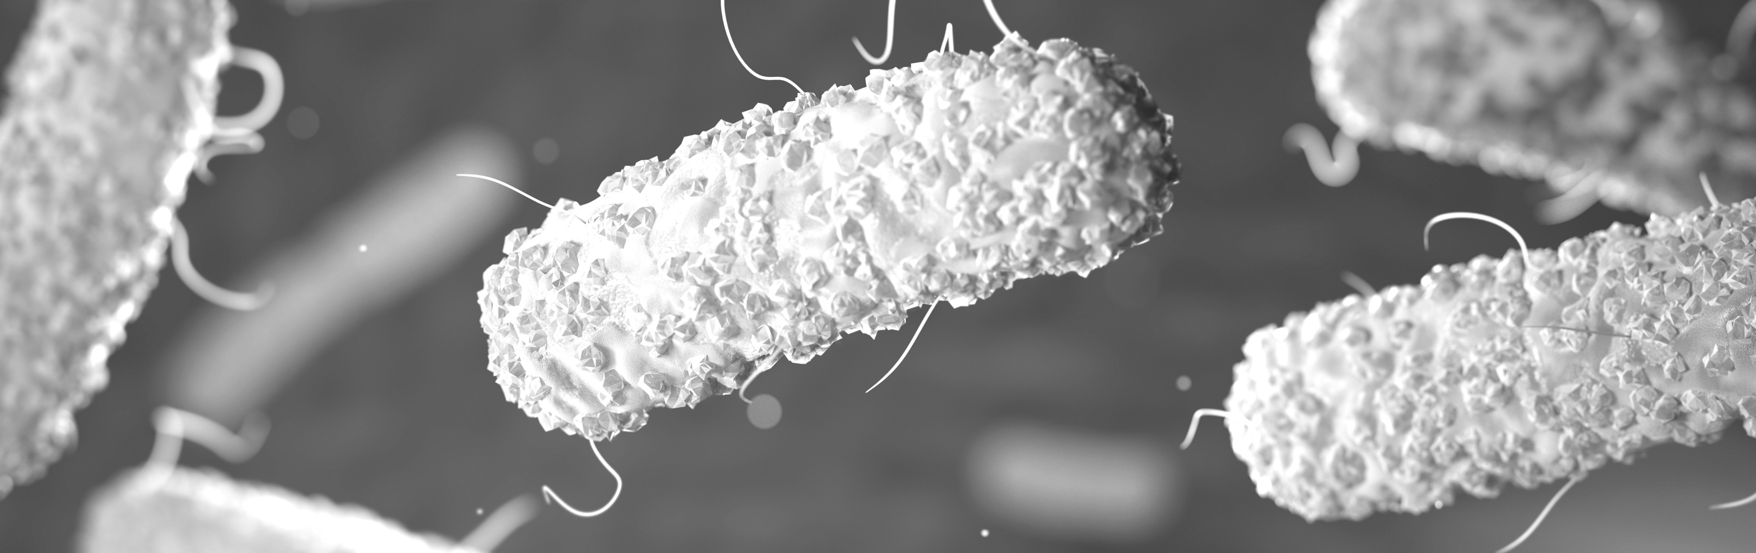

FUNDAMENTALS OF TB
3

Slide 4
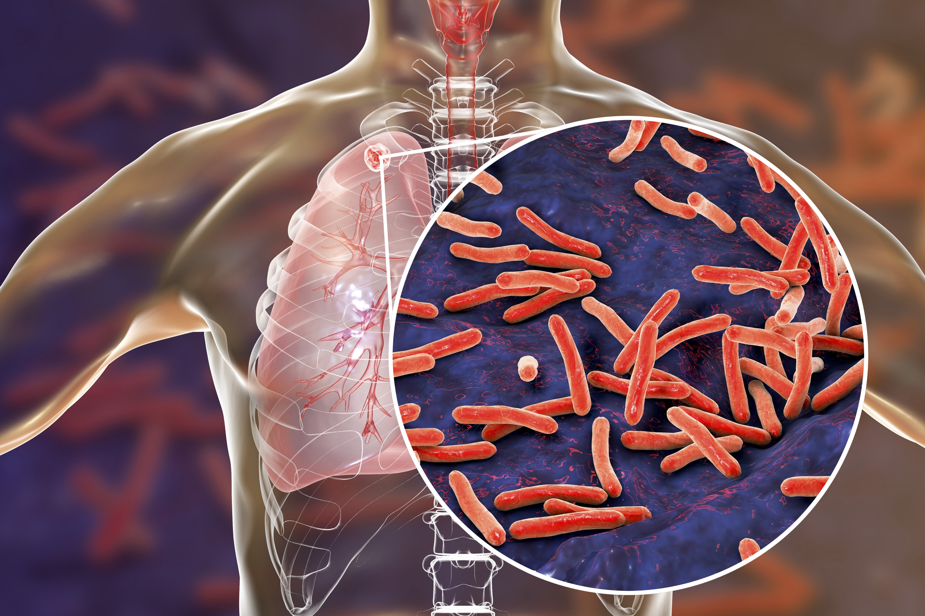
FUNDAMENTALS
What is Tuberculosis?
Tuberculosis, commonly known as TB, is a disease that most commonly affects the lungs
TB infection is caused by bacteria, called Mycobacterium tuberculosis (MTB)
Under a microscope, MTB is identified by its long, rod-like shape and its waxy appearance
4
Notes:
The MTB bacteria is named for both its appearance (myco meaning “waxy” in Latin) and the disease it causes (tuberculosis).
TB bacilli are rod-shaped organisms -the term bacilli refers to the “rod shape.”

Slide 5
FUNDAMENTALS
Bacteria are single-celled organisms, able to survive either independently or dependent on another organism to carry out life functions
Like viruses, bacteria can be beneficial, harmful, or neutral to the human body
  Humans require several bacteria and viruses to carry out bodily functions, like digestion or reproduction
  MTB is often harmful to the human body
  MTB are commonly referred to as TB bacilli
  The thick, waxy cell wall allows the TB germ to spread through the air and survive for days outside of the body
MTB,
the TB-causing bacterium
5
Notes:
Not all mycobacterias are harmful but MTB is the most harmful to humans

Slide 6
TRANSMISSION OF TB
6
Notes:
Ask participants how TB is transmitted?

Slide 7
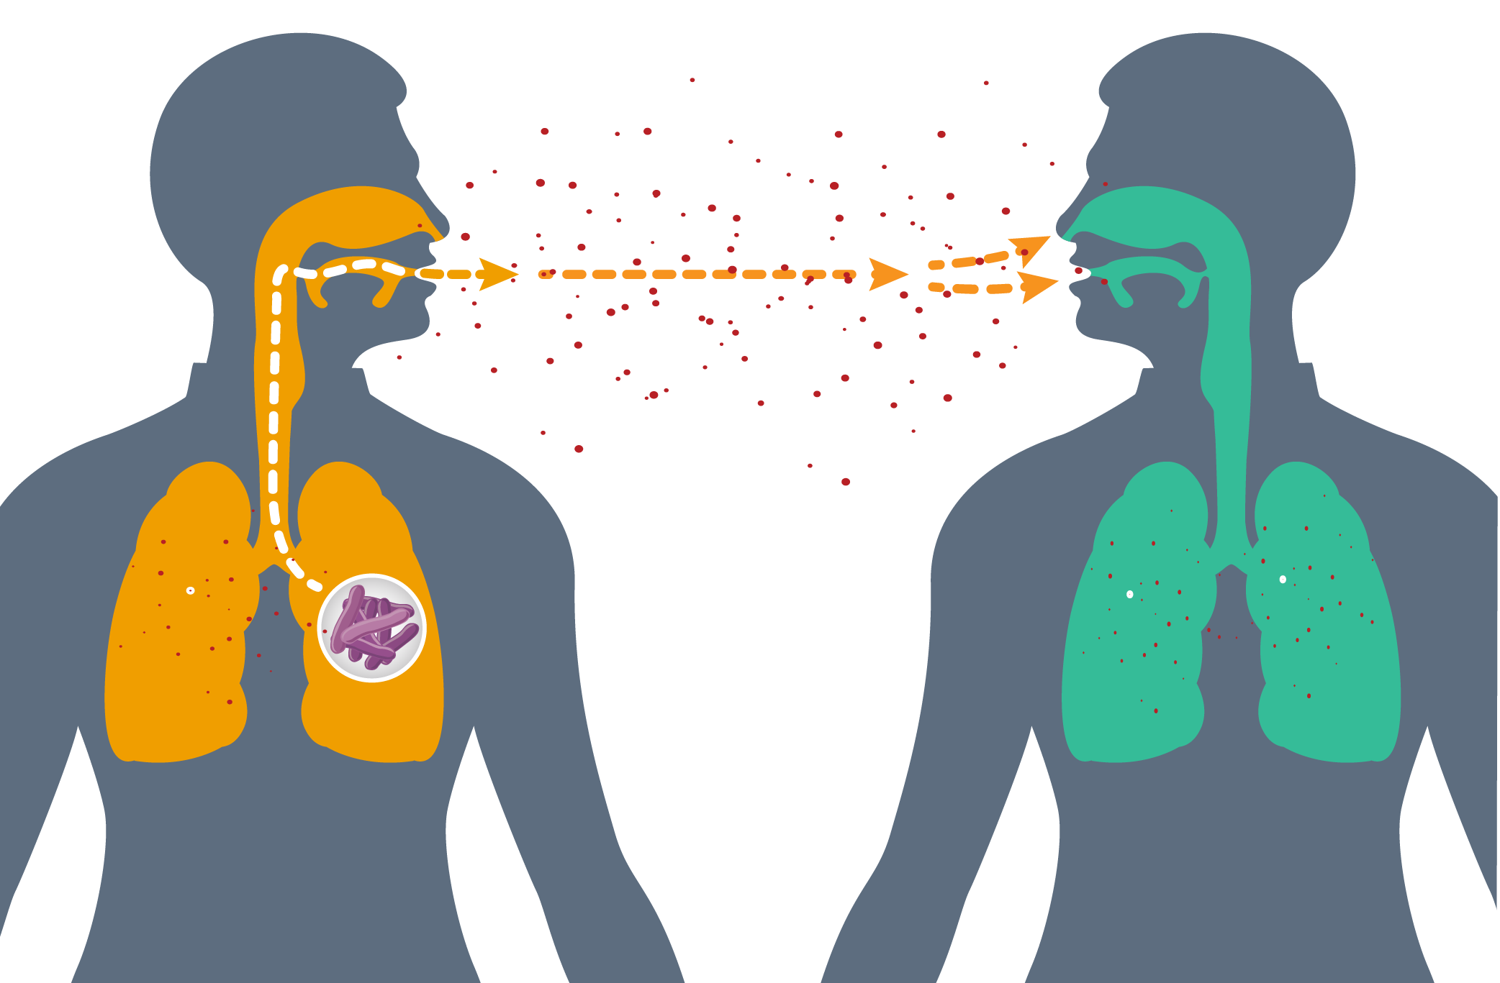
TRANSMISSION
How is TB Transmitted?
TB is passed (transmitted) through the air when someone who is infected coughs, sneezes, shouts, or sings
Droplets of saliva contain thousands of
TB bacilli
Once inhaled, the droplets push their way into the lungs, settling in tiny air sacs (alveoli)
TB is NOT spread through touch, blood, sperm, vaginal fluids, food or liquids, sharing utensils, dust, dirt, or vehicle fumes
7
Notes:
TB loves oxygen. So it often initially takes root in the oxygen-filled regions of the lungs.
To get inside the lungs, TB typically travels through the nose and mouth.

Slide 8
TRANSMISSION
Factors related to the person with TB (index case):
  Bacillary count/load (amount of MTB in the body)
  Presence of TB in lungs (pulmonary TB) and a cough
  Being on effective TB medication
    After 2-3 weeks on an effective treatment regimen, people are usually not infectious anymore, though must continue treatment through cure
  Wearing a mask
What Affects Transmission?
Factors related to the person being exposed to TB (contact):
  Closeness and frequency of contact with index case
  Age of contact (children and older persons are more likely to develop TB)
  Wearing an N-95 respirator (special kind of mask)
Environmental factors:
  ventilation
  size of room or space
  duration of exposure
  sunlight or ultraviolet (UV) light (sunlight/UV light kills TB bacteria)
8

Slide 9
TB is a virus.
  True
  False
TB is passed (transmitted) when someone who is infected:
  Coughs
  Sneezes
  Shares utensils
  All of the above
Which of the following affects TB transmission?
  Bacillary load
  Closeness + frequency of contact
  Drug-resistance
  All of the above
9
Notes:
ANSWER KEY:
(b) false – TB is a bacterium
(a) coughs and (b) sneezes
(a) bacillary load and (b) closeness + frequency of contact

Slide 10
THE IMMUNE RESPONSE TO TB
10

Slide 11
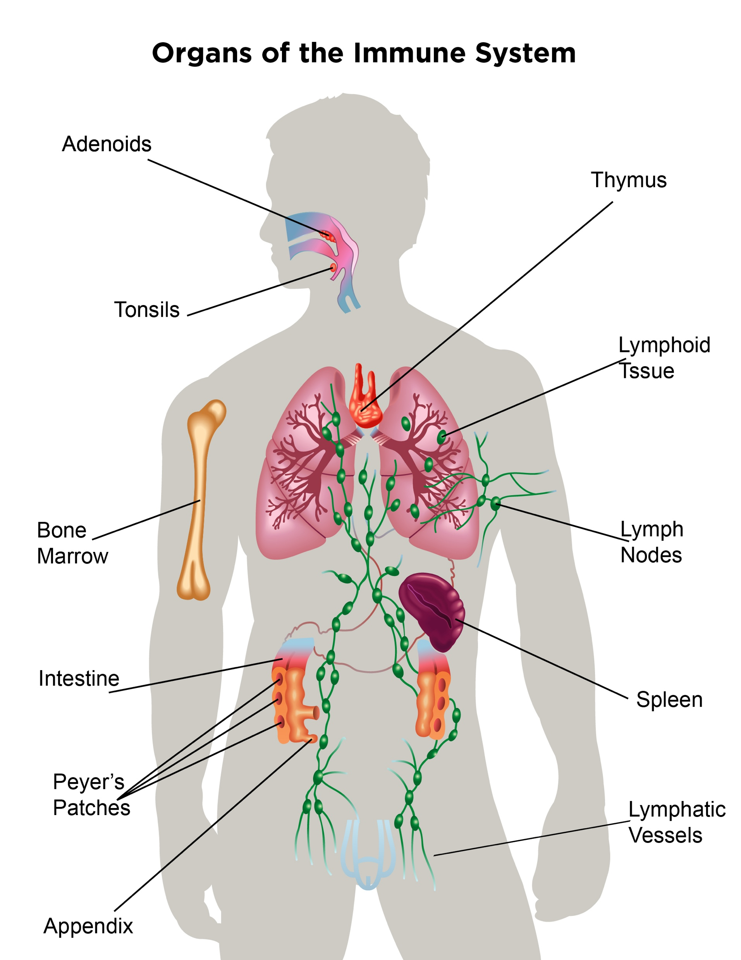
IMMUNE RESPONSE
The Immune Response To TB
The immune system detects foreign particles in the body and triggers an immune response in order to remove them
In a healthy individual, the immune system coordinates different cells to act together in order to identify and remove a potentially harmful agent
When an individual is exposed to TB, the immune system is activated
11

Slide 12
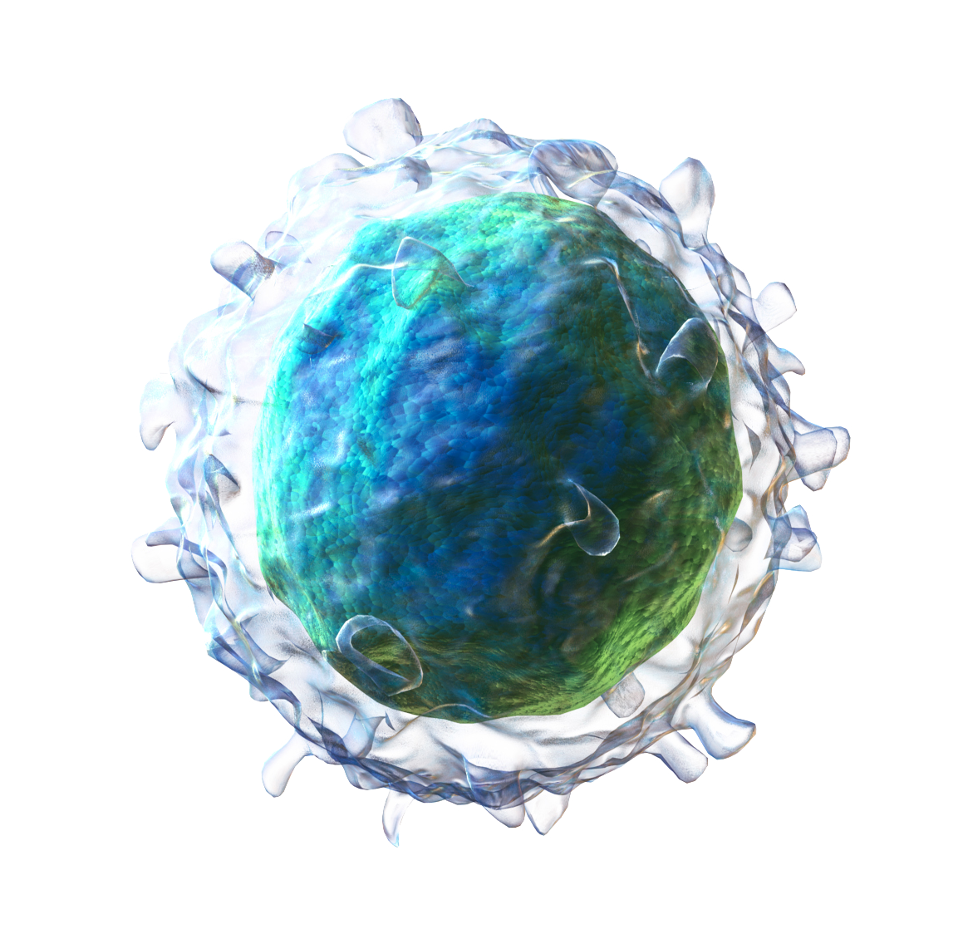
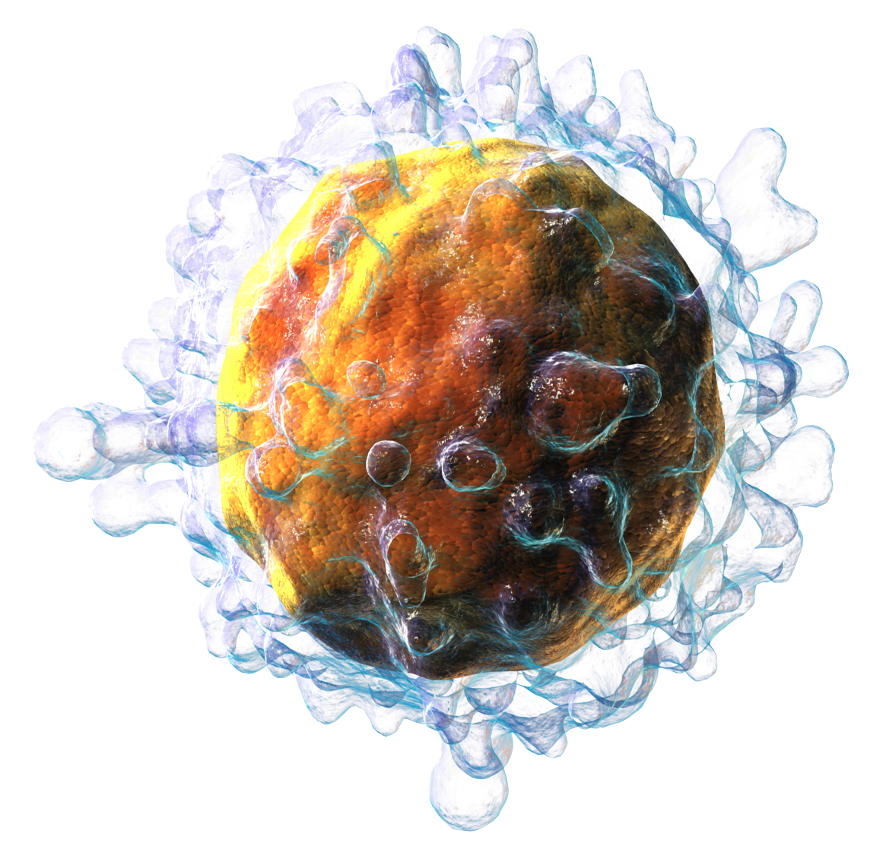
IMMUNE RESPONSE
ANTIGEN-PRESENTING CELLS - (macrophages
and dendritic cells) patrol the body looking for germs
CD4 T-CELLS - act as coordinator of the immune response instructing other cells to attack specific invading germs
CYTOTOXIC T-CELLS - are involved in cell-to-cell killing, when ordered by CD4 T-cells they seek out
and destroy cells that have been infected by a specific germ
B CELLS - are immune cells that, when instructed
by the CD4 T-cells, make antibodies
ANTIBODIES – are proteins that attach to their specific germs, marking them for destruction by the immune system or stopping their ability to reproduce
The Immune System
12
Notes:
When TB gets into a person’s body, the immune system will try and get rid of it.
To do this, the immune system sends out an army of immune cells. The first wave of cells will include cells known as dendritic cells and macrophages. These cells are also known as antigen-presenting cells, and guard against foreign invaders entering the body.
Antigen-presenting cells can be thought of as the “advance scouts” of the immune system. They patrol areas of the body where invading microbes are found, looking for anything that is not supposed to be there. Dendritic cells use long tentacles, called dendrites, to grab TB bacilli while macrophages engulf TB.
Macrophages are large cells that eat microbes. Macro means “large” and phage means “eat.”
Dendritic cells are a type of antigen-presenting cell, and have long, stringlike projections from their cell bodies called dendrites. These dendrites act like the strings on a mop, grabbing a hold of invading organisms to transport them to the CD4 T cell.
Macrophages are a type of antigen-presenting cell, they are large (macro) cells that engulf (phage meaning “to eat”) invading organisms and bring them to the coordinating cell of the immune system, the CD4 T cell.

Slide 13
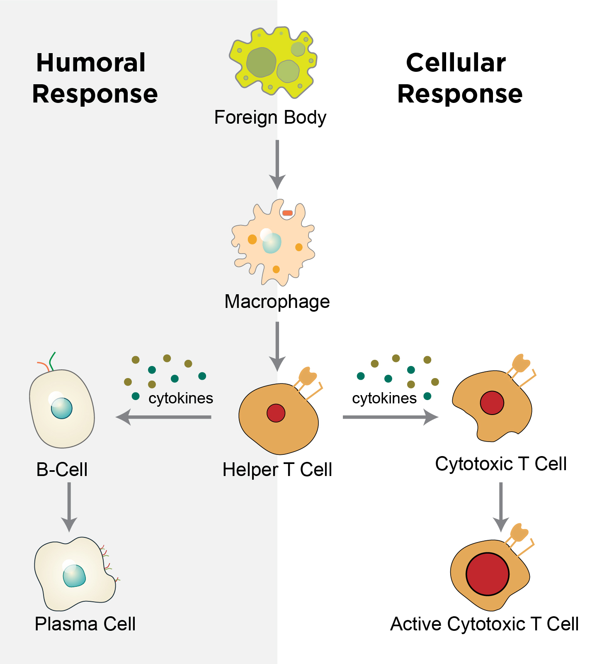
IMMUNE RESPONSE
The Immune Response to TB
The antigen presenting cells (dendritic cells and macrophages) transport TB to the lymph nodes, acting as the communication and meeting center for the immune system
In the lymph nodes, the cells chop up the TB bacilli and present it to the (helper) CD4 T-cell to coordinate the immune response
Cytotoxic T-cells are activated to kill cells infected with TB bacilli and B cells release antibodies, which also target infected cells to kill
13

Slide 14
TB INFECTION VS. TB DISEASE
14

Slide 15
INFECTION VS DISEASE
There is a difference between TB INFECTION and
TB DISEASE
  It is possible to be infected with TB and
  not develop TB disease
  About 10% of people living with TB infection
  develop TB disease
  People can progress directly to developing active
  disease without having a long “latent” period
[Latent] TB infection (LTBI) refers to the period when the immune system is successful in containing the TB and preventing progression to disease
  The TB bacilli remains encased in a hard shell,
  called a tubercle
Active TB disease refers to the time when TB is no longer contained by the immune system and causes disease
These were previously thought to be two different disease states; now they are thought to be part of a disease spectrum, in which “latent” TB could be early-stage
(“sub-clinical”) active TB with a smaller number of bacteria
TB Infection vs. Disease
15
Notes:
Latent TB infection and active disease are defined by whether the TB bacteria are in a state of latency and contained by the immune system or actively replicating and causing damage and disease in the body
Both forms of TB require treatment
The medicines used to treat latent TB infection, often referred to as TB Preventive Therapy or TPT are the same medicines used to treat active disease, the regimens however for TB prevention are composed of fewer medicines and taken for shorter durations
Latent TB and active disease were previously thought of as two distinct and binary states, but research has shown that it is in fact more of a spectrum, with latent TB as a form of early, sub-clinical disease.
Of note, it is possible to be infected with TB and to not go on to develop disease. In fact one third of the global population is estimated to have latent TB infection. But only 10% of people with latent infection go on to develop active disease. This process is often referred to as progression to active disease. A compromised immune system and other stressors increase our risk for progressing from infection to disease.
The good news is that treating TB infection prevents progression to active TB disease.

Slide 16
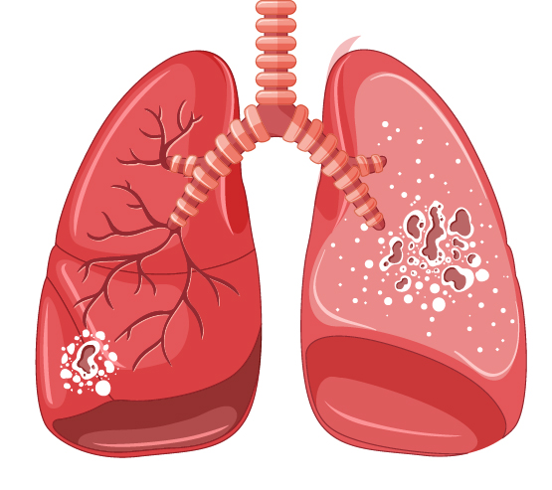
INFECTION VS DISEASE
(Latent)TB Infection vs.
(Active) TB Disease
Latent TB
TB Disease
TB lives but doesn’t grow in the body
Doesn’t make a person feel sick or have symptoms
Can’t spread from person to person
Can advance to TB disease
TB is active and grown in the body
Makes a person feel sick and have symptoms
Can spread from person to person
Can cause death if not treated
16
Notes:
To quickly recap the main points of difference:
Latent TB is not replicating or growing, whereas for active TB it is
Latent TB does not make you feel sick or experience symptoms, whereas active TB does
Latent TB is non-infectious, whereas active TB can spread from person to person
If left untreated, latent TB can progress and become active TB, whereas if active TB is left untreated it will likely kill you, in most cases, slowly and with much suffering.

Slide 17
INFECTION VS DISEASE
TB infection can progress to active disease when the body becomes weak, for example from malnutrition, immune suppression, or advanced age
Among people living with HIV and without reliable access to effective HIV treatment, the immune system becomes compromised and more vulnerable to the progression of TB infection into active TB
  TB is a common co-infection among, and the leading killer of, people living with HIV
  People living with HIV are up to 21X more likely to develop TB disease than people without HIV
Young children are up to 10X more likely to develop TB and tend to develop more severe forms of TB
Progression to TB Disease
17

Slide 18
INFECTION VS DISEASE
Active TB disease affects the lungs (pulmonary TB) or other parts of the body (extrapulmonary TB)
Pulmonary TB is the most common form of TB disease
Extrapulmonary TB (EPTB) can occur in all populations affected by TB, but is most common among young children and in people living with HIV (~40% of TB cases among people living with HIV involve extrapulmonary TB)
  EPTB usually takes place in multiple organs
  in people with HIV
Individuals can have pulmonary TB, EPTB, or both
(Active) Pulmonary vs. Extrapulmonary TB Disease
18

Slide 19
INFECTION VS DISEASE
When exposed to
TB, young children
(< five years) cannot usually mount
a robust immune response. For this reason, they are more likely to develop severe forms of TB, including TB outside of the lungs (extra-pulmonary TB).
Children who
are immuno-
compromised
due to HIV, malnutrition, or other sicknesses
are also at risk
for developing
more severe
forms of TB.
Immune Response in Children
A functional immune system takes many years to develop in a child.
As children age
and their
immune systems
develop, they
can better
control TB when exposed. If they get sick, they tend to have a disease that is more like adults.
Adolescents (ages
10 to 18 years)
are more likely
to develop TB.
This may be due
to the impact of hormones/ puberty on the immune response to TB and increased social activity.
19

Slide 20
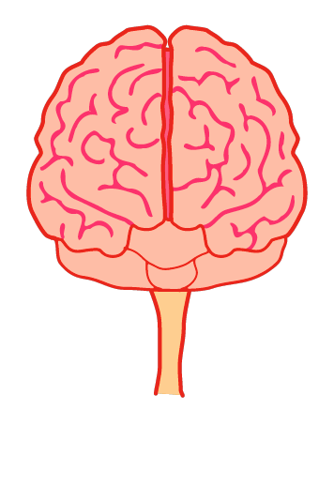
INFECTION VS DISEASE
TB meningitis (TB in the brain/nervous system)
70-80% of children with TB have TB in the chest and lungs (pulmonary TB)
TB in Children
Miliary or disseminated TB (TB throughout the body)
Pott’s disease (TB in the bones and spine)
Children can become sick from a smaller number of TB germs (paucibacillary TB)
TB can cause disease in any part of the body, but the most worrisome kinds are:
Children are more likely than adults to develop TB outside of the lungs—
or what is called extra-pulmonary TB
20
Notes:
Forms of TB outside the lungs are more common among children
Still 70-80% of children with TB will have TB in the chest and lungs

Slide 21
It is possible to be infected with TB but to not have symptoms or disease.
  True
  False
Which of the following can affect an individual’s risk
of TB infection progressing to active disease?
  HIV
  Malnutrition
  Age
  All of the above
Miliary TB is in what part(s) of the body?
  Brain and nervous system
  Bones and spine
  Disseminated throughout the body
  Lungs
21
Notes:
ANSWER KEY:
1. (a) true
2. (d) all of the above
3. (c) disseminated throughout the body

Slide 22
DRUG-SENSITIVE VS. DRUG-RESISTANT TB
22
Notes:
Exercise: Ask participants to define MDR-TB and XDR-TB…what drugs does one have to be resistant to?

Slide 23
DRUG-SENSITIVE
VS. RESISTANT TB
Drug-resistant TB (DR-TB) means a strain of MTB has mutated (changed) in a way that helps it evade or resist being killed by a specific drug(s)
Resistance to TB drugs can be naturally occurring (“wild type”) or develop over time as a result of inadequate or irregular TB drug exposures, e.g., from:
  Incorrect prescription by healthcare provider
  Poor quality drugs resulting in inadequate drug levels / exposures
  Drug shortages resulting in treatment interruption / discontinuation
  Lack of adherence to the treatment
Most DR-TB is transmitted (primary resistance) rather than developed (secondary resistance)
Treatment for DR-TB is longer, more expensive, and harder to tolerate than treatment for drug-sensitive TB
DR-TB is generally separated into four groups, defined by the medicine(s) to which TB bacteria are resistant
Drug Resistance
23
Notes:
23

Slide 24
DRUG-SENSITIVE
VS. RESISTANT TB
Defining Drug-Resistant TB (DR-TB)
DS-TB
MDR-TB
Pre-XDR-TB
XDR-TB
rifampicin
rifampicin
rifampicin
rifampicin
isoniazid
isoniazid
isoniazid
isoniazid
fluoroquinolone
fluoroquinolone
fluoroquinolone
fluoroquinolone
aminoglycoside
aminoglycoside
aminoglycoside
aminoglycoside
2020
2021
DS-TB
MDR-TB
Pre-XDR-TB
XDR-TB
rifampicin
rifampicin
rifampicin
rifampicin
isoniazid
isoniazid
isoniazid
isoniazid
fluoroquinolone
fluoroquinolone
fluoroquinolone
fluoroquinolone
Group A drugs
(bedaquiline, linezolid)
Group A drugs
(bedaquiline, linezolid)
Group A drugs
(bedaquiline, linezolid)
Group A drugs
(bedaquiline, linezolid)
24
Notes:
Before we get into the standard of care diagnostics and treatments for drug-sensitive and drug-resistant TB, it’s important to understand that there are multiple forms of drug-resistance, each defined by the drugs that will not work.
So drug sensitive or drug-susceptible TB, represented by DS-TB, is TB that is not resistant to anything – our two most powerful drugs, isoniazid and rifampicin will work.
Multidrug-resistant TB or MDR-TB, is TB that is resistant BOTH isoniazid and rifampicin; neither drug will work against this form of TB.
In 2021, the WHO updated the definitions of pre-X and XDR-TB:
Pre-extensively drug-resistant TB, represented by pre-XDR-TB, used to be defined as TB that is multidrug-resistant, so resistant to BOTH isoniazid and rifampicin, AND resistant to one of two other important classes of drugs, the fluroquinolones (levofloxacin or moxifloxacin) OR the aminoglycosides, also commonly referred to as the second-line injectables. It is now defined as MDR-TB (resistant to BOTH isoniazid and rifampicin) with additional resistance to fluoroquinolones (i.e., moxifloxacin or levofloxacin)
Finally, extensively drug-resistant TB, represented by XDR-TB, used to be defined as TB that is multidrug-resistant, so resistant to BOTH isoniazid and rifampicin, AND resistant to BOTH fluroquinolones and second-line injectable agents. It is not defined as MDR-TB with additional resistance to fluoroquinolones (pre-XDR-TB) AND resistance to other Group A drugs (i.e., bedaquiline and/or linezolid).
Similar to how rifampicin and isoniazid make up the backbone of treatment for drug-sensitive TB, the fluoroquinolones and group A drugs (e.g., bedaquiline) now make up the backbone of treatment for drug-resistant TB. The second-line injectables used to be very important for the treatment of drug-resistant TB but we have since learned that the second-line injectables are not that great, and can cause permanent harm (hearing loss), so these are no longer a part of the standard of care and the definitions have finally caught up to the science and new standard of care.
What remains most important in defining the type of drug-resistant TB we are talking about, and the corresponding standard of care regimens available, is fluoroquinolone resistance (more on this in the training module focused on TB treatment).
24

Slide 25
DRUG-SENSITIVE
VS. RESISTANT TB
TB Treatment Regimens
DRUG-SENSITIVE TB (DS-TB)
4–6 months
4 drugs
first-line medicines
DRUG-RESISTANT TB (DR-TB)
6–20 months
3–8 drugs
second-line, new / repurposed medicines
H = isoniazid
R = rifampicin
Z = pyrazinamide
E = ethambutol
P = rifapentine
M = moxifloxacin
Bdq, J = bedaquiline
Lz, Lzd = linezolid
L, Lx, Lfx = levofloxacin
M, Mx, Mfx = moxifloxacin
C, Cs = cycloserine
Dlm, D = delamanid
Pa = pretomanid
Am = amikacin
Eto = ethionamide
Pto = prothionamide
… see module on TB Treatment for more information / detailed explanation.
25
Notes:
25

Slide 26
Drug-resistant TB is less likely to be transmitted between people.
  True
  False
How does drug resistance develop?
  Inadequate drug exposures
  Prescription for inappropriate/weak regimen
  Inconsistent adherence to treatment
  Naturally occurring mutations
XDR-TB is resistant to which of the following medicines?
  rifampicin
  isoniazid
  moxifloxacin
  bedaquiline
  All of the above
26
Notes:
ANSWER KEY:
1. (b) false
2. a, b, c, d – all answers are correct and can contribute to drug-resistance
3. (e) All of the above – rifampicin, isoniazid, moxifloxacin, bedaquiline

Slide 27
GLOBAL STATISTICS
27

Slide 28
STATISTICS
Global Estimates of TB
It is estimated that one-fourth of
the world
is infected
with TB
(latent TB infection)
There were
an estimated 10.0 million new cases of TB in 2019 (active TB disease),
among which 500,000 had drug-resistant TB
An estimated
1.2 million children
became sick
with TB in 2019 (children
account for
12% of the
global disease burden)
There were an estimated
1.2 million deaths from
TB in 2019 (nearly 5,000 deaths per day)
  TB is the number one killer of people living with HIV, accounting for an additional 208,000 deaths in 2019
  Until recently overtaken by COVID-19, TB was the leading infectious cause of death worldwide
Geographically, most people who developed TB in 2019 were in
South-East Asia (44%), Africa
(25%), and the
Western Pacific regions (18%)
28

Slide 29
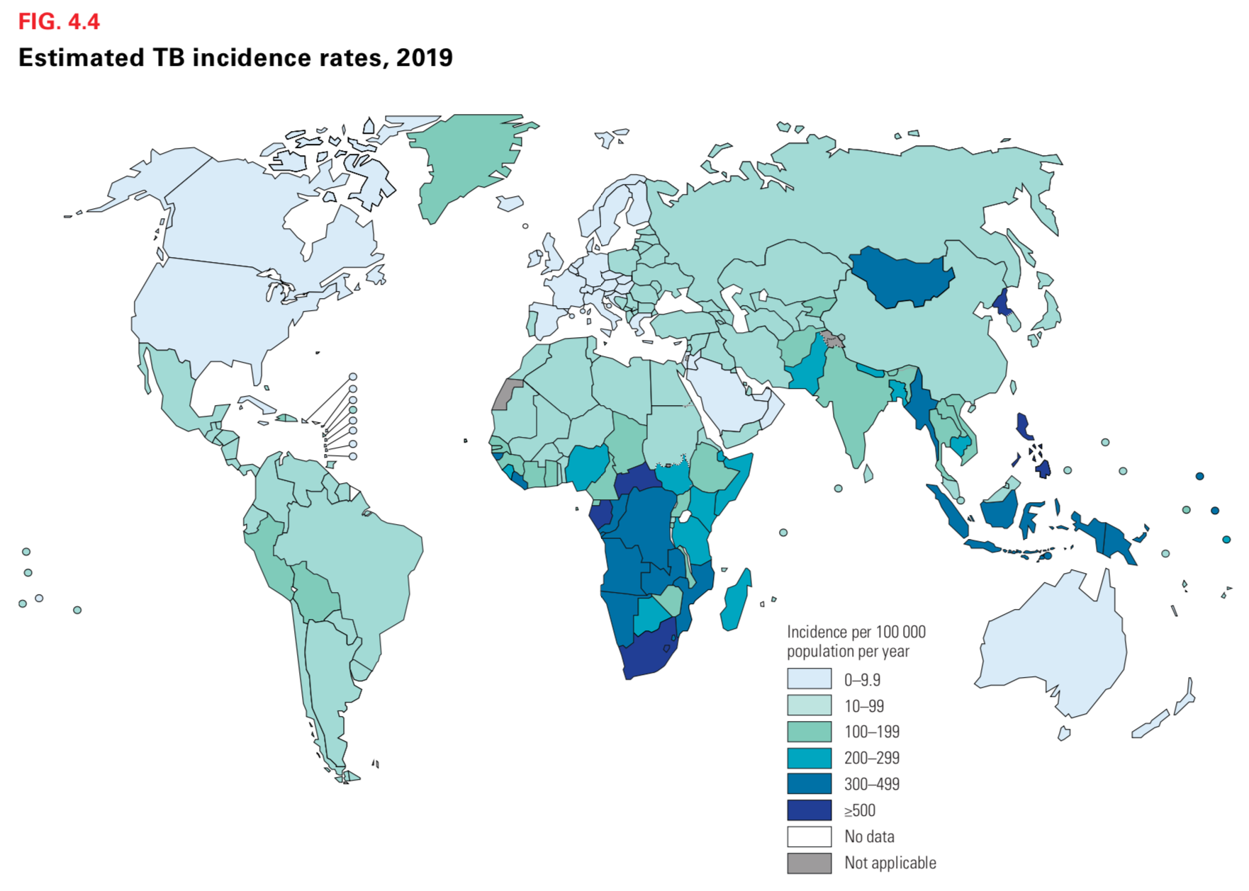
29
2020 WHO Global TB Report
Notes:
29

Slide 30
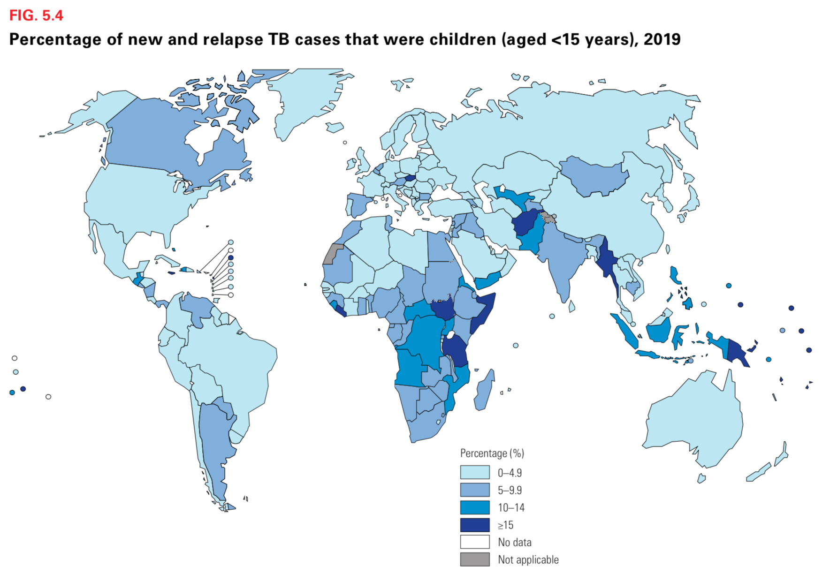
30
2020 WHO Global TB Report
STATISTICS
Notes:
30

Slide 31
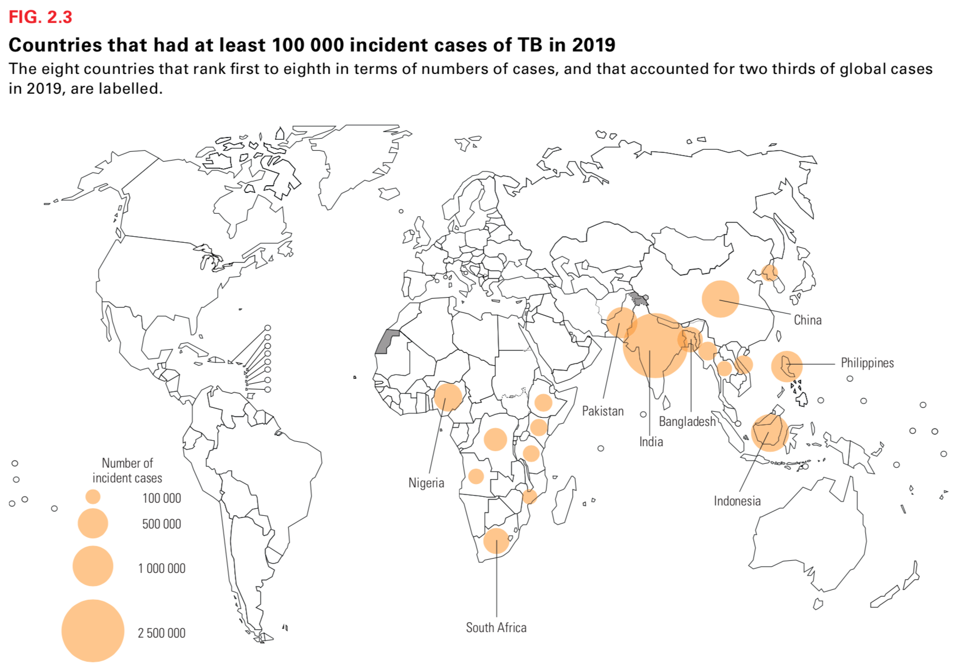
8 countries contain 67% of new cases
India. • China
Indonesia • The Philippines
Pakistan. • Nigeria
Bangladesh • South Africa
31
2020 WHO Global TB Report
Notes:
31

Slide 32
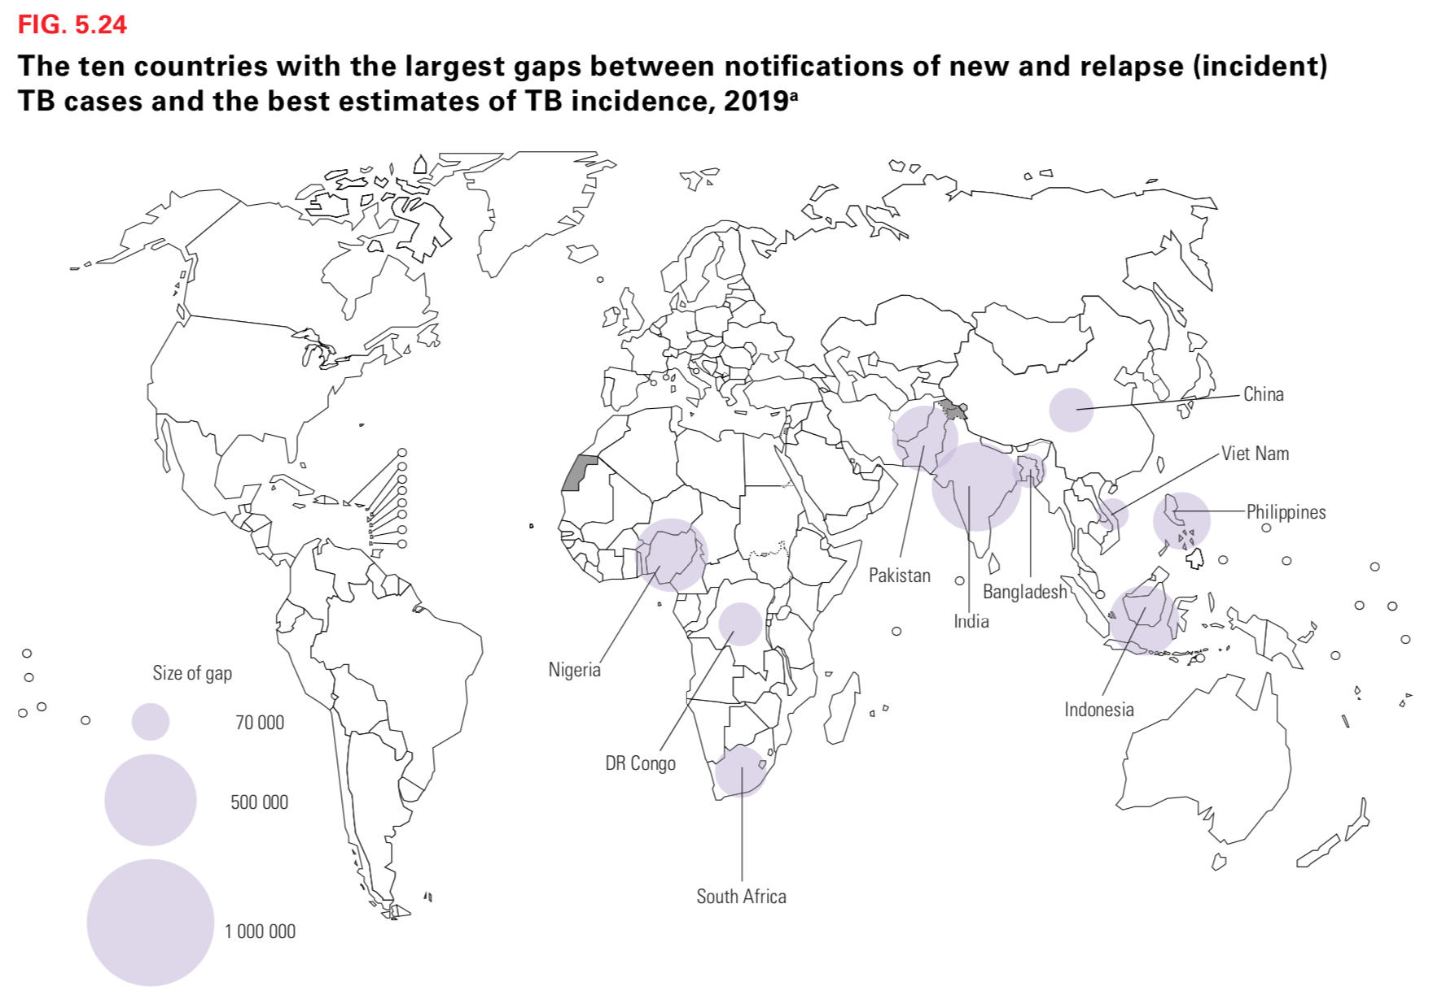
32
2020 WHO Global TB Report
Notes:
32

Slide 33
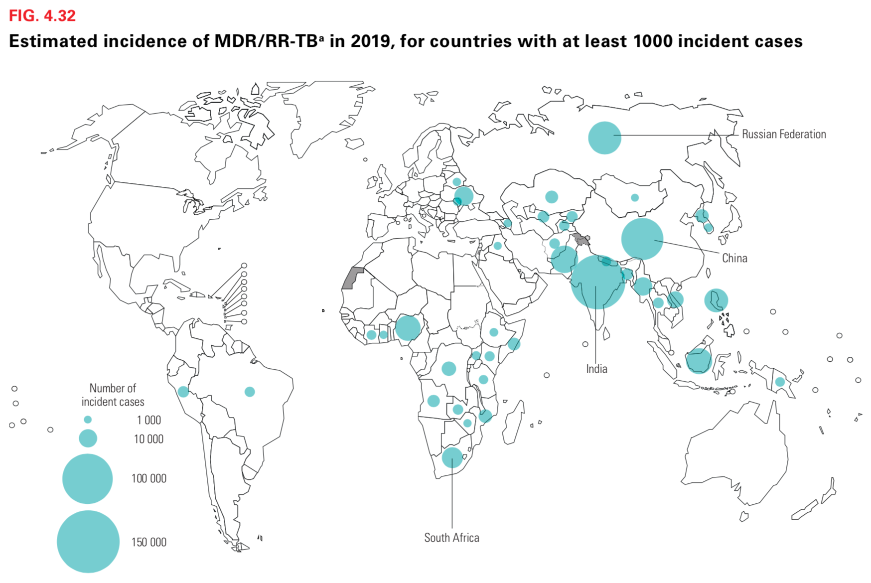
33
2020 WHO Global TB Report
Notes:
33

Slide 34
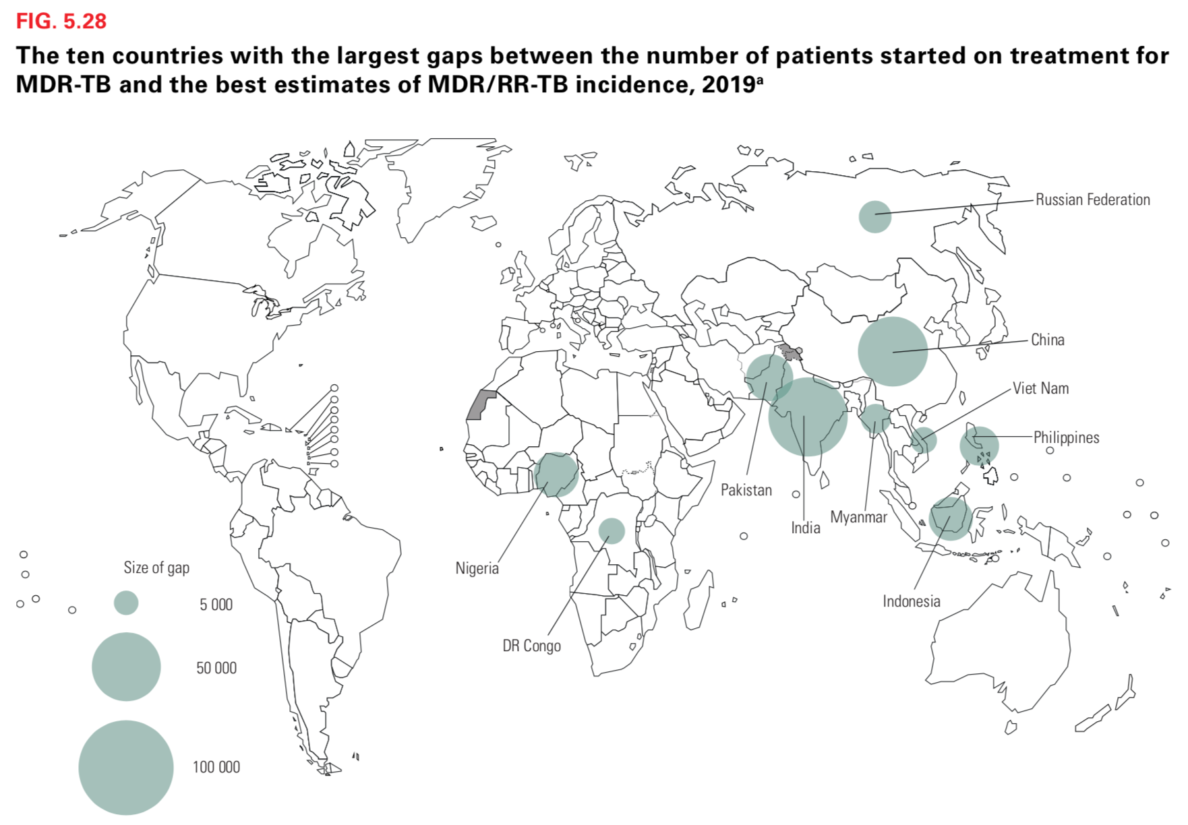
34
2020 WHO Global TB Report
Notes:
34

Slide 35
35
Notes:
35

Slide 36
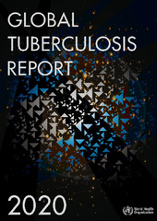
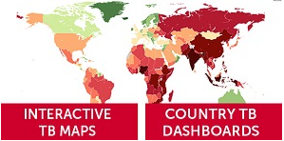
STATISTICS
See Full Report and Country Profiles:
https://www.who.int/teams/global-tuberculosis-programme/tb-reports/global-tuberculosis-report-2020
Where
to Find Country-level Statistics/ Information
See Interactive Maps and Country TB Dashboards:
http://www.stoptb.org/resources/cd/
36
Notes:
36

Slide 37
TB AND COVID-19
37

Slide 38
TB AND COVID-19
COVID-19 caused by SARS-CoV-2 is a respiratory pathogen that emerged in late 2019 and has caused sickness in millions of persons worldwide;
Symptoms of COVID-19 and TB may overlap (e.g., fever, cough), and persons being tested for COVID-19 should be tested for TB (many platforms used for TB testing can also be used for COVID-19 testing, e.g., GeneXpert);
Persons with current TB or a history of TB may be at increased risk of poor outcomes if they become sick with COVID-19 so should take extra care to practice mask-wearing, social distancing, and other protective behaviors;
The global COVID-19 pandemic has put at risk many of the strides made in addressing TB on a global level
WHO model estimates that a 25% drop in the number of people diagnosed and treated for TB over a three-month period will result in 200,000 excess TB deaths (rolling global progress against TB back to where we were in 2015)
STBP model predicts that COVID-19 could cause an additional 6.3 million TB cases globally between 2020 and 2025
TB and COVID-19
38
38
Notes:
QUESTIONS FOR FACILITATED GROUP DISCUSSION
What are some of the ways the COVID-19 pandemic might impact the number of people who develop TB each year?
-lockdowns increasing household exposure to TB or worsening treatment outcomes / making medications harder to get and/or healthcare workers harder to reach
-economic contractions / loss of income worsening socio-economic factors that contribute to TB
How have access to health services been impacted in your community? And /or how have programs adapted?
-reallocation of staff / facilities?
-reallocation of GeneXpert machines?
-dispensing supplies of medicines that can last longer?
-reducing number of visits to healthcare center? Using digital technologies?
How can this information help support TB advocacy at the local level? At the national level?
-inform asks to policy and other decision makers
-support changes to how health services are offered / delivered within the community
-help increase / adjust funding allocations
38

Slide 39
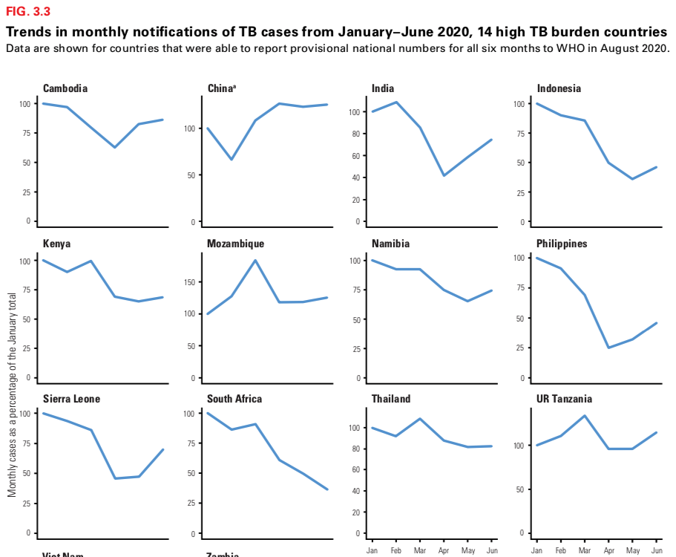
TB AND COVID-19
39
2020 WHO Global TB Report
Notes:
39

Slide 40
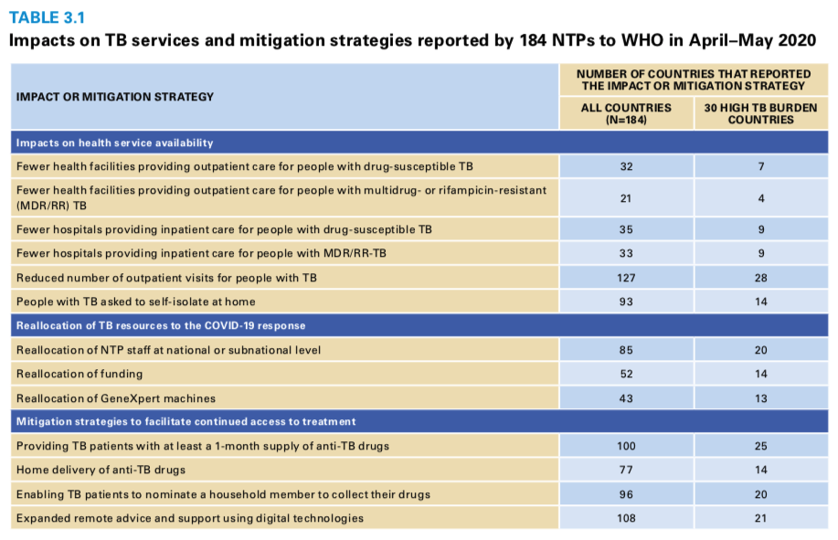
TB AND COVID-19
40
2020 WHO Global TB Report
Notes:
40

Slide 41
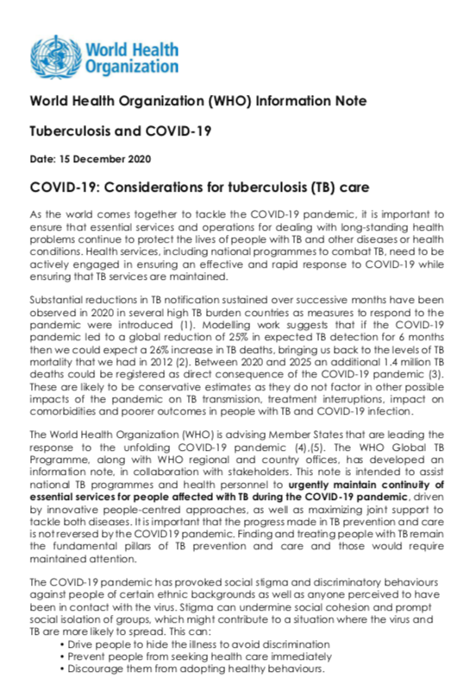
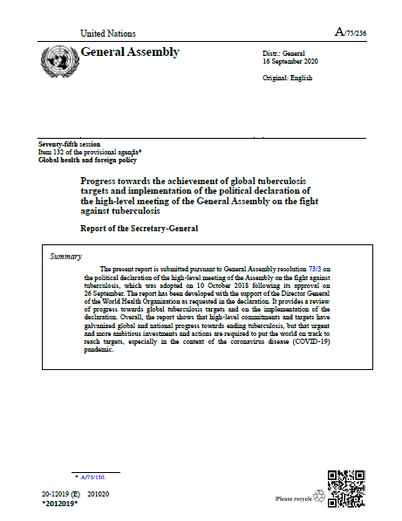
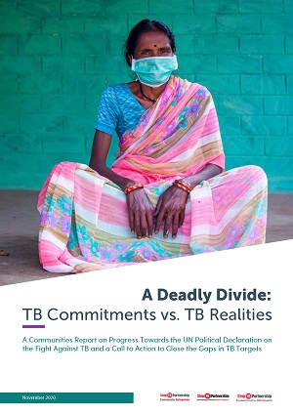
TB AND COVID-19
2020 WHO Global TB Report, Chapter 3: https://www.who.int/teams/global-tuberculosis-programme/tb-reports/global-tuberculosis-report-2020
More Information and Resources
WHO TB and COVID-19 Resource Page: https://www.who.int/teams/global-tuberculosis-programme/covid-19
2020 UNSG Report on TB: https://www.who.int/news/item/21-10-2020-un-secretary-general-outlines-priority-recommendations-to-accelerate-the-tb-response-and-reach-targets
A Deadly Divide: TB Commitments vs.
TB Realities:
http://www.stoptb.org/communities/divide.asp
41
Notes:
41

Slide 42
KEY TAKEAWAYS
42

Slide 43
KEY TAKEAWAYS
The Main Points
1
3
4
5
Tuberculosis (TB)
is a disease caused
by the bacteria, Mycobacterium tuberculosis
There is a spectrum of
TB disease,
including:
(Active) TB Disease: when the presence
of MTB causes disease
(Latent) TB Infection: when MTB is present without disease
Drug resistance,
a result of inadequate
or irregular
TB drug exposures,
is on the rise and evolving with increased use of new and repurposed
TB medicines
TB is a common
co-infection among, and the number one killer of, people living with HIV
2
6
TB is spread through saliva droplets in the air when a person sick with pulmonary TB coughs, sneezes, shouts, or sings
Coordinated efforts are needed to address TB
in the era of COVID-19
43

