Slide 1
Tuberculosis (TB) Diagnosis
Treatment Action Group
TB/HIV Advocacy Toolkit
March 2021

Slide 2
Fundamentals of TB Screening & Diagnosis
Screening for Active TB
Diagnosing Active TB
Drug-susceptibility Testing
TB Treatment Monitoring
Testing for TB Infection
Global Statistics
Research
Access to TB Diagnostic Testing
Taking Action
Key Takeaways
Overview
Overview
2

Slide 3
FUNDAMENTALS OF TB
SCREENING & DIAGNOSIS
3

Slide 4
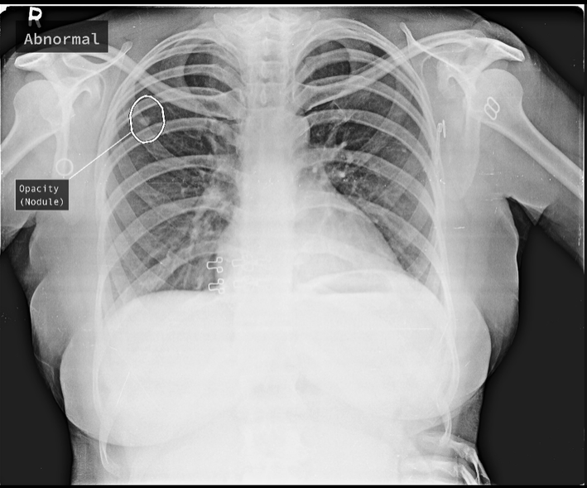
What is Screening?
FUNDAMENTALS
Screening identifies people who may have active TB disease and enables rapid TB diagnosis and treatment initiation. Screening may use various methods such as evaluating symptoms of possible TB and/or chest X-ray
  TB screening can take place as part of routine care in health facilities or in communities
  All people who are at high-risk of TB should be screened for TB, such as people living with HIV (PLHIV) and children who are household contacts of people with active TB
  Screening positive for TB is not a TB diagnosis and requires further diagnostic evaluation for TB
Image copyright qure.ai
4

Slide 5

What is Diagnosis?
FUNDAMENTALS
Diagnosis is the determination that a person has active TB, and results in the clinical decision to initiate treatment
  Diagnosis can be determined following:
    Microbiological confirmation of the presence of TB bacteria using a WHO-recommended diagnostic test; or
    Clinical judgement of the presence of TB based on signs and symptoms and assessed risk of TB, even in the absence of a positive TB diagnostic test result (especially among children and PLHIV)
  Following a positive TB diagnosis, further drug-susceptibility testing is required to identify the most appropriate anti-TB drug treatment regimen
5

Slide 6
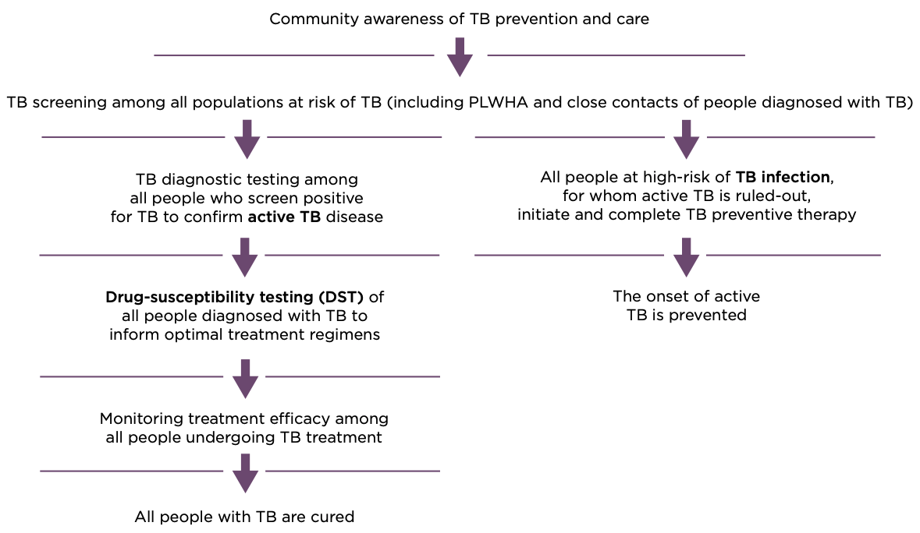
The highest standard of care for TB diagnosis
FUNDAMENTALS
Adapted from TAG’s An Activist’s Guide to Tuberculosis Diagnostic Tools
6

Slide 7
Key Vocabulary
FUNDAMENTALS
Sensitivity: the proportion of people that a test correctly identifies as having a disease or condition
Note: TB screening tools must be sensitive
Specificity: the proportion of people that a test correctly identifies as NOT having a disease or condition condition
Note: TB diagnostic tools must be sensitive and specific
False Negative: when someone who has TB incorrectly receives a negative test result, due to imperfect test sensitivity
False Positive: when someone who does NOT have TB incorrectly receives a positive test result, due to imperfect test specificity
7

Slide 8
Key Vocabulary
FUNDAMENTALS
Microbiological confirmation: diagnosing TB with a sensitive and specific test to confirm the presence of Mycobacterium tuberculosis, the bacterium that causes TB, in a sample by:
  detecting TB DNA (genotypic), or
  by growing and visually seeing TB bacteria (phenotypic)
Drug-susceptibility testing (DST): using genotypic or phenotypic tests to determine if the strains of TB that have infected a person are susceptible or resistant to first-line or second-line anti-TB drugs, to inform the most appropriate treatment
TB biomarker: physical material or a change in the body that can be detected to indirectly point to the presence of TB and/or the severity or stage of TB disease
8

Slide 9
FUNDAMENTALS
Which groups of people should be screened for TB?
  People living with HIV
  Children who are household contacts of people with TB
  People at high risk of TB
  People at low risk of TB
Microbiological confirmation of TB is required in all cases in order to diagnose TB
  True
  False
If a diagnostic test produces a large number of false positive results, it has:
  Low sensitivity
  High sensitivity
  Low specificity
  High specificity
9

Slide 10
SCREENING FOR ACTIVE TB
10

Slide 11
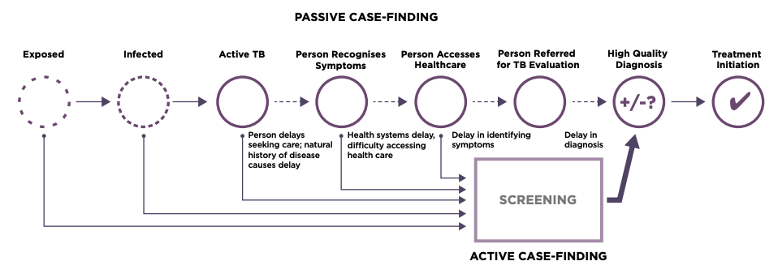
TB Screening Approaches
SCREENING
There are two approaches to screening:
  “passive case-finding”, or waiting for people with TB signs and symptoms to seek care at health facilities, and
  “active case-finding”, or systematically screening high-risk groups for TB in health facilities and in communities. Active case-finding is also called systematic screening
Source: WHO Systematic screening for active tuberculosis: an operational guide, 2015; Adapted from TAG’s An Activist’s Guide to Tuberculosis Diagnostic Tools
11

Slide 12
TB Screening Approaches
SCREENING
High-risk groups should always be systematically screened for TB, including:
    household and close contacts of people with TB
    people living with HIV
    people working in places where they are exposed to high levels of silica (mainly some types of miners)
    people in prisons and penitentiary institutions
Systematic screening may take place in:
    communities
    primary health centers
    hospital outpatient and inpatient departments
    residential institutions
    immigration and refugee service centers
    workplaces with high occupational exposure
12

Slide 13
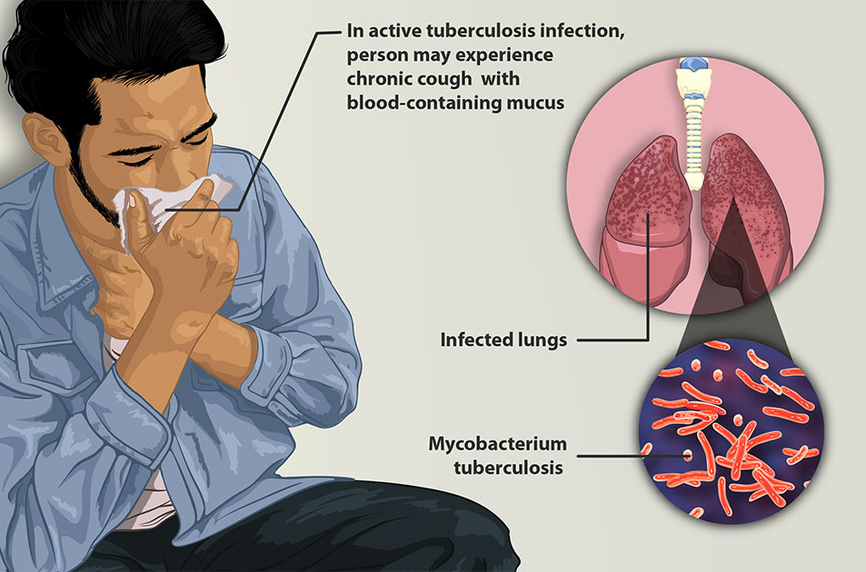
TB Screening Tools
SCREENING
TB screening tools are sensitive, so they cast a wide net to be able to identify people who may have TB, but they are usually not very specific, so can lead to high rates of false positive results
  Symptom screen
    TB symptoms include current cough, hemoptysis (coughing up blood), fever, weight loss, or night sweats
    Evaluation of TB symptoms is the most commonly-used screening tool
Image copyright Recharge Medical
13

Slide 14
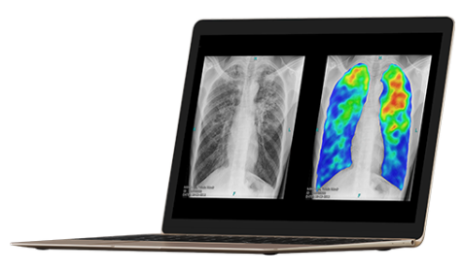
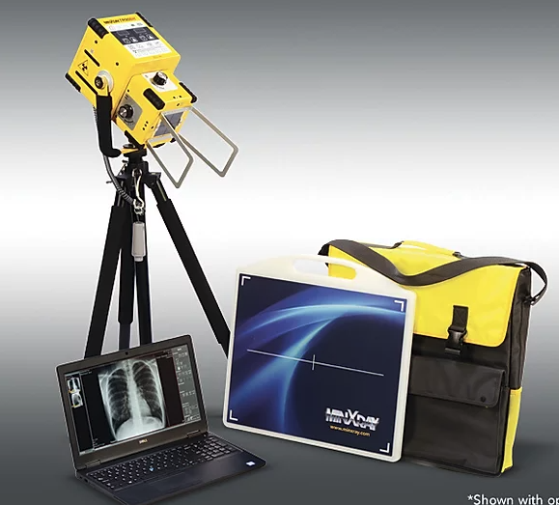
TB Screening Tools
SCREENING
  Chest X-ray
    Chest X-ray, or radiography, produces an image of the internal structures of the lungs to identify abnormalities that may be associated with TB
    Historically, chest X-ray required trained human readers, but now, computer-aided detection (CAD) software can be used to assist healthcare workers to detect abnormalities that may be associated with TB
    Chest X-ray devices are becoming more portable and feasible to implement at the community level
    Chest X-ray can detect lung abnormalities associated with TB even before symptoms appear
Image copyright CAD4TB
Image copyright MinXray
14

Slide 15
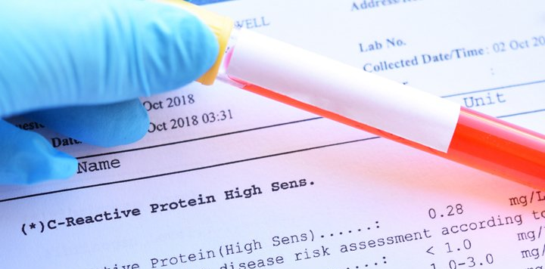
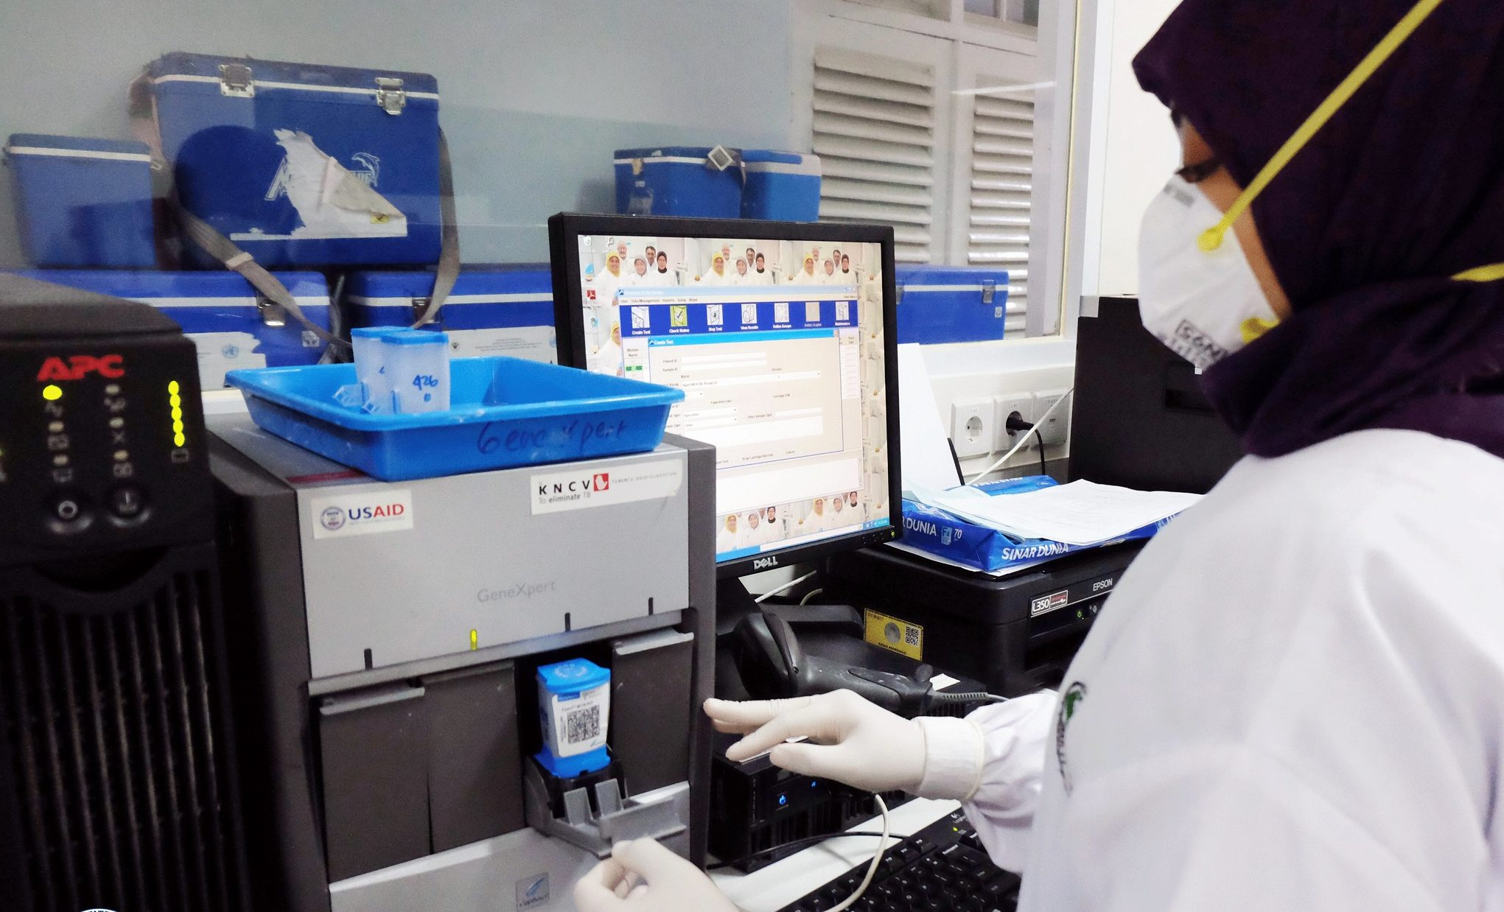
TB Screening Tools
SCREENING
Screening tools for people living with HIV (PLHIV)
  C-reactive protein (CRP)
    CRP is a blood-based test for inflammation in the body that is commonly associated with TB among PLHIV
  Rapid molecular tests
    Rapid molecular tests, such as GeneXpert and Truenat, may be used to screen for TB among all PLHIV, and especially among inpatients
Image copyright Life Extension
Image copyright USAID
15

Slide 16
SCREENING
Systematically screening high-risk groups for TB in health facilities and in communities is known as:
  Systematic screening
  Active case-finding
  Passive case-finding
TB screening tools must be very sensitive to identify people who may have TB, but are usually not very specific, and can lead to high rates of false positive results
  True
  False
Examples of TB screening tools include:
  Symptom screen
  Chest X-ray
  Computer-aided detection (CAD)
  C-reactive protein (among PLHIV)
  Rapid molecular tests (among PLHIV)
16

Slide 17
DIAGNOSING ACTIVE TB
17

Slide 18
How To Diagnose Active TB
DIAGNOSIS
Microbiological confirmation of TB bacteria
  Microbiological confirmation detects the presence of Mycobacterium tuberculosis (MTB) bacteria in a sample. WHO recommends rapid molecular tests (GeneXpert or Truenat) as the initial TB diagnostic test for all people being evaluated for TB
Urine-LAM testing for PLHIV
  Urine-LAM tests can be used to support rapid TB diagnosis and immediate TB treatment initiation among people living with HIV while awaiting results from confirmatory molecular testing. Urine-LAM testing and immediate TB treatment initiation following LAM-positive results has been proven to save lives among people with advanced HIV disease (Gupta-Wright et al, Lancet, July 2018)
Clinical diagnosis
  Even with a negative molecular test result, clinicians may diagnose TB based on signs and symptoms of TB and other risk factors for TB. This is especially the case among PLHIV and children, for whom TB diagnostic tests are generally less sensitive due to the smaller amount of TB bacteria in samples
18

Slide 19
Microbiological Confirmation
DIAGNOSIS
Technologies for microbiological confirmation:
Nucleic Acid Amplification Tests (NAATs)
  NAATs are genotypic molecular tests that extract DNA from a sample, bind with specific sections of TB DNA (also called “genetic targets”), and amplify them in order to detect them. DNA amplification takes place through a process called polymerase chain reaction (PCR)
  NAATs are highly sensitive and specific tests that can produce results within a few hours, and may be used for both TB detection as well as detection of DNA mutations associated with resistance to certain drugs
TB Culture
  TB culture is a phenotypic test that physically grows TB bacteria using a liquid or solid medium in order to visually detect it; TB culture takes between 2 to 6 weeks for results, so is not appropriate to be used as an initial TB test
  TB culture is the most sensitive and specific TB test, and as such is generally used as the reference standard for determining the sensitivity and specificity of other TB diagnostic tests
  TB culture may also be used for drug-susceptibility testing
19

Slide 20
Obtaining Samples For Testing (1/2)
DIAGNOSIS
Diagnostic testing for TB requires obtaining samples from parts of the body that are affected by TB or where biomarkers for TB may be detected
Pulmonary TB
  The most commonly-used sample for pulmonary TB is sputum that is coughed up from the lungs; however, sputum is not easy to obtain from some PLHIV or children, who often have difficulty producing sputum, and is not appropriate for people with extrapulmonary TB
Extrapulmonary TB
  Samples for extrapulmonary TB (TB outside of the lungs) must be obtained by removing fluid or tissue from the affected part of the body, such as the lymph nodes, the pleural cavity surrounding the lungs, the brain or spinal cord, the bones or joints, or the abdominal cavity
20

Slide 21
Obtaining Samples For Testing (2/2)
DIAGNOSIS
People living with HIV
  Easily obtainable samples such as urine are highly appropriate for PLHIV with advanced HIV disease. Urine-LAM tests should be used among PLHIV to support TB diagnosis but are not yet accurate enough to be used as stand-alone diagnostic tests, and must be used alongside more accurate molecular tests
Children
  Urine or stool are the easiest samples to obtain from children, and using these samples helps to avoid invasive sampling procedures. Other commonly used samples from children include gastric specimens and nasopharyngeal specimens, which have a higher diagnostic yield but require invasive procedures to obtain samples
21

Slide 22
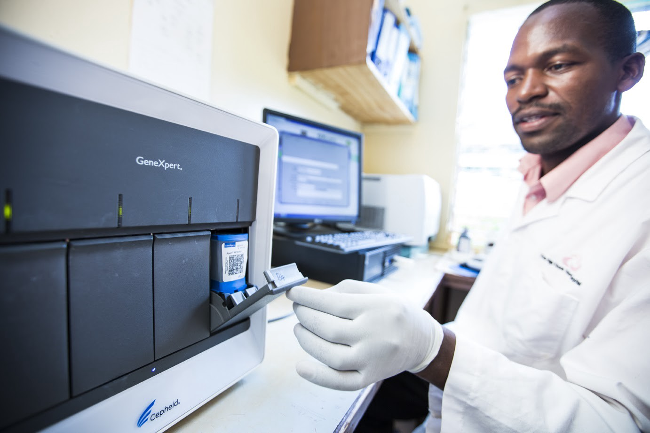
Molecular Tests (NAATs)
DIAGNOSIS
Rapid Molecular Tests
  Rapid molecular tests are low-complexity cartridge- or chip-based automated tests that:
  are highly sensitive and specific
  can be run in decentralized facilities by lab technicians with basic training
  produce results in less than 2 hours
  require an expensive instrument to run each test
Image copyright FIND/John Rae
  WHO recommends rapid molecular tests as the initial test for detecting TB and resistance to the first-line TB drug rifampicin (RIF)
22

Slide 23
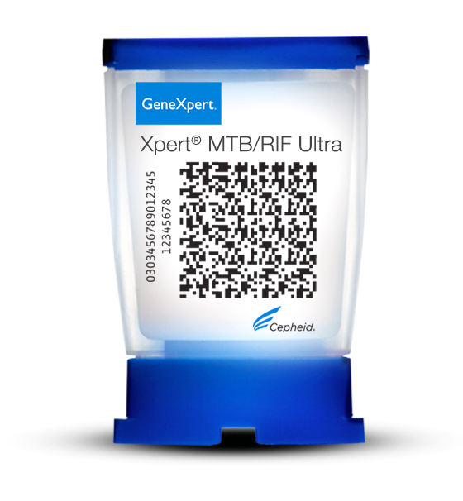
Molecular Tests (NAATs)
DIAGNOSIS
GeneXpert
  GeneXpert, developed by the U.S. company Cepheid, is a cartridge-based rapid molecular testing system for TB and rifampicin resistance that can be performed at the district-lab level
  In 2010, WHO endorsed the Xpert MTB/RIF test
  in 2017, WHO endorsed the more sensitive Xpert MTB/RIF Ultra test,
  which is more appropriate for use among PLHIV and children
  There is extensive evidence on the high diagnostic accuracy
  of GeneXpert TB tests on:
  pulmonary samples such as sputum
  extrapulmonary samples such as fluids and tissues from other
  parts of the body affected by TB,
  pediatric samples such as gastric, nasopharyngeal, and
  stool specimens
Image copyright Cepheid
  Cepheid has held a monopoly on the rapid molecular test market for TB and other infectious diseases since 2010
  GeneXpert TB tests cost about $10 per test
23

Slide 24
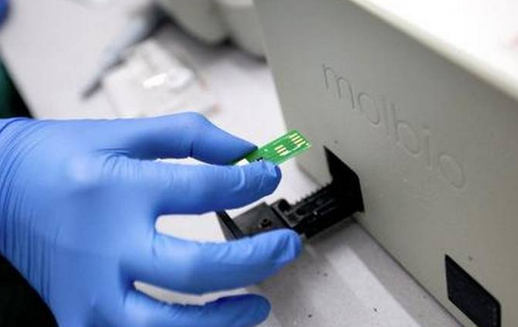
Molecular Tests (NAATs)
DIAGNOSIS
Truenat
  Truenat, developed by the Indian company Molbio, is a chip-based rapid molecular test for TB that is designed to be operated at the peripheral lab level, closer to the point of care than GeneXpert, with better tolerance for higher temperatures and dust
  In 2020, WHO endorsed Truenat MTB, Truenat MTB Plus, and Truenat MTB-RIF Dx TB tests, breaking Cepheid’s decade-long monopoly over the rapid molecular test market for TB
  Truenat utilizes separate instruments for DNA extraction and PCR and includes an additional micro-pipetting step to transfer the extracted DNA onto the test chip. Truenat also utilizes separate test chips for the detection of TB and rifampicin resistance
  Truenat tests cost $9 per test, comparable to GeneXpert tests
Image copyright The Hindu/Special Arrangement
24

Slide 25
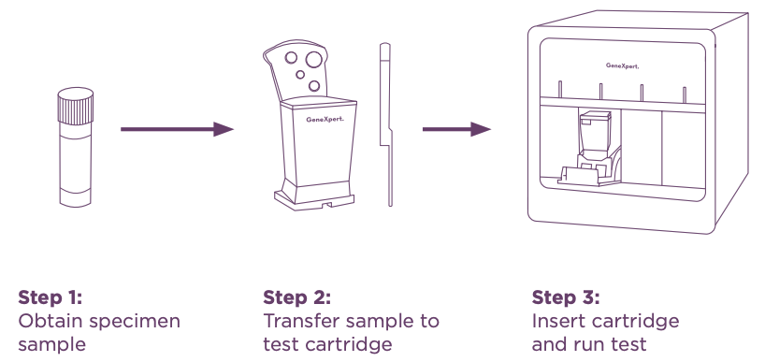
Molecular Tests (NAATs)
DIAGNOSIS
Comparison of GeneXpert and Truenat workflows
GeneXpert workflow
Adapted from TAG’s An Activist’s Guide to Tuberculosis Diagnostic Tools
Truenat workflow
25

Slide 26
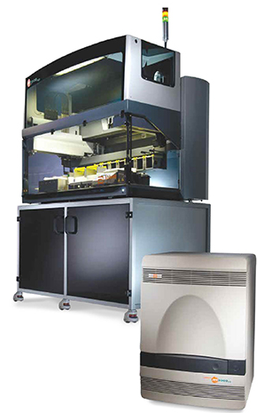
Molecular Tests (NAATs)
DIAGNOSIS
High-throughput centralized molecular tests
In addition to rapid molecular tests, in 2021 the WHO endorsed high-throughput molecular tests for initial detection of TB and resistance to first-line drugs rifampicin and isoniazid (INH), including:
    Abbott’s RealTime MTB RIF/INH Resistance
    BD’s BD MAX MDR-TB (RIF/INH)
    Hain’s FluoroType MTBDR Version 2.0
    Roche’s cobas MTB-RIF/INH
Image copyright Abbott Molecular
These tests are generally performed in well-equipped centralized labs due to their moderate complexity and the large instruments required to run the tests. These instruments are capable of testing large numbers of samples (up to 95) at a time and producing results in several hours
Many of these instruments are already in place in central labs for HIV viral load testing
26

Slide 27
Urine Lam Tests
DIAGNOSIS
  LAM, or lipoarabinomannan, is a component of the outer cell wall of TB bacteria that is detectable in urine. LAM is a biomarker for TB
  PLHIV with disseminated TB spread throughout the body have higher concentrations of LAM in urine, so LAM tests are most sensitive in PLHIV with advanced disease
  Urine-LAM tests are rapid point-of-care tests that can provide results on the same health care visit, and should be performed alongside a confirmatory rapid molecular diagnostic test
  Rapid urine-LAM testing and immediate TB treatment initiation following LAM-positive results is proven to save lives among people with advanced HIV disease (Gupta-Wright et al, Lancet, July 2018)
Detecting LAM in urine
Adapted from TAG’s An Activist’s Guide to the LAM Test
27

Slide 28
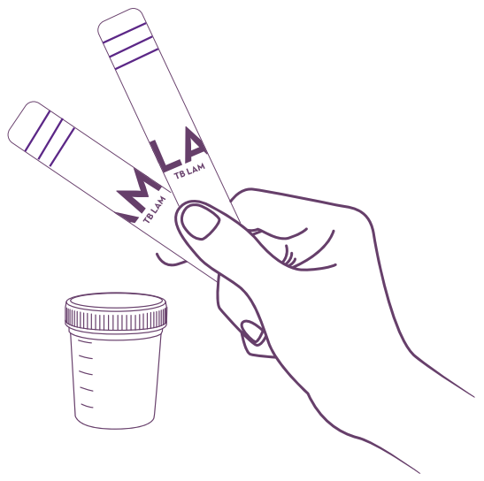
Urine Lam Tests
DIAGNOSIS
Determine TB LAM Ag
  Determine TB LAM Ag, developed by Alere/Abbott, is a simple, paper-based lateral-flow test, that uses unprocessed urine to produce results in just 25 min. Determine TB LAM costs just $3.70 per test, and is the only commercially available LAM test
  Determine TB LAM is most sensitive in PLHIV with advanced HIV disease and low CD4 cell counts
  In 2019, WHO updated its recommendations on LAM testing for all PLHIV with:
    signs and symptoms of TB,
    serious illness, or
    AIDS, with less than 200 CD4 cells/mm³ for inpatients, and less than 100 CD4 cells/mm³ for outpatients
  Abbott’s LAM test has been commercially available since 2013 and recommended by the WHO since 2015, yet uptake of this test by country programs has remained limited, despite its low cost and mortality benefit
Adapted from TAG’s An Activist’s Guide to the LAM Test
28

Slide 29
Urine Lam Tests
DIAGNOSIS
SILVAMP TB LAM
  SILVAMP TB LAM, developed by Fujifilm, applies a technology that binds silver particles to LAM antigens to amplify their detection
  In early studies, SILVAMP TB LAM has been shown to be 30% more sensitive than Determine TB LAM among PLHIV (Broger et al, PLOS Medicine, 2020). Due to the more costly materials used in its construction, it is also likely to be more expensive
  SILVAMP TB LAM is expected to be reviewed by the WHO in early 2022
Adapted from Broger et al, PLOS Medicine, 2020
29

Slide 30
Urine Lam Tests
DIAGNOSIS
Next-Generation Sensitive LAM Tests
  New LAM tests are currently in development that aim to improve sensitivity for use among PLHIV as well as HIV-negative people
  Next-generation sensitive LAM tests offer the possibility of low-cost tools to support TB diagnosis at the community level
30

Slide 31
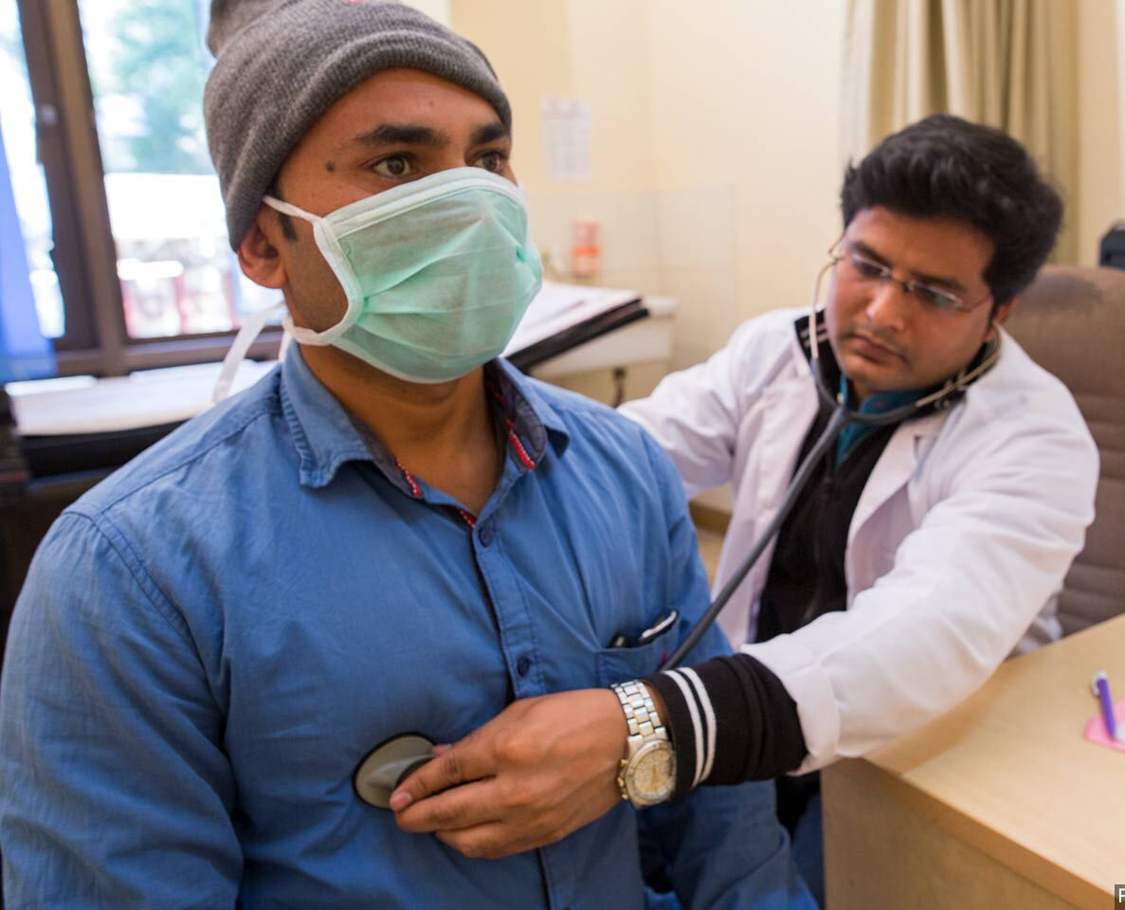
TB & COVID-19 Testing
DIAGNOSIS
  TB and COVID-19 may have overlapping pulmonary symptoms
  All persons being tested for COVID-19 should be tested for TB as well, especially in high-burden settings and if TB risk factors are present
  Persons should not be denied access to testing for TB because they have COVID-19, and persons with TB should not be denied access to testing for COVID-19
Image copyright ILO Asia Pacific
31

Slide 32
DIAGNOSIS
Nucleic acid amplification tests (NAATs) are phenotypic tests that physically grow TB bacteria using a liquid or solid medium in order to visually detect it:
  True
  False
Because of their high sensitivity, urine-LAM tests are the only test that is needed to diagnose TB among PLHIV
  True
  False
Which of the following tests are appropriate to use as an initial TB diagnostic test:
  TB culture
  Rapid molecular tests
  High-throughput molecular tests
  Urine-LAM plus a rapid molecular test (among PLHIV)
  Clinical diagnosis without attempting microbiological confirmation
32

Slide 33
DRUG-SUSCEPTIBILITY TESTING
33

Slide 34
Overview Of DST (1/2)
DRUG-SUSCEPTIBILITY TESTING
Why test for drug susceptibility?
  After many years of TB treatment using the same drugs, strains of TB bacteria have emerged that are resistant to first-line TB drugs such as rifampicin (RIF) and isoniazid (INH), and second-line TB drugs such as fluoroquinolones (FLQs) (moxifloxacin and levofloxacin), ethambutol (ETH), amikacin (AMK), bedaquiline (BDQ), and linezolid (LZD)
  Drug-resistant TB (DR-TB) takes on a range of profiles, including rifampicin-resistant TB (RR-TB), isoniazid-resistant TB (HR-TB) multidrug-resistant TB (MDR-TB), and extensively drug-resistant TB (XDR-TB)
  Information on drug susceptibility is essential to inform the most effective treatment regimens to treat TB and DR-TB, in order to reduce avoidable morbidity and mortality from TB, and minimize the continued expansion of drug resistant TB
34

Slide 35
Overview Of DST (2/2)
DRUG-SUSCEPTIBILITY TESTING
Drug-susceptibility testing (DST) should be universal
  Universal drug-susceptibility testing means that all people being evaluated for TB should also receive DST as part of the initial TB test, with follow-up DST as needed
  Rapid DST for resistance to RIF, INH, and FLQ resistance is necessary to immediately inform the type of TB treatment regimen that is most appropriate and to also inform the need for further DST for other TB drugs
35

Slide 36
Technologies For DST
DRUG-SUSCEPTIBILITY TESTING
Technologies for drug-susceptibility testing:
Nucleic Acid Amplification Tests (NAATs)
  NAATs can be used to detect and microbiologically confirm the presence of TB bacteria as well as drug resistance. NAATs are genotypic tests for drug resistance that amplify specific genetic mutations in TB DNA that are associated with resistance to certain TB drugs, in order to detect the presence or absence of these resistance-associated mutations
TB Culture
  TB culture is a phenotypic test that evaluates whether TB bacteria grows in the presence of anti-TB drugs to determine whether the strains of TB present in the sample are susceptible or resistant to those drugs
Next-Generation Sequencing
  Next-generation sequencing (NGS) utilizes targeted or whole genome sequencing to determine in a single test the entire drug resistance profile of the strains of TB in a sample
36

Slide 37
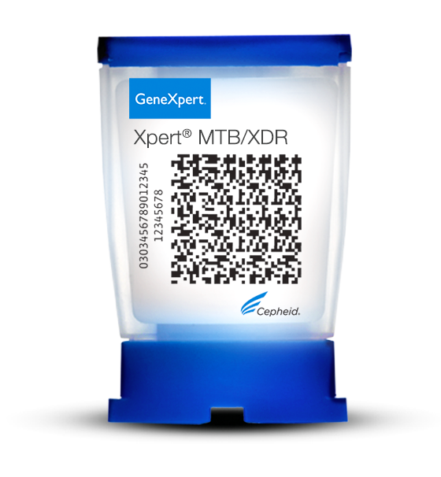
Molecular Tests (NAATs)
DRUG-SUSCEPTIBILITY TESTING
Rapid molecular tests:
  WHO recommends GeneXpert and Truenat tests for detection of TB and RIF resistance as the initial test for all people being evaluated for TB. These tests only provide drug-susceptibility information for RIF resistance
  Xpert MTB/XDR
    In 2021, WHO recommended Cepheid’s Xpert MTB/XDR as a follow-on test for resistance to INH, FLQs, ETH, and AMK
    Xpert MTB/XDR can be performed in decentralized labs, but requires an expensive upgrade to a 10-color GeneXpert instrument module (from the standard 6-color module) in order to be able to run the test
Image copyright Cepheid
High-throughput molecular tests:
  In 2021, WHO also endorsed high-throughput molecular tests as an initial test for TB and resistance to RIF and INH, including:
    Abbott’s RealTime MTB RIF/INH Resistance
    BD’s BD MAX MDR-TB (RIF/INH)
    Hain’s FluoroType MTBDR Version 2.0
    Roche’s cobas MTB-RIF/INH
37

Slide 38
Molecular Tests (NAATs)
DRUG-SUSCEPTIBILITY TESTING
Line Probe Assays:
  Line probe assays (LPAs) are high-complexity molecular tests that use a strip-based technology with banding patterns that indicate the presence of specific genetic targets associated with resistance to certain drugs
  Implementing LPAs requires well-equipped labs with multiple instruments and trained technicians to perform several manual laboratory procedures, so these tests are most appropriate for central labs
  LPAs turn around drug-susceptibility results within 1-2 days, compared to culture, which can take 2-6 weeks
  While rapid, more automated molecular tests for drug resistance that can be implemented in decentralized settings are preferred, LPAs continue to play a key role in DST for certain anti-TB drugs that are not yet included in these simpler molecular assays
Adapted from Hain image and TAG’s An Activist’s Guide to Tuberculosis Diagnostic Tools
38

Slide 39
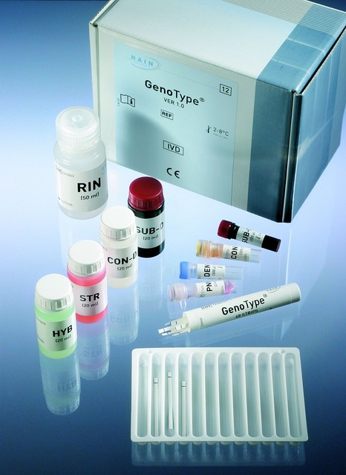
Molecular Tests (NAATs)
DRUG-SUSCEPTIBILITY TESTING
Line Probe Assays:
WHO-recommended LPAs include:
  Hain’s GenoType MTBDRplus Version 2.0, which tests for resistance to first-line drugs RIF and INH
  Hain’s GenoType MTBDRsl Version 2.0, which tests for resistance to second-line drugs FLQs, AMK, & capreomycin (CAP)
  Nipro’s Genoscholar NTM+MDRTB II, which tests for resistance to first-line drugs RIF and INH
  Nipro’s Genoscholar PZA TB II, which tests for resistance to the first-line drug pyrazinamide (PZA)
Image copyright Hain
39

Slide 40
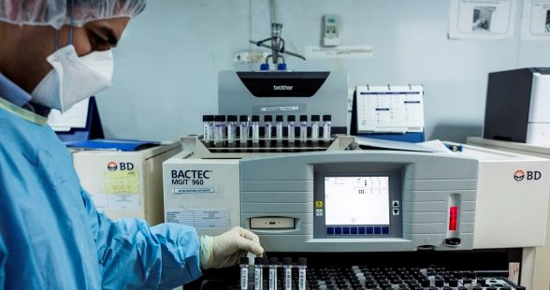
TB Culture
DRUG-SUSCEPTIBILITY TESTING
  Culture-based phenotypic DST attempts to physically grow TB bacteria in the presence of certain drugs—if the bacteria grows, this indicates drug resistance—which can take
  2 to 6 weeks for results
  There are two types of culture-based phenotypic DST: solid culture, which places TB bacteria on a solid medium to promote growth; and liquid culture, which places TB bacteria in a liquid medium to promote growth
Image copyright FIND
  Solid culture is less expensive than liquid culture but takes longer for results (4 to 8 weeks). WHO recommends liquid culture-based DST for drugs that are not yet included in faster molecular tests, such as new and repurposed drugs bedaquiline, linezolid, pretomanid, and delamanid
  WHO recommends liquid culture using BD’s BACTEC MGIT 960 system as the preferred method
  The BACTEC MGIT 960 system can hold up to 320 tubes of liquid culture at a time and is capable of automatically identifying which tubes are positive and which tubes are negative for TB bacterial growth
40

Slide 41
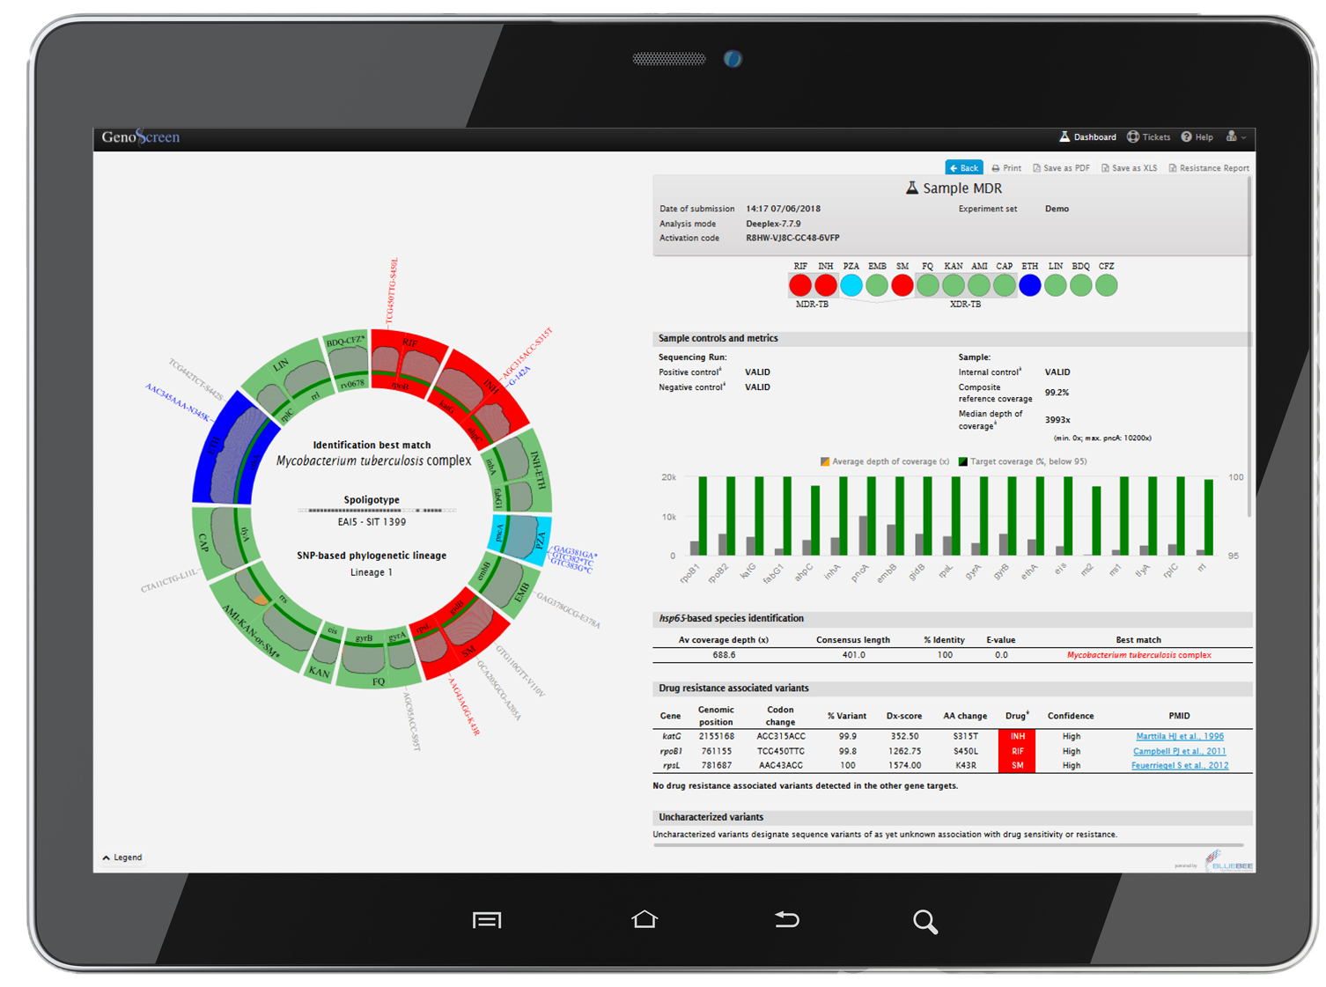
Next-Generation Sequencing
DRUG-SUSCEPTIBILITY TESTING
  Next-generation sequencing (NGS) for TB drug resistance can deliver comprehensive DST at high levels of accuracy in a single test and produce results to inform individualized DR-TB treatment regimens in one to two days
  NGS can also test for varying degrees of drug resistance and identify multiple strains of TB with different drug resistance profiles in a sample
Image copyright GenoScreen
  Compared to currently available molecular tests that target specific gene mutations, NGS provides the option of detecting mutations associated with resistance in a wider region of the genome, or even the whole genome
  NGS assays currently require well-equipped laboratories to be performed, with expensive instruments to extract and amplify the DNA from a sample and to sequence the whole or targeted sections of the genome. Once sequenced, special computer software is then used to interpret the sequencing results
  Several new NGS assays are under development, including the Deeplex Myc-TB assay by GenoScreen, and are expected to be reviewed by the WHO in 2022
41

Slide 42
DRUG-SUSCEPTIBILITY
TESTING
Universal drug-susceptibility testing means that all people being evaluated for TB should also receive DST as part of the initial TB test, with follow-up DST as needed
  True
  False
Match the molecular test with the appropriate level of complexity
  Rapid molecular tests d) High complexity
  High-throughput molecular tests e) Low complexity
  Line probe assays f) Moderate complexity
Because the genetic targets associated with resistance to new and repurposed drugs (i.e., BDQ, LZD, PTD, DLM) have not yet been sufficiently defined, the following test must be used for DST:
  Rapid molecular tests
  High-throughput molecular tests
  Line probe assays
  TB culture
  Next generation sequencing
42

Slide 43
TB TREATMENT MONITORING
43

Slide 44
Treatment Monitoring Tools
TREATMENT MONITORING
Why we need tests for treatment monitoring
  During treatment for drug-susceptible or drug-resistant TB, it is essential that the effectiveness of the treatment regimen is closely monitored, in order to identify treatment failure as quickly as possible so that the treatment regimen can be adjusted if needed
  The pivotal moment in TB treatment is the conversion of samples from TB-positive to
  TB-negative, which generally takes place after two to three months of treatment
Currently available tools for treatment monitoring:
  The tools currently used to monitor TB treatment include smear microscopy, which
  has low sensitivity, and culture, which takes 2-6 weeks for results
  Currently available molecular tests cannot be used for treatment monitoring because they cannot differentiate between dead and live TB bacilli
  Research is underway to develop new and better tests for TB treatment monitoring
44

Slide 45

Treatment Monitoring Tools
TREATMENT MONITORING
New tools in the pipeline:
  TB Molecular Bacterial Load Assay (MBLA): MBLA is a molecular test that utilizes PCR to amplify a specific RNA gene (16S ribosomal RNA) from viable TB bacteria in order to quantify the number of live TB bacteria in sputum, essentially performing the same task as mycobacterial liquid culture in a matter of hours instead of weeks
  Transcriptomic biomarker tests: These tests also utilize PCR and can be used to detect and quantify specific changes to a person’s RNA, or transcriptome, that indicate different stages of TB, including non progressing TB infection, incipient TB, active TB disease, treatment success or failure, and post-treatment cure
Image copyright LifeArc
45

Slide 46
TREATMENT MONITORING
Tools currently used to monitor TB treatment include:
  Rapid molecular tests
  Smear microscopy
  TB culture
  Next generation sequencing
Treatment monitoring is necessary to identify treatment failure as quickly as possible so that the treatment regimen can be adjusted if needed
  True
  False
New tools in development for treatment monitoring may also have application for detecting different stages of TB, including non-progressing TB infection, incipient TB, and active TB disease:
  True
  False
46

Slide 47
TESTING FOR TB INFECTION
47

Slide 48
Testing For TB Infection
TB INFECTION
Who is most at risk of TB infection progressing to active TB?
  A quarter of the world’s population has TB infection, and overall, people with TB infection have a 5 to 15 percent lifetime risk of developing active TB, but this risk is much higher for PLHIV and close contacts of people with TB
  Testing for TB infection helps determine who should take TB preventive therapy (TPT), but diagnosing TB infection is not a precondition for initiating TPT among PLHIV and among children who are household contacts of people with TB
48

Slide 49
Testing For TB Infection
TB INFECTION
Diagnosing TB infection:
  There are two types of tools used to detect TB infection: skin tests and blood tests, also called interferon gamma release assays (IGRAs)
  Both types of tools test for the presence of TB antibodies in the body, indicating that a person had prior exposure to TB and developed an immune response
  Because tests for TB infection detect antibodies and cannot differentiate between TB infection and active TB, people who test positive for TB infection should be further evaluated for active TB. If active TB is ruled out, then that person may be diagnosed with TB infection
  Research is underway to develop new tests capable of differentiating between TB infection and active disease
49

Slide 50
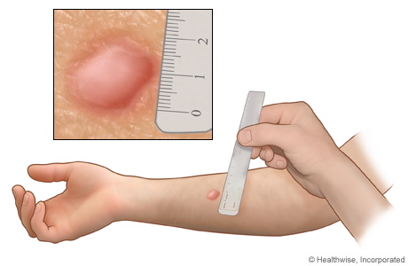
Testing For TB Infection
TB INFECTION
Tuberculin Skin Tests (TST):
  Tuberculin skin tests are the most common test for TB infection globally. These tests are inexpensive and appropriate for use in low-resource settings
  The test consists of an injection of tuberculin antigens just under the skin—usually in the arm—and an assessment after 48–72 hours to measure the size of the swelling at the site of the injection. The size of the swelling is associated with the strength of the immune response and indicates the presence of antibodies to the tuberculin antigens, and therefore prior exposure to TB
Image copyright Healthwise, Incorporated
  Because some of the tuberculin antigens used in TST are common to those used in the Bacille Calmette-Guérin (BCG) TB vaccine, TST may indicate an immune response among people with prior BCG vaccination who do not have TB infection
  New skin tests such as C-Tb from the Serum Institute of India and Diaskintest from Generium use different TB antigens that do not overlap with those used in the BCG vaccine, thereby improving the specificity of these skin tests
50

Slide 51
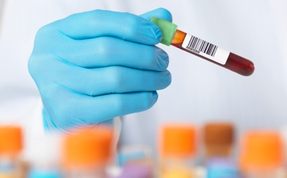
Testing For TB Infection
TB INFECTION
Interferon Gamma Release Assays (IGRAs):
  IGRAs are laboratory-based blood tests for TB infection with high sensitivity and specificity that are not affected by prior BCG vaccination
  These tests are expensive and require laboratory infrastructure, so they have not been commonly implemented in low- and middle-income countries
Image copyright Quest Diagnostics
  WHO recommends two commercially available IGRAs:
    QuantiFERON-TB Gold Plus, manufactured by Qiagen
    T-SPOT.TB, manufactured by Oxford Immunotec
  To address limited access to IGRA testing in low- and middle-income countries, Qiagen is developing Access QFT, a lateral flow IGRA test that produces results in less than 20 minutes and can be used at the community level—the same level as skin tests. Access QFT uses a digital reader to accurately read the lateral flow test result and is expected to be priced at about $10 per test
51

Slide 52
TB INFECTION
PLHIV and close contacts of people with TB have low risk of TB infection
    True
    False
Testing for TB infection is a precondition for initiating TB preventive therapy among PLHIV and among children who are household contacts of people with TB
    True
    False
Which of the following tests for TB infection are not affected by prior Bacille Calmette-Guérin (BCG) vaccination:
    Tuberculin Skin Test (TST)
    C-TB
    Diaskintest
    Interferon gamma release assays (IGRAs)
    Access QFT
52

Slide 53
GLOBAL STATISTICS
53

Slide 54
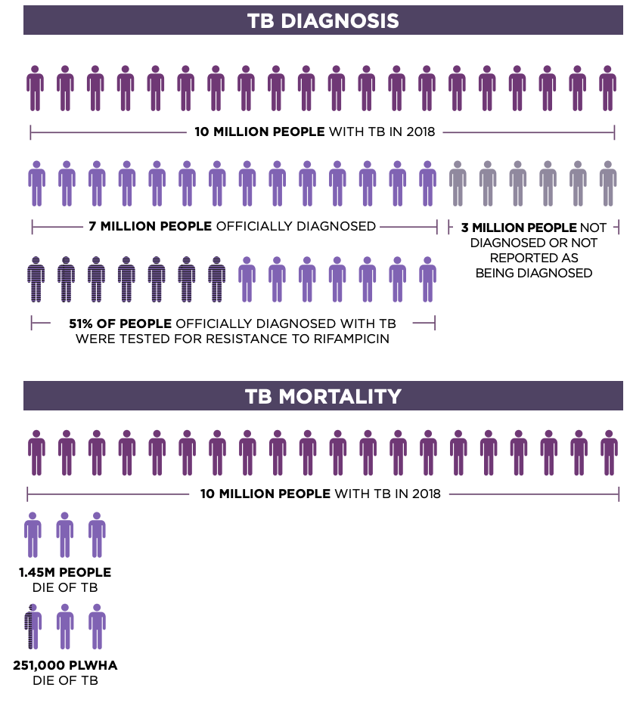
The Global State Of TB, 2018
GLOBAL STATISTICS
54
Source: WHO Global Tuberculosis Report 2019; Adapted from TAG’s An Activist’s Guide to Tuberculosis Diagnostic Tools

Slide 55
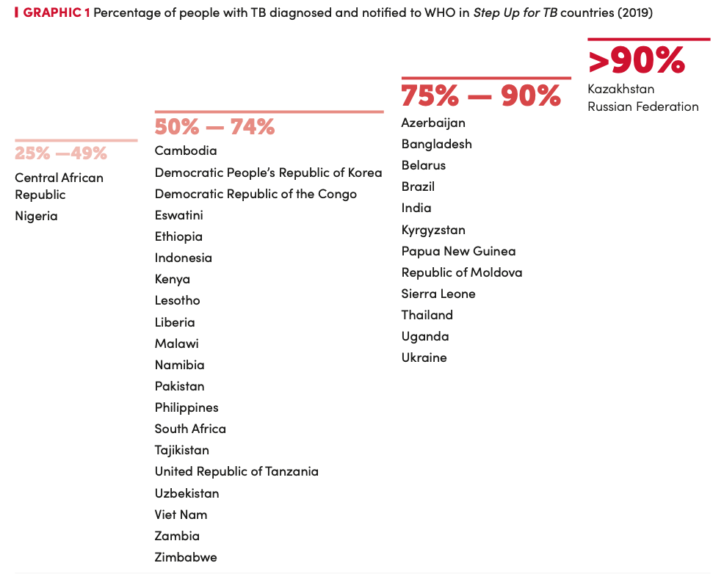
TB Diagnosis & Notification
GLOBAL STATISTICS
55
Source: Step Up for TB 2020

Slide 56
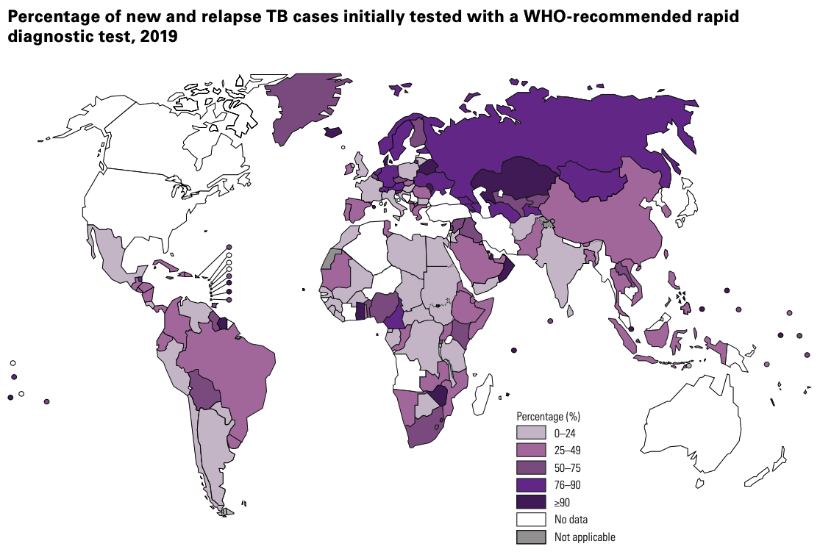
Rapid Testing For TB
GLOBAL STATISTICS
56
Source: Global Tuberculosis Report 2020

Slide 57
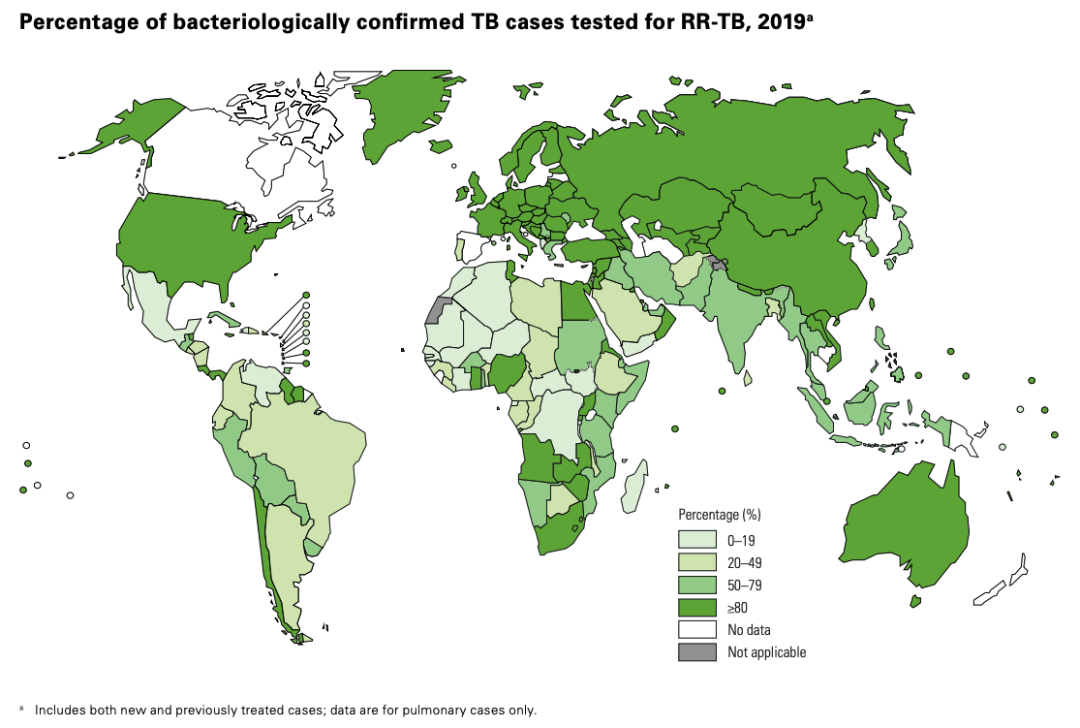
Testing For RIF Resistance
GLOBAL STATISTICS
57
Source: Global Tuberculosis Report 2020

Slide 58
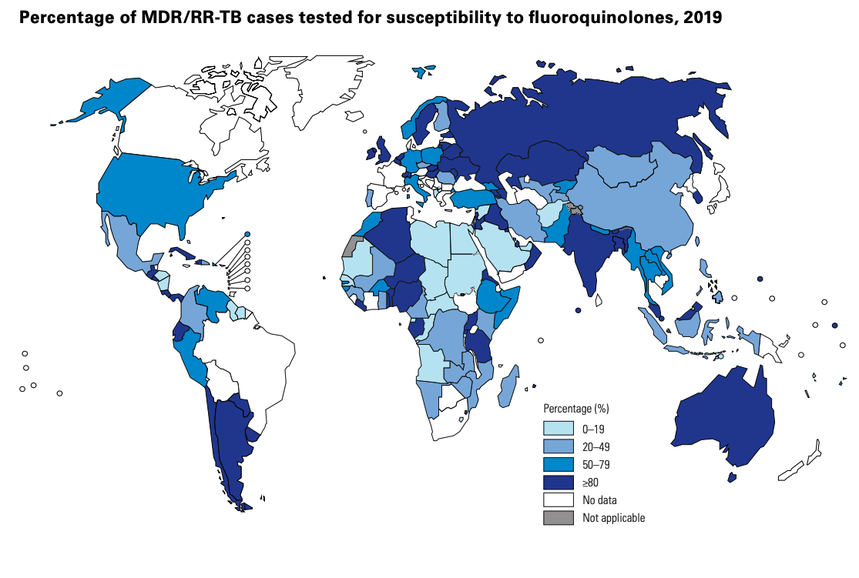
Testing For FLQ Resistance
GLOBAL STATISTICS
58
Source: Global Tuberculosis Report 2020

Slide 59
RESEARCH
59

Slide 60
Target Product Profiles
RESEARCH
WHO and the Foundation for Innovative New Diagnostics (FIND) developed a set of target product profiles (TPPs) to guide the development of new TB diagnostic tools
  The TPPs detail the types of tools that are needed according to different use cases and establish the criteria these tools should meet in terms of optimal and minimal performance and operational characteristics. The TPPs include:
    A rapid biomarker-based non-sputum-based test for detecting TB
    Community-based triage or referral test for identifying people with presumptive TB
    Rapid sputum-based test for detecting TB at peripheral centres
    Next-generation drug-susceptibility testing at peripheral centres
    Detection of resistance associated mutations in Mycobacterium tuberculosis complex utilizing Next Generation Sequencing
    Tests for predicting progression from tuberculosis infection to active disease
  A number of WHO-recommended diagnostic tools that are currently in use meet some of the minimal and optimal TPP criteria, but none meet all of the minimal TPP criteria, underscoring the urgent need for continued research, development, and innovation
60

Slide 61
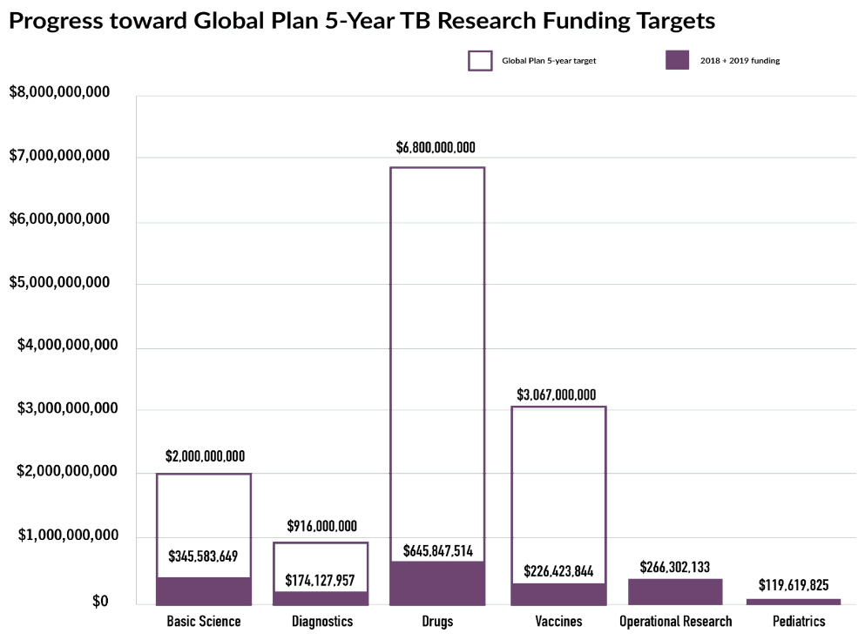
TB Research Funding, 2019
RESEARCH
61
Source: Tuberculosis Research Funding Trends 2005–2019

Slide 62
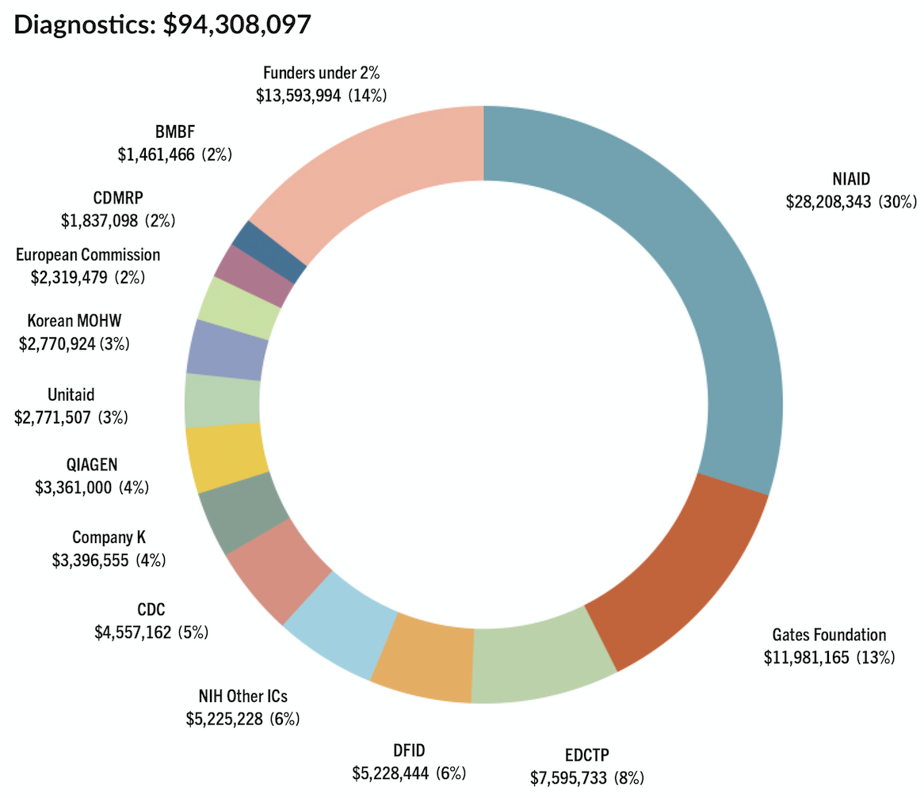
TB Research Funding, 2019
RESEARCH
62
Source: Tuberculosis Research Funding Trends 2005–2019

Slide 63
ACCESS TO TB DIAGNOSTIC TESTING
63

Slide 64
The Right To Quality TB Diagnostic Testing
ACCESS
Right to Science
  All people at risk of TB have the right to quality TB diagnostic testing at the highest standard of care
  In 2020, the United Nations Committee on Economic, Social, and Cultural Rights (CESCR) released a general comment on the right of all people to the benefits and applications of scientific progress
  In the comment, the CESCR explained that an essential element of the right is “quality,” which it defined as “the most advanced, up-to-date and generally accepted and verifiable science available at the time, according to the standards generally accepted by the scientific community”
  Under the right to science, countries are obligated to provide access to WHO-recommended TB diagnostic testing to all people at risk of TB
  However, realizing this right in practice requires identifying the barriers that prevent access to quality TB diagnostic testing and developing advocacy initiatives to address and remove them
64

Slide 65
Identifying Access Barriers (1/2)
ACCESS
Identifying barriers to access is the first step toward promoting access
1. Insufficient country uptake and implementation of tools and policies
  Many countries are slow to adopt the latest WHO policies on TB diagnostic tools and algorithms, and implement a lower standard of care than what WHO recommends
  An example is the slow uptake of urine-LAM testing despite its WHO recommendation since 2015, its low cost at just $3.70 per test, and its proven mortality benefit among PLHIV with advanced HIV disease
2. Unfair and high pricing
  The prices of most TB diagnostic tests are not transparent, despite public investment in the development of many of these tests, so it is unclear how much profit is being made by private companies off the sale of each test. These prices are also often very high, preventing many countries from being able to fully scale up these tests according to WHO policy
  An example is the high cost of GeneXpert TB tests at $10 per test, despite evidence that it costs $3-$5 to manufacture each test. This high cost has limited country uptake of GeneXpert testing and the ability to scale up rapid molecular testing as the initial TB test
65

Slide 66
Identifying Access Barriers (2/2)
ACCESS
3. Insufficient investment in TB diagnostics research & development
  Investments in COVID-19 diagnostics fueled the rapid development of many low-cost and effective tests in the first year of the pandemic. Meanwhile, years of insufficient investment in TB diagnostics research has yielded slow results and diagnostic tools that do not yet meet the WHO target product profiles
66

Slide 67
Promoting Access (1/2)
ACCESS
1. Country uptake and implementation of tools and policies
  Countries should rapidly adopt new WHO policies on TB diagnostic tools and algorithms and fully implement them in country programs, and should allocate sufficient funding to do so
  Increased funding from global donors and lower prices for TB diagnostic tools are also needed to support country uptake and implementation of TB diagnostic testing according to the highest standard of care
2. Fair pricing
  TB diagnostic testing at the highest standard of care should be free for all people at risk of TB. For countries to realize this, TB diagnostic tools must be priced fairly and affordably, based on cost-of-goods-sold (COGS) and volumes
  COGS should be public information, and fair pricing should be determined by a normative body using a standardized methodology that allows for reasonable profit
  Donors should require COGS transparency and fair pricing as part of all research and development funding agreements and procurement contracts with diagnostics companies
67

Slide 68
Promoting Access (2/2)
ACCESS
3. Investment in TB diagnostics research & development
  Investments by donors and countries in the research and development of new TB diagnostics must be increased, in order to accelerate development of the TB diagnostic tools that are needed according to the WHO target product profiles
  Funders and developers must engage TB-affected communities in all stages of TB diagnostics research and development to ensure that new TB diagnostic tools are developed with community input and reflect community needs and priorities
68

Slide 69



Define Access Barriers Along The TB Care Cascade In Your Community
ACCESS
Challenges in communities
Challenges in health programs
Recognizing symptoms
Seeking
care
Diagnosis
Starting
treatment
Completing
treatment
69
Notes:
Facilitator prompt: Ask participants to fill in challenges along the cascade of TB care
Once mapped out, discuss potential solutions and advocacy approaches or other strategies that might be employed to address the challenges described.

Slide 70
TAKING ACTION
70

Slide 71
TAKING ACTION
Image credit Noah Seelam/AFP
Realizing the highest standard of care for TB diagnosis requires accountability and action from country governments, global donors, and diagnostics companies. Activists can demand this by:
71

Slide 72

Taking Action
TAKING ACTION
Increase funding for TB research and development (R&D).
Include conditions of cost-of-goods-sold (COGS) transparency and fair pricing as part of all R&D funding agreements with TB diagnostics developers.
Increase domestic funding for health and expand TB budgets to sufficiently invest in strengthening national health systems and fully scaling-up and implementing quality TB diagnostic tools in accordance with WHO recommendations.
Calling on country governments to:
Engage in pooled procurement with other countries and global donors to secure TB diagnostic tools at the lowest possible prices through shared volumes.
Update national TB and HIV program policies and implementation guidelines in accordance with new WHO recommendations.
Establish clear plans for the rapid introduction, scale-up, and implementation of WHO-recommended TB diagnostic tools and algorithms, including through countrywide training of health workers and lab technicians in the use of new diagnostic tools and technologies.
72

Slide 73
Taking Action
TAKING ACTION
Increase funding for R&D of new TB diagnostic tools.
Include binding access commitments requiring COGS transparency and fair pricing as a condition of R&D funding.
Calling on global donors to:
Increase funding support for countries to invest in the introduction, full scale-up, and implementation of quality TB diagnostic tools in accordance with WHO recommendations.
Coordinate together and with countries to apply collective procurement power and leverage toward negotiating lower prices for TB diagnostic tools reflective of COGS, volumes, and public and philanthropic funding.
Invest in building regional and country know-how and capacity— including through technology transfer—for generic diagnostics manufacturing.
73

Slide 74
TAKING ACTION
TAKING ACTION
Taking Action
Increase funding for R&D of new TB diagnostic tools.
Invest in the R&D of new TB diagnostic tools in line with the WHO target product profiles and engage communities—including community advisory boards (CABs)—to inform design and access considerations in the early stages of the development of these new tools.
Calling on diagnostics companies to:
Ensure that new TB diagnostic tools are accessible in all countries with high burdens of TB, that service and maintenance plans—if applicable—are effective and priced equitably and affordably, and that sufficient manufacturing capacity is in place to reach volumes that fully meet the supply and pricing needs of all high-TB-burden countries.
74
74

Slide 75
KEY TAKEAWAYS
75

Slide 76
TB Diagnosis Key Takeaways (1/2)
KEY TAKEAWAYS
All people at risk of TB have the right to quality TB diagnostic testing at the highest standard of care
People at high risk of TB, including PLHIV and household contacts of people with TB, should be systematically screened for TB
WHO recommends rapid molecular testing as the initial TB test for all
PLHIV should receive point-of-care urine-LAM testing and rapid molecular testing according to WHO recommendations
Microbiological confirmation of TB should be attempted, but PLHIV and children can be diagnosed based on clinical judgement
76
Notes:
Note to facilitator: this is not an exhaustive list and can be used as start for discussion.

Slide 77
TB Diagnosis Key Takeaways (2/2)
KEY TAKEAWAYS
All people diagnosed with TB should receive drug-susceptibility testing
Treatment monitoring is essential to ensure that anti-TB drugs are working
Diagnosing TB infection is not required for initiating TB preventive therapy among PLHIV and among children who are household contacts of people with TB
Increased investment in TB diagnostics research and development and improved access to TB diagnostic tools is necessary to close the TB diagnostics gap
Advocacy by and engagement of affected communities is essential to set the agenda and priorities for TB diagnostics research and access
77
Notes:
Note to facilitator: this is not an exhaustive list and can be used as start for discussion.

Slide 78
Additional Resources
KEY TAKEAWAYS
An Activist’s Guide to Tuberculosis Diagnostic Tools:
https://www.treatmentactiongroup.org/publication/an-activists-guide-to-tuberculosis-diagnostic-tools/
An Activist’s Guide to the LAM Test:
https://www.treatmentactiongroup.org/publication/an-activists-guide-to-the-tb-lam-test/
Tuberculosis Diagnostics Pipeline Report:
https://www.treatmentactiongroup.org/resources/pipeline-report/2020-pipeline-report/
Tuberculosis Research Funding Trends 2005–2019:
https://www.treatmentactiongroup.org/resources/tbrd-report/tbrd-report-2020/
Step Up for TB Report:
https://www.msf.org/step-tb-report-2020
Global Tuberculosis Report:
https://www.who.int/publications/i/item/9789240013131
78

