Slide 1

Tuberculosis Treatment
Treatment Action Group
TB/HIV Advocacy Toolkit
March 2021

Slide 2
Treatment Fundamentals
How TB is Treated
Treatment in Special Groups
Determining Access Barriers
Treatment Research
Taking Action
Key Takeaways
Additional Resources
Overview
Overview
2

Slide 3
TREATMENT FUNDAMENTALS
3

Slide 4
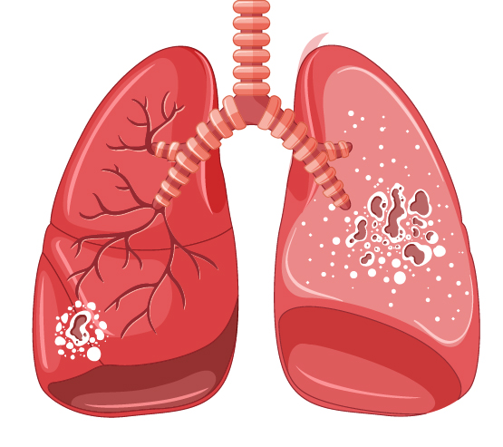
FUNDAMENTALS
(Latent)TB Infection vs.
(Active) TB Disease
Latent TB
TB Disease
TB lives but doesn’t grow in the body
Doesn’t make a person feel sick or have symptoms
Can’t spread from person to person
Can advance to TB disease
TB is active and grown in the body
Makes a person feel sick and have symptoms
Can spread from person to person
Can cause death if not treated
4
Notes:
This presentation is focused on treating active TB disease, i.e., TB that is active and growing in the body, causing illness, and can be spread from person to person and fatal if left untreated.
There is a separate training module focused on treating TB infection.

Slide 5
FUNDAMENTALS
Principles of TB treatment
The goal of treatment is to cure TB, restore health, and prevent transmission
The aim of treatment is to provide the safest and most effective therapy in the shortest period of time
Three basic principles of TB treatment:
  Regimens must contain multiple drugs to which the organisms are susceptible to prevent against the development of resistance
  Drug exposure (how much drug is in the body) must stay at a high enough level over time to kill bacteria – this means drugs must be taken regularly
  Drug therapy must continue long enough to kill all remaining TB organisms in the body
5

Slide 6
FUNDAMENTALS
Treatment Monitoring
How do you know it’s working?
Bacteriologic tests: to detect live (replicating) TB bacteria
  Smear microscopy
  Solid and liquid culture
Clinical monitoring for improvement TB symptoms (e.g., weight gain)
Radiography: the use of chest X-rays
*Molecular tests like GeneXpert cannot be used for treatment monitoring as they are sensitive enough to detect dead TB bacteria
6

Slide 7
FUNDAMENTALS
Knowing Which Drugs to Use
Drug susceptibility testing (DST) is essential to inform treatment regimen selection
Everyone should have a rapid molecular test (e.g., GeneXpert) as a first diagnostic test. Existing rapid molecular tests can detect both TB and rifampicin-resistance (RR-TB)
Among people who test positive for rifampin-resistance, further DST testing is needed to determine which regimen for drug-resistant TB is most appropriate.
People with RR-/MDR-TB are eligible for the 9-12 month standardized shorter regimen
People with additional resistance require treatment with different regimens (more on this shortly!).
7
Notes:
More in depth coverage of how to detect TB, resistance to TB medicines, and to monitor treatment is covered in the module focused on TB diagnostics.

Slide 8
FUNDAMENTALS
Defining Drug-Resistant TB (DR-TB)
DS-TB
MDR-TB
Pre-XDR-TB
XDR-TB
rifampicin
rifampicin
rifampicin
rifampicin
isoniazid
isoniazid
isoniazid
isoniazid
fluoroquinolone
fluoroquinolone
fluoroquinolone
fluoroquinolone
Group A drugs
(bedaquiline, linezolid)
Group A drugs
(bedaquiline, linezolid)
aminoglycoside
aminoglycoside
2020
2021
DS-TB
MDR-TB
Pre-XDR-TB
XDR-TB
rifampicin
rifampicin
rifampicin
rifampicin
isoniazid
isoniazid
isoniazid
isoniazid
fluoroquinolone
fluoroquinolone
fluoroquinolone
fluoroquinolone
Group A drugs
(bedaquiline, linezolid)
Group A drugs
(bedaquiline, linezolid)
Group A drugs
(bedaquiline, linezolid)
Group A drugs
(bedaquiline, linezolid)
8
Notes:
The type of treatment an individual is prescribed will depend on the type of TB they have, often referred to as the “resistance profile”.
Before we get into the different standard of care treatments for drug-sensitive vs. drug-resistant TB, it’s important to understand that there are multiple forms of drug-resistance, each defined by the drugs that will not work against the organism/bacteria given its “resistance profile”.
So drug sensitive or drug-susceptible TB, represented by DS-TB, is TB that is not resistant to anything – our two most powerful drugs, isoniazid and rifampicin will work.
Multidrug-resistant TB or MDR-TB, is TB that is resistant BOTH isoniazid and rifampicin; neither drug will work against this form of TB.
In 2021, the WHO updated the definitions of pre-X and XDR-TB:
Pre-extensively drug-resistant TB, represented by pre-XDR-TB, used to be defined as TB that is multidrug-resistant, so resistant to BOTH isoniazid and rifampicin, AND resistant to one of two other important classes of drugs, the fluroquinolones (levofloxacin or moxifloxacin) OR the aminoglycosides, also commonly referred to as the second-line injectables. It is now defined as MDR-TB (resistant to BOTH isoniazid and rifampicin) with additional resistance to fluoroquinolones (i.e., moxifloxacin or levofloxacin)
Finally, extensively drug-resistant TB, represented by XDR-TB, used to be defined as TB that is multidrug-resistant, so resistant to BOTH isoniazid and rifampicin, AND resistant to BOTH fluroquinolones and second-line injectable agents. It is not defined as MDR-TB with additional resistance to fluoroquinolones (pre-XDR-TB) AND resistance to other Group A drugs (i.e., bedaquiline and/or linezolid).
Similar to how rifampicin and isoniazid make up the backbone of treatment for drug-sensitive TB, the fluoroquinolones and group A drugs (e.g., bedaquiline) now make up the backbone of treatment for drug-resistant TB. The second-line injectables used to be very important for the treatment of drug-resistant TB but we have since learned that the second-line injectables are not that great, and can cause permanent harm (hearing loss), so these are no longer a part of the standard of care and the definitions have finally caught up to the science and new standard of care.
What remains most important in defining the type of drug-resistant TB we are talking about, and the corresponding standard of care regimens available, is fluoroquinolone resistance (more on this in the training module focused on TB treatment).

Slide 9
TB Treatment Regimens
Drug-Sensitive TB
(DS-TB)
4–6 months
4 drugs
first-line medicines
Drug-Resistant TB
(DR-TB)
6–20 months
6–8 drugs
second-line, new / repurposed medicines
H = isoniazid
R = rifampicin
Z = pyrazinamide
E = ethambutol
P = rifapentine
M = moxifloxacin*
Bdq = bedaquiline
Lzd = linezolid
Lfx = levofloxacin
Mfx = moxifloxacin*
Cs = cycloserine
Cfz = clofazimine
Dlm = delamanid
Pa = pretomanid
Am = amikacin
Eto = ethionamide
Pto = prothionamide
9
Notes:
FACILITATOR PROMPT:
How many months is treatment for drug-sensitive TB?
How many medicines are regimens for DS-TB composed of?
Name three first line medicines.
How many months is treatment for drug-resistant TB?
How many medicines are regimens for DR-TB composed of?
Name three second line medicines.
Bonus: which medicine(s) are included in regimens to treat drug-sensitive and drug-resistant TB?
Answer(s): pyrazinamide, moxifloxacin, high dose isoniazid, ethambutol.
*Moxifloxacin is a second line drug but is also listed here under drug-sensitive TB because a large phase III study – TBTC Study 31 – recently found a 4-month rifapentine and moxifloxacin containing regimen as good as the 6-month standard of care…more on this later.

Slide 10
HOW TB IS TREATED
10

Slide 11
DRUG-SENSITIVE TB (DS-TB)
11

Slide 12
TREATMENT
Drug-Sensitive TB (1/3)
There are two phases of treatment for drug-sensitive TB:
  Initial/intensive phase: to kill actively growing bacteria
  Continuation phase: to eliminate any remaining bacteria and
  reduce treatment failure / relapse
  The WHO recommends the following 6-month regimen:
  2 H R Z E / 4 H R
  Two months of daily treatment with four first-line drugs (isoniazid, rifampicin, pyrazinamide, ethambutol), followed by four months of daily treatment with isoniazid and rifampicin
12
Notes:
DRUG SENSITIVE TB (susceptible to all medicines; can be treated with first-line medicines)
The standard of care for drug-sensitive TB is a 6-month regimen broken out into two parts:
Part I is the intensive phase, which is made up of 4 drugs taken for 2 months –the number represents the duration and each letter represents a TB medicine, so 4HRZE – represents four months of isoniazid, rifampicin, pyrazinamide, and ethambutol taken daily.
Part II is the continuation phase, which is made up of 2 drugs taken for 4 months – represented by 4HR – which stands for four months of isoniazid and rifampin taken daily
This regimen has been around for decades and is widely used and available in fixed-dose combination tablets, including those that disperse in liquid for easier administration to children. In trials, this regimen has proven to successfully cure >90% of people with drug-susceptible TB.

Slide 13
TREATMENT
Drug-Sensitive TB (2/3)
A recent phase III study known as TBTC Study 31 / ACTG 5349 assessed a four-month regimen for drug-susceptible TB:
  2 H P M Z / 2 H P M
Two months of daily treatment with isoniazid, rifapentine, moxifloxacin and pyrazinamide, followed by two months of daily treatment with isoniazid, rifapentine, moxifloxacin
* Rifapentine replaced rifampicin and moxifloxacin replaced ethambutol
The phase III study compared this 4-month regimen to the 6-month standard of care that has been around for decades (described on the previous slide)
The study found this 4-month regimen to be non-inferior to (i.e. “not worse than”) the 6-month standard of care that successfully cures ~85% of adults with DS-TB
13
Notes:
These results were presented at the 2020 Union Conference, and a more detailed write up can be found in TAG’s 2020 TB Treatment Pipeline Report: https://www.treatmentactiongroup.org/wp-content/uploads/2020/11/pipeline_tb_treatment_2020_final.pdf.
These data have not yet been published in a peer reviewed journal and the WHO has not yet reviewed these findings or issued guidance on the use of the 4-month regimen for drug-sensitive TB.
All of the drugs contained in this regimen have been around and in use against TB for decades, what’s new is the combination, which has allowed for treatment duration to be cut by two months.
This regimen won’t be able to be given to children until pediatric studies determine rifapentine dosing and safety in children (to match the 1,200 mg dosing given to adults in TBTC Study 31).
Rifapentine and isoniazid are also used to treat TB infection / latent TB (the left side of slide #4) – there are two different regimens (covered in more detail in the TB Prevention module) – 3HP [3-months of once weekly isoniazid and rifapentine; rifapentine is dosed at 900 mg] and 1HP [1 month of daily isoniazid and rifapentine; rifapentine is dosed at 600 mg]

Slide 14
TREATMENT
Drug-Sensitive TB (3/3)
A recent phase III study in children known as the “SHINE” trial assessed a four-month regimen for drug-susceptible TB in children with minimal disease:
  2 H R Z E / 2 H R
Two months of daily treatment with isoniazid, rifampicin, pyrazinamide, and ethambutol followed by two months of daily treatment with isoniazid and rifampicin
* This regimen is identical to the 6-month standard of care regimen described on slide 11, except the continuation phase of treatment is 2 months shorter
How is minimal disease defined?
TB which is both smear-negative and non-severe in form (i.e., in lymph nodes outside of the chest or, if inside of the chest, confined to one lobe of the lungs with no cavities or to lymph nodes without significant airway obstruction and no bilateral airway narrowing).
14
Notes:
These results were presented at the 2020 Union Conference, and a more detailed write up can be found in TAG’s 2020 TB Treatment Pipeline Report: https://www.treatmentactiongroup.org/wp-content/uploads/2020/11/pipeline_tb_treatment_2020_final.pdf.
These data have not yet been published in a peer reviewed journal and the WHO has not yet reviewed these findings or issued guidance on the use of the 4-month regimen for drug-sensitive TB.
The four-month regimen is something that programs can move to implement right away, as they should already have access to the tools used in the trial to determine minimal/ non-severe TB (smear microscopy and X-ray) and to treat minimal TB according to the four-month regimen. The medicines and formulations required for the four-month regimen are exactly the same as those already in use for the six-month standard of care—the continuation phase of treatment just ends two months earlier.
Ongoing work by the SHINE investigators to define minimal TB when molecular tests are used as the initial test (as opposed to smear microscopy) in line with WHO guidelines, will be important for implementation.

Slide 15
DRUG-RESISTANT TB (DR-TB)
15

Slide 16
DS-TB
MDR-TB
rifampicin
rifampicin
isoniazid
isoniazid
fluoroquinolone
fluoroquinolone
Group A drugs
(bedaquiline, linezolid)
Group A drugs
(bedaquiline, linezolid)
Pre-XDR-TB
XDR-TB
rifampicin
rifampicin
isoniazid
isoniazid
fluoroquinolone
fluoroquinolone
Group A drugs
(bedaquiline, linezolid)
Group A drugs
(bedaquiline, linezolid)
16
Notes:
FACILITATOR PROMPT:
Instruct participants to place an “X” next to each drug or drug class that will not work in line with the type of TB listed at the top of the column.
BONUS: ask participants to name a drug in the fluoroquinolone class
Answer: moxifloxacin or levofloxacin

Slide 17
TREATMENT
Isoniazid-Resistant TB (HR-TB)
Isoniazid is a first-line drug included in the standard six-month regimen for drug-susceptible TB (2HRZE/4HR)
Isoniazid is a powerful drug; if there is resistance to isoniazid, a different drug regimen is needed to make up for losing isoniazid:
  Levofloxacin replaces isoniazid
  6 (H) R Z E + Lfx
Six-months of daily treatment with rifampicin, pyrazinamide, ethambutol, and levofloxacin
Some persons may continue to receive isoniazid as it may still have some activity against certain types of isoniazid-resistant TB strains and it often comes in the combination tablets used in treatment
If a fluoroquinolone cannot be used, then a 6(H)RZE regimen may be used (six-months of daily treatment with rifampicin, pyrazinamide, ethambutol with or without isoniazid)
17
Notes:
ISONIAZID-MONORESISTANT TB
In people with TB that is resistant to isoniazid alone, the WHO recommends a six month regimen composed of rifampicin, ethambutol, pyrazinamide, and levofloxacin.7 People unable to tolerate treatment with levofloxacin can be treated with six months of rifampicin, ethambutol, and pyrazinamide. Higher doses of isoniazid may be able to overcome resistance conferred by certain mutations (inhA), but evidence in humans is limited. Whether or not to include isoniazid, and at an increased or standard dose, is left to provider discretion as there is no clear evidence that the addition of isoniazid to these regimens offers benefit or causes harm to people with HR-TB. The use of fixed-dose combinations (rather than provider discretion) may dictate the inclusion of isoniazid alongside the other medicines recommended for the treatment of HR-TB.

Slide 18
TREATMENT
Rifampicin- / Multidrug-Resistant TB (RR-/MDR-TB):
Program Conditions
In 2020, the WHO recommended a 9-12-month standardized, all-oral regimen for treating TB in individuals with rifampicin-/multidrug-resistant TB (RR-/MDR-TB)
The 9-12 standardized, all-oral regimen is the same as the standardized, shorter regimen recommended in 2016 (commonly referred to as the “modified Bangladesh regimen”), but instead of the injectable drug (kanamycin or amikacin), bedaquiline is given:
  6 Bdq + 4-6 Eto hdH Lfx Cfz Z E / 5-6 Lfx Cfz Z E
9-to-12-months of daily clofazimine, levofloxacin (or moxifloxacin), ethambutol, and pyrazinamide; supplemented by bedaquiline for the first 6 months and high dose isoniazid, ethionamide (or prothionamide) for the first 4-to-6-months.
This regimen is specifically for people whose TB is resistant to rifampicin +/- isoniazid but has not been treated with or shown to have resistance to a fluoroquinolone (moxifloxacin or levofloxacin) – i.e., only RR-/MDR-TB.
18
Notes:
RIFAMPICIN-/MULTIDRUG-RESISTANT TB (resistant to rifampicin +/- isoniazid; cannot be treated with first-line medicines)
The 9-12 month standardized shorter regimen – this is a regimen that may already look familiar as it was previously recommended by the WHO since 2016 – the difference here is that bedaquiline is now recommended in place of the injectable agent.
The 9-12 month standardized regimen consists of 9-12 months of clofazimine, moxifloxacin (or levofloxacin), ethambutol, and pyrazinamide, supplemented by high dose isoniazid, ethionamide (or prothionamide) and bedaquiline for the first 4-6 months.
People with RR-/MDR-TB with (1) previous exposure to the medicines used in the 9-12 month standardized, all-oral regimen, or with (2) extensive TB disease, or with (3) severe extrapulmonary TB, or with (4) resistance to the fluoroquinolones are not eligible for the 9-12 month standardized, all-oral regimen, and would instead likely be treated with a longer individualized, all-oral regimen (more on this on slide 20).
Modifications to the 9-12 month standardized shorter regimen are allowed, but only under conditions of operational research because of uncertainty regarding the safety and efficacy of these modifications (more on slide 19).

Slide 19
TREATMENT
Rifampicin- / Multidrug-Resistant TB (RR-/MDR-TB):
Operational Research
Persons with RR-/MDR-TB can be treated with modified versions of the 9-to-12-month, all-oral regimen represented on the previous slide under operational research conditions
The WHO Global TB Program and Tropical Disease Research team developed ShORRT (Short, all-Oral Regimens For Rifampicin-resistant Tuberculosis), an operational research package for countries interested in implementing and studying modified versions of the 9-12-month, all-oral regimen: https://www.who.int/tdr/research/tb_hiv/shorrt/en/
  Some countries (e.g., South Africa) are implementing the 9-12-month shorter regimen with linezolid given in place of ethionamide so that the regimen contains all three group A drugs
  Modified 9-12-month, all-oral regimens are attractive to countries given that the 9-12-month standardized, all-oral regimen has a high pill burden and utilizes drugs that are otherwise only recommended for salvage regimens (i.e. ethionamide) or may not be effective in many people with MDR-TB (i.e. isoniazid, ethambutol)
The WHO regularly reviews data emerging from clinical trials and operational research initiatives in order to update the regimens it recommends in line with the latest available evidence
19

Slide 20
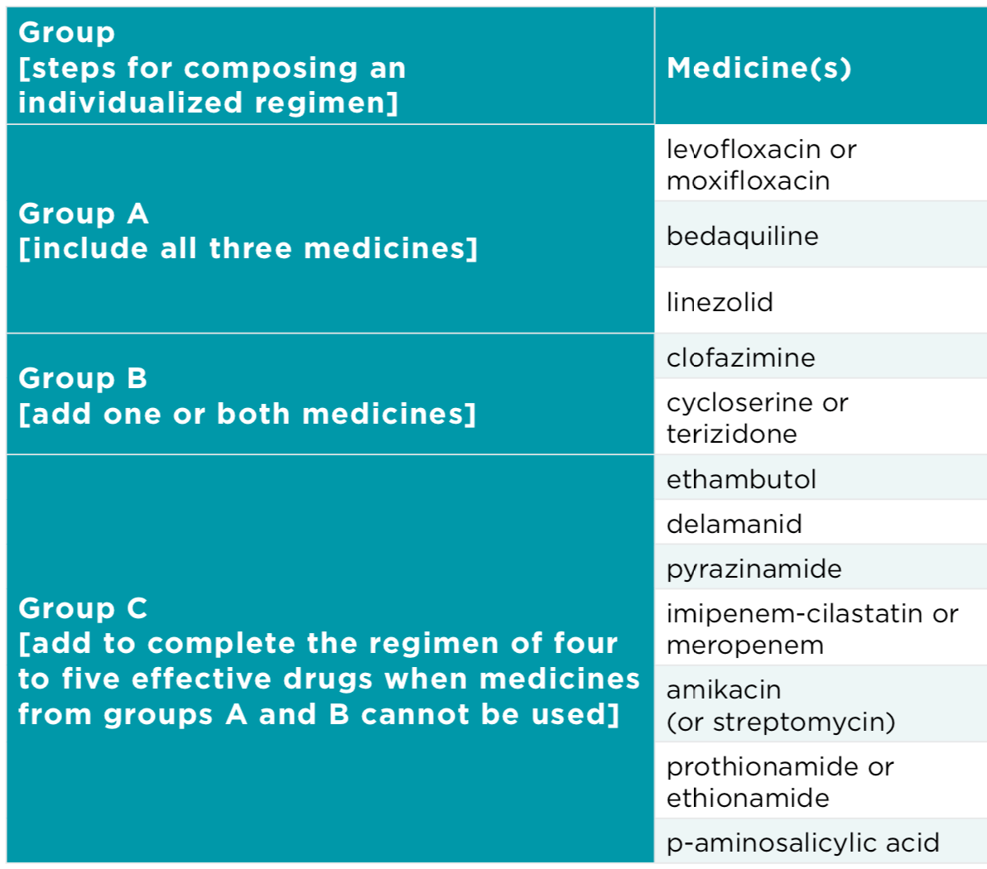
TREATMENT
Rifampicin- / Multidrug-Resistant TB (RR-/MDR-TB):
Program Conditions
In 2020, the WHO also recommended that RR-/MDR-TB could be treated with an 18-20-month individualized, all-oral regimen constructed of 4-5 medicines according to the table on the left side of the screen
This regimen can be used for people whose TB is resistant to rifampicin +/- isoniazid (RR-/MDR-TB) AND for people whose TB has been previously treated with and/or shown to have resistance to a fluoroquinolone – moxifloxacin or levofloxacin (pre-XDR-TB)
20
Notes:
Under program conditions, people with RR-/MDR-TB with previous exposure to the medicines used in the 9-12 month standardized, all-oral regimen, or with extensive TB disease, or with severe extrapulmonary TB, or with resistance to the fluoroquinolones should instead be treated with the 18-20 month individualized regimen, constructed according to the table on the slide. These groups are not eligible for the 9-12 month standardized, all-oral regimen.

Slide 21
TREATMENT
Pre-Extensively Drug-Resistant TB (pre-XDR-TB): Operational Research
In 2020, the WHO recommended that pre-XDR-TB be treated under program conditions with an 18-20-month individualized, all-oral regimen constructed of 4-5 effective medicines (selected according to the table on previous slide)
18-20 BDQ LZD CFZ CS +/- E OR DLM
Under conditions of operational research, the WHO also recommended that
pre-XDR-TB (i.e., MDR-TB with additional fluoroquinolone resistance) could be treated with the 6-to-9-month Nix-TB or “BPaL” regimen
6-9 Bdq Pa Lzd
6-to-9-months of daily bedaquiline, pretomanid, and linezolid
Can only be given to persons without prior exposure to bedaquiline or linezolid or prior exposure for no more than two weeks; prior exposure to clofazimine (cross-resistance with bedaquiline), or delamanid (same drug class as pretomanid) should also be considered in determining regimen eligibility;
Cannot be given to persons younger than 14 years old, weighing less than
35 kg, and/or with extrapulmonary TB
21
Notes:
FACILITATOR PROMPT:
Who remembers how pre-XDR-TB is defined?
A: MDR-TB with additional fluoroquinolone resistance; TB that is resistant to rifampicin, isoniazid, AND moxifloxacin or levofloxacin.
PRE-XDR-TB (MDR-TB with additional resistance to fluoroquinolones)
Under routine program conditions, the WHO recommends an 18-20 month individualized regimen for pre-XDR-TB and XDR-TB, constructed according to the drug-resistance profile and the table on the previous slide, starting with Group A and B and working down the list until a regimen with 4-5 effective medicines can be constructed.
Under conditions of operational research, because of uncertainties given the small number of participants in the Nix-TB trial, and the significant toxicity observed with the high dose of linezolid used, is the Nix-TB regimen, which consists of bedaquiline, linezolid and pretomanid. The Nix-TB regimen, also commonly referred to as the BPaL regimen, is only recommended for use for the treatment of pre-XDR, and treatment intolerant or non-responsive MDR-TB, and again, only under conditions of operational research.

Slide 22
Which of the following groups are eligible for the
9-12-month standardized, all-oral regimen?
  People with resistance to fluoroquinolones (e.g., moxi or levo)
  People with extrapulmonary TB
  Children
  None of the above
How might a regimen be constructed for a person
diagnosed with TB resistant to rifampicin and isoniazid only?
  Write out your answer [duration and drugs to be included]
What about a regimen for a person diagnosed with TB
resistant to rifampicin, isoniazid, and moxifloxacin?
  Write out your answer [duration and drugs to be included]
Answer 1: 18-20 months of Lfx + Bdq + Lzd + Cfz +/- Cs
Answer 2: 6 Bdq + 4-6 Eto hdH Lfx Cfz Z E / 5-6 Lfx Cfz Z E
Answer 1: 18-20 months Bdq + Lzd + Cfz Cs +/- E or Dlm
22
Notes:
ANSWER KEY
(1) Which of the following groups are eligible for the 9-12-month standardized, all-oral regimen?
A: the answer is (C) children
(2) How would a regimen be constructed if a person were diagnosed with TB resistant to rifampicin and isoniazid only?
A1: 18-20 months of Lfx + Bdq + Lzd + Cfz +/- Cs
A2: 6 Bdq + 4-6 Eto hdH Lfx Cfz Z E / 5-6 Lfx Cfz Z E
(3) What about if a person were diagnosed with TB resistant to rifampicin, isoniazid, and moxifloxacin?
A: 18-20 months Bdq + Lzd + Cfz Cs +/- E or Dlm

Slide 23
TREATMENT
Extensively Drug-Resistant TB (XDR-TB)
The WHO recommends that XDR-TB, be treated with an 18-20-month individualized regimen composed of at least 4-5 effective drugs selected according to the WHO table that prioritizes TB medicines into groups A, B, and C (see slide #20)
Some examples of what regimens for XDR-TB might look like, depending on which group A medicine(s) and individual’s TB is resistant to include:
    18-20 Bdq Cfz Cs Dlm +/- Z or E or other group C drugs
    18-20 Lzd Cfz Cs Dlm +/- Z or E or other group C drugs
    18-20 Cfz Cs Dlm +/- Z or E or other group C drugs
Kanamycin and capreomycin (injectable agents) are no longer recommended by the WHO to treat drug-resistant TB as their use was associated with worse treatment outcomes in an analysis of 13,000 patients;
Amikacin (an injectable agent) may still be used as a group C drug in salvage situations, but patients should be closely monitored for hearing loss
23
Notes:
FACILITATOR PROMPT:
Ask participants if they remember the new definition for XDR-TB
A: MDR-TB with additional resistance to fluoroquinolones AND other group A medicines, i.e., bedaquiline +/- linezolid
XDR-TB (MDR-TB with additional resistance to fluoroquinolones and other group A medicines, i.e., bedaquiline +/- linezolid)
XDR-TB can be treated under routine program conditions using an 18-20-month individualized regimen, again constructed according to the table slide 20 given that by definition this type of TB is resistant to some of our most powerful second line medicines (i.e., fluoroquinolones, bedaquiline, linezolid – Group A); regimens designed to treat XDR-TB are also commonly referred to as salvage regimens.

Slide 24
DS-TB
2HRZE/4HR
“6-month regimen”
H = isoniazid
R = rifampicin
Z = pyrazinamide
E = ethambutol
RR-/MDR-TB
6B + 4hdHEtoCLxEZ/5CLxEZ
“9-12 month standardized, shorter, all-oral regimen”
B = bedaquiline
C = clofazimine
Lx = levofloxacin
hdH = high-dose isoniazid
Eto = ethionamide
PRE-XDR-TB
18–20-month individualized regimen composed of 4-5 medicines selected according to the priority grouping of medicines recommended by the WHO
Or under operational research conditions:
6-9BPaL (Nix-TB regimen)
B = bedaquiline
Pa = pretomanid
L = linezolid
modifications to the 9-12 month standardized, shorter, all-oral regimen
DS-TB
RR-/MDR-TB
Pre-XDR-TB
HR-TB
6(H)RZE + Lfx
Lx = levofloxacin
*H may be included at provider discretion or because FDCs are used
XDR-TB
18–20-month individualized regimen composed of 4-5 medicines selected according to the priority grouping of medicines recommended by the WHO
HR-TB
XDR-TB
24
Notes:
FACILITATOR PROMPT:
For each type of TB listed on the screen describe the regimen(s) that would be used according to WHO recommendations.
DRUG SENSITIVE TB (susceptible to all medicines; can be treated with first-line medicines)
The standard of care for drug-sensitive TB is a 6-month regimen broken out into two parts:
Part I is the intensive phase, which is made up of 4 drugs taken for 2 months –the number represents the duration and each letter represents a TB medicine, so 4HRZE – represents four months of isoniazid, rifampicin, pyrazinamide, and ethambutol taken daily.
Part II is the continuation phase, which is made up of 2 drugs taken for 4 months – represented by 4HR – which stands for four months of isoniazid and rifampin taken daily
ISONIAZID-MONORESISTANT TB
In people with TB that is resistant to isoniazid alone, the WHO recommends a six month regimen composed of rifampicin, ethambutol, pyrazinamide, and levofloxacin.7 People unable to tolerate treatment with levofloxacin can be treated with six months of rifampicin, ethambutol, and pyrazinamide. Higher doses of isoniazid may be able to overcome resistance conferred by certain mutations (inhA), but evidence in humans is limited. Whether or not to include isoniazid, and at an increased or standard dose, is left to provider discretion as there is no clear evidence that the addition of isoniazid to these regimens offers benefit or causes harm to people with HR-TB. The use of fixed-dose combinations (rather than provider discretion) may dictate the inclusion of isoniazid alongside the other medicines recommended for the treatment of HR-TB.
RIFAMPICIN-/MULTIDRUG-RESISTANT TB (resistant to rifampicin +/- isoniazid; cannot be treated with first-line medicines)
The 9-12 month standardized shorter regimen – this is a regimen that may already look familiar as it was previously recommended by the WHO since 2016 – the difference here is that bedaquiline is now recommended in place of the injectable agent.
The 9-12 month standardized regimen consists of 9-12 months of clofazimine, moxifloxacin (or levofloxacin), ethambutol, and pyrazinamide, supplemented by high dose isoniazid, ethionamide (or prothionamide) and bedaquiline for the first 4-6 months.
Modifications to the 9-12 month standardized shorter regimen are allowed, but only under conditions of operational research because of uncertainty regarding the safety and efficacy of these modifications. If someone is resistant to or unable to tolerate any of the medications contained in the standardized shorter regimen, they may receive a modified version of the shorter regimen under operational research.
PRE-XDR-TB (MDR-TB with additional resistance to fluoroquinolones)
Under routine program conditions, the WHO recommends an 18-20 month individualized regimen for pre-XDR-TB and XDR-TB, constructed according to the drug-resistance profile and the table on the previous slide, starting with Group A and B and working down the list until a regimen with 4-5 effective medicines can be constructed.
Under conditions of operational research, because of uncertainties given the small number of participants in the Nix-TB trial, and the significant toxicity observed with the high dose of linezolid used, is the Nix-TB regimen, which consists of bedaquiline, linezolid and pretomanid. The Nix-TB regimen, also commonly referred to as the BPaL regimen, is only recommended for use for the treatment of pre-XDR, andTI/NR-MDR-TB, and again, only under conditions of operational research.
XDR-TB (MDR-TB with additional resistance to fluoroquinolones and other group A medicines, i.e., bedaquiline +/- linezolid)
XDR-TB can be treated under routine program conditions using an 18-20-month individualized regimen, again constructed according to the table on slide 20– given that by definition this type of TB is resistant to some of our most powerful second line medicines (i.e., fluoroquinolones, bedaquiline, linezolid – Group A); regimens designed to treat XDR-TB are also commonly referred to as salvage regimens.

Slide 25
First-line medicines for TB
Medicine | What does it look like? | How does it work? “mechanism of action” | What are possible side effects and drug reactions?
rifampicin |  | Prevents bacterial replication by inactivating bacteria’s ability to make proteins and copy its genetic info (DNA) | Red/orange urine, saliva, sweat, tears Nausea/ headache Rash / hives Flu-like syndrome Liver problems Blood disorders
isoniazid |  | Prevents bacterial growth by inhibiting production of the building blocks of the cell wall | Nausea Numbness or tingling of arms/ legs or swollen joints Liver problems
ethambutol |  | Prevents bacterial growth by obstructing formation of the cell wall | Nausea / headache Confusion Painful or swollen joints Eye pain, blurred vision or other vision changes
pyrazinamide |  | Inhibits vital enzymes and transport across the cell membrane by creating acidic environment within the bacterial cell (active against non-growing/ “persisters”) | Joint or muscle pain Nausea / vomiting Liver problems
25
TREATMENT
Notes:
First line medicines are commonly manufactured and administered as fixed-dose combinations; each tablet contains a certain amount of each medicine in the regimen.

Slide 26
Second-line medicines for TB
Medicine | What does it look like? | How does it work? “mechanism of action” | What are possible side effects and drug reactions?
moxifloxacin |  | Prevents bacterial replication by inhibiting bacteria’s ability to copy its genetic info (DNA) | Nausea, headache, diarrhea, dizziness; rash; muscle aches; tendon problems; irregular heartbeats
levofloxacin |  | Prevents bacterial replication by inhibiting bacteria’s ability to copy its genetic info (DNA) | Nausea, headache, diarrhea, dizziness, insomnia; nightmares/paranoia; muscle aches; tendon problems
bedaquiline |  | Inhibits energy production by interfering with a key enzyme | Nausea, headache, rash; irregular heartbeats /chest pain; liver problems
linezolid |  | Disrupts bacterial growth by inactivating bacteria’s ability to make proteins | Nausea, headache, diarrhea; numbness/tingling/hot hands/feet, vision changes; blood disorders
cycloserine / terizidone |  | Prevents bacterial growth by inhibiting production of the building blocks of the cell wall | Headache, drowsiness/confusion, restlessness; mood changes, suicidal thoughts
clofazimine |  | Inhibits energy production by destabilizing the bacterial cell membrane | Nausea, diarrhea, skin darkening, dry skin; irregular heartbeats
delamanid |  | Prevents bacterial growth by inhibiting production of components of the cell wall | Nausea, vomiting, headache, insomnia, dizziness; irregular heartbeats /chest pain; nightmares, mood changes
ethionamide / prothionamide |  | Prevents bacterial growth by inhibiting production of the building blocks of the cell wall | Nausea, vomiting, stomach pain, diarrhea, increased saliva; thyroid problems
pretomanid |  | Prevents bacterial growth by inhibiting production of the building blocks of the cell wall | Nausea, vomiting, stomach pain, diarrhea, headache; blood disorders, liver problems; [problems with sperm]
26
TREATMENT

Slide 27
TB TREATMENT IN SPECIAL GROUPS
27

Slide 28
SPECIAL GROUPS
People Living With HIV (1 of 3)
In people diagnosed with TB and HIV at the same time, timing of antiretroviral therapy (ART) is important
A serious reaction called immune reconstitution inflammatory syndrome (IRIS) can occur in people simultaneously starting TB treatment and ART
IRIS may present as fever, enlarged lymph nodes, worsening pulmonary infiltrates, respiratory distress, inflammatory changes, or more general clinical deterioration
IRIS is avoided by starting TB therapy before ART
ART is recommended for all people co-infected with HIV and TB, as early as possible (within the first 8 weeks) following initiation of TB treatment
ART should be started within the first 8 weeks of TB treatment, regardless of CD4 cell count, and within the first 2 weeks in patients with profound immunosuppression (e.g., CD4 counts <50 cells/mm3)
28

Slide 29
SPECIAL GROUPS
People Living With HIV (2 of 3)
Rifamycins (e.g., rifampicin, rifapentine) induce drug-metabolizing enzymes and transporters, sometimes affecting the amount of other medicines available in the body
These are referred to as drug-drug interactions, and are common between rifamycins and other medicines processed through similar pathways in the liver (e.g., protease inhibitors, non-nucleoside reverse transcriptase inhibitors)
Drug-drug interactions can be overcome by dosing adjustments, changing HIV drugs, and/or changing TB drugs, e.g., using rifabutin instead of rifampicin
Bedaquiline also interacts with some antiretroviral medications, i.e., efavirenz reduces the amount of bedaquiline in the body; lopinavir/ritonavir increases the amount of bedaquiline in the body (these drugs should not be used together)
29
Notes:
For more information on treating TB/HIV coinfection see:
Chapter 8 of the 2014 WHO Companion Handbook to the Guidelines for the programmatic management of drug-resistant TB, which can be found at: https://apps.who.int/iris/bitstream/handle/10665/130918/9789241548809_eng.pdf;jsessionid=47BCABD109F34F61CF232C0B6C3BD97A?sequence=1
WHO’s 2016 Consolidated ART Guidelines and 2019 policy brief on first- and second-line antiretroviral regimens, which can be found at: https://www.who.int/hiv/pub/guidelines/en/

Slide 30
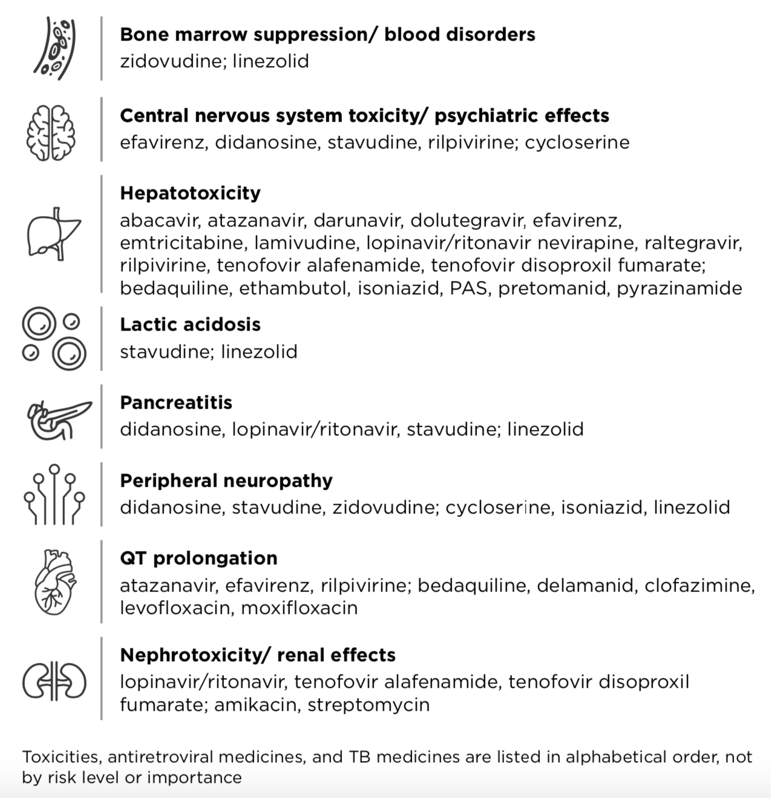
People Living With HIV (3 of 3)
TB and antiretroviral medicines
have overlapping toxicities:
Bone marrow suppression/ blood disorders: a reduction in the production of blood cells from the bone marrow. This can manifest as anemia (red blood cells; causing fatigue), neutropenia (white blood cells; increasing risk of severe infection), or thrombocytopenia (platelets; leading to easy bruising or bleeding).
Central nervous system toxicity/ psychiatric effects: general terms used to denote a group of neurological and psychiatric adverse effects, including weakness, numbness, dizziness, impaired concentration, confusion, insomnia, depression, agitation, hallucinations, psychosis, and suicidal thoughts.
Hepatotoxicity: drug-induced damage or injury to the liver.
Lactic acidosis: when lactic acid accumulates in the bloodstream, causing weakness, muscle pain, and nausea.
Pancreatitis: inflammation of the pancreas.
Peripheral neuropathy: nerve damage in the extremities, which can cause numbness and pain starting in the fingers and toes, spreading upwards.
QT prolongation: a disturbance in the heart’s electrical activity that can lead to serious (and sometimes fatal) rhythmic disturbances.
Nephrotoxicity/ renal effects: drug-induced damage or injury
to the kidneys.
30
SPECIAL GROUPS
Notes:
Overlapping toxicities may also require changing HIV and/or TB medicines.

Slide 31

Adolescents & Children
Adolescents have similar TB disease presentation (cavitary in the lungs) and drug metabolism to adults and so are typically treated with the same regimens and tablets as adults (though adolescents often require additional counseling and adherence support)
Children can have different forms of TB disease presentation compared to adults (e.g., higher rates of paucibacillary TB [fewer bacteria] and TB outside the lungs) – the site and severity of TB disease determines the composition and duration of the regimen
Limited pediatric dosing and safety information for certain drugs, especially for young children, also affect regimen composition and duration (delamanid is WHO-recommended for
children age 3 years and up; bedaquiline is WHO-recommended for children age 6 years and up; pretomanid and the Nix-TB regimen are not yet WHO-recommended for anyone under 14 years of age)
New pediatric-friendly, appropriately dosed formulations of first-line TB medicines are widely available as dispersible fixed-dose combinations +/- stand alone dispersible ethambutol
Not all second-line TB medicines are available in child-friendly formulations, but dispersible or mini tablets of bedquiline, levofloxacin, moxifloxacin, clofazimine, cycloserine, and ethionamide can all be procured from the Global Drug Facility (GDF), and a child-friendly formulation of delamanid is available from Otsuka under compassionate use
In children, it can be difficult to diagnose, monitor, and assess response to treatment – clinicians often rely on a combination of bacteriological, clinical, and empirical information
31
SPECIAL GROUPS
Notes:
WHO age and weight-based dosing recommendations and other guidance related to treating TB in children are available from:
2014 / second edition Guidance for national tuberculosis programmes on the management of tuberculosis in children: https://www.who.int/tb/publications/childtb_guidelines/en/
Module 4 of the WHO Operational Handbook on TB: https://www.who.int/publications/i/item/9789240006997

Slide 32

SPECIAL GROUPS
Pregnant individuals
Pregnant individuals are typically excluded from clinical trials, limiting data available to inform treatment
Several medicines used for the treatment of drug-resistant TB are contraindicated during pregnancy, i.e., the injectable agents
(amikacin, streptomycin) and ethionamide/prothionamide
Pregnant individuals with drug-sensitive TB are treated with the
same regimens as non-pregnant individuals, consisting of rifampicin,
isoniazid, ethambutol +/- pyrazinamide
Pregnant individuals with drug-resistant forms of TB may receive
treatment with a modified nine- to 12-month shorter regimen (linezolid
given in place of ethionamide)
Alternatively, pregnant individuals with drug-resistant TB may receive treatment with an individualized regimen, the composition of which
is informed by a mix of animal data, expert opinion/experience,
and risk-benefit analysis
Data from a cohort of 108 pregnant individuals from South Africa, among which 58 were treated with a bedaquiline-containing regimen, suggest that bedaquiline can be safely used during pregnancy
32

Slide 33

SPECIAL GROUPS
People with Hepatitis C Virus
Direct-acting antiviral drugs (DAAs), used to treat HCV, are metabolized in the liver by enzymes that can be inhibited or induced by other
drugs
Inhibition of these enzymes can lead to slower drug metabolism resulting in higher drug exposures, and induction can lead to faster drug metabolism resulting in lower drug exposures
Rifamycins (rifampicin, rifapentine), used to treat drug-sensitive TB, are known to induce these enzymes, decreasing the concentration of DAAs to subtherapeutic levels
Limited data are available regarding the effects of medicines used to treat drug-resistant TB on enzymes involved in the metabolism of DAAs
Given the limited knowledge of potential interactions between DAAs and the medicines used to treat drug-resistant TB, people with HCV undergoing treatment for DR-TB should consult with their health care provider about how to optimally time and safely initiate treatment for HCV
33

Slide 34

SPECIAL GROUPS
People Who Use Drugs
Some people who have used heroin or other opiates take opioid substitution therapy (OST) to help them stop using drugs
Methadone and buprenorphine are the most used forms of OST
Rifampicin interacts with these forms of OST, reducing methadone and buprenorphine levels in the body
People with TB on OST may need to switch from rifampicin to rifabutin (similar to rifampicin, but does not interact with methadone in this way) or a higher dose of OST
Bedaquiline likely also reduces the amount of methadone and buprenorphine in the body
People on OST and treatment for drug-resistant TB should be closely monitored for signs of opiate withdrawal and other adverse events
(e.g., liver toxicity, QT prolongation) requiring dose adjustments or treatment interruptions
Active drug use should not be used as a reason to withhold
treatment for TB
34
Notes:
*for more information on opiod substitution therapy go to http://www.who.int/substance_abuse/publications/en/PositionPaper_English.pdf
*for more information on TB drug interactions go to http://www.who.int/emlib/Medicines.aspx

Slide 35
DETERMINING ACCESS BARRIERS
35

Slide 36






BARRIERS
The Cascade Of TB Care
10 million people become sick with TB each year
71% of people are diagnosed and started on treatment (7.1 million)
60% of people are successfully treated (6 million; 85% treatment success rate)
36

Slide 37
BARRIERS
The Cascade Of TB Care
500,000 people become SICK with DR-TB each year
37% people are DIAGNOSED
31% people are
STARTED ON TREATMENT
12-17% people are SUCCESSFULLY TREATED
37

Slide 38



Define Along The TB Care Cascade In Your Community
Challenges in communities
Recognizing symptoms
Seeking
care
Diagnosis
Starting
treatment
Completing
treatment
Challenges in health programs
38
BARRIERS
Notes:
Facilitator prompt: Ask participants to fill in challenges along the cascade of TB care
Once mapped out, discuss potential solutions and advocacy approaches or other strategies that might be employed to address the challenges described.

Slide 39
Determining Access Barriers
Access to TB testing and appropriate diagnosis is a major barrier to TB treatment (this is covered in depth in the training module focused on TB Diagnosis and An Activist’s Guide to Tuberculosis Diagnostic Tools).
First-line medicines are affordable and widely available, often as fixed-dose combinations (FDCs).
Repurposed second-line medicines are also relatively affordable, especially with the introduction of multiple quality-assured generic suppliers of these medicines (levofloxacin, moxifloxacin, linezolid, clofazimine) in recent years.
Sponsors of newer TB drugs, bedaquiline, delamanid, and pretomanid, however, still benefit from patent protections, and control the prices of these medicines directly and through voluntary licenses granted to generics companies.
Historically, knowledge gaps have played an outsized role in restricting access to newer medicines and regimens for drug-resistant TB / slowed the speed at which they have been taken up by National TB Programs.
Though important limitations remain, registration, intellectual property, and pricing barriers are now more obviously impeding access to the newer medicines needed to compose the regimens that the WHO recommends.
39
BARRIERS
Notes:
REGISTRATION: the process through which drug sponsors seek regulatory approval.
INTELLECTUAL PROPERTY: a category
of property, including knowledge and products, over which companies can claim ownership.

Slide 40
Where Are New TB Drugs Registered With National Regulatory Authorities (as of June 2020)?
Medicine | Approved | Filed | Planned
bedaquiline | Armenia, Belarus, Brazil, Burundi, Cameroon, China, Democratic Republic of Congo, Ethiopia, European Union, Hong Kong, Iceland, India, Indonesia, Israel, Japan, Liechtenstein, Macau, Mexico, Moldova, Mongolia, New Zealand, Norway, Peru, Philippines, Russian Federation, Rwanda, South Africa, South Korea, Taiwan, Tanzania, Thailand, Turkey, Turkmenistan, Uganda, Ukraine, United Kingdom, United States, Uzbekistan | Ghana, Kenya, Malaysia, Myanmar, Namibia, Nigeria, Tajikistan, Vietnam, Zambia, Zimbabwe | Bahrain
delamanid | China, European Union, Hong Kong, India, Indonesia, Japan, Kazakhstan, Mongolia, Peru, Philippines, Russian Federation, South Korea, South Africa, Turkey, Turkmenistan, Ukraine, United Kingdom | Azerbaijan, Brazil, Mexico, Morocco, Uzbekistan | Armenia, Belarus, Cameroon, Democratic Republic of Congo, Ethiopia, Georgia, Ghana, Kenya, Kyrgyzstan, Malawi, Moldova, Mozambique, Nigeria, Pakistan, Tanzania, Uganda
pretomanid | India, United States | Democratic Republic of Congo, Ethiopia, European Union, Mozambique, Philippines, South Africa, Thailand, Vietnam, Zimbabwe | Australia, Azerbaijan, Bangladesh, Belarus, Brazil, Cambodia, Cameroon, Georgia, Indonesia, Kazakhstan, Kenya, Kyrgyzstan, Laos, Moldova, Myanmar, Nigeria, Pakistan, Peru, South Korea, Tajikistan, Turkmenistan, Ukraine, Uzbekistan
40
BARRIERS
Notes:
*Table is for adult formulations as of 16 June 2020.

Slide 41
What is driving the cost of drug-resistant TB treatment regimens?
Medicine | Current Price* (per patient per month) | Target Price for Generic Versions (per patient per month)**
moxifloxacin (M; Mx; Mfx) | US$10 | US$4–8
levofloxacin (L; Lx; Lfx) | US$2.50 | US$7–17
linezolid - 600 mg (Lz; Lzd) | US$13 | US$5–13
clofazimine (Cfz) | US$15 | US$4–11
bedaquiline (J; Bdq) | US$45–57 | US$8–17
delamanid (D; Dlm) | US$283 | US$5–16
pretomanid (Pa) | US$61 | US$5–16
*Lowest GDF price: http://www.stoptb.org/gdf/drugsupply/drugs_available.asp. **Target price ranges are based on the estimated costs of active and inactive pharmaceutical ingredients, formulation, packaging, and a cost-plus model, which includes a reasonable profit margin: https://doi.org/10.1093/jac/dkw522.
41
BARRIERS

Slide 42
Who Controls the Cost of DR-TB Treatment Regimens?
Medicine | International (PCT) patent applications* (expiry) | Company | Price per month | Geographic scope**
bedaquiline | base compound: WO2004011436 (Jul 2023) fumarate salt: WO2008068231 (Dec 2027) | Johnson & Johnson (J&J)/ Janssen (patent holder) | Adult form: LMIC: US$45-57† HIC: US$5,000 Pediatric form: LMIC: US$33 HIC: US$2,500 | Global (minus Georgia and CIS countries)
 |  | Pharmstandard (licensee) | CIS: US$246 | Russian Federation, Armenia, Azerbaijan, Belarus, Georgia, Kyrgyzstan, Kazakhstan, Moldova, Tajikistan, Turkmenistan, Uzbekistan
delamanid | base compound: WO2004033463 (Oct 2023) | Otsuka (patent holder) | LMIC: US$283 HIC: US$5,000 | Australia, Canada, China, Egypt, European Union, Iceland, Liechtenstein, Norway, Switzerland, Hong Kong, Indonesia, Japan, Myanmar, Philippines, South Korea, Singapore, Taiwan, Thailand, Turkey, United States, Vietnam
 |  | R-Pharm Russia/ R-Pharm Germany (licensee) | Unknown | Russian Federation, Armenia, Azerbaijan, Belarus, Georgia, Kyrgyzstan, Kazakhstan, Moldova, Tajikistan, Turkmenistan, Ukraine, Uzbekistan
 |  | Mylan (licensee) | LMIC: US$283 South Africa: US$157 | Global (minus Otsuka + R-Pharm)
pretomanid | combination regimen (BPaL): WO2017066053A1 (Oct 2036) | TB Alliance (patent holder) | NA | No plans for direct commercialization
 |  | Mylan (licensee) | LMIC: US$61 HIC: US$600 | 214 countries (70 exclusive) – see medspal.org
 |  | Macleods (licensee) | Unknown | 143 countries – see medspal.org
 |  | Hongqi Pharma (licensee) | Unknown | China, Taiwan, Hong Kong, Macau
42
BARRIERS
Notes:
*Please note that not all relevant international (PCT) applications are listed here. For a more detailed overview of relevant patents and their current status by country (granted, pending, filed) visit medspal.org, conduct a national patent search, or contact your national patent office
**Geographic scope refers to territories where patent holders retained or licensed rights to commercialize products, not territories where patents are granted, pending, or filed
†LMIC price range listed for bedaquiline reflects a baseline price of US$57 per month plus up to 20% free goods at annual volumes above 125,000 treatment courses. Up to 30% free goods is possible at annual volumes above 200,000 under the agreement negotiated between J&J and the Stop TB Partnership Global Drug Facility (GDF).
LMIC means low- and middle-income countries; HIC means high-income countries; and CIS refers to member states of the Commonwealth of Independent States

Slide 43
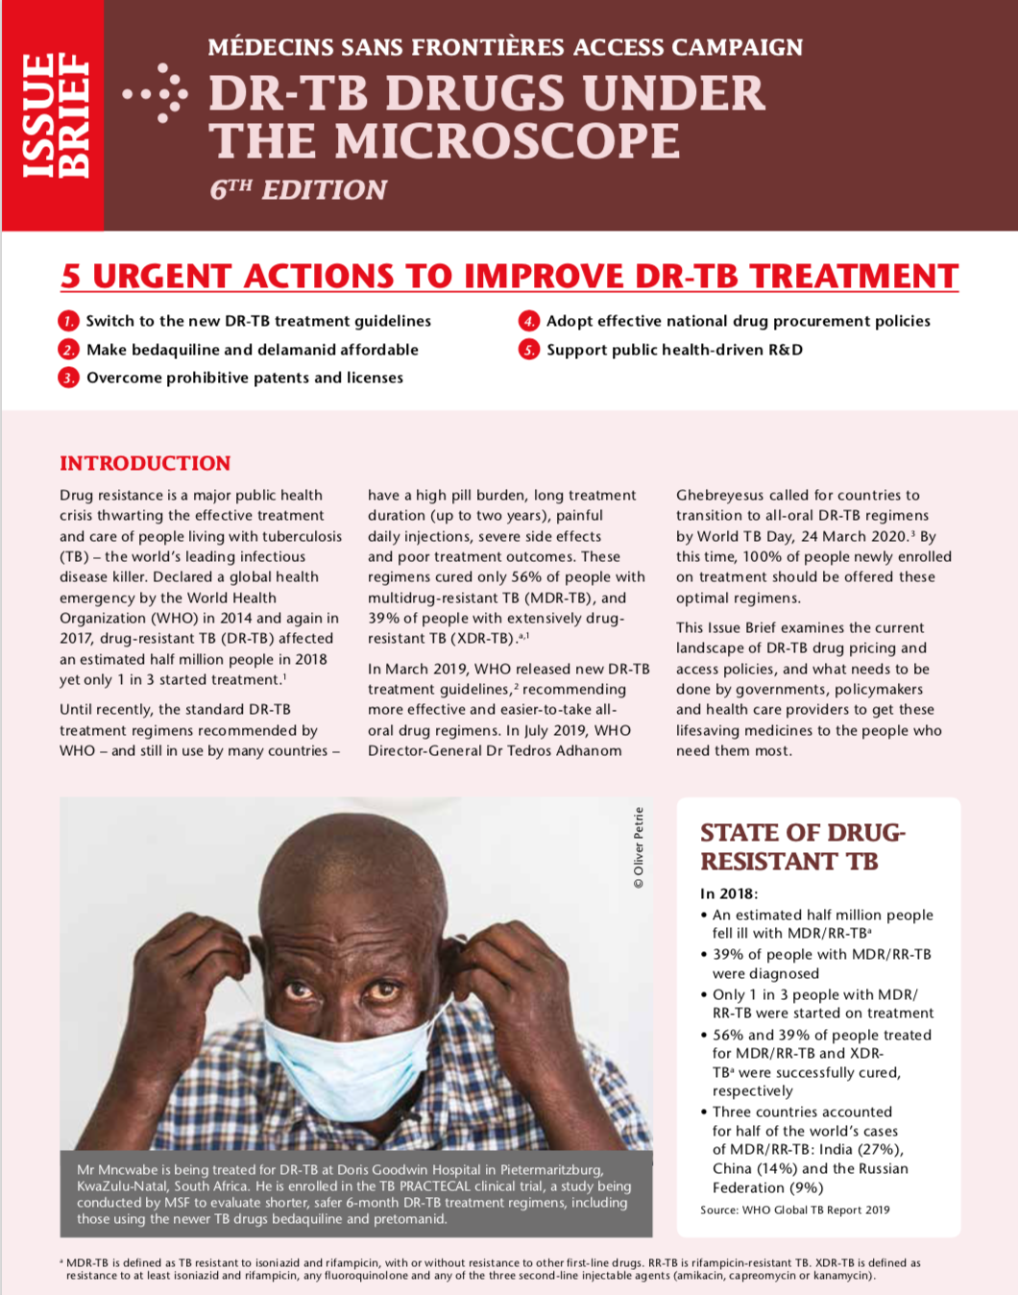
TB Drugs: Under the Microscope
For a comprehensive overview of TB drug supply, pricing, and patent issues by medicine, refer to MSF’s issue brief, DR-TB Drugs Under the Microscope, 6th Edition.
Médecins Sans Frontières Access Campaign outlines five urgent actions for governments, policymakers, and health care providers:
adopt new treatment guidelines;
lower the price of breakthrough drugs;
surmount prohibitive patents and licensing policies;
implement effective drug procurement practices; and
support public health-driven research and development (R&D).
43
BARRIERS

Slide 44

2020 Step Up for TB Report:
TB Policies in 37 Countries
National policies / guidelines also play an important role in facilitating (or in some cases limiting) access to TB treatments.
The MSF/STBP Step Up for TB Report compares national TB policies in 37 countries (representing 77% of the global TB burden) with international best practices based on WHO guidelines and the latest scientific research.
Three quarters of surveyed countries have revised national policies to include newer, safer, and more effective treatments.
Almost all countries now include longer all-oral regimens in their guidelines, and more than half are implementing a modified shorter all-oral DR-TB regimen.
Yet alarmingly, almost half of countries report continued use of the most toxic injectable medicines and most countries have yet to adopt more person-centered models of care.
Key policies check list and dashboard highlight the successes and opportunities for improvement of national policy responses to TB.
Country factsheets and advocacy tools available here: http://www.stoptb.org/suft/.
44
BARRIERS

Slide 45
TREATMENT RESEARCH
45

Slide 46
RESEARCH
Why Do We Need TB Treatment Research?
TB treatment has improved greatly in recent years, especially treatment for drug-resistant forms of TB
Still, TB treatment can range in duration from 6–20-months, depending on the type of TB, and regimens are composed of multiple medicines, some of which interact with other medicines and/or have have challenging side effects and toxicities
Researchers are evaluating different strategies to improve TB treatment regimens by making them shorter, safer, and more effective, e.g., by optimizing the dose and combinations in which existing and repurposed drugs are given and by advancing new drugs with novel mechanisms of action
46

Slide 47
RESEARCH
Preclinical v. Clinical Research
Preclinical research – in vitro/ in vivo (animals)
hit-to-lead
lead optimization
toxicology
pharmacology / metabolism
Clinical research – in vivo (humans)
phase I – SAD, MAD [single or multiple ascending dose]
phase II – EBA [early bactericidal activity]
phase III – confirmatory trials
phase IV – post marketing surveillance
47
Notes:
Even though the protocols we typically focus on are for clinical trials, it’s important to be aware of the research steps that take place and are necessary before a new medicine can be studied in humans.
First we have what are referred to as discovery studies:
“Hit to lead” and “lead optimization” refer to stages in early drug development where small molecule hits identified through high throughput screening exercises are evaluated and undergo limited optimization to identify promising lead compounds
Promising lead compounds then undergo more extensive optimization in subsequent steps of the drug discovery process, which helps to determine candidates that are potent, targeted, and have characteristics favorable enough for further evaluation and preclinical development.
Preclinical studies look at safety, toxicity, pharmacokinetics, and metabolism
Two categories of pre-clinical studies:
In vitro: study performed or taking place in a test tube, culture dish, or elsewhere outside a living organism.
In vivo: study performed or taking place in a living organism, but in the case of preclinical studies, limited to animals or isolated cells.
Preclinical studies are important for predicting how a compound will behave in the body and for determining whether there are any major toxicities prior to first use in humans in clinical trials.

Slide 48
Drug Development Process
Preclinical (conducted in laboratories)
  In vitro (in test tubes)
  Animal models (In vivo)
Clinical trials (conducted in humans)
  Phase I evaluates the safety, tolerability, pharmacokinetics, pharmacodynamics of a drug; usually in healthy participants for a very short amount of time
  Phase IIa evaluates early bactericidal activity and dosing in participants with TB (usually two weeks)
  Phase IIb evaluates anti-TB activity and early safety in slightly larger group of participants with TB (usually for 2-6 months)
  Phase IIc is small like a Phase IIb but follows patients for longer like phase III to give more info about final outcome
  Phase III evaluates the efficacy of the drug in a larger group of participants at multiple locations and follows patients through to final outcome (relapse-free cure, treatment failure, or death)
  Phase IV collects information on the post marketing use of the drug
48
RESEARCH
Notes:
Phase Ia is “first in human” study so primarily a single dose given to handful of healthy volunteers and focused on safety
Phase Ib is typically a multiple ascending dose study, again given to a handful of healthy volunteers and focused on safety
Phase II is where we start to get a sense of efficacy, which is how the drug does at killing TB – phase IIa enrolls people with TB, and evaluates early bactericidal activity, EBA – so the ability of the drug of interest to kill TB bacteria typically over the course of 7-14 days
Phase IIb is where we start to evaluate the efficacy and safety of a drug of interest when it’s given in combination with other medicines and for a longer period of time, typically ranging from 2–6 months; in these trials the outcomes of interest are usually time to sputum culture conversion, which is a fancy way of saying the amount of time it takes someone to test negative for TB
Phase III trials are much larger and look at drugs in combination and for the full intended duration of treatment; in these trials, the endpoint of interest is relapse free cure
We typically keep an eye on compounds in IIA -- as how compounds are studied in phase IIb determines accelerated/conditional approval and if and in what regimens they will be evaluated in phase III

Slide 49
RESEARCH
Drug Discovery and its Impact on Treatment Duration
1920
BCG vaccine
1943
streptomycin
1963
capreomycin
rifampicin
9-12-month regimen
DR-TB
1955
cycloserine
6-month regimen
DS-TB
2HRZE/4HR
4-month regimen
DS-TB
2HPMZ/2HPM
1934
Gold therapy
abandoned
2014
rifapentine*
delamanid
1952
isoniazid
1961
ethambutol
1920s
1930s
1940s
1950s
1960s
1970s
1980s
1990s
2000s
2010s
2020s
1940
actinomycin
streptothricin
1954
pyrazinamide
2019
pretomanid
6-9-month regimen
DR-TB
1960
ethionamide
1998
rifapentine
1924
Gold therapy
introduced
2012
bedaquiline
1948
PAS
thiacetazone
1957
kanamycin
Duration of Treatment
24 months
6 months
*approved for treating latent TB infection
49

Slide 50
TB Treatment Research (DS-TB)
Study Name | Experimental Arms | For Treatment of | Number of Participants | Phase | Estimated to Complete
SimpliciTB NCT03338621 | 4JPaMZ | DS-TB (MDR-TB) | 450 | III | Feb 2022 [fully enrolled]
RIFASHORT NCT02581527 | 2HR₁₂₀₀ZE/2HR₁₂₀₀ 2HR₁₈₀₀ZE/2HR₁₈₀₀ | DS-TB | 654 | III | Dec 2021
TBTC Study 31/ A5349 NCT02410772 | 2HPZE/2HP 2HPZM/2HPM | DS-TB | 2,516 | III | Results presented 2020 Union Conf.
TRUNCATE-TB NCT03474198 | 2HR_{Hd}ZELz 2HR_{Hd}ZEC 2HPZLzLx 2HZELzJ | DS-TB | 675 | II/III | Dec 2021 [fully enrolled]
APT NCT02256696 | 2PaBHZ/1PaBH 2PaRHZ/1PaRH | DS-TB | 183 | II | Sep 2022
SUDOCU NCT03959566 | 3JDMStz₆₀₀ 3JDMStz₁₂₀₀ 3JDMStz_{600 BID} 3JDMStz_{800 BID} | DS-TB | 75 | IIb | Oct 2021
DECODE NCT04550832 | 4JDMDzd₄₀₀ 4JDMDzd₈₀₀ 4JDMDzd₁₂₀₀ 4JDMDzd_{800 BID} | DS-TB | 75 | IIb | May 2022
Focused on shortening treatment to 2–4 months by optimizing rifamycin selection (i.e., R vs. P) and dosing, and/or by introducing new and repurposed medicines to first-line regimens (e.g., J, D, Pa, C, M, Lx, Lz, Stz, Dzd).
B = rifabutin
J = bedaquiline
Lz = linezolid
Lx = levofloxacin
M = moxifloxacin
C = clofazimine
Dzd = delpazolid
Stz = sutezolid
P = rifapentine
Pa = pretomanid
H = isoniazid
R = rifampicin
Z = pyrazinamide
E = ethambutol
Hd = high dose
BID = twice daily
50
RESEARCH

Slide 51
TB Treatment Research (DR-TB)
Study Name | Duration | For Treatment of | BDQ | DLM | PTD | LZD | CFZ | FQ | PZA | Other(s) | Estimated to Complete
SimpliciTB NCT03338621 | 6 months | MDR-TB (DS-TB) | X |  | X |  |  | M | X |  | February 2022 [fully enrolled]
Nix-TB NCT02333799 | 6-9 months | XDR-TB, pre-XDR-TB, TI/NR MDR-TB | X |  | X | X |  |  |  |  | Final results presented CROI 2021
ZeNix NCT03086486 | 6-9 months | XDR-TB, pre-XDR-TB, TI/NR MDR-TB | X |  | X | X |  |  |  |  | December 2021 [fully enrolled]
TB-PRACTECAL NCT02589782 | 6 months | MDR-TB Pre-XDR-TB XDR-TB | X |  | X | X | (X) | (M) |  |  | February 2023
BEAT-Tuberculosis NCT04062201 | 6 months | RR-TB | X | X |  | X | (X) | (Lx) |  |  | March 2023
endTB NCT02754765 | 9 months | MDR-TB | X | X |  | X | X | M/Lx | X |  | January 2023
endTB-Q NCT03896685 | 6-9 months | FQ-R MDR-TB | X | X |  | X | X |  |  |  | September 2023
NEXT NCT02454205 | 6-9 months | MDR-TB | X |  |  | X |  | Lx | X | Eto or HdH or Tzd | December 2020 [fully enrolled]
STREAM stage II NCT02409290 | 6-9 months | MDR-TB | X |  |  |  | X | Lx | X | HdH; Pto or Kan; +/- Emb | July 2022 [fully enrolled]
MDR-END NCT02619994 | 9-12 months | MDR-TB |  | X |  | X |  | Lx | X |  | June 2021
Focused on shortening treatment to 6–12 months and improving outcomes and tolerability by optimizing linezolid dose and duration, and/or by evaluating different combinations of new and repurposed medicines (e.g., J, D, Pa, C, M, Lx, Lz).
51
RESEARCH
Notes:
In terms of ongoing and planned research for drug-resistant TB, here you can see the drugs likely to continue to play an important role in the treatment of drug-resistant TB.
These include bedaquiline, linezolid, the floroquinolones; and to a slightly lesser extent pretomanid, delamanid, and clofazimine.
Of note, all of these medicines are already in use for the treatment of drug-resistant TB – these studies are primarily phase IV studies to help us better understand how to optimally combine newer existing and repuposed medicines to shorten treatment and improve outcomes and tolerability. Results are expected between 2021—2023.

Slide 52
New TB Drugs in Clinical Development
Target | Drug | Class | Mechanism of action | Sponsor | Phase
Energy production | pyrifazimine (TBI-166) | riminophenazine | Inhibits ion transport and bacterial respiration | IMM/CAMS/PUMC | I
 | telacebec (Q203) | imidazopyridine | Inhibits ATP synthesis (QcrB) and bacterial respiration | Qurient/ Infectex | IIa
 | TBAJ-876 | diarylquinoline | Inhibits ATP synthase and bacterial respiration | TB Alliance | Ia/Ib
Cell wall synthesis | BTZ-043 | benzothiazinone | Inhibits cell wall synthesis (DprE1) | University of Munich/DZIF | Ib/IIa
 | macozinone (PBTZ169) | benzothiazinone | Inhibits cell wall synthesis (DprE1) | iM4TB/Nearmedic | Ib/IIa
 | OPC-167832 | carbostyril | Inhibits cell wall synthesis (DprE1) | Otsuka | Ib/IIa
 | SQ109 | 1,2-ethylene diamine | Inhibits cell wall synthesis (MmpL3) | Sequella | IIb
 | TBA-7371 | azaindole | Inhibits cell wall synthesis (DprE1) | TB Alliance | IIa
Protein synthesis | delpazolid (LCB01-0371) | oxazolidinone | Inhibits protein synthesis (23S ribosome) | LegoChem Biosciences | IIb
 | sutezolid | oxazolidinone | Inhibits protein synthesis (23S ribosome) | TB Alliance/ Sequella | IIb
 | TBI-223 | oxazolidinone | Inhibits protein synthesis (23S ribosome) | TB Alliance/ Institute of Materia Medica, China | Ia
 | GSK3036656 (GSK-070) | oxaborole | Inhibits protein synthesis (LeuRS) | GSK | IIa
DNA synthesis | SPR720 | benzimidazole | Inhibits bacterial DNA synthesis (GyrB) | Spero Therapeutics/BMG MRI | Ia/Ib
Cholesterol catabolism | GSK2556286 (GSK-286) |  | Inhibits cholesterol catabolism (target to be determined) | GSK | Ia/Ib
52
RESEARCH
Notes:
Here we have the TB drugs that are further upstream in clinical development.
So to orient you to the table working from left to center, we have the target, the name of the compound, the drug class and the mechanism of action, and then on the right we have the sponsor, some familiar and some newer to us, and finally the phase of development.
15 compounds in clinical development for TB
8 with novel targets/ mechanisms of action
+ 3 oxazolidinones, 1 riminophenazine, and 2 diarylquinolines, of interest as potential advantaged alternatives to existing TB medicines, linezolid, clofazimine, and bedaquiline, respectively
Novel targets:
QcrB (cytochrome bc complex), an essential component of the respiratory electron transport chain required for ATP synthesis;
DprE1 (decaprenylphosphoryl- β-D-ribose 2-epimerase), an enzyme important for cell wall synthesis;
LeuRS (leucyl-tRNA synthetase), an enzyme important for protein synthesis;
GyrB (DNA gyrase subunit B), which plays an essential role in DNA replication; and
Target not yet fully determined, necessary for cholesterol catabolism.
*Compounds that have new targets and/or mechanisms of action are important for constructing effective regimens and staying ahead of drug resistance
***TABLE OBSERVATIONS***
So, if we look back at the table and the compounds in development, there are a couple of things worth taking note of:
The two drugs at the very top of the table work by inhibiting the TB bacteria’s ability to make energy – another drug that inhibits energy production is bedaquiline, which as you heard previously in this presentation, is a core element of regimens for drug-resistant TB
The next four drugs in the table work by inhibiting the TB bacteria from building its cell wall – two other drugs we’ve already heard about that also inhibit cell wall synthesis are delamanid and pretomanid, both from nitroimidazole class
And finally the next 4 drugs in the table, which inhibit protein synthesis are from the same class as another drug we’ve heard about already, and that, similar to bedaquiline, is a core element of regimens for drug-resistant TB, and that drug is linezolid. The hope is that one of these oxazolidinones will be as effective as linezolid but with a better toxicity and safety profile.
So in the pipeline we have drugs from new classes, and in some cases with new mechanisms of action, and we also have drugs from the same class as existing medicines, but that may have a more favorable safety profile. And the ones we should be paying especially close attention to are those in phase IIa and IIb trials.

Slide 53
TB Drug Discovery and Development Landscape
Discovery
Pre-clinical
Phase I/IIa
Phase IIb/c
Phase III
IMI2 AMR Accelerator Programs
RespiriTB, ERA4TB, UNITE4TB
TB Drug Accelerator
NVF CEO Roundtable/ BMGF
Pharmaceutical Companies/ Product Development Partnerships
Clinical Trial Networks and Consortia
ACTG, IMPAACT, TBTC, TBRU, PanACEA, CTCTC
Gates Medical Research Institute
Evotech, J&J, Otsuka, GSK
53
RESEARCH
Notes:
This slide shows some of the actors in the TB drug discovery and development space that help move drugs through the pipeline and the various phases of research.
In blue and yellow you can see where the public-private partnerships fit in, mostly in the discovery, pre-clinical and translational stages of development
The public partner in the partnerships represented by the blue is the European Union via the Horizon 2020 initiative
The public partner in the partnerships represented by the yellow is the Bill and Melinda Gates Foundation
In orange we have pharma and the TB Alliance which is a non-profit organization called a product development partnership, a PDP
And in green we have publicly funded research and clinical trials networks which are focused on the translational and later stages of development
ACTG, IMPAACT, TBTC, and TBRU are funded by the US government
PanACEA is a partnership between European and African governments
And the CTCTC is the China TB Clinical Trials Consortium
This figure is not exhaustive but gives you an idea of who is playing what type of role in the discovery and development of TB drugs

Slide 54
RESEARCH
TB Treatment Research Funding, 2019
54
Source: https://www.treatmentactiongroup.org/resources/tbrd-report/tbrd-report-2020/
Notes:
54
For more information on TB R&D funding trends check out TAG’s TB R&D Resource Tracking Report at http://www.treatmentactiongroup.org/tbrd

Slide 55
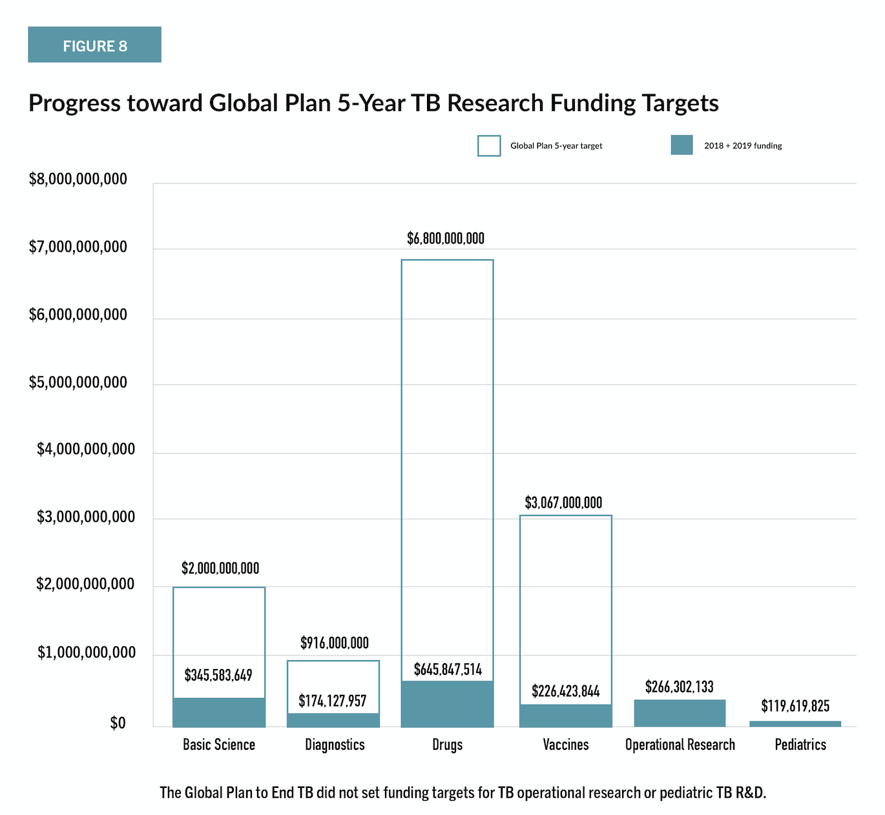
RESEARCH
TB Research Funding v. Targets, 2019
55
Source: https://www.treatmentactiongroup.org/resources/tbrd-report/tbrd-report-2020/

Slide 56
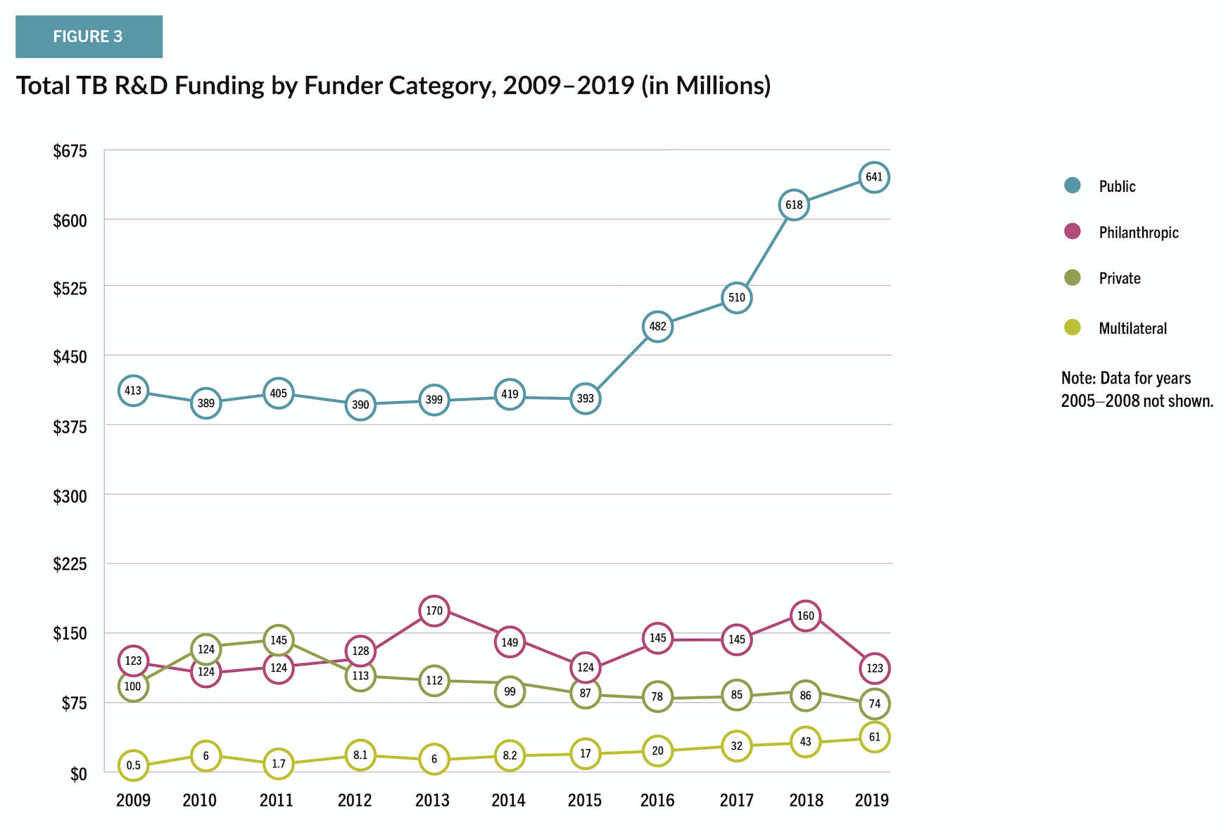
TB Research Funding By Type Of Funder, 2019
Source: https://www.treatmentactiongroup.org/resources/tbrd-report/tbrd-report-2020/
56
RESEARCH

Slide 57
The Push For Better Drugs
Drugs used in TB treatment are far from perfect. The following are a few of the reasons why activists are advocating for access to better drugs / regimens and continued investments in research and development:
  Adherence issues
  Duration of treatment
  Potentially toxic side effects
  Tolerability (e.g., painful injections, peripheral neuropathy)
  Drug interactions
  Poor cure rates with older regimens for drug-resistant TB
  Very little information on treating TB in pregnant/lactating women and other important special populations (e.g., people who use drugs)
Most funding for R&D comes from the public sector. At the UN High Level Meeting on TB in 2018, Heads of State committed to increasing national investments in research and need to be held accountable for delivering on this promise (tracked by TAG by measuring national investments in TB research against national expenditures on research and development overall [GERD] – commonly referred to as “fair share” funding targets).
57
RESEARCH
Notes:
Note to facilitator: This list is by no means exhaustive and facilitators are encouraged to ask group to explore more gaps and challenges of TB treatment that research could address.

Slide 58
TAKING ACTION
58

Slide 59
Taking Action
Collect information to support appeals to national and subnational policy makers to adopt the global standard of care articulated in the WHO consolidated tuberculosis treatment guidelines and informed by evolving scientific evidence.
Apply pressure to government and other national and local actors to increase the number of people with TB and drug-resistant TB that are diagnosed and treated with the regimens recommended by the WHO.
Hold drug sponsors
and generics suppliers of bedaquiline, delamanid, and pretomanid accountable for making these medicines available, accessible, and affordable.
Advocate for governments, drug sponsors, and other funders of TB research and development (R&D) to continue to invest in initiatives designed to fill critical data gaps and further optimize treatment for TB.
59
TAKING ACTION

Slide 60
TAKING ACTION
Review your National Strategic Plan (NSP) and TB Treatment Guidelines to look for policies that are misaligned with WHO guidance (or refer to STBP/MSF 2020 Step Up for TB Report);
Request information on the number of TB and drug-resistant TB treatment starts by regimen, and compare these figures with local incidence estimates;
Collect information to support appeals to national and subnational policy makers to adopt the global standard of care articulated in the WHO consolidated tuberculosis treatment guidelines and informed by evolving scientific evidence.
Examine the national TB donor landscape (i.e., the overall program budget, the percent funded, and the proportion that is domestic vs. donor funding);
Understand the mechanisms and sources of funding used to procure medicines for TB and how corresponding government tenders work;
Look into the availability of nutritional, economic, and mental health support or other assistance programs for patients undergoing treatment for TB; and
Survey healthcare workers and former and current TB patients to understand their experiences and concerns, document policy-practice gaps, and articulate barriers to accessing treatment.
60

Slide 61
TAKING ACTION
Generate demand by empowering TB-affected communities to conduct TB diagnosis and treatment literacy trainings and to monitor the availability of TB tests and treatment regimens locally;
Create links between members of TB-affected communities and community-based and civil society organizations;
Apply pressure to government and other national and local actors to increase the number of people with TB and drug-resistant TB that are diagnosed and treated with the regimens recommended by the WHO.
Build rapport with the National TB Program and providers in the private sector to understand their positions and needs, and to identify entry points and opportunities for advocacy;
Write to members of parliament and officials at government agencies, including those at the district or other sub-national levels, involved in appropriating domestic and donor funding to health programs;
Engage members of your Country Coordinating Mechanism (CCM) and any other bodies that inform funding requests made to international donors.
61

Slide 62
TAKING ACTION
Demand transparency on volumes, costs of goods, pricing, and the terms and conditions of licensing agreements;
Push for a single global access price based on costs-of-goods-sold (COGS; the amount it costs a manufacturer to produce a medicine) and annual volumes;
Hold drug sponsors
and generics suppliers of bedaquiline, delamanid, and pretomanid accountable for making these medicines available, accessible,
and affordable.
Work with lawyers, academics, and public interest organizations to explore national pro-access policies, legal safeguards, and other mechanisms available to support market entry of additional generics manufacturers;
Advocate for new medicines and their generic equivalents to be registered with your national regulatory authority, and for your national regulatory authority to expedite its review of applications for the registration of TB medicines.;
62

Slide 63
TAKING ACTION
Read up on and sensitize policymakers to the TB treatment pipeline, including how, if proven, the medicines and regimens contained therein may make treatment for TB shorter, simpler, safer, and more effective;
Encourage your government to increase its investments in TB R&D, and to contribute to the development of appropriate incentives for, and innovative models of, research that promote transparency, collaboration, and access;
Advocate for governments, drug sponsors, and other funders of TB research and development (R&D) to continue to invest in initiatives designed to fill critical data gaps and further optimize treatment for TB.
Set up or apply to participate in community advisory boards (CABs) or other mechanisms through which TB-affected communities can engage with TB drug and study sponsors to ensure that research investments reflect community needs and priorities.
63

Slide 64
KEY TAKEAWAYS
64

Slide 65
TB Treatment Key Takeaways
TB is curable; the cure (regimen) differs by type of TB (in terms of location, severity, and drug-resistance pattern)
Treatment must be guided by drug susceptibility testing (see module on TB Diagnosis)
New treatment options (all-oral, shorter regimens composed of new and repurposed drugs) must be made widely available
There are a wide variety of issues that affect access to and completion of TB treatment – issues (and solutions) may differ between countries and communities
Communities need access to clear information about TB treatment, especially as new drugs and regimens become available, and support to make it through the cascade of care to treatment completion and beyond
More investment in research is needed to further improve treatment regimens by making them shorter, safer, and more effective, and to inform their optimal use in special populations
65
KEY TAKEAWAYS

Slide 66
Additional Resources
An Activist’s Guide to Treatment for Drug-Resistant Tuberculosis: https://www.treatmentactiongroup.org/publication/an-activists-guide-to-treatment-for-drug-resistant-tuberculosis/
TB Treatment Pipeline Report: https://www.treatmentactiongroup.org/resources/pipeline-report/2020-pipeline-report/
Step Up for TB Report:
https://www.msf.org/step-tb-report-2020
DR-TB Drugs: Under the Microscope:
https://msfaccess.org/drtb-drugs-under-microscope
Guide to Delivering Comprehensive Supportive Care to People with Drug-Resistant Tuberculosis:
https://pdf.usaid.gov/pdf_docs/PA00TNZK.pdf
66
KEY TAKEAWAYS

