Slide 1
Adebola Tope Adams’
Seven-year journey fighting drug-resistant tuberculosis

Slide 2
Adebola Tope Adams went for her tertiary education at the polytechnic in Ondo State.

Slide 3
Tope’s last semester of her final year was between October 2003 and March 2004, with a December break. This is when she started losing a lot of weight and having a persistent cough.
The weight loss and coughing began during the previous semester, but had started getting worse.
On the way back to the school after her mid-semester break in February 2004, Tope was coughing persistently, and nothing was helping.
She bought all kinds of medicines at the chemist, but she was still feeling weak and coughing.

Slide 4
At the end of the semester, Tope went back home.
She then went to the private clinic with her mom, where she received a chest X-ray. When the results from the chest X-ray came back, the doctor said it was tuberculosis (TB), which was treatable.
Along with the TB medication he prescribed, the doctor offered Tope treatment literacy on TB and the importance of treatment adherence.

Slide 5
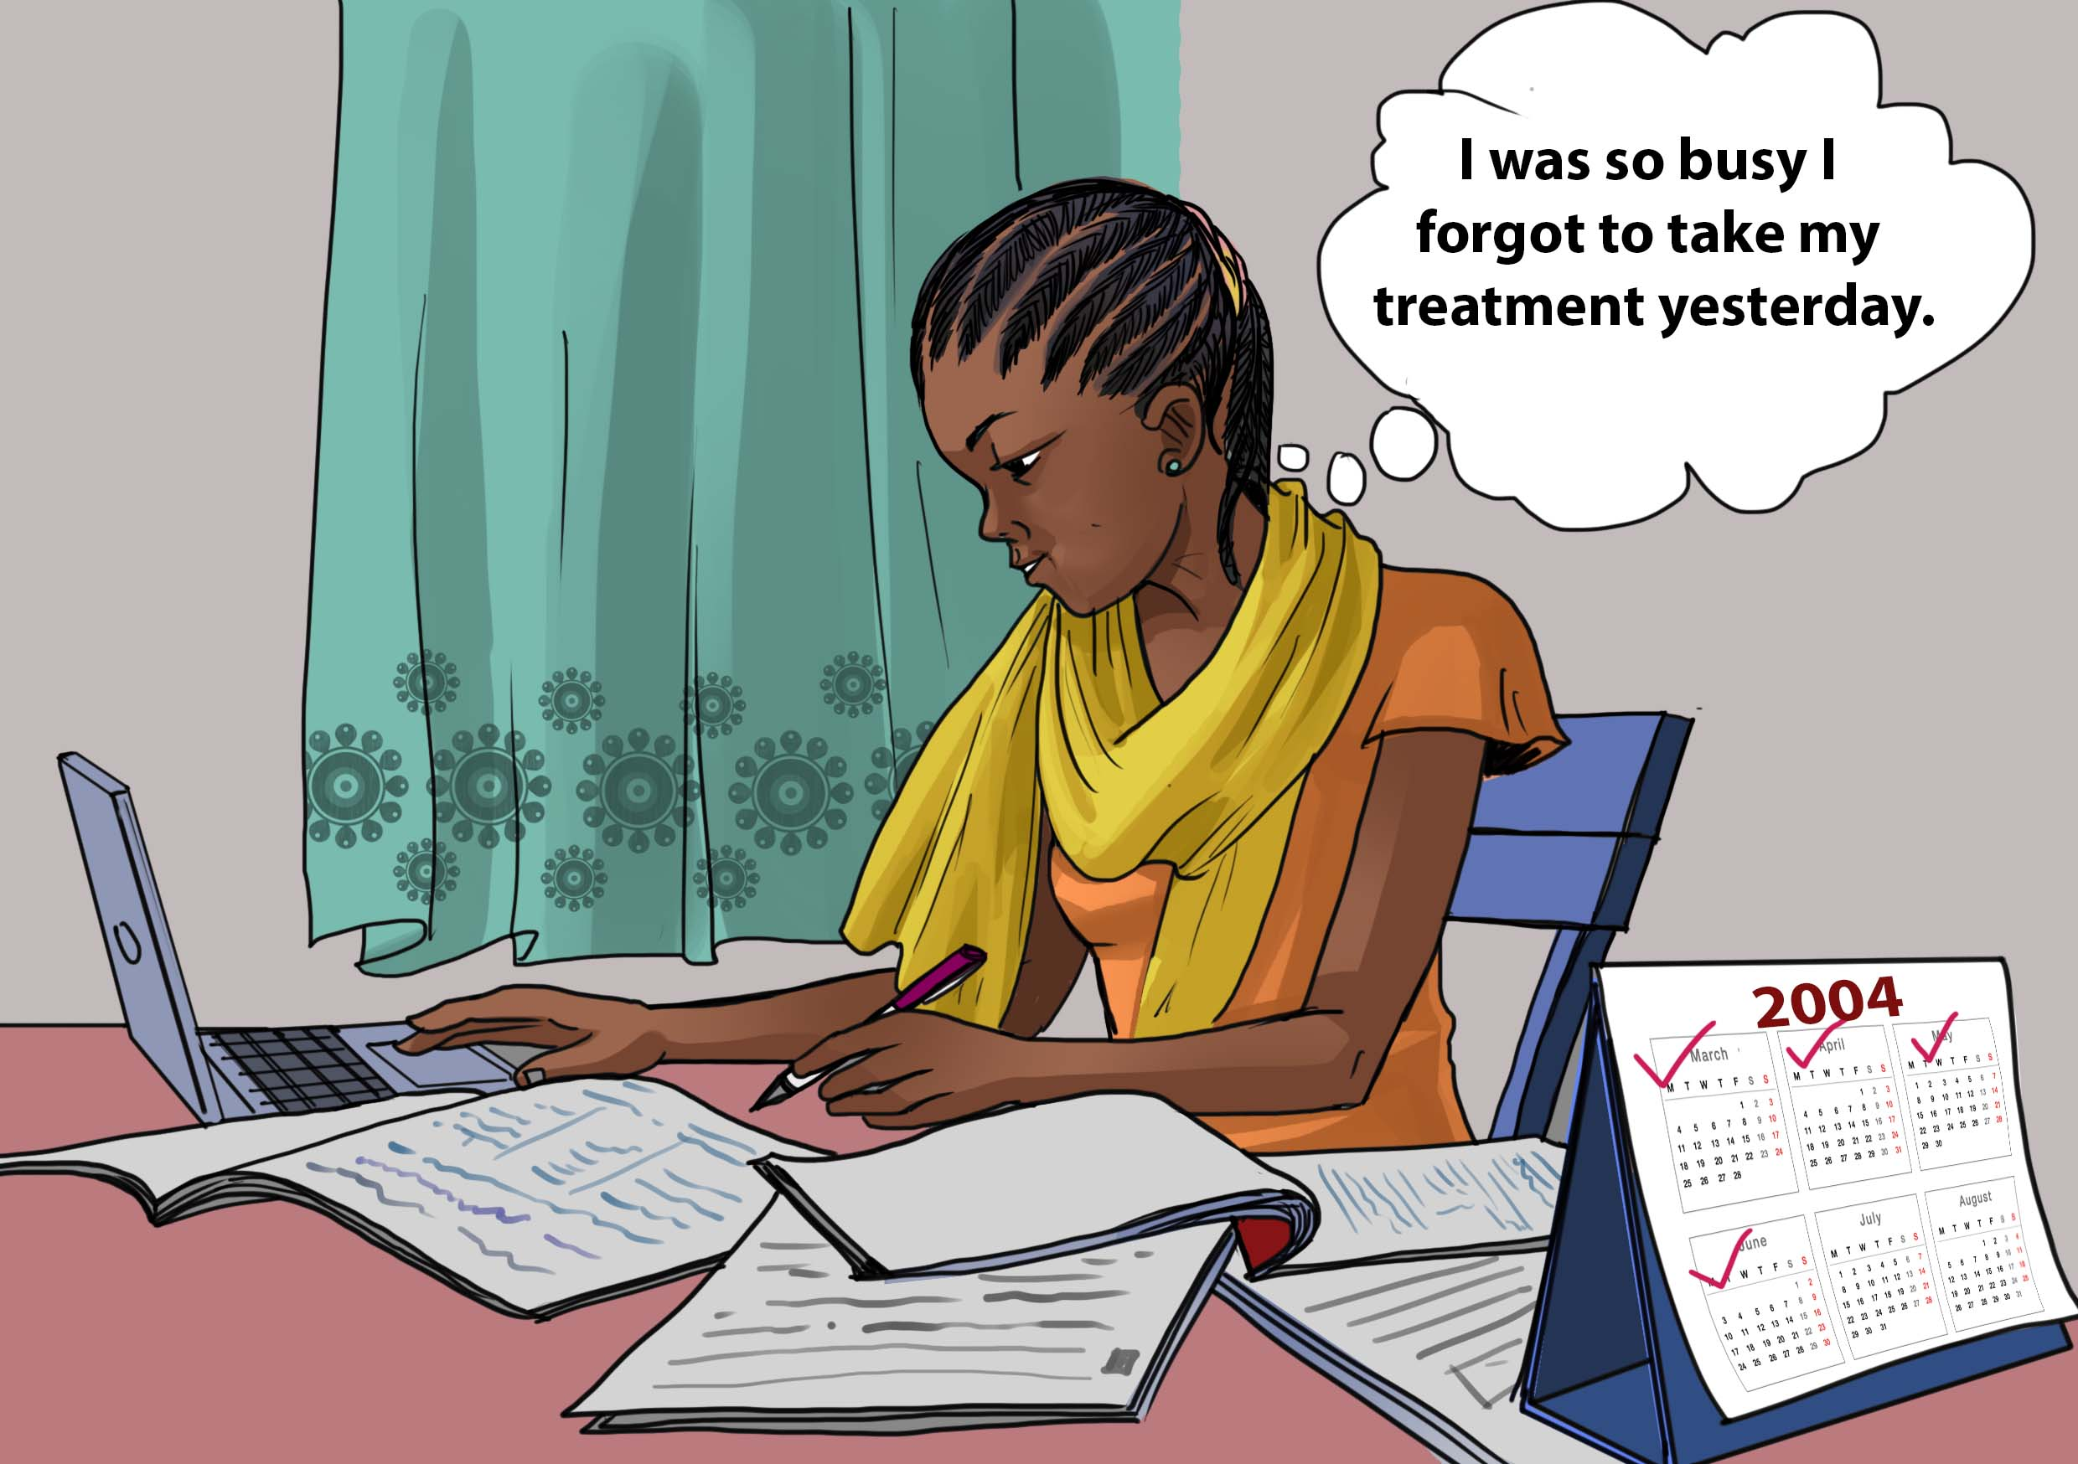
Tope went back to school to complete the rest of her studies. The doctor advised against it, but she was persistent. Arrangements were made with her family to get the medication to her in the other State. She was a 23-year-old student, and treatment adherence was a problem due to her diet. Sometimes Tope took the tablets in the morning and sometimes in the evening. Sometimes she skipped a day or two. But after a week of taking the medication, she started seeing a difference, feeling a bit human again.

Slide 6
Tope completed her degree and went back home. She was still sick. In August 2004, her mom took her to Jericho Chest Hospital in Oyo State. She was asked to do a sputum test, which came out positive. This was the first time Tope experienced stigma from a healthcare worker. The nurse told her to move back, making a noise and embarrassing Tope, her mom, and her uncle. They were isolated. She was referred to the primary healthcare center for retreatment with TB drugs. Tope continued to take the tablets for a few months, including the newly-introduced fixed-dose combination (FDC) in her 3rd month of treatment.
Move back,
you have tuberculosis!

Slide 7
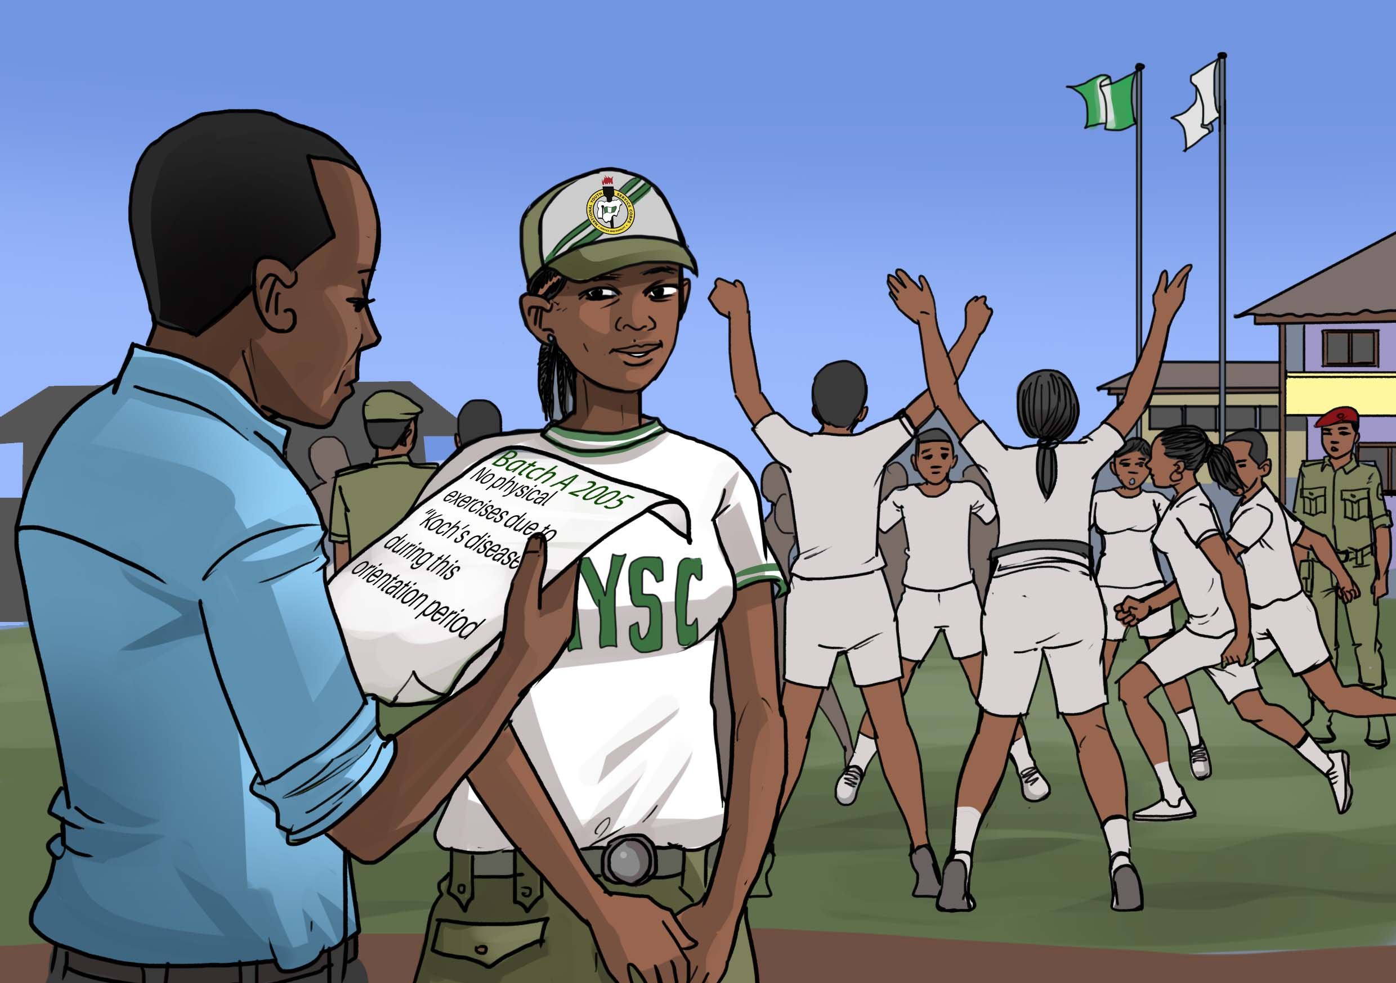
In 2005, Tope was due for the National Youth Service Core (NYSC), which was compulsory vocational training for a year after one’s graduation. By February 2005, a call up letter for NYSC came from the government. Tope needed to go to orientation camp for 3 weeks, similar to soldiers. Her mom had a friend in the NYSC Secretariat, so Tope was able to remain in Oyo State. She was given her drugs everyday through directly observed therapy (DOT) at the primary health facility. Tope went to the physician in charge at the health centre to give her a letter to excuse her from the rigorous morning exercises. She gave the letter to her superiors, and was exempted from these drills.

Slide 8
After the NYSC orientation, Tope was sent to her place of assignment. She was deployed at a school, where she taught Integrated Sciences. Tope enjoyed the job but fell ill often. The people were understanding, and her aunt worked at the school. Tope suffered a relapse of TB in May 2005. Even after the treatment, she was still feeling sick, and continued to relapse often.

Slide 9
Tope was getting progressively worse. Her mom took her to a private clinic. The doctor prescribed three drugs, including the injectable capreomycin for 3 months, as well as more vitamins.

Slide 10
After Tope attended the NYSC parade in February 2005, her spirit was ready for a full-time job, but her body remained weak. Due to her health complications, Tope decided to pursue a Master’s Degree instead of sitting at home. She applied for an MSc in Urban and Regional Planning and commenced her studies in August 2006. This was a two-year programme that took Tope more than two years to complete due to illness as well as the project work. By March 2007, while at school, Tope’s health was deteriorating again, and she went to the school DOT centre in the university clinic. Tope received her treatment there for eight months.

Slide 11
The hospital looked at Tope’s samples and when the results came back, Tope started receiving amikacin injections every day for four months, in addition to other anti-TB medication. Tope’s mom sold a piece of land to pay for her treatment, transportation, and food. The treatment included amikacin injections (400 Naira daily x 4 months) and drugs (7,000 Naira per week x 16 weeks).

Slide 12
On 4th February 2009, Tope defended and completed her Master’s degree and secured a lecturing job. She was supposed to begin her duties the following week, but due to ill-health, she could not accept the job. Tope’s condition was not improving even after taking the concoction of anti-TB treatments. In May 2009, Tope got worse and started coughing up blood! She was weak. Tope was taken to the hospital to the outpatient section, where she met a doctor who said that they would take her sputum samples for testing somewhere else.

Slide 13
Tope met her boyfriend (future husband) on March 6, 2008. She had completed the TB treatment but there was no improvement. In November 2009, Tope’s condition was deteriorating again. She looked close to death. Her boyfriend took her to a place where she was given herbal solutions. The traditional healer advised that she just eat fruit with the herbal medication. She lost a lot of weight.

Slide 14
On 19 December 2009, Tope could not breathe. She was gasping for air and was about to give up. Her mom took her to the University College Hospital the next day. At the hospital, the doctor (who had asked her to send her samples elsewhere for testing) advised that he would get an IV with levofloxacin. The doctor requested that she be admitted at a private health care facility as he feared that she would be stigmatized if she stayed at the hospital. She was admitted to a private clinic, where she stayed for 10 days. Tope took her treatment there and was discharged on 29 December 2009. She then went back home to continue her treatment. She looked a bit better.

Slide 15
Tope visited the University College Hospital in June 2010 for her samples to be transported to a laboratory in Belgium. Her mom paid for the transportation of the sputum. There were new drugs, which were almost available in-country. Tope was meditating and doing a lot of spiritual exercises. Because of her belief and faith, she kept going. She asked for the drugs that they knew were working.

Slide 16
Tope took these drugs every day for a month, with daily transportation requiring 2 cabs costing 200 Naira per day.

Slide 17
On 2 July 2010, Tope was informed that a new progressive treatment had arrived after years of waiting. She was told that the Infectious Diseases Centre was modified and repurposed, and she was advised that she would be admitted for 6 months to be placed on this new treatment. She went home to pack with her mom and nanny to go to hospital.

Slide 18
Tope was admitted to the Infectious Diseases Centre on 5 July 2010, where the patients were all placed on a new treatment programme for drug-resistant TB (DR-TB). They took samples, and people were fed and they rested. Tope was given injections, starting with amikacin. Her behind was sore from the daily injections. Upon admission, Tope weighed 40kgs. After a week, she gained 3 kgs. (Her normal weight was 56-60kgs.) People were crying when it was injection time (**7/10 pain levels**).

Slide 19
I’m finally getting better
Tope was admitted at the Infectious Diseases Centre for 7 months, and during this time, her test results came back negative. Even after she was discharged, she kept going back for 17 months of daily treatment. She felt that she finally had her life back.

Slide 20
Tope got married in November 2011. On 4 July 2012, she completed her two years of TB treatment.

Slide 21
The health care workers at the Infectious Diseases Centre were so supportive that Tope wanted to be a champion and to help others with DR-TB. She has since been invited to TB and leprosy supervisors training workshops, and she works on TB-related matters on a voluntary basis. Tope was a spokesperson on World TB Day in 2013 in Abuja. Shortly after she got married, Tope was part of a patient-centered approach workshop in Lagos. She has met the first lady and has spoken about her journey on numerous occasions. In 2015, in Abuja, Tope was invited to join the Stop TB Partnership Board. In 2019, Tope attended a gala hosted by the Stop TB Partnership and the Presidency. She continues to be an advocate for TB People in Nigeria.

Slide 22
Tope became pregnant with her first child in August 2012. She has since had three other children. Tope is studying towards her PhD and is currently writing children’s books, because she cannot find a job as a TB survivor.
JOB
REJECTION

