Slide 1
Paran Sarimita Winarni’s
Journey fighting drug-resistant tuberculosis

Slide 2
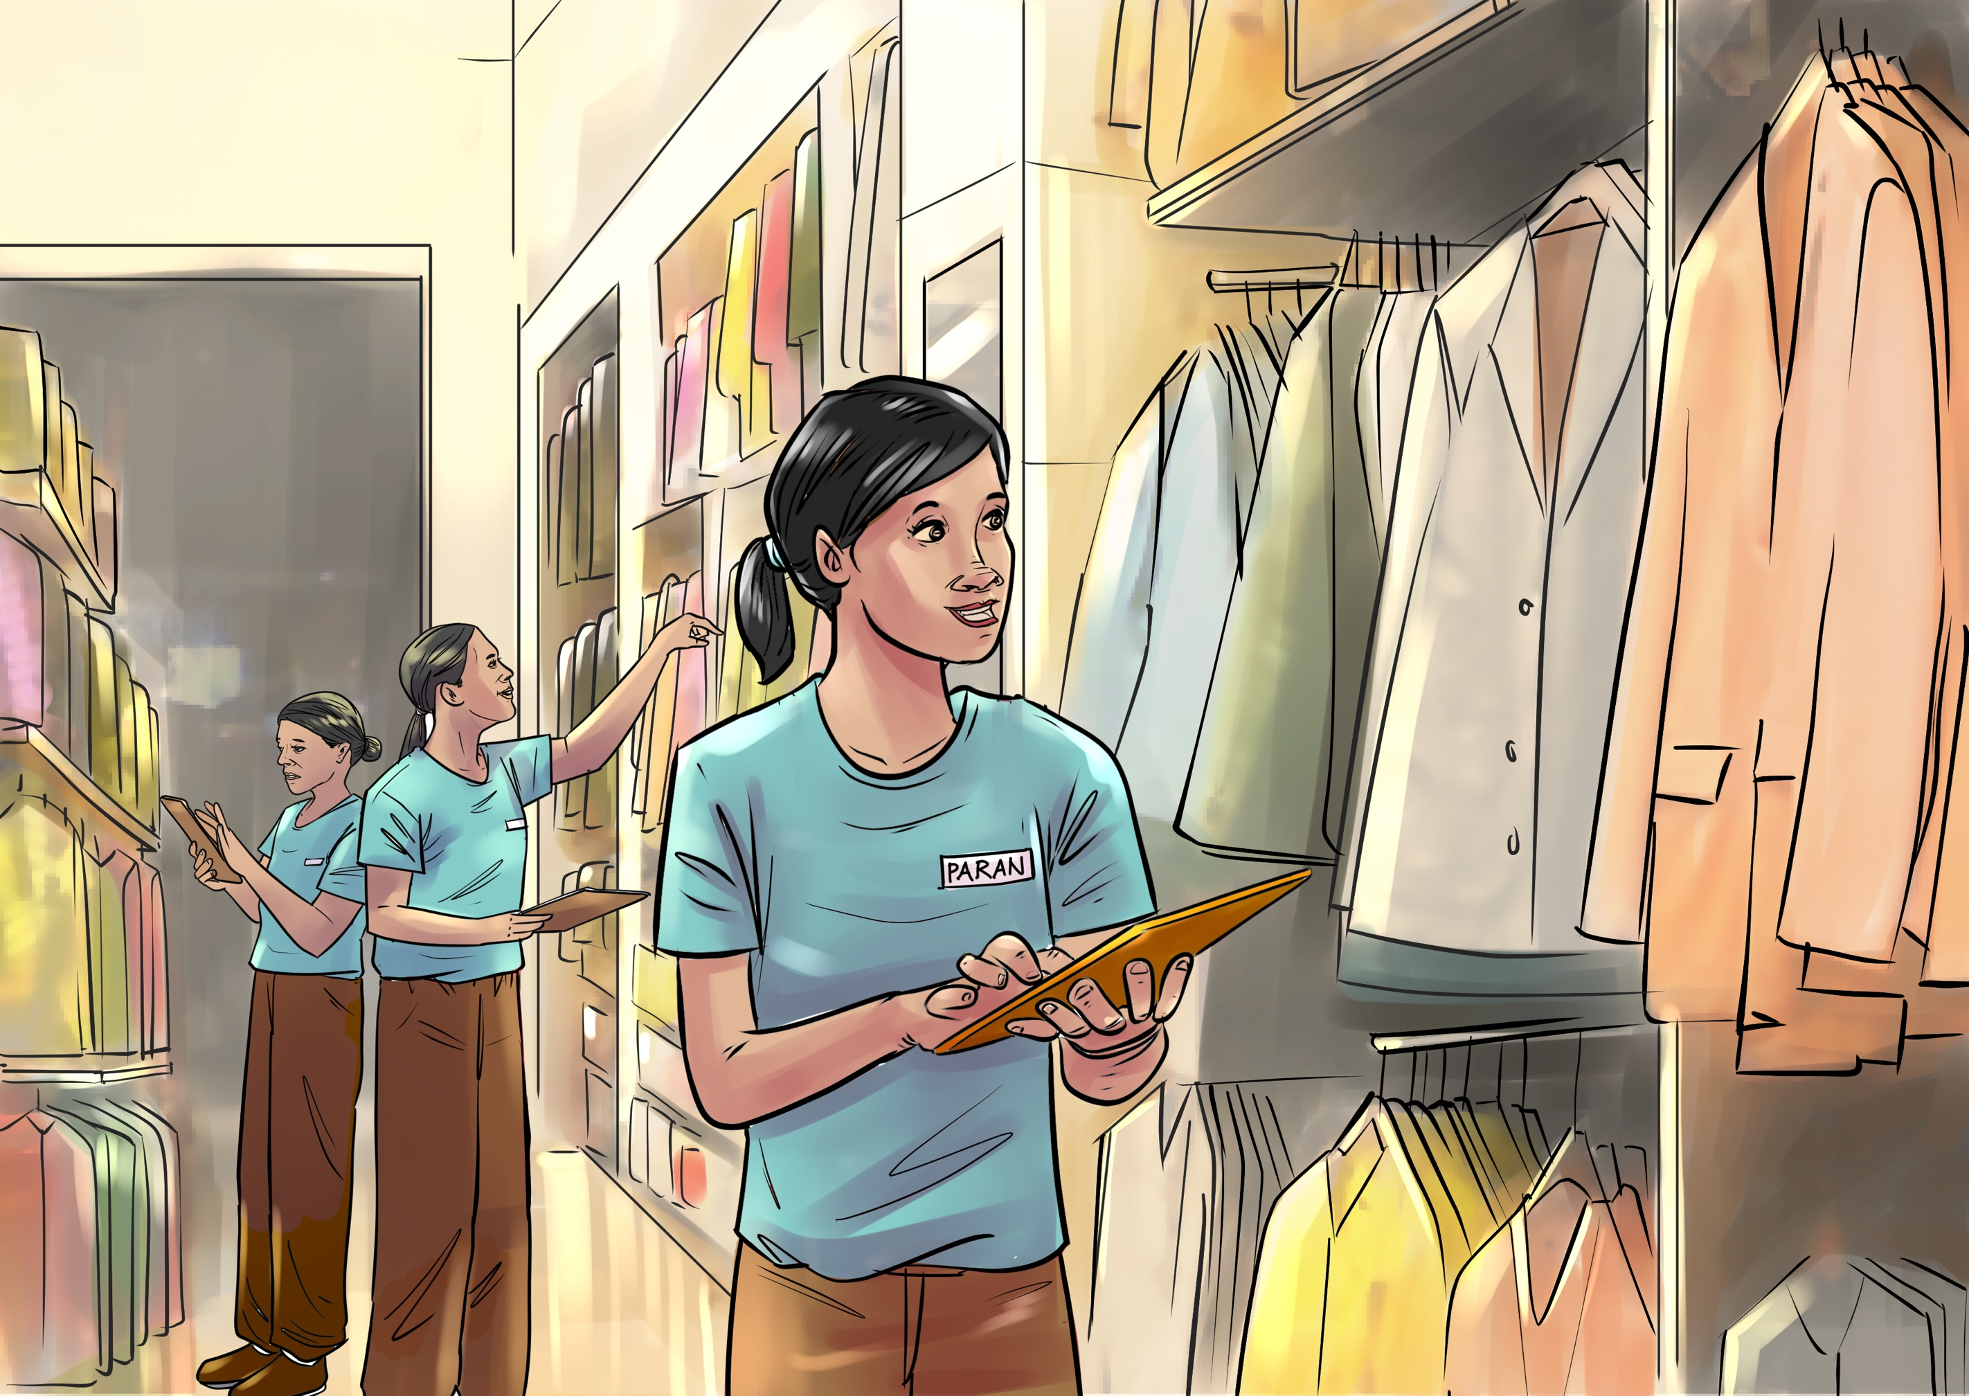
Paran Sarimita Winarni spent almost a decade of her life fighting drug-resistant tuberculosis. Click through the following pages to learn about her journey and the challenges she faced, many of which are shared by individuals and communities affected by TB all over the world.

Slide 3
Paran is a young woman with lots of energy and dreams about her future. She works in retail as a supervisor and helps her Father support their family.

Slide 4
Paran has asthma so when she developed a persistent cough, she didn’t think much of it and continued to go to work. Over time her cough worsened, and she started to develop other worrying symptoms, including night sweats, fatigue, and weight loss.

Slide 5
Paran decided to visit the primary health care center, where she was given new asthma medication.
Barrier: Lack of awareness of TB and proper diagnosis / complicated by pre-existing condition (asthma)

Slide 6
Paran diligently took her new asthma medication as it was prescribed and started to feel better. But after a week, her coughing fits returned. Paran started to worry that the asthma medicine she received from primary health care center was poor quality. Her illness was getting progressively worse and she stressed that she would lose her job due to absenteeism. A neighbor recommended that she visit the doctor at the private health facility instead. Paran would have to pay but she thought it was worth the money to see a doctor at a facility with a good reputation.

Slide 7
So Paran paid the $10-15 fee to see the doctor at the private healthcare facility, where she received a chest X-ray and was prescribed rifampicin and isoniazid. Paran wasn’t given much information about her condition or the medicines she was given but was happy to be on her way to getting well.
Barrier: Out of pocket expenses for the consultation, chest X-rays and prescribed medicines; now follow up testing to confirm TB or determine drug-resistance and inappropriate and inadequate treatment prescribed.

Slide 8
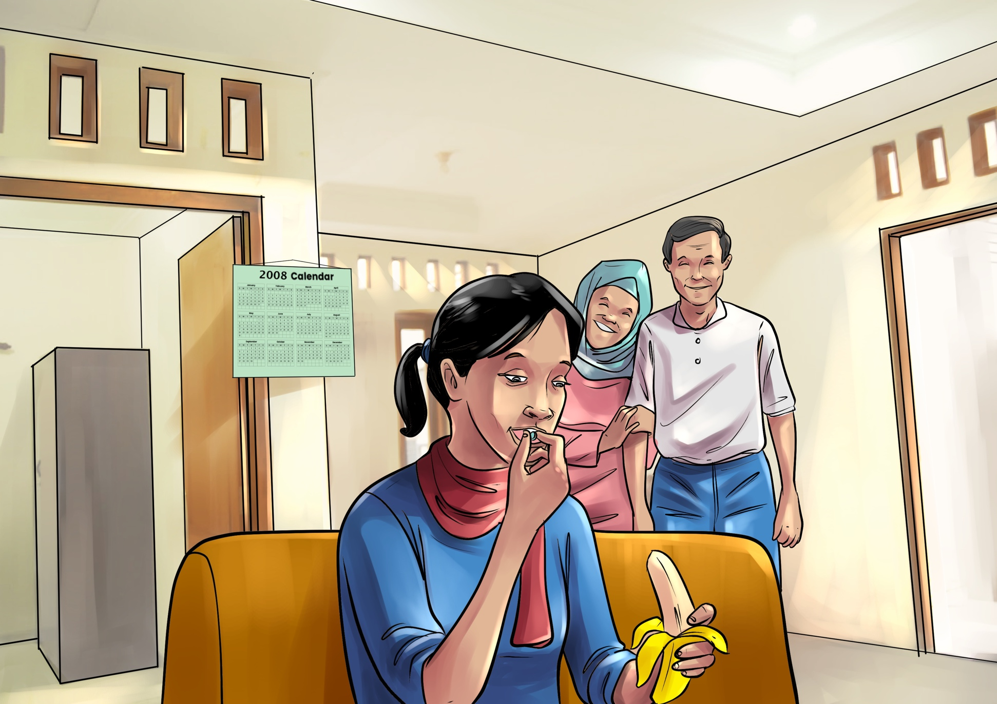
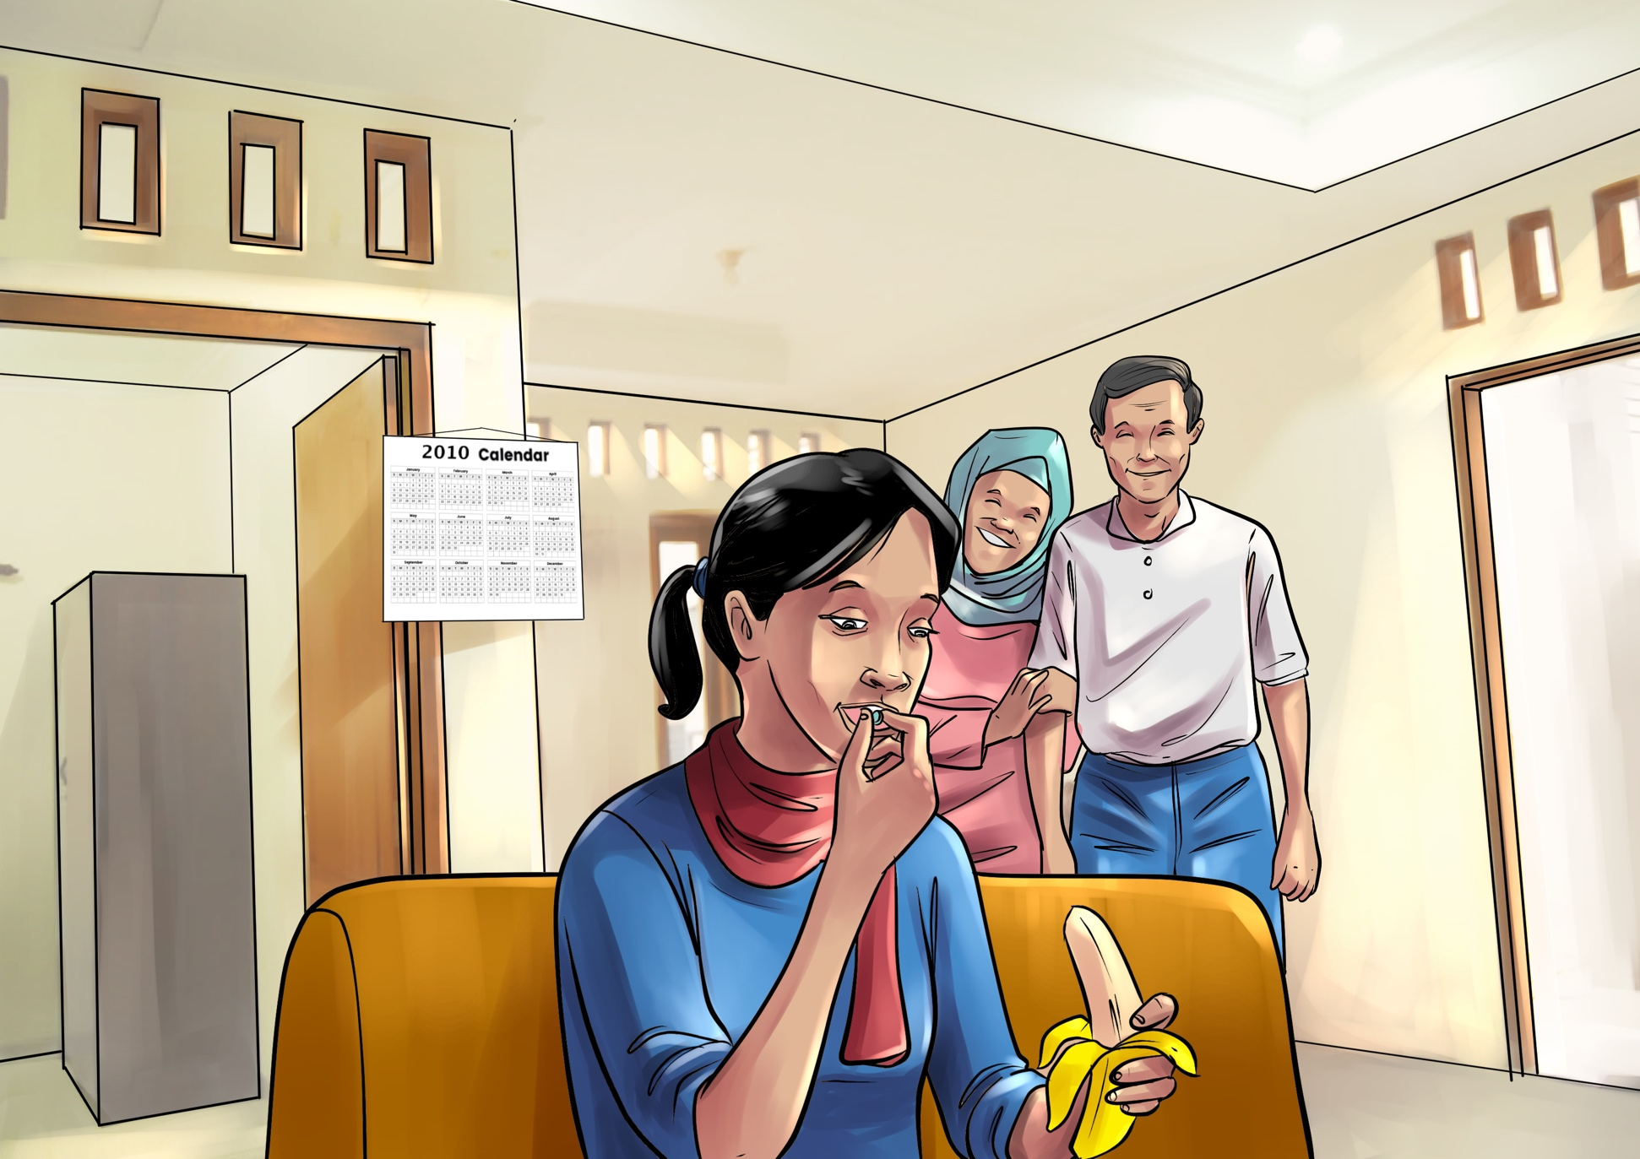
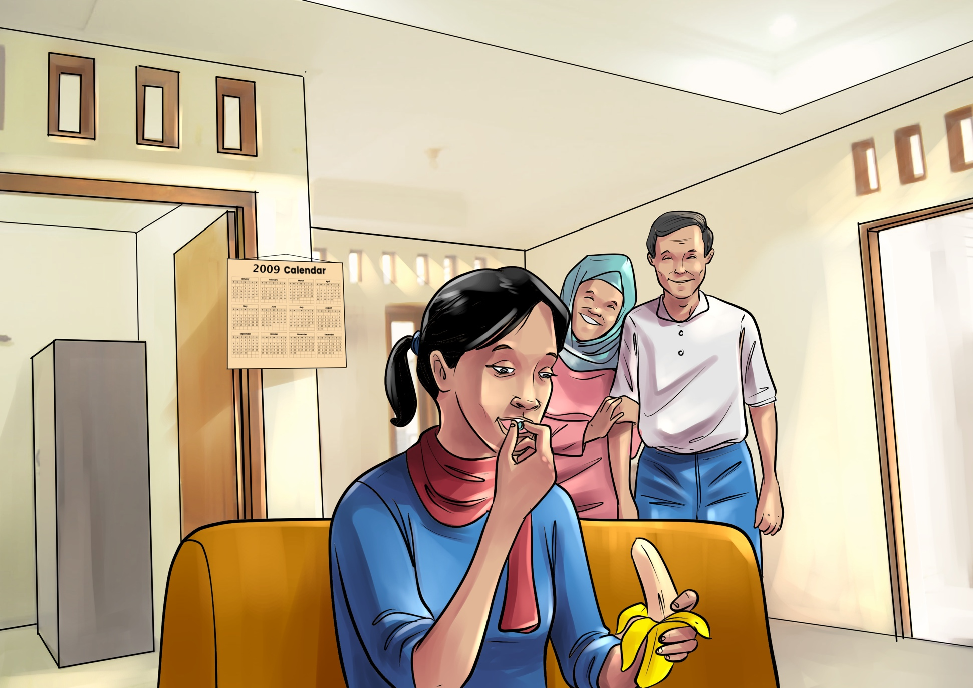
Paran took the treatment prescribed to her for 2 years, paying out of pocket at the pharmacy because it was less expensive than going back to the private facility where she would also have to pay to see the doctor. During this time Paran started to feel better and was even able to return to work. She felt optimistic and happy to be able to help support her family again.

Slide 9
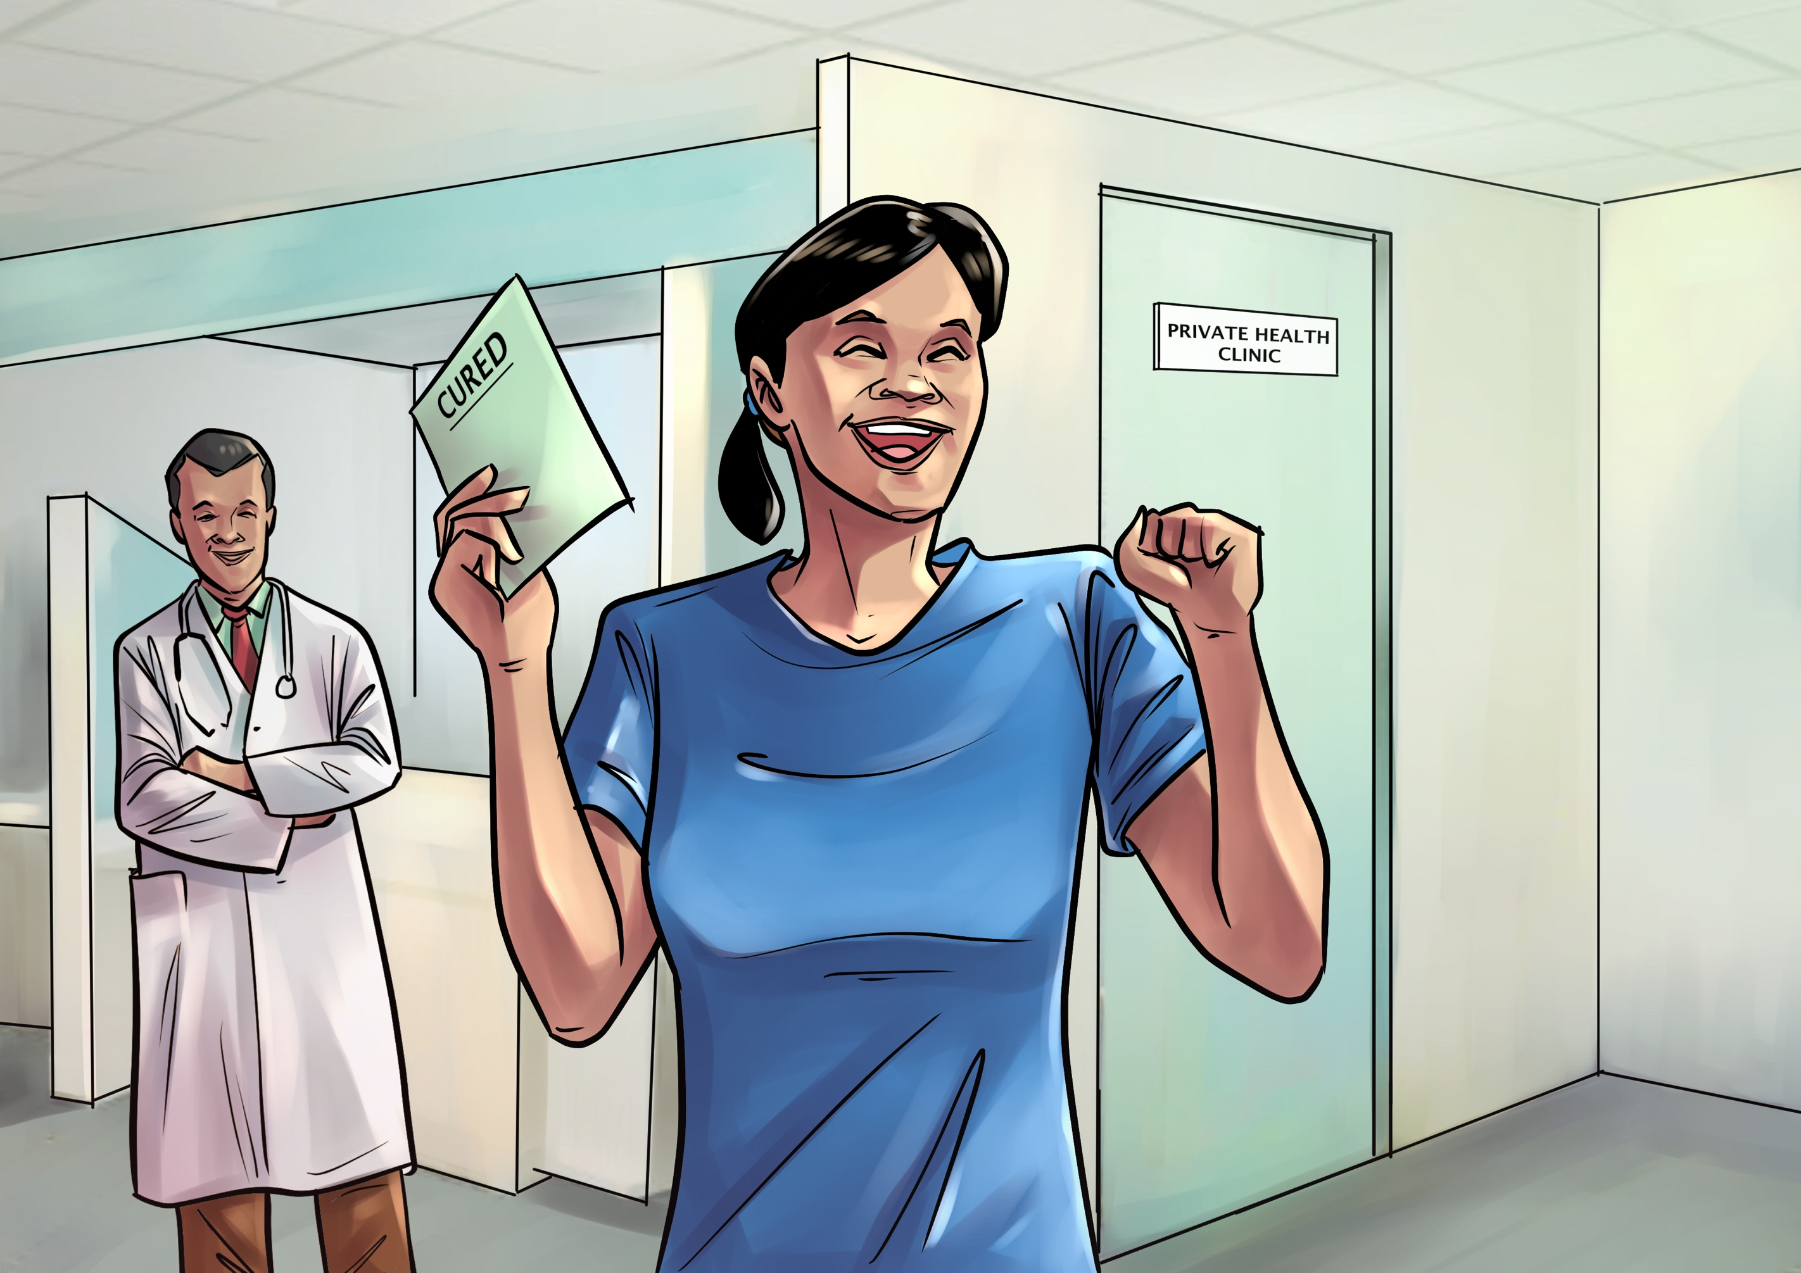
After two years of taking her medicines, Paran decided to go back to the doctor to see if she was healed. She was feeling strong and wanted confirmation that she was better and could stop taking medicines. The doctor took a chest X-ray doctor and told her that she was cured.

Slide 10
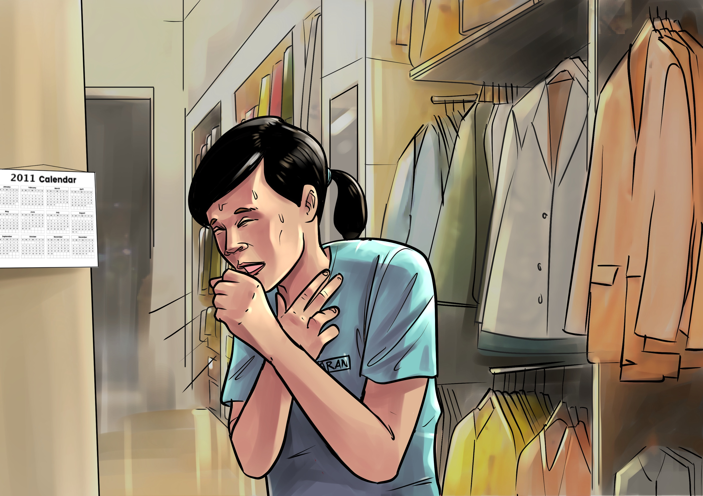
A year later, Paran’s cough and other symptoms returned. She suspected that the illness had returned but was scared that this time, she would lose her job.

Slide 11
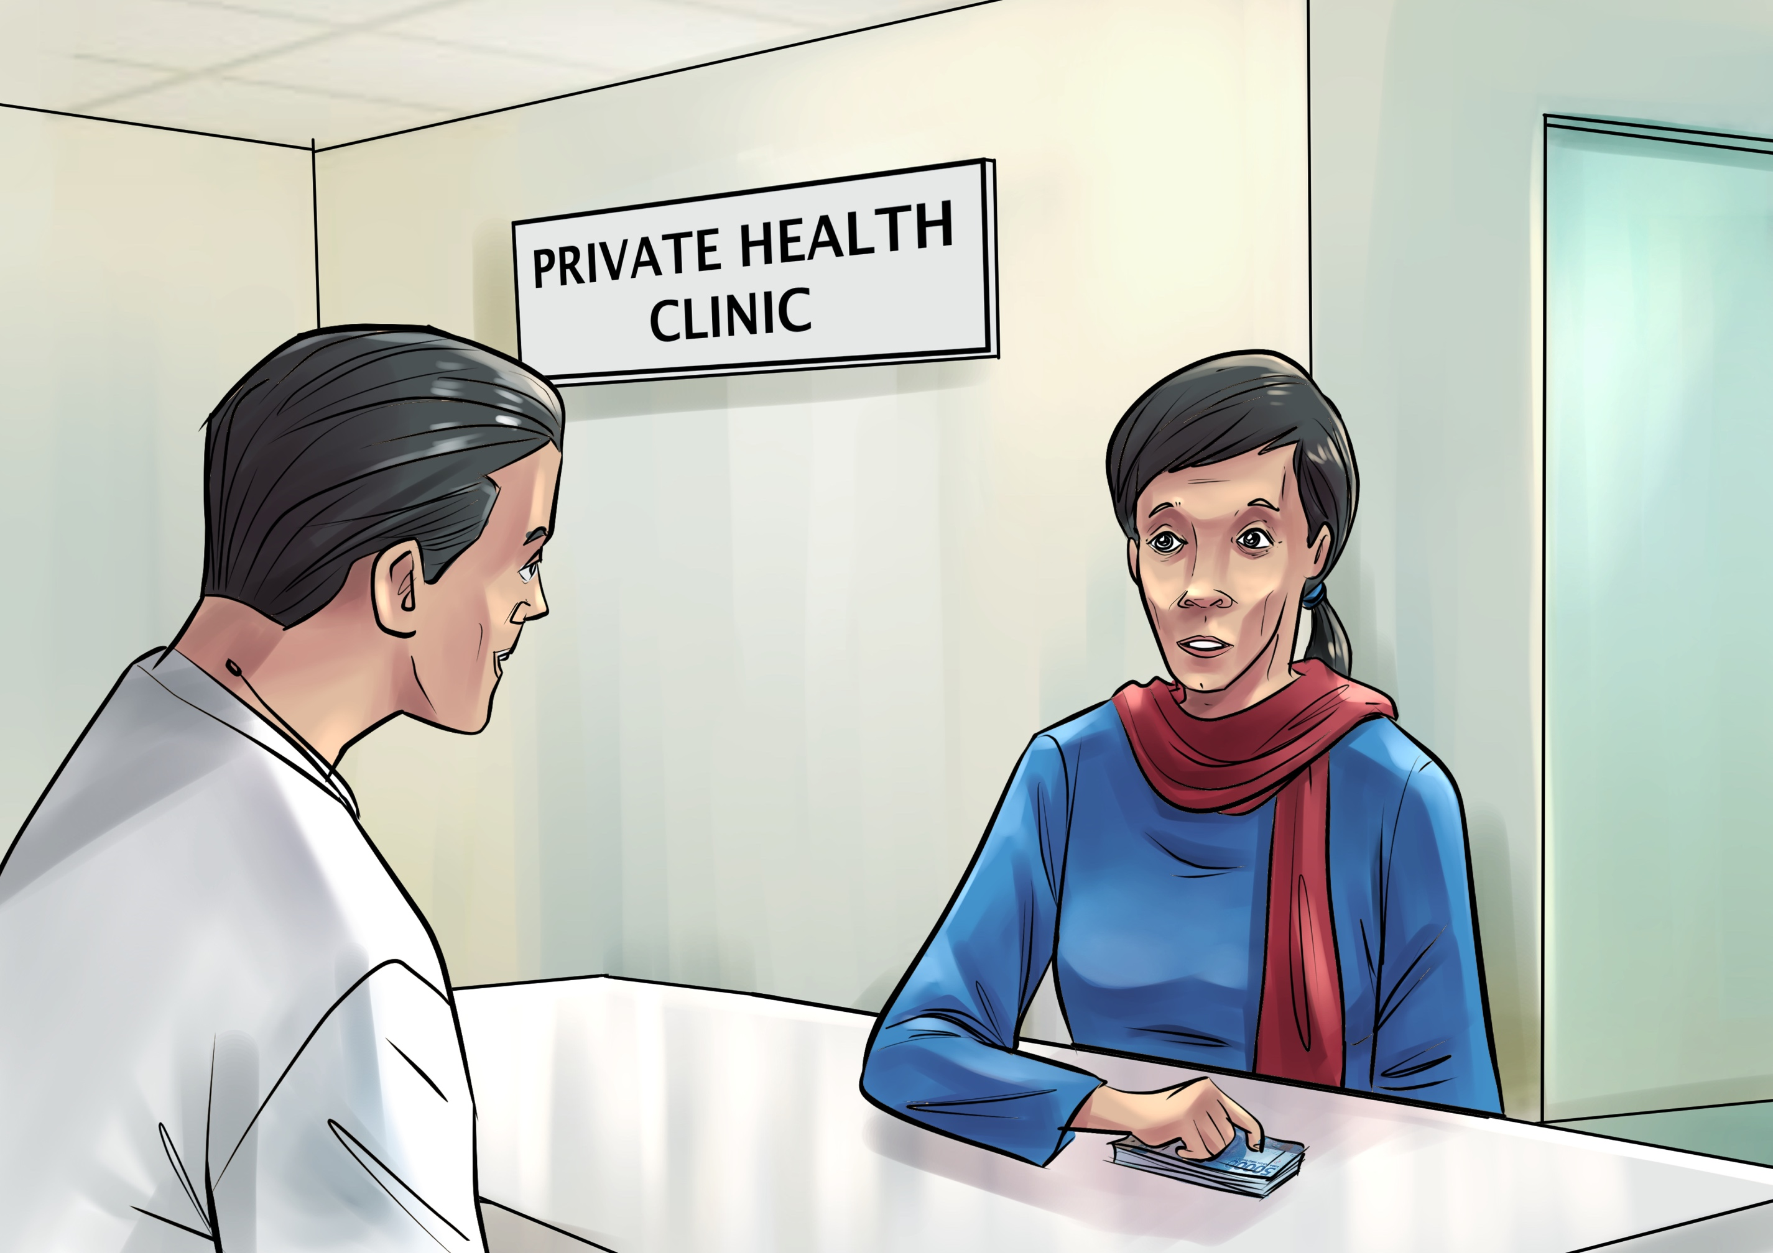
Paran decided to visit the doctor who cured her the year before. The doctor prescribed double doses of the same two medicines she had taken during her previous treatment. She was concerned but had become accustomed to taking the bad-tasting tablets.
Barrier: Again, inappropriate treatment; out of pocket costs for consultation and medicines.

Slide 12
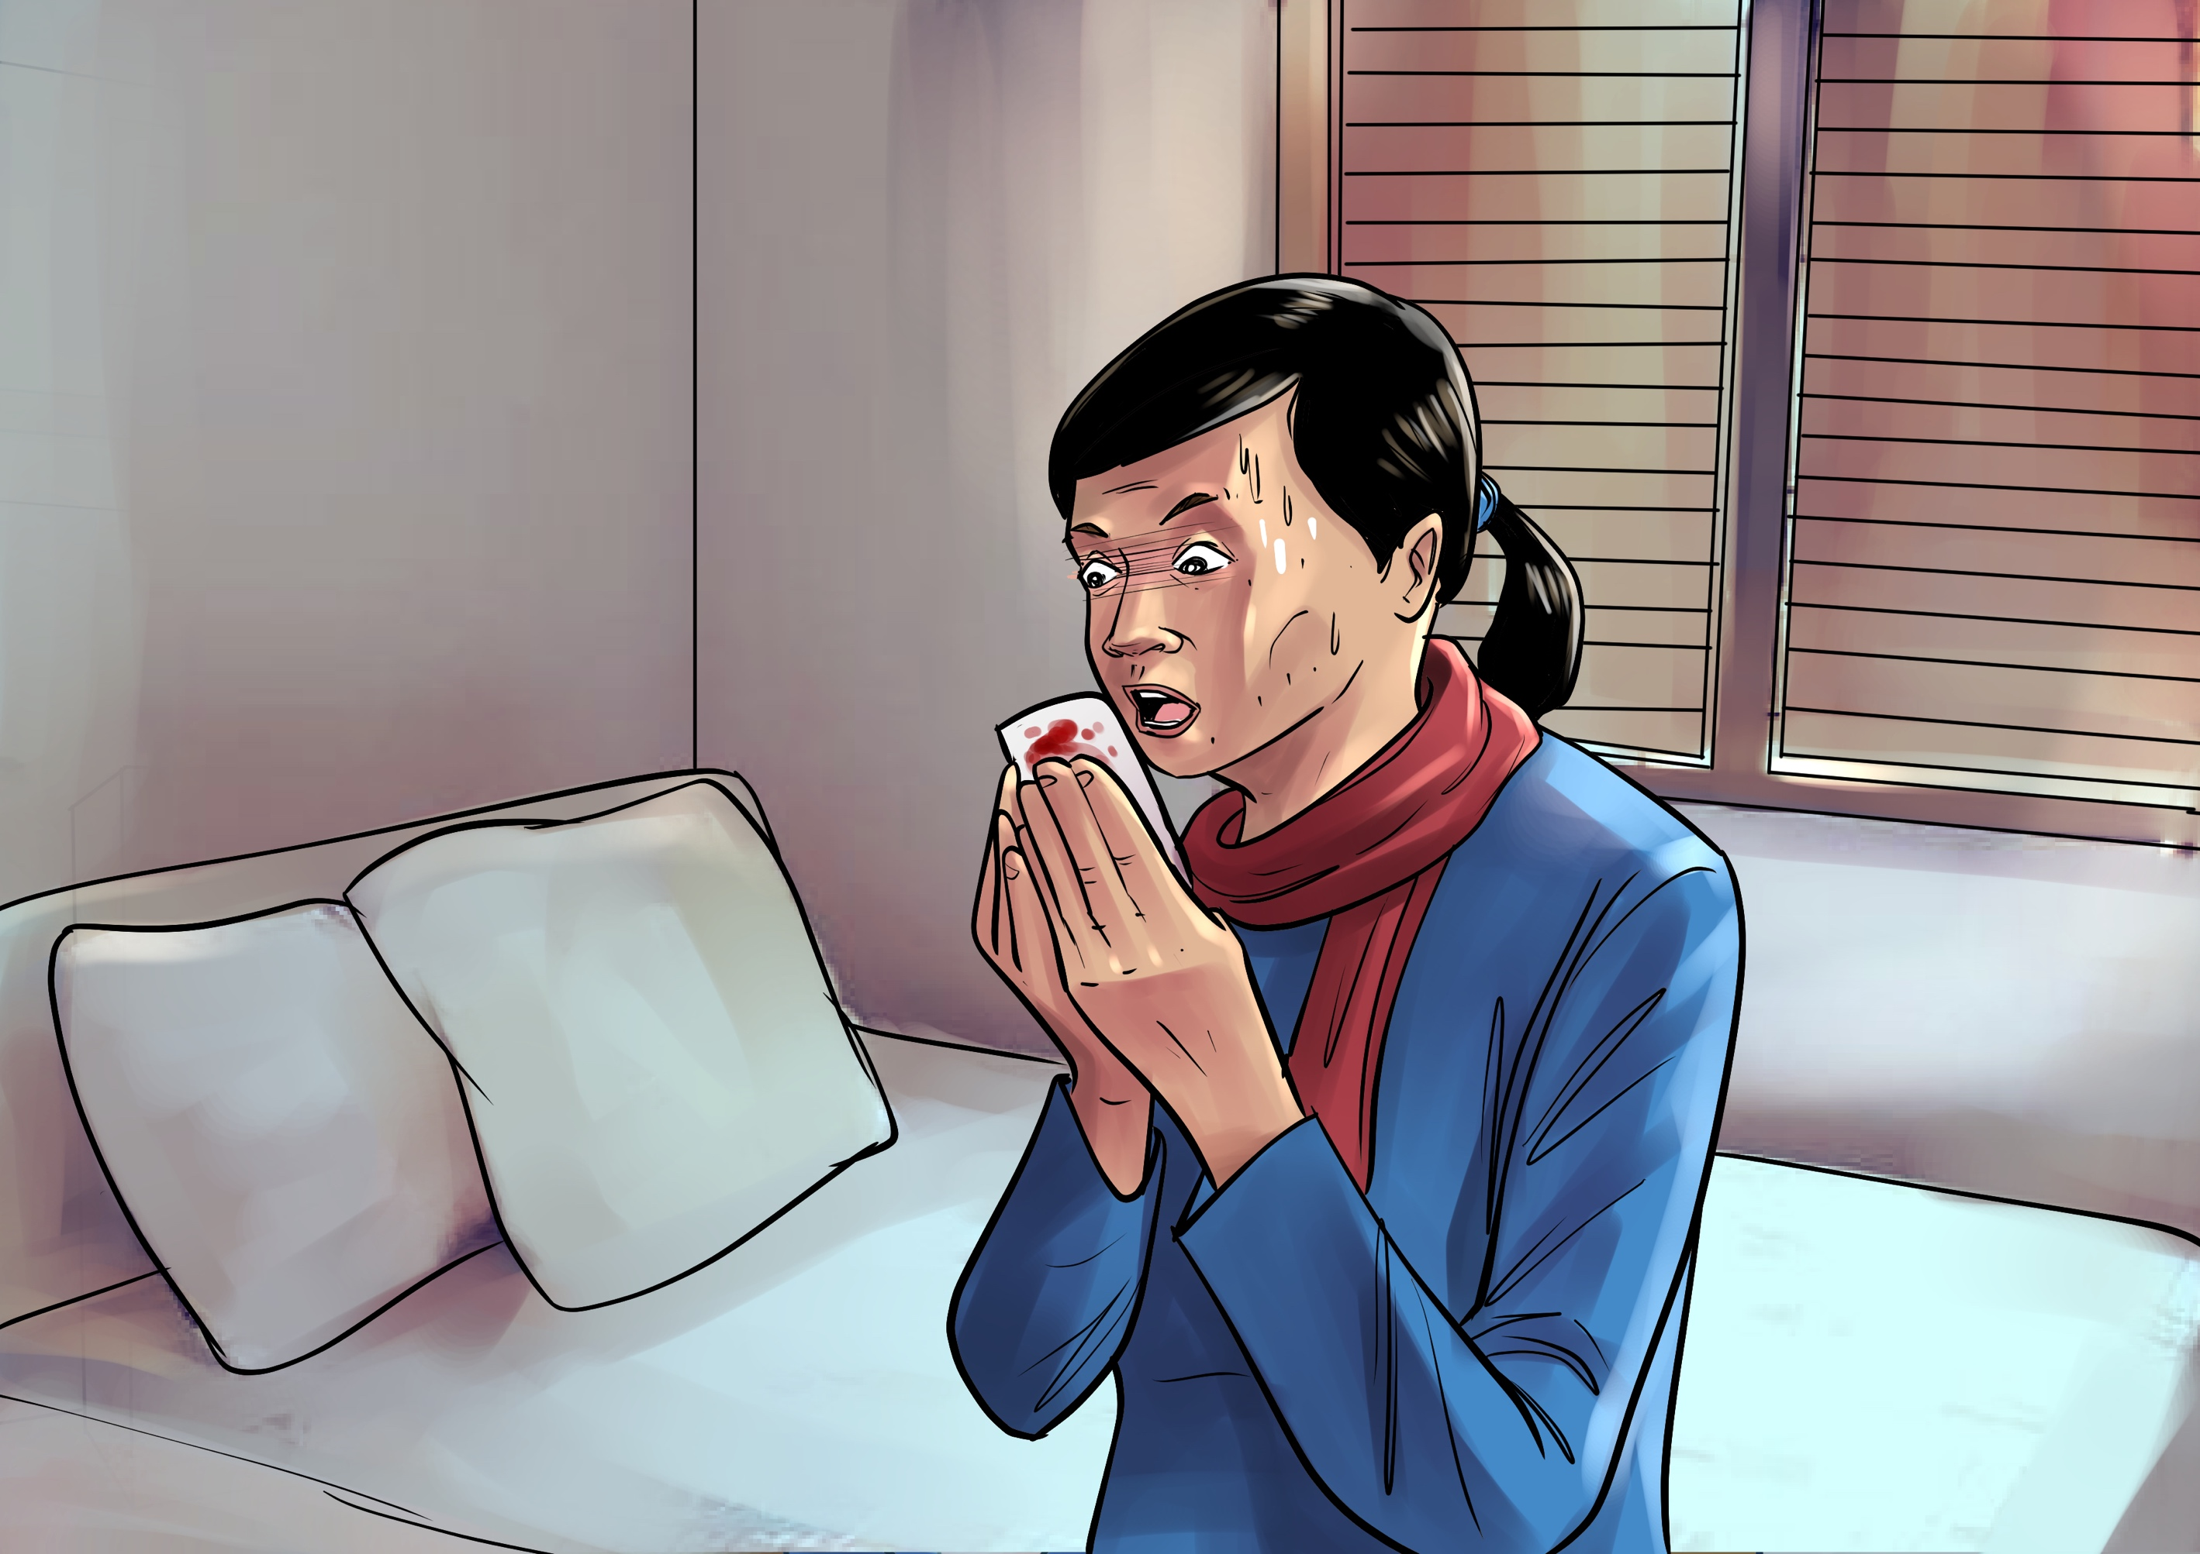
After a month, Paran was feeling worse than ever. She started coughing up blood and bleeding from nose. She had to stop working. She was devastated as her savings were running out and she was starting to feel like a burden to her family.
Barrier: Loss of job security due to TB disease

Slide 13
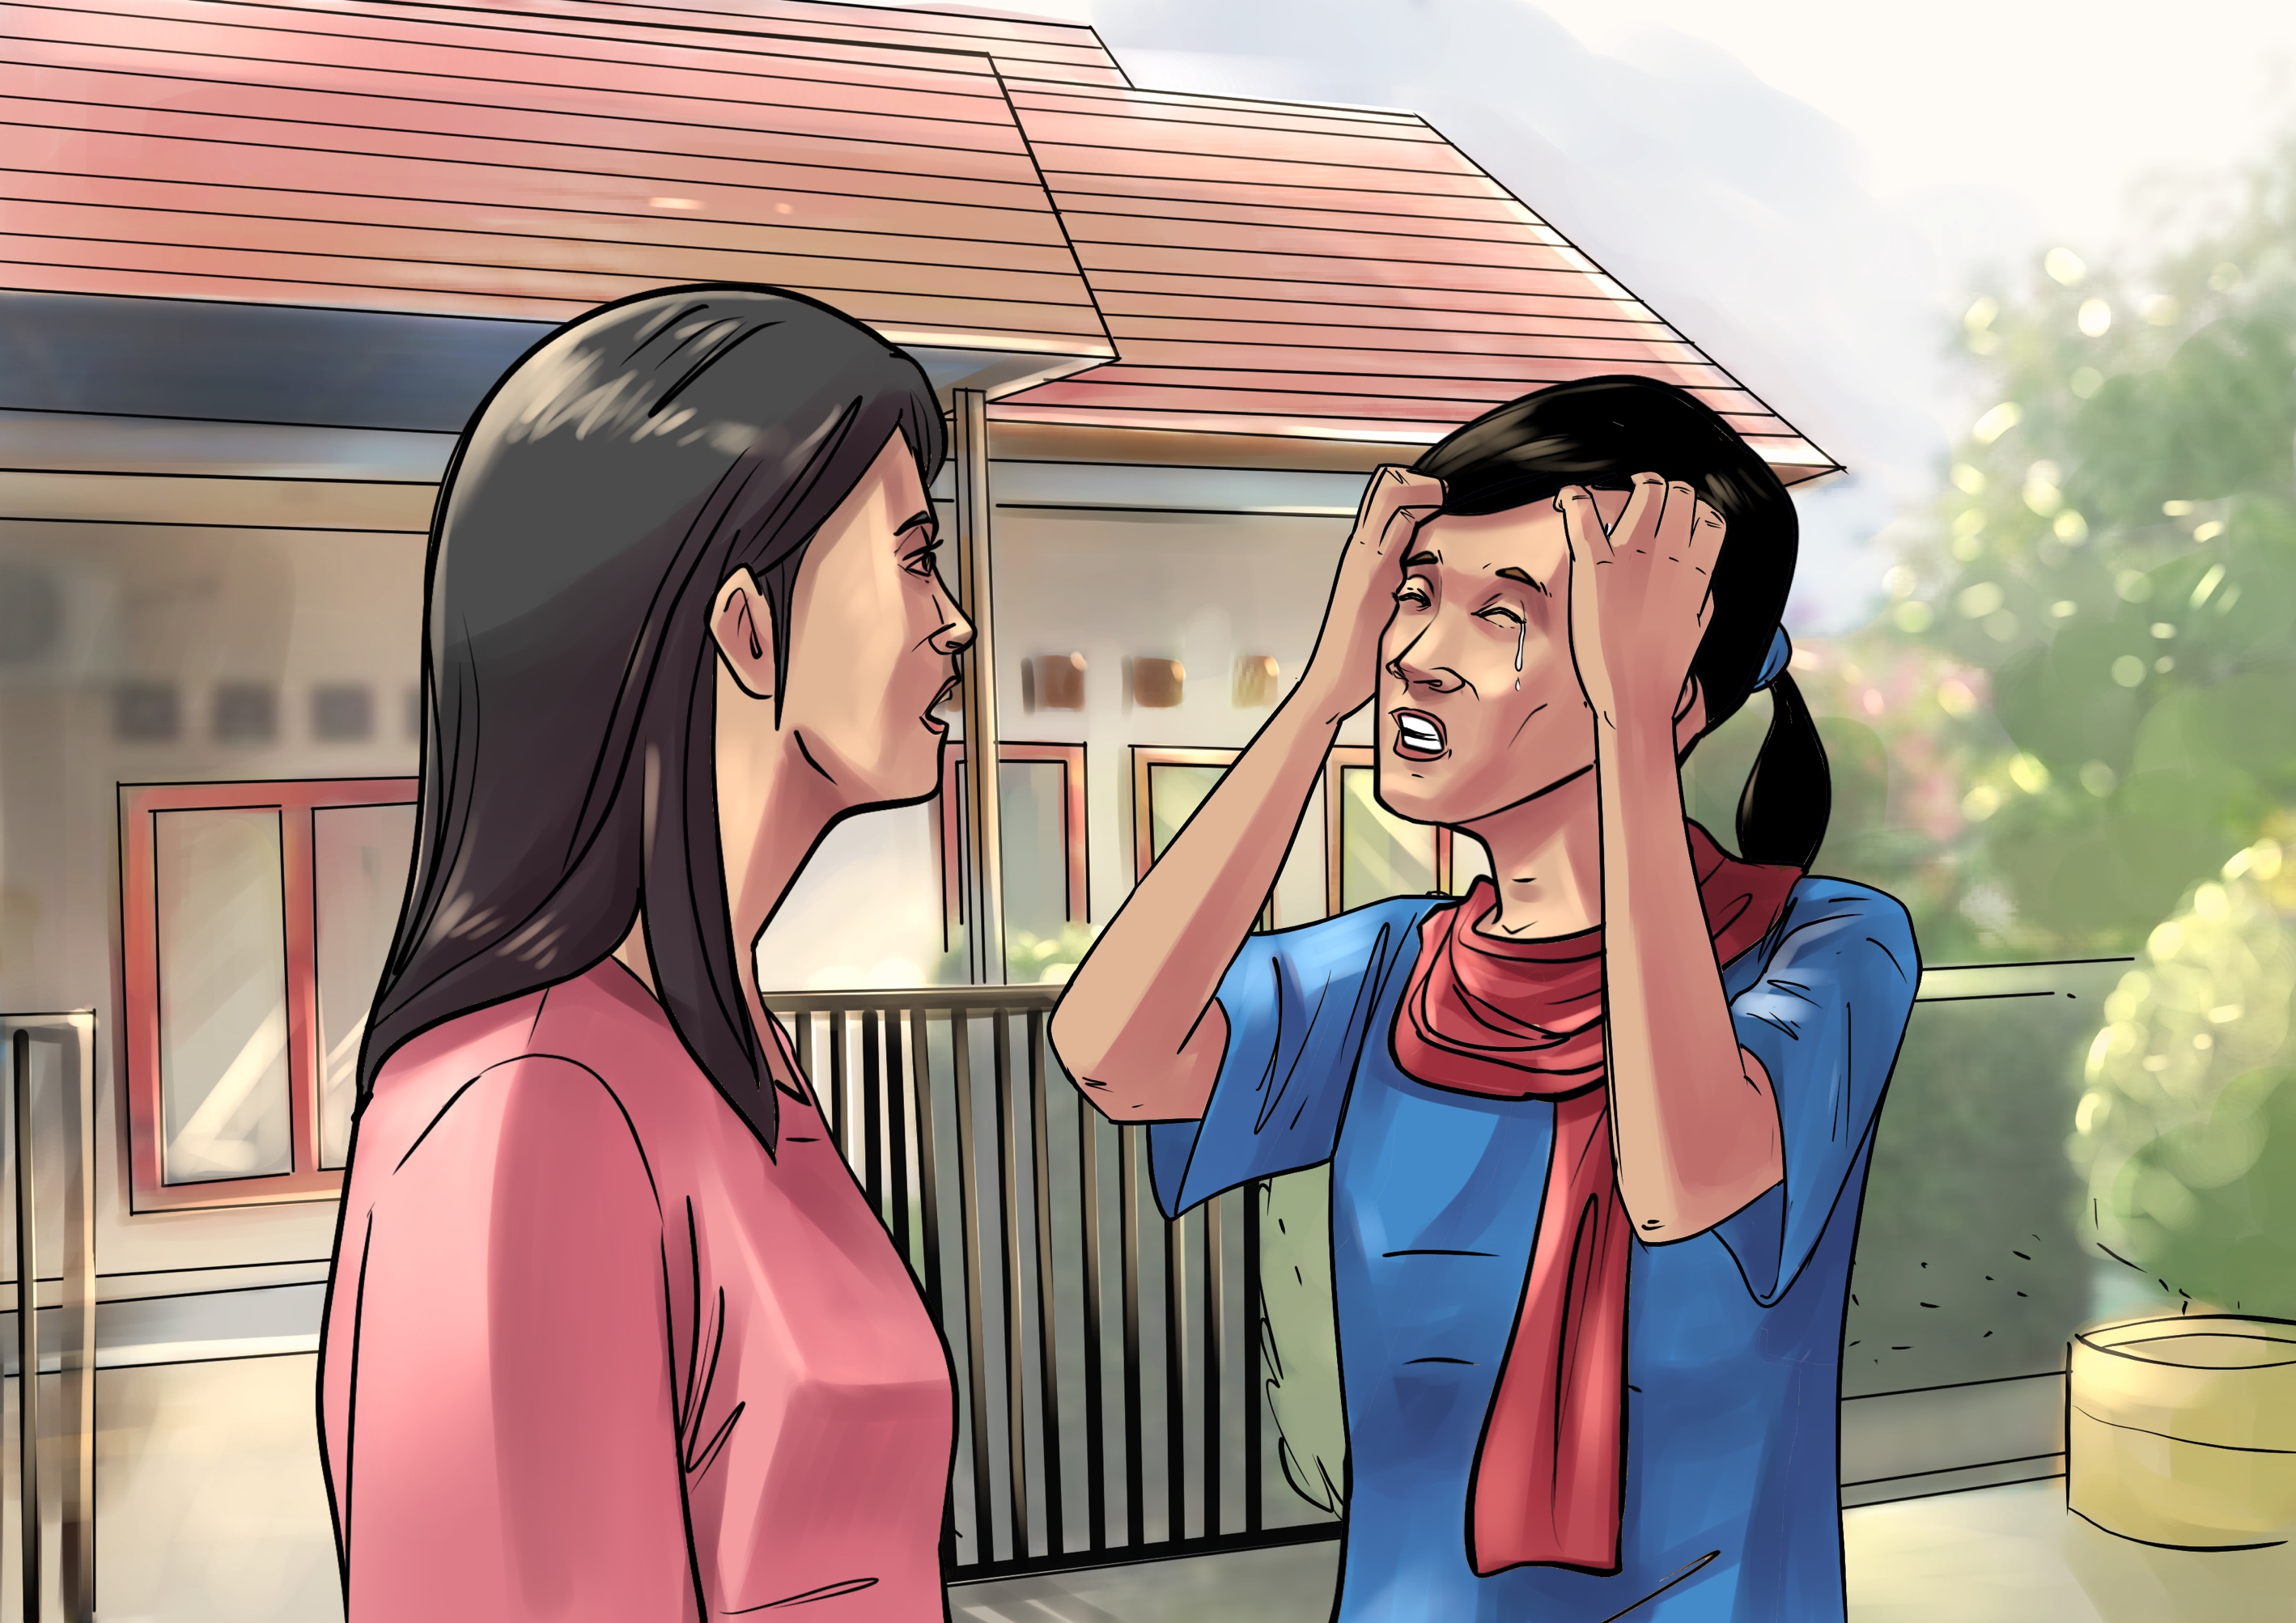
Paran was losing confidence in the private health care facility. She also wasn’t working and so couldn’t afford to go back anyway. A neighbor advised that treatment was being offered at that primacy healthcare center for free and suggested Paran go.

Slide 14
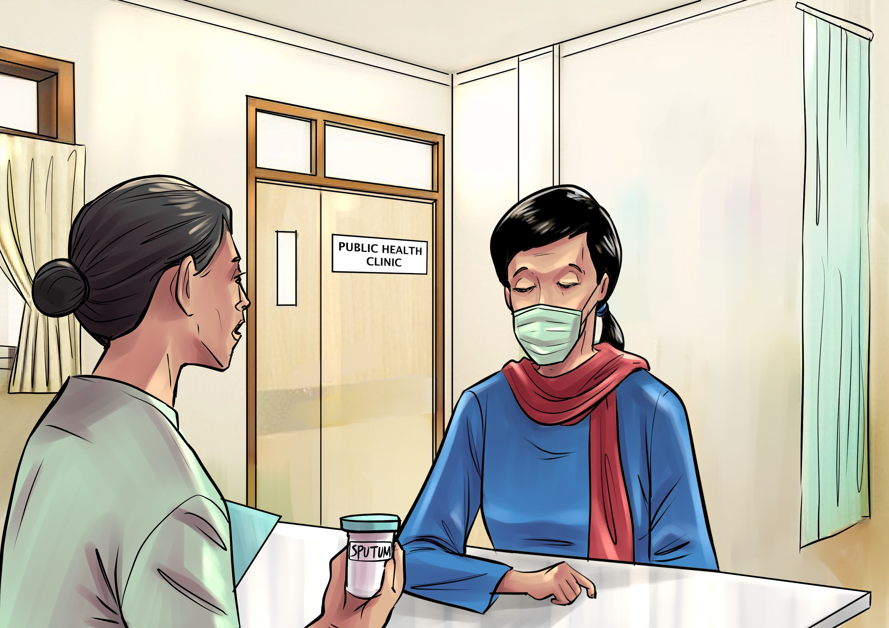
So Paran visited the primary healthcare center where her sputum was taken and tested positive for tuberculosis. Four years had passed since Paran first started to feel unwell and finally Paran had a proper diagnosis.
The health worker told Paran she would have to visit the referral hospital to access better diagnostic testing with GeneXpert as they feared she might have drug-resistant TB. So Paran did just that and was finally diagnosed with drug-resistant TB.

Slide 15
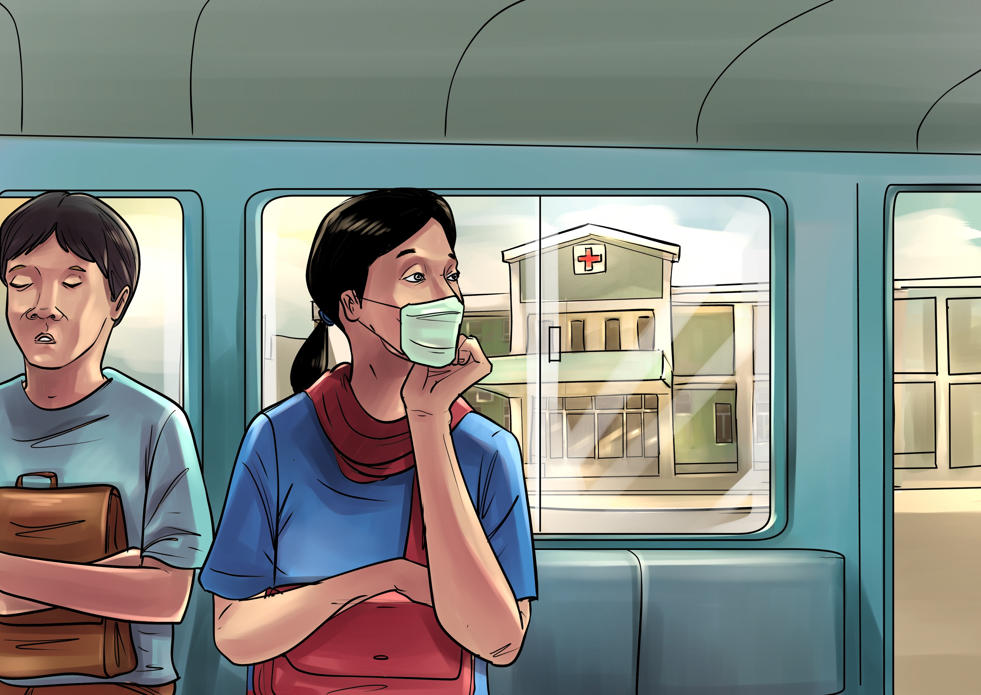
The primary facility did not stock the DR-TB medicines Paran needed, so she was transferred to a referral hospital for treatment. She would have to travel there daily. The trip was expensive and long, almost 2 hours each way.
Barrier: Out of pocket expense for daily long-distance travel to the hospital.

Slide 16
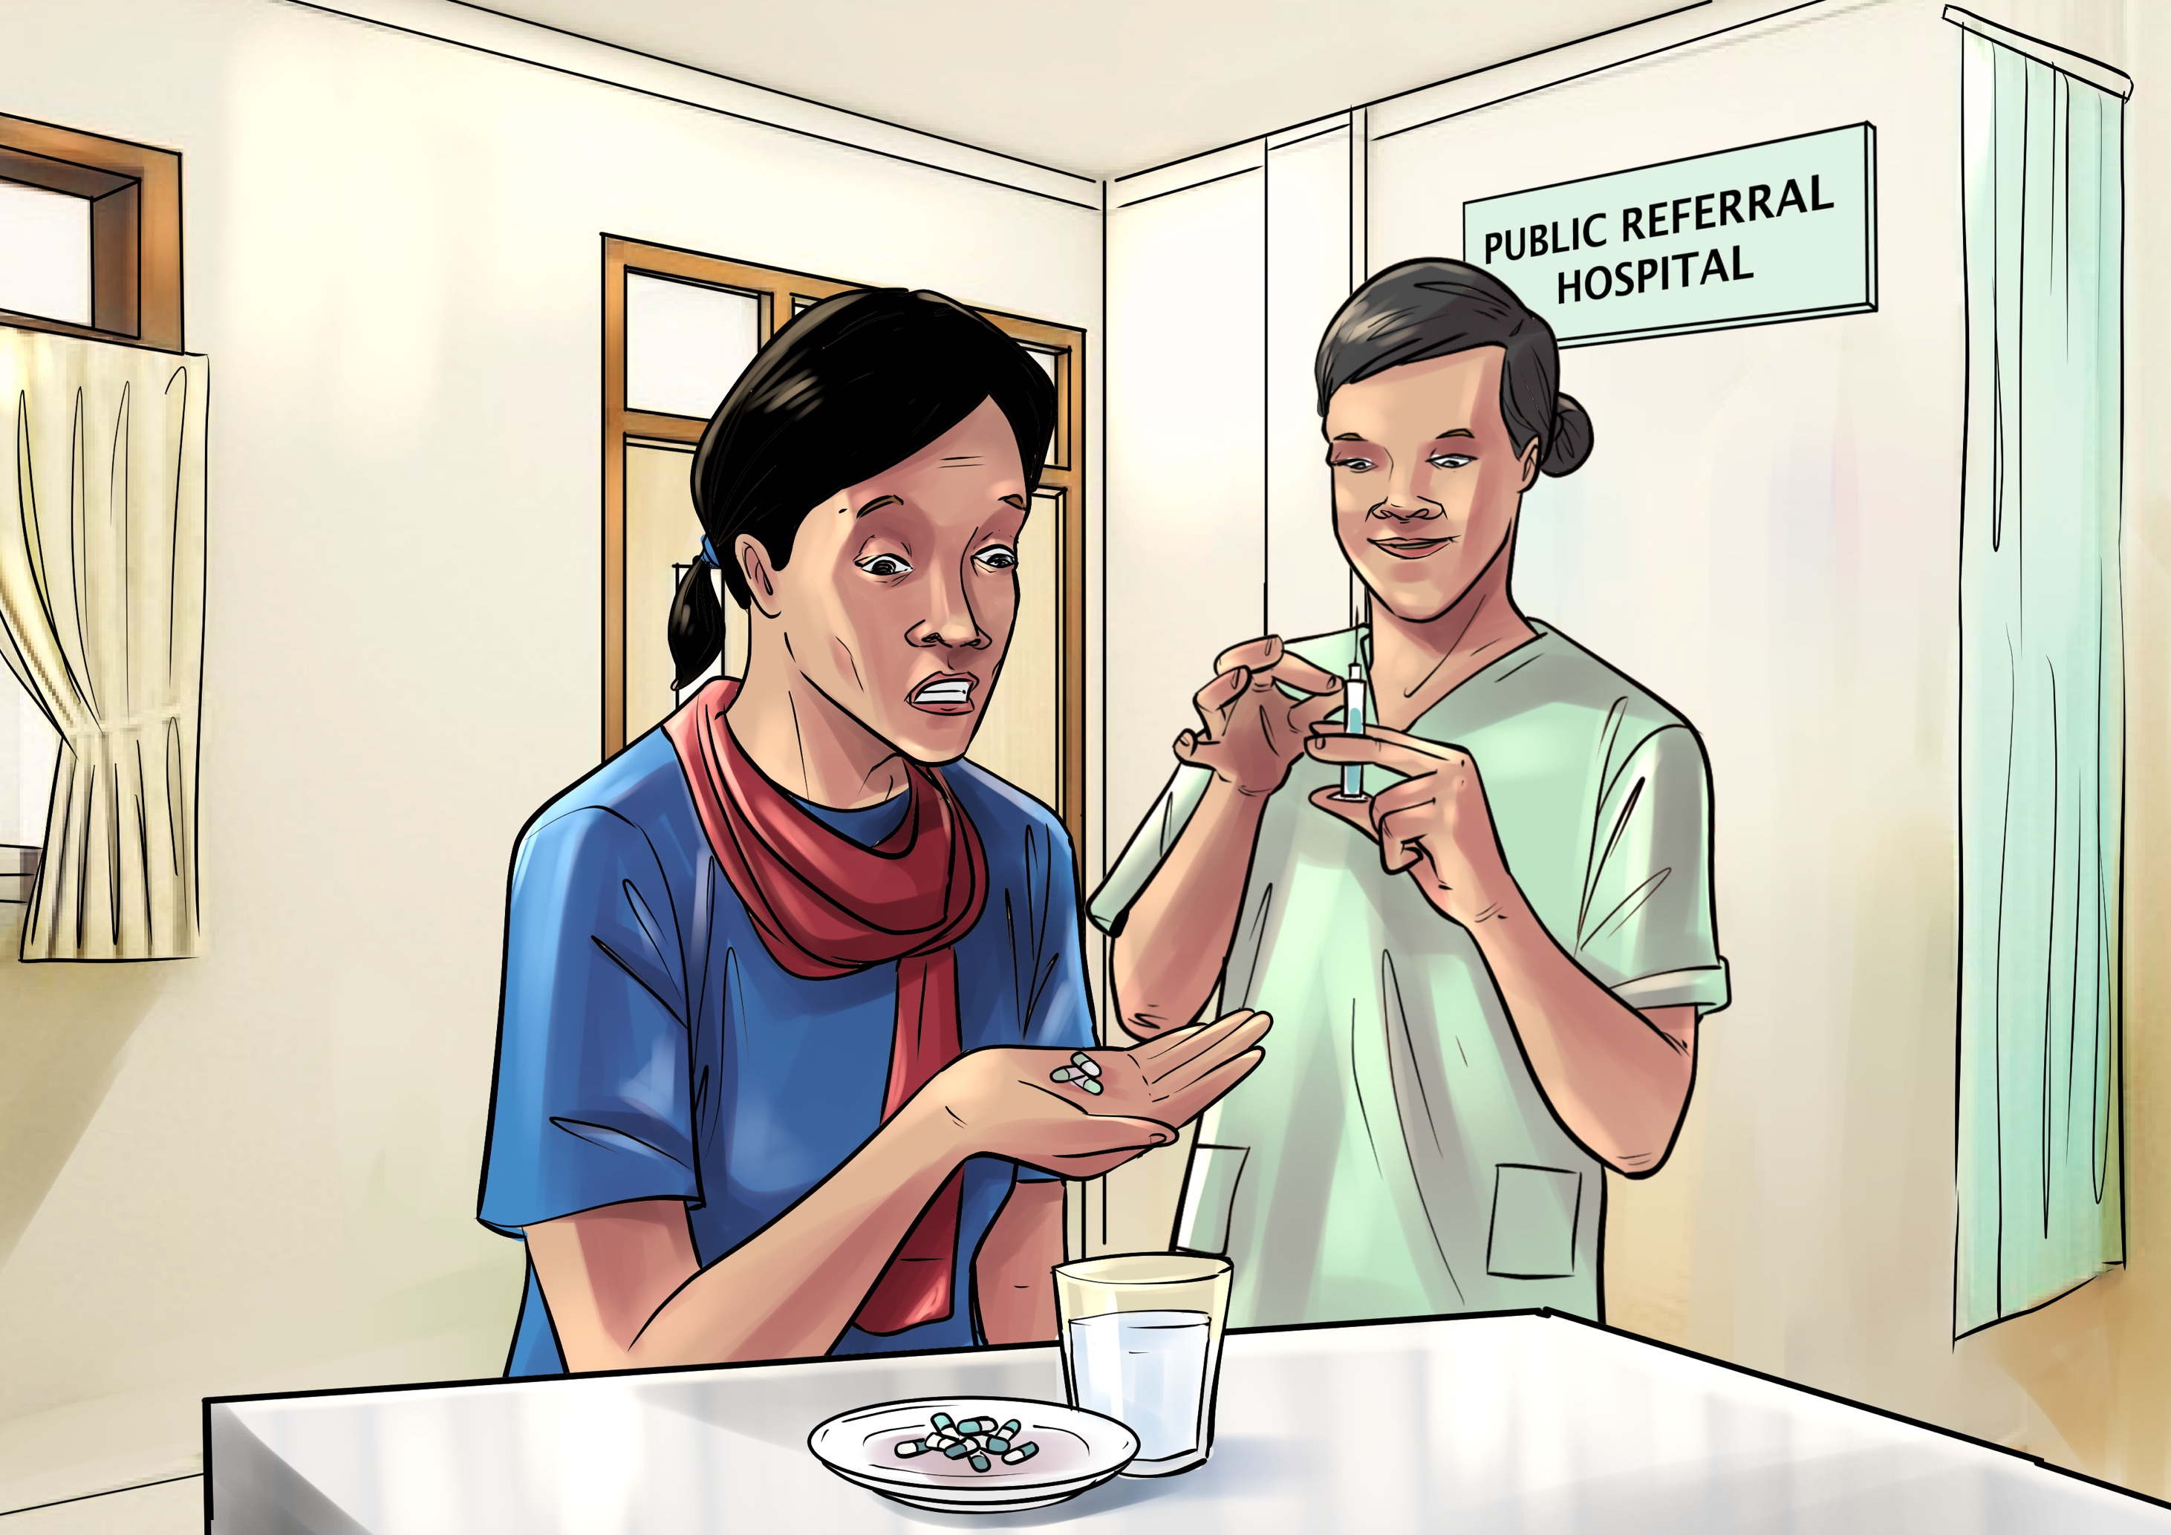
Paran made the journey to the referral hospital daily where she was given 15 tablets and an injection at each visit. The trip became difficult to make alone given the side effects of the DR-TB medicines, which included nausea, but Paran didn’t want her family to accompany her out of fear they might get sick.
Barrier: Heavy pill burden, painful injection and heavy side effects

Slide 17
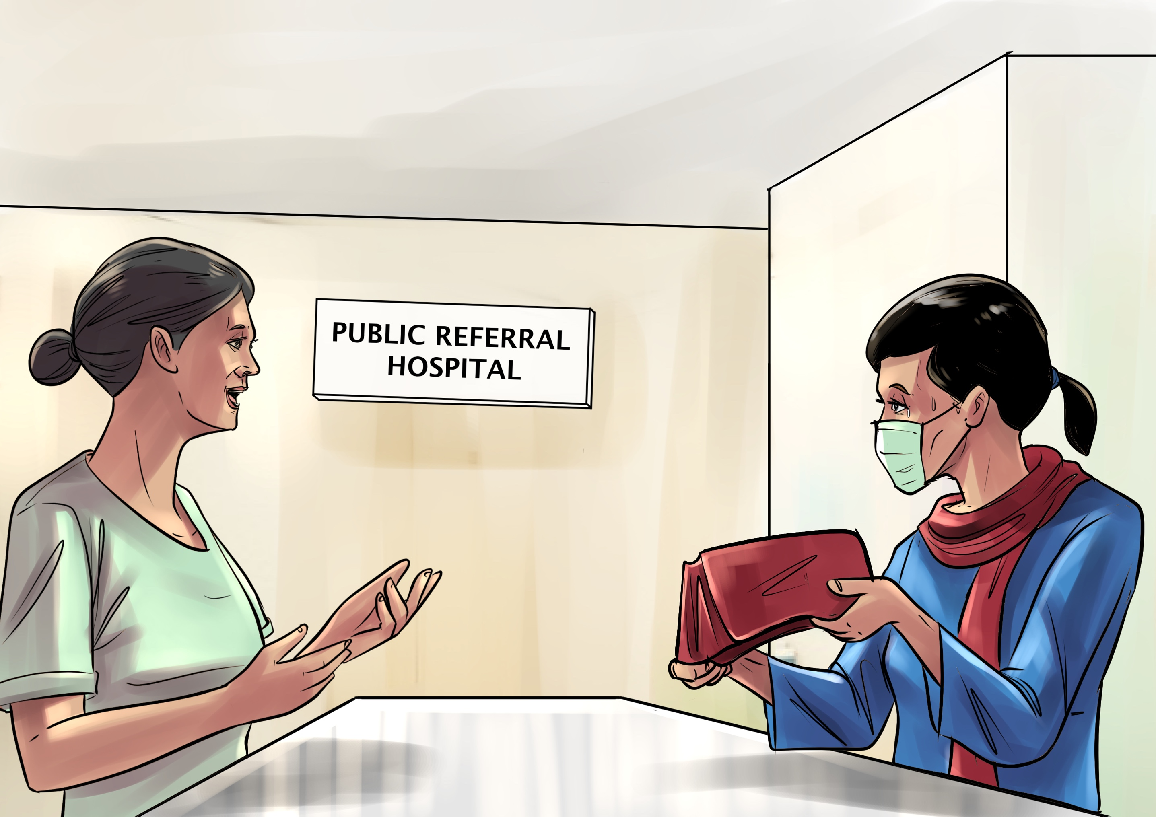
Paran explained these challenges to the health care workers at the referral hospital and asked if she could receive her medicines at the healthcare center closer to her home instead. The healthcare workers agreed and arranged for Paran to continue her treatment closer to her home.

Slide 18
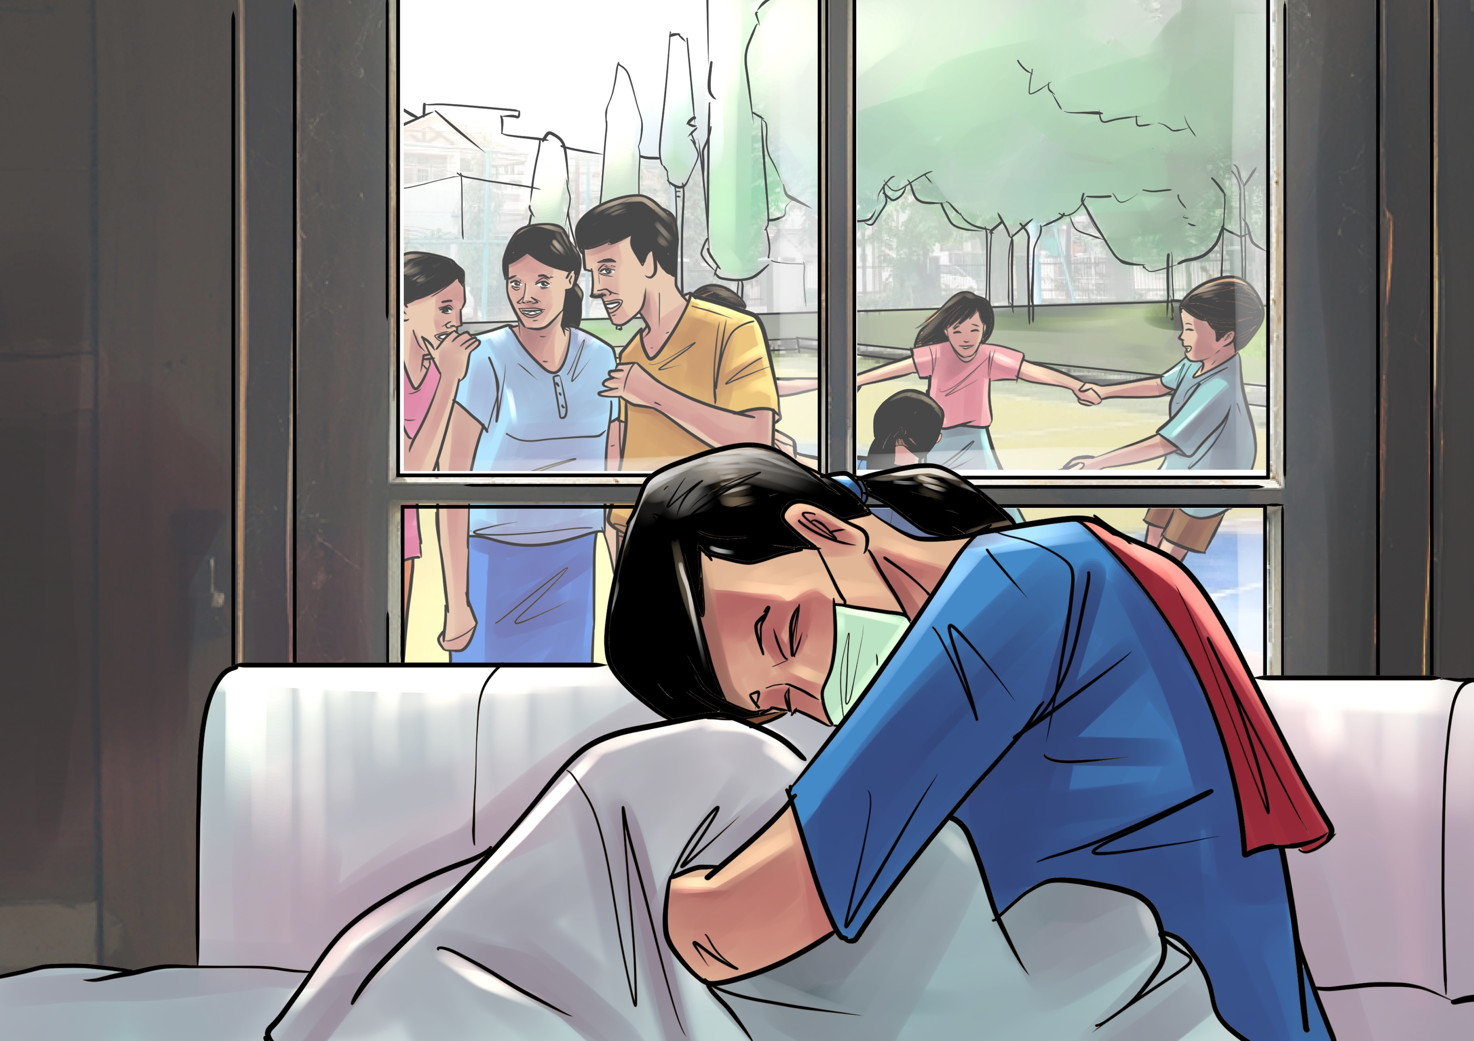
Shortly after transferring to the health care center near her home, one of the healthcare workers realized that Paran’s family home was next to a kindergarten and made her feel guilty and pressure to move. Paran feared her family would be forced out of their home. She was already feeling isolated and couldn’t imagine moving away from her family so she reported the incident to the provincial health authorities who ended up supporting her to stay in her home. Paran’s family and close neighbors were supportive but Paran couldn’t help feeling like a burden. She wanted to die.
Barrier: Stigma and discrimination from health care workers; feelings of isolation and guilt.

Slide 19
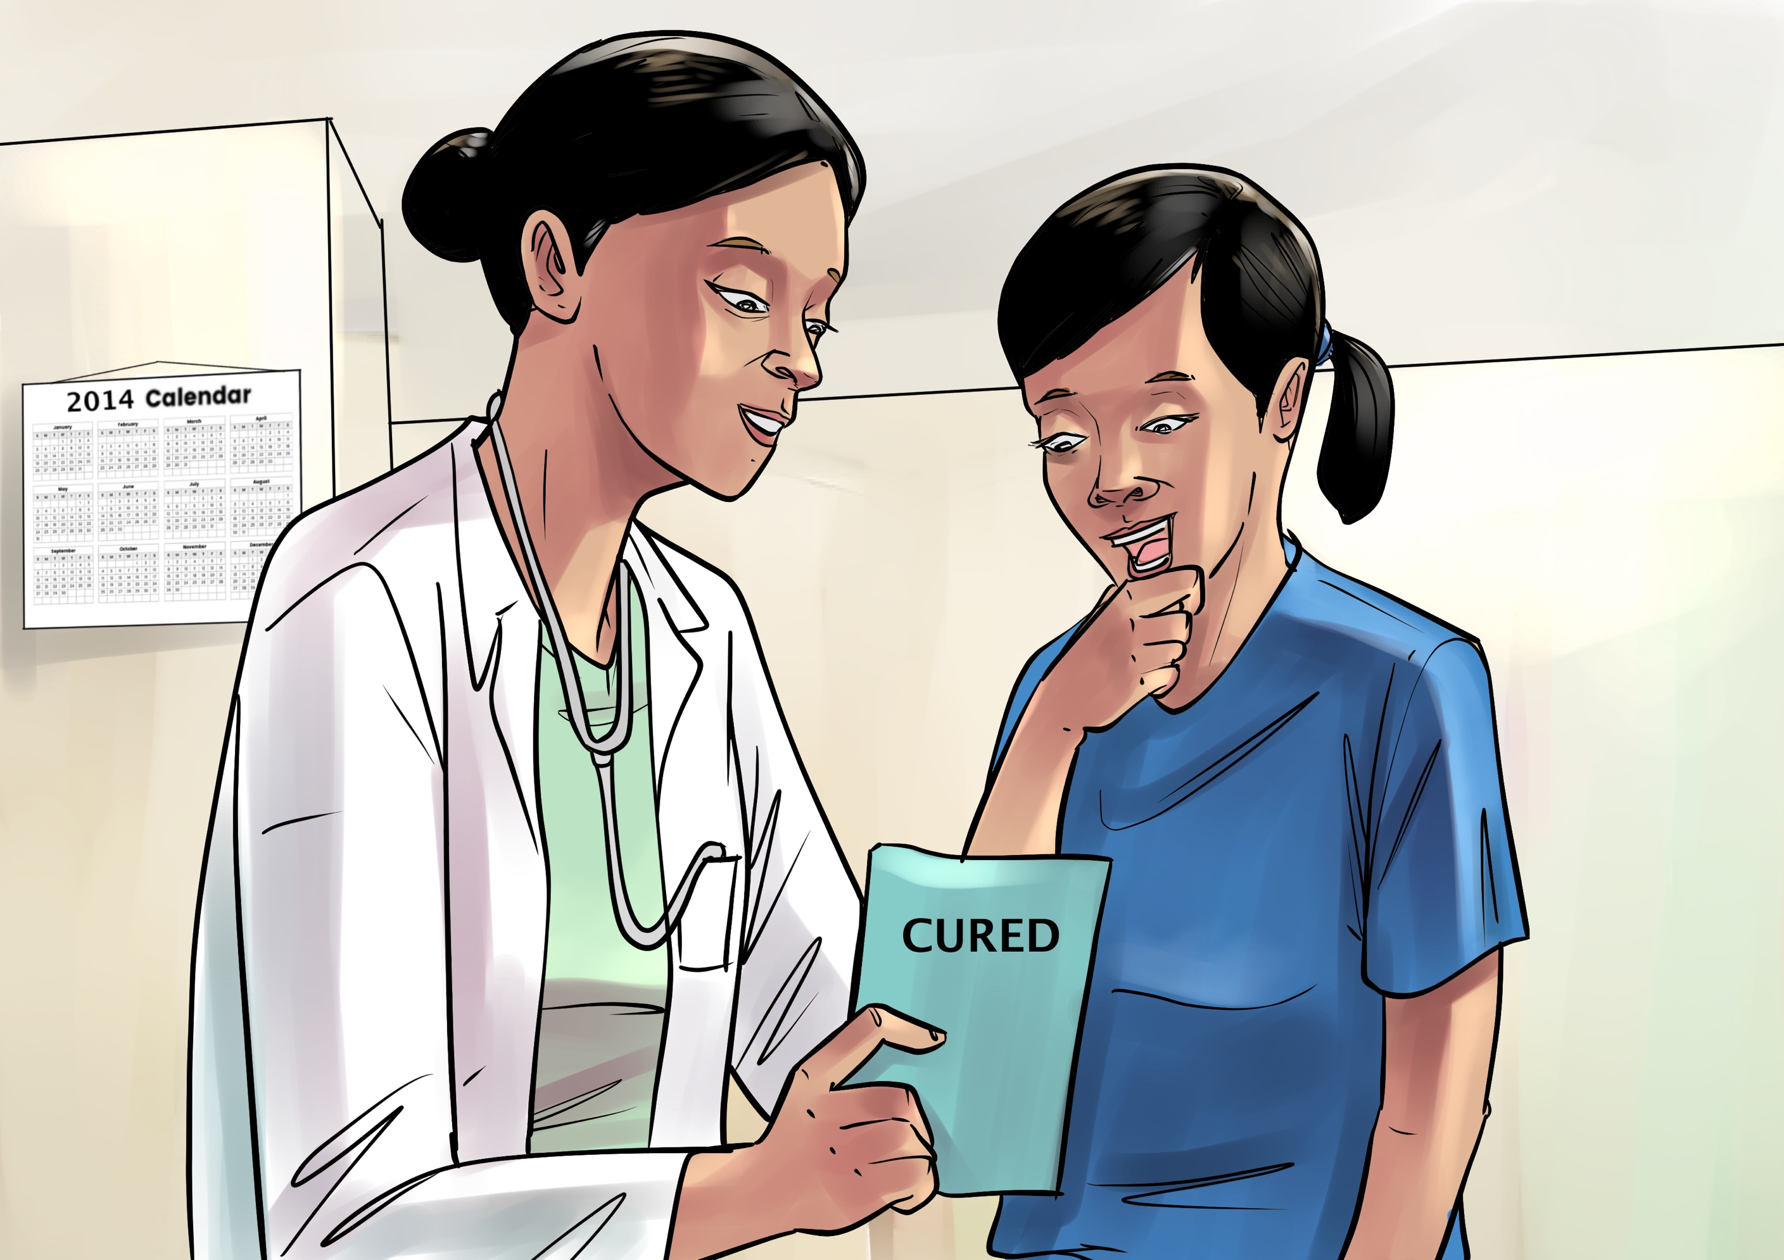
After 19 months and 28 days, Paran finished her treatment and was declared cured of TB. It had been 7 years since Paran had first started to feel unwell.

Slide 20
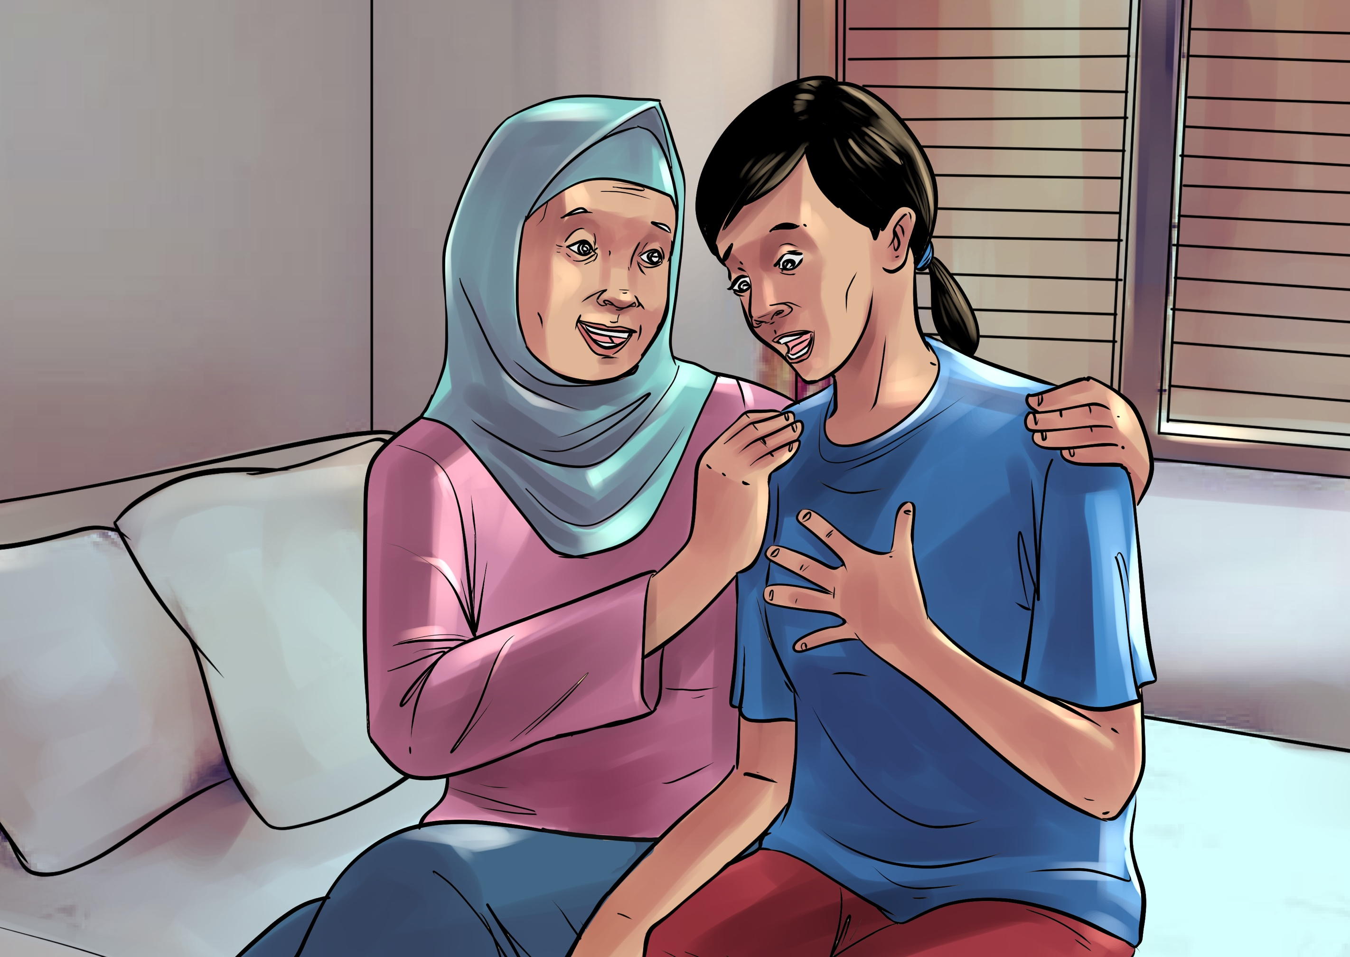
After completing treatment, Paran slowly regained her strength. She could breathe easier and walk longer distances, but she had trouble adjusting to no longer being a patient. She had become so used to the routine. One day she woke up late and started yelling at her mom for letting her oversleep the time she was supposed to take her medicines. Her mom had to remind her that she was cured and no longer had to take her medicines.

Slide 21
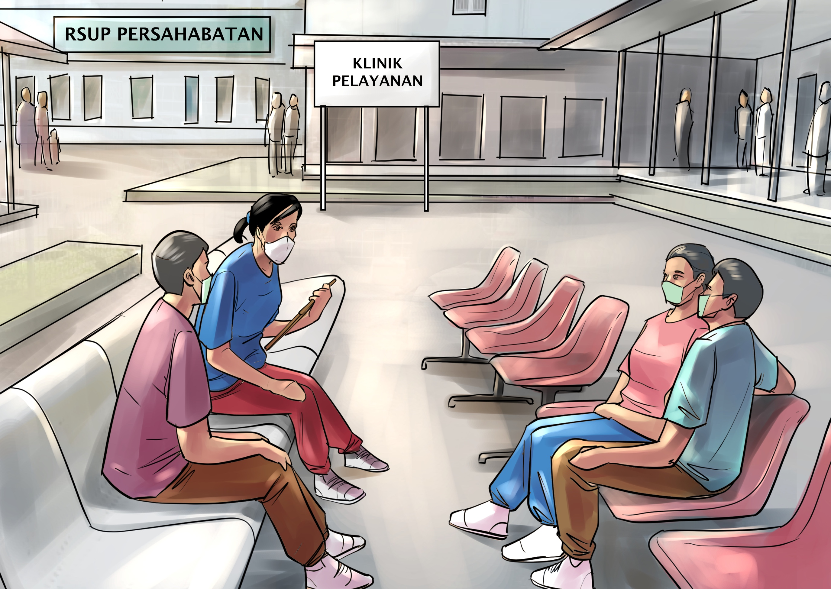
Paran hadn’t given much thought to what she would do with her life after treatment. In many ways she felt like TB had robbed her of so much time that her dreams were no longer possible. She had been out of the work force for so many years she feared she wouldn’t be able to get a job, especially as many employers ask to see your health records.
She decided to join an organization called Pejuang Tangguh (PETA) as Peer Educator for DR-TB patients, to help other people get through what she had experienced first-hand. Later on, she joined the Global Coalition of TB Activists (GCTA) and was invited to become a member of the regional Advisory Committee on MDR-TB (rGLC SEARO), which she now vice-chairs.

Slide 22
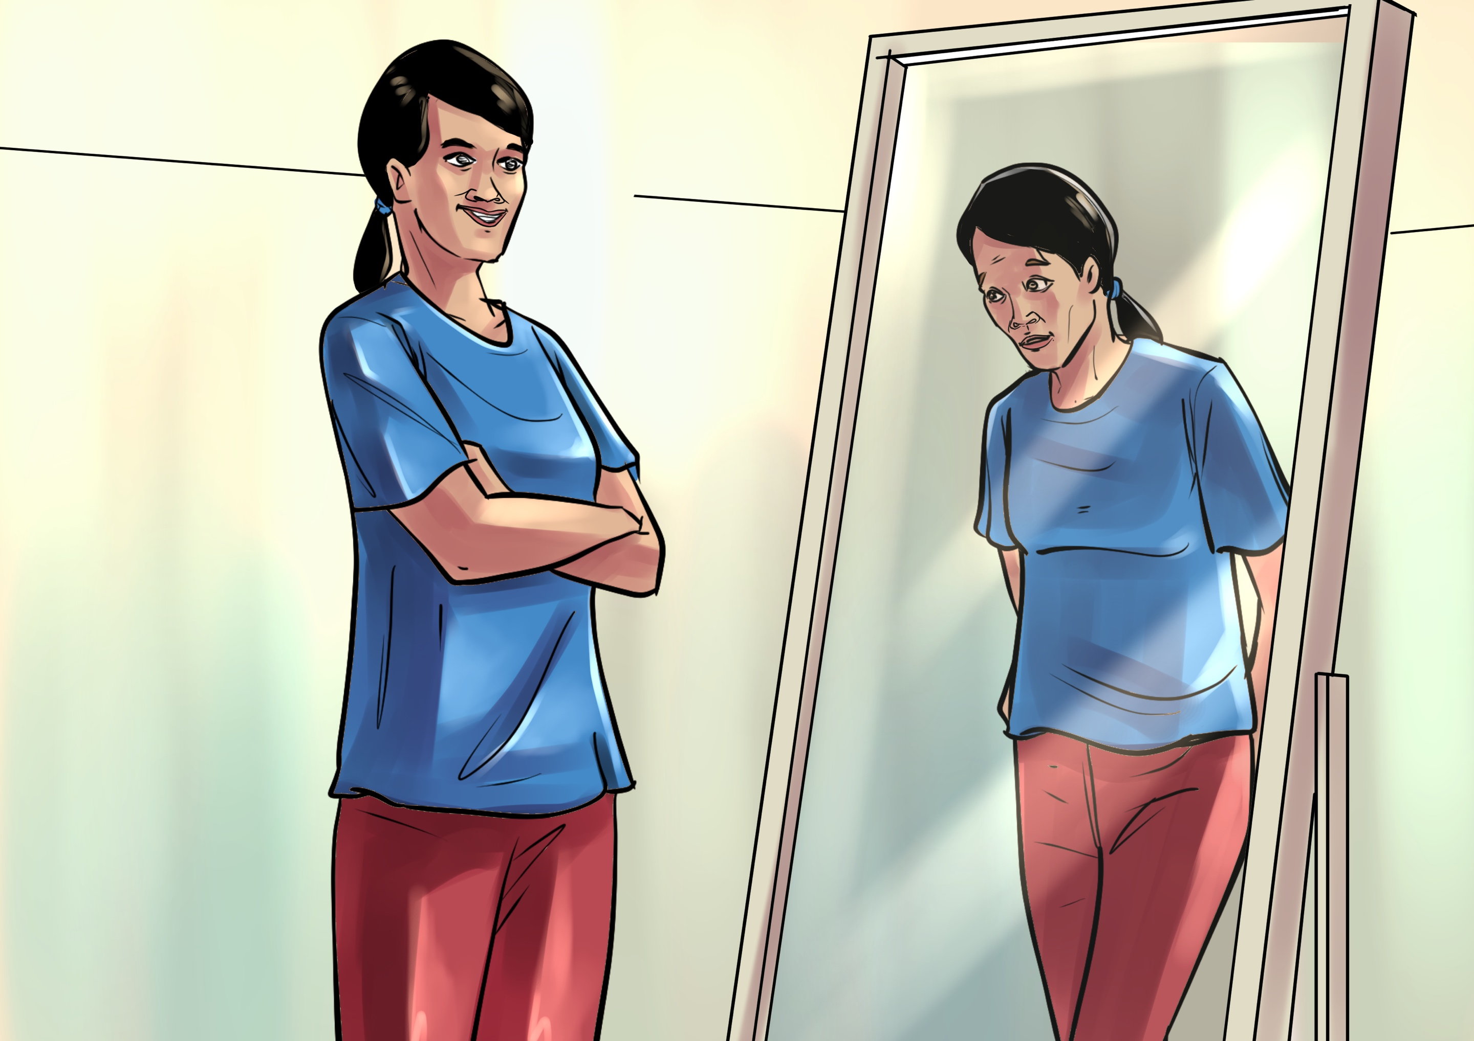
Paran also established and leads a coalition of young people, the Youth Movement Against TB of Indonesia (IMUT) and continues to work as a patient supporter for DR-TB patients at 3 referral Hospitals and 2 primary health care centers.
Even though Paran is involved in so many things, the scars of her experience with TB linger deep down inside and she often still feels badly about herself and her situation.
Barrier: Rehabilitation services and employment opportunities for DR-TB survivors.

