Slide 1
Umar Abdulbaki’s
Journey fighting drug-resistant tuberculosis

Slide 2
Umar was a healthy 16-year-old carefree teenage boy, who loved playing soccer. He dreamt of becoming a soccer star one day.
Originally from Kano State, Umar attended school in Borno State, where he lived with his older married brother (who was a textile businessman).

Slide 3
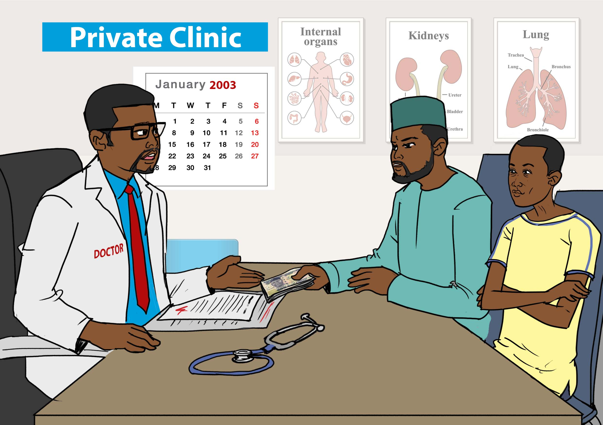
In January 2003, Umar started experiencing strange symptoms: headache, fever, persistent cough, and night sweats.
His older brother took him to the private health care clinic where they paid to get him medication. After two weeks, his condition did not improve.
His older brother decided to then take Umar to the public health care facility and there too he was prescribed medication that he did not know much about.

Slide 4
Umar was taking his medication and his condition was not improving. He was losing weight and his symptoms remained the same. He was losing faith. He spoke to an elder, who advised him to drink honey and lemon to stop the coughing, in addition to taking the pharmaceutical medicines. This did not help, and he just got weaker and was losing weight and coughing.

Slide 5
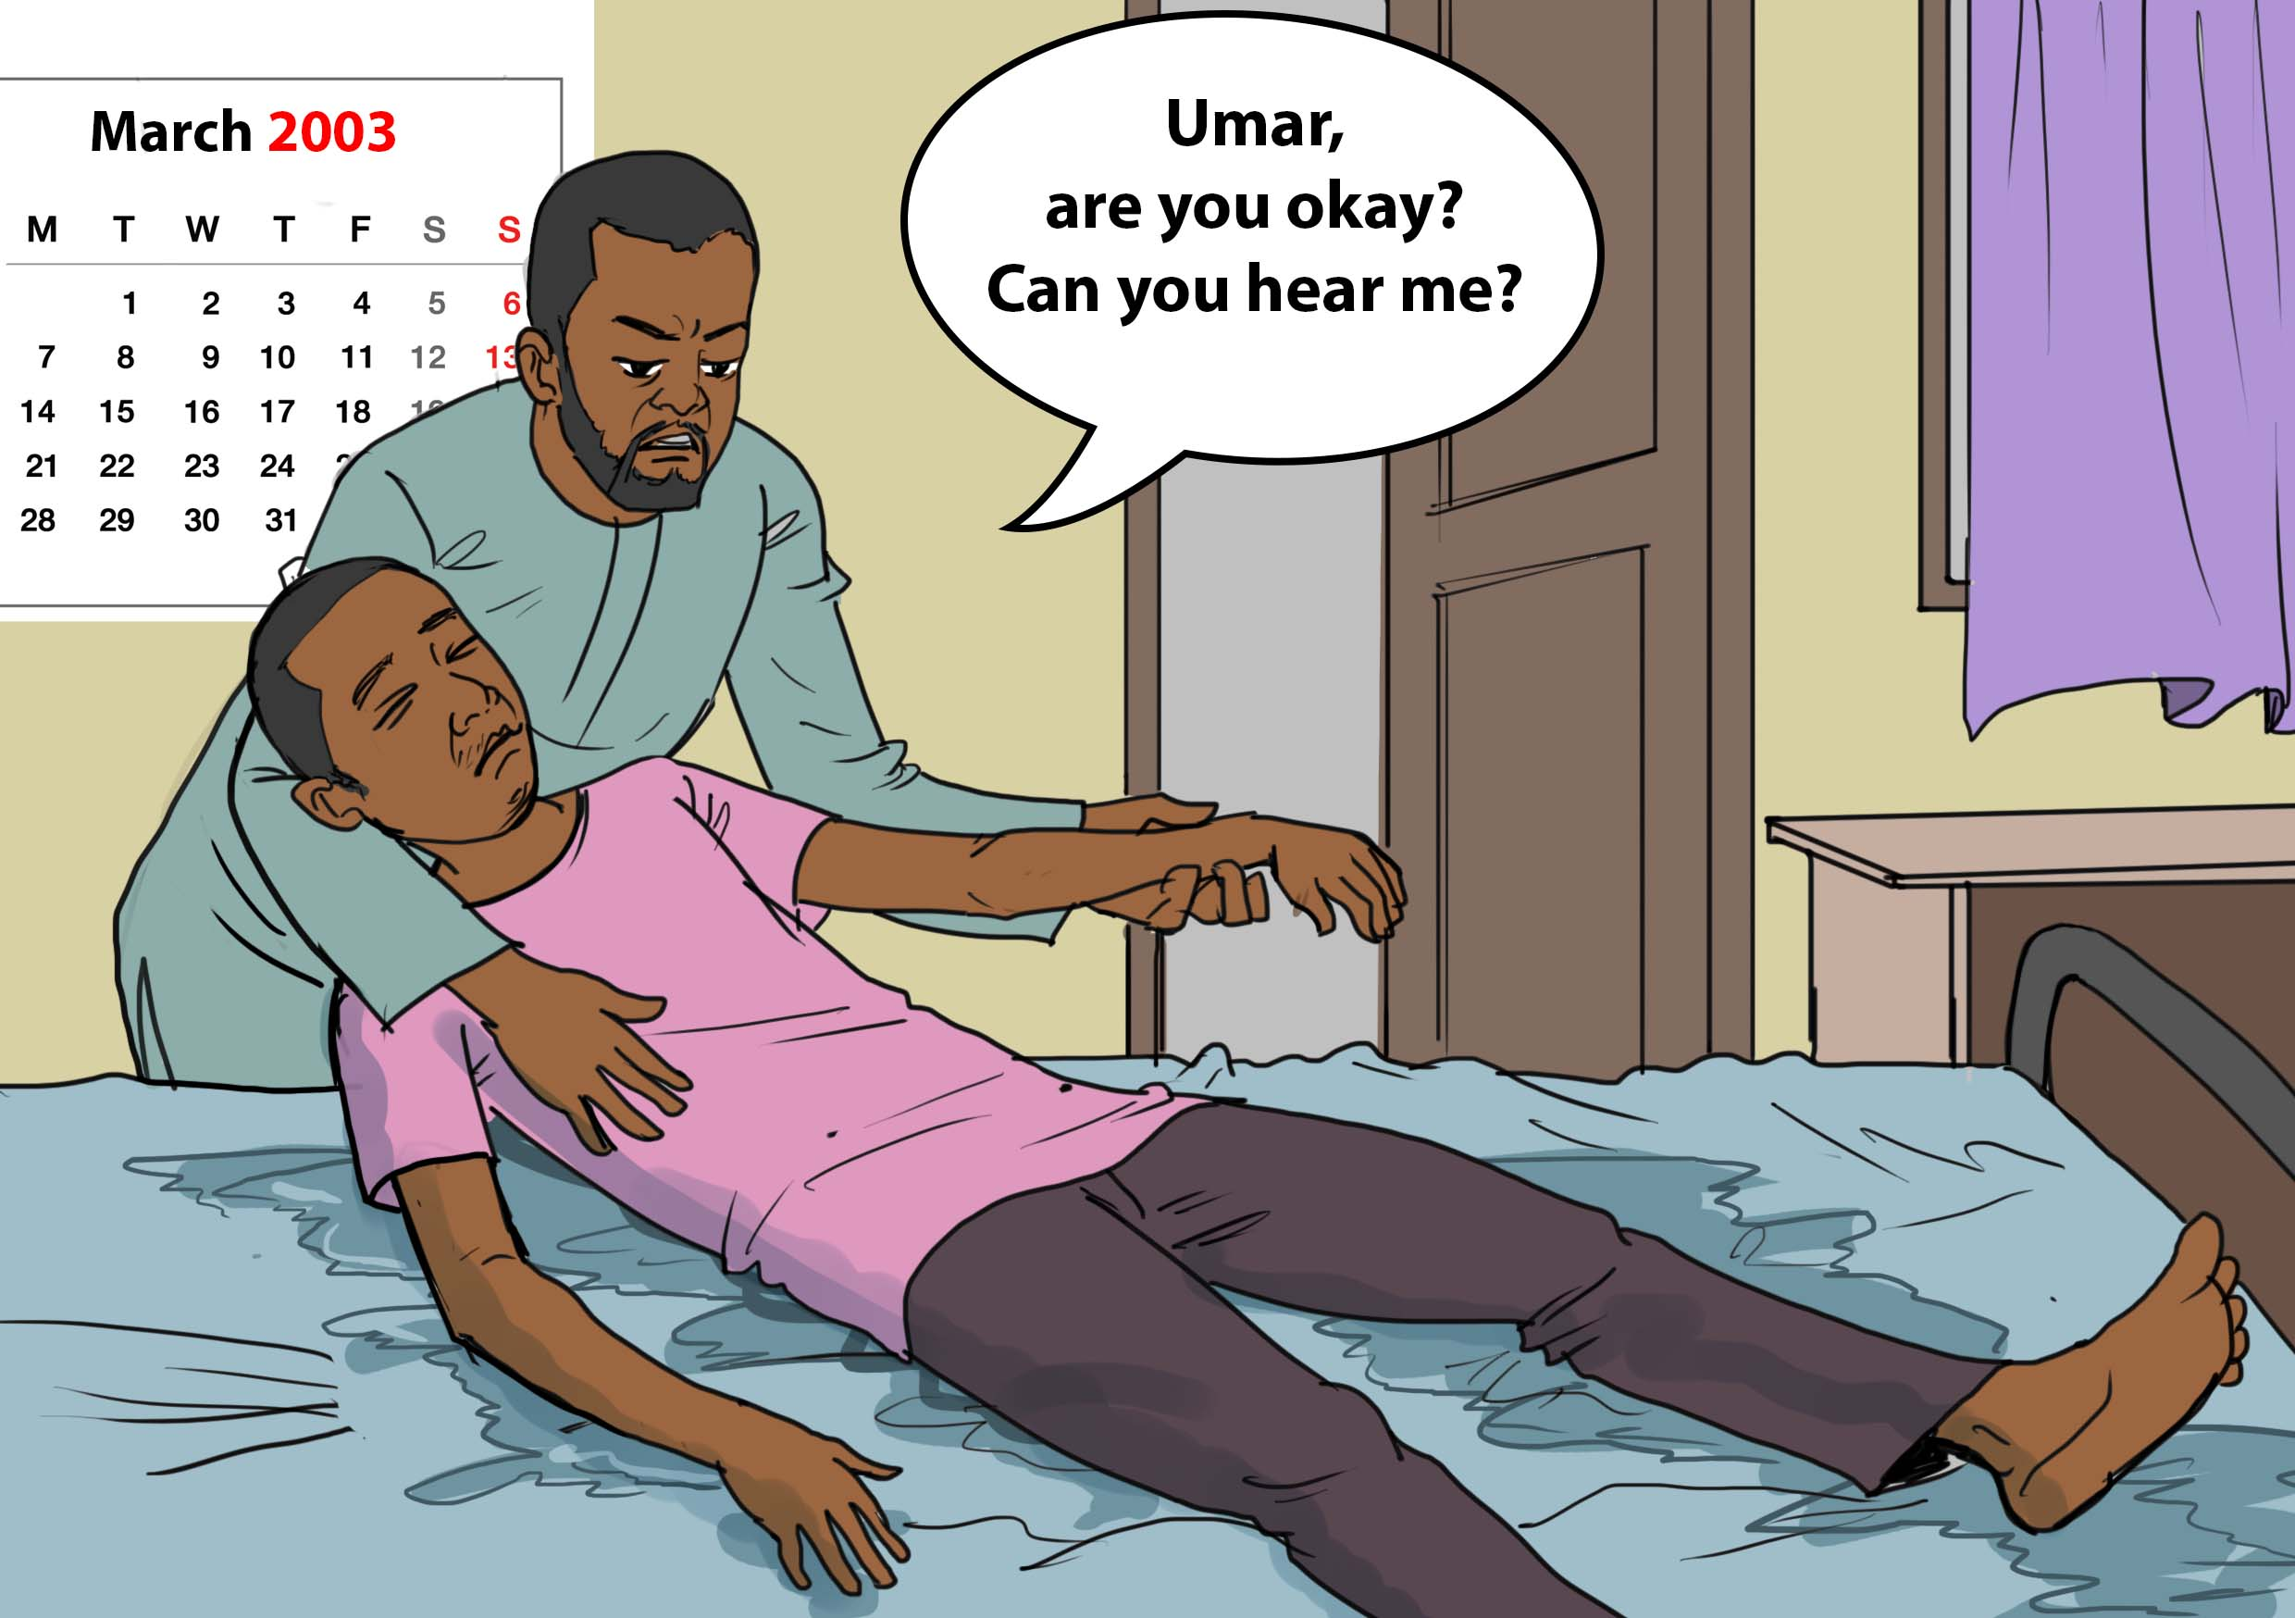
One night, Umar could not sleep because of the coughing fits. His fever was extremely high, and he was so sick that he collapsed.

Slide 6
His brother immediately took him to the hospital where he was admitted. He stayed there for two weeks undergoing various screening and tests. The prognosis was that he had kidney issues. His brother did not believe this prognosis and wanted a second opinion. He took Umar back home to Kano State (their native State), where their dad lived.

Slide 7
Umar was admitted to Murtala Mohammad Specialist Hospital in Kano State, where it was confirmed that he had tuberculosis (TB). He was prescribed 6 months of anti-TB medication, but he was not allowed to take the tablets home. He was advised to travel to the hospital daily to receive his medication.

Slide 8
During the intensive phase of treatment (2 months) Umar had to travel daily to the hospital to take his medication. The hospital was 30km away from his home. His dad gave him transportation money every day. He took the medication with the DOT supporter. He was then able to take his medication on his own for the remaining 4 months. Umar travelled to the hospital monthly to collect his medication from the DOT supporter.

Slide 9
Umar started feeling fully healed by month 5. He had already missed many treatment courses because he thought he was fine.

Slide 10
Umar (who thought he was now healed) transferred academically to Kano State from Borno State, where he lived with his family, including his two mothers and siblings. He no longer played soccer due to his chest issues and focused on his studies.

Slide 11
Early in 2011, Umar was in tertiary school at the Polytechnic Institute. He started feeling sick with TB symptoms again. He went to the chemist and got medication, but nothing improved. He went to the public hospital, and was prescribed some more medication, including antibiotics. After taking them, there was still no improvement.

Slide 12
One of Umar’s friends advised him to go to the Infectious Diseases Hospital in Kano State. The doctor prescribed medication and after one week of taking the medication, Umar observed no improvements. He went back to the hospital to explain that nothing had changed. This happened during the period when he was writing tests at school. He was given sputum containers and provided a sputum sample. He had a persistent cough during his exam. Then the results came back and he had TB. Again, he was traumatised!

Slide 13
Umar was put on second line anti-TB treatment. This included injections for two months along with other medicines, followed by another four months of oral medication.

Slide 14
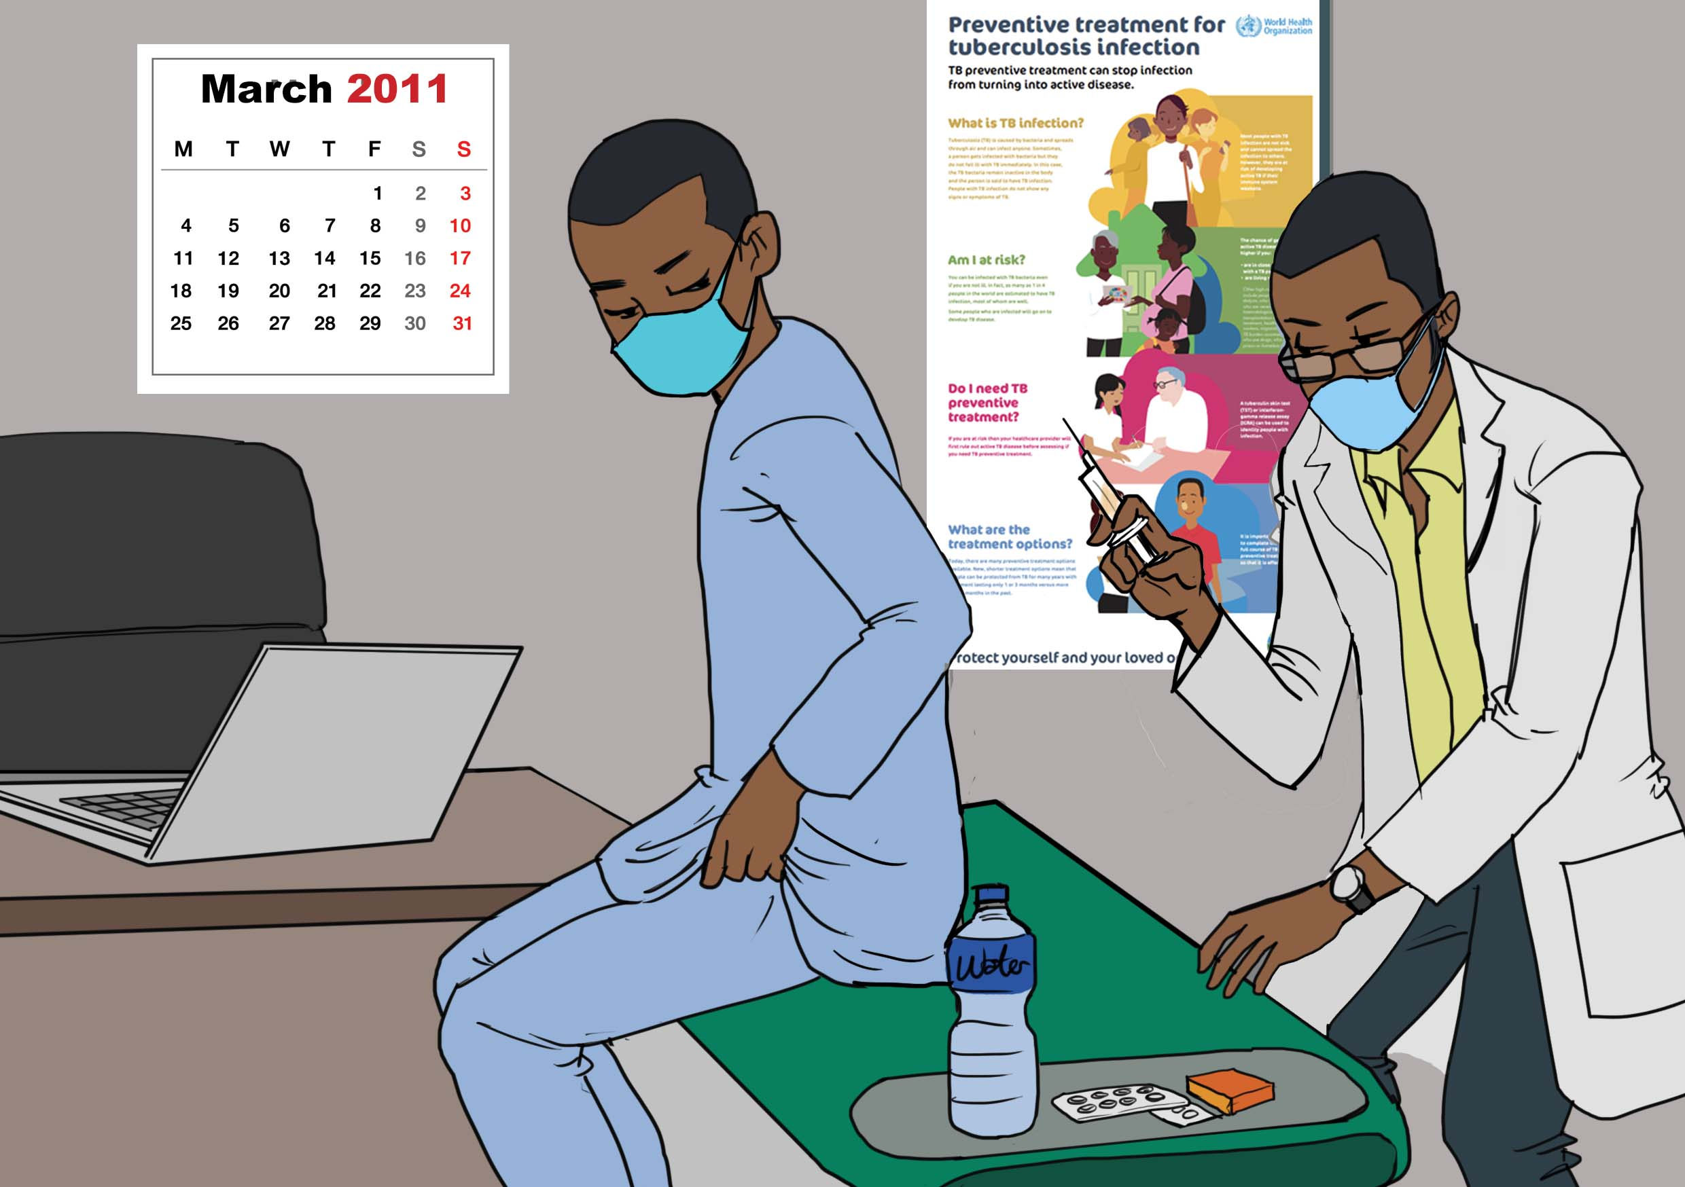
For the first two months, Umar went to the hospital every morning for the injection and other drugs (3 tablets) and then went to school. There remained 4 months of oral medication, without the injections.

Slide 15
Before Umar completed the full 6 months of treatment, he travelled away from home to another State. Unfortunately, he only took 1 week of medicines with him on the trip. This was his last month on treatment. He spent two weeks away and missed 1 week of treatment. When he got back home, he completed the missed doses. He was confirmed as cured after that.

Slide 16
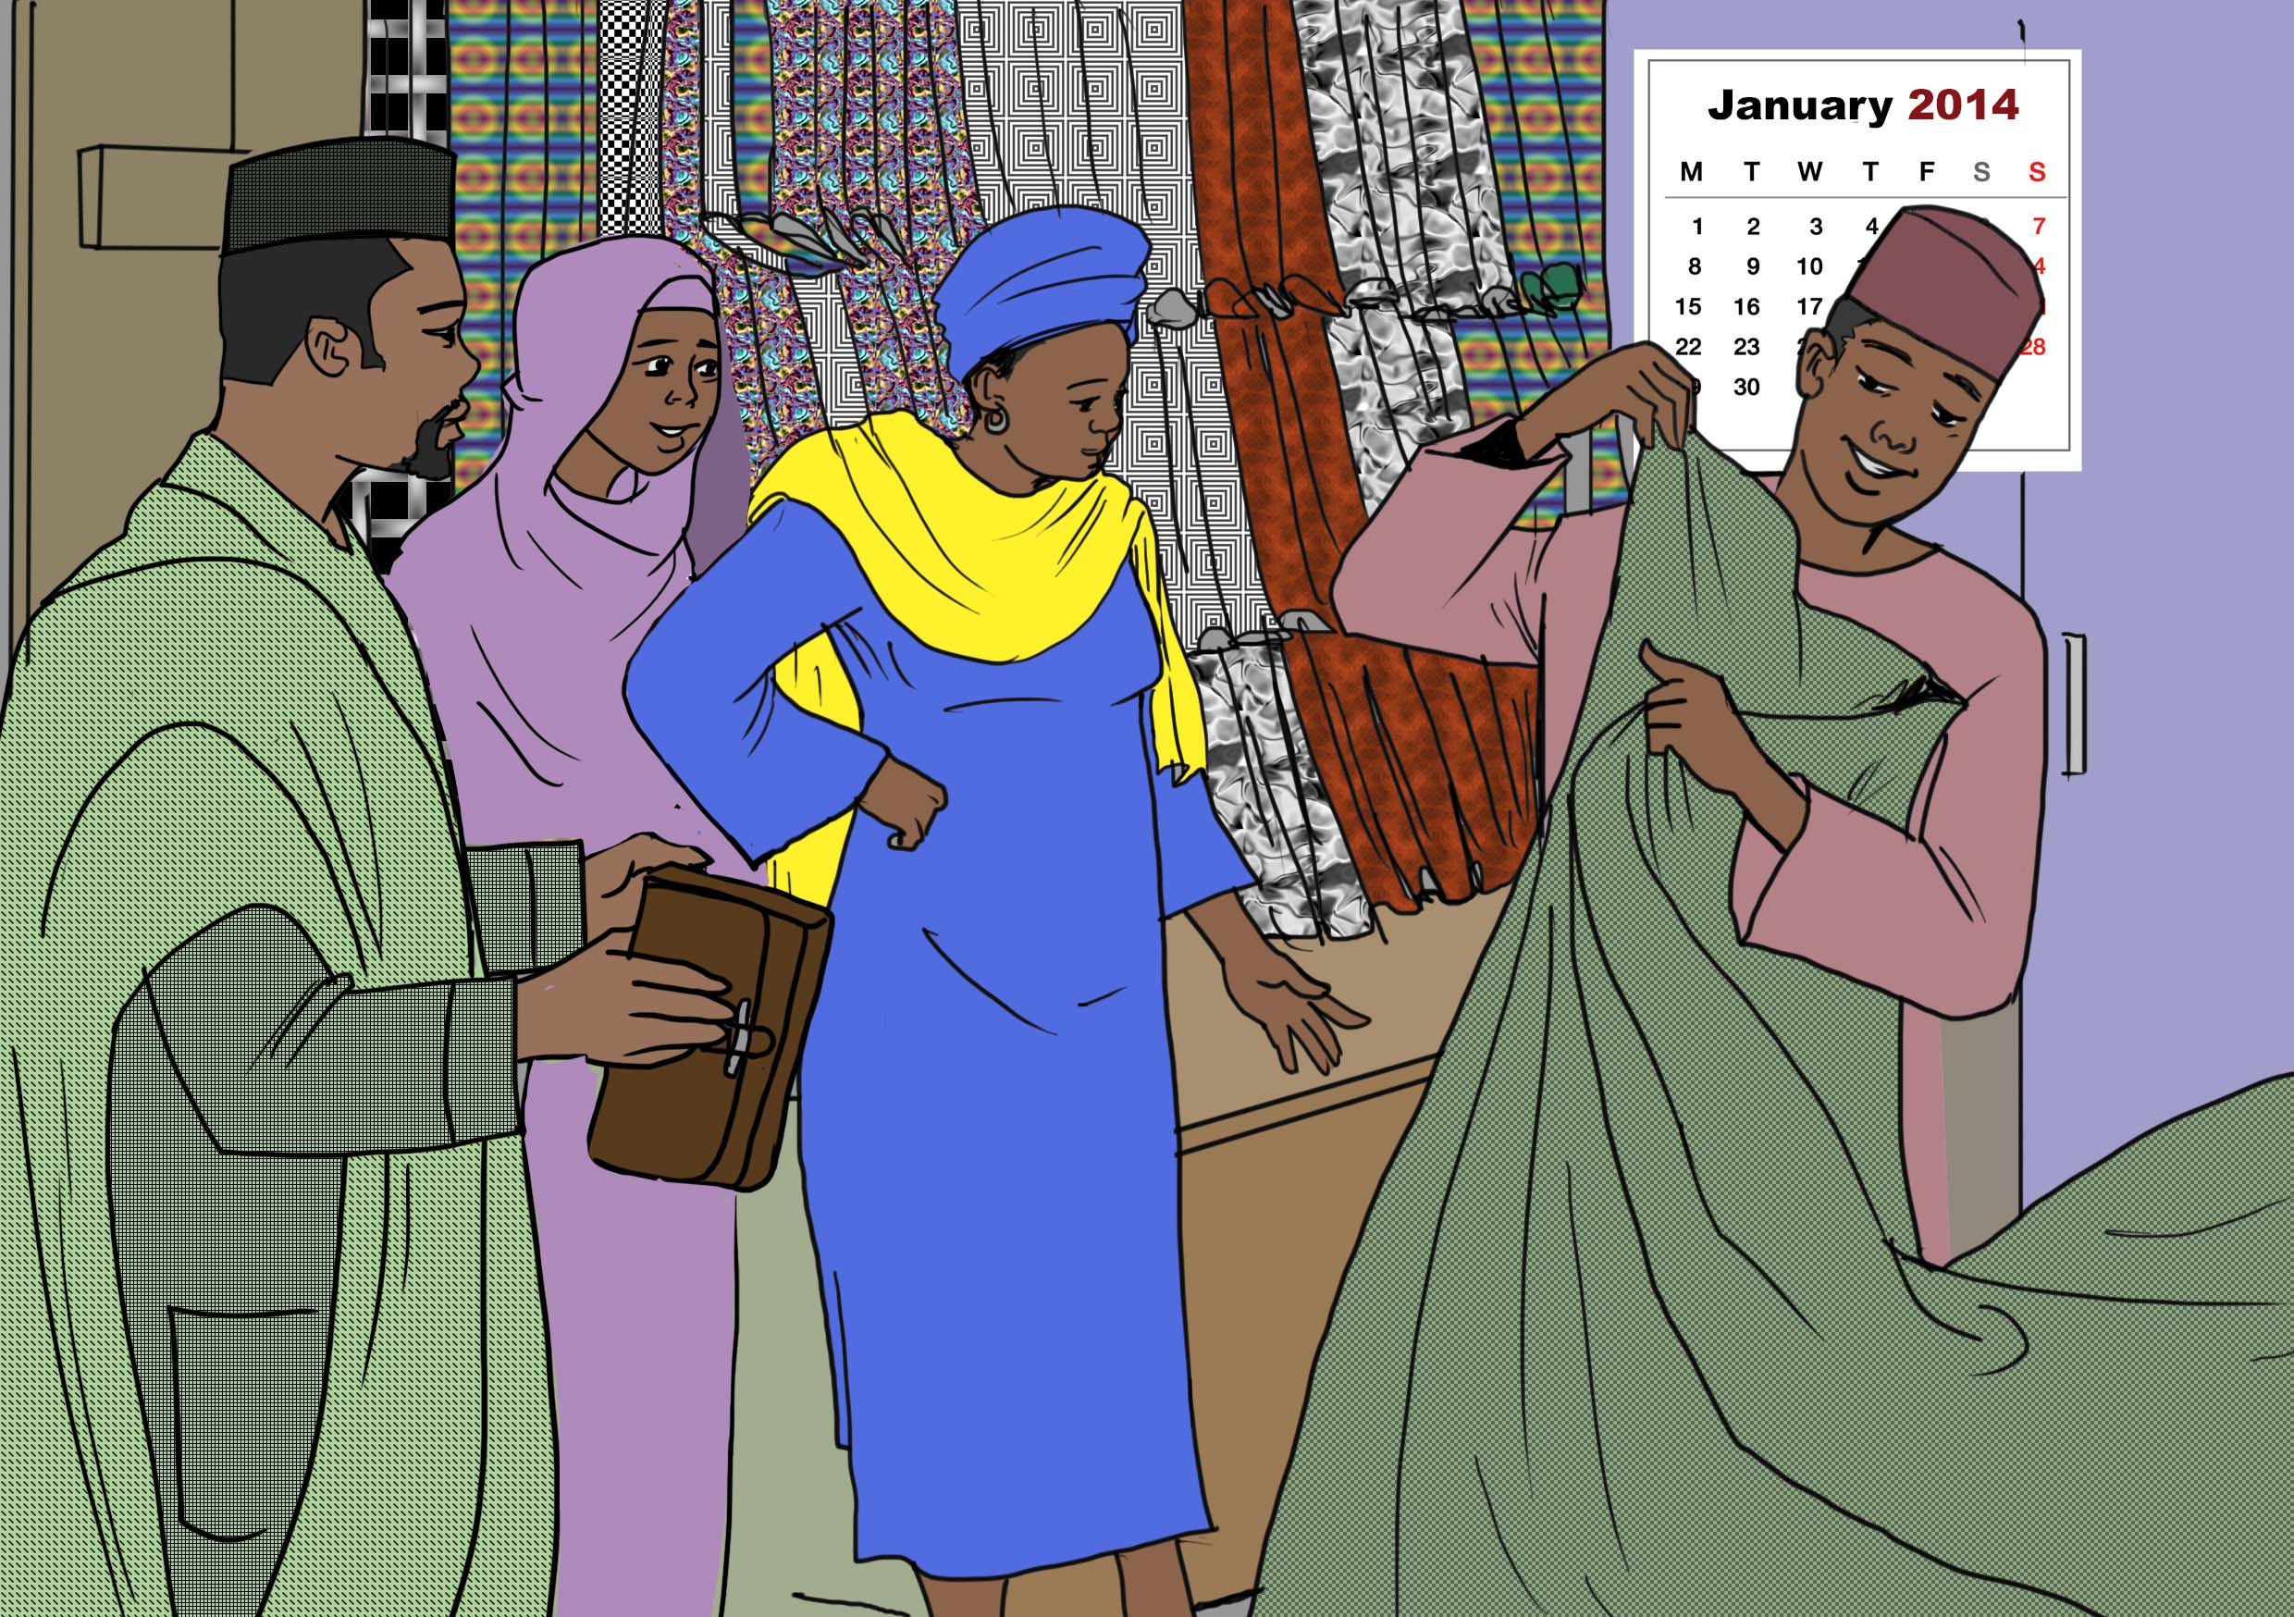
Three years later… At the beginning of 2014, Umar started working at the market selling textiles. He was finished with his tertiary education.

Slide 17
Umar started feeling sick again in February 2014. He went back to the Infectious Diseases Hospital with his clinic card to find his previous DOT supporter. On his way to those offices, he saw a poster on the wall of the hospital about the signs and symptoms of tuberculosis. He knew what was wrong even before he even met with the medical personnel.

Slide 18
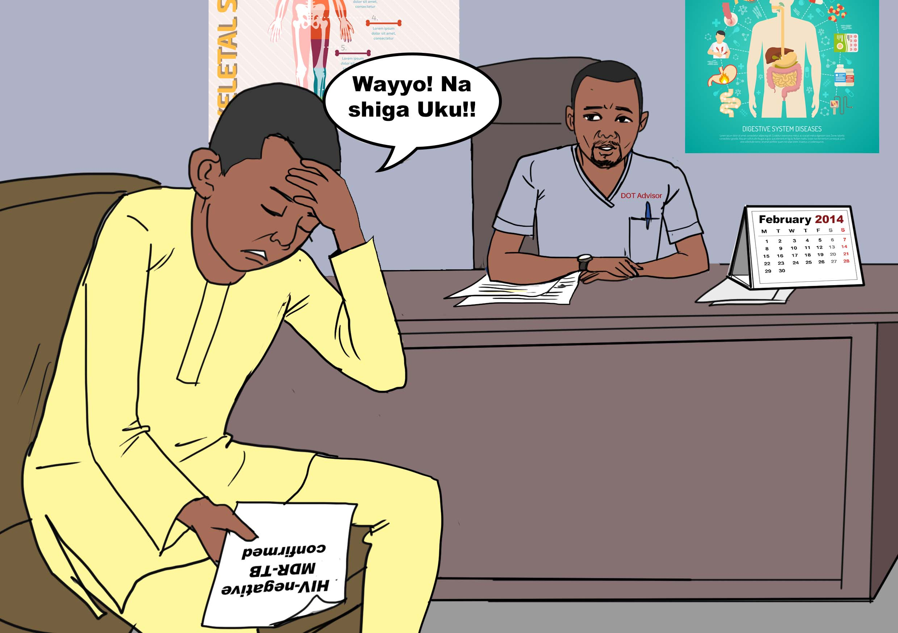
Umar received a referral form for further tests from a health care worker, including for HIV and TB. He went to the lab and they did an HIV test and found it negative. He was also given a sputum cup and was told to bring back a sample the next morning. A few days later, the test results came back and Umar was told he had multidrug-resistant tuberculosis (MDR-TB). He was very unhappy and frustrated by this result, thinking back on his journey. Umar was then told by the DOT advisor that he had options; (1) he could be admitted or (2) he could take the medication at the Area Community Health Care referral centre. Umar took option 2. He was advised that he had to wait for the arrival of the medication, which would take two weeks.

Slide 19
On 19 June 2014, Umar received a call from one of the supervisors, telling him that he was starting home-based treatment on 20 June 2014. The community health worker would go to his house every morning for 8 months. When he started the treatment, the injections were the worst.

Slide 20
Umar had 200 plus injections and he also took a large number of tablets daily for two years. He hated the side-effects. He could not handle it anymore.

Slide 21
Umar contacted his previous DOT advisor, who was now the DR-TB focal person. He complained about the side effects and the pain. He begged him to share the phone numbers of other MDR-TB patients. Umar wanted to contact these other patients, to ask them if they felt the same side-effects. He asked the patients about their treatment journeys. Some were at 2, 4, or 6 months into their treatment. They were exchanging stories about their journeys, and could share with one another how they felt about the treatment side effects. Umar started this ‘loose’ patient support group.

Slide 22
Umar finished with the injections on 1 January 2015 (after 8 months of injections) and he continued taking the tablets for another 12 months. This time, he did not miss any of his treatment doses. Umar was encouraged to write down his story. This gave him the idea of writing the ‘Patient’s Guide to MDR-TB’, because there were not enough DR-TB patient/peer supporters. Umar believes that when you write something, it is better than sweat. He did not want his story to be forgotten, so he wrote this guide in English to (1) make sure that his suffering is documented and does vanish and (2) as a peer support guide. He got inspiration from listening to the radio, where a Hausa writer spoke about how the “pen is better than the sword.”

Slide 23
During his treatment in 2016, Umar met his wife, who supported him during his treatment. They got married on 31 July 2016.

Slide 24
Umar used to go to the hospital to visit the MDR-TB inpatients. He gave them counselling and advice, using himself as an example. He worked closely with the National TB Program (NTP) in their State, to ensure that there was MDR-TB support. He did this on a voluntary basis. He walked the patients through the treatment journey that they had to take. Umar is a TB ambassador. Umar like other MDR-TB survivors had difficulty finding a job. He was struggling until he was employed as a rider for Riders4Health. He wrote to them and submitted his application. He was hired and has since worked with Riders4Health.

Slide 25
Umar had a little boy who passed away. He was 16 months old when he got sick, and he passed away after 3 days of illness. After another year, Umar and his wife conceived again and had another son.

