Slide 1


HIV Cure-Related Research Strategies
Notes:
Hi Everyone, and welcome to the CUREiculum module on HIV cure-related research strategies.
Today, we review the main approaches that are being investigated in the search towards an HIV-1 cure.

Slide 2






Module Outline
Key timeline events
Research process overview
Research ‘dam’ analogy
Stem cell transplantations
Early ART
Draining the ‘reservoir’
Reinforcing the ‘dam’
Making cells stronger
Putting different strategies together
Notes:
Our proposed module outline is as follows.
In this module, we will review:
Key timeline events in the search towards an HIV cure
Research process overview
Helpful analogies - one such analogy is the use of the dam (e.g., draining the reservoir and reinforcing the dam)
Different HIV cure research approaches
The likely need for combination approaches to keep HIV under control without antiretroviral treatment

Slide 3
Key timeline events
Notes:
First, let us review key timeline events.

Slide 4
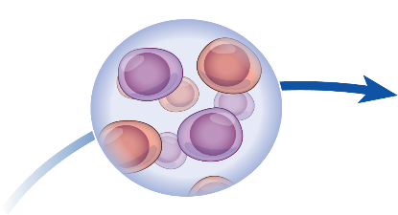
HIV cure
is rare.
Notes:
HIV cure, or elimination of HIV from the body, either naturally or with interventions, is extremely rare.

Slide 5




HIV Cure is Rare: Elimination and Durable ART-Free Suppression
VISCONTI/SPARTAC/CHAMP
LOREEN WILLENBERG
THE
SAN
FRANCISCO
PATEINT.
2010
POST
TREATMENT
CONTROL
2020
THE
BERLIN
PATIENT
THE
LONDON
PATIENT
2009
2019
TIMOTHY RAY BROWN
ADAM CASTILLEJO
Hutter et al., N Engl J Med 2010; Gupta et al., Nature 2019; Gupta et al, Lancet HIV 2019; Jiang et al., Nature 2020
SLIDE CREDIT: Sharon Lewin, Singapore AIDS Conference 2020
Notes:
This slide shows some of the rare emblematic cases.
Timothy Ray Brown, or the Berlin Patient, was the first person considered cured of HIV infection, following a bone marrow transplant to treat his leukemia in 2007. His donor had a very special gene deletion (called homozygous CCR5 delta-32) that made his cells resistant to HIV.
Adam Castillejo, also known as the London patient, is the second person cured of HIV. His body became resistant after receiving a bone marrow transplant to treat his Hodgkin’s lymphoma (a type of cancer).
In both cases, the risk of the stem cell transplant was justified by the cancer. Stem cell transplants could not be performed in people who are otherwise healthy.
There is a third person, called the Düsseldorf patient, who is thought to be the third case of HIV cure.
Loreen Willenberg, also known as the San Francisco patient, is an exceptional elite controller whose HIV appears to be ‘locked away’ where it can’t produce new virus. Loreen has never taken HIV treatment and her body can control the infection. This is an exceptionally rare case that can give clues to how we could keep HIV under control without ART. Loreen’s cases is inspiring a strategy that could keep HIV ‘silenced’ inside the cells. We will come back to that.
The VISCONTI cohort (which stands of Viro-Immunological Sustained CONtrol after Treatment Interruption) is a group of 14 patients with HIV in France that have been treated early. They have been able to stop their HIV medication without the resurgence of virus in their body.
SPARTAC (Short Pulse Antiretroviral Therapy at Seroconversion) was a study designed to test whether a short period of treatment in the early stages of HIV could delay the need for ART. The study showed that giving treatment to people who recently acquired HIV had significant advantages, compared to no treatment - including much heathier immune systems.
The CHAMP (Control of HIV After Antiretroviral Medication Pause) study help define the frequency of post-treatment controllers. In 14 studies in the AIDS Clinical Trials Group, 67 people were able to keep HIV suppressed without ART. Of these, 38 were treated during early HIV infection, and 25 during the chronic phase. Post-treatment control was more frequent in people who started ART early in the course of infection.

Slide 6
Overview of the Research Process
Notes:
Now, we review the research process.

Slide 7






Overview of Research Process
Notes:
To understand how difficult it is to find a cure for HIV, we must understand how the research process works.

Slide 8







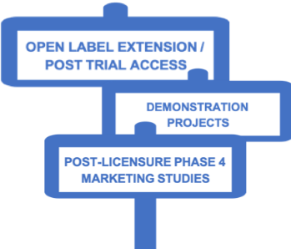



BASIC
SCIENCE
PRODUCT INTRODUCTION
Notes:
We are used to seeing a very linear translational research pathway, from basic science, pre-clinical research, translational research and clinical trials – including Phase I, II, IIb, and III, moving progressively towards efforts.
The truth is that finding a cure will likely require several iterative steps, and the process will be step-by-step (incremental).
Experiments will inform the next steps of experiments, and we will move progressively to finding a cure, or regimen that could keep HIV suppressed without ART.

Slide 9



Why is HIV so hard to cure?
So few cells harbor HIV in people on antivirals medications and these cells appear normal to our immune system
Notes:
When the immune cell is on patrol but has not recognized a familiar pathogen, it is “resting” or “not activated” or reproducing itself; the cells aren’t sending out any signals for destruction.
During this time HIV appears not to be doing anything either.
The rest of the immune system can’t see it because it is hiding inside the body’s own cell. ARV’s can’t find it either, for the same reason.
Not only are these cells hard to find because they aren’t sending out signals.
They are also hard to find because there are very of these reservoir cells in the body.
It is important to note a unique feature of HIV that makes curing more challenging:
I think it is worth describing the unusual feature of HIV that it integrates into the DNA of an infected cell.
This ‘superpower’, which is almost unique amongst viruses, guarantees that HIV can remain a permanent part of any cell it infects.
This then leads to the idea that its not enough to have drugs that can inactivate any virus in the body, but you also have to eliminate any cells that have been infected.
This feature is key in the ‘latent reservoir.’

Slide 10

Research ‘dam’ analogy
Notes:
A very helpful analogy to understand how HIV cure-related research strategies work is the ‘dam’ analogy.

Slide 11


How Can We Prevent HIV From Rebounding Off Therapy?
R. Brad Jones
Drain the HIV reservoir
Eliminate HIV-infected cells
“Classic cure”
2) Reinforce the dam
Boost the immune response to HIV
“Virologic suppression off ART/remission”
HIV Reservoir
(in a person)
SLIDE CREDIT: Jones RB. The Newest Science in Cure and Vaccine.
Plenary Presentation Main IAS 2018 Conference.
Notes:
At 2018 International AIDS Society Meeting in Amsterdam, Brad Jones from Cornell University presented the newest science in the search for a cure during a plenary session using the analogy of the little Dutch boy. To find a strategy that could keep HIV suppressed without ART, we must either: 1) drain the HIV reservoir (eliminate HIV-infected cells), or 2) reinforce the dam (boost the immune response to HIV).
All strategies being investigated for curing HIV infection aim to achieve one or the other of these objectives. Jones explained that therapies aimed at reducing viral reservoirs or inducing remission are showing promise, but we must view HIV cure as a long-term goal. Basic science research is needed to improve methods of targeting and measuring persistent sources of the virus.

Slide 12



Strategies Towards HIV Cure
R. Brad Jones
Latency reversal– reactivate latent HIV with drugs and kill with immune system
Gene therapy to delete HIV out of cells
Gene therapy to make cells resistant to HIV
Vaccines / Immunotherapies – enhance immune responses to control virus
‘Block and lock’ – permanently silence HIV expression (force into deeper latency)
SLIDE CREDIT: Jones RB. The Newest Science in Cure and Vaccine.
Plenary Presentation Main IAS 2018 Conference.
Notes:
We can use this metaphor to categorize the different cure strategies which are currently being pursued.
Latency reversing agents aim to empty the reservoir – by reactivating latent HIV with drugs and then clearing them with the immune system.
Gene therapy to delete HIV from cells is another way to empty the reservoir.
Whereas another type of gene therapy that makes new cells resistant to HIV infection is a way of controlling HIV, or re-enforcing the damn.
Another very promising way of reinforcing the damn is through the use of vaccines or immunotherapies.
Finally, you may have heard of ‘block and lock’ which aims to permanently shut down HIV – and this is analogous to stopping the flow of water by freezing the lake (a form of permanent silencing).

Slide 13

HIV Cure-Related Research Strategies Under Investigation
HIV Cure-Related Research Strategies Under Investigation
To limit the establishment of the reservoir
To reduce the size of the reservoir
To control the reservoir
Early ART
Render uninfected cells resistant to HIV
Deplete
infected
cells
Flush out
the latent reservoir
Therapeutic vaccines
Immunotherapy
Cartoon Credit: BEAT-HIV Collaboratory
Slide Credit: Nicolas Chomont
Notes:
There are different strategies being explored to achieve ART-free HIV suppression or HIV cure.
Each of these strategies takes a different approach to the challenge of bringing HIV under control without ART.
We will review some of the main strategies currently under investigations.
One important thing to remember is that we do not yet know what a cure will look like.

Slide 14








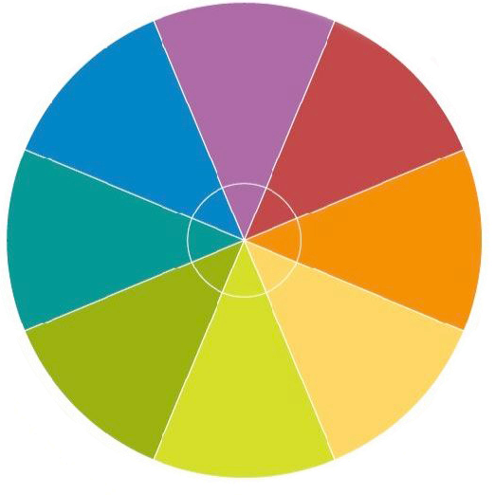









Early Antiretroviral Treatment
‘Block and Lock’
Latency Reversal Agents
Cell & Gene
Therapy
Immunotherapy
Strategies
Stem Cell
Transplantations
Co-Inhibitory
Receptors
Broadly Neutralizing Antibodies
Notes:
This wheel depicts the main HIV cure-related research strategies:
Early antiretroviral treatment, which means treating someone as early as possible after infection to reduce the size of the HIV reservoir, and increase the chance that the person could keep HIV suppressed without ART.
Latency-reversing agents: trying to reawaken HIV that has become dormant insides the cells to make it visible to the immune system.
Immunotherapy strategies which reinforce the immune system
Co-inhibitory receptors which regulate the response of the immune system (like putting one’s foot on a pedal)
Broadly neutralizing antibodies which aim to neutralizing multiple HIV strains in the conserved epitopes of the virus (the parts that remain the same)
Stem cell transplantations, which aim to make cells resistant to HIV infection, but are only justified in people with malignant cancers
Cell and gene therapy, which aim to make cells resistant to HIV infection or remove the HIV
‘Block and lock’ or silencing agent, which would not remove HIV but would keep it permanently dormant inside the cells
Some HIV cure studies require analytical treatment interruptions - also called ATIs. We have a separate CUREiculum module on ATIs.

Slide 15





Stem Cell Transplantations
13 years
7 months
5
years
+
Donor: CCR5 $Δ32 homozygous$
Recipient: CCR5 $Δ32 heterozygous$
Donor: CCR5 $Δ32 homozygous$
Recipient: CCR5 $Wild Type$
Acute myelogenous leukemia
Hodgkins lymphoma
Two stem cell transplants
One stem cell transplant
Total body irradiation full intensity conditioning
T cell depletion with ATG
No irradiation reduced intensity conditioning
T cell depletion with aCD52
Mild GVHD* / 100% chimerism
Mild GVHD* / 100% chimerism
**GVHD = Graft Vs. Host Disease
Notes:
Only Two People Have Been Cured of HIV
There are only individuals who have achieved a state of ‘complete cure’ of HIV infection following an intervention.
The first person, Timothy Ray Brown–otherwise known as the Berlin patient–received a stem cell transplantation to treat his leukemia (a type of cancer).
The stem cell donor had a special deletion in his CCR5 (C-C chemokine receptor 5) gene, the co-receptors that HIV needs to be able to enter a cell.
Timothy Brown had to interrupt his HIV medication for his cure to be discovered.
Timothy Brown has now been without evidence of HIV for 13 years.
Another person, Adam Castillejo–known as the London patient–received a similar milder form of stem cell transplantation to treat his lymphoma (another type of cancer). The stem cell donor had the same type of CCR5 gene mutation. Adam Castillejo’s virus has not returned 30 months after he interrupted his HIV treatment.
Possibly third person (Dusseldorf patient)
It is important to note that both these individuals had a cancer that warranted a stem cell transplant, which is a very risky procedure.
The stem cell transplant would not be justified in people living with HIV who are otherwise healthy, because the risk would be too high.
Both Timothy and Adam received a stem cell transplant from a donor who lacked the gene for Delta 32 which is responsible for the CCR5 co-receptor HIV uses to infect the target CD4 helper T cell.
Hematopoietic stem cells, produced in the bone marrow, are the source of all the blood cells in the body.
Stem cell transplants are used to treat life-threatening illnesses such as cancer.
Stem cell transplants involve the transfer of cells that lack a key receptor (CCR5) on their surface, followed with a process called conditioning, aimed at eliminating an individual’s immune system to make room for a donor system and reduce the risk of a transplant rejection.
There are two types of stem cell transplants: autologous (cells obtained from the same individual) or allogeneic (cells obtained from a different person).
Stem cell transplants are indicated for individuals who already have cancer and are very ill.
Scientists believe that allogeneic stem cell transplants are too dangerous (a lot of people who get these transplants die) and not readily scalable as a practical cure for most people.
To date, the only two people who has been cured, were cured through this process.
Note on CCR5 gene deletion:
The overwhelming majority of newly diagnosed people have a viral strain that uses CCR5 as a co-receptor.
Most people living with HIV have a virus that uses CCR5, but this may evolve over time (particularly in those not receiving ART: the virus typically evolves from a CCR5-using phenotype to a CXCR4-using phenotype over years).
In theory, you could establish an infection with a CXCR4-using virus in a person homozygote for CCR5D32.
This has been reported in the past (see attached Lancet paper form 1997), but this is extremely rare.

Slide 16

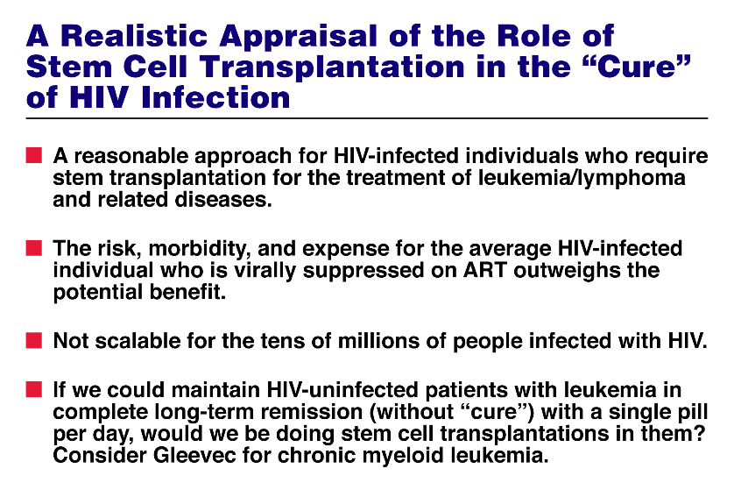

Fauci, IAS 2017 Special Lecture
Notes:
This is a slide that we borrowed from Dr. Anthony Fauci from the 2017 International AIDS Society meeting. (Please kindly forgive the use of the word ‘infected’).
He proposed a realistic appraisal of the role of stem cell transplants towards an HIV cure.
This would only be a reasonable approach for people who have both HIV and a malignant cancer that would warrant such a risky approach.
Stem cell transplantations would not be scalable to the millions of people who have HIV around the world.
Finding people with the CCR5 gene deletion is difficult, and mostly limited to Northern Europe.

Slide 17



International collaboration to study potential HIV cure by stem cell transplants in Europe
Looking at the reservoir of virus in people with HIV who either had or may get an allogeneic stem cell transplant
Special laboratories with the highly sensitive tests to measure the reservoir and the quality of the immune system
\come with a high rat
e of death.
tion thereforcannot
be registered.
Unfortunately, stem cell transplants are dangerous procedures which come with a high rate of death.
People who do not have a disease requiring a transplantation therefore cannot be registered.
Unfortunately, stem cell transplants are dangerous procedures which come with a high rate of death.
People who do not have a disease requiring a transplantation therefore cannot join this study.
Notes:
Stem cell transplantation is also a high risk procedure which comes with a high mortality and people who do not have a disease requiring a transplantation.
There is a group in Europe, called Ici-Stem, that is very invested in this approach for people with both HIV and cancer.
While stem cell transplants could give clues into how we could achieve cure, we still need to find strategies that could be more widely available and easily accessible around the world.

Slide 18

Timing of ART Initiation
Following HIV Infection
Timing of ART Initiation Following HIV Infection
Very early ART
Early ART
Chronic ART
Caroline Tiemessen
Effects of early ART
Reduced immune activation
Limited virus escape/diversity
Reduced morbidity and mortality
Better control on ART
No seroconversion, lack of adaptive immune responses
Smaller reservoirs
Fiebig I/II (1-3 wks p.i.)
Preserved immunity
<48 hours
< 6 months
> 6 months - years
SLIDE CREDIT: Tiemessen CT. Post-Treatment Control. Community Cure Workshop.
Saturday July 21, 2018.
Notes:
Another approach being investigated is the use of early treatment - meaning as early as possible after HIV infection.
Early treatment has many advantages, such as:
Reduced immune activation
Limited virus escape and diversity
Reduced morbidity and mortality
Better control of HIV on ART
Smaller reservoirs
Preserved immunity
Some people who were treated extremely early in HIV infection have not yet seroconverted, meaning that the antibodies cannot be detected in their blood.

Slide 19

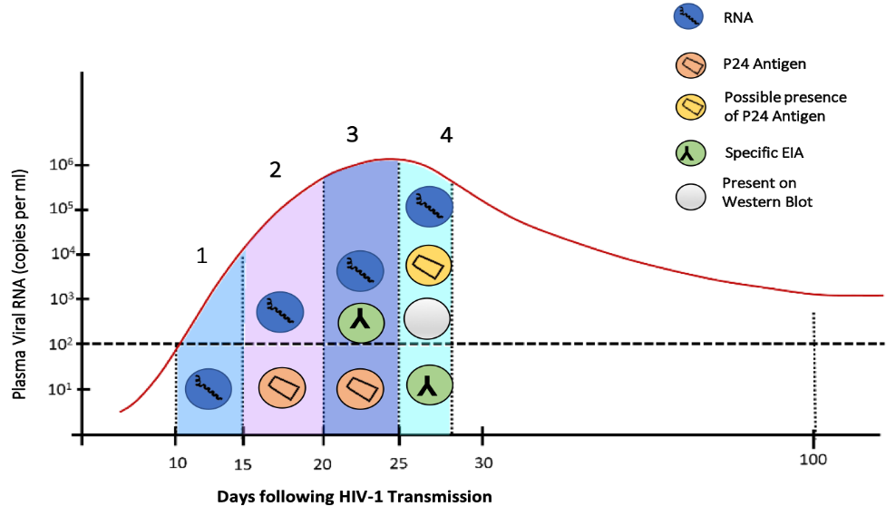
What are the Fiebig Stages?
Go
Deeper
Notes:
One way to categorize the early stages of HIV infection is the use of the Fiebig stages.
Fiebig 1: Only HIV RNA present in the blood
Fiebig 2: Only HIV RNA and p24 antigen present in the blood. p24 is a protein that is distinctive of early HIV infection.
Fiebig 3: HIV RNA, p24 and detection by enzyme immunoassay (or EIA)
Fiebig 4: Detection by HIV RNA, p24, EIA and Western Blot (which can detect HIV protein molecules)
In the early stages of HIV infection, people move through the Fiebig stages.

Slide 20
What is the Definition of Early?
What is the Definition of Early?
Feibig
I
I
I
IV
10⁷
Symptoms Begin
10⁶
10⁵
10⁴
10³
Eclipse Phase
Virus concentration in extracellular fluid of plasma
(copies per ml)
10²
10¹
T₀
Limit of detection of assay for
Plasma viral RNA
10⁰
10⁻¹
10⁻²
10⁻³
Reservoir Established
10⁻⁴
10⁻⁵
0
5
10
15
20
25
30
35
40
45
50
70
80
90
100
Days following HIV-1 Transmission
Adapted from McMichael AJ, Nature Reviews Immunology, 2010
Notes:
The HIV reservoir is known to become established very early in HIV infection - within 72 hours (3 days).
Symptoms usually become after the HIV reservoir is established, but not everyone experience symptoms of acute HIV infection - the so-called ‘acute retroviral syndrome’ or ARS (e.g., characterized by flu-like symptoms).

Slide 21


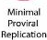


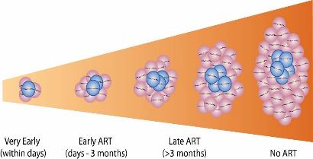
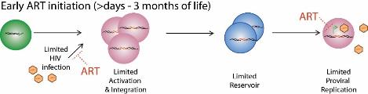



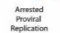

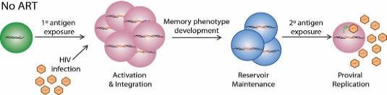
Early ART in Infants
Early ART in Infants
Timing
Of ART Initiation
Latent
Reservoir
Remission
Duration
Viremia
Re-Establishment
Very Early
(within 2 days)
Minimal
HIV
Exposure
Early
(3 days to 3 months)
Limited
HIV
Exposure
Late
(>3 months)
Arrested
HIV
Exposure
No Treatment
Extensive
HIV
Exposure
Rainwater-Lovett et al 2015 Curr Opin HIV AIDS
Notes:
Early ART is a strategy that is often used in infants to reduce the size of their HIV reservoir.
The earlier infants born with HIV can be treated, the smaller their HIV reservoir will be.

Slide 22
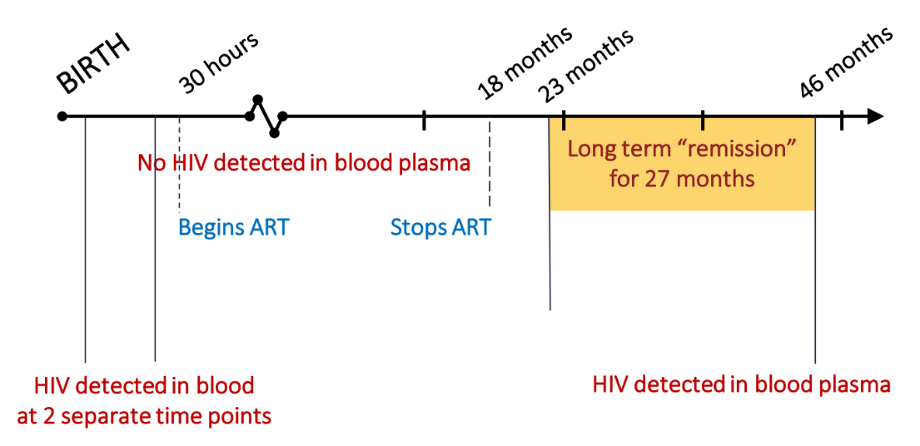

The Mississippi Child
Persaud et al 2013 NEJM; Luzuriaga et al 2015 NEJM
BIRTH
30 hours
18 months
46 months
23 months
Long term “remission”
for 27 months
No HIV detected in blood plasma
Begins ART
Stops ART
HIV detected in blood
at 2 separate time points
HIV detected in blood plasma
Notes:
The Mississippi child is a girl who in 2013 was thought to have been cured of HIV.
She had contracted HIV at birth. She was treated 30 hours after birth, and did not have HIV detectable in her blood for the first 18 months of her life.
She stopped ART at 18 months, and was lost to follow-up for 5 months.
The doctors expected to find a lot of HIV in her blood, but instead HIV was undetectable.
At 46 months, her HIV came back.
The Mississippi child was able to keep HIV suppressed without ART for a long time, so she gave hope for the field.
But her case also showed that it takes even a small amount of HIV present in the blood for it to come back.
This is why the immune system must be ‘ready’ when the virus comes back.

Slide 23
Draining the ‘reservoir’
Notes:
Now, let’s turn to strategies that could reduce (or ‘drain’) the HIV reservoir.

Slide 24
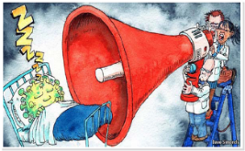

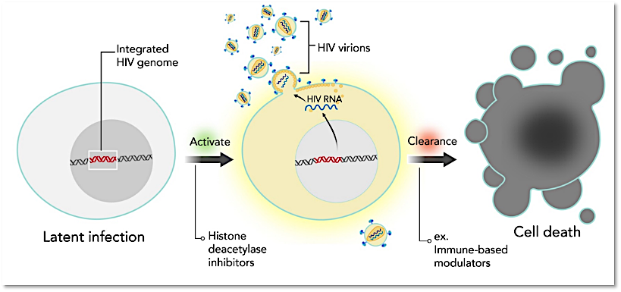
Latency-Reversing Agents
Latency Reversing Agents
Image credit: The Economist, July 11
Illustration Credit: Grace Hsu, MS, CMI, Scientific Animation, Animation Lab: https://animationlab.utah.edu/
Notes:
Latency-reversing agents are being investigated to delete the HIV that has become integrated inside the cells.
The goal would be to reactivate (or reawaken) HIV that has become dormant (latent) to make it visible to the immune system.
That way, the immune system would know that the cell contains HIV, and could clear the cell from the body.

Slide 25

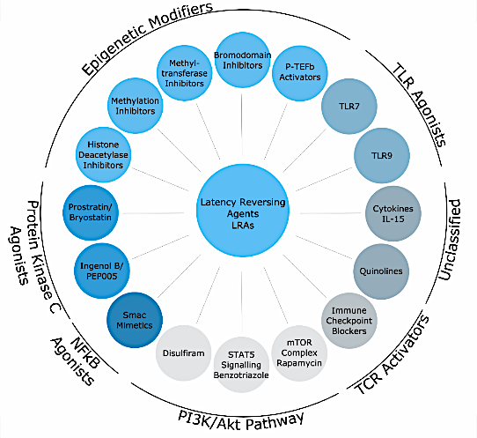



Latency-Reversing Agents
Latency-Reversing Agents
None are HIV specific
None are as potent as T-cell activation
Unclear if virus is coming from all cells or just a few
Still need better latency-reversing agents
dCA
Sharon Lewin
Kim, Anderson and Lewin. Cell Host Microbe 2018
Lewin SR. Why Should We ‘Shock and Kill’. Community Cure Workshop. Saturday July 21, 2018.
Notes:
There are many different classes (or families) of latency-reversing agents (LRAs) being investigated.
These all have complicated names.
If you hear things like toll-like receptor (TLR) agonists, or epigenetic modifiers (such as histone deacetylase inhibitors or HDACs), protein kinase C (PKC) agonists, or SMAC mimetics, just know that these are trying to wake up HIV inside the cells.
None of the LRAs are HIV specific.
These should not lead to global T cell activation, since this would become very dangerous for people with HIV.
Most likely, we will need to use a combination of LRAs, and we still need to find better ones, so more research is needed.

Slide 26
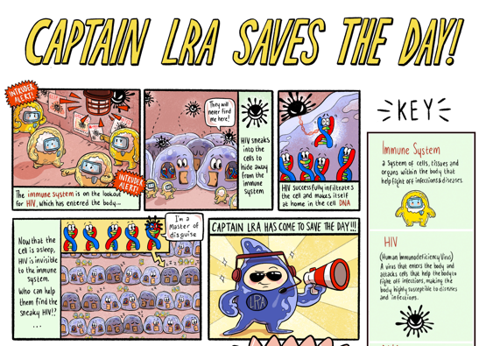
Notes:
LRAs jolts the HIV awake, and now HIV becomes visible to the immune system (by producing virions).
The HIV-infected cell is found out, and the immune system can clear it.
LRAs will likely need to be combined with strong immune-based strategies.

Slide 27
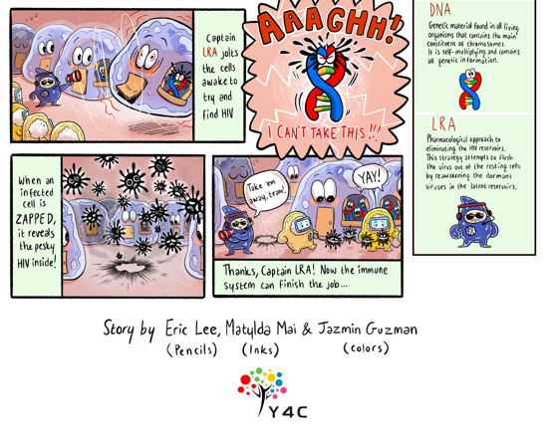
Visual Art Credit:
Eric (Yi-Hao) Lee, Jasmin Guzman, and Matylda McCormack-Sharp
Notes:
Here is a visual art that depicts how LRAs work.
The immune system is on the look out for HIV, but can’t find HIV hidden inside the cells.
LRA tries to reawaken the dormant HIV by ‘knocking’ it out of its sleep (by reactivating specific genes so HIV can transcribe itself).

Slide 28





The “Block and Lock” Approach
Block & Lock
Transcription
inhibitor
Sleeping beauty keeps on sleeping
She never wakes up for the prince
¹Kessing, Cell Report 2017; ²Ahlenstiel, Mol Ther Nucleic Acid 2015
SLIDE CREDIT: Ananworanich, A. Overview of Ongoing Cure Research Globally.
Community Cure Workshop. Saturday July 21, 2018.
Notes:
The opposite of LRAs are ‘block and lock’ agents that would permanently silence HIV.
This way, HIV could not re-awaken.
There are much fewer ‘block and lock’ agents that LRAs, because research on those agents is just beginning.
These agents would be specific to HIV, so they would not shut down the entire immune system.
For example, the Tat inhibitor didehydro-Cortistatin A (dCA) could inhibit HIV transcription, and overtime ‘lock’ HIV.
We need more research on ‘block and lock’ agents.
It is important to note that the gene’s naturally tendency is to be turned off, so this approach could be promising.

Slide 29
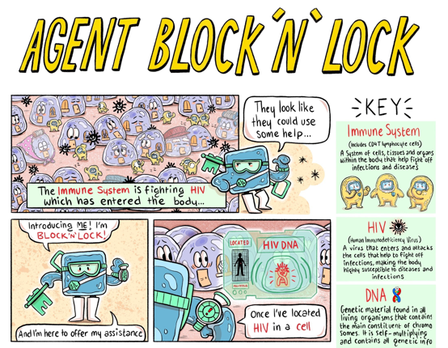
Notes:
‘Block and lock’ agents would then block the proviral NDA, and then lock it.
The HIV would not be able to reawaken, and the cell would grow old and eventually die.

Slide 30
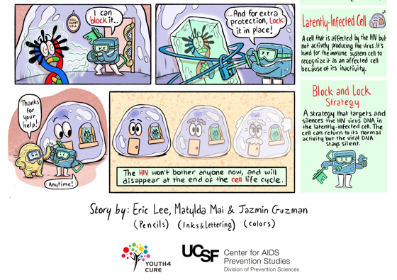
Visual Art Credit:
Eric (Yi-Hao) Lee, Jasmin Guzman, and Matylda McCormack-Sharp
Notes:
Here is a visual art of how ‘block and lock’ agents would work.
They would first locate a cell that would have latent (or proviral) HIV DNA.

Slide 31
Reinforcing the ‘dam’
Notes:
Now, let’s turn to strategies that could reinforce the dam, or make the immune system stronger at fighting HIV.

Slide 32
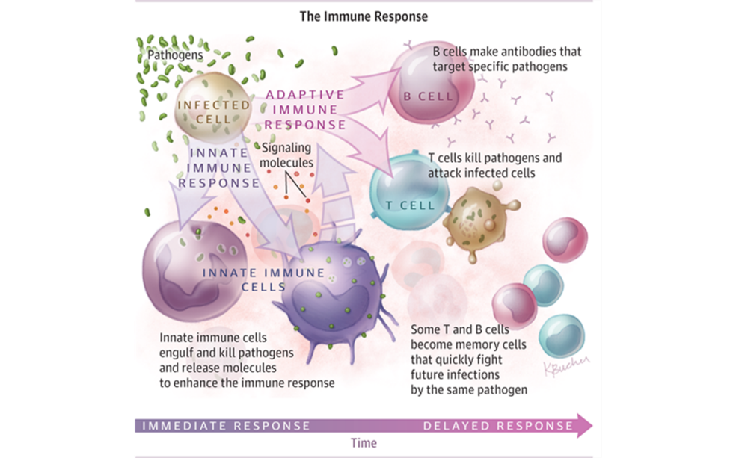
Notes:
In the first CUREiculum module, we discussed how complex the immune response can be when pathogens invade the body.
The innate immune cells engulf and clean pathogens, and then release modules that enhance the immune response.
The adaptive immune cells are more specialized.
B cells make antibodies that target specific pathogens (e.g., neutralizing antibodies).
T cells clear pathogens and attack infected cells. However, HIV also target T cells.

Slide 33






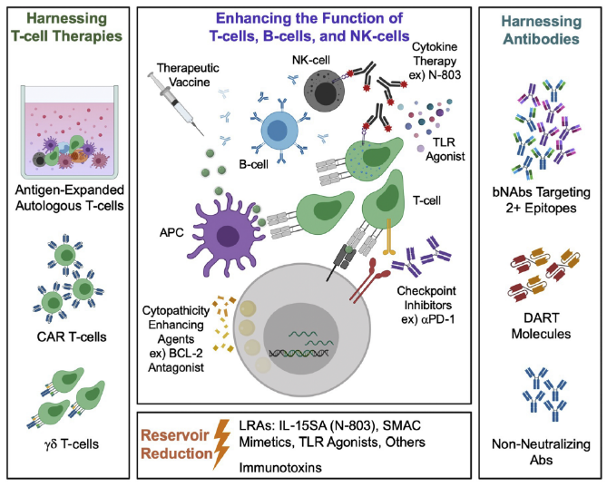

Immunological Approaches
VISCONTI
SPARTAC
CHAMP
Timothy Brown
Berlin
Post treatment control
Adam Castillejo
London
2009
2019
2020
2010
Lorraine Willenberg
San Francisco
Immunological Approaches
Hutter et al., N Engl J Med 2010; Gupta et al., Nature 2019; Gupta et al, Lancet HIV 2019; Jiang et al., Nature 2020
SLIDE CREDIT: Sharon Lewin, Singapore AIDS Conference 2020
Ward A, Mota TM, Jones RB. Immunological Approaches to HIV Cure. Semin Immunol 2020.
Notes:
There are many ways scientists are trying to strengthen the immune system.
You do not need to remember all these strategies. You should need to know that these aim at making the immune system better able to keep HIV at bay.
Some of the strategies harness the T cell responses.
For example, chimeric antigen receptors (or CAR) T cells, which would be like super-T cells.
Antigen-expanded autologous T cells, which would take the good cells, expand them outside of the body, and give them back to the person with HIV.
Other approaches aim at expanding the function of T cells, B cells and natural killer cells.
For example, therapeutic vaccines, or checkpoint inhibitors.
Other approaches would harness antibodies, like broadly neutralizing antibodies, or dual-affinity retargeting (DART) molecules.

Slide 34






Targeting Virus vs. Improving Immune System
Very early ART
Broadly neutralising antibodies (bNAbs)
Latency reversal
T-cell vaccines
Pro-apoptotic drugs
Immunomodulation
Immunotoxins
virus
Immune system
CAR T-cells
Latency silencing
Gene
editing
Gene
editing
SLIDE CREDIT: Sharon Lewin, AIDS 2020
Notes:
This slide shows another way to organize the different HIV cure-related strategies under investigation.
Those that ‘target’ the virus include:
Very early treatment
Latency reversal or latency silencing
Immunotoxins, which are like artificial proteins that aim at clearing bad cells. They are used for the treatment of some kinds of cancer and few viral infections.
Gene editing
Those that are aimed at improving the immune system include:
Broadly neutralizing antibodies or bNAbs (we will come back to these)
T cell vaccines
Immunomodulators
Chimeric antigen receptor (CAR) T cells (we will come back to these

Slide 35




Improve CD8+ T Cell Clearing of HIV-Infected Cells
Improve CD8+ T Cell Killing of HIV-Infected Cells
*CD8+ T cells help clear cells that are infected with virus
*CD8+ T cells help clear cells with the virus
Therapeutic
Vaccines
T-Cell Trafficking
HIV+
cells
Immune Checkpoint
Blockers
CD8
CXCR5
IL-15 superagonist⁶
PD-1
Anti-inflammation
ChAdV63/MVA (HIVconsv)¹
Ad26/MVA or protein²
DNA/MVA³
Dendritic cell+/-LRA³
mTOR inhibitors⁷
In people with cancer/HIV⁵
Anti-PD1 or PDL1
Anti-CTLA-4
www.treatmentactiongroup.org; www.clinicaltrials.gov :¹NCT02336074; ²NCT02919306/³NCT02972450;⁴NCT02707900/NCT02767193
⁵NCT02408861/NCT02595866; ⁶NCT02191098; ⁷NCT02440789/NCT02990312
SLIDE CREDIT: Ananworanich, A. Overview of Ongoing Cure Research Globally.
Community Cure Workshop. Saturday July 21, 2018.
Notes:
The strategies that are aimed at improving the ‘clearing’ of HIV-infected cells (or cytotoxic T cells) include:
Therapeutic vaccines
Immune checkpoint blockers (that regulate the response to the immune system)
And those aimed at improving T cell trafficking (e.g., Interleukin-15 superagonist)
The slide shows examples of these specific approaches. You do not need to remember all of these.
Just know that there are many approaches being developed to help clear cells that contain HIV.

Slide 36
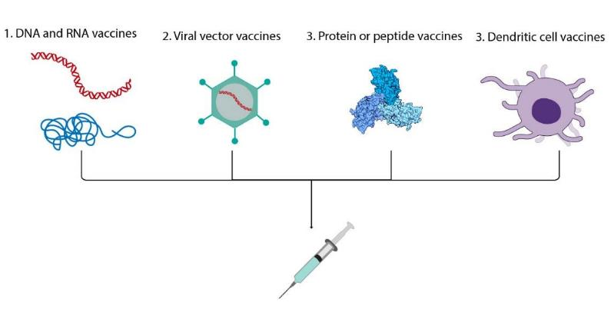
Types of HIV Therapeutic Vaccines
Illustration Credit: Grace Hsu, MS, CMI, Scientific Animation, Animation Lab:
https://animationlab.utah.edu/
Notes:
This slide shows different types of HIV therapeutic vaccines under investigation:
1. DNA or RNA vaccines: these are gene-based vaccines that produce proteins similar to the ones found in real HIV, so the body is ready to fight the real virus.
2. Viral vector vaccines: vectors are carriers, like a plane or a truck that would deliver a cargo. They carry special genetic materials to help combat HIV by instructing the body to make specific proteins.
3. Protein or peptide vaccines: These contains proteins (or small pieces) found in HIV.
4. Dendritic cell vaccines: these are rate cells that are uniquely potent against HIV.

Slide 37
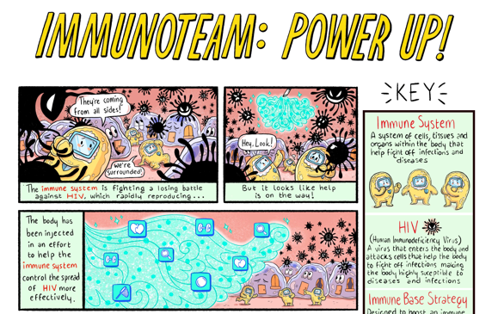

Notes:
The immune system grows stronger, and is better able to fight HIV.

Slide 38

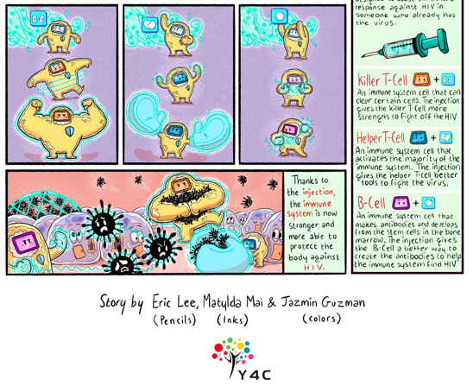
Visual Art Credit:
Eric (Yi-Hao) Lee, Jasmin Guzman, and Matylda McCormack-Sharp
Notes:
This is a visual art that summarizes how immune-based approaches work.
The immune system is trying to fight HIV.
The body is injected with a substance that helps the immune system control HIV more effectively.
Here, the immune-based approaches are showed by the blue wave, which contains a magnifying glass (to better see HIV), mittens (to better catch HIV), weights (to make the immune system stronger), and so on.

Slide 39



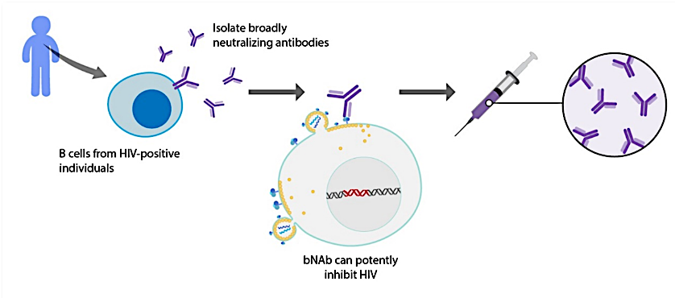
Passive Immunization:
Broadly Neutralizing Antibodies
Illustration Credit: Grace Hsu, MS, CMI, Scientific Animation, Animation Lab:
https://animationlab.utah.edu/
Notes:
Passive immunization is the transfer of ready-made antibodies.
The use of broadly-neutralizing antibodies is a form of passive immunization.
The good B cells from people with HIV are taken, then expanded, and infused to help inhibit HIV.
Antibodies are “Y”-shaped molecules, and they bind to specific regions of the invading particles.

Slide 40
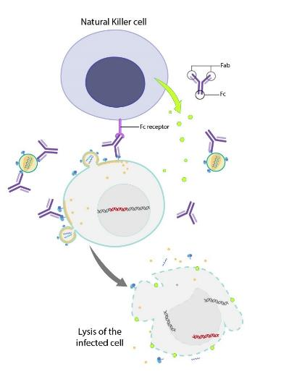

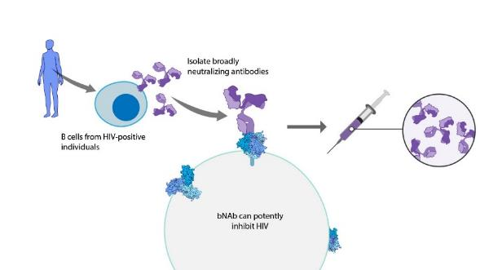
Broadly Neutralizing Antibodies (bNAbs)
Illustration Credit: Grace Hsu, MS, CMI, Scientific Animation, Animation Lab:
https://animationlab.utah.edu/
Notes:
This is another slide showing how broadly-neutralizing antibodies work inside the body.
They are unique in that they target conserved epitopes of the virus, meaning that if the virus mutates, the targeted epitopes will still exist.

Slide 41




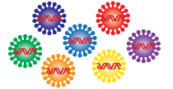

Broadly Neutralizing Antibodies (bNAbs)
NK
NK
Main obstacle
- Pre-existing resistance
Strategies
- Broad and potent
- Multiple
- Tri-specific
- Long-acting
- Novel delivery platforms
- Early administration
- Combine with other agents
bNAbs facilitate
antibody-dependent
cell cytotoxicty (ADCC)
Enhance
CD8 T cell
function
CD8
bNAbs can bind
many HIV strains
Kong, J Virol 2015; Barr, NEJM 2016; Scheid, Nature 2016; Caskey, Nature Med 2017; Hessell, Nature Med 2016; Liu, Science 2016;
Nishimura, Nature 2017; Pardi, Nature Communications 2017; Gardner, Nature 2015; Pitman, Lancet 2018
SLIDE CREDIT: Ananworanich, A. Overview of Ongoing Cure Research Globally.
Community Cure Workshop. Saturday July 21, 2018.
Notes:
bNAbs can bind many HIV strategies.
However, bNAbs can also become resistant, so like HIV drugs, it is important to use them in combination.
Strategies to make bNAbs better at controlling HIV include using them in combinations, helping make them longer-acting, developing novel delivery platforms, and combining them with other agents.

Slide 42



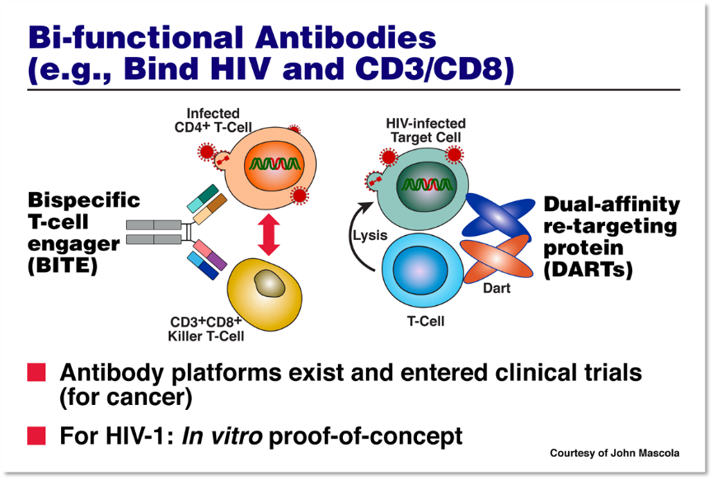



Two-headed figure
analogy
Hammer-screwdriver combo analogy
Fauci, IAS 2017 Special Lecture
Notes:
Scientists are also looking into developing bi-functional (bi-specific) or event tri-functional (trispecific) antibodies.
Think of these are two-headed figures, or as a hammer-screwdriver or multi-task tool.
The bi-specific T cell engager (BITE) and dual-affinity retargeted (DARTs) proteins are examples of these dual and triple agents under investigation.
These would help redirect the immune system to better fight HIV.

Slide 43



Genetic Engineered T cells:
Creating Super T Cells
Genetic Engineered T cells:
Creating Super T Cells
Chimeric Antigen Receptor
(CAR) T cells
HIV-infected cell
with surface
expression of
HIV envelope
CD8+ T cells
Single chain variable fragments derived from bNAbs
‘Super T cell’
CAR-T cell therapy in
virally suppressed people on ART
(China; NCT03240328)
Modified from a slide by Dr. Thor Wagner (U Washington)
Hale and Wagner, Mol Ther 2017; Ali, J Virol 2016;
Liu, J Virol 2016; Hale, Mol Ther 2017
SLIDE CREDIT: Ananworanich, A. Overview of Ongoing Cure Research Globally.
Community Cure Workshop. Saturday July 21, 2018.
Notes:
Scientists are also trying to engineer T cells that are better able at fighting HIV. These would be like super-T cells, like super-heroes inside the body if they are found to work.
For example, chimeric antigen receptor (CAR) T cells are being investigated to see if they can find cells that contain HIV.
They would provide the immune ‘surveillance’ to clear latently infected cells.
CAR T cells have been approved for the treatment (and cure) of certain cancers, and are now being developed against HIV.

Slide 44

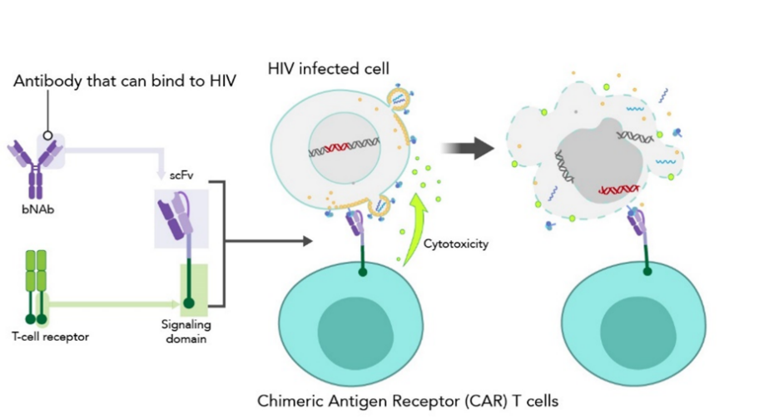

Chimeric Antigen Receptor (CAR) T Cells
‘CAR’ [T-cell] of the future analogy’
Illustration Credit: Grace Hsu, MS, CMI, Scientific Animation, Animation Lab:
https://animationlab.utah.edu/
Notes:
This is a more advanced slide showing how CAR T cells would work inside the body.
They would have special receptors that could bind to HIV, and clear cells that are latently-infected.

Slide 45
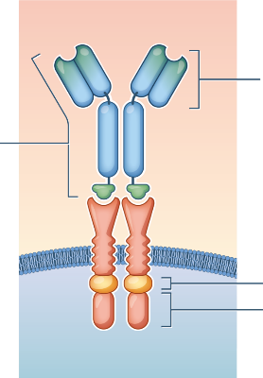


Chimeric Antigen Receptor (CAR) T Cells
Autologous T-cells or NK cells undergo gene editing to express a CAR to bind and kill cells that express HIV envelope ¹⁻⁴
CAR T-cells for HIV tested in mice, macaque models and in clinical trials in China (x3) and the US (x1)⁵
Major challenges include toxicity (potentially preventable), delivery to tissue sites and low expression of HIV envelope on ART
HIV bNAb
or
CD4
Ligand binding domain
Signalling domain
T-cell or NK cell
1 Deeks et al., Mol Ther 2002; 2 Sung et al., Mol Ther 2018; 3 Herzig et al., Cell 2019; 4 Anthony-Gonda Sci Transl Med 2019; 5 clinical trials.gov
Lewin, CROI 2020
Notes:
Some of the potential challenges of CAR T cells would be:
potential for cytokine release storms, or when the immune system becomes very activated, but there are ways to counter these effects.
potential for neurotoxicity
Scientists are looking at ways to make CAR T cells against HIV both safe and effective at keeping HIV suppressed without ART.

Slide 46


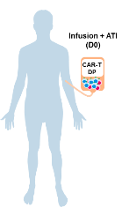
Anti-HIV duoCAR-T cell therapy
The new kid on the block!
X
Protects CD4⁺ T cells
Dual targeting of HIV⁺ cells via the Env glycoprotein
Activation of duoCAR-T cells
Clearance of HIV⁺ cells
CAR blocks HIV entry
“Licensed to clear”
CD4⁺ T cell
CD8⁺ T cell
DuoCAR
DuoCAR-T Cells for HIV Infection
PI: Steven Deeks, MD
Collaborator: Caring Cross
US, NCT04648046
DuoCAR-T cell approach
“Protecting T cells against HIV using Two CARs, One Cell”
SLIDE CREDIT: Kim Anthony-Gonda, Boro Dropulic 2021
Notes:
Similar to the bi-specific and tri-specific antibodies, scientists are also investigating duoCAR T cells.
These would protect against HIV using two CARs on one cell.
There would be protection of the CD4+ T cells, and a dual targeting of HIV-infected cells.
duoCAR T cells could also better clear HIV infection from the body.
A clinical trial is underway at UCSF (with Dr. Steve Deeks and Lentigen) looking at duoCAR T cells.
These would only require one infusion, so the potential for scalability is high.

Slide 47

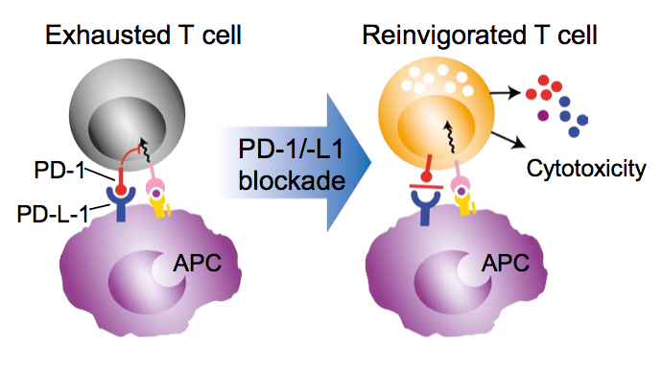

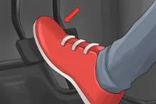
Immune Checkpoint Blockers
Stephen Mason, Bristol-Myers Squibb.
The potential role of PD-1/PD-L1 blockade in HIV Remission & Cure.
Community Cure Workshop, February 22, 2015 Seattle, WA
Notes:
Finally, immune checkpoint blockers are borrowed from the cancer field.
These would regulate the response to the immune system, much like putting one’s foot on a gas/break pedal.
Checkpoint inhibitors work by blocking immune checkpoints, so these could ‘unleash’ potent immune responses.
If you hear ‘PD-1’ or ‘anti-PD-L1’, please know that this is an example of an immune checkpoint blockers.
We must still monitor for adverse events to make sure these are safe for people.

Slide 48
Making cells stronger
Notes:
Now, let’s discuss strategies that would make cells stronger, or more resistant, or better at fighting HIV.

Slide 49

What is Cell and Gene Modification?
A branch of Regenerative Medicine, an emerging field that involves the "process of replacing, engineering or regenerating human cells, tissues or organs to restore or establish normal function”.
Gene therapy is the delivery of therapeutic gene into a patient's cells to treat disease.
Cell therapy is the delivery of intact, living cells into a patient to treat disease.
Combination Cell/Gene Modification approaches that seek to insert genes into a patients’ own cells to control or kill HIV are in clinical trials now.
Notes:
Cell and gene modification is a branch of Regenerative Medicine, an emerging field that involves the "process of replacing, engineering or regenerating human cells, tissues or organs to restore or establish normal function”.
Gene therapy is the delivery of therapeutic gene into a patient's cells to treat disease.
Cell therapy is the delivery of intact, living cells into a patient to treat disease.
Combination Cell/Gene Modification approaches that seek to insert genes into a patients’ own cells to control or kill HIV are in clinical trials now.

Slide 50


Gene Modification: Targets and Strategies
Attack: enhance anti-HIV immune responses
Protect: engineer uninfected cells to be resistant to HIV
        Purge: directly eliminate the virus itself
Delivery of gene therapy a major challenge:
ex vivo (gene editing of cells outside the body) or in vivo (gene editing in the body)
Lewin, CROI 2020
Slide Courtesy of Paula Cannon
Notes:
This is a slide borrowed from Dr. Sharon Lewin from the 2020 Conference on Retroviruses and Opportunistic Infections (CROI).
Gene modification could work in one of three ways:
Enhancing anti-HIV immune responses (‘attacking’)
Engineering uninfected cells to be resistant to HIV (‘protecting’)
Directly eliminating the virus itself (‘purging’)
There are two main delivery mechanisms being investigated:
Ex vivo: meaning gene editing of cells occurs OUTSIDE of the body
In vivo: meaning gene editing of cells occurs INSIDE of the body

Slide 51
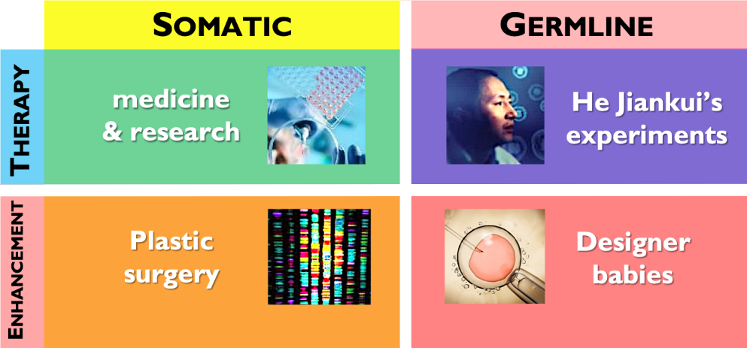

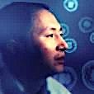
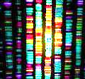
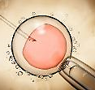
Somatic versus Germline Modification
Therapy
Enhancement
Somatic
Germline
medicine
& research
He Jiankui’s experiments
Plastic
surgery
Designer
babies
Notes:
Another important distinction is ‘somatic’ versus ‘germline’ modification.
All cell and gene therapies being investigated towards an HIV cure would involve SOMATIC changes, meaning these would not be passed down to off springs. They would not modify the germline.
However, in 2018 a scientist named He Jiankui tried to use CRISPR technology (a form of gene editing tool) to prevent HIV in babies, and he crossed a line. He received global condemnation for his research activities.

Slide 52
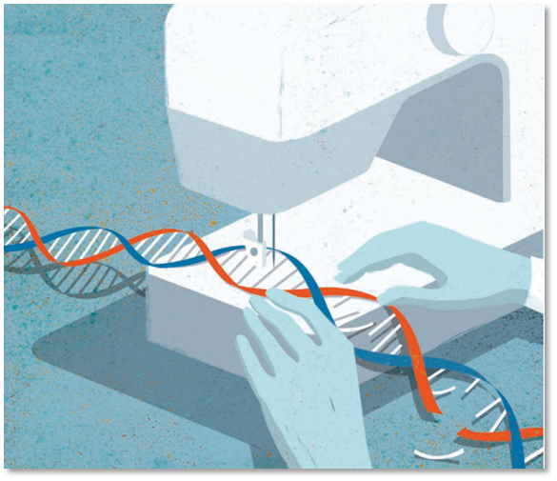
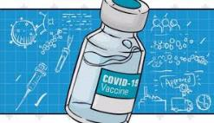
Cell and Gene Modification
Cell and Gene Modification
Scheufele DA et al. U.S. Attitudes on Human Genome Editing. Science 2017; 357 (6351): 553 – 4.
Notes:
How, let’s review cell and gene therapies in more details.

Slide 53

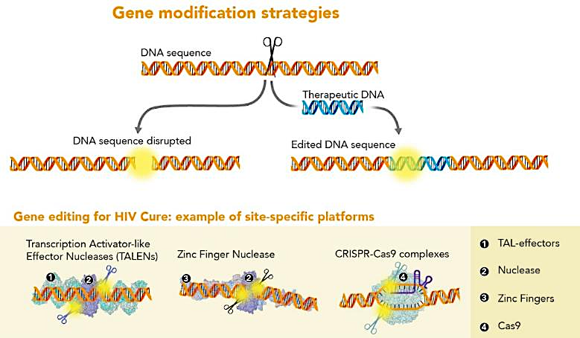
Illustration Credit: Grace Hsu, MS, CMI, Scientific Animation, Animation Lab:
https://animationlab.utah.edu/
Notes:
This slide shows some of the main gene modification platforms being investigated.
These would excise (or remove) proviral HIV DNA, like a genetic scissor, and would sow the gene back together.
For example:
Transcriptor activator-like effector nucleases (TALENS)
Zinc-finger nucleases
CRISPR0Cas9 complexes

Slide 54
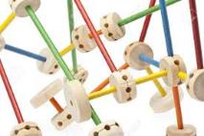
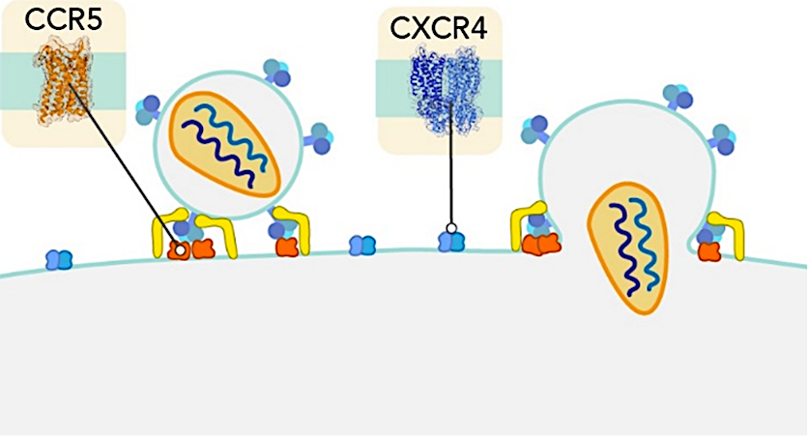

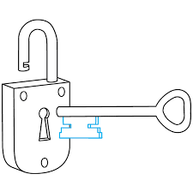


Prevent HIV from Entering Cells
‘Tinkering with the Lock & Key’
Illustration Credit: Grace Hsu, MS, CMI, Scientific Animation, Animation Lab:
https://animationlab.utah.edu/
Notes:
Another helpful analogy to depict cell and gene therapy is the lock and key.
This would prevent HIV from entering inside the cells, and would make cells resistant to HIV.
By removing the CCR5 genes, HIV would not be able to go inside the cells, and reproduce itself, and it would eventually disappear.

Slide 55

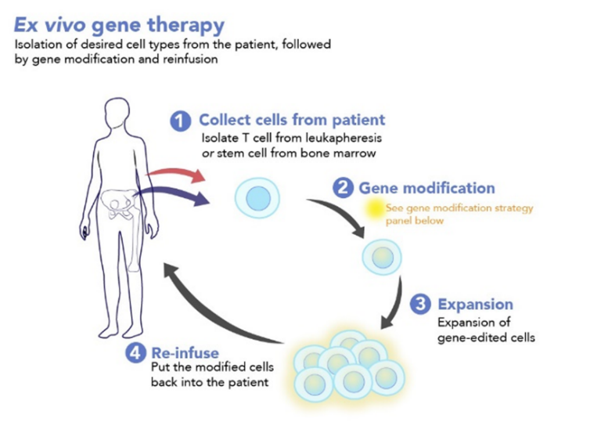

Modification Occurring Outside the Body ‘Ex Vivo’
Modification Occurring Outside the Body ‘Ex Vivo’
Outside of the body
Illustration Credit: Grace Hsu, MS, CMI, Scientific Animation, Animation Lab:
https://animationlab.utah.edu/
Notes:
Ex vivo gene therapy would involve isolating desired cell types, and expanding them outside of the body, and then re-infusing them inside the patient.
Think of these as an external hard drive that works overtime for your body’s immune system (the computer).
Most of these approaches work in an autologous fashion, meaning taking and enhancing a person’s own cells, to help ensure safety.
This prevents the person to develop an allergic reaction to the infusion.

Slide 56

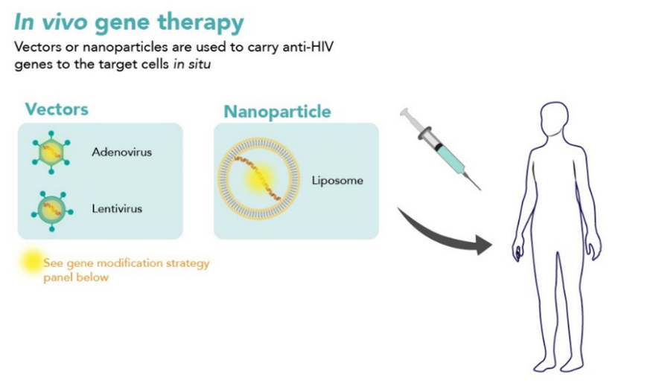

Modification Occurring Inside the Body ‘In Vivo’
Modification Occurring Inside the Body ‘In Vivo’
Inside of the body
Illustration Credit: Grace Hsu, MS, CMI, Scientific Animation, Animation Lab: https://animationlab.utah.edu/
Notes:
In contrast, in vivo gene therapy involves using vectors or nanoparticles to carry anti-HIV genes to target cells inside the body.
These vectors include adenoviral and lentiviral vectors that would deliver genetic materials that would fight HIV inside the body.
Think of these as strategies being directed at a person’s internal hard drive.
If this could eventually work, it would represent the ‘holy grail’ but we would need to make sure that it remains safe.
More research is needed to develop in vivo gene therapies towards an HIV cure.

Slide 57


Gene Modifications to Make Cells Resistant to HIV
Gene Modifications to Make Cells Resistant to HIV
Leukapharesis
CD4+ T-cell isolation
Strategies
Use stem cells
Conditioning therapies
CCR5 and other anti-HIV genes
Newer editing technologies
CCR5+
CCR5-
Gene modification strategy
People with HIV/no cancer
  SB-728mR-T+cyclophosphamide¹
  shRNA-modified stem cells²
People with HIV and cancer
  Stem cells gene-modified to encode multiple anti-HIV RNAs³
  CRISPR CCR5 modified CD34+ cells⁴
Re-infuse
Tebas P, NEJM 2014
www.treatmentactiongroup.org; www.clinicaltrials.gov : ¹NCT02388594; ²NCT03517631; ³NCT02343666/NCT02337985; ⁴NCT03164135
SLIDE CREDIT: Ananworanich, A. Overview of Ongoing Cure Research Globally.
Community Cure Workshop. Saturday July 21, 2018.
Notes:
The goal of gene modifications would be to make cells resistant to HIV infection.
Several strategies are being investigated, as showed on this slide.
Some of them also involve the use of stem cells and conditioning therapies, as well as newer editing technologies.
Clinical trials are underway in people with HIV and with HIV and cancer.

Slide 58
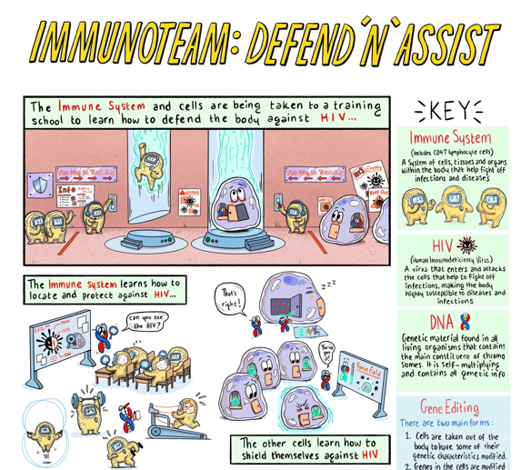
Youth-Friendly Cell and Gene Therapy Approaches
Notes:
After their training, the cells are taken back to the body to fight HIV, and teach cells how to defend the body against HIV.

Slide 59
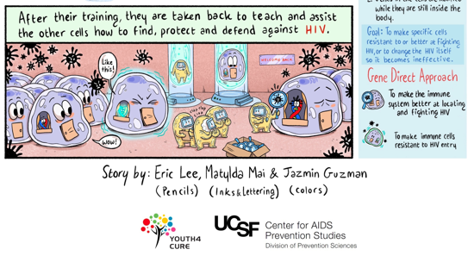
Youth-Friendly Cell and Gene Therapy Approaches
Visual Art Credit:
Eric (Yi-Hao) Lee, Jasmin Guzman, and Matylda McCormack-Sharp
Notes:
This is a visual art showing the ex vivo cell and gene modification approach.
The immune cells are being taken to an outside school for additional training - e.g., being taught how to better find HIV.

Slide 60
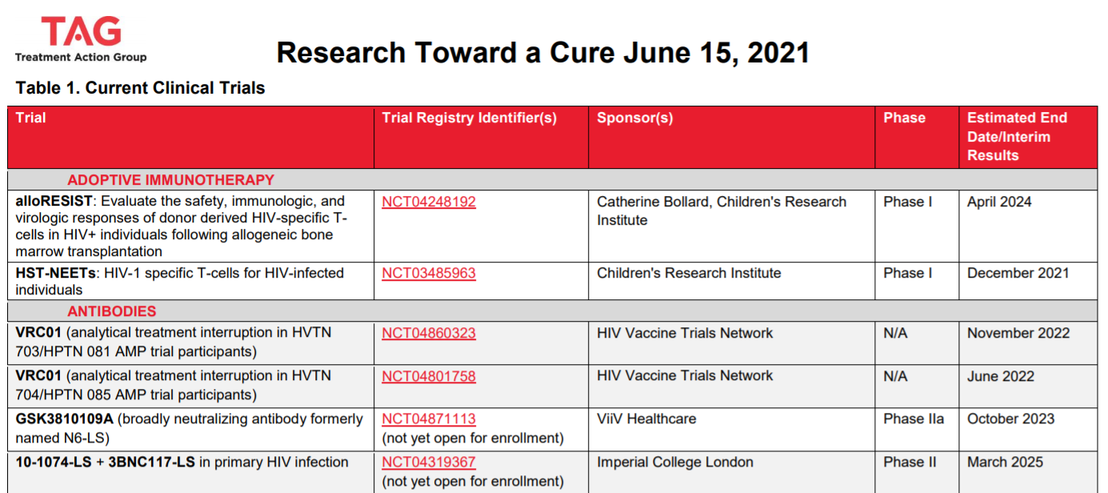
Treatment Action Group
Research Towards an HIV Cure (Trials)
Treatment Action Group
Research Towards an HIV-1 Cure Trials
List of trials and pipeline report
https://www.treatmentactiongroup.org/cure/trials/
Notes:
We have covered a lot of different strategies being investigated towards an HIV cure.
The Treatment Action Group (TAG) keeps a list of all current and past clinical trials, organized by strategy.
People can also look at ClinicalTrials.Gov to find out about ongoing clinical trials.

Slide 61
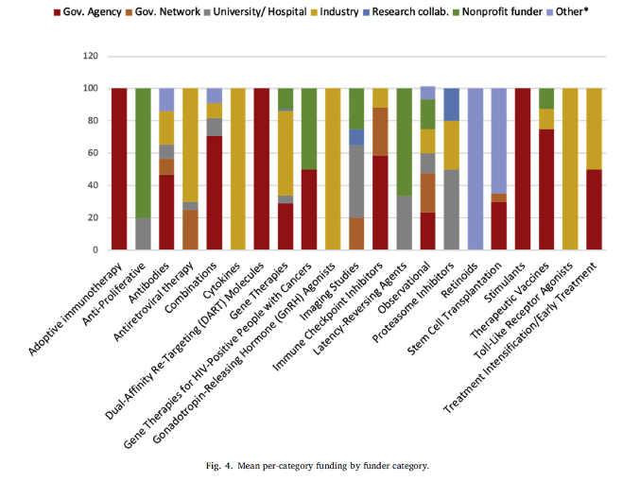
Landscape Analysis of HIV Cure-Related Trials
Barr L, Jefferys R. A Landscape Analysis of HIV Cure-Related Clinical Research in 2019. Journal of Virus Eradication 2020; 6(4): 100010
Notes:
The Treatment Action Group (TAG) also conducted a landscape analysis of HIV cure-related trials.
As you can see, there are many different types of approaches being investigated, some of which we did not cover in this module.
Scientists will continue to come up with ways to either ‘drain the reservoir’ or ‘reinforce the dam’.
It is very hard to keep track of the science, because it is evolving very rapidly. So you do not have to worry about learning all the different strategies.
We still do not know what a cure for HIV will look like.

Slide 62



Putting different strategies together
Notes:
Most likely, we will need to put the different strategies together, or use them in combination.
Just think of how HIV treatment works. We need 3 drugs to be combined to prevent the development of resistance.

Slide 63
Combination Approaches
Immunotherapy
Cell & Gene Therapy
Early Treatment
HIV CURE
bNAbs
Latency Reversing
Agent
Block and Lock
© Copyright PresentationGO.com – The free PowerPoint and Google Slides template library
Notes:
A growing number of clinical trials are testing strategies in combination.
Think of these are different roads or paths converging.
For example, latency-reversing agents could be used in combination with an immune-based approach to find cells that have dormant HIV inside them, and then boost the immune system to increase the body’s ability to clear the virus.
Immune-based strategies or gene editing approaches could also be used in combination.
Combining HIV cure research approaches may increase the risks of these interventions.
Scientists will need to ensure these combination approaches remain safe.

Slide 64
Questions for Discussion
Notes:
We thank you for your attention.
We can now open it up for questions and discussion.
We would love your thoughts on the different HIV cure-related research strategies that we covered in this module.

Slide 65





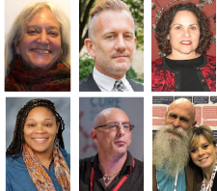









ACKNOWLEDGMENTS
Module developers
Richard Jefferys TAG
Danielle Campbell DARE CAB
Christopher Roebuck BEAT-HIV CAB
Michael Louella defeatHIV CAB
Karine Dubé UNC Chapel Hill
Illustrators:
Eric (Yi-Hao) Lee
Jasmin Guzman
Matylda McCormack-Sharp
Grace Hsu, Animation Lab
We wish to thank AIDS Treatment Activists Coalition for the funding to complete this module
Their caring support of the CUREiculum 2.0. will make a difference in the lives of thousands. of people living with HIV
Biomedical Co-Leads
Professor Sharon Lewin, Doherty Institute
David R Kuritzkes, MD, Brigham and Women’s Hospital
Jintanat Ananworanich, Bill and Melinda Gates Research Institute
Notes:
Several people contributed to developing this module:
Karine Dubé led module development
Michael Louella led design component
Eric Lee, Jasmin Guzman and Matylda McCormack-Sharp prepared visual arts
Grace Hsu (from the Animation Lab) provided illustrations
Professor Sharon Lewin and Dr. David Kuritzkes served as biomedical leads
Several slides were borrowed from Dr. Jintanat Ananworanich
We also want to thank ATAC for funding this work, AIDS Action Baltimore, the national Martin Delaney Community Advisory Board and the Treatment Action Group (TAG)

