Slide 1
HIV Persistence
What We Know about How HIV Persists in Your Body
Despite Taking Antiretroviral Therapy

Slide 2
The basic idea to start from…

Slide 3
The basic idea to start from…

Slide 4
The basic idea to start from…

Slide 5
The basic idea to start from…

Slide 6
The basic idea to start from…

Slide 7
The basic idea to start from…

Slide 8
…the HIV reservoir

Slide 9
HIV viral load and the hidden reservoir

Slide 10
HIV viral load and the hidden reservoir
When HIV is replicating in the body, copies of the virus are floating freely in the bloodstream and can damage the immune system.
Created with BioRender.com

Slide 11
HIV viral load and the hidden reservoir
Antiretroviral therapy (ART) blocks the virus from replicating, preventing damage to the immune system
Created with BioRender.com

Slide 12
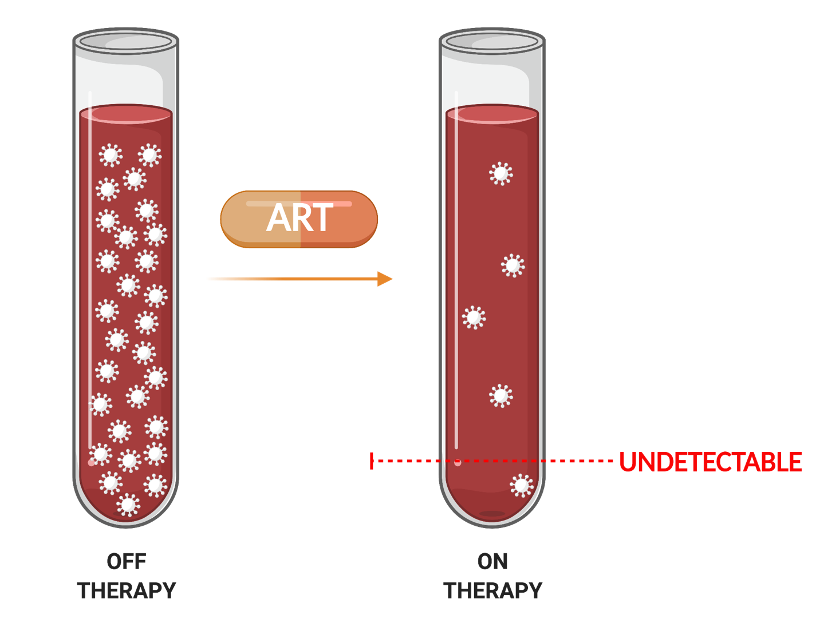
HIV viral load and the hidden reservoir
In people on ART, the number of HIV copies that can be measured in a blood sample by the viral load test typically declines to levels too low to detect (“undetectable”).
Created with BioRender.com

Slide 13
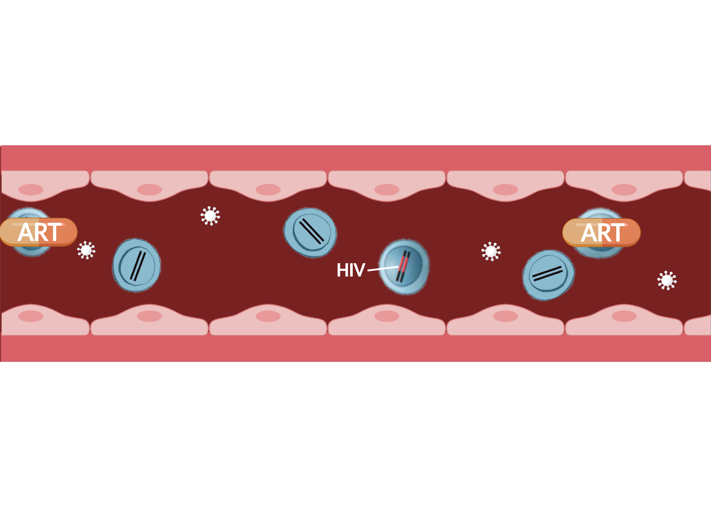
HIV viral load and the hidden reservoir
But even if viral load is undetectable, HIV usually remains present inside some cells (the persistent HIV reservoir).
Created with BioRender.com

Slide 14
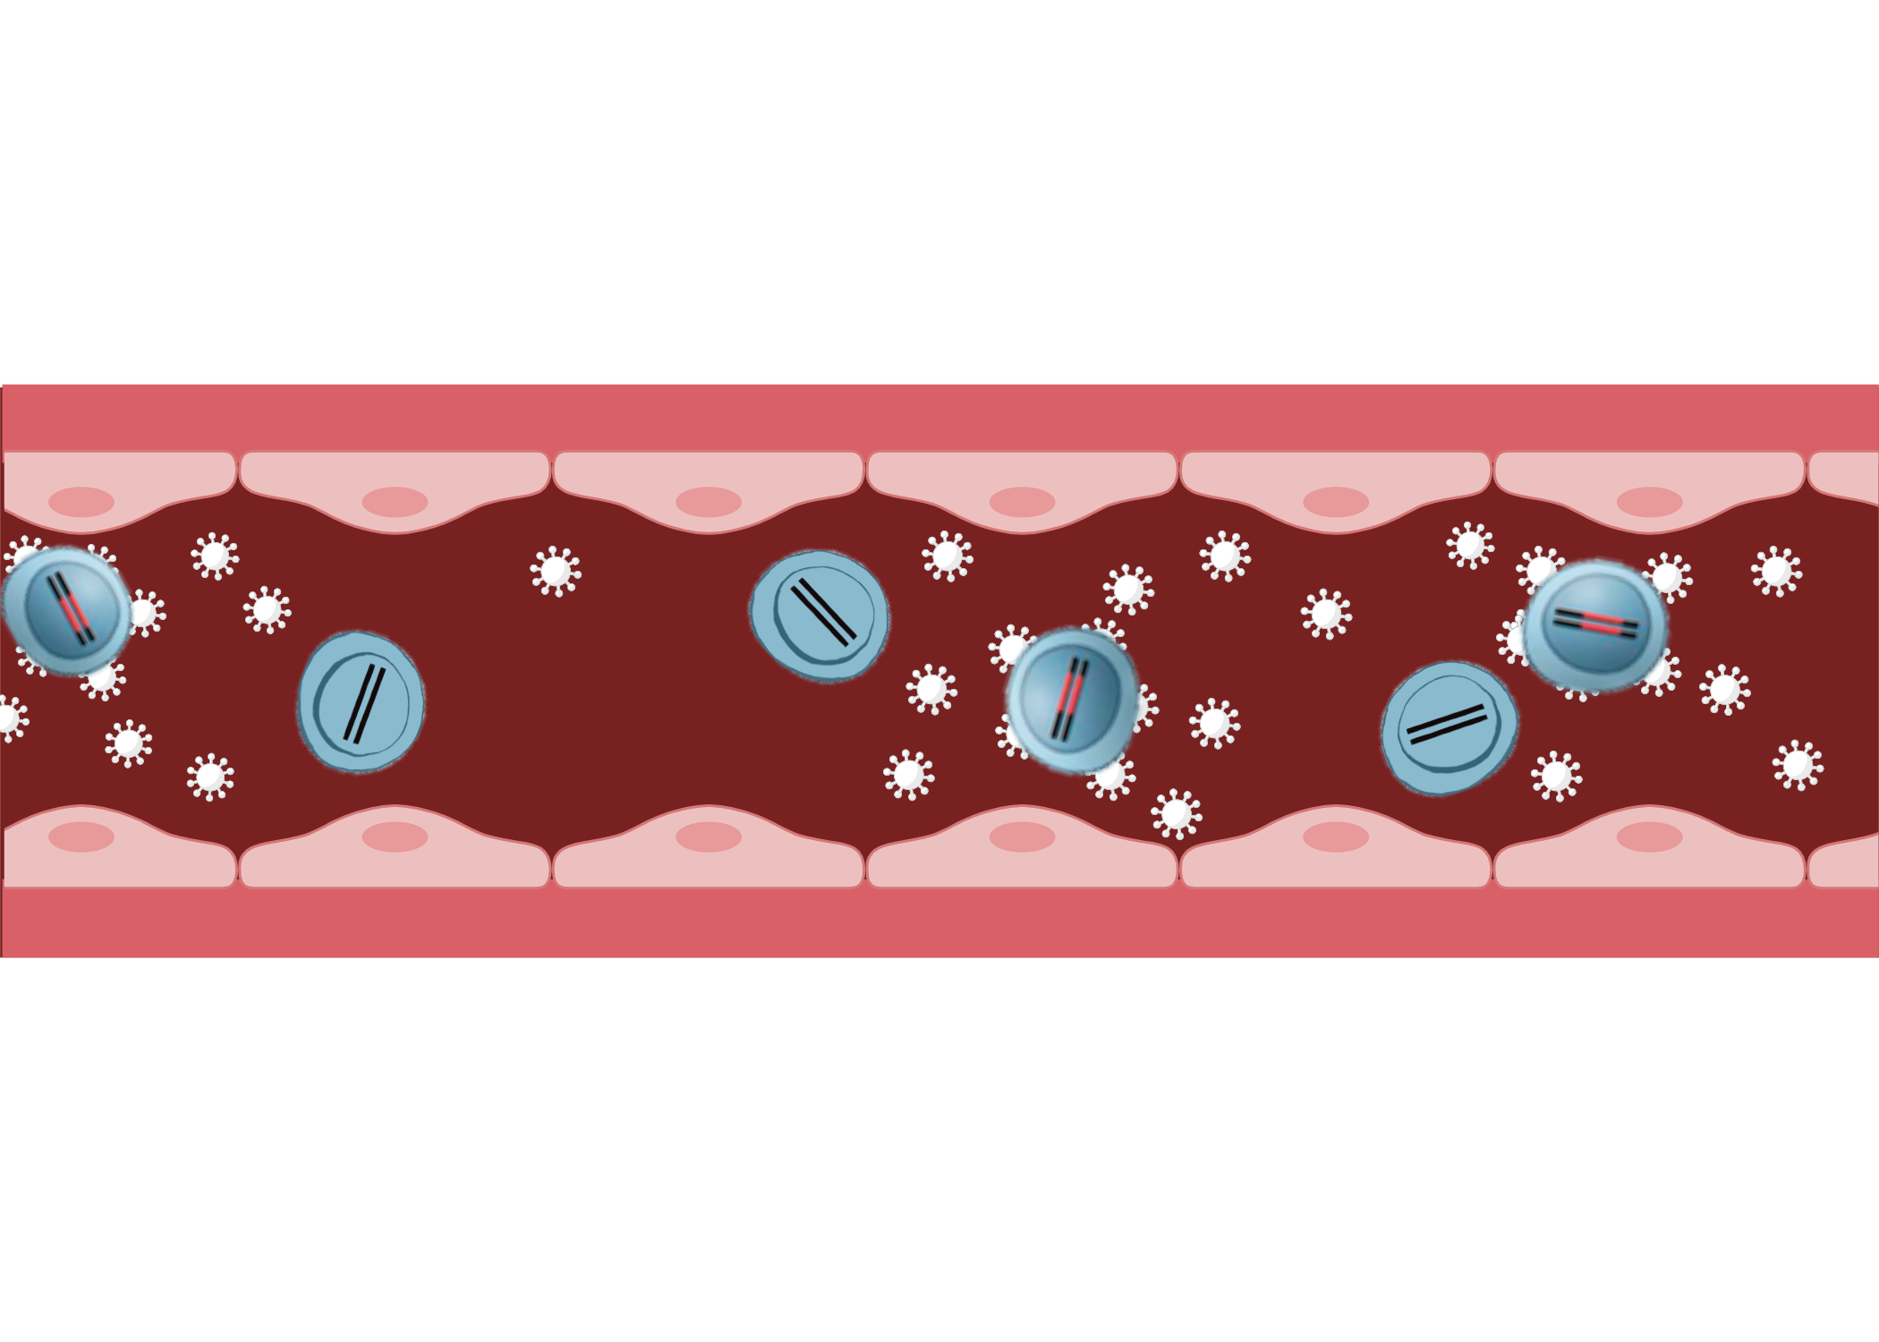
HIV viral load and the hidden reservoir
Unfortunately, if ART is stopped, HIV replication almost always restarts from this reservoir and HIV copies become detectable again by the viral load test
Created with BioRender.com

Slide 15
HIV persistence

Slide 16
HIV persistence

Slide 17
HIV persistence

Slide 18
HIV persistence

Slide 19
HIV persistence
ART
HIV production

Slide 20
HIV persistence
ART
HIV production

Slide 21
ART doesn’t cure HIV infection
Initiate ART
10⁷
10⁵
Infected cells in blood
10⁶
10⁴
10⁵
10³
10⁴
10²
Plasma HIV (Copies/mL)
Virus particles in blood
HIV Infected CD4 Cells
10³
10¹
10²
10⁰
10¹
10⁻¹
10⁰
10⁻²
10⁻¹
10⁻³
-1
0
1
2
3
4
5
6
7
8
9
10
11
Years on cART
The number of HIV RNA copies (viral load) declines rapidly after ART is started, but the number of HIV-infected cells containing the virus’s genetic blueprint in the form of DNA declines very slowly

Slide 22
How does HIV persist?

Slide 23
How does HIV persist?

Slide 24
How does HIV persist?

Slide 25
How does HIV persist?

Slide 26
How does HIV persist?

Slide 27
How does HIV persist?
J Intern Med. 2011 Dec;270(6):550-60. doi: 10.1111/j.1365-2796.2011.02457.x

Slide 28
How does HIV persist?
J Intern Med. 2011 Dec;270(6):550-60. doi: 10.1111/j.1365-2796.2011.02457.x

Slide 29
How does HIV persist?
J Intern Med. 2011 Dec;270(6):550-60. doi: 10.1111/j.1365-2796.2011.02457.x

Slide 30
How does HIV persist?
J Intern Med. 2011 Dec;270(6):550-60. doi: 10.1111/j.1365-2796.2011.02457.x

Slide 31
How does HIV persist?
J Intern Med. 2011 Dec;270(6):550-60. doi: 10.1111/j.1365-2796.2011.02457.x

Slide 32
How does HIV persist?
J Intern Med. 2011 Dec;270(6):550-60. doi: 10.1111/j.1365-2796.2011.02457.x

Slide 33
How does HIV persist?
J Intern Med. 2011 Dec;270(6):550-60. doi: 10.1111/j.1365-2796.2011.02457.x

Slide 34
HIV integration

Slide 36
HIV integration into CD4+ T cells

Slide 37
HIV integration into CD4+ T cells

Slide 38
HIV integration into CD4+ T cells

Slide 39
HIV integration into CD4+ T cells

Slide 40
HIV integration into CD4+ T cells

Slide 41
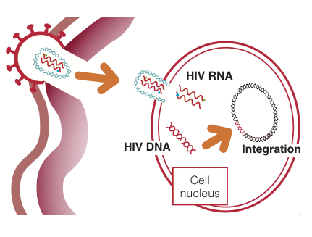
HIV integration
HIV first binds to cell and inserts virus’s genetic material
Image credit: HIV i-Base

Slide 42
HIV integration
HIV first binds to cell and inserts virus’s genetic material
in the form of RNA
Image credit: HIV i-Base

Slide 43
HIV integration
HIV RNA then “reverse-transcribes” into HIV DNA,
Image credit: HIV i-Base

Slide 44
HIV integration
HIV RNA then “reverse-transcribes” into HIV DNA,
which integrates into the cell’s
DNA genome
Image credit: HIV i-Base

Slide 45
Things to remember about integration

Slide 46
Things to remember about integration

Slide 47
Things to remember about integration

Slide 48
Things to remember about integration

Slide 49
How do HIV-infected CD4+ T cells persist?

Slide 50
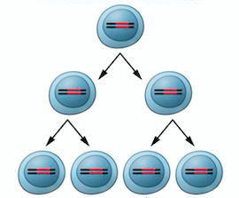
How do HIV-infected CD4+ T cells persist?
Memory CD4+ T cells can copy themselves in a process called “homeostatic proliferation” (a process used by the immune system to maintain numbers of memory CD4+ T cells)

Slide 51
How do HIV-infected CD4+ T cells persist?
If HIV is integrated into the CD4+ T cell’s genome (the red bands in the image), the genetic blueprint for the virus gets copied along with the cell

Slide 52
HOW do HIV-infected CD4+ T cells persist?

Slide 53
HOW do HIV-infected CD4+ T cells persist?
Memory CD4+ T cells may respond to a pathogen that they recognize (e.g. the measles virus), which causes rapid cell proliferation

Slide 54
HOW do HIV-infected CD4+ T cells persist?
Memory CD4+ T cells may respond to a pathogen that they recognize (e.g. the measles virus), which causes rapid cell proliferation
E.g. if the memory CD4+ T cell developed in response to a measles infection (or vaccine) in childhood, being exposed to measles as an adult will cause that CD4 T cell to proliferate, preventing a second measles illness

Slide 55
HOW do HIV-infected CD4+ T cells persist?
Memory CD4+ T cells may respond to a pathogen that they recognize (e.g. the measles virus), which causes rapid cell proliferation
E.g. if the memory CD4+ T cell developed in response to a measles infection (or vaccine) in childhood, being exposed to measles as an adult will cause that CD4 T cell to proliferate, preventing a second measles illness
The parts of a pathogen that trigger an immune response are called antigens, so this is referred to as antigen-specific CD4+ T cell proliferation

Slide 56
HOW do HIV-infected CD4+ T cells persist?
Memory CD4+ T cells may respond to a pathogen that they recognize (e.g. the measles virus), which causes rapid cell proliferation
E.g. if the memory CD4+ T cell developed in response to a measles infection (or vaccine) in childhood, being exposed to measles as an adult will cause that CD4 T cell to proliferate, preventing a second measles illness
The parts of a pathogen that trigger an immune response are called antigens, so this is referred to as antigen-specific CD4+ T cell proliferation
As with homeostatic proliferation, if HIV is integrated into the cell’s genome, the genetic blueprint for the virus gets copied along with the CD4+ T cell

Slide 57
HOW do HIV-infected CD4+ T cells persist?
HIV integration into certain places in the genome of a memory CD4+ T cell may allow the virus to influence the proliferation and survival of the cell
Researchers have reported that the proliferation and survival of a minority of HIV-infected memory CD4+ T cells (~2%) in people on ART may be driven by this mechanism

Slide 58
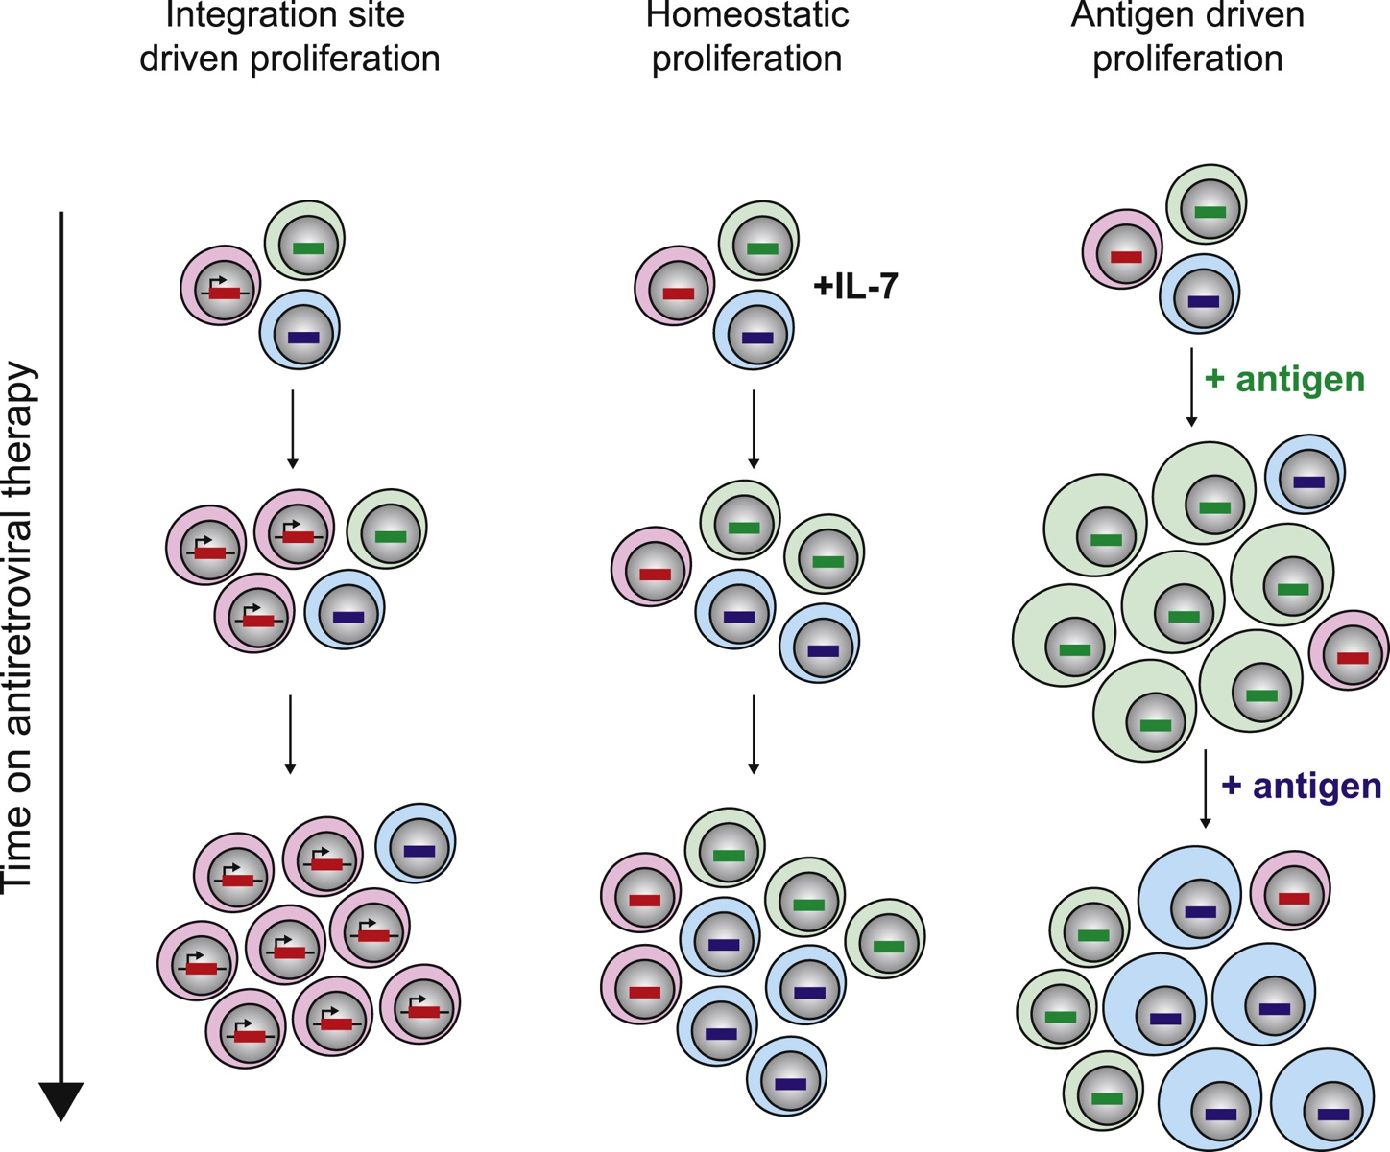
3 DIFFERENT WAYS CD4+ T cells containing HIV can be triggered to copy themselves
3
DIFFERENT WAYS
CD4+ T CELLS
CONTAINING HIV
CAN BE TRIGGERED
TO COPY THEMSELVES

Slide 59
3 DIFFERENT WAYS CD4+ T cells containing HIV can be triggered to copy themselves

Slide 60
3 DIFFERENT WAYS CD4+ T cells containing HIV can be triggered to copy themselves
Integration site driven: promoted by HIV's integration into the cell’s DNA

Slide 61
3 DIFFERENT WAYS CD4+ T cells containing HIV can be triggered to copy themselves
1.
Integration site driven: promoted by HIV's integration into the cell’s DNA

Slide 62
3 DIFFERENT WAYS CD4+ T cells containing HIV can be triggered to copy themselves
1.
Integration site driven: promoted by HIV's integration into the cell’s DNA
Homeostatic: maintaining the body’s total count of memory cells

Slide 63
3 DIFFERENT WAYS CD4+ T cells containing HIV can be triggered to copy themselves
1.
2
Integration site driven: promoted by HIV's integration into the cell’s DNA
Homeostatic: maintaining the body’s total count of memory cells

Slide 64
3 DIFFERENT WAYS CD4+ T cells containing HIV can be triggered to copy themselves
1.
2
3
Integration site driven: promoted by HIV's integration into the cell’s DNA
Homeostatic: maintaining the body’s total count of memory cells
Antigen driven: responding to a pathogen or other trigger (e.g. cancer)

Slide 65
3 DIFFERENT WAYS CD4+ T cells containing HIV can be triggered to copy themselves
1.
2
3
Integration site driven: promoted by HIV's integration into the cell’s DNA
Homeostatic: maintaining the body’s total count of memory cells
Antigen driven: responding to a pathogen (e.g. measles) or other trigger (e.g. cancer)
Cell Host Microbe. 2020 Apr 8;27(4):519-530. doi: 10.1016/j.chom.2020.03.014.

Slide 66
Where do HIV-infected CD4+ T cells persist?

Slide 67
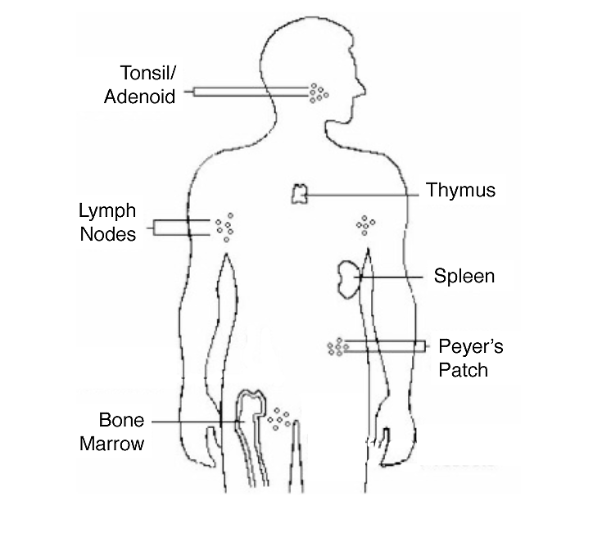
Where do HIV-infected CD4+ T cells persist?
Brain and spinal cord
Multiple potential sites of HIV persistence
Lymph nodes and gut-associated lymphoid tissue (GALT) are the major sites

Slide 68
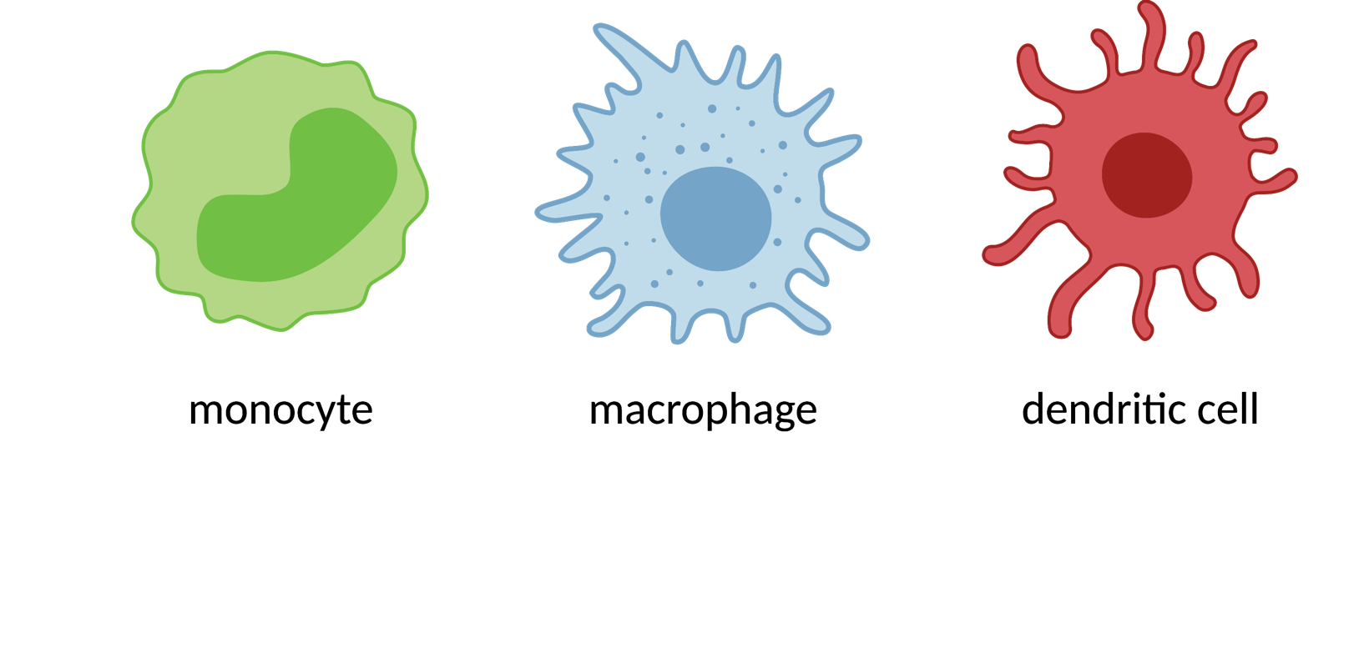
Other cells targeted by HIV?
CD4+ T cells are not the only type of immune cell that HIV can infect
HIV can also be found in immune cells called monocytes, macrophages and dendritic cells
There is debate among scientists about whether HIV can persist long-term in these cells when people are on ART

Slide 69
Other cells targeted by HIV?
The latest evidence is that the source of viral load rebound after ART interruption is HIV emerging from infected CD4+ T cells
Most scientists consider HIV-infected CD4+ T cells to be the major site of HIV persistence in people on ART
For this reason, a primary goal in cure research is eliminating, reducing, or controlling the HIV reservoir in CD4+ T cells

Slide 70
Measuring HIV persistence

Slide 71
Measuring HIV persistence
Scientists constantly working to identify better ways of measuring the amount of HIV that persists despite ART
Efforts are particularly focused on HIV that is intact and capable of replicating if ART is stopped

Slide 72
Examples of HIV reservoir tests

Slide 73
Examples of HIV reservoir tests
HIV DNA: measures the amount of HIV genetic material, but can’t show whether it represents intact or defective virus

Slide 74
Examples of HIV reservoir tests
HIV DNA: measures the amount of HIV genetic material, but can’t show whether it represents intact or defective virus
Quantitative virus outgrowth assay (QVOA): estimates the amount of HIV present in a sample that is capable of replicating in a lab dish

Slide 75
Examples of HIV reservoir tests
HIV DNA: measures the amount of HIV genetic material, but can’t show whether it represents intact or defective virus
Quantitative virus outgrowth assay (QVOA): estimates the amount of HIV present in a sample that is capable of replicating in a lab dish
Intact proviral DNA assay (IPDA): measures the amount of virus genetic material that appears intact and likely able to replicate

Slide 76
CONCLUSION
The ability of HIV to persist in the body represents a challenge for efforts to cure HIV infection
Multiple approaches being pursued to try to reduce, eliminate or control persistent HIV without the need for ongoing treatment
See other CUREiculum modules for additional information

Slide 77
ACKNOWLEDGMENTS
Module developers
Richard Jefferys TAG
Richard Strange BELIEVE CAB
Michael Louella defeatHIV CAB
We wish to thank AIDS Treatment Activists Coalition for the funding to complete this module
Their caring support of the CUREiculum 2.0. will make a difference in the lives of thousands. of people living with HIV
Biomedical Review
R. Brad Jones, Assistant Professor of Immunology in Medicine at Weill Cornell Medicine.

