Slide 1


Analytical Treatment Interruptions (“ATIs”)

Slide 2
Participant Testimonials

Slide 3


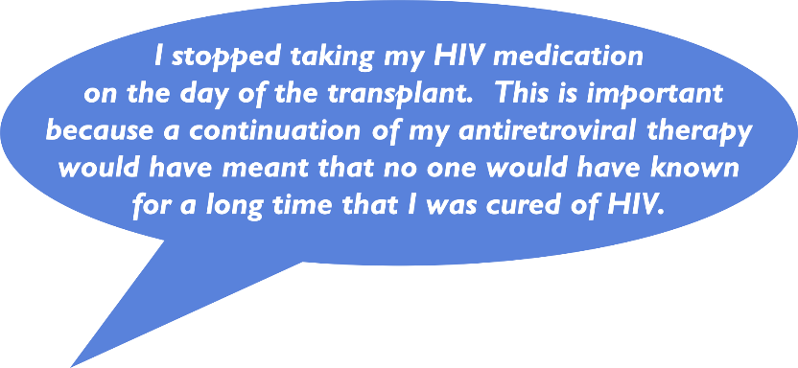

Participant Testimonials
I stopped taking my HIV medication
on the day of the transplant. This is important because a continuation of my antiretroviral therapy would have meant that no one would have known for a long time that I was cured of HIV.
Timothy Ray Brown
“The Berlin Patient”

Slide 4


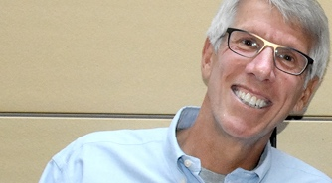
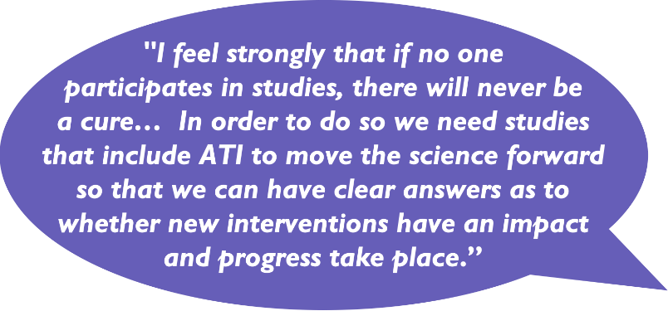
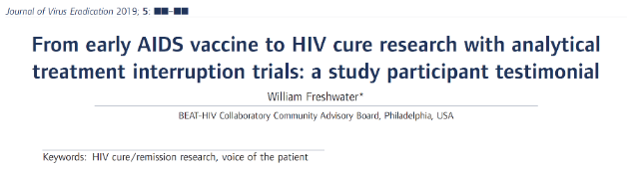

"I feel strongly that if no one participates in studies, there will never be a cure… In order to do so we need studies that include ATI to move the science forward so that we can have clear answers as to whether new interventions have an impact and progress take place.”
I stopped taking my HIV medication on the day of the transplant. This is important because a continuation of my antiretroviral therapy would have meant that no one would have known for a long time that I was cured of HIV.
Timothy Ray Brown – The Berlin Patient
William (“Bill”) Freshwater

Slide 5
What is an ATI?

Slide 6

What is an ATI?
stands for Analytic Treatment Interruption
also called IMAP – Intensively Monitored Antiretroviral Pause
As part of participation in a research study, a volunteer/participant is asked to pause their HIV medications under careful observation from a doctor, researcher and/or healthcare team
Clinical status and safety labs including viral load, CD4+ T cell count are monitored closely and frequently, usually through weekly blood samples
  It remains important to stay in close contact with your primary care provider
image: Michael Louella

Slide 7

ATIs in Context
Short or brief ATIs: some treatment pauses may last days to weeks
Restrictive ATIs: restart HIV medicines as soon as virus is detectable
Extended or prolonged ATIs: may last weeks to months
Permissive ATIs: may allow high levels of HIV under close monitoring for weeks to months before restarting HIV medicines

Slide 8

If HIV medicines are effective, why pause them?
HIV reservoir: HIV that is “hidden” in different cells and tissues
Goal of many “HIV cure” studies: reduce the reservoir and teach the immune system to control reservoir
There is currently no other way to know for sure if any decreases in reservoir size or changes in immune function caused by a cure intervention have enhanced a person’s ability to control HIV
So, ATIs are needed to determine whether a cure intervention has enhanced a person’s ability to control HIV in the absence of
HIV medicines

Slide 9
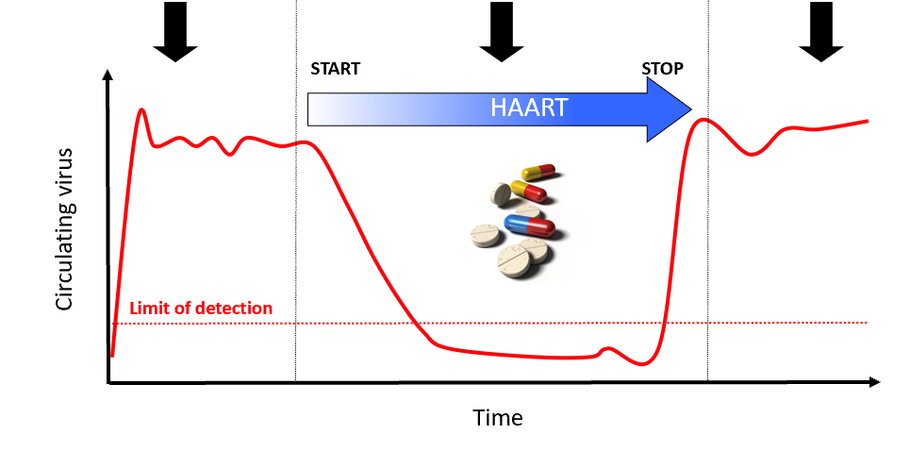
Current Medicines Do Not Eliminate HIV
HIV levels are high in untreated HIV infection
HIV medicines decrease HIV to “undetectable” levels
When HIV medicines are stopped, HIV “rebounds”
“Highly Active Antiretroviral Therapy”
WHY? Because HIV hides in a “reservoir” that is not cleared by HIV medicines
Notes:
HIV comes back quickly (“rebounds”) if we stop antiretroviral treatment
Even after years of being on antiviral therapy that keeps the virus at undetectable levels, we know if these medications are stopped that the virus rebounds quickly. This why we need a strategy to address the flaws in the thought that triple drug therapy alone would lead to a cure (the elimination of HIV from the body).
ART, however, does not eliminate the viruses that persist in the latent reservoirs. HIV remains “hidden” in these latent reservoirs and will rebound if ART if stopped. For these reasons ART is a lifelong therapy to keep the virus from rebounding and causing sickness. But, long term ART can lead to short-term and long-term toxicities and is very expensive. It is uncertain whether there will be sufficient resources on a global level to provide HIV treatment to everyone who needs it. So far, the world has fallen far short of this challenge. Furthermore, people living with HIV deserve a cure to keep themselves and partners safe and healthy.

Slide 10

What do we learn from an ATI?
Is the volunteer a post-treatment controller (someone whose HIV levels stay low without HIV medicine)?
Has the HIV reservoir been decreased?
Has the immune system been taught to control HIV?
What may the study teach us about the experimental intervention?
  The effects of the intervention on participants’ health
  The ability of the intervention to control or eliminate HIV

Slide 11
Types of Experimental Therapies Where ATIs Might Be Necessary
Immune-based approaches: jump start the immune system
Broadly neutralizing antibodies: defend the body from infectious particles and kill infectious particles
Cell and gene therapy: change immune cells in order to prevent HIV from entering the body
Combination approaches: mixing different approaches together

Slide 12

Risks & challenges of an ATI

Slide 13


Slide 14

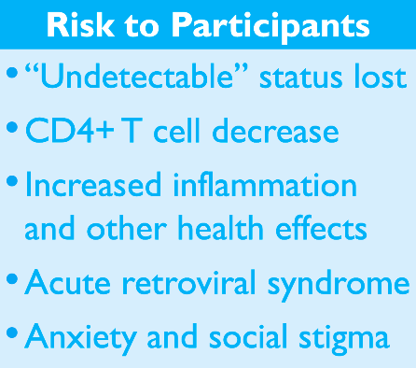
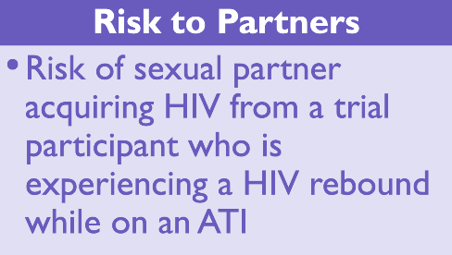
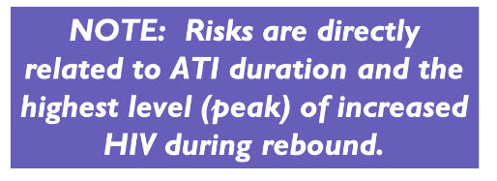
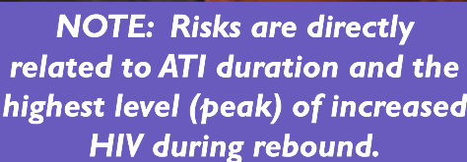
The Risks of ATIs
Risk to Participants
“Undetectable” status lost
CD4+ T cell decrease
Increased inflammation
and other health effects
Acute retroviral syndrome
Anxiety and social stigma
Risk to Partners
Risk of sexual partner acquiring HIV from a trial participant who is experiencing a HIV rebound while on an ATI
NOTE: Risks are directly related to ATI duration and the highest level (peak) of increased HIV during rebound.
Notes:
HIV comes back. Inflammation can cause serious health issues like heart attacks. Other effects may include becoming resistant to some HIV medications.
Acute infection lasts for several weeks and may include symptoms such as fever, swollen lymph nodes, inflammation of the throat, rash, muscle pain, malaise, and mouth and esophageal sores.

Slide 15

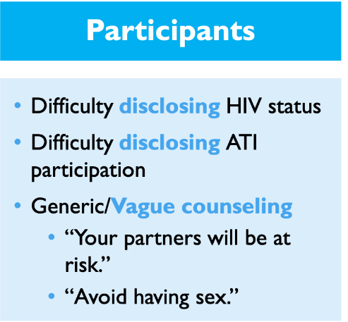
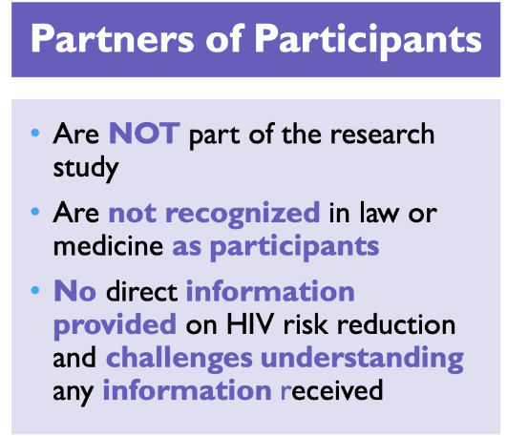
Specific Challenges of ATIs
Participants
Partners of Participants
Difficulty disclosing HIV status
Difficulty disclosing ATI participation
Generic/Vague counseling
  “Your partners will be at risk.”
  “Avoid having sex.”
Are NOT part of the research study
Are not recognized in law or medicine as participants
No direct information provided on HIV risk reduction and challenges understanding any information received

Slide 16


Recent ATI Transmission Cases
France: male to female transmission
Spain: male to male transmission
PrEP (Pre-Exposure Prophylaxis) unavailable during either study
Shows the urgency of efforts to mitigate transmission risk
in the context of clinical trial
Make every attempt to proactively ensure that PrEP & PEP (post-exposure) are available and accessible to all identified participants’ partners

Slide 17
Designing an ATI

Slide 18

Designing an ATI:
Key Considerations
Ragon Institute meeting: 2018 meeting of experts to reach to consensus on how to implement ATIs safely
  Community reps helped organize the meeting and participated
  All attendees has an opportunity to comment and vote on all key focus areas
Key focus areas:
  Inclusion & exclusion criteria for clinical trials
  How frequently to monitor viral load during ATIs?
  When to restart ART after HIV rebound?
  How to decrease HIV transmission risk?

Slide 19
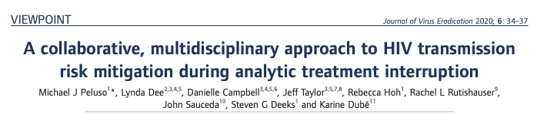
Provided a practical starting point to reduce HIV transmission risk during ATIs
Described strategies in a cure trial that may be applicable to other urban areas with university based medical centers and accessible PrEP
Included extensive community involvement

Slide 20

Integrating Risk Mitigation into Protocol
Script and checklists for discussion of transmission risk during ATI
Standardized counseling at enrollment prior to ATI
  For both study participants and partners
Build counseling into study protocol
  Hands-on PrEP referrals made for partners whenever possible

Slide 21

Testing and Disclosure
Counseling materials help to facilitate discussion about HIV status and ATI between participant and partner(s)
Directs partner(s) who don’t know their HIV status to local HIV testing resources

Slide 22
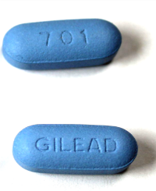
Focus on PrEP (Pre-Exposure Prophylaxis)
Passive navigation to PrEP and providing condoms is not enough
Mandatory protocol provisions for PrEP education and active navigation to PrEP are necessary
De-stigmatizing PrEP and PEP Information sheets, including information specific to women and trans communities must be provided
Image: Creative Commons

Slide 23


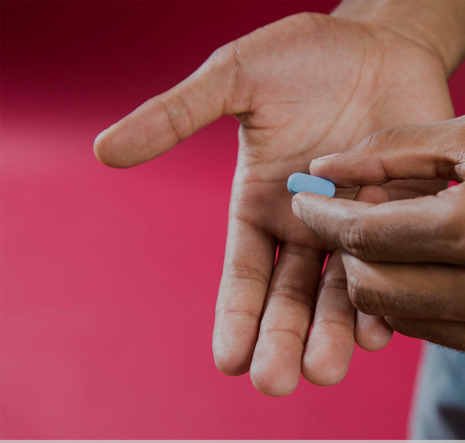
Study Team Engagement
Encourage participants to engage partners whenever and
if possible
  Invite to study visits
  Partner participation encouraged at least 4 weeks prior to ATI
Hands-on study team engagement with partners
  Access to study physician to discuss PrEP issues
  Initial and repeated transmission counseling
  Direct referrals to local PrEP and PEP sites
  Warm hand-off to directly connect partner to PrEP and PEP clinics

Slide 25

Specific Anticipated Challenges
PrEP use considerations in women, communities of color & trans communities
Multiple or anonymous partners
Unwillingness of participants to disclose HIV status or ATI participation
Unwillingness of participants to involve partners

Slide 26

Navigation to PEP
In cases with known possible HIV exposure without PrEP
Rapid PEP navigation assistance (< 72 hours)
Study team will facilitate PEP via established pathways at the study site and in the community

Slide 27

Our Ultimate Goal
In some settings, it may be feasible for studies to include access to PrEP and PEP
Universal HIV testing, PrEP and PEP education
More behavioral research to understand values, motives, and prevention practices
Increased focus on women, communities of color & trans communities
More research to identify partners’ experiences/preferences

Slide 28

Our Recommendations
“Standard of risk reduction” packet
  Integrate risk reduction/mitigation into study protocol
    Risk reduction/mitigation concerns and practices should be integrated into the design of cure research studies
  Promote and support testing and disclosure in couples where only one person is HIV+ (serodiscordant couples) or when someone’s HIV status is unknown
  Focus on providing and accessing PrEP and PEP
  Foster collaborations between study team, participant, and partner(s)
  Provide Navigation to PrEP and PEP
  Promote open and honest communication between participants, researchers, and study team
This Photo by Unknown Author is licensed under CC BY-SA

Slide 29

Limitations of
Recommendations
Recommendations are based on widespread understanding of HIV transmission risk, universal testing, access to treatment, and PrEP and PEP for prevention
Strong stakeholder support available and political will to address issues on local level
Community engagement, including Community Advisory Boards (CABs) are essential
Researchers collaboration with local communities to create plans that are consistent with local needs and cultures, including gender and sex dynamics, structures are essential to help prevent racial discrimination,social stigma and intimate partner violence.

Slide 30














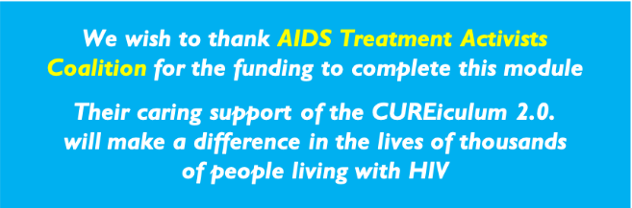

ACKNOWLEDGMENTS
Module developers
Danielle Campbell, DARE CAB (Community Lead)
Lynda Dee, AIDS Action Baltimore
Christopher Roebuck, BEAT-HIV CAB
William Carter, BEAT-HIV CAB
Michael Louella, defeatHIV CAB
Karine Dubé, UNC Chapel Hill
We wish to thank AIDS Treatment Activists Coalition for the funding to complete this module
Their caring support of the CUREiculum 2.0. will make a difference in the lives of thousands of people living with HIV
Biomedical Lead:
Michael Peluso, Assistant Professor
Division of HIV, Infectious Diseases and Global Medicine, UCSF, San Francisco, CA, USA

