Slide 1



Community & Stakeholder Engagement in
HIV Cure-Related Research

Slide 2
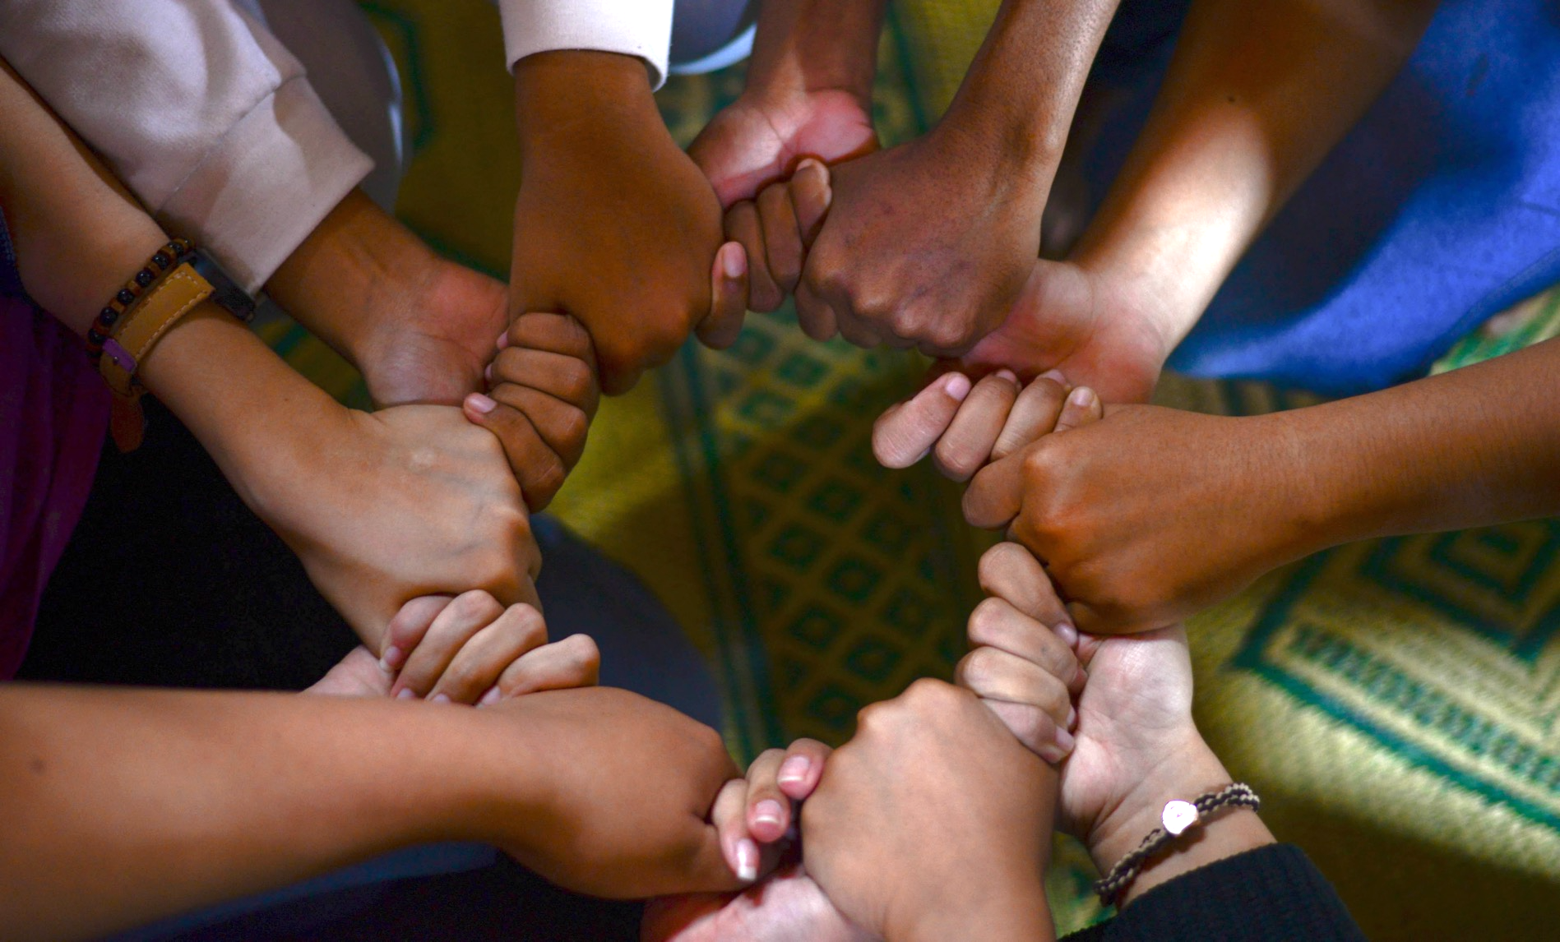
Outline
“Nothing About Us Without Us”
How Can We Define Stakeholders??
How Can We Define Community?
Where Does Engagement Fit?
What Principles Make Good Engagement?
Why Is Engagement Important?
Engagement in HIV Cure-Related Research
Why is Stakeholder Engagement Important?
The Paramount Importance of Community-Friendly Information
Examples and Ideas

Slide 3


“Nothing About Us
Without Us”

Slide 4
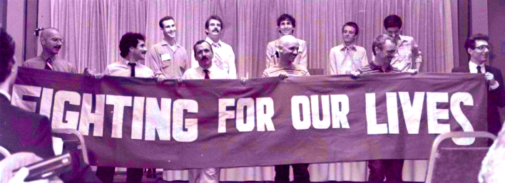
The Denver Principles, 1983

Slide 5
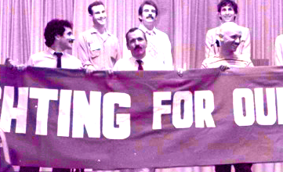
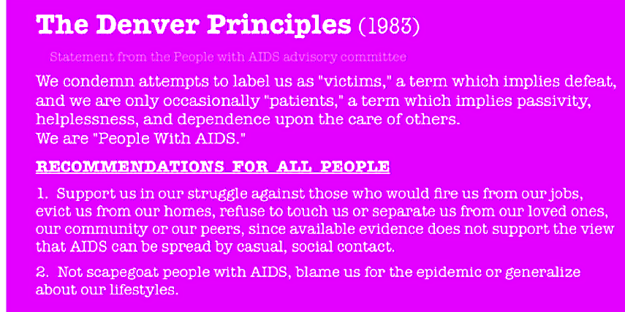

Slide 6
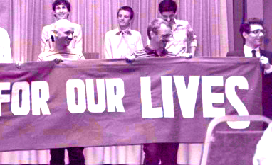
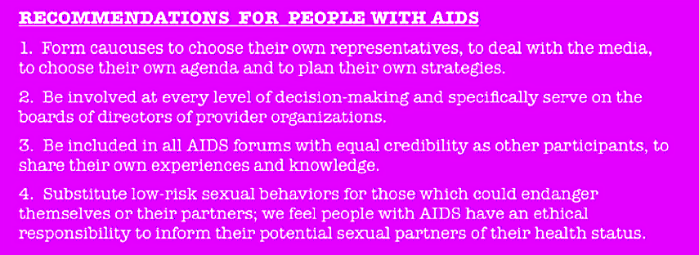

Slide 7

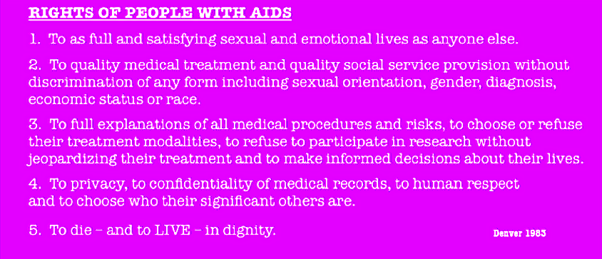
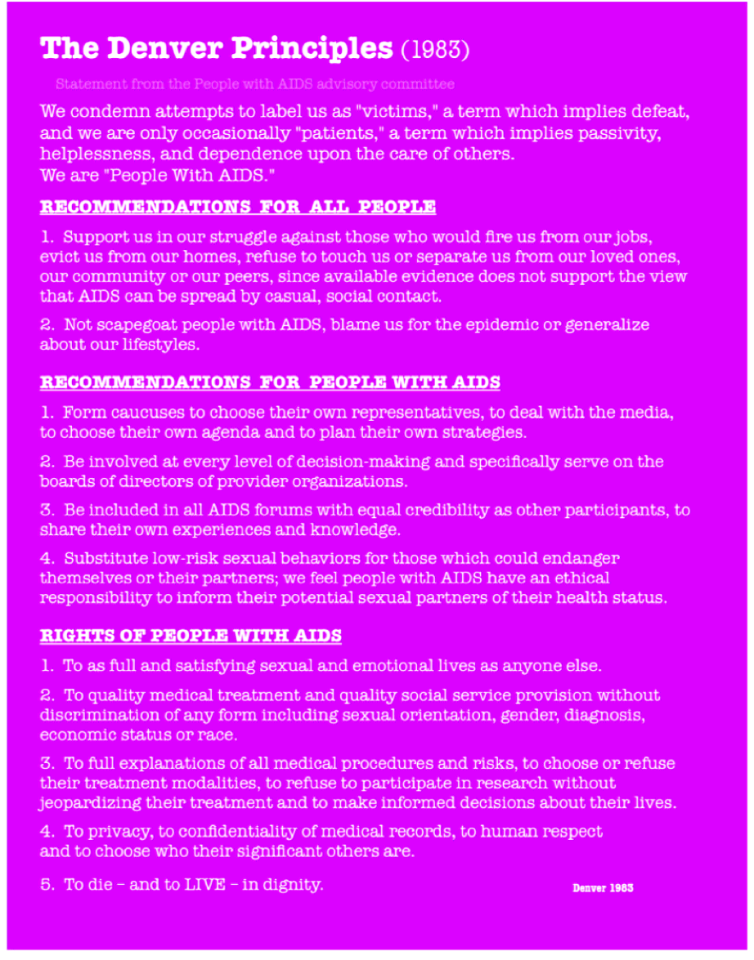
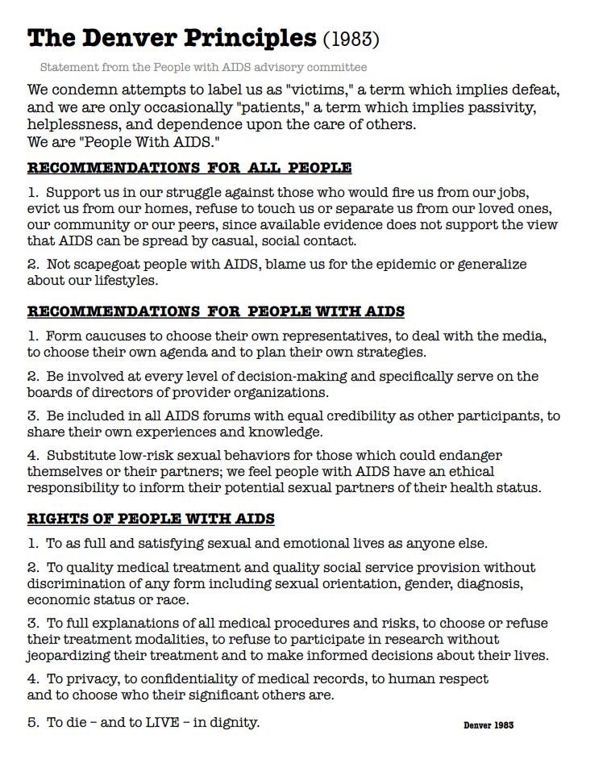
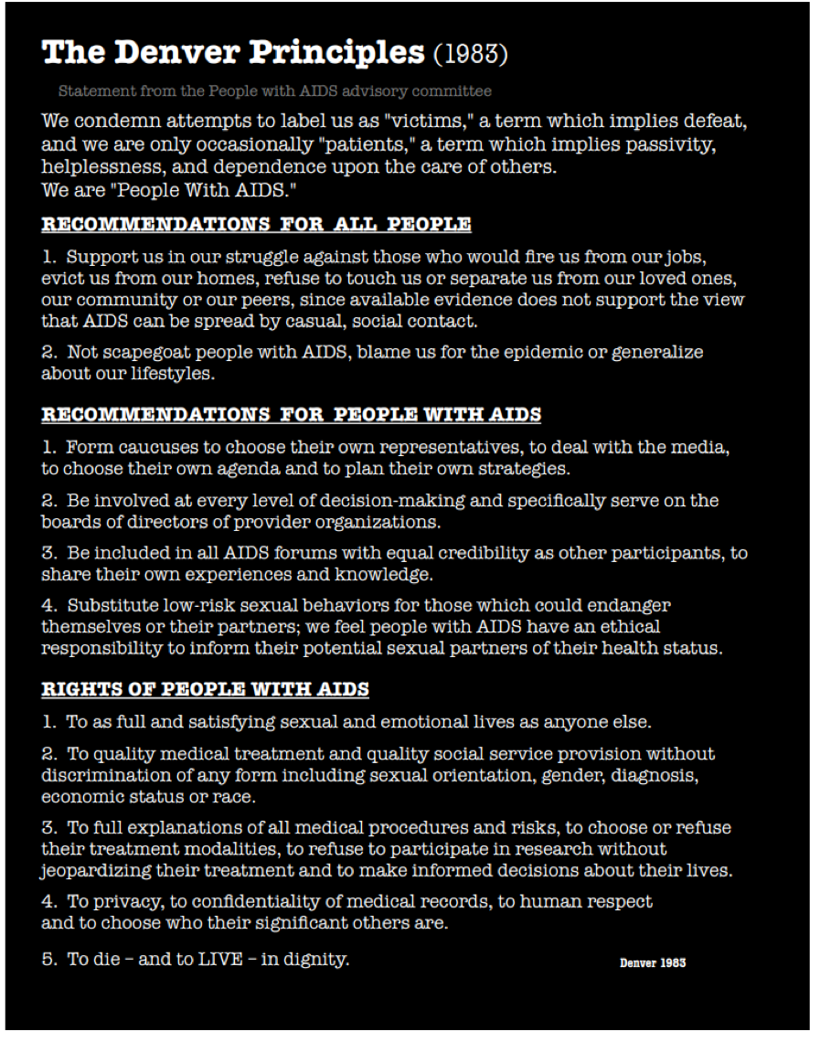

Slide 8
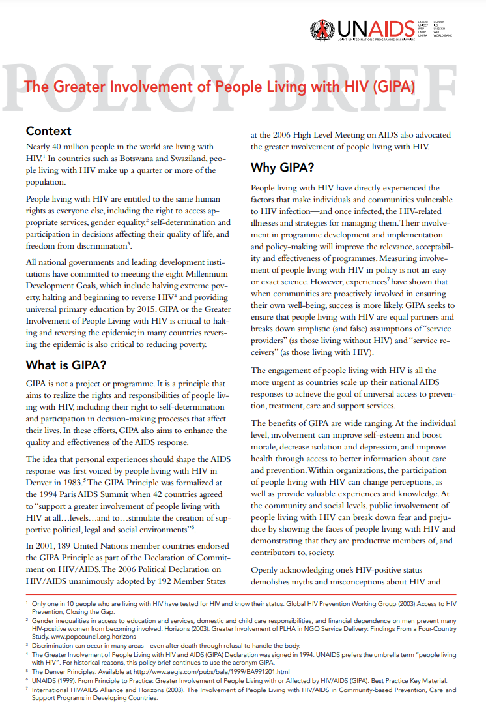
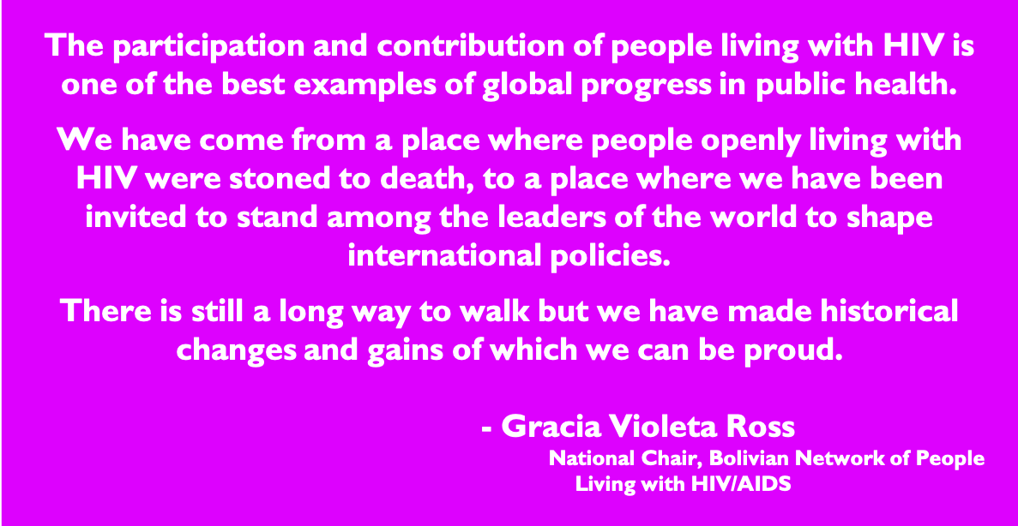
The Greater Involvement of People Living with HIV (GIPA)
https://data.unaids.org/pub/briefingnote/2007/jc1299_policy_brief_gipa.pdf

Slide 9
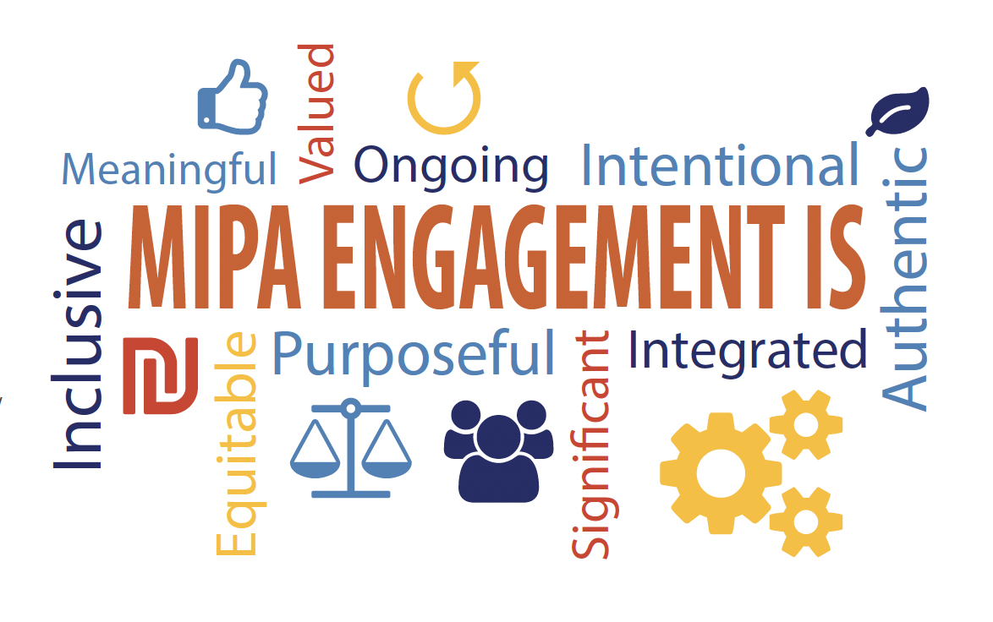
The Meaningful Involvement of People Living with HIV (MIPA)
intentional engagement of people living with HIV in leadership, advisory, and decision-making roles
critical to ensure that the voices of people most affected by an issue or decision are heard
https://aidsunited.org/meaningful-involvement-of-people-with-hiv-aids-mipa/

Slide 10
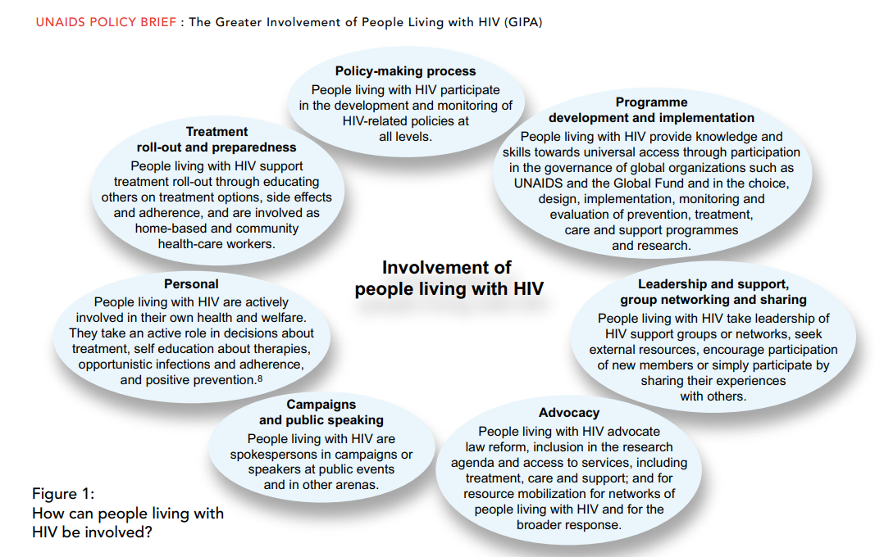
How Can People Living with HIV Be Involved?
https://data.unaids.org/pub/briefingnote/2007/jc1299_policy_brief_gipa.pdf

Slide 11
How Can We Define Stakeholders?

Slide 12

How Can We Define Stakeholders?
Global Stakeholders
National Stakeholders
Broader stakeholders
Community Stakeholders
Trial Participants/Potential Participants

Slide 13
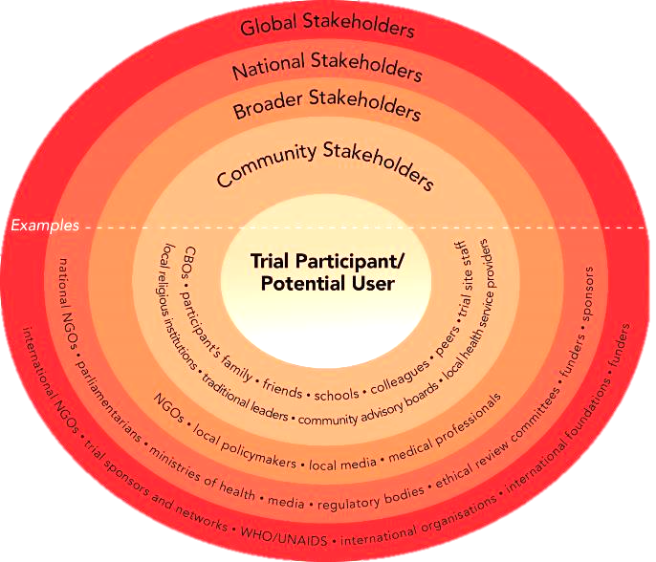

Slide 14
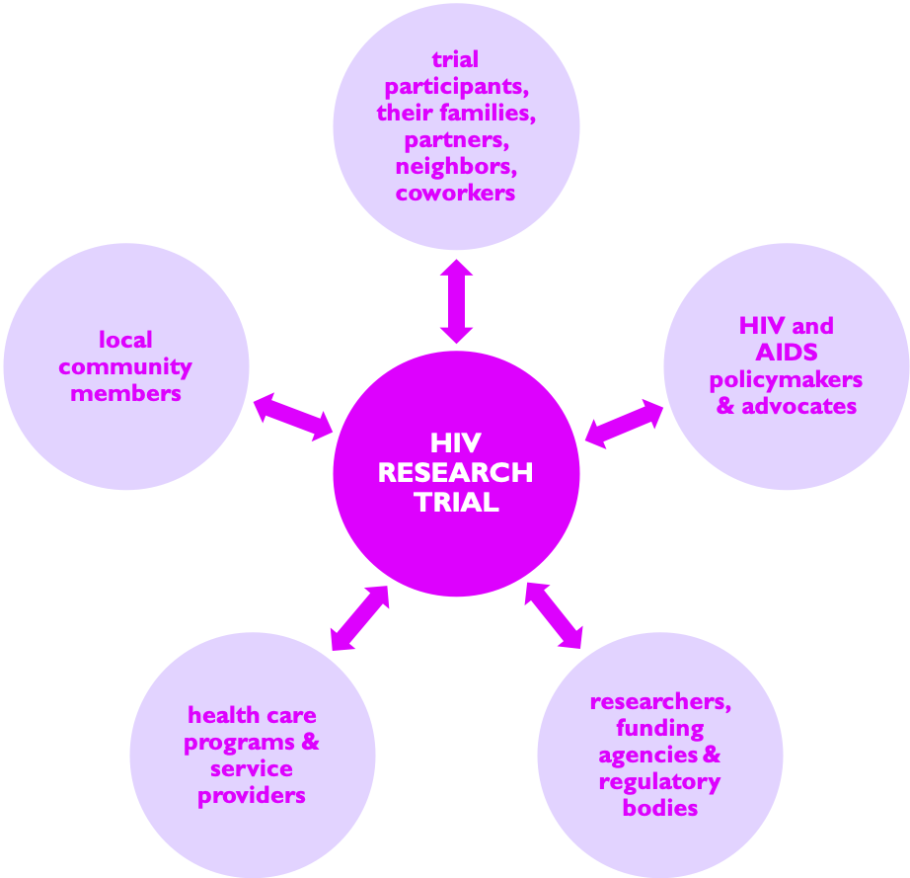
…WHO ARE YOU ‘ENGAGING?’
Adapted from Stakeholder Engagement Toolkit for HIV Prevention Trials

Slide 15
How Can We
Define Community?

Slide 16

How Can We Define Community?
“A group of people with diverse characteristics who are linked by social ties, share common perspectives, and engage in joint action in geographical locations or settings.”
(MacQueen, 2001)
“who is included and who is excluded from membership”
(Institute of Medicine, 1995)

Slide 17
Where Does Engagement Fit?
WHO
CIOMS
UNAIDS
Good Clinical Practice
Stakeholder Engagement
Human
Rights Considerations

Slide 18



Good Clinical Practice is NOT Good Participatory Practice
T
T
T
Good Clinical Practice
Research
Investigator
Trial Participants
S
S
S
Research teams
(and trial sponsors and funders)
Good Participatory Practice
Stakeholders

Slide 19
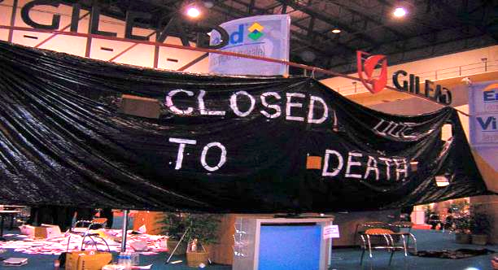
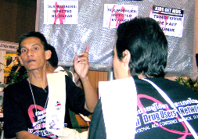

Why Do We Engage Beyond the Participant?
PrEP research trial controversy
  2004 – Cambodia trials were not initiated
  2005 – Cameroon and Nigeria trials discontinued
Notes:
Presenter’s Note: Ask if any members of the audience know these early PrEP trials.
These trials had gone through standard ethical process. Meaning the trials had IRB approval, undergone a protocol review process, had CAB input. However the trials were stopped because sex worker advocates thought the trial was exploiting the sex workers.
More recent trials in Thailand conducted with intravenous drug users did consult community. However the community recommendations of needle exchange were not adopted. The trial went forward and found positive results however much of the target community does not accept the results of the trial.

Slide 20
What Principles Make
Good Engagement?

Slide 21
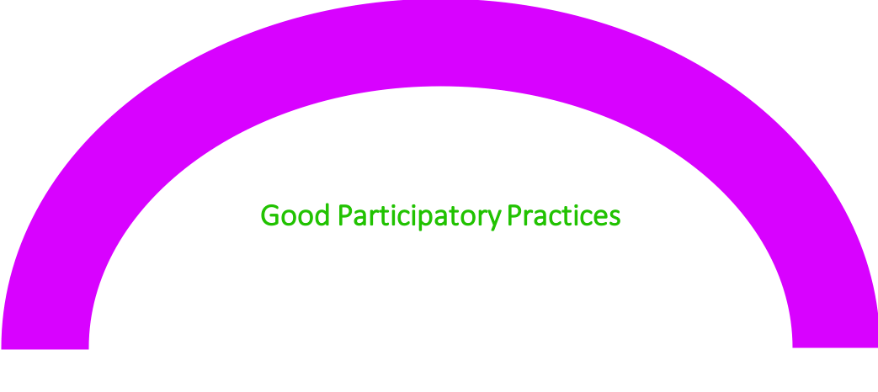
Guiding Principles of Engagement
Integrity
Transparency
Mutual Understanding
Accountability
Community Stakeholder Autonomy
Respect
Effective Stakeholder Engagement

Slide 22
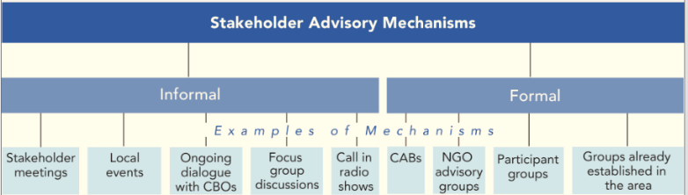
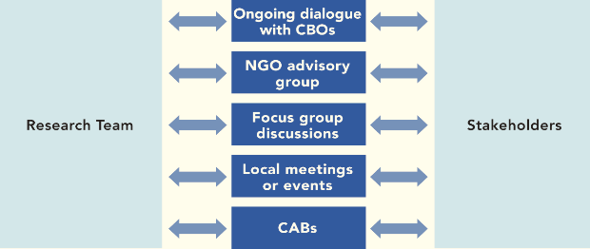
How Do We Engage?

Slide 23
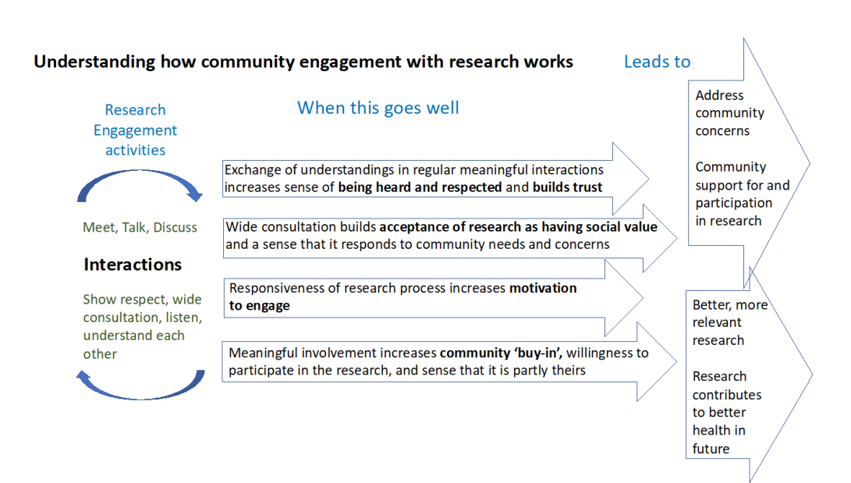
Adhikari B et al. A Realist View of Community Engagement with Health Research. Wellcome Open Research 2019; 4:87.

Slide 24
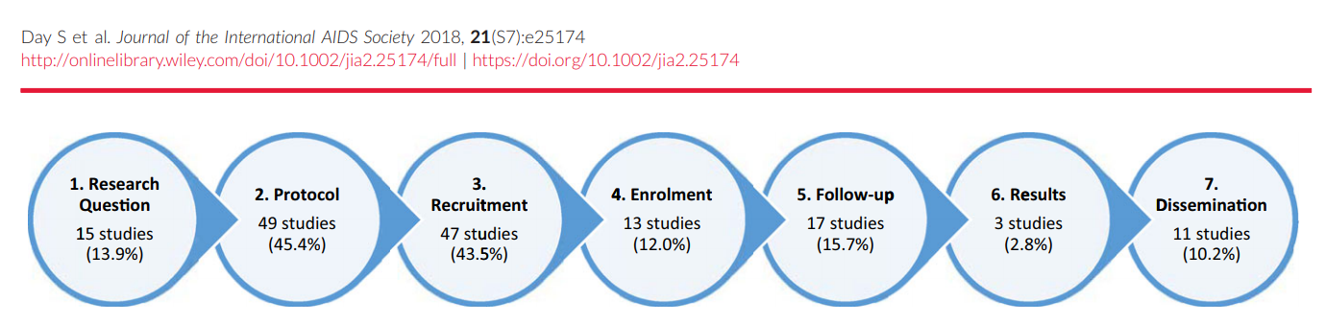
Engagement Throughout
Entire Study Cycle
Day S et al. Stakeholder Engagement to Inform HIV Clinical Trials: A Systematic Review of the Evidence. JIAS 2018; 21(S7): e25174.

Slide 25
Why is Engagement Important?

Slide 26
Landscape of Engagement
Racial Stigma
Homophobia
Stigma
Personal Health
Gender-Based Violence
Food security
HIV-positive Diagonosis
Job security
Treatment Access
Discrimination
Criminalization
Housing security
Poverty
Adopted from Joe Amon

Slide 27


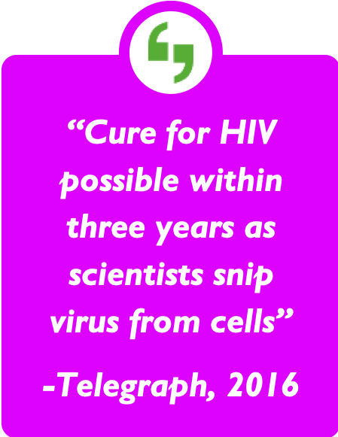
Research in the Age of
Fast Media
“Cure for HIV possible within three years as scientists snip virus from cells”
-Telegraph, 2016
Headlines aren’t always accurate
Potential to spread rumors
Potential to erode trust

Slide 28
Engagement in
HIV Cure-Related Research

Slide 29
Engagement in HIV
Cure-Related Research
Education and transparency are key goals that stakeholder advisory mechanisms must strive to incorporate
Critical that all stakeholders, including health care providers, understand how early phase cure related research can benefit future populations
Developing comprehensive engagement plans that reflect sociocultural norms and stakeholder needs are crucial to advancing research aims

Slide 30
Formative Research Activities
Allows the research team to understand:
  Informed understanding of local populations
  Socio-cultural norms
  Local power dynamics
  Local perceptions
  Channels of communication
  Site selection
Notes:
Presenter’s note: These activities can be broad and overlap with stakeholder advisory mechanisms
Formative research is not only the activity of the research team. Local stakeholders can proactively engage researchers in civil society consultations as well.
Formative research is the time to decide what is important to take inventory on and to gather a baseline for those items. Research literacy among different communities, not just potential participants, is important to determine prior to research starting because these community groups may impact the research outcome.
Much of cure research is still happening at the bench in labs. Selecting sites is about choosing facilities that have the technical resources to conduct the studies.
SearcHIV (searchiv.web.unc.edu/), a group funded out of UNC, is conducting formative research on international perspectives of HIV cure research.

Slide 31

Stakeholder
Engagement Plan
Communication component
  Policies and strategies to increase broad awareness of the trial and facilitate accurate dissemination of research
Education component
  Key to building research literacy and empowering community stakeholders as decision-making agents
Notes:
Presenter’s note: both the communication and educational component are both outlined as separate plans in the GPP guidelines. Learners may want to refer to the guidelines to discuss the applications for cure research. Central to this idea is the idea of informed consent. Members of the community need to understand the research that is being proposed. The informed consent process has its own engagement elements and best practices that should be considered. The foundation of the informed consent process is always education.

Slide 32

Policies on Trial-Related Harm
How research teams will treat and compensate trial participants
Physical harms: include any negative physical event
Social harms: non-medical consequences such as
    Social isolation
    Stigma or discrimination
    Employment or housing loss
    Difficulties in personal relationships
Notes:
Presenter’s note: This topic area An HIV-positive individual may be receiving medical and social benefits related to their HIV status. This might include enrollment in housing, Medicaid or Medicare funding, or any other assistance programing. A potential harm may be the actual success of a product that allows an individual to remove the positive from their status. If a participant goes into remission their may be potential social harms to content without.
Social harms differ from those in treatment and prevention. There could potentially be a loss of identity for an individual who has embraced their HIV positive status.
Physical harms are very important to consider given the experimental quality of these novel drug compounds. Early phase research in humans may present complications not seen in animal models. Particularly as these drugs move from population to population (women, children, MSM). In early phase research these harms may be unknown.

Slide 33
Why is Stakeholder Engagement Important?

Slide 34

Recruitment for Clinical Research
Populations of interest
Eligibility screening
Research
Systematic work
Enrollment in clinical research
Meaningful dialogue
Generalizable knowledge
Research
methods
Informed
consent
Four Common
(Mis)conceptions
Community engagement is not recruitment for clinical research.
Community engagement and community advisory boards serve related but different purposes.
Community engagement and education is not merely community service.
Community engagement is not research or ethics.
in HIV Cure-Related
Research

Slide 35
Four Common Misconceptions in HIV Cure Research
Recruitment for Clinical Research
Populations of interest
Eligibility screening
Research
Systematic work
Enrollment in clinical research
Meaningful dialogue
Generalizable knowledge
Research
methods
Informed
consent
Community and Patient Engagement
Creation of relationships
Management of expectations
Community Advisory Boards
Input into research process
Sounding board
Sharing of information
Meaningful dialogue
Mutual literacy and understanding
Protocol or research review
Critical safeguard in research process
Community engagement is not recruitment for clinical research.
Community engagement is not recruitment for clinical research.
Community engagement and community advisory boards serve related but different purposes.
Community engagement and education is not merely community service.
Community engagement is not research or ethics.
Trust, Mutual Respect, Transparency, Autonomy

Slide 36
Four Common Misconceptions in HIV Cure Research
Recruitment for Clinical Research
Populations of interest
Eligibility screening
Research
Systematic work
Enrollment in clinical research
Meaningful dialogue
Generalizable knowledge
Research
methods
Informed
consent
Community and Patient Engagement
Creation of relationships
Management of expectations
Community Advisory Boards
Input into research process
Sounding board
Sharing of information
Meaningful dialogue
Mutual literacy and understanding
Protocol or research review
Critical safeguard in research process
2. Community engagement and community advisory boards serve related but different purposes.
Community engagement is not recruitment for clinical research.
Community engagement and community advisory boards serve related but different purposes.
Community engagement and education is not merely community service.
Community engagement is not research or ethics.
Trust, Mutual Respect, Transparency, Autonomy

Slide 37
Four Common Misconceptions in HIV Cure Research
Four Common
in HIV Cure Research
Recruitment for Clinical Research
Populations of interest
Eligibility screening
Research
Systematic work
Enrollment in clinical research
Meaningful dialogue
Generalizable knowledge
Research
methods
Informed
consent
Community and Patient Engagement
Creation of relationships
Management of expectations
Community Advisory Boards
Input into research process
Sounding board
Sharing of information
Meaningful dialogue
Mutual literacy and understanding
Protocol or research review
Critical safeguard in research process
  3. Community engagement and education is not merely community service.
Community engagement is not recruitment for clinical research.
Community engagement and community advisory boards serve related but different purposes.
Community engagement and education is not merely community service.
Community engagement is not research or ethics.
Trust, Mutual Respect, Transparency, Autonomy
in HIV Cure Research

Slide 38
Four Common Misconceptions in HIV Cure Research
Four Common
in HIV Cure Research
Recruitment for Clinical Research
Populations of interest
Eligibility screening
Research
Systematic work
Enrollment in clinical research
Meaningful dialogue
Generalizable knowledge
Research
methods
Informed
consent
Community and Patient Engagement
Creation of relationships
Management of expectations
Community Advisory Boards
Input into research process
Sounding board
Sharing of information
Meaningful dialogue
Mutual literacy and understanding
Protocol or research review
Critical safeguard in research process
    4. Community engagement. is not research or ethics.
Community engagement is not recruitment for clinical research.
Community engagement and community advisory boards serve related but different purposes.
Community engagement and education is not merely community service.
Community engagement is not research or ethics.
Trust, Mutual Respect, Transparency, Autonomy
in HIV Cure Research

Slide 39



ENGAGEMENT IS…
the creation of relationships
local, national
& international
individuals & groups
ALIGN INTERESTS
COOPERATION
CO-CREATION
FOLLOWING THESE PRINCIPLES:
RESPECT
TRANSPARENCY
MUTUAL UNDERSTANDING
ACCOUNTABILITY
INTEGRITY
www.avac.org/gpp
AUTONOMY

Slide 40
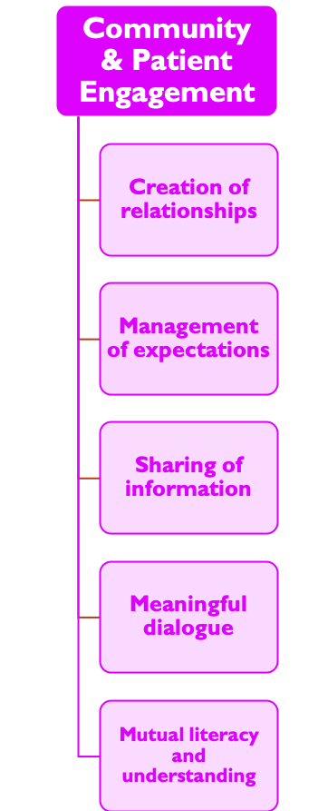
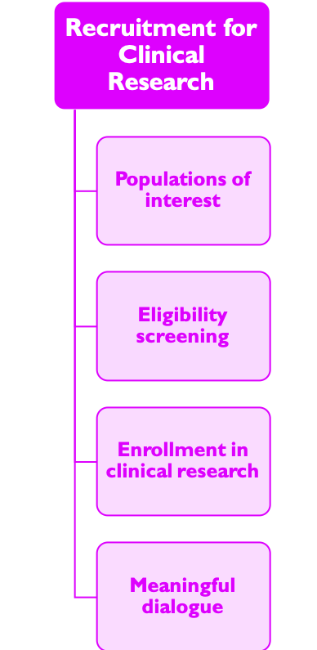
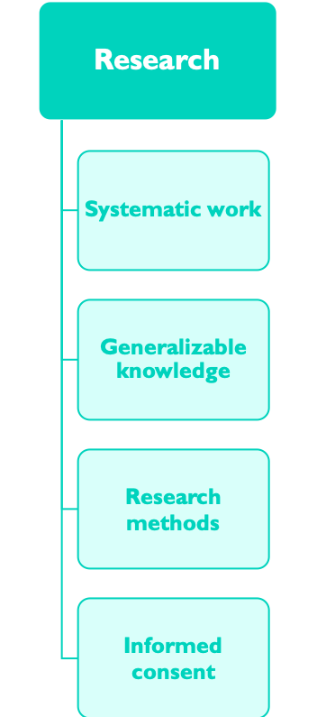
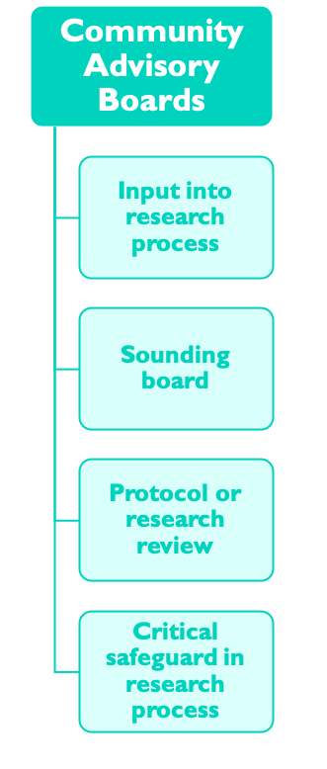
Community & Patient Engagement
Creation of relationships
Management of expectations
Community Advisory Boards
Input into research process
Sounding board
Sharing of information
Meaningful dialogue
Mutual literacy and understanding
Protocol or research review
Critical safeguard in research process
Recruitment for Clinical Research
Populations of interest
Eligibility screening
Research
Systematic work
Enrollment in clinical research
Meaningful dialogue
Generalizable knowledge
Research
methods
Informed
consent
Trust, Mutual Respect, Transparency, Autonomy
Credit: Karine Dubé

Slide 41
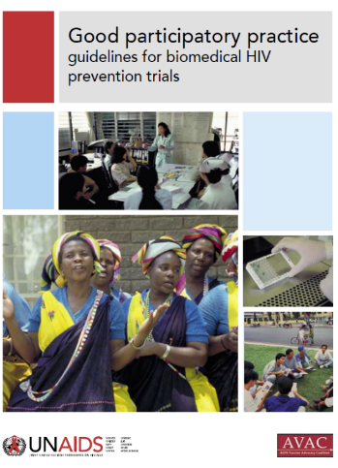
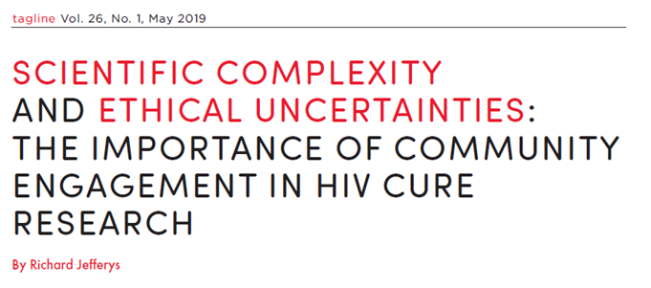
The Need for Consensus on Best Practices for Community and Stakeholder Engagement in
Early-Phase (HIV Cure) Research

Slide 42

What should community & stakeholder engagement look like in the context of early-phase, basic and translational HIV cure research?

Slide 43
  Need practical, applied model for engagement
  May need deliberative process to define best practices
What should community and stakeholder engagement look like in the context of early-phase, basic and translational HIV cure research?
  May need similar deliberative process to define practices as the one that lead to the ATI consensus workshop statement
  Need practical, applied model for engagement
  Make people living with HIV and community feel comfortable giving input
  May also mean building capacity of researchers to value community input
  Need to plan for the long-term (may not be specific to a trial)

Slide 44
  May need similar deliberative process to define practices as the one that lead to the ATI consensus workshop statement
  Need practical, applied model for engagement
What should community and stakeholder engagement look like in the context of early-phase, basic and translational HIV cure research?
  May need similar deliberative process to define practices as the one that lead to the ATI consensus workshop statement
  Need practical, applied model for engagement
  Make people living with HIV and community feel comfortable giving input
  May also mean building capacity of researchers to value community input
  Need to plan for the long-term (may not be specific to a trial)

Slide 45
  Make people living with HIV and community feel comfortable giving input
What should community and stakeholder engagement look like in the context of early-phase, basic and translational HIV cure research?
  May need similar deliberative process to define practices as the one that lead to the ATI consensus workshop statement
  Need practical, applied model for engagement
  Make people living with HIV and community feel comfortable giving input
  May also mean building capacity of researchers to value community input
  Need to plan for the long-term (may not be specific to a trial)

Slide 46
  May also mean building capacity of researchers to value community input
What should community and stakeholder engagement look like in the context of early-phase, basic and translational HIV cure research?
  May need similar deliberative process to define practices as the one that lead to the ATI consensus workshop statement
  Need practical, applied model for engagement
  Make people living with HIV and community feel comfortable giving input
  May also mean building capacity of researchers to value community input
  Need to plan for the long-term (may not be specific to a trial)

Slide 47
  Need to plan for the long-term (may not be specific to a trial)
  Need practical, applied model for engagement
  Make people living with HIV and community feel comfortable giving input
  May also mean building capacity of researchers to value community input
  Need to plan for the long-term (may not be specific to a trial)
What should community and stakeholder engagement look like in the context of early-phase, basic and translational HIV cure research?
  May need similar deliberative process to define practices as the one that lead to the ATI consensus workshop statement
  Need practical, applied model for engagement
  Make people living with HIV and community feel comfortable giving input
  May also mean building capacity of researchers to value community input
  Need to plan for the long-term (may not be specific to a trial)

Slide 48
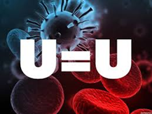
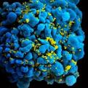
The Paramount Importance of Community-Friendly Information
Credit: Dazon Dixon Diallo, SisterLove, Inc.
The Research: | HPTN 052
The Implementation: | Treatment as Prevention
The Translation: | U = U
The Policy: | End the Epidemic (U.S.), 90-90-90

Slide 49

Credit: Dazon Dixon Diallo, SisterLove, Inc.
The Paramount Importance of Community-Friendly Information
Lessons from U = U
Need to invest in community scientific literacy and in scientific literacy around community concerns

Slide 50
Credit: Dazon Dixon Diallo, SisterLove, Inc.
The Paramount Importance of Community-Friendly Information
Lessons from U = U
Pay attention to language choice

Slide 51
Credit: Dazon Dixon Diallo, SisterLove, Inc.
The Paramount Importance of Community-Friendly Information
Lessons from U = U
Engage former study participants, as this can be a powerful way to share information about studies and build trust

Slide 52


Credit: Dazon Dixon Diallo, SisterLove, Inc.
Lessons from U = U
Lessons from U = U
The Research: | HPTN 052
The Implementation: | Treatment as Prevention
The Translation: | U = U
The Policy: | End the Epidemic (U.S.), 95 95 95
Credit: Dazon Dixon Diallo, SisterLove, Inc.

Slide 53

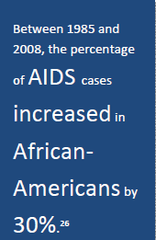

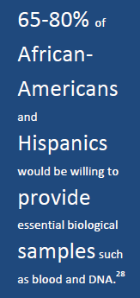
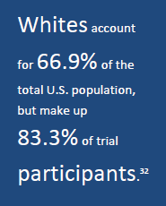
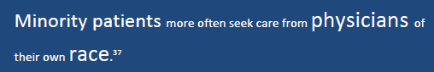
Minority Participation in Clinical Research
Note: Could replace this slide with the new FDA 2020 report:
https://www.fda.gov/regulatory-information/search-fda-guidance-documents/enhancing-diversity-clinical-trial-populations-eligibility-criteria-enrollment-practices-and-trial
Also need considerations for women and gender minorities
Notes:
Non-whites still account for less than 5 percent of clinical trial participants (2014)
NIH Revitalization Amendment 1993
Do interventions/therapies studied differentially affected women or men or members of minority groups?
Annual reporting of gender and race/ethnicity
Cost is not a legitimate reason for excluding ethnic minorities
Challenges to minority participations in HIV cure studies may include:
Study location
Cultural differences
Lack of knowledge about available HIV cure-related research studies
Poor access to medical care
Concerns about research
Successful strategies and recommendations for diversity included:
Recruiting female and minority physicians
Building trust through communication
Educating to raise awareness
Involving communities
Re-examining trial design and ethics
Incorporating new technologies
FDA’s White Paper on Diversifying Trial Participants:
http://www.fda.gov/downloads/ScienceResearch/SpecialTopics/WomensHealthResearch/UCM334959.pdf

Slide 54
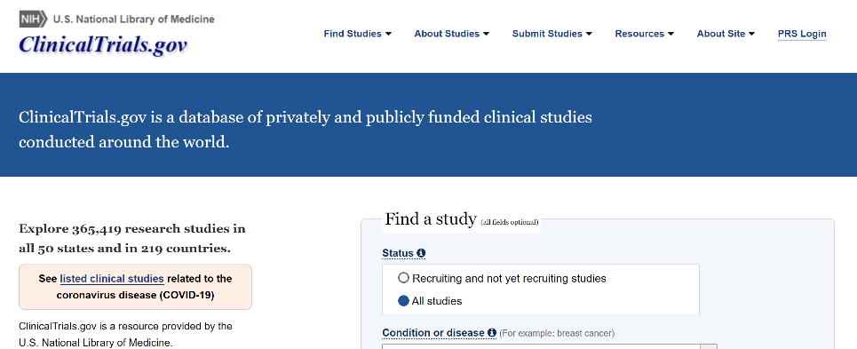
Finding a Clinical Research Study
Notes:
ClinicalTrials.gov may be very intimidating. Would perhaps add a link to the TAG Research Towards a Cure webpage:
https://www.treatmentactiongroup.org/cure/trials/
Would also mention some of the key institutional websites where to find active trials, or ACTG website with list of trials that are currently enrolling.

Slide 55

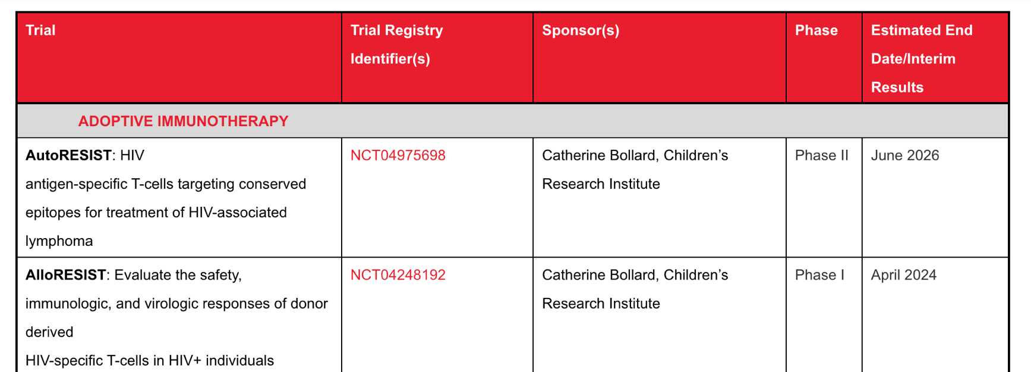
Finding a Clinical Research Study
TAG’s Research Towards a Cure webpage: https://www.treatmentactiongroup.org/cure/trials/
Notes:
ClinicalTrials.gov may be very intimidating. Would perhaps add a link to the TAG Research Towards a Cure webpage:
https://www.treatmentactiongroup.org/cure/trials/
Would also mention some of the key institutional websites where to find active trials, or ACTG website with list of trials that are currently enrolling.

Slide 56


Finding a Clinical Research Study
The ACTG conducts offers a wide range of studies for people with HIV: https://actgnetwork.org/studies/
Notes:
ClinicalTrials.gov may be very intimidating. Would perhaps add a link to the TAG Research Towards a Cure webpage:
https://www.treatmentactiongroup.org/cure/trials/
Would also mention some of the key institutional websites where to find active trials, or ACTG website with list of trials that are currently enrolling.

Slide 57

Questions?

Slide 58










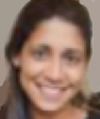


ACKNOWLEDGMENTS
Module developers:
Morénike Gina Onaiwu, ACTG
William B Carter, BEAT-HIV CAB
Beth Peterson, BEAT-HIV CAB
Jeff Taylor, CARE & DARE CABs
Danielle Campbell, DARE CAB
Michael Louella, defeatHIV CAB
Christopher Roebuck, BEAT-HIV CAB
Karine Dubé, UNC Chapel Hill
We wish to thank AIDS Treatment Activists Coalition for the funding to complete this module
Their caring support of the CUREiculum 2.0. will make a difference in the lives of thousands. of people living with HIV
We would like to thank Jessica Salzwedel (AVAC) for contributions to developing the initial CUREiculum module on community and stakeholder engagement.

Slide 59
Examples and Ideas

Slide 60

Publications

Slide 61
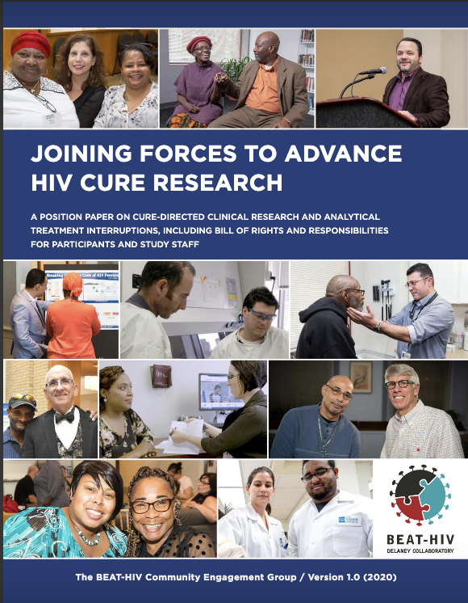
BEAT-HIV CAB POSITION PAPER
The product of a partnership among the BEAT-HIV Community Advisory Board (CAB), BEAT-HIV principal investigators, clinical researchers, and pioneering community health center Philadelphia FIGHT, this paper is written with the community in mind.
It’s meant to clarify and demystify HIV cure-directed studies, especially those that employ an analytical treatment interruption (ATI).
DOWNLOAD THE PAPER:
https://beat-hiv.org/ati-position-paper/

Slide 62
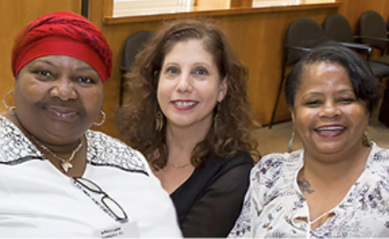
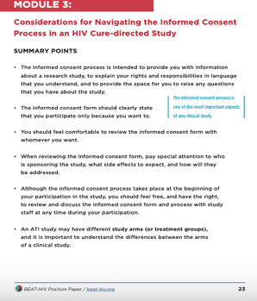
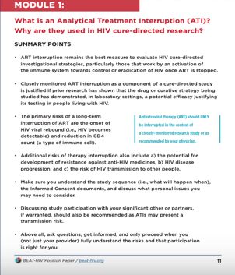
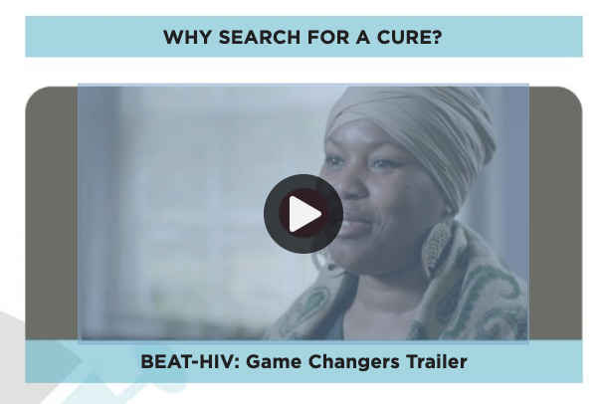
BEAT-HIV CAB POSITION PAPER
They took a “trauma-informed approach” in developing this paper, because many people living with HIV are impacted by lifetime individual- and community-level trauma.
The paper contains five educational modules
with linked videos featuring community members and researchers.

Slide 63
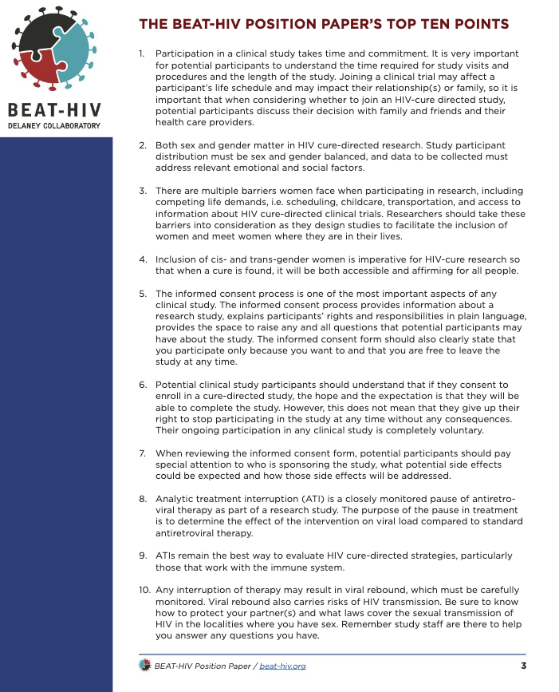
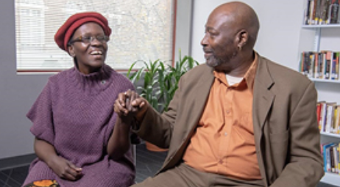
To advance research literacy, you must engage potential
study participants and their communities, HIV researchers, healthcare providers, funding agencies, and others looking to support HIV cure research.

Slide 64
Amplify community voices

Slide 65
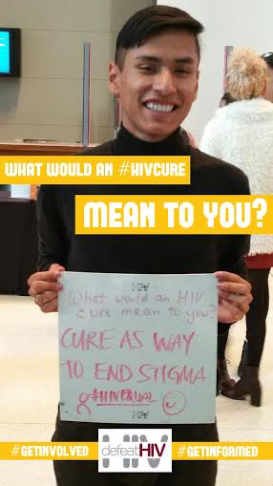
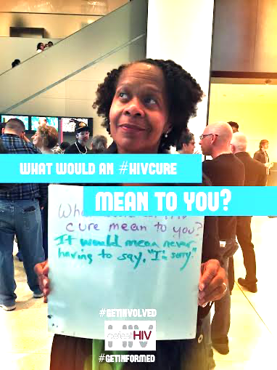
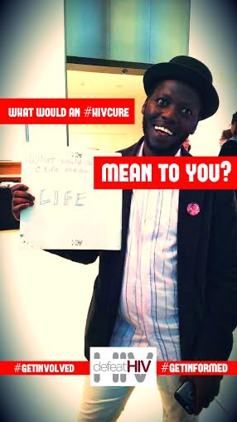
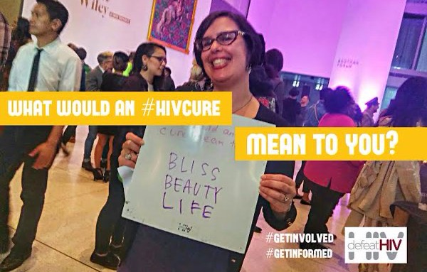

AMPLIFY THE VOICES IN YOUR COMMUNITY
Create activities that allow people to express their thoughts
about an HIV cure.
collect anonymously
or feature the person as well as what they say
can be shared in many ways
  newsletters
  emails
  websites
  social media
  posters
  abstracts
  magazines

Slide 66






Slide 67


WHAT WOULD AN HIV CURE MEAN TO YOU?
Volunteers from the Martin Delaney Collaboratories (MDC) Community Advisory Board (CAB) created an “HIV Cure Tree” at the 2016 IAS Conference Global Village in Durban, South Africa.

Slide 68


They asked Global Village attendees from around the world. to write on paper leaves their answers to the question, “What would an HIV cure mean to you?”
. Leaves were later sorted into themes
Respondents included clinicians, researchers, policy-makers, people with HIV, activists, and others.

Slide 69



Slide 70



Slide 71


Afterwards, members of the Seattle-based defeatHIV Community Advisory Board sorted the paper leaves into themes.
A word cloud was created from the 244 responses, morphing the words into the shape of a tree.
MDC CAB members then wrote an abstract based on the themes and submitted it to the 2017 IAS conference.
The abstract was accepted for poster presentation at the conference, and the word cloud was used as a central image.

Slide 72



Slide 73



Slide 74


After the conference, MDC CAB members submitted the word cloud for publication in the 2017 Sept-Oct issue of Positively Aware
The resulting article, “Tree of Life”, appeared in print and online on Sep 6, 2017.
https://www.positivelyaware.com/articles/tree-life

Slide 75
Poster presentations

Slide 76


Slide 77


Slide 78


Slide 79
Events

Slide 80


  COMMUNITY FORUMS:
  CURED/NOT CURED: A TALE OF TWO DIAGNOSES
    A community forum with Dr. Timothy Henrich and Gary Steinkohl to discuss the research around Boston Patients and its implications for people living with HIV
    Hosted by 3 advocate representing the spectrum of experience of living with HIV who led the conversation
    89 people attended
Click on the underlined text to get other ideas for your events.

Slide 81

  COMMUNITY FORUMS:
  CURED/NOT CURED: A TALE OF TWO DIAGNOSES
EVENT PLANNING TIP: Create a press release for your event and send it to your local media, including newspapers, radio and TV news.
    KING 5 TV NEWS segment
    KOMO Radio interviews with Dr. Henrich and Mr. Steinkohl
    Entry into The Stranger Suggests calendar (a popular Seattle publication)
    Recorded by the Seattle Channel and posted to the defeatHIV YouTube channel

