Slide 1
Ethical Considerations for HIV Cure Research

Slide 2
Glossary of Key Terms

Slide 3
Ethics
guided
reasoning
for determining
right vs. wrong
actions

Slide 4
Ethics
or for choosing
the most ethical path
from many choices
Bioethics is the application
of this reasoning to health,
healthcare, and research.

Slide 5
Informed consent
Process of learning
about the risks & benefits
of a procedure, test, or study
so that the patient
or research participant
is fully informed
and gives
--or does not give—
permission to continue

Slide 6
Regulations
Rules that govern
how new therapies
are approved
by authorities

Slide 7
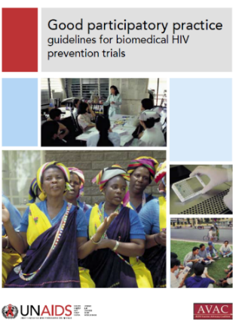
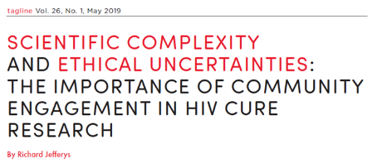
Importance of community in contemporary HIV Cure-Related Research

Slide 8
An incredible history of community participation in HIV research
Community members have long been at the vanguard of demanding that research endeavors are ethical and research participants be treated ethically
Gaining knowledge about research ethics is an important step for being able to add your voice to shaping what comes next

Slide 9
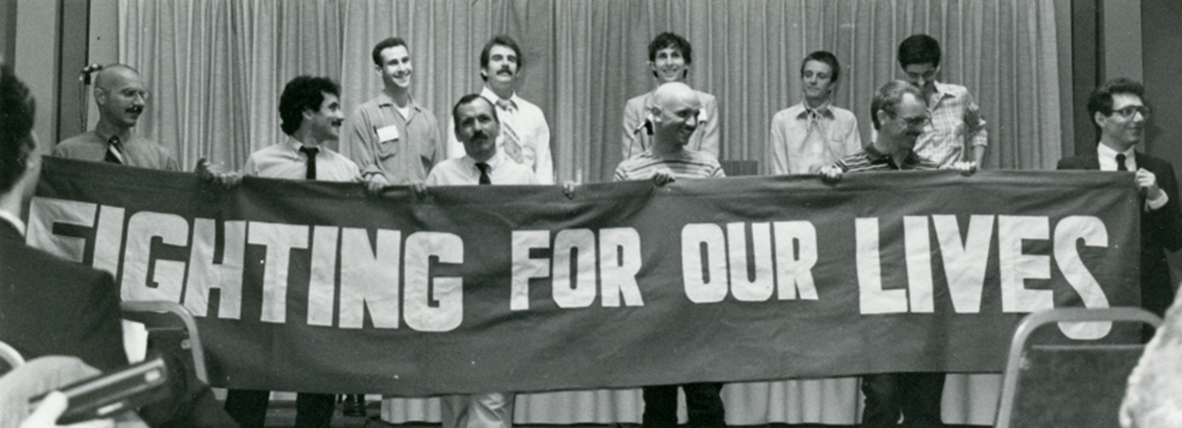
Denver Principles
Community involvement in HIV/AIDS research began with the Denver Principles in 1983
when people living with AIDS
demanded a place at the table
Notes:
Presenter’s note: One of the highlights of engagement in HIV/human rights issues. The most recognized declaration of identity among people with AIDS, later extending to HIV-positive individuals.
The Denver Principles are a document put together by a group of people living with AIDS. Perhaps the most memorable slogan to come out of the meeting was “nothing for us without us” .

Slide 10
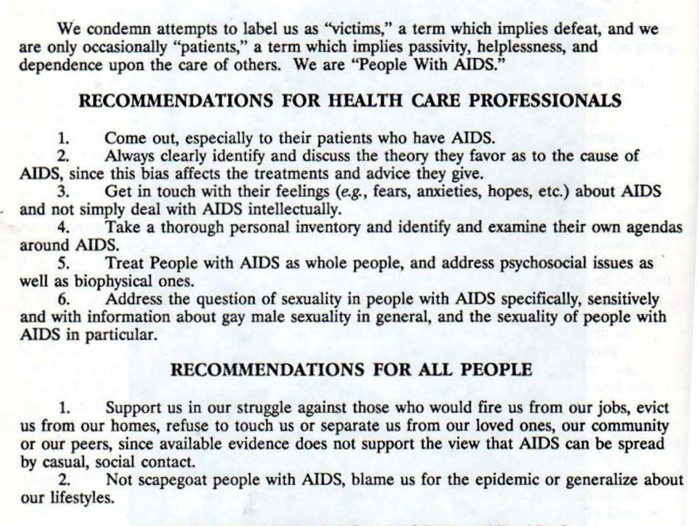
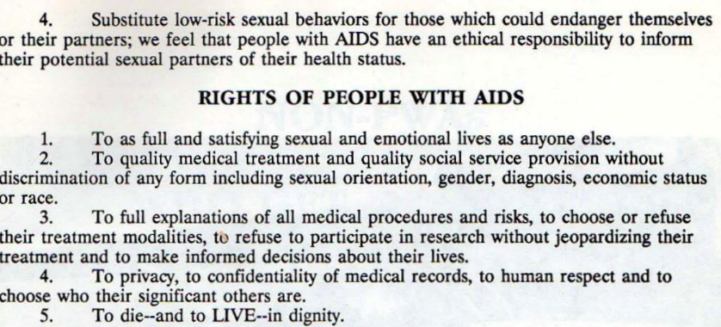
a deeper dive:
How 'The Denver Principles' Changed Healthcare Forever - POZ

Slide 11
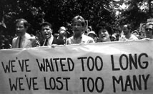
These early pioneers were asking for more ETHICAL engagement between science, medicine, research and PEOPLE.
Let’s dive in!

Slide 12
Outline of Module
What is Bioethics?
What is it not?
A primer on the principles and theories of bioethics
The birth of bioethics
Research Ethics
Focus on informed consent
Regulatory agencies
Ethics of HIV cure-related research
Conclusions & Take-Aways
Notes:
Presenter’s note: One of the highlights of engagement in HIV/human rights issues. The most recognized declaration of identity among people with AIDS, later extending to HIV-positive individuals.
The Denver Principles are a document put together by a group of people living with AIDS. Perhaps the most memorable slogan to come out of the meeting was “nothing for us without us” .

Slide 13
Part 1: What is Bioethics?

Slide 14
What is Bioethics?
Ethics is a field of study that helps us answer questions like:
What must we* do?
What must we* not do?
What is permissible to do?
How may we (not) do what we do?
*“we” = doctors, scientists, researchers, ourselves
Bioethics asks these questions in places where health, medicine, disease, research, healthcare, science, and society intersect

Slide 15
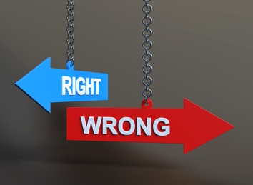
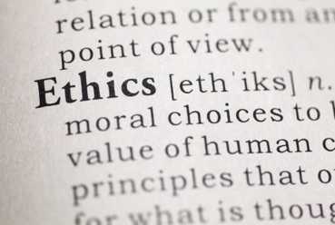
Distinguishing Bioethics, Morals, and Law
Bioethics is related to, but not the same
as morals
Morals are our own personal sense of right and wrong – they are individual, coming from our parents, religion, and education
Bioethics refers to a collective understanding of right and wrong – they apply to professions like medicine or research
Bioethics is related to, but not the same as the law
Laws and regulations come from ethical reasoning, but the law changes over time and place, and at times, something can be legal (or at least not illegal) but deemed not to be ethical.
US laws have established offices – like Institutional Review Boards – to help make sure that research is ethical.

Slide 16
Distinguishing Bioethics, Morals, and Law
Bioethics is related to, but not the same as the law
Laws and regulations come from ethical reasoning, but the law changes over time and place, and at times, something can be legal (or at least not illegal) but deemed not to be ethical
US laws have established offices – like Institutional Review Boards – to help make sure that research is ethical

Slide 17
Bioethics as guideposts and a toolbox
You can think of bioethics as both a set of guideposts, indicating right and wrong action…
…AND
a toolbox to help us make those decisions

Slide 18
The Bioethics Toolbox
what matters
to each stakeholder
guides for making
a decision about
a course of action
Principles
Theories

Slide 19
A Bioethics Toolbox – Principles What matters to each person involved
Autonomy
The right to determine what happens to one’s own body
Beneficence
This principle highlights ‘doing good’ for others – for research participants, patients, each other
Non-maleficence
This principle highlights the need to actively avoid doing harm to others
Justice
Justice is the principle that says we must allocate resources
in a fair and just manner
Notes:
Note that ththis slide is how mainstream/traditional bioethics understands principles; the right is stemming from newer forces in the field (such as urban bioethics - https://urbanbioethics.medium.com/a-short-primer-on-urban-bioethics-69204dee70f7)

Slide 20
A Bioethics Toolbox – Principles What matters to each person involved
Equity and Community-based Principles
Agency
Agency refers to someone’s ability to make and carry out a choice. We all have limits on our agency, and ignoring that fact is like being ‘color blind’ – racism, sexism, and homophobia
Social Justice
Social justice asks us to consider the fact that ‘equal’ is not always ‘equitable’.
We should be conscious of how social and structural forces can be
discriminatory and actively work to counter them
A deeper dive:
A short primer on Urban Bioethics
Notes:
Note that principles on this slide come from newer forces in the field (such as urban bioethics - https://urbanbioethics.medium.com/a-short-primer-on-urban-bioethics-69204dee70f7)

Slide 21
The Bioethics Toolbox - Theories
Sometimes there is more than one right and ethical principle. Theories help us make a decision when there is more than one right principle to follow
For example:
A patient may want to stop treatment for advanced cancer, choosing instead to receive comfort care. This is their right – they have autonomy
Their doctor may may have medical knowledge of another treatment that may give the patient more years of life (beneficence)
There is a conflict here between autonomy and beneficence – both are ethically right, but they are in conflict

Slide 22
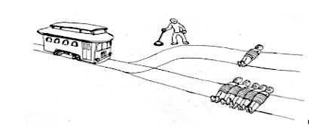
A Bioethics Toolbox – Theories
Most ethical action is the one that leads to the most ‘best’ outcomes (pull the lever, kill one person, and save 5)
Most ethical action is the one that most follows our duties (don’t pull the lever because actively killing is wrong; doesn’t matter that 4 more folks die)
vs.
‘best’ outcome
following duty

Slide 23
The Birth of Bioethics
Bioethics was born as a field after the public learned that researchers and doctors did not always act ethically – they took advantage of vulnerable people for their own ends.
History is unfortunately full of examples of scientists abusing their power in the name of science.
There are 2 specific examples
that have led to modern
research ethics.…

Slide 24
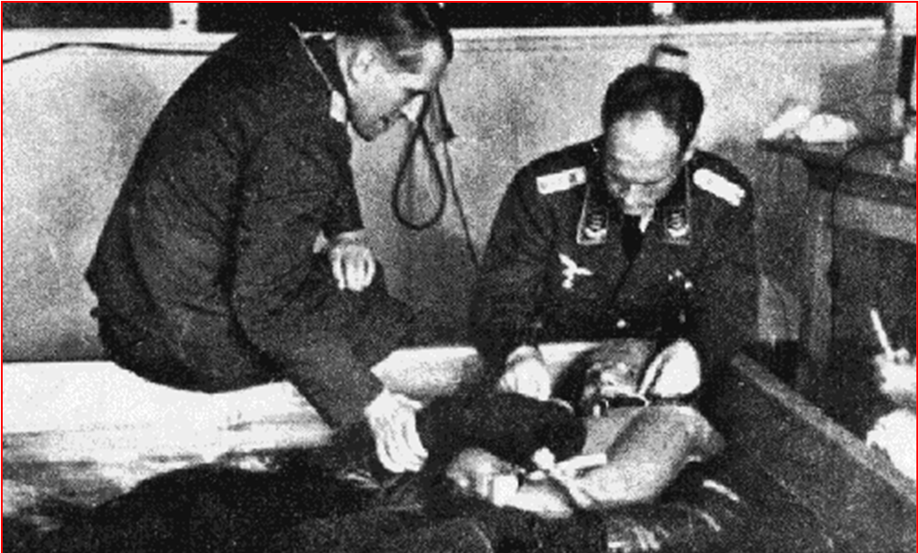
Nazi Medical Experiments in WWII
#2
A deeper dive:
https://www.pbs.org/wgbh/nova/holocaust/experiside.html
https://encyclopedia.ushmm.org/content/en/article/nazi-medical-experiments

Slide 25
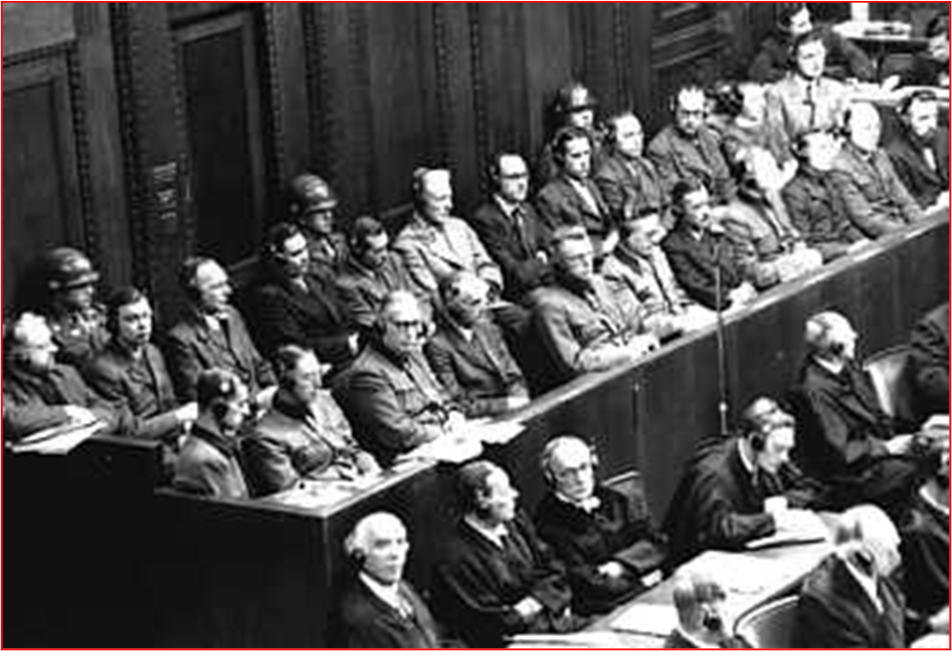
Case No. 1 of the Nuremberg Military Tribunal
U.S.A. vs. Karl Brandt et al.
Dec. 9, 1946 – Aug. 20, 1947

Slide 26
Nuremberg Code of 1947
Voluntary informed consent essential
Research should yield useful results
Base research on prior work
Avoid physical and mental suffering
No expectation of death or disabling injury
Risk must be outweighed by importance
Participants must be protected from injury
Qualified scientists, adequate facilities
Participant free to stop at any time
Investigator must be ready to withdraw participant
A deeper dive: https://cioms.ch/

Slide 27
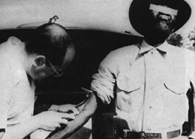
“Untreated Syphilis in the Male Negro” US-Public Health Service Tuskegee, Alabama 1932-1972
A deeper dive:
Ugly History: The US syphilis experiment
Tuskegee Syphilis Study Part 1: The Lie
Miss Evers' Boys (Based on the True Story of the Infamous Tuskegee Experiment)
Notes:
Known as the Tuskeegee study, researchers deliberately withheld treatment from black men they knew had syphilis so they could “observe” the course of the disease and its outcomes, causing decades of unnecessary suffering.

Slide 28
This study wasn’t hidden…
1956
Journal of Chronic Diseases
It wasn’t addressed because of racism and the power
of the United States Public Health Service.
It was only after a 1972 New York Times article
‘broke the story’ that it was stopped.
A deeper dive:
Bill Jenkins, Who Tried to Halt Tuskegee Syphilis Study, Dies at 73

Slide 29
THE BELMONT REPORT Ethical Principles and Guidelines for the Protection of Human Subjects of Research
National Commission for the Protection of Human Subjects
of Biomedical and Behavioral Research, 1979
Respect for persons: protecting autonomy, Informed Consent with truthfulness and without deception
Beneficence: doing no harm to the participant while maximizing the project’s benefits
Justice: distributing costs and benefits fairly and equally among participants and potential participants
Notes:
Unpack Belmont Report’s key principles and their definitions

Slide 30
National Research Act, July 1974 Responding to Tuskegee Syphilis Experiment
Established National Commission for Protection of Human Subjects
Led to 1981 Code of Federal Regulations:
Institutional Review Boards (IRBs)
Informed consent
And the Common Rule harmonizing regulations across all US federal bodies, 1991
Public Law 93-348
Notes:
IRB- Purpose is to assure research is ethical, participants are not undertaking undue risk, and that they have provided voluntary, informed consent. Any institution that engages in “human subjects” research MUST have an IRB.
Informed consent is the process by which studies and their purpose, risks, benefits, compensation, and the voluntary nature of participation are explained to potential participants.

Slide 31
Importance of an ethical toolbox for everyone!
Ethical research requires:
Transparency
Accountability
An engaged public that understands and can demand ethical research
Notes:
There have been many instances of ethical abuse of vulnerable populations in research- soldiers exposed to nuclear blasts, prisoners given LSD without their knowledge, development of HeLa cells from Henrietta Lacks’s cells without her knowledge and consent- the list goes on.
The more the public understands research ethics the more confidently they can effectively engage in assuring research is conducted ethically. For example

Slide 32
Part 2: Research Ethics

Slide 33
Contemporary Research Ethics
What makes research ethical?
Beyond the Belmont Report
Informed consent
What makes research just?

Slide 34
What Makes Research Ethical?
Scientific Validity
Is the research designed well enough to answer the research question?
Social Value
Is the research likely to foster scientific progress and provide an important benefit to society?
Scalability
Can the end products of the research eventually be implemented on a large scale to those who need it?
Fair Participant Selection
Are benefits and burdens equitably distributed between selected research participants and potential research beneficiaries?
Favorable Risk/Benefit Ratio
Are risks to participants minimized and acceptable in view of personal or social benefits?
Adapted from Lo and Grady, Curr Opin HIV AIDS 2013

Slide 35
What Makes Research Ethical?
Informed Consent, Confidentiality, Privacy
Do participants understand enough to consent? Is what they disclose during research protected?
Community Engagement
Are communities impacted by the research meaningfully involved at all stages of the research?
Independent Review
Will the research be subject to scientific and ethical evaluation by legitimate third parties?
Justice, solidary, & public health ethics – an increasingly recognized value!
Public health values include the advancement of research justice and the recruitment/involvement of under-represented communities into the research process
Adapted from Lo and Grady, Curr Opin HIV AIDS 2013

Slide 36
A deep dive into ‘Informed Consent’
Notes:
Maybe a note about how this is one area that really needs community involvement – note that IRBs have community reps to help ensure this; and as community voices, communicating is what the audience for this module will be mostly doing (is that right?) so IC makes sense to focus on

Slide 37
Principles of Informed Consent
Informed consent is a dialogue:
1: An assessment of a participant’s ability to decide
2: Disclosure of relevant information
3: An assessment participant’s comprehension
4: Affirmatively obtain consent from participant
Informed consent is NOT a signature on a document
It is a PROCESS!
The signed informed consent form alone does not mean someone is informed

Slide 38
The ethics underlying Informed Consent in research
Autonomy
Participants have the right to be fully informed of the procedures, tests, interventions
Participants have the right to have their questions answered and concerns addressed
Participants have the right to decide for themselves
Beneficence
Obligation to maximize potential benefit to the participants
Obligation to minimize harm to the participants
Non-maleficence
Doctrine of primum non nocere (first do no harm)
Justice
People should be treated equally
Research cannot selectively burden certain populations
Agency + Social Justice
Informed consent forms and conversations must be presented in a way that the potential participant can understand – attention to health literacy
Notes:
Beneficence:
The Physician/Researcher:
Must have the best interests of the patient/participant in mind
Minimally influenced by other concerns
The Patient/Participant:
Must trust that the physician, their advocate/agent
Non-Maleficence:
The Physician/Researcher:
Must not intentionally harm or disadvantage a patient/participant.
The Patient/participant:
Must trust that the physician/researcher will not willingly harm
Justice:
Prohibition against denying benefit:
Capriciously
By selective criteria
Obligation not to “selectively burden”
Autonomy:
The informed consent process provides essential trial information to potential participants and empowers them to make a rationale and informed decision about participation (Kadam, 2017).
Agency – health literacy
Degree to which individuals have capacity to obtain, process and understand basic health information needed to make appropriate health decisions.
Only 12% of Americans are proficient in health literacy
Average American reads on an 8th grade level. In communities with high poverty, underfunded schools, and other negative social determinants, the average reading level is 4th grade.

Slide 39
Required Elements of Informed Consent
The study involves research; explanation of study purpose, procedures and duration
Reasonably foreseeable risks/discomforts
Benefits to participants/others; lack of direct benefit should be stated; inclusion of potential societal benefits
Alternative possibly advantageous procedures and treatments
Confidentiality of records identifying the participant
Explanation of compensation and/or treatments if injury occurs when risk is greater than minimal
Whom to contact for answers to questions
Participation is voluntary; refusal will involve no penalty/loss of entitled benefits; discontinue participation at any time

Slide 40
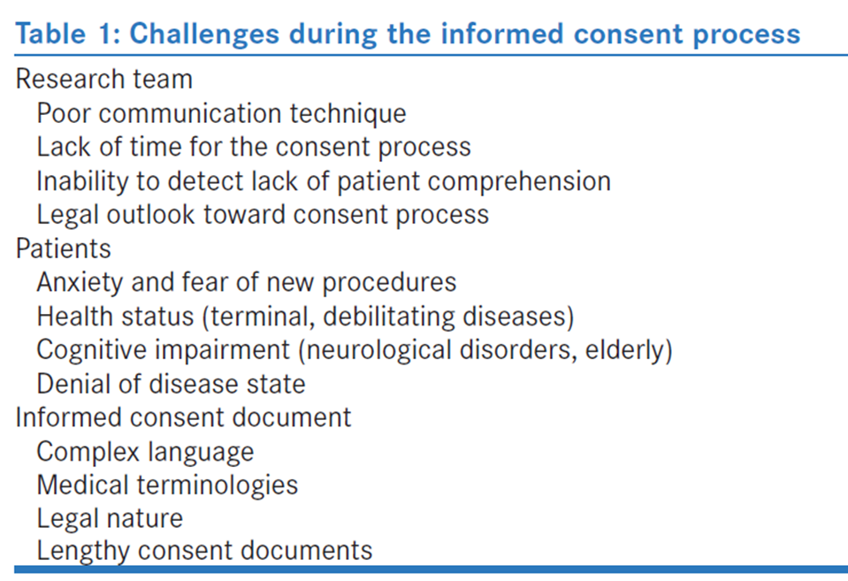
Possible Challenge to Informed Consent
We need to add suggestions for how to make the Informed Consent process meaningful and relevant for a diversity of communities; linguistic, literacy, etc.
Kadam RA. Informed Consent Process: A Step Further Towards Making It Meaningful!
Perspectives in Clinical Research 2017; 107 – 12.
Notes:
Advancements in medical research have generated complex medical protocols resulting in elaborate and complicated information to be conveyed during the informed consent process (Kadam, 2017).
The complexity of consent documents also stems from the fact that sponsors as well as investigators view it as a legal and symbolic document of participant’s agreement to participate in the research study. This results in an informed consent that is legally right but often inadequate in terms of simplicity and ease of understanding for the study participants (Kadam, 2017).
Readability is also an important factor that determines the effectiveness of informed consent document (recommendation: 8th grade level) (Kadam, 2017).

Slide 41
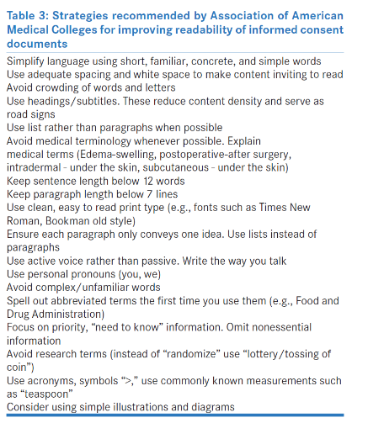
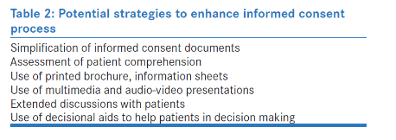
Making Informed Consent Meaningful
Continuous, dynamic process rather than one-time, isolated event
Kadam RA. Informed Consent Process: A Step Further Towards Making It Meaningful!
Perspectives in Clinical Research 2017; 107 – 12.
Notes:
Techniques such as ‘teach back’ methods
Informed consent supplementary videos or multi-component [these require resources]
Flowcharts, PowerPoint presentations, models, instructional videos

Slide 42
Who ensures the Informed Consent process is ethical?
Institutional Review Boards (IRBs for short)
Because of the Belmont Report, all institutions receiving federal money to conduct research must have an IRB.
The IRB must have researchers AND community representation.
One important job of the IRB is to make sure the recruitment process is fair and just and that the informed consent process and documents are clear and truthful.

Slide 43
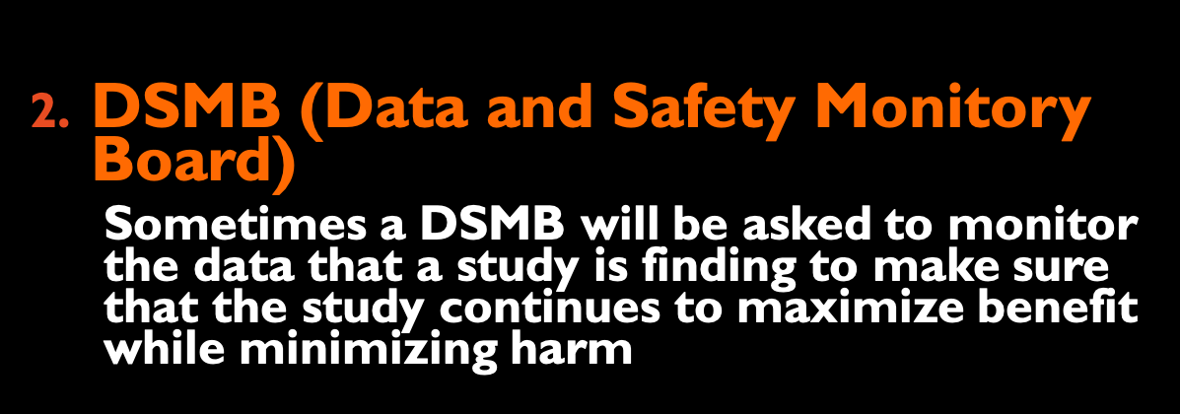
Other Regulatory Bodies
Scientific Review Committees
Committees within institutions that review investigator’s study plans to make sure that they are scientifically sound – does the plan for the study actually provide information that answers the question.
DSMB (Data and Safety Monitory Board)
Sometimes a DSMB will be asked to monitor the data that a study is finding to make sure that the study continues to maximize benefit while minimizing harm
Notes:
DSMBs may decide to stop studies either because one of the groups clearly shows a benefit earlier than planned because an intervention works so well, because one group appears to be experiencing harm, or because it appears the study won’t be able to answer the question (called futility).

Slide 44
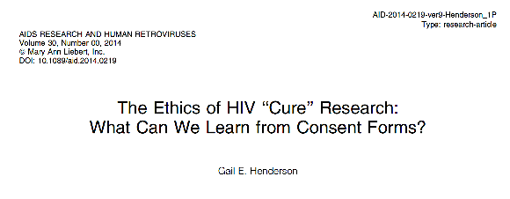
A Question: What are the ethics of using the word “Cure” in informed consent forms?

Slide 45
Part 3: Ethics of HIV Cure-Related Research

Slide 46
Informed Consent in HIV Cure-Related Research
In addition to everything discussed so far, HIV-cure directed research is particularly susceptible to:
Therapeutic Misconception
False belief that the purpose of the research is personal health benefit for participants
Curative Misconception
False belief that HIV cure research will provide a cure for research participants
Notes:
There is a difference between therapeutic misconception and hope. Hope is like buying a lottery ticket. You fully understand the odds are against you. You get that millions of others are entering as well and it is highly unlikely that you will win. But you cannot win a lottery without being in it so you hope you will hope you win. Therapeutic misconception is believing you will win.
Cure could be both a permanent remission or complete eradication. There has been work on what a cure means to individuals but not about what type of cure they are thinking of when they think of cure in a protocol.

Slide 47
Informed Consent in HIV Cure-Related Research
HIV cure-related research is scientifically and socially complex. There is a need for mutual literacy between communities and researchers
Scientific Literacy
Initiatives to translate research terms in to lay language for broader audiences
Community Literacy
Initiatives to improve awareness of how cure research engages with the lives of community members and research participants’ lives and concerns

Slide 48
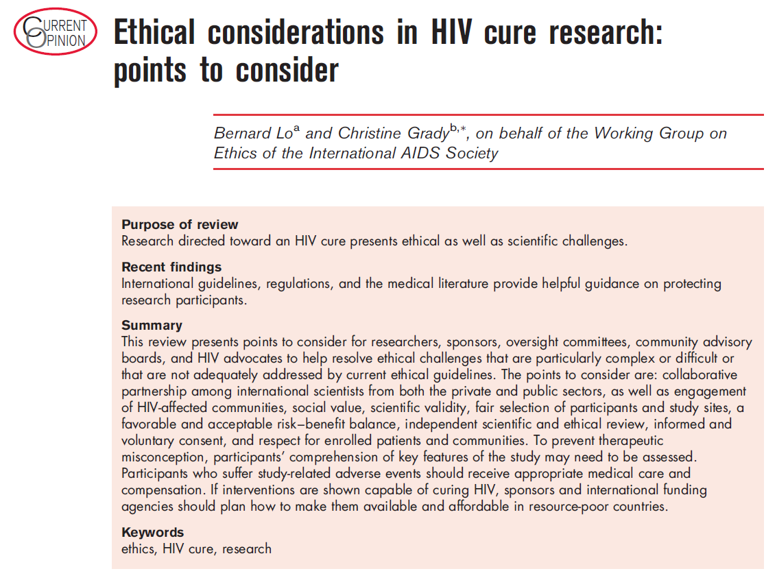
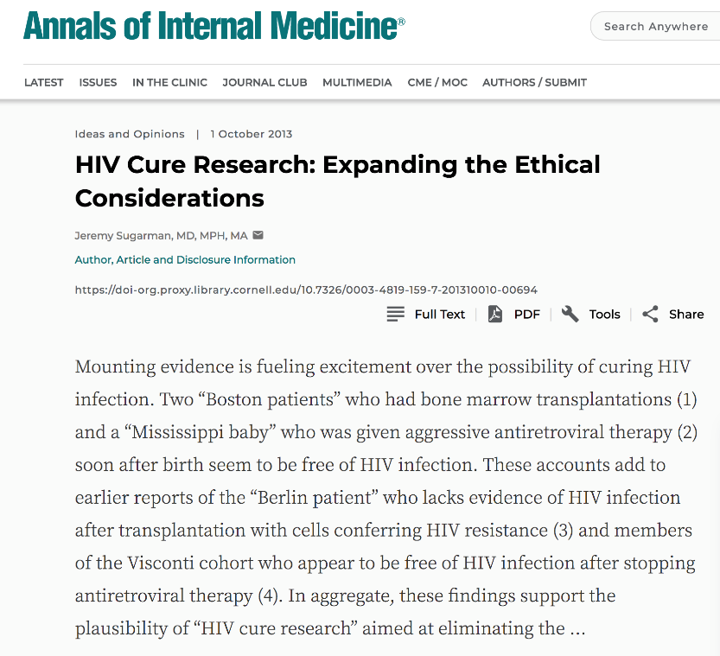
General Ethical Considerations
HIV Cure Research
Lo B and Grady C. Ethical Considerations in HIV Cure Research: Points to Consider. Curr Opin HIV AIDS 2013, 8: 243 – 9.
Sugarman J. HIV Cure Research. Expanding the Ethical Considerations.
Annals of Internal Medicine 2013: 159
Notes:
Lo and Grady:
This review presents points to consider for researchers, sponsors, oversight committees, community advisory boards, and HIV advocates to help resolve ethical challenges that are particularly complex or difficult or that are not adequately addressed by current ethical guidelines. The points to consider are: collaborative partnership among international scientists from both the private and public sectors, as well as engagement of HIV-affected communities, social value, scientific validity, fair selection of participants and study sites, a favorable and acceptable risk–benefit balance, independent scientific and ethical review, informed and voluntary consent, and respect for enrolled patients and communities. To prevent therapeutic misconception, participants’ comprehension of key features of the study may need to be assessed.
Participants who suffer study-related adverse events should receive appropriate medical care and compensation. If interventions are shown capable of curing HIV, sponsors and international funding agencies should plan how to make them available and affordable in resource-poor countries.
Scientific Validity
Is the research designed well enough to answer the research question?
Social Value
Is the research likely to foster scientific progress and provide an important benefit to society?
Scalability
Can the end products of the research be implemented on a large scale to those who need it?
Fair Participant Selection
Are benefits and burdens equitably distributed between selected research participants and potential research beneficiaries?
Favorable Risk/Benefit Ratio
Are risks to participants minimized and acceptable in view of personal or social benefits?
Informed Consent, Confidentiality, Privacy
Do participants understand enough to consent? Is what they disclose during research protected?
Community Engagement
Are communities impacted by the research meaningfully involved at all stages of the research?
Independent Review
Will the research be subject to scientific and ethical evaluation by legitimate third parties?
________________________________________________________________________________________________________
Sugarman expanded the considerations:
Risks to others
Confidentiality
Non-financial and financial conflicts of interests
Public attention
Number of papers published on ethical considerations in the context of specific HIV cure research strategies (stem cell transplant, pediatric HIV cure research)
Literature still needs to be expanded considerably

Slide 49
Research programs that are the first of their kind – like HIV cure-related research – often carry more risk than potential benefit and raise questions about the quality of the consent of research participants
Three concerns:
How information is communicated to potential participants
Participants’ motivations for enrolling in potentially high-risk research with no prospect of direct benefit
Participants’ understanding of the details of the trials in which they enroll
Bromwich D and Millum JR. Informed Consent for HIV Cure Research.
Journal of Medical Ethics 2017; 43(2): 108 – 12.

Slide 50
The research is increasingly focused on achieving sustained viral remission – need to use careful language to describe the research
Participants in early-phase trials tend to overestimate the benefits of study participation
Bromwich D and Millum JR. Informed Consent for HIV Cure Research.
Journal of Medical Ethics 2017; 43(2): 108 – 12.

Slide 51
In other words…
Many early HIV cure studies will NOT have individual medical benefits for participants
There may be health-related ‘side-benefits’ from participation
Side-benefits are positive outcomes related to participation (e.g., better medical care or increased self-esteem) that are not the focus of the study
Notes:
Are low (or no) benefit, high-risk research studies acceptable?
Should side-benefits count in assessment of the risk/benefit relationship?

Slide 52
Word “cure” should not be used in obtaining consent for ‘HIV cure’ trials
The language we recommend include terms such as ...
Names of people in past experiments should be avoided in the informed consent process
These two modest proposals should reduce the risks of the therapeutic misconception in ‘cure research’
Annas GJ. Cure Research and Consent: The Mississippi Baby, Barney Clark, Baby Fae and Martin Delaney. Journal of Medical Ethics 2017; 43: 104 – 7.

Slide 53
Benefits may potentially be over-emphasized or over-estimated, while risks may be less talked about
Because HIV-cure directed research is so new, there is less consistency across studies
It is ethically important that there be more consistency and clear, specific language when describing study aims, risks, benefits, and possible return of results
Henderson G. The Ethics of HIV “Cure” Research: What Can We Learn from Consent Forms?
AIDS Res Hum Retrov 2015; 31(1): 56 – 63.

Slide 54
When recruiting relatively healthy participants into treatment interruption trials, treatment interruption is necessary to observe the effectiveness of early interventions
but they need to be extra ethically careful when asking participants to stop doing something that has been keeping them healthy
Henderson G. The Ethics of HIV “Cure” Research: What Can We Learn from Consent Forms?
AIDS Res Hum Retrov 2015; 31(1): 56 – 63.

Slide 55
Researchers need to recognize that what they know to be the endpoint of the study – what information they are looking for – is often not what a participant understands as an endpoint
It makes sense that participants without scientific training may not understand the importance of small changes in lab values that don’t translate to any changes in how they feel
Henderson G. The Ethics of HIV “Cure” Research: What Can We Learn from Consent Forms?
AIDS Res Hum Retrov 2015; 31(1): 56 – 63.

Slide 56
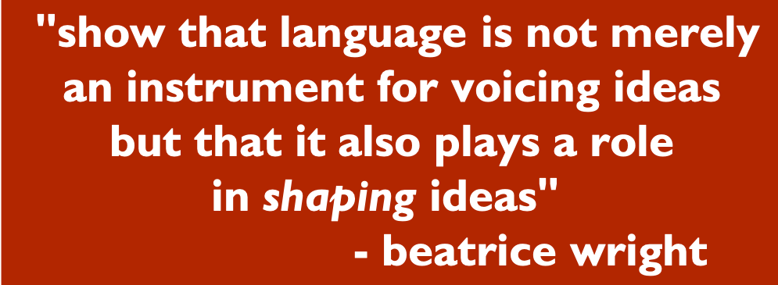
Language Matters
"show that language is not merely an instrument for voicing ideas but that it also plays a role in shaping ideas"
- beatrice wright
Ethical Highlight:
Shaping Attitudes through Person-First Language
puts a person before a diagnosis
what a person "has" rather than what a person "is”
avoids marginalization or dehumanization when discussing people with a chronic illness or disability
people with HIV
participants
not HIV-infected people
not subjects not volunteers
Notes:
Explain why language matters and provide examples for:
Non-stigmatizing words
People first language
Subject vs. participant vs. volunteer
HIV infected vs. people living with HIV
Medication, therapy vs. investigational product
Cure vs. sustained-ART-free durable suppression
More on the responsive use of language:
Language, identity and HIV: why do we keep talking about the responsible and responsive use of language? Language matters, Dilmitis et al, 2012, JIAS
A Guide to Talking About HIV – CDC
https://www.cdc.gov/stophivtogether/library/stop-hiv-stigma/fact-sheets/cdc-lsht-stigma-factsheet-language-guide.pdf
NIAIDS resent publication: “HIV NIAID Language Guide:” https://impaactnetwork.org/DocFiles/News/NIAID%20HIV%20Language%20Guide%20-%20March%202020.pdf)

Slide 57
Ethical Highlight: Analytical Treatment Interruption See separate ATI module for further details
Analytic treatment interruptions (ATI) are currently an important part of many cure-related studies.
ATI studies ask participants to pause ART. Viral loads and health status are very closely monitored in ATI studies. They have a stopping point if viral loads get too high.
ATIs may have notable risks, but there’s much uncertainty. Examples include:
If or when HIV will come back?
More durable inflammation?
Increased risk of HIV transmission?

Slide 58
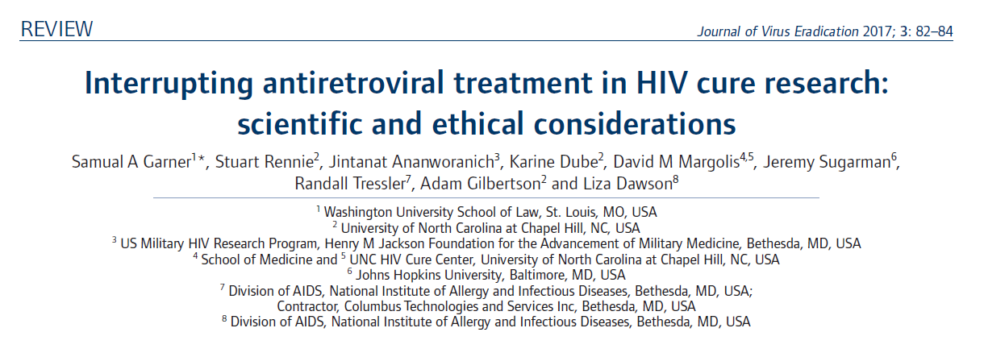
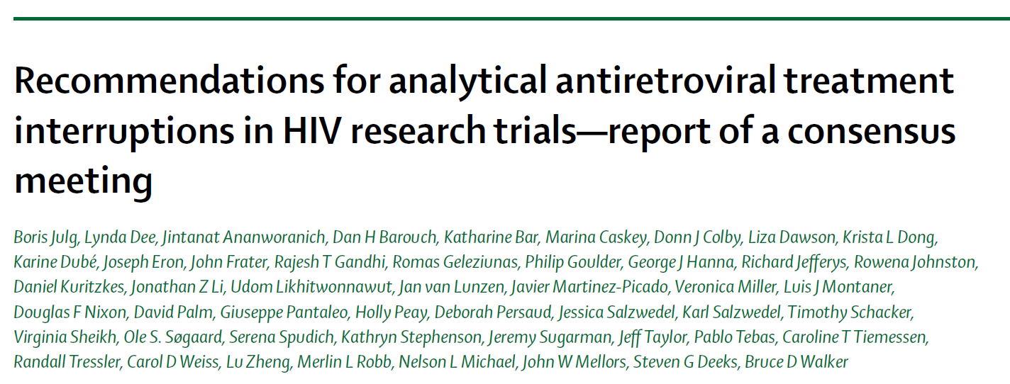
Social and Ethical Considerations of ATIs See separate ATI module for further details
Scientific utility of ATIs
Risk thresholds
Equitable participant selection
Fostering agency of participants
Study design and monitoring, considering sexual partners
Meaningful and contextual Informed consent
Image credit: Michael Louella
Notes:
Normative work:
Community recommendations for clinical research involving ATIs generated with the Forum for Collaborative HIV research HIV cure project
Article by Garner et al. around scientific and ethical considerations
Scientific Utility of ATIs
ATIs justified if they provide valuable data to answer an important research question where there are no, less risky alternative methods to obtain that information, and if known risks are minimized
ATIs may be essential for studies of viral control, but their usefully for measuring reductions in viral reservoir reduction
Relationship between viral rebound and size of the replication-competent HIV reservoir not clearly defined not theoretically predictable
Time to rebound is a multi-dimensional phenomenon (size of initial reservoir, immune response and inflammation)
Risk Thresholds
No precise and reproductive direct assays of the size and composition of the reservoir
Clinical implications of a change in size of reservoir
Need for more systematic data on risks of viral rebound in a short, closely monitored ATI
Participant Selection
With co-morbidities that might increase risks of non-AIDS AEs during study
Who would have difficulty with careful monitoring
Pregnant women
With low CD4 counts and possibly lower pre-ART CD4 nadir
History of resistant virus or limited options for subsequent regimens
Study Design and Monitoring
Need specific feasibility, safety and futility criteria for starting and stopping ATIs and restarting ART
Frequent viral load monitoring during ATIs for risk mitigation >>> balance with concern about burdens for participant
Reliance on assay that can measure recovery of replicative HIV
Informed Consent
No anticipated direct clinical benefit to participants
ATIs are not recommended for clinical care
Treatment guidelines recommend lifelong treatment regardless of CD4 count
Misconceptions around benefits of HIV cure research

Slide 59
In other words…
Cure trials will ultimately require an interruption of antiretroviral drugs in order to determine if a participant has been cured
Ideally, there will be a useful biomarker (a molecule in our bodies, found through blood tests) that can be used to predict success BEFORE interrupting treatment
This could limit the risks associated with ATI studies, including periods of uncontrolled virus replication
Notes:
There are several regulatory issues that will have to be addressed as the development of a cure progresses. Some of these issues are related to scientific issues. For example, we cannot recommend useful surrogate biomarkers for use as clinical endpoints to sponsors because we don’t yet have an example of what biological responses to an effective cure product will look like. The development of a therapeutic cure will benefit tremendously when biomarkers that can predict positive outcomes have been identified. Several potential biomarkers, such as reductions in the numbers of latently-infected cells, are being evaluated.
An interesting regulatory consideration is that the assays used for measuring responses to cure therapies might need to be co-developed along with the actual therapy. In other words, if an experimental assay is used to guide the treatment of patients in cure trials of a product that ultimately proves to be safe and effective, then that assay might also need receive FDA approval so that it can be made available to the public along with the therapy itself.
Trial volunteers will ultimately have to stop taking their antiretrovirals in order to determine if a cure treatment has been successful. There are risks for these treatment interruptions; for example, some regimens are more likely to select for resistant virus when interrupted, and people who are not cured and experience rebound of their virus are more likely to transmit virus to their partners than if they remained suppressed.
Ideally, a useful biomarker will limit treatment interruptions to those who are most likely to have successfully responded to a cure therapy, thereby limiting treatment interruptions to people who are most likely to have been cured.

Slide 60
Other HIV Cure-Related Issues
Development for special populations (e.g., pediatrics)
Ethics and regulations require that studies are safe and effective in adults before studies can be done with children.
Notes:
Another regulatory consideration that will have to be addressed is when to expand cure trials into special populations, such as children. Our current thinking is that initiation of those trials will require a great deal of supportive safety and efficacy data in adults. Keep in mind that we don’t regulate basic research that does not include an experimental therapy, such as a drug or therapeutic vaccine, and we believe that several ongoing studies in theses populations, such as those designed to determine how the HIV reservoir is established and maintained in children, are very important. In fact, these studies may help us to determine if a therapy that appears promising in one group, such as in healthy adults, may also have the potential to benefit special populations and may help us to design the trials specific for special populations.
One challenge to clinical trial design of potential HIV cures is that the duration of the trials may need to be very long. For example, it took about 8 months for virus to rebound in one of the Boston patients. At this time it’s unclear how long a person might need to remain undetectable or suppressed before they can be considered cured, but the follow up periods of early trials may extend for years until a predictive biomarker has been identified.
Some therapies being studied as a potential cure may also have long-term risks, such as increased risk of cancer. Trials using these agents may require very long follow-up times in order to figure out whether or not their use is associated with long-term harm.
It’s possible than an effective HIV cure will require therapy with a combination of products, such as with a histone deacetylase inhibitor, which might be needed to reverse viral latency, and a therapeutic vaccine, which might be needed to assure efficient clearance of the infected cells once latency has been reversed. Each component of a combination product must be shown to contribute to overall efficacy, so it’s necessary that each component be studied by itself and in combination with each other. It’s also possible that each component of a combination product will have different regulatory requirements, for example a small molecule drug and a biologic may require that different types of nonclinical studies be completed before human trials can be initiated. Finally, regulatory approval of combination products may require review from multiple divisions at the FDA; fortunately, we have procedures in place for dealing with combination products and have experience with their review and approval.

Slide 61
Other HIV Cure-Related Issues
Trial durations may be very long
It is not known how long virus will need to remain undetectable once off of antiretroviral treatment before a person can be considered cured
It is also unclear how long people should be followed for safety in order to detect slowly developing adverse events that may be related to the HIV cure treatment; e.g., cancer risks
Notes:
Another regulatory consideration that will have to be addressed is when to expand cure trials into special populations, such as children. Our current thinking is that initiation of those trials will require a great deal of supportive safety and efficacy data in adults. Keep in mind that we don’t regulate basic research that does not include an experimental therapy, such as a drug or therapeutic vaccine, and we believe that several ongoing studies in theses populations, such as those designed to determine how the HIV reservoir is established and maintained in children, are very important. In fact, these studies may help us to determine if a therapy that appears promising in one group, such as in healthy adults, may also have the potential to benefit special populations and may help us to design the trials specific for special populations.
One challenge to clinical trial design of potential HIV cures is that the duration of the trials may need to be very long. For example, it took about 8 months for virus to rebound in one of the Boston patients. At this time it’s unclear how long a person might need to remain undetectable or suppressed before they can be considered cured, but the follow up periods of early trials may extend for years until a predictive biomarker has been identified.
Some therapies being studied as a potential cure may also have long-term risks, such as increased risk of cancer. Trials using these agents may require very long follow-up times in order to figure out whether or not their use is associated with long-term harm.
It’s possible than an effective HIV cure will require therapy with a combination of products, such as with a histone deacetylase inhibitor, which might be needed to reverse viral latency, and a therapeutic vaccine, which might be needed to assure efficient clearance of the infected cells once latency has been reversed. Each component of a combination product must be shown to contribute to overall efficacy, so it’s necessary that each component be studied by itself and in combination with each other. It’s also possible that each component of a combination product will have different regulatory requirements, for example a small molecule drug and a biologic may require that different types of nonclinical studies be completed before human trials can be initiated. Finally, regulatory approval of combination products may require review from multiple divisions at the FDA; fortunately, we have procedures in place for dealing with combination products and have experience with their review and approval.

Slide 62
Other HIV Cure-Related Issues
Special risks for partners
Because an ATI study may increase a participant’s detectability viral load, it may be more possible to transmit HIV to sexual partners.
This risk can be addressed through very frequent monitoring of viral load, as well as by giving sexual partners access to PrEP, use of barrier protection, or abstaining from sexual relations during the ATI.
Notes:
Another regulatory consideration that will have to be addressed is when to expand cure trials into special populations, such as children. Our current thinking is that initiation of those trials will require a great deal of supportive safety and efficacy data in adults. Keep in mind that we don’t regulate basic research that does not include an experimental therapy, such as a drug or therapeutic vaccine, and we believe that several ongoing studies in theses populations, such as those designed to determine how the HIV reservoir is established and maintained in children, are very important. In fact, these studies may help us to determine if a therapy that appears promising in one group, such as in healthy adults, may also have the potential to benefit special populations and may help us to design the trials specific for special populations.
One challenge to clinical trial design of potential HIV cures is that the duration of the trials may need to be very long. For example, it took about 8 months for virus to rebound in one of the Boston patients. At this time it’s unclear how long a person might need to remain undetectable or suppressed before they can be considered cured, but the follow up periods of early trials may extend for years until a predictive biomarker has been identified.
Some therapies being studied as a potential cure may also have long-term risks, such as increased risk of cancer. Trials using these agents may require very long follow-up times in order to figure out whether or not their use is associated with long-term harm.
It’s possible than an effective HIV cure will require therapy with a combination of products, such as with a histone deacetylase inhibitor, which might be needed to reverse viral latency, and a therapeutic vaccine, which might be needed to assure efficient clearance of the infected cells once latency has been reversed. Each component of a combination product must be shown to contribute to overall efficacy, so it’s necessary that each component be studied by itself and in combination with each other. It’s also possible that each component of a combination product will have different regulatory requirements, for example a small molecule drug and a biologic may require that different types of nonclinical studies be completed before human trials can be initiated. Finally, regulatory approval of combination products may require review from multiple divisions at the FDA; fortunately, we have procedures in place for dealing with combination products and have experience with their review and approval.

Slide 63
Part 4: Conclusions and Take-Aways

Slide 64
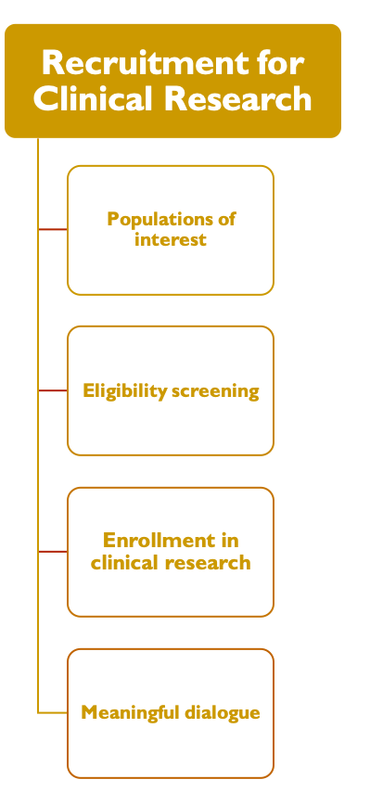
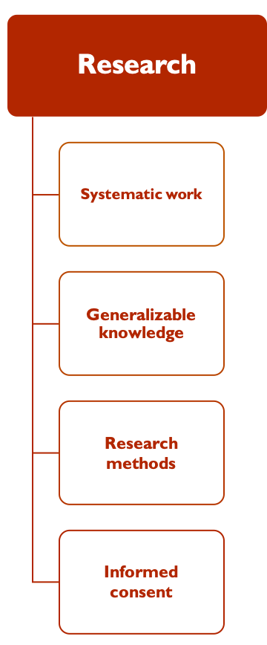
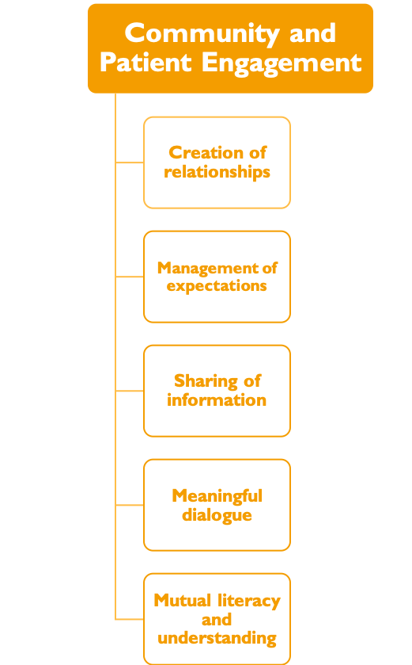
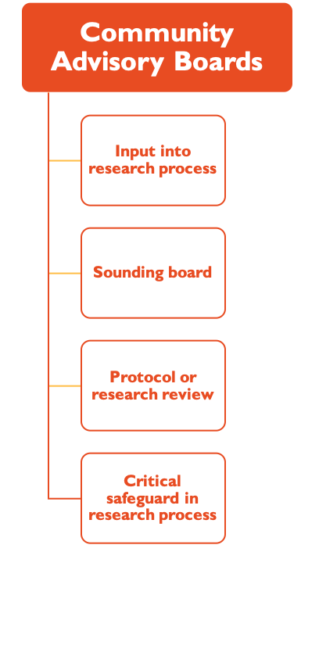
Community and Patient Engagement
Creation of relationships
Management of expectations
Community Advisory Boards
Input into research process
Sounding board
Sharing of information
Meaningful dialogue
Mutual literacy and understanding
Protocol or research review
Critical safeguard in research process
Recruitment for Clinical Research
Populations of interest
Eligibility screening
Research
Systematic work
Enrollment in clinical research
Meaningful dialogue
Generalizable knowledge
Research
methods
Informed
consent
Trust, Mutual Respect, Transparency, Autonomy
Notes:
This slide summarizes fundamental distinctions between: 1) community/patient engagement, 2) community advisory boards, 3) recruitment, and 4) socio-behavioral research
But what if we ever asked community to design an HIV cure research protocol, what would that really look like?

Slide 65
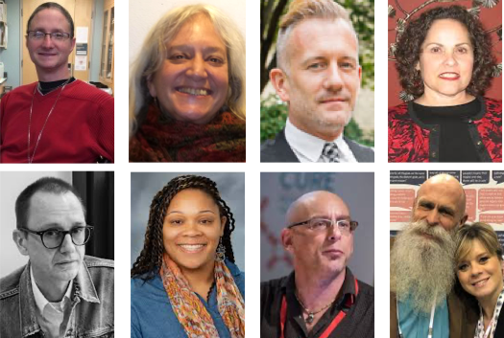
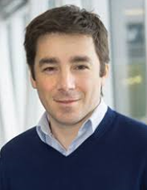
ACKNOWLEDGMENTS
Module developers:
Christopher Roebuck, BEAT-HIV CAB
Danielle Campbell, DARE CAB
Laurie Sylla, defeatHIV CAB
Karine Dubé, UNC Chapel Hill
Stuart Rennie, UNC Chapel Hill
Gail Henderson, UNC Chapel Hill
Damon Daming, FDA Division of AntiViral Products
Michael Louella, defeatHIV CAB
We wish to thank AIDS Treatment Activists Coalition for the funding to complete this module
Their caring support of the CUREiculum 2.0. will make a difference in the lives of thousands. of people living with HIV
Bioethics Lead:
Nora Jones, Center for Urban Bioethics, Temple University

Slide 66
Background References:
Lo B, Grady C, on Behalf of the Working Group on Ethics of the International AIDS Society. Ethical Considerations in HIV Cure Research: Points to Consider. Current Opinion in HIV/AIDS 2013; 8: 243 – 9.
Eyal N, Holtzman LG, Deeks SG. Ethical Issues in HIV Remission Trials. Current Opinion in HIV/AIDS 2018; 13(5): 422 – 7.
Dresser R. First-in-Humans HIV-Remission Studies: Reducing and Justifying Risk. J Med Ethics 2017; 43: 78 – 81.
Sugarman J. Ethics of HIV and Hepatitis B Cure Research. Current Opinion in HIV/AIDS 2020; 15(3): 180 – 4.
Garner SA, Rennie S, Ananworanich J, Dubé K, Margolis DM, Sugarman J, Tressler R, Gilbertson A, Dawson L. Interrupting Antiretroviral Treatment in HIV Cure Research: Scientific and Ethical Considerations. Journal of Virus Eradication 2017; 3: 82 – 4.
Julg B, Dee L., Ananworanich J, Barouch BH, Bar K, et al. Recommendations for Analytical Treatment Interruption in HIV Research Trials – Report of a Consensus Workshop. Lancet HIV 2019; 6(4): e259 – 68.

Slide 67
Background References:
Dubé K, Kanazawa J, Taylor J, Dee L, Jones N, Roebuck C, Sylla L, Louella M, Kosmyna J, Kelly D, Clanton O, Palm D, Campbell DM, Onaiwu MG, Patel H, Ndukwe S, Henley L, Johnson MO, Saberi P, Brown B, Sauceda JA, Sugarman J. Ethics of HIV Cure Research: An Unfinished Agenda. BMC Medical Ethics 2021; 22:83. https://bmcmedethics.biomedcentral.com/track/pdf/10.1186/s12910-021-00651-1.pdf
This article contains a list of open research ethics questions for the field of HIV cure-related research. These questions were developed with strong input from the community.
Dubé K, Sylla L, Dee L, Taylor J, Evans D, Bruton CD, Gilbertson A, Gralinski L, Brown B, Skinner A, Weiner BJ, Greene SG, Corneli A, Adimora AA, Tucker JD, Rennie S. Research on HIV Cure: Mapping the Ethics Landscape. PLoS Medicine 2017; 14(12): e1002470.
Dubé K, Gianella S, Concha-Garcia S, Little SJ, Kaytes A, Taylor J, Mathur K, Javadi S, Nathan A, Patel H, Luter S, Philpott-Jones S, Brown B, Smith D. Ethical Considerations for HIV Cure-Related Research at the End of Life. BMC Medical Ethics 2018; 19: 83.
Dubé K, Dee L. Willingness to Risk Death Endpoint in HIV Cure-Related Research with Otherwise Healthy Volunteers is Misleading. Journal of Virus Eradication 2020; 6: 81 – 4
This article contains a list of safeguards to help minimize risks in HIV cure clinical research.
Dubé, K., Kanazawa, J., Taylor, J., Dee, L., Jones, N., Roebuck, C., ... & Sugarman, J. (2021). Ethics of HIV cure research: an unfinished agenda. BMC medical ethics, 22(1), 1-14.

