Slide 1
Introduction to HIV Cure-Related Research

Slide 2
What is the ?
Series of modules and tools to simplify the science of HIV cure-related research
Designed by community for community
Hope it will lead to meaningful community-centered conversations
6 modules:
Introduction to HIV cure-related research
Analytical treatment interruptions (ATIs)
HIV persistence
HIV cure-related research strategies
Ethics of HIV cure-related research
Community, patient & stakeholder engagement
Notes:
The following series of modules are designed to explain in simple detail key concepts relevant to HIV cure-related research.
Several members of the National Martin Delaney Community Advisory Board (MDC CAB), which includes people living with HIV, community advocates and community educators from advocacy organizations, have formed a working group to create a well-rounded HIV cure research training tool (called the ‘CUREiculum’) to increase HIV cure research literacy of lay community members who do not have scientific or clinical training.
The goal of the CUREiculum is to strengthen community capacity to understand and engage in discussions about HIV cure-related research by providing basic information on a variety of topics in meaningful and accessible language, so that it is understandable to a wide variety of audiences and learning styles. The tools are designed for community educators, funders, media and other stakeholders interested to learn more about HIV cure-related research. Each module also has a set of current resources and blogs to connect individuals to the larger conversation about HIV cure-related research.

Slide 3
Glossary of Key Terms
Antiretroviral (ART)-free HIV suppression:
Control of virus in the absence of HIV treatment (also: ‘post-treatment control’ or ‘ART-free durable control’)
Antiretroviral (ART)-free HIV suppression:
Control of virus in the absence of HIV treatment (also: ‘post-treatment control’ or ‘ART-free durable control’)
Latency:
The ability of a virus to stay dormant (inactive) within a cell
Provirus:
A virus’ genetic material that has become integrated inside the DNA (deoxyribonucleic acid) of a cell

Slide 4
Glossary of Key Terms
Antiretroviral (ART)-free HIV suppression:
Control of virus in the absence of HIV treatment (also: ‘post-treatment control’ or ‘ART-free durable control’)
Reservoirs:
Cells and compartments in the body where HIV can hide and not be found, even in the presence of antiretroviral therapy
Viral rebound:
When a person has detectable levels of HIV in the blood after a period of having undetectable levels

Slide 5
A Whirlwind Tour
What do we mean by cure
Why an HIV cure is needed
Why we believe an HIV cure is possible
Path to a cure
Why is curing HIV so difficult
Cure strategies being pursued
Ethical Issues
Notes:
Today I am going to provide a brief overview of HIV cure research- I am going to be moving through these topics rather quickly, and will be happy to answer any questions you have at the end.

Slide 6
Why HIV is it so hard to cure in a nutshell!
HIV
Notes:
HIV makes it to the core of the nut. This is symbolic to show it passes barriers to get into very sensitive areas in our body. Once inside, it makes changes that allows it be there even though drugs to treat it keep it from replication. We need to get to the seed in order to reach a cure.

Slide 7
What Would HIV Cure Mean?
“Cure”
A complete or permanent solution or remedy
To bring about recovery from
To permanently restore health
Two main pathways being investigated:
“Complete” or “classic” cure = complete elimination of the virus from the body
ART-free durable suppression (or control) = the ability to control HIV replication without HIV treatment
Notes:
How Can We Define a Potential Cure for HIV Infection?
There are two broad categories of a potential cure for HIV infection under investigation.
What do we mean when we say a cure for HIV?
Most of us think of what is referred to as a complete or classic cure- Simply meaning that HIV would be completely eliminated from the body, and someone who had HIV would no longer have HIV. They would be HIV-free.
Cure research also includes what is known as ART-Free durable suppression, where, in the absence of taking HIV medication, often referred to as ART- antiretroviral medication, HIV remains undetectable, unstransmittable, and does no on-going damage to the body. Sometimes this is referred to as a “functional cure”- a term you may hear at the conference. I and many other advocates prefer to avoid the term functional cure as its meaning is unclear and has been interpreted in a variety of different ways. Some people believe this may be easier to achieve than complete elimination of HIV from the body.
First, ART-free durable suppression is defined as the ability to control HIV replication in the absence of treatment. It can also be defined as the restoration or stabilization of the immune system and a reduced risk of transmitting HIV to others given a stable low-level viral load. Other expressions to describe this phenomenon would be ‘post-treatment control’ or ‘ART-free durable control’.
Secondly, a complete or classic cure is defined as the complete elimination of virus from the body. This type of cure would be extremely difficult to achieve.

Slide 8
What Kind of Cure Do PWH Want?
Safe
Simple
Affordable
Scalable
Complete
Durable
Prevents Transmission
(ideally both ways)
Notes:
When surveyed or interviewed, people with HIV have been pretty clear about what they want. Not surprisingly ,they want a cure they can trust completely to protect them from disease recurrence, protect their partners from infection, is easy to tolerate, affordable, and that is accessible to people around the globe.

Slide 9
Why do we need a cure?
Notes:
So, now that we are in the age of what, to those of us who remember the early days of the epidemic, miraculous treatment, why do we need a cure?

Slide 10
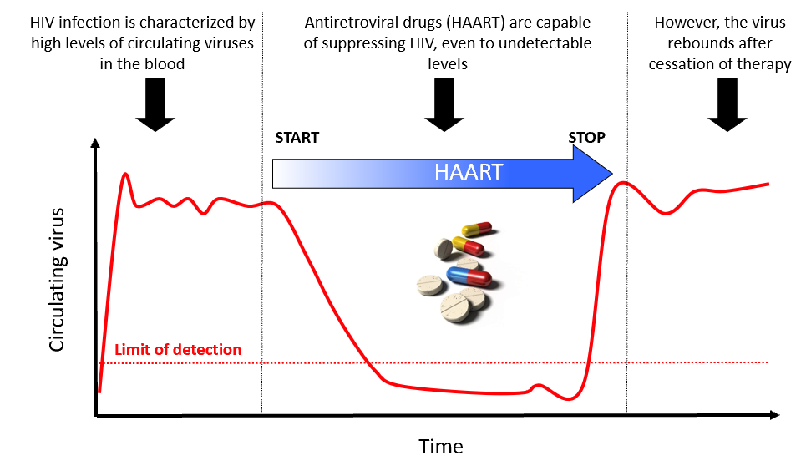
Current anti-HIV drugs do not eliminate HIV
HIV hides in places that are not sensitive to current therapies
Notes:
We need a cure because ART only suppresses HIV as long as people take it.
No matter how long someone is on ART, keeping the virus suppressed, HIV comes back quickly (“rebounds”) if we stop antiretroviral treatment.
The red line is showing you what happens to a person’s viral load when they are on and off medication.
HIV comes back quickly (“rebounds”) if we stop antiretroviral treatment
Even after years of being on antiviral therapy that keeps the virus at undetectable levels, we know if these medications are stopped that the virus rebounds quickly. This why we need a strategy to address the flaws in the thought that triple drug therapy alone would lead to a cure.
ART, however, does not eliminate the viruses that persist in the latent reservoirs and results in the need for lifelong therapy. It can lead to short-term and long-term toxicities and is very expensive. It is uncertain whether there will be sufficient resources on a global level to provide HIV treatment to everyone who needs it. So far, the world has fallen far short of this challenge. Furthermore, people living with HIV deserve a cure.

Slide 11
Notes:
Additionally, a cure has great symbolic meaning to people with and without HIV. At the 2016 IAS World AIDS Conference in South Africa, nearly 250 people who stopped by Martin Delaney Collaboratory CAB booth at the Global Village answered the question, What would an HIV cure mean to you? After the conference we turned their answers into this word cloud- you can see how strongly people associated an HIV cure with freedom, hope, love, relief, and an end to stigma.
“What would an HIV cure mean to you?” That’s the question Karine Dube, David Evans, Richard Jeffreys, Michael Louella, Laurie Sylla, and Jeff Taylor asked their fellow attendees at last year’s International AIDS Conference in Durban, South Africa. Respondents wrote their answers on leaf-shaped pieces of paper. Afterward, members of the Seattle-based defeatHIV community advisory board sorted the paper “leaves” into themes. A word cloud was created from the 244 responses, and the words morphed into a tree. The word tree was unveiled in a presentation at IAS 2017. “That it captures the most common themes while preserving all the voices that answered our question was a great source of interest at IAS, especially for those living with HIV,” said Michael Louella.
From Positively Aware

Slide 12
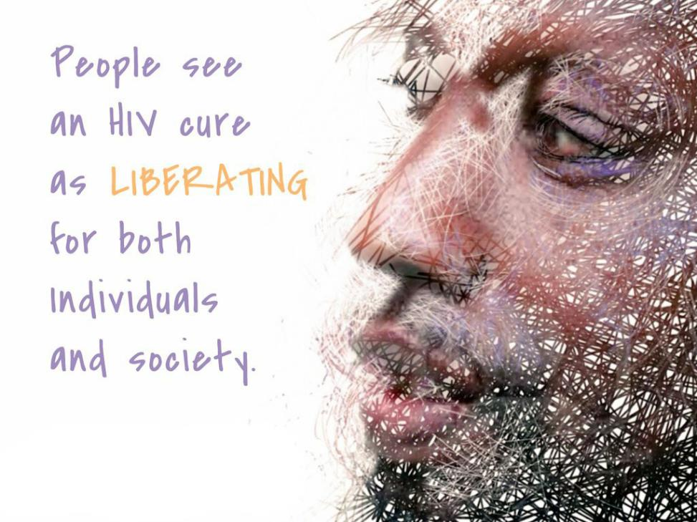

Slide 13
The Holy Grail
Notes:
The Holy Grail would be the eliminaton of all the virus infected cells from a person infected with HIV.

Slide 14
Dr. Fauci, NIH-Sponsored Workshop on HIV Cure Research, November 16, 2020
Notes:
First, we need to remember that not everyone has access to this highly effective treatment. For a variety of reasons I don’t have time to go into now, despite incredible progress, about 1/3 of people with HIV worldwide still have no access to ART. And, the COVID epidemic has shown us just how fragile maintaining access to treatment can be. In addition to the impact of lockdowns, and interrupted supply chains, we need to remember that most people’s access to ART is subsidized- by government entities and charitable payors, and there is no guarantee those sources will continue or ever fully meet treatment need.

Slide 15
Dr. Fauci, NIH-Sponsored Workshop on HIV Cure Research, November 16, 2020

Slide 16
Why Do We Need an HIV Cure?
Side effects of Antiretroviral therapy (ART)
Access to ART
Chronic Inflammation*
Economic burden of ART
Stigmatization
Criminalization*
Notes:
Art access, cost, side effects and long-term toxicity, Stigma and
chronic inflammation, even when the virus is suppressed,
all contribute to the need for a cure
Why Do we need an HIV Cure?
>37 million people living with HIV around the world
Most require life-long antiretroviral treatment to prevent transmission and disease
Toxicity of ART (i.e., we need to reduce co-morbidities and side effects of ART)
Continued damage of HIV to the body (e.g., inflammation)
Economic impact and financial burden of HIV on health care systems (i.e., goes beyond the cost of HIV pills, to include human suffering, job loss, etc.)
Access to ART
Stigmatization and criminalization
Inequalities globally around access to ART (and viral suppression rates)
Fauci, DAIDS Cure Meeting, October 2018:
Rationale for intensifying HIV cure research
It may not be economically nor logically feasible to deliver antiretroviral therapy to >37 million people living with HIV for their entire lives
Challenges of adherence and negotiating the “care continuum”
Drug resistance, cumulative toxicities and stigma associated with ART

Slide 17
Why Do We Need an HIV Cure?
Cardiovascular
disease
Immune system
exhaustion
Premature
aging & frailty
Chronic Inflammation
Osteopenia
(weaker bones)
Lipodystrophy
Leads to non-AIDS
life-threatening diseases
Diabetes
Neurologic
disorders
Cancer
Inspired from: https://www.cryophiladelphia.com/what-is-chronic-inflammation-how-can-it-damage-your-body/
Notes:
In spite of viral suppression, chronic inflammation remains a driving force for many health issues that face people living with HIV. People with HIV are more prone to heart attacks, certain cancers, and other comorbidities as they age than those without HIV.
In spite of viral suppression, chronic inflammation remains a driving force for many health issues that face people living with HIV.
The scope can affect every organ system and is compounded as we age with HIV.

Slide 18
What is HIV stigma?
HIV stigma is negative attitudes and beliefs about people with HIV. It is the prejudice that comes with labeling an individual as part of a group that is believed to be socially unacceptable.
Here are a few examples:
Believing that only certain groups of people can get HIV
Making moral judgments about people who take steps to prevent HIV transmission
Feeling that people deserve to get HIV because of their choices
Notes:
https://www.cdc.gov/hiv/basics/hiv-stigma/index.html

Slide 19
What is HIV Criminalization?
the overly broad use of criminal law to penalize alleged, perceived or potential HIV exposure
or alleged nondisclosure of a known HIV-positive status prior to sexual contact (including acts that do not risk HIV transmission)
or nonintentional HIV transmission
sentencing can involve decades in prison or required sex offender registration, even when no HIV transmission occurred
“Evidence also indicates that penalties associated with HIV specific statutes are unevenly imposed on the basis of race and sex.” Communities of color, particularly women of color, are singled out for harsh penalties and long prison sentences.
- Yang & Underhill. 2018. New England Journal of Medicine
Nearly 200 cases prosecuted in the US since 2008
Notes:
The criminalization of HIV only reinforces the fact if you do not know your status, you can’t be held accountable.
The Sero Project has been working on changing the laws in every state. No other infectious disease has been criminalized like HIV.
http://www.aidsunited.org/data/files/Site_18/2014AidsUnited-FactSheet-HIVCriminalization.pdf
Rethinking Criminalization of HIV Exposure — Lessons from California’s New Legislation
https://www.nejm.org/doi/full/10.1056/NEJMp1716981

Slide 20
Why do we think a cure for HIV is possible?

Slide 21
Notes:
This is Timothy Ray Brown.
Also known as The Berlin Patient.
He is the first person to be cured of HIV.
He is the reason why the HIV cure research field exists.
He is the reason we think a cure for HIV is possible.
Some of the science of cure attempts to copy what happened to him that led him to be cured, but in a way that is safer for people and accessible to them everywhere.

Slide 22
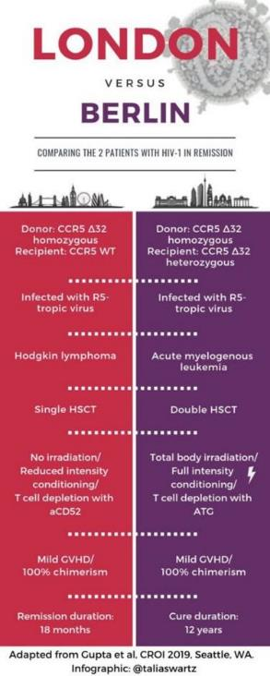
Why We Believe a Cure Might be Possible
Timothy Ray Brown
“The Berlin Patient”
March 11, 1966 – September 29, 2020
Adam Castillejo
“The London Patient”
Notes:
A second person, Adam Castillejo, known as the London Patient, also appears to be cured of HIV. I don’t really have time to go into detail about their cures. Timothy was HIV free for 13 years until he died of a recurrence of his cancer, and Adam has been HIV free for about 3 years. They both received hematopoietic stem cell transplants (sometimes known as bone marrow transplants) for their life-threatening cancers, with donors whose blood was genetically resistant to HIV, as they lacked a key receptor HIV needs to attach to in order to invade a cell. After their transplants, they essentially grew an HIV-resistant blood supply, and became HIV free. Unfortunately, these kinds of transplants are costly, and more importantly, very risky, with high mortality rates.
Their cures are not scalable, but they are inspirational, and scientists are looking to develop more practical alternatives, some based on modifying the interventions Timothy and Mr. Castillejo received.
Only Two People Have Been Cured of HIV
There are only individuals who have achieved a state of ‘complete cure’ of HIV infection following an intervention.
The first person, Timothy Ray Brown–otherwise known as the Berlin patient–received a stem cell transplantation to treat his leukemia (a type of cancer).
The stem cell donor had a special deletion in his CCR5 (C-C chemokine receptor 5) gene, the co-receptors that HIV needs to be able to enter a cell.
Timothy Brown had to interrupt his HIV medication for his cure to be discovered.
Timothy Brown has now been without evidence of HIV for 13 years.
Another person, Adam Castillejo–known as the London patient–received a similar milder form of stem cell transplantation to treat his lymphoma (another type of cancer). The stem cell donor had the same type of CCR5 gene mutation. Adam Castillejo’s virus has not returned 30 months after he interrupted his HIV treatment.
Possibly third person (Dusseldorf patient)
It is important to note that both these individuals had a cancer that warranted a stem cell transplant, which is a very risky procedure.
The stem cell transplant would not be justified in people living with HIV who are otherwise healthy, because the risk would be too high.
Both Timothy and Adam received a stem cell transplant from a donor who lacked the gene for Delta 32 which is responsible for the CCR5 co-receptor HIV uses to infect the target CD4 helper T cell.
Hematopoietic stem cells, produced in the bone marrow, are the source of all the blood cells in the body.
Stem cell transplants are used to treat life-threatening illnesses such as cancer.
Stem cell transplants involve the transfer of cells that lack a key receptor (CCR5) on their surface, followed with a process called conditioning, aimed at eliminating an individual’s immune system to make room for a donor system and reduce the risk of a transplant rejection.
There are two types of stem cell transplants: autologous (cells obtained from the same individual) or allogeneic (cells obtained from a different person).
Stem cell transplants are indicated for individuals who already have cancer and are very ill.
Scientists believe that allogeneic stem cell transplants are too dangerous (a lot of people who get these transplants die) and not readily scalable as a practical cure for most people.
To date, the only two people who has been cured, were cured through this process.
Note on CCR5 gene deletion:
The overwhelming majority of newly diagnosed people have a viral strain that uses CCR5 as a co-receptor.
Most people living with HIV have a virus that uses CCR5, but this may evolve over time (particularly in those not receiving ART: the virus typically evolves from a CCR5-using phenotype to a CXCR4-using phenotype over years).
In theory, you could establish an infection with a CXCR4-using virus in a person homozygote for CCR5D32. T
his has been reported in the past (see attached Lancet paper form 1997), but this is extremely rare.

Slide 23
What has been the pathway to an HIV cure?
Notes:
So, what kind of cures are being pursued?

Slide 24
Background to HIV Cure-Related Research A Continuum
Notes:
To understand the perspectives of people living with HIV and on HIV cure research, we must understand what is happening in the background
We have several classes of highly potent HIV medicines [for example: NRTIs, NNRTIs, protease inhibitors, fusion inhibitors, CCR5 antagonists, integrase inhibitors, pharmacokinetic enhances, and better and better formulations]
And very soon, we will have long-acting ART injectables and implants that may blur the boundary of what is means to be in HIV remission, and not having to think about HIV every day
We also now have much greater knowledge around reduced transmission under viral suppression in the community in the form of the U = U message

Slide 25
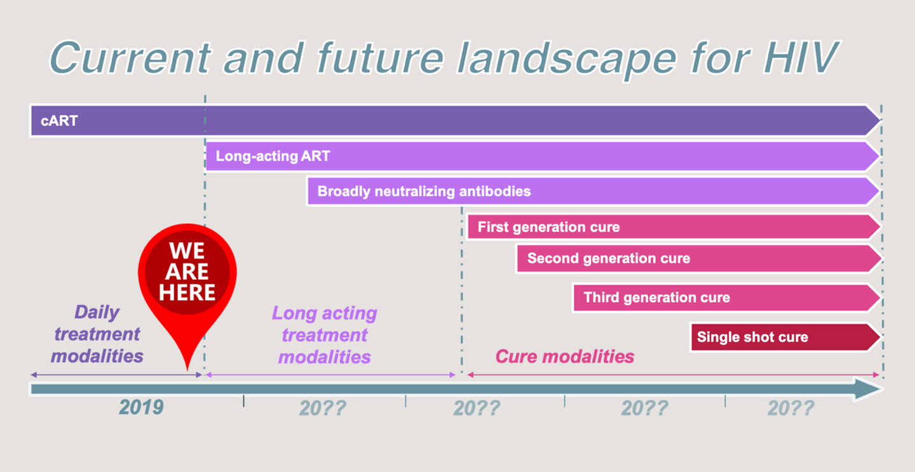
Evolution of HIV Cure Research

Slide 26
HIV Time-Line
Second Man Cured of HIV Adam Castillejo
2016
Advancing Broadly Neutalizing Antibodies (bNabs)
2009
Latent integrated HIV-1 forms a stable, inducible viral reservoir
1997
First Man Cured of HIV-1 Timothy Ray Brown
2009
First HIV Protease Inhibitor approved
1995
First Antiviral drug approved
1987
CD8+ T cells control virus levels
1994
Clinical test developed for HIV-1
1985
Complete HIV-1 Sequence is described
1985
CD4 is the Receptor for HIV-1
1984
Discovery of HIV-1
1983
First Reports of AIDS Cases
1981
https://www.nature.com/collections/mghkkdjlgx/timeline/

Slide 27
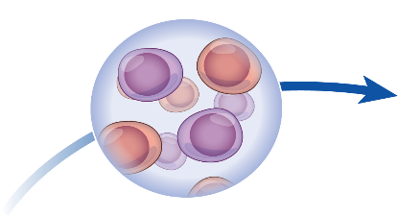
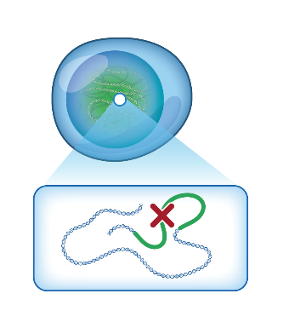
HIV Cure is Rare: Examples of Complete Elimination and Durable ART-Free Suppression
VISCONTI
SPARTAC
CHAMP
Post treatment control
Adam Castillejo
London
Timothy Brown
Berlin
2009
2019
2020
2010
Lorraine Willenberg
San Francisco
Hutter et al., N Engl J Med 2010; Gupta et al., Nature 2019; Gupta et al, Lancet HIV 2019; Jiang et al., Nature 2020
SLIDE CREDIT: Sharon Lewin, Singapore AIDS Conference 2020

Slide 28
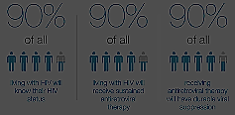
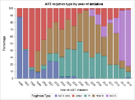
Evolving HIV Treatment Paradigm
Long Acting Injectables ?
The Integrase Era
Single-Tablet Regimens
Triple-Drug Therapy
ZDV/3TC
ZDV monotherapy
HIV-1 discovered
Cure?
1983
1987
1995
1996
2006
2012–2013
2017
2020
3TC = lamivudine
ZDV = zidovudine
ART-free durable control?
Notes:
We need to bear in mind that with all the treatment advances we have made over the past 40 years and are still making , that cure research is taking place at a time when many people with HIV have access to effective treatment that keeps their HIV under control and that also keeps them from transmitting HIV.
Antiretroviral treatment (ART) is one of the greatest medical advances of the late 20th century.
When used effectively and consistently, ART can restore the immune system, results in viral suppression, reduces viral transmission, improves quality of life and even increases life expectancy.
People can live for decades on current HIV treatment regimens.
Unlike the early days of HIV treatment, the pill burden is now low (sometimes 1 pill per day) and many regimens are well-tolerated.
Also, there are long-acting formulations of ART that are being developed that would not require taking 1 pill every day.
For these long-acting agents, people would have to receive an injection at regular intervals (every month or every 2 months).
There have been many advancements in the treatment of HIV that decrease the burden of taking so many pills each day.
We know now that if you have an undetectable viral load, you are unable to transmit the virus to someone else. That is the purpose behind the U=U campaign.
Now from oral daily regimens to less frequent to no regimen at all
Paradigm of viral suppression → durable control

Slide 29
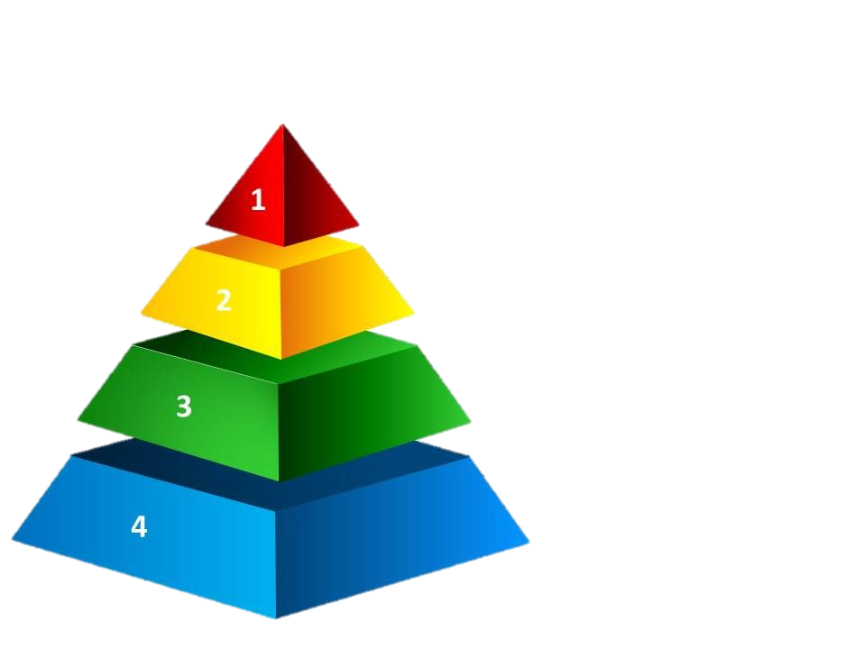
Stages of Clinical Research
Studies with cells in culture.
Studies in animal models.
Pre-clinical studies looking at safety.
Larger clinical studies looking at efficacy.
Notes:
It is important to understand the research process. New interventions first undergo preclinical testing- first in a lab and then with animals, for indications of activity and safety. Should an intervention look promising based on these studies, they move into small safety studies in humans, then larger safety studies, and finally into large scale efficacy studies to see if the intervention works. You may hear these referred to as Phase 1 (early safety), Phase 2 (expanded safety) and Phase 3 (Efficacy)

Slide 30
HIV
Cure-Related Research
Bench Science
Intervention Trials
Ethics &
Social-Behavioral
Sciences
Understanding Persistence & Immune control
Animal & Human Studies
Decision-making
Perceptions of risks and benefits
Attitudes about research
Individual and societal impact
Viral subtype
Genetics
Tissues
Intervention Mechanism
Analysis of preliminary work
Single or Combination Interventions
Early
ART
Latency modifying agents
Immune Therapies
Cell & Gene Therapies
Adapted from Jintanat Ananworanich, Community HIV Cure Workshop, AIDS 2018
Notes:
We can think of cure research as including basic science research, clinical trials testing interventions in people, and importantly, social sciences and ethics studies as well

Slide 31
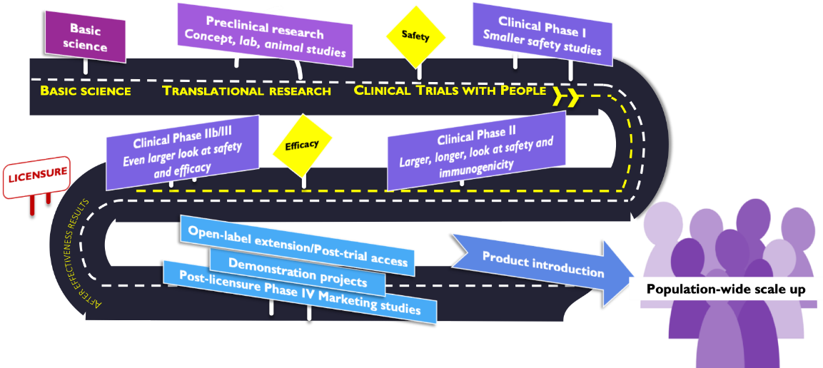
Overview of Research Process
Courtesy of AVAC
Notes:
Here is a typical journey an intervention takes from concept to approval and scale-up. You can see it progressing from preclinical research, through the clinical trial phases, and then to approval. Post approval studies are referred to as Phase 4, when researchers and product developers continue to collect data after a product is brought to market. These are usually observational studies.
In fact, we are used to seeing a very linear translational research pathway, from basic science, pre-clinical research, translational research and clinical trials – including Phase I, II, IIb, and III, moving progressively towards efforts.

Slide 32
Global Investment in HIV Cure R & D (2019)
approximately US $323.9 million
http://www.adamco.com/innerpages.aspx?id=12&Root=no

Slide 33
Why is it difficult to cure HIV?

Slide 34
Why is HIV so hard to cure?
So few cells harbor HIV in people on antivirals medications and these cells appear normal to our immune system.
Notes:
Almost immediately after infection, HIV creates a reservoir, where it sneaks inside resting long-lived memory cells. When it hides insides these cells, there are no signals sent to the immune system, and they evade detection. It hides in very few of these cells- typically in about 1 in a million. So, these viruses and the cells that hide them, are very hard to find. The problem is, should these cells become activated or woken up, HIV can come roaring back.
When the immune cell is on patrol but has not recognized a familiar pathogen, it is “resting” or “not activated” or reproducing itself; the cells aren’t sending out any signals for destruction.
During this time HIV appears not to be doing anything either.
The rest of the immune system can’t see it because it is hiding inside the body’s own cell. ARV’s can’t find it either, for the same reason.
Not only are these cells hard to find because they aren’t sending out signals.
They are also hard to find because there are very of these reservoir cells in the body.
It is important to note a unique feature of HIV that makes curing more challenging:
I think it is worth describing the unusual feature of HIV that it integrates into the DNA of an infected cell.
This ‘superpower’, which is almost unique amongst viruses, guarantees that HIV can remain a permanent part of any cell it infects.
This then leads to the idea that its not enough to have drugs that can inactivate any virus in the body, but you also have to eliminate any cells that have been infected.
This feature is key in the latent reservoir.

Slide 35
Where is the HIV Reservoir?
Brain
Lymph nodes
Peripheral blood
Gut
Bone marrow
Genital tract
Chaillon A, Gianella S, Dellicour S, Rawlings SA, Schlug TE, De Oliveira MF, et al. HIV Persists Throughout Deep Tissues with Repopulation from Multiple Anatomical Compartments. Journal of Clinical Investigation 2020.
Notes:
Cells of the immune system travel through the blood stream and make their way each of these organs.
Either CD4 T helper lymphocytes or macrophages or microglia ( macrophage like cells that reside in the brain) infected with HIV can be found in all these organs.

Slide 36
Sex Differences in HIV
Immune system differences
Anatomic and hormonal differences
Different epigenetic landscapes (environments that surrounds genes)
Genetic differences (e.g. X chromosomes)
Different microbiomes
(e.g. bacteria in the body)
Scully, Curr HIV/AIDS Rep, 2018
Slide Credit: Ndung’u T. HIV Cure Research in Women. Community Cure Workshop. Saturday July 21, 2018.

Slide 37
What pathways are currently being explored?

Slide 38
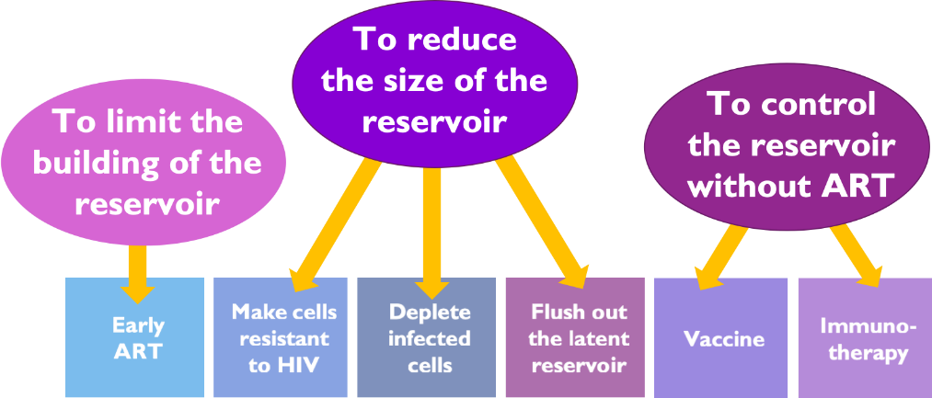
HIV Cure-Related Research Strategies Under Investigation
Slide Credit: Nicolas Chomont
Cartoon Credit: BEAT-HIV Collaboratory
Notes:
There are different strategies being explored to achieve ART-free HIV suppression or an eliminating cure.
Each of these strategies takes a different approach to the challenge of bringing HIV under control without ART.
Strategies may try to prevent the establishment of the reservoir, some try to eliminate the reservoir, and some try to strengthen the immune system so it can more effectively wipe out or control HIV. Most likely we will need a combination approach.
What are Some of the HIV Cure-Related Strategies Being Pursued?
There are different strategies being explored to achieve ART-free HIV suppression or HIV cure.
Each of these strategies takes a different approach to the challenge of bringing HIV under control without ART.
Most likely, we will need a combination of approaches, because HIV is very complex.
For example, latency-reversing agents could be used in combination with an immune-based approach to find cells that have dormant HIV inside them, and then boost the immune system to increase the body’s ability to clear the virus. Immune-based strategies or gene editing approaches could also be used in combination. Combining HIV cure research approaches may increase the risks of these interventions.

Slide 39
Strategies Towards HIV Cure
R. Brad Jones
Latency reversal– reactivate latent HIV with drugs and kill with immune system
Gene therapy to delete HIV out of cells
Gene therapy to make cells resistant to HIV
Vaccines / Immunotherapies – enhance immune responses to control virus
‘Block and lock’ – permanently silence HIV expression (force into deeper latency)
SLIDE CREDIT: Jones RB. The Newest Science in Cure and Vaccine.
Plenary Presentation Main IAS 2018 Conference.

Slide 40
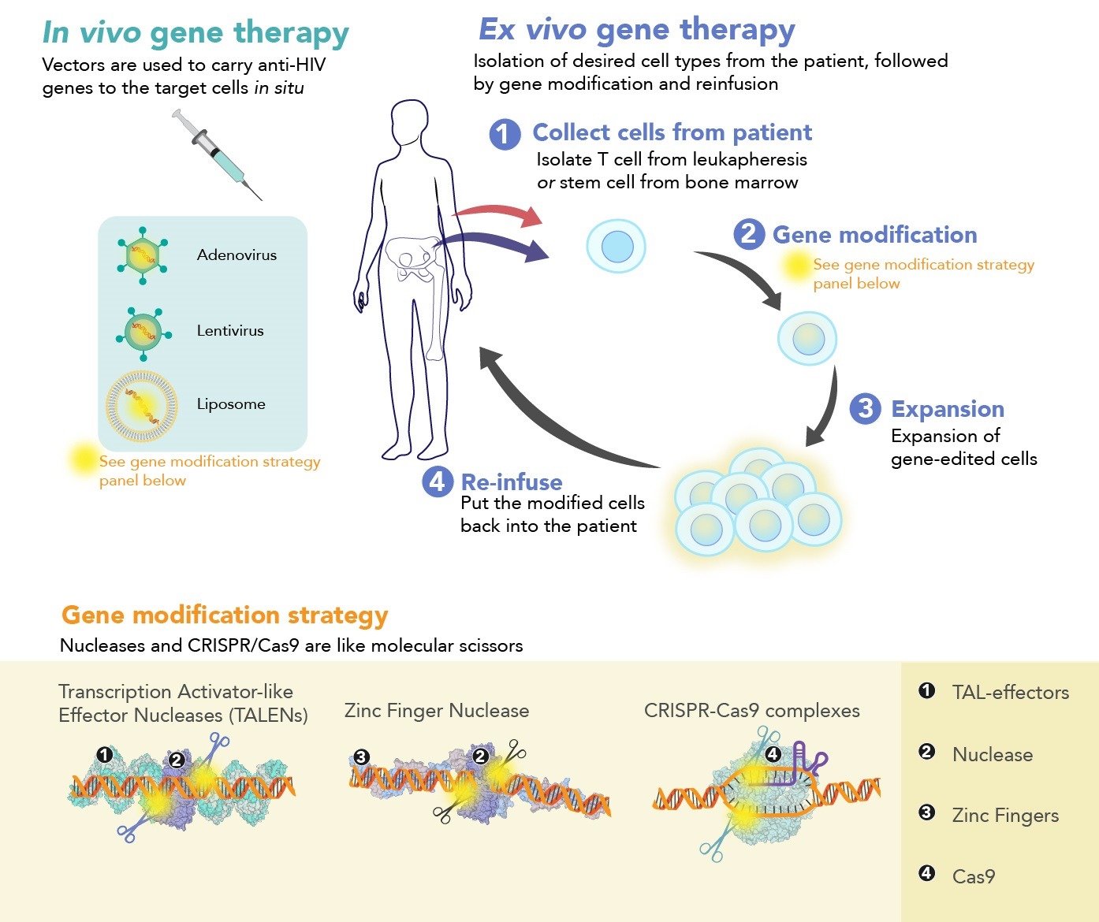
Cell &
Gene
Approaches
Illustration Credit: Grace Hsu, MS, CMI, Scientific Animation, Animation Lab:
https://animationlab.utah.edu/
Notes:
Cell and Gene therapy approaches may involve altering the body’s own cells so that they become resistant to HIV or better at successfully fighting HIV, or to change the HIV virus itself so it becomes ineffective. You can think of this as using molecular scissors to cut out a portion of the gene and then stitching it back together.
While some people are concerned about scalability of cell and gene therapy, rapid advances in the field continue to bring cost and complexity down. Researchers are hoping to one day be able to deliver this kind of treatment as a single shot- an aspirational goal.
Gene editing represents a technologically complex HIV cure-related strategy.
The main goal is to change specific cells so that they become resistant to HIV or better at successfully fighting HIV, or to change the HIV virus itself so it becomes ineffective.
This can be done by altering the genes of a person’s immune cells, as the genes are the blueprint for the cells’ architecture.
For example, an alteration that removes a key receptor or a protein that HIV uses for infection can make the cell resistant to HIV infection.
One of the gene therapy approaches being investigated involves extracting bone marrow stem cells from a person living with HIV and modifying them with a method that disables the gene that encodes the CCR5 receptor (which HIV uses as a foothold to gain entry into cells) and then putting them back into one’s own body.
Further, other examples of classes of DNA-editing enzymes being evaluated include the zing finger nucleases (ZFNs) and transcription activator-like effector nucleases (TALENs).
The gene sequence of HIV itself can also be altered. A useful analogy is the use of molecular scissors to “cut out” parts of the HIV gene.
A number of gene therapy approaches will be able to be combined with other approaches.
For example, a latency-reversing agent could be combined with a genetically strengthened immune cells.
It is important to note that these gene modifications would not be passed down to children.
These would be ‘somatic’ changes and would not affect the germline.
https://www.youtube.com/watch?v=4ym94wNlHAA

Slide 41
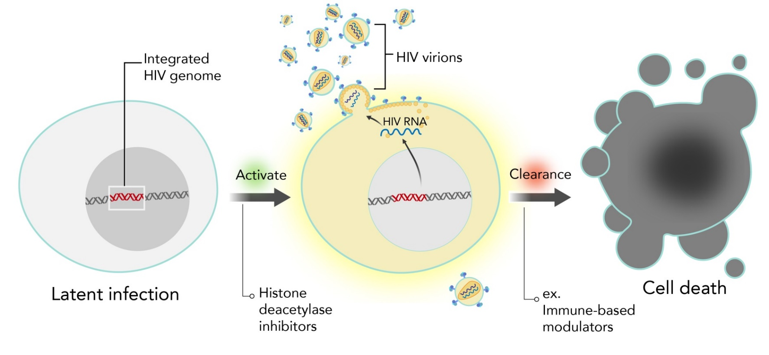
Latency Reversing
Agents
Image credit: The Economist, July 11
Illustration Credit: Grace Hsu, MS, CMI, Scientific Animation, Animation Lab:
https://animationlab.utah.edu/
Notes:
Latency Reversing Agents
This strategy attempts to flush the virus out of the resting cells by awakening the dormant viruses in the latent reservoirs.
This approach is usually accompanied by a second step which attempts to effectively clear the infected cells and wipe out any virus released.
This strategy has sometimes been referred to as “kick and kill”
More recently, there has been some interest in an opposite approach called “block and lock”, with the idea of sealing HIV up in the cells they are inhabiting so they can’t wake up.
Latency-reversing agents (LRA) can also be called the pharmacological approach to eliminating the HIV reservoirs.
This strategy attempts to flush the virus out of the resting cells by reawakening the dormant viruses in the latent reservoirs.
This approach is usually accompanied by a second step which attempt to effectively clear the infected cells.
The main component of this strategy is determining how to “wake” the virus or stimulate the cells enough to begin producing virus so they can be eliminated by the immune system.
Most of the latency-reversing agents being investigated currently are repurposed therapeutic agents borrowed from the cancer field.
The most famous class is called HDAC (histone deacetylate) inhibitors that might force latently infected cells to produce virus, but there are newer ones under development (e.g., SMAC mimetics).
Some of the latency-reversing agents are known to produce significant toxicity and must be administered as a low dose.
Scientists will need to find molecules that are safe and able to be combined to reactivate the virus that has is dormant inside the cells.
If scientists detect a burst of virus after a latency-reversing agent is given, this is a signal of anti-latency activity.

Slide 42
How Can We Prevent HIV From Rebounding Off of Therapy?
R. Brad Jones
Drain the HIV reservoir
Eliminate HIV-infected cells
“Classic cure”
2) Reinforce the dam
Boost the immune response to HIV
“Virologic suppression off ART/remission”
SLIDE CREDIT: Jones RB. The Newest Science in Cure and Vaccine.
Plenary Presentation Main IAS 2018 Conference.

Slide 43
The “Block and Lock” Approach
Block & Lock
Transcription
inhibitor
Sleeping beauty keeps on sleeping
She never wakes up for the prince
¹Kessing, Cell Report 2017; ²Ahlenstiel, Mol Ther Nucleic Acid 2015
SLIDE CREDIT: Ananworanich, A. Overview of Ongoing Cure Research Globally.
Community Cure Workshop. Saturday July 21, 2018.
Notes:
Valente discussed the new “block and lock” approach to keep the virus under hibernation. The secret lies in the chromatin gene that keeps the latent HIV gene turned off. Actually, the default for latently-infected cells is for the HIV gene to remained turned off. There is only one potential “block and lock” agent at this time, called dCA. This strategy could be promising in the future if more investigational agents can be found. This approach would be specific to HIV infection (a gene called ‘Tat’ that regulates the passage from latent to active infection). “Block and lock” would not permanently silence other regulatory pathways that are necessary to fight other infections.
Poz Blog:
Effectively the opposite of the kick and kill strategy, the “block and lock” method, also known as latency silencing, is based on the presumption that if rooting out and killing all the latently infected cells in the body is too challenging, keeping them in a silent state indefinitely may be a viable alternative. A recent study conducted in mice sought to inhibit a viral protein known as tat that acts as an on-off switch for viral replication in cells. The study successfully reduced the amount of HIV RNA expressed in tissue biopsies from the animals and delayed viral rebound after the interruption of ARV treatment.

Slide 44
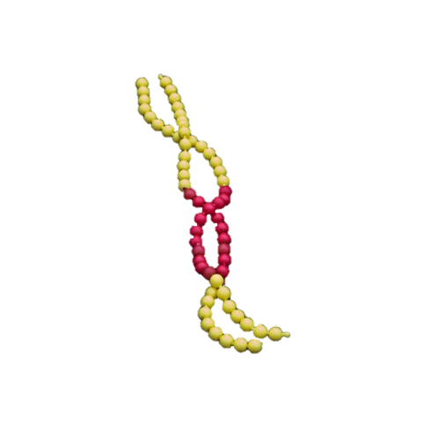
Block and Lock
Lock the HIV DNA from ever being read
Block the reading of the HIV DNA
https://www.labroots.com/trending/health-and-medicine/7121/scientists-discover-block-and-lock-drug-cure-hiv
https://kirby.unsw.edu.au/news/block-lock-pathway-hiv-remission
Notes:
HIV inserts the blueprint for making more of itself into the DNA of the cell it infects. There are strategies being explored that will block the reading of this virus DNA as well as lock it up for good. Our own DNA dictates many of our characteristics such as hair and eye color to name just a few. The DNA that HIV inserts is specific to make for virus that will go out and infect other cells. Blocking and locking would prevent the virus DNA from making more of itself.

Slide 45
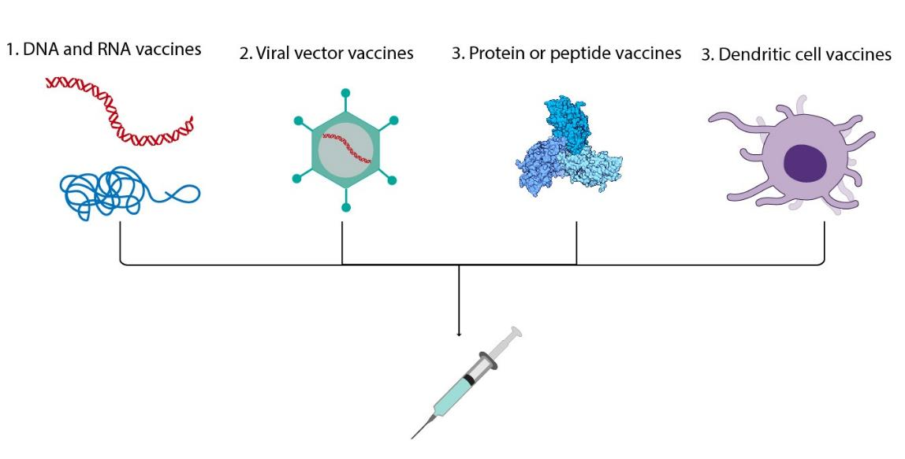
Immune-Based Strategies
Illustration Credit: Grace Hsu, MS, CMI, Scientific Animation, Animation Lab:
https://animationlab.utah.edu/
Notes:
There are other strategies designed to boost the immune response as well, including therapeutic vaccines or engineered antibodies.
Immune-based modulators are designed to boost or induce immune responses against HIV in someone who already has the virus. Most of these strategies are aimed at increasing the potency of cells that can clear HIV from the body, such as HIV-specific CD8+ T cells or natural killer (NK) cells. The hope is that immune-based modulators might contribute to controlling the virus in the absence of antiretroviral treatment and perhaps allow one’s own immune system to help eliminate HIV infected cells.
Immune-based modulators might be used alone or in combination with other strategies, such as latency-reversing agents or genetic modification.
Examples include therapeutic vaccines, broadly naturalizing antibodies (bnAbs), or special antibodies with multiple functions (bi- or tri-specific antibodies).

Slide 46
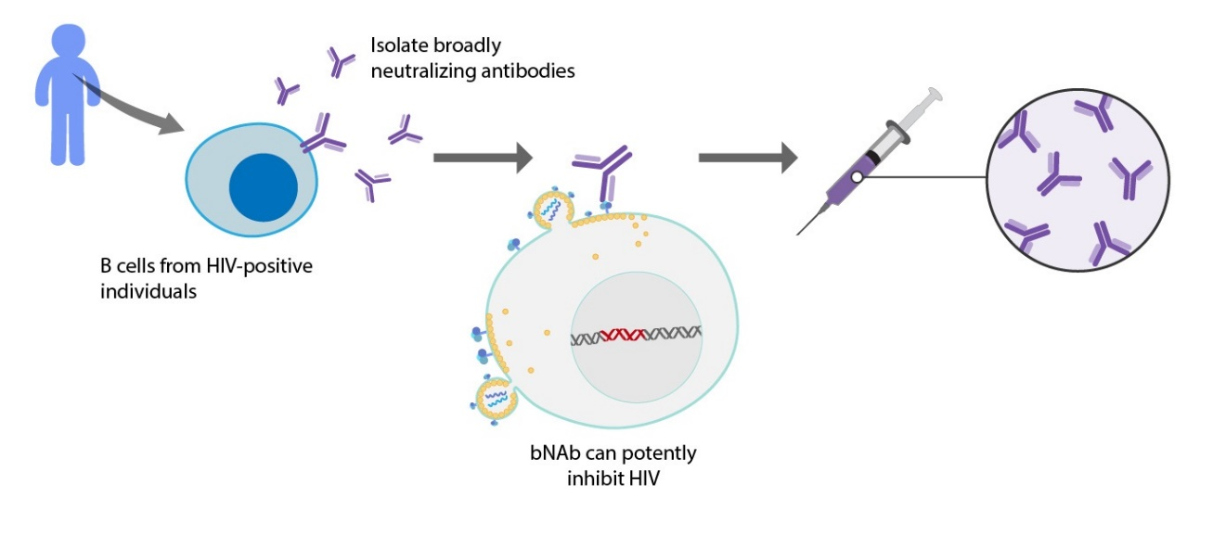
Broadly Neutralizing Antibodies
Illustration Credit: Grace Hsu, MS, CMI, Scientific Animation, Animation Lab:
https://animationlab.utah.edu/
Notes:
Broadly Neutralizing HIV-1 Antibodies (bNAbs) are neutralizing antibodies that are effective at killing multiple HIV-1 viral strains.^{[1]} This would be an example of strengthening the immune response.
Broadly Neutralizing HIV-1 Antibodies (bNAbs) are neutralizing antibodies which neutralize multiple HIV-1 viral strains.^{[1]} bNAbs are unique in that they target conserved epitopes of the virus, meaning the virus may mutate, but the targeted epitopes will still exist.^{[2]} In contrast, non-bNAbs are specific for individual viral strains with unique epitopes. The discovery of bNAbs has led to an important area of research, namely, discovery of a vaccine, not only limited to HIV, but also other rapidly mutating viruses like Influenza.
https://en.wikipedia.org/wiki/Broadly_neutralizing_HIV-1_antibodies

Slide 47
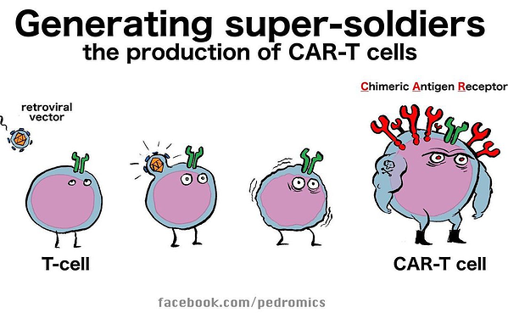
Chimeric Antigen T cells (CAR-T cell)
https://blog.seracare.com/ngs/aacr-2019-day-one-highlights-next-generation-car-t-cells?utm_medium=social&utm_source=facebook
Notes:
Chimeric Antigen T cells or CAR-T cells are developed from the patients own blood. They are modified using a virus to turn them into precise killing machines towards their target. Most of the early work has been done in cancer but now this technology is being explored an HIV cure strategy.

Slide 48
Antiretroviral Treatment Interruptions (ATIs) to evaluate cure interventions See separate ATI module for further details
temporarily interrupting or pausing ART in someone who has HIV
Other terms:
Structured treatment interruptions (STI)
Intensively Monitored Antiretroviral Pause (IMAP)
Why pause ART?
We cannot easily measure the HIV reservoir
We need to “jump start” the immune system
Image credit: Michael Louella
Notes:
Some clinical trials will need to include treatment interruptions. This is to see if the intervention being studied actually keeps HIV from coming back. As there is another presentation about this, I am not going to go into detail here, other than to note that it is an important part of the research process.
HIV Treatment Interruptions
Some HIV cure-related research protocols require the interruption of HIV treatment.
This would mean that a participant would stop taking HIV medications for a period of time, and would be carefully monitored during that period.
HIV cure-related studies that involve strengthening the immune system may include an interruption of HIV treatment, to see if HIV can be kept under control without taking HIV medications.
HIV treatment interruptions means that the virus can come back in the blood.
Study participants who are no longer undetectable for HIV would also be able to pass HIV to sexual partners.
It is very important for study participants to use protection methods during these HIV treatment interruptions.

Slide 49
Ethical Challenges to HIV Cure-Related Research See separate Ethics module for further details
Language of HIV cure-related research
Participation of people living with HIV
Informed consent
Background standard of care and U = U
Biological and social context of HIV cure-related research
Risks and benefit
Representation in research
ATIs and partner protections (see separate ATI module)
Scalability of interventions
Access and affordability
Structural inequities
Notes:
There are quite a number of ethical issues that need tending to as the cure research field advances. These include assuring that informed consent is truly informed, that participants and their partners are protected, and that people with HIV around the globe will be able to benefit from curative interventions developed.
What Are Some of the Ethical Challenges?
There are a number of ethical challenges related to conducting HIV cure-related research.
Language of HIV cure-related research (e.g., “cure”, “sterilizing cure”, “functional cure”, “subjects” vs. participants/volunteers, etc.)
Participation of people living with HIV:
Ensuring true informed consent
Effective HIV treatment as background standard of care; U = U
Weighing risks and benefits
Representation in research (e.g., cisgender and transgender women, ethnic and gender minorities)
Analytical treatment interruptions:
Risks to participants and partners (e.g., HIV acquisition)
Another challenge is resource allocation.
In a world where we know people could potentially live long healthy lives with HIV if they were on treatment, but not everyone has access to treatment, should resources be devoted to cure-related research or are they better spent on making treatment more available, or on preventing new infections?

Slide 50
Useful Video Links
Useful Video Links
Game Changers: Who & What is Behind an HIV Cure-Directed Study https://player.vimeo.com/video/341333676?autoplay=0&badge=0&byline=0&portrait=0&title=0&api=1&wmode=transparent&fullscreen=1
Flower Lesson For HIV Cure: https://www.youtube.com/watch?v=IVLbIsEn_AA&t=18s
Who Has Been Cured of HIV? https://www.youtube.com/watch?v=BxBGyrYoacU
HIV Criminalization: Masking Fear And Discrimination https://www.youtube.com/watch?v=SgWjJeDBSaQ
HIV: Basic Function Of The Immune System https://www.youtube.com/watch?v=YUNVGCQVe2g
HIV Infection Stages, Pathology And Treatment https://www.youtube.com/watch?v=horX8xLVpCg
HIV Infection Mechanism – Dendritic Cells https://www.youtube.com/watch?v=ZroXIBg8keA
Understanding HIV Reservoirs https://www.youtube.com/watch?v=XkQqE02gbVc
Understanding Broadly Neutralizing Antibodies https://www.youtube.com/watch?v=Dr7werW5Or4&t=26s

Slide 51
Useful Video Links (cont’d)
Gene Editing explained https://www.youtube.com/watch?v=E8vi_PdGrKg
CAR-T Cells in cancer https://www.youtube.com/watch?v=OadAW99s4Ik
Live Cell Imagine T cells with Macrophages https://www.youtube.com/watch?v=SkT1ZxsVSGM
How One Cell Becomes Two Through Mitosis https://www.youtube.com/watch?v=L61Gp_d7evo

Slide 52
ACKNOWLEDGMENTS
Module developers
Marc Wagner I4C CAB (Community Lead)
Laurie Sylla defeatHIV CAB
Christopher Roebuck BEAT-HIV CAB
Richard Jefferys TAG
Danielle Campbell DARE CAB
Michael Louella defeatHIV CAB
Lynda Dee AIDS Action Baltimore
Karine Dubé UNC Chapel Hill
We wish to thank AIDS Treatment Activists Coalition for the funding to complete this module
Their caring support of the CUREiculum 2.0. will make a difference in the lives of thousands. of people living with HIV
Biomedical Co-Leads
Paula Cannon, Associate Professor of Microbiology, Keck School of Medicine of USC
Nicolas Chomont, Associate Professor,
Université de Montréal, Montréal, QC, Canada

