Slide 1


Daud Yamikani 3HP in a Malawi household
Pathways to TB preventive treatment among household contacts illustrated story series

Slide 2
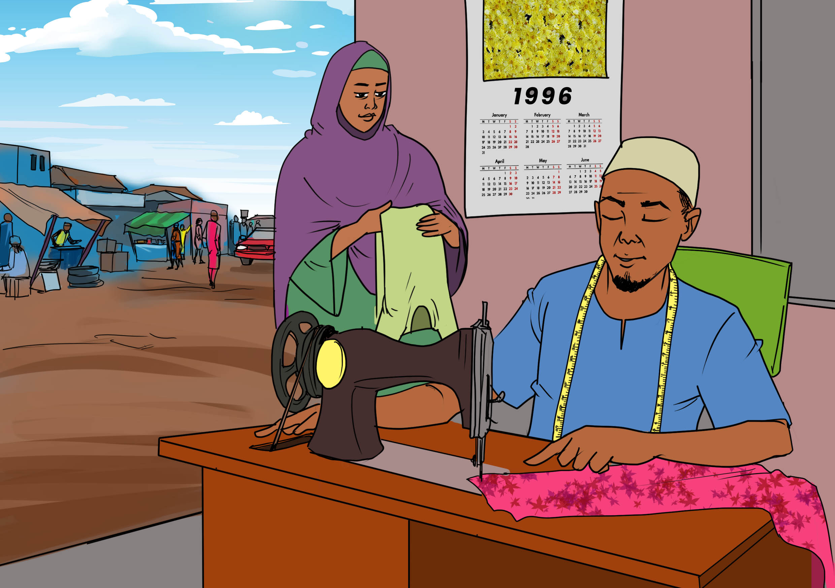
In 1996 Daud at the age of 45 married Alima, aged 22. At that time, he was staying in M’baluku in the lake shore district of Mangochi, Southern Malawi.
Daud and Alima are both Muslim and Yao by culture. Daud works as a tailor and also grows rice and maize to earn a living.

Slide 3
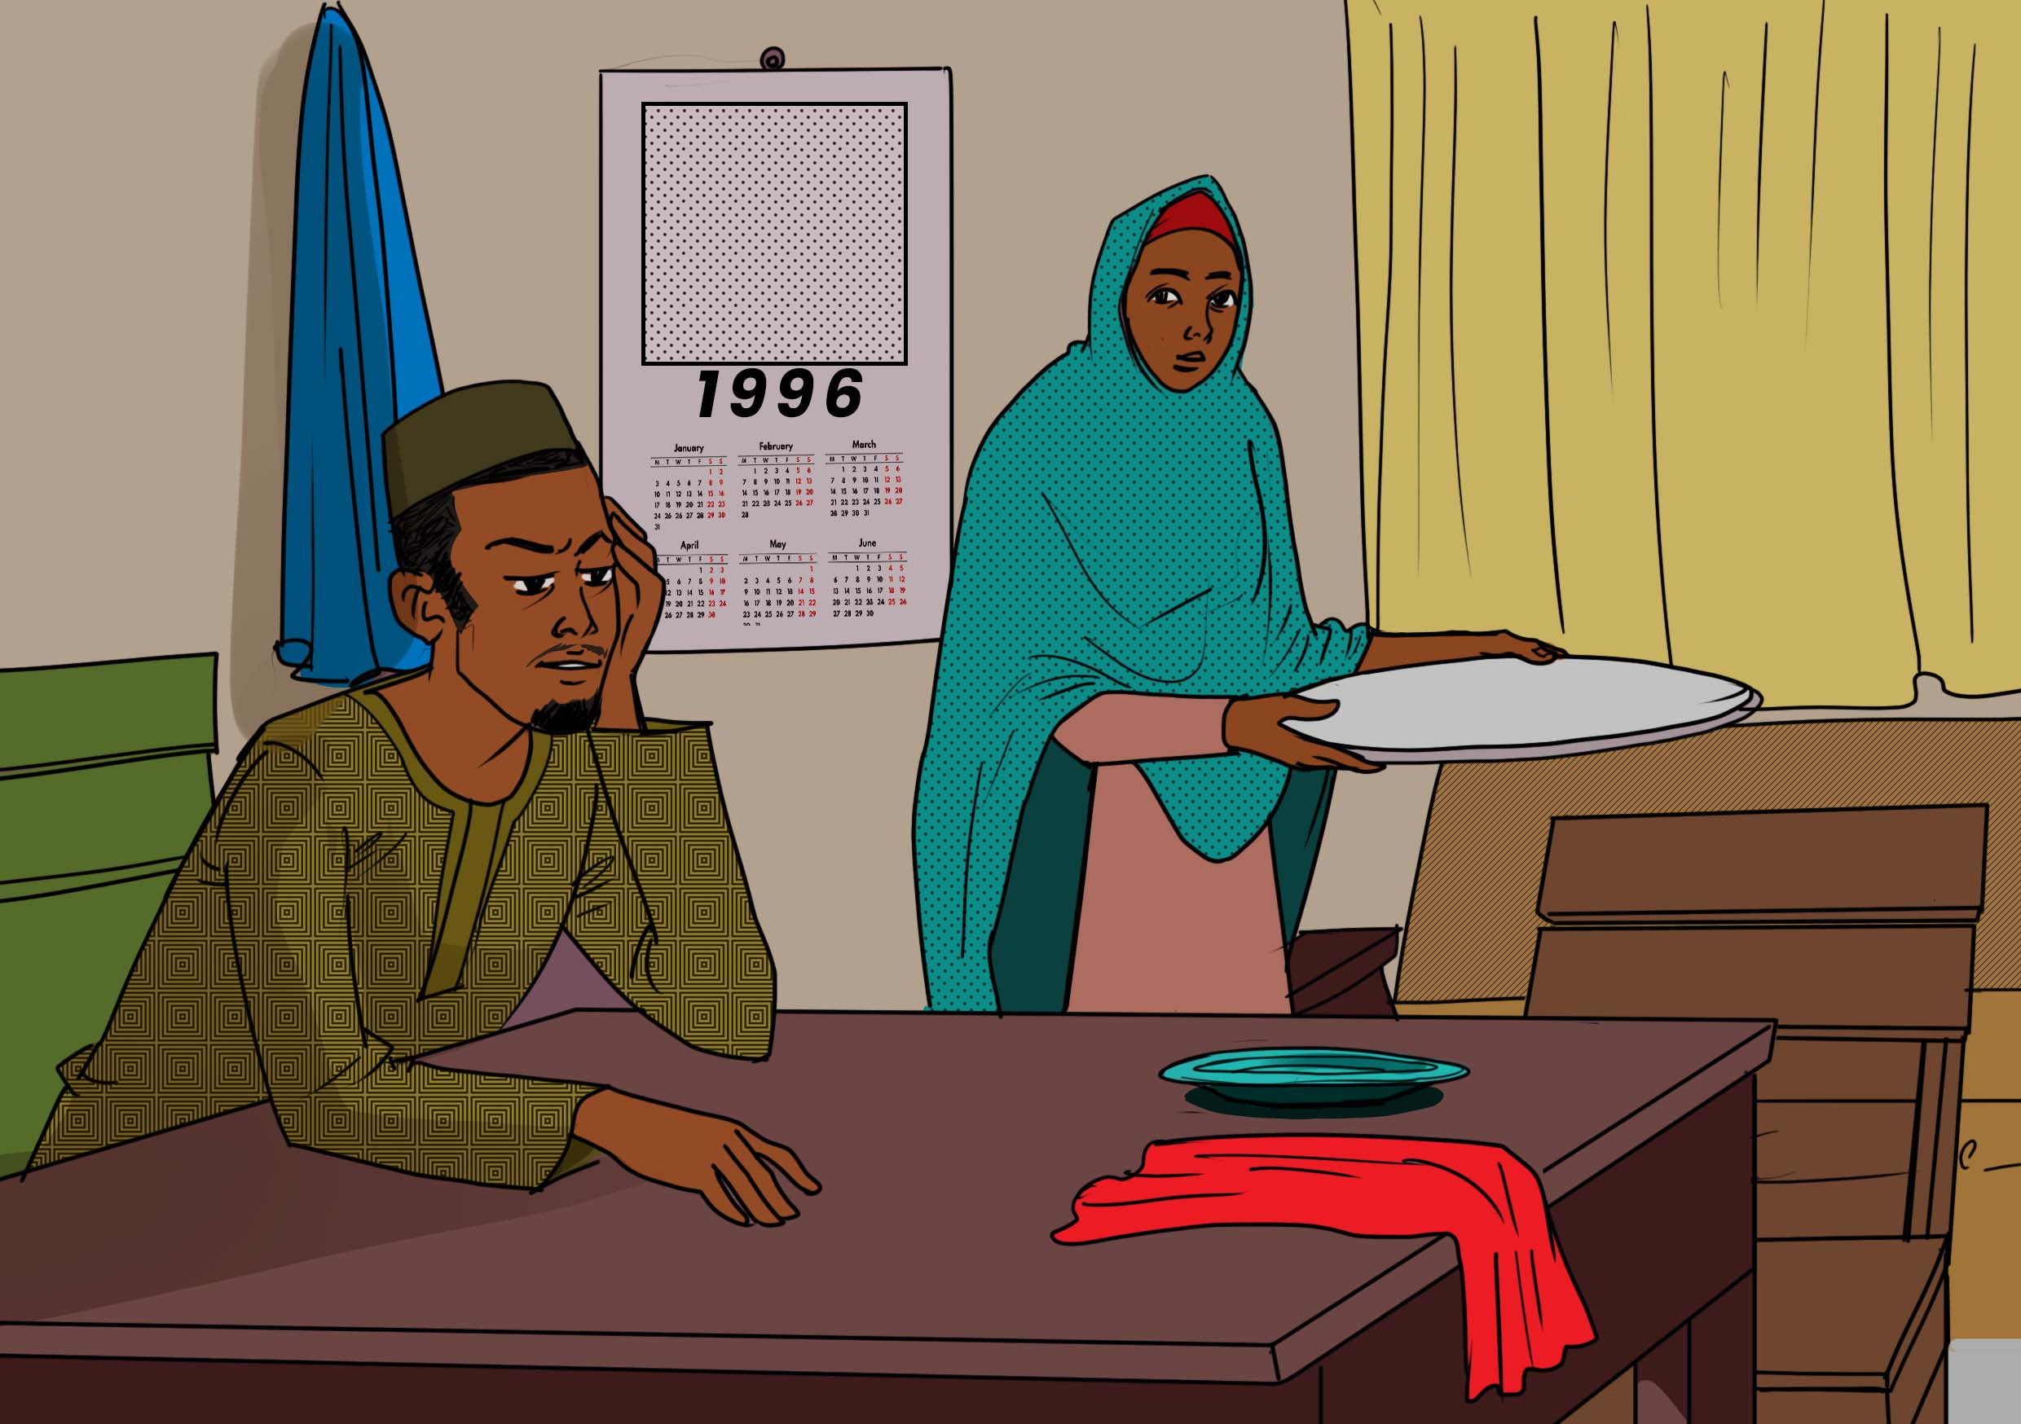
How will I feed my family? Maybe we should seek other opportunities outside of Mangochi.
The income in their home as a newly wedded couple was not good. Daud was earning a living through tailoring and he and Alima seized the opportunity to leave their home to seek a better living outside Mangochi district.

Slide 4
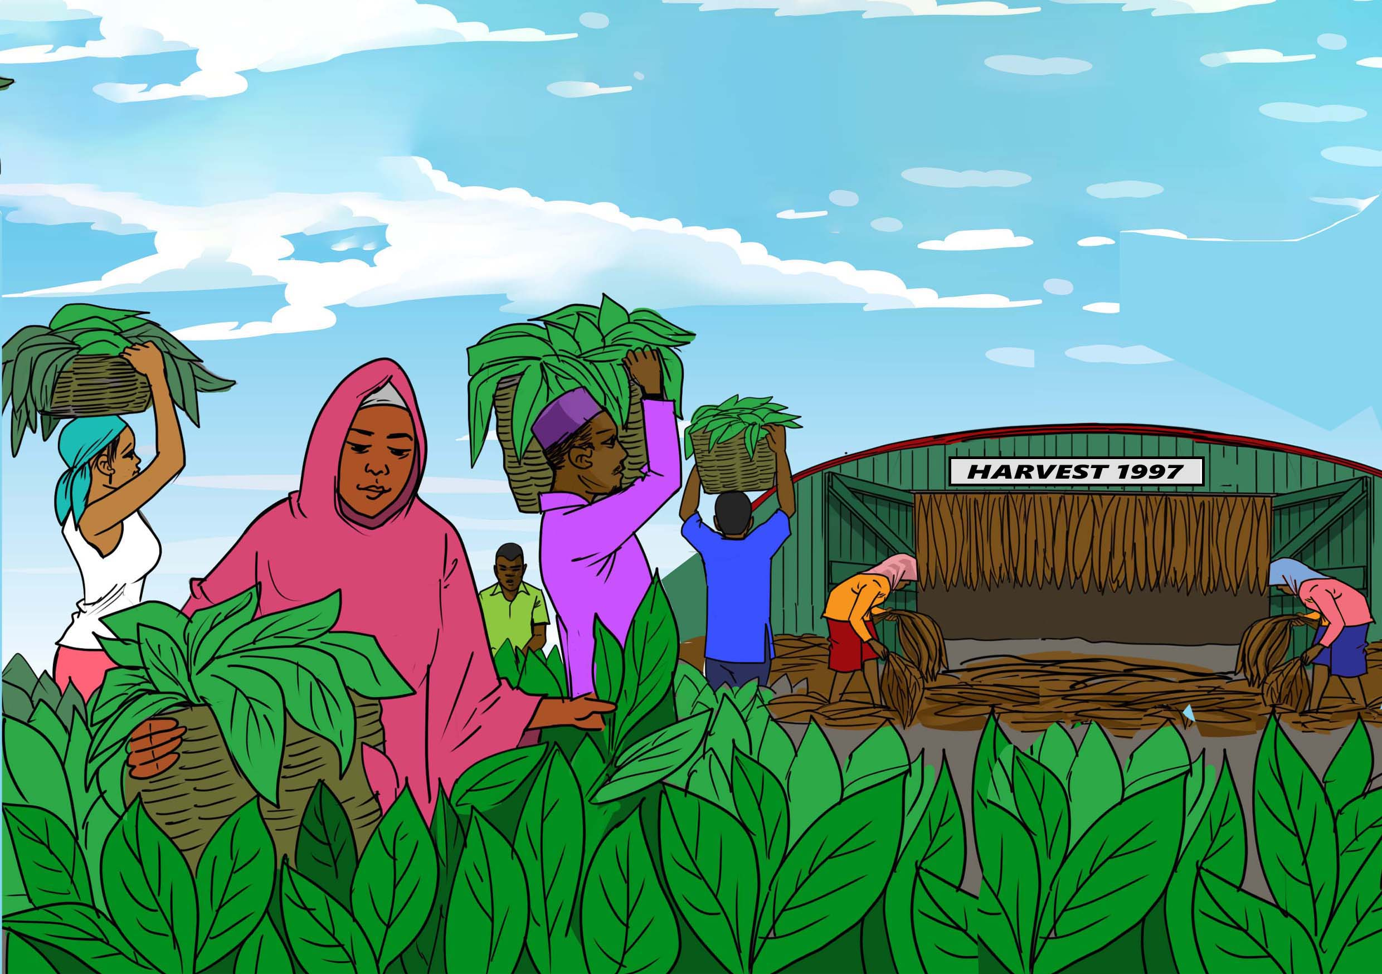
In 1997, Daud and Alima moved to the vast tobacco estates of Kasungu district, where money flowed easily. They worked harvesting and drying tobacco.
Sometimes they felt sick, including having coughs which they thought could be ‘green tobacco sickness.’ No one at the time thought that TB might one day visit their family.

Slide 5
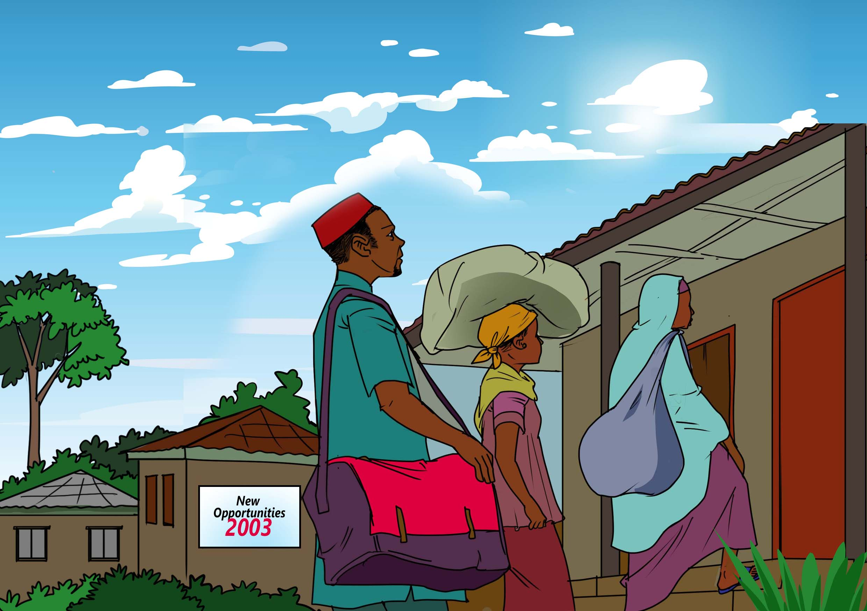
In 2003, after working for 7 years on the tobacco farms in Kasungu, Daud and Alima decided to leave the harsh tobacco estate conditions and returned to their home district of Mangochi with their first-born daughter, Fatsani.
Back in Mangochi, Daud used some of the savings from his work on the tobacco estate to build their own house to avoid paying rentals.

Slide 6
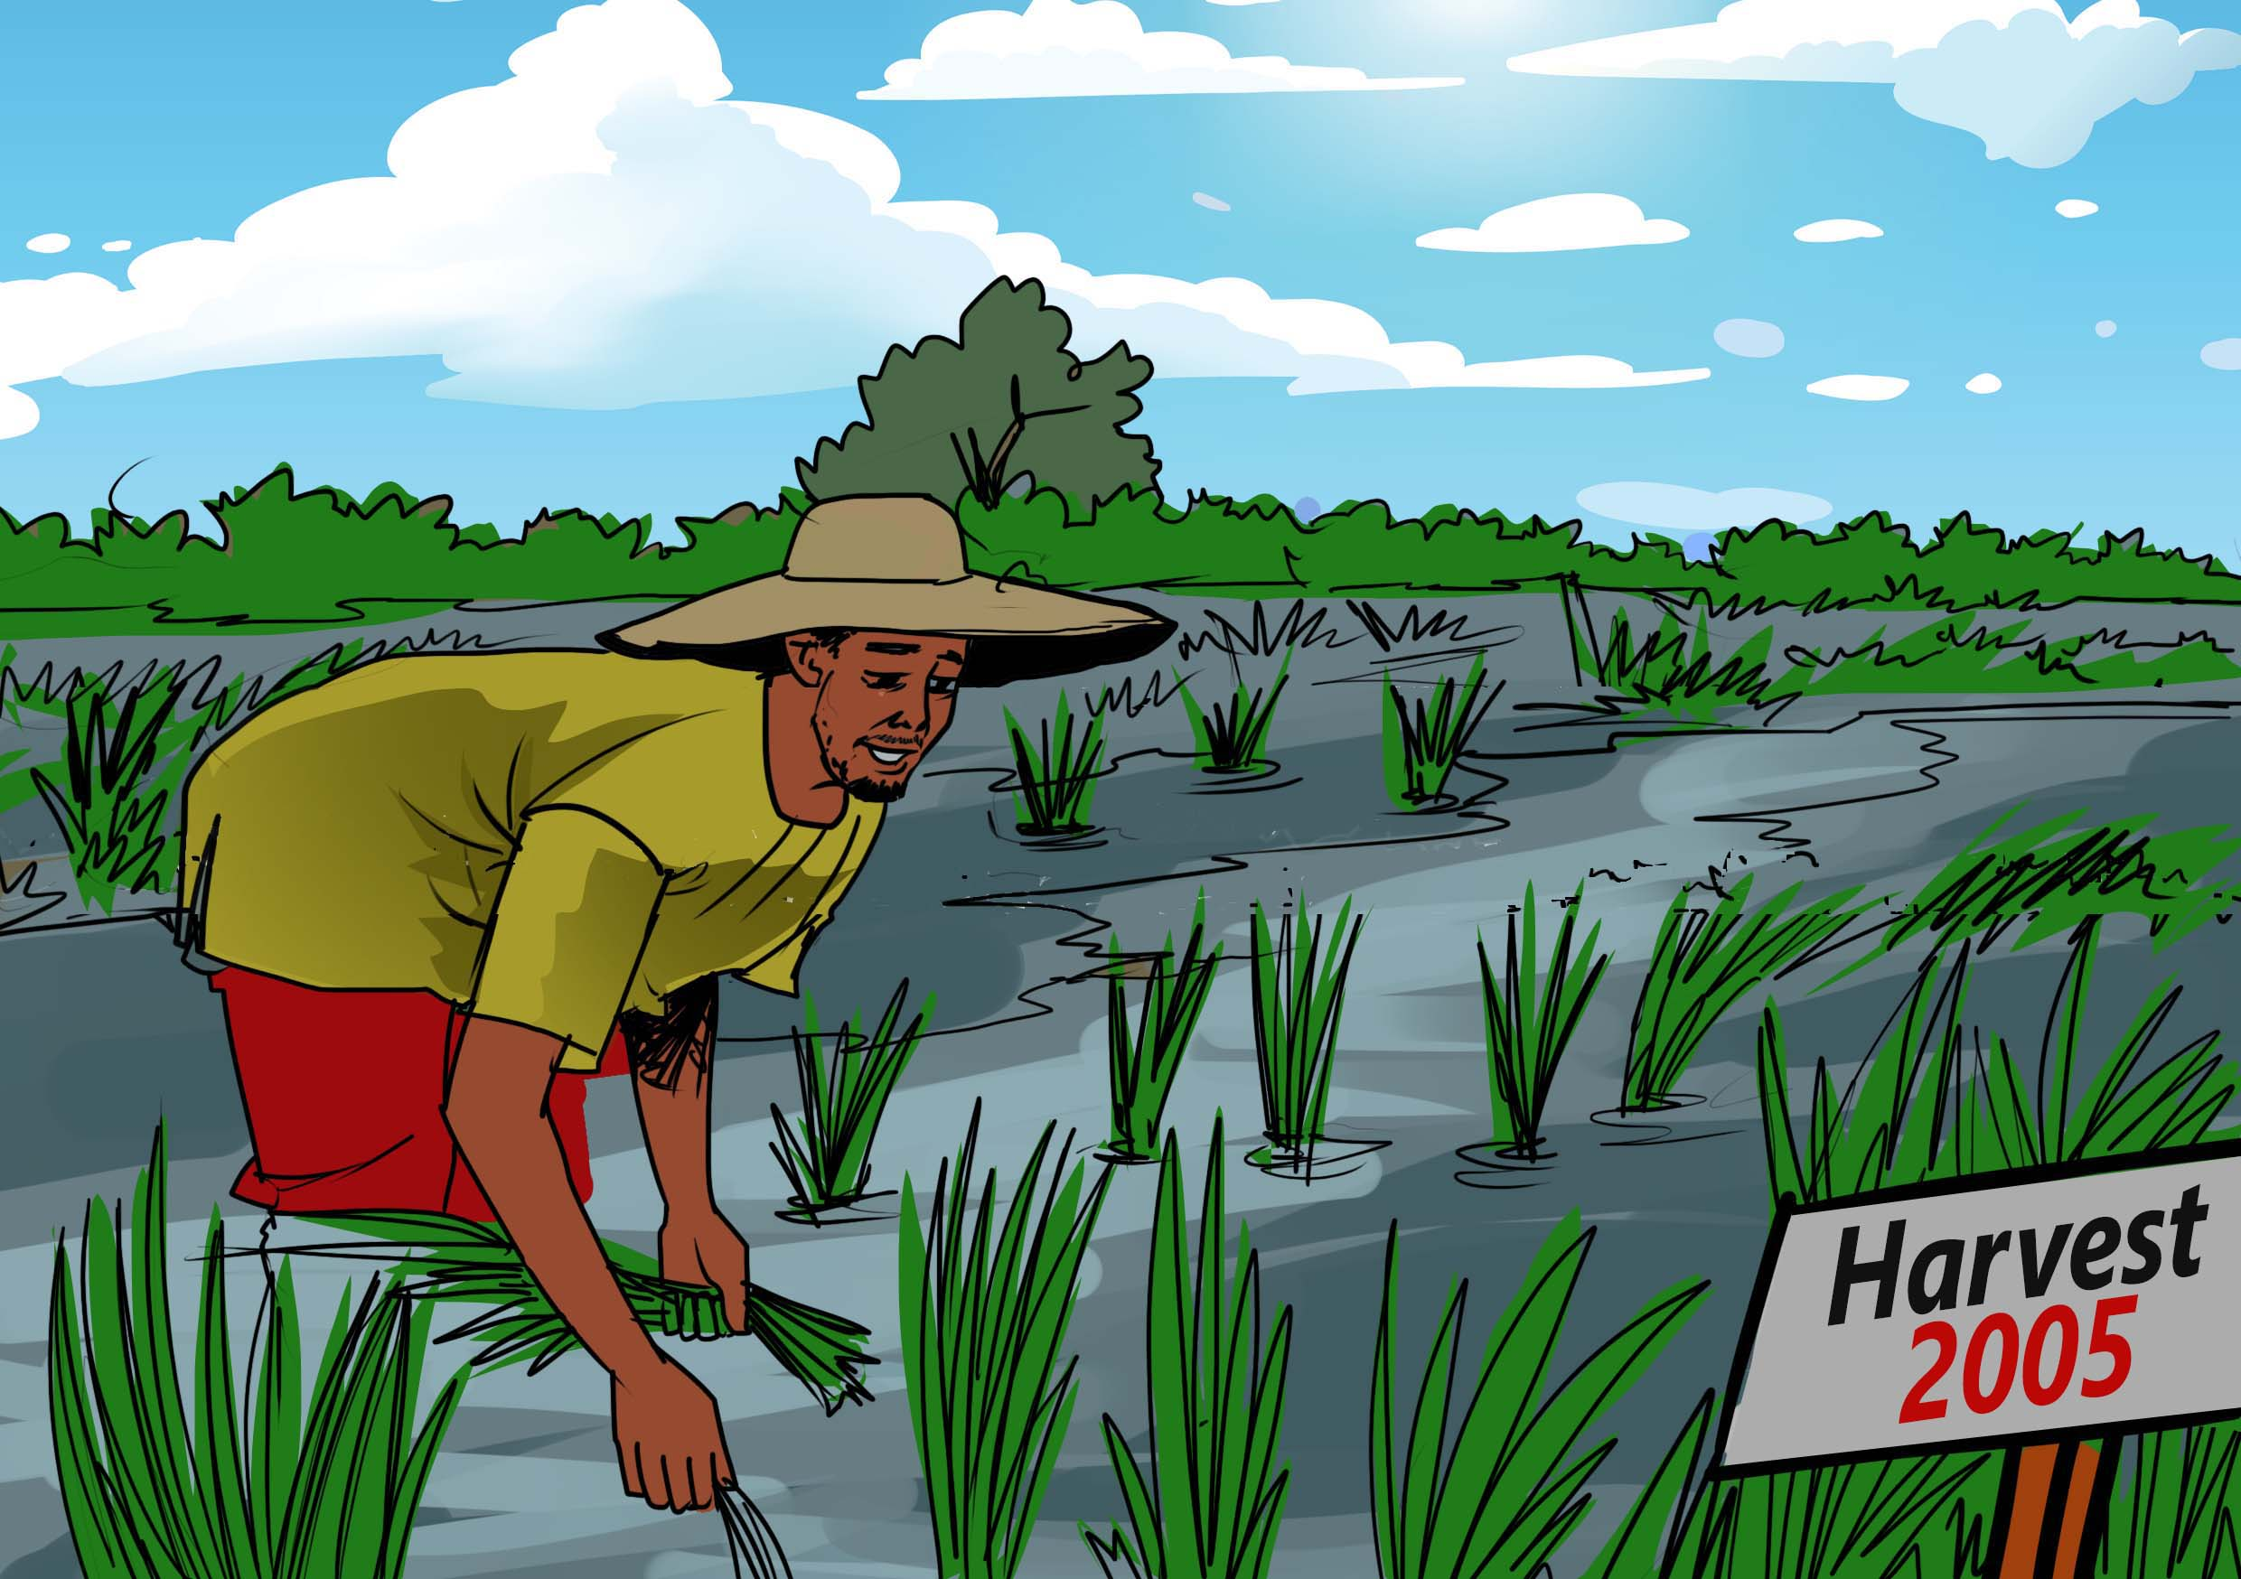
In 2005, back in Mangochi, the family earned their income from farming, selling agricultural produce including rice, cassava, and maize.

Slide 7
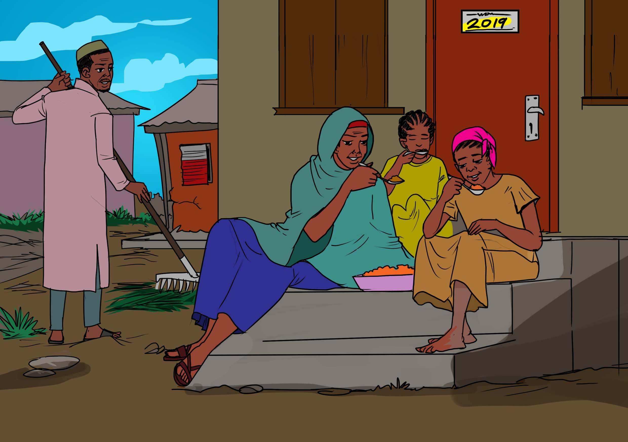
Time passed and the family grew. Daud completed his dream of building a two-bedroom home in Traditional Authority Mponda. Daud and Alima raised their family in this home.
By 2019, their oldest daughter, Fatsani, had left to live on her own, leaving four people in the household: Alima, Daud, and their younger daughters Bertha and Yamikani.

Slide 8
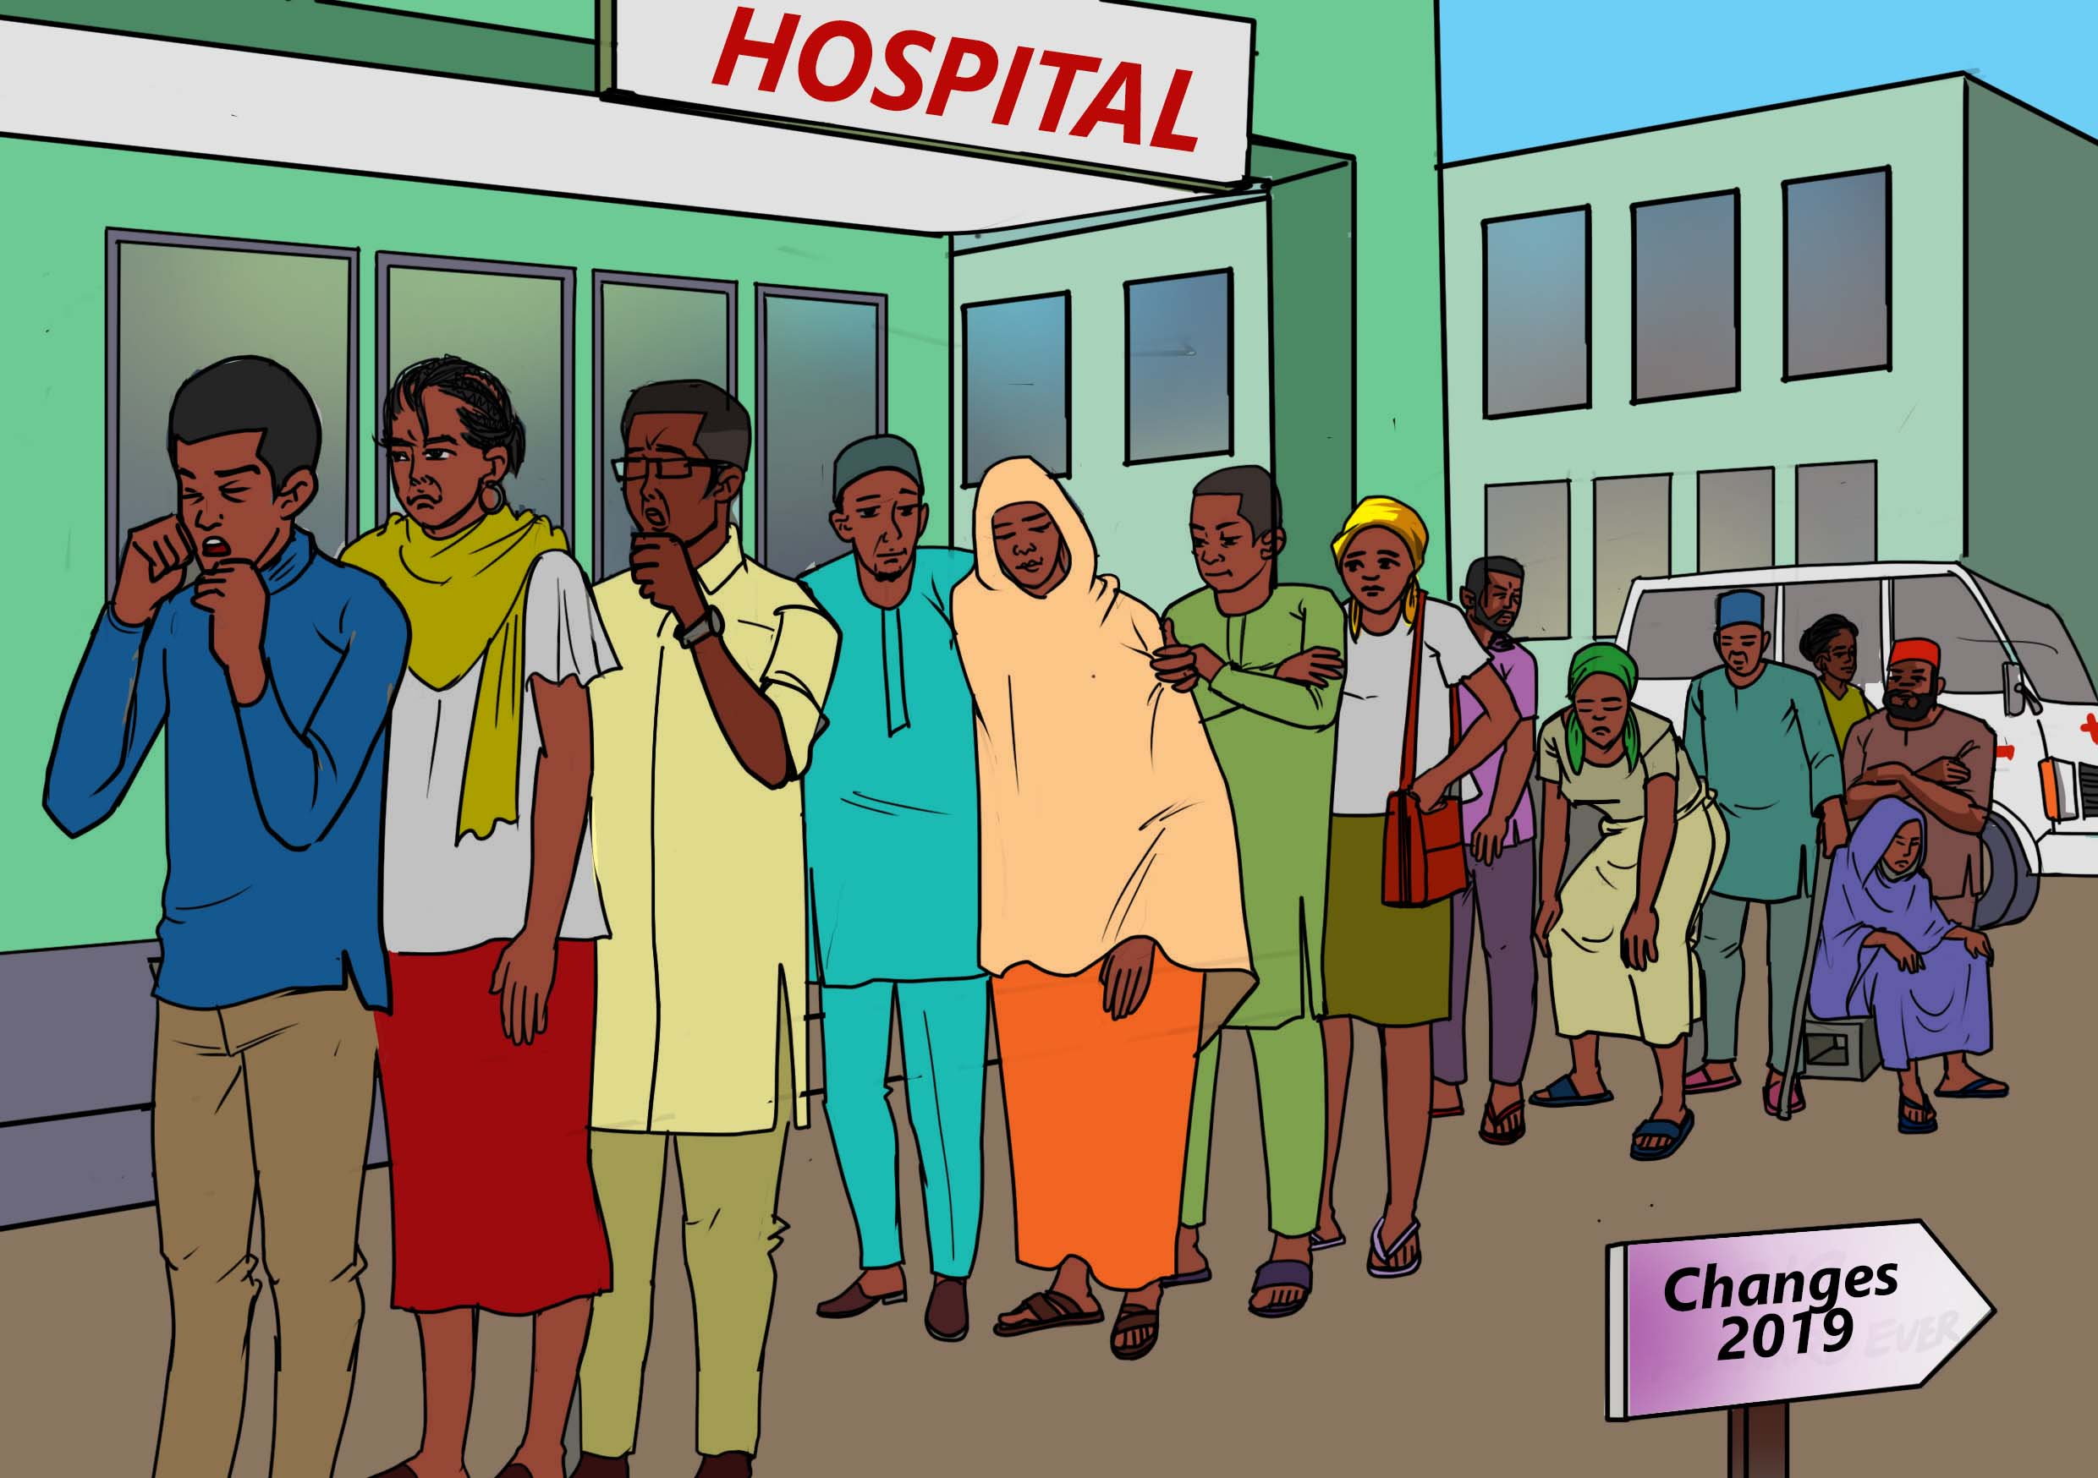
In 2019, Alima started complaining of joint and chest pains and prolonged body weakness.
The family spent a lot of money on transport fares seeking a diagnosis for Alima, amounting to a dollar a day for the two to move to and from their home and the Mangochi district hospital. During this time, the family’s income declined sharply.
Discussion Points:
Long wait times at health facilities are a huge barrier to accessing TB care. Wait times are often due to staff shortages, which are acute across all health facilities in Malawi and especially district hospitals.
Out-of-pocket payments to access TB care are very common and expose people with TB and their households to financial risks. Even when diagnosis or treatment are free, people can still spend significant amounts of money on other costs such as transportation.
Coupled together, long wait times and out-of-pocket costs derail the promise of universal health coverage and equitable, universal access to TB diagnosis and treatment within that.
Discussion question: What are some of the barriers to accessing affordable TB prevention, treatment, and care where you live?

Slide 9
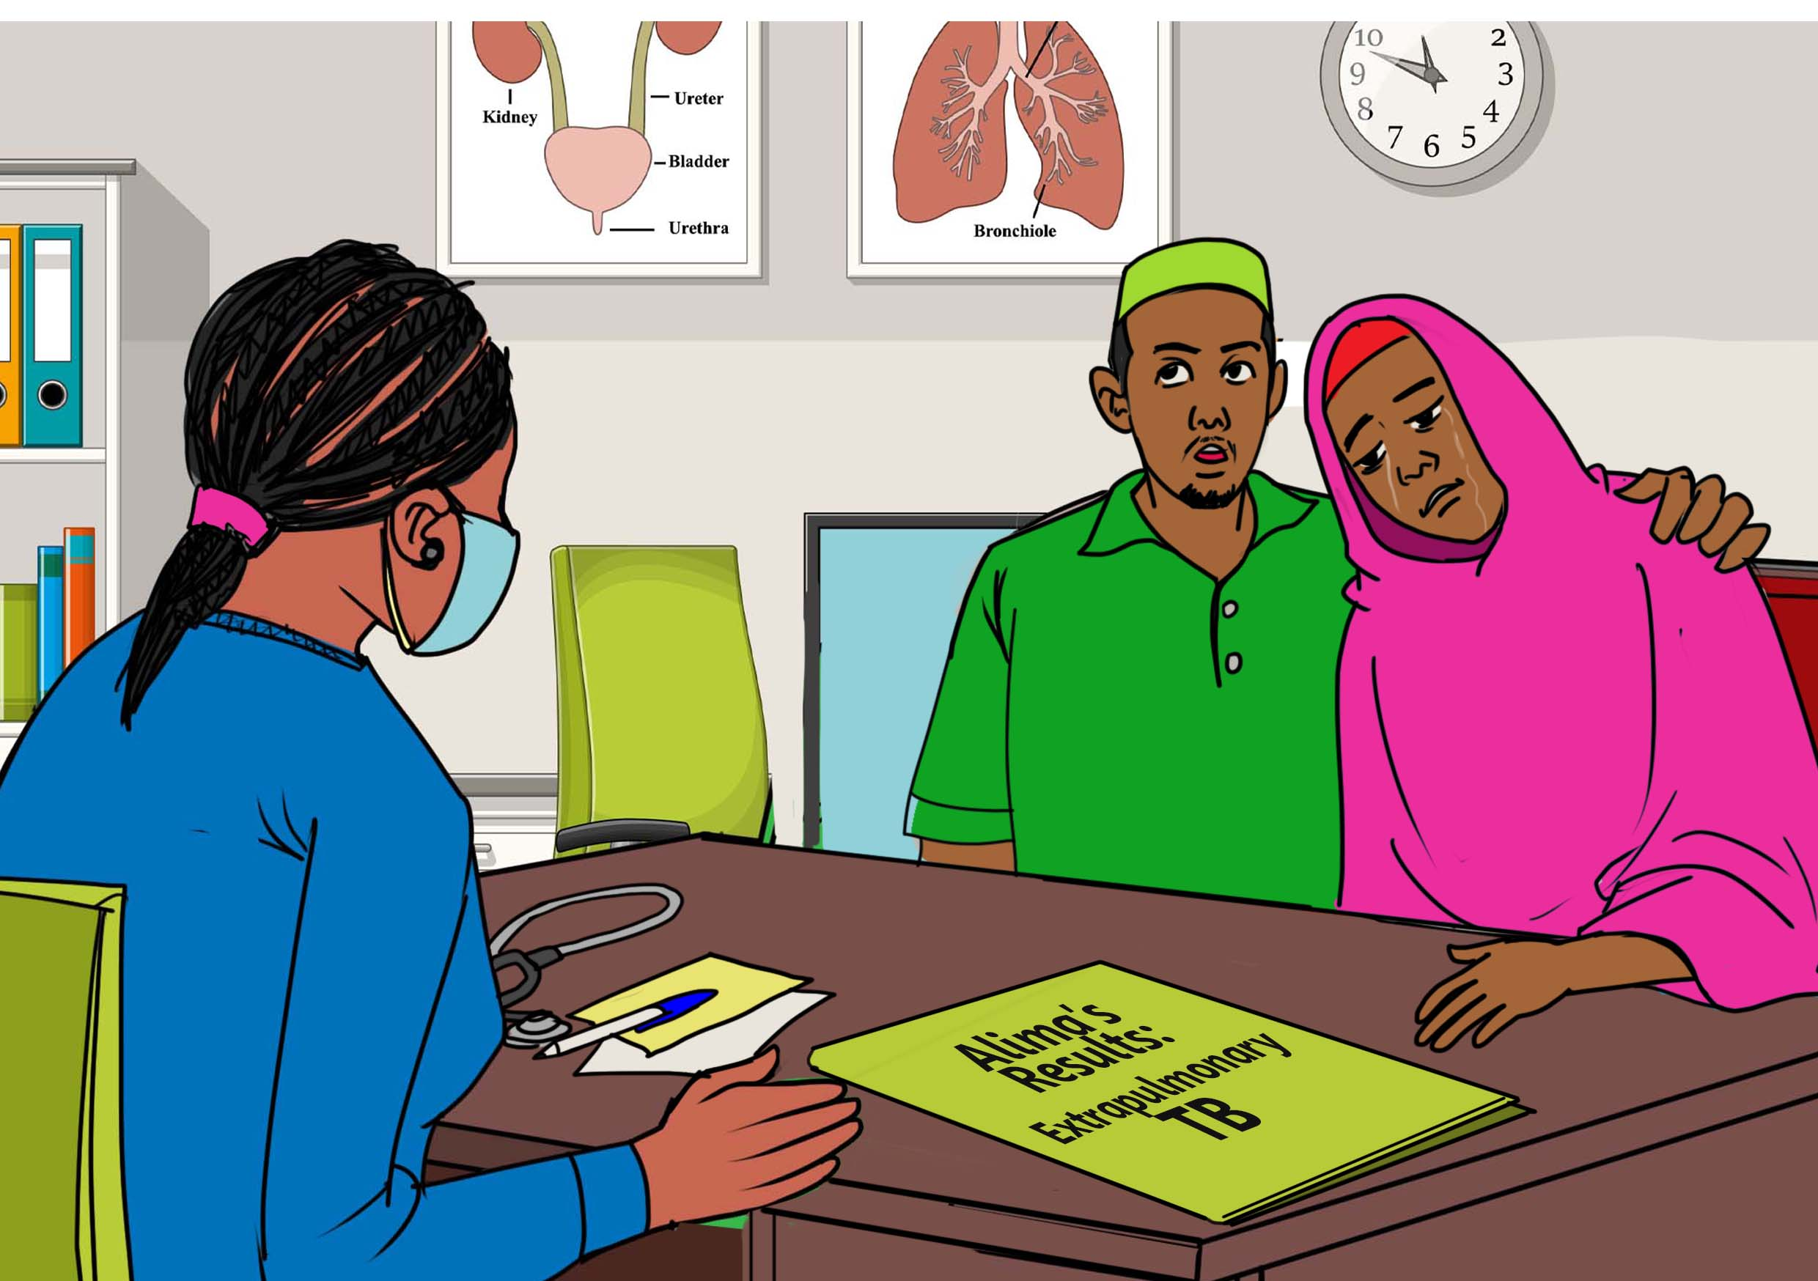
Finally, after many months of pain and multiple visits to the district hospital, Alima was diagnosed with bone TB.
Daud was devastated to hear Alima’s diagnosis.
Alima was initiated on a 6-month TB treatment regimen, which she would go on to complete successfully.

Slide 10
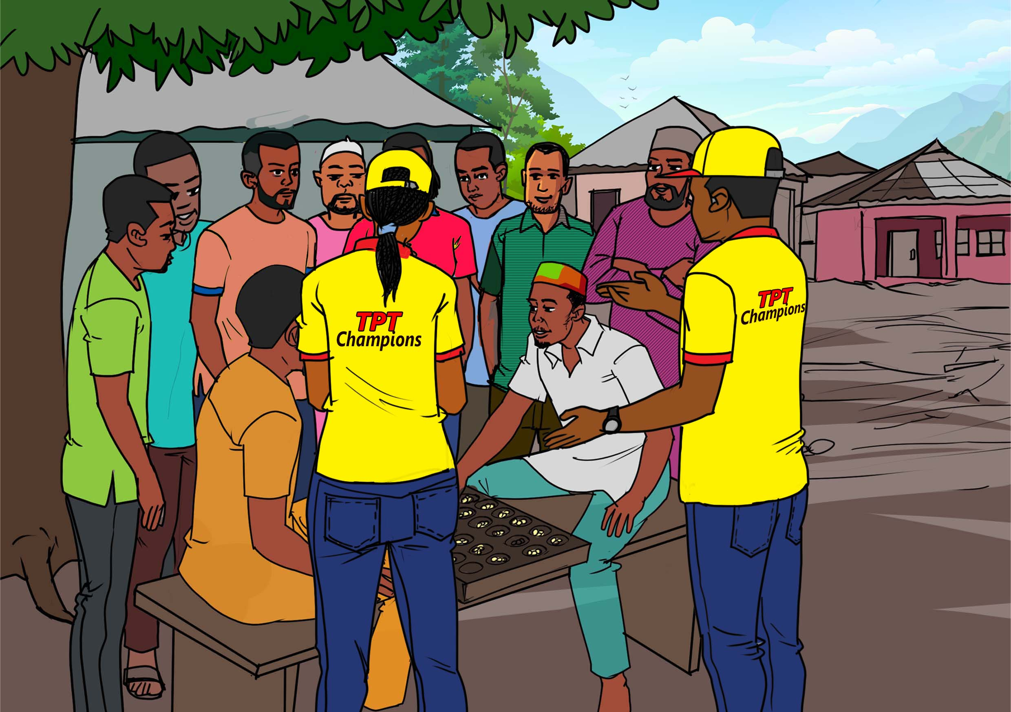
When not working or caring for Alima, Daud liked to spend time playing bawo with friends around his community and here men would discuss social and health issues like TB.
It was during a bawo game that Daud learnt about TB preventive treatment (TPT) from volunteers with Baylor Foundation Malawi, a local NGO. They were working under the Unitaid-funded IMPAACT4TB project to raise awareness about TPT in Mangochi district.
3HP is a medication that protects the whole family from contracting tuberculosis. 3HP is taken as 12 once-weekly doses of isoniazid and rifapentine to prevent TB.
Discussion Points:
There are multiple different drug regimens used as TB preventive treatment. The community health volunteers Daud met were raising awareness about a regimen called 3HP.
The 3HP regimen is taken once-a-week for 12 weeks. It combines two drugs: rifapentine and isoniazid. 3HP can be taken by many people, including adults, children, and people living with HIV.
3HP and other TPT regimens are taken by people at risk of TB to stop them from developing TB disease.
Discussion question: Is 3HP available in your community? Aside from 3HP, what other TPT regimens have you heard about? How do they compare to 3HP?

Slide 11
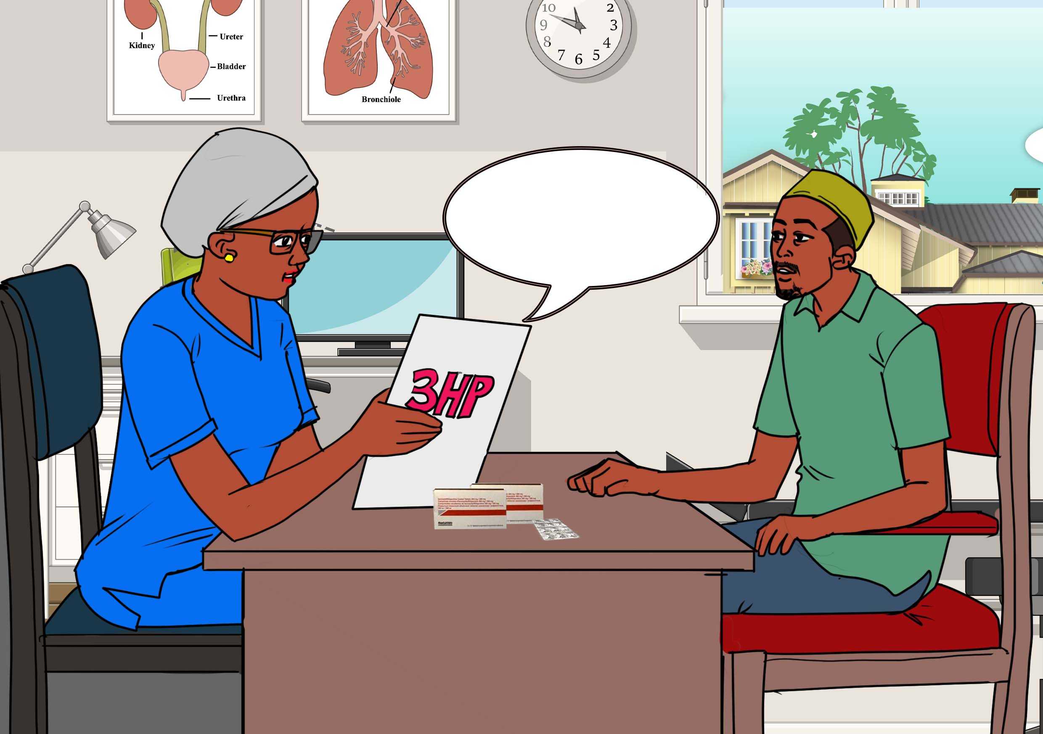
After talking to the community volunteers, Daud returned to the clinic to ask about 3HP. Realizing that Daud’s wife Alima had TB disease, health workers knew Daud might be eligible for TPT as a “household contact.”
Before initiating Daud on 3HP, healthcare workers first had to rule out active TB disease, which is part of guidelines for TB preventive treatment. Health workers first screened Daud and ruled out TB disease using a chest X-ray.
Upon hearing that Daud was a household contact of someone with TB, health workers should have immediately offered him 3HP. Instead, he had to request TPT for himself.
This is how you take 3HP… it is easy and with little side effects.
Discussion Points:
Daud and his daughters were eligible for TPT because they were what is called “household contacts.” That is, people who live with–or share air with—people who have TB disease.
Low awareness of TPT among household contacts is very common, with most people unaware of the benefits of taking TPT regimens such as 3HP.
Ideally, Daud and his daughters should have been screened for TB and offered 3HP soon after Alima’s TB diagnosis. In actuality, Daud only learned about 3HP some time after Alima began TB treatment.
Daud’s daughters, Bertha and Yamikani, who were both living at home with Alima and Daud, were not started on 3HP – another missed opportunity to prevent TB in the home with screening and TB preventive treatment.

Slide 12
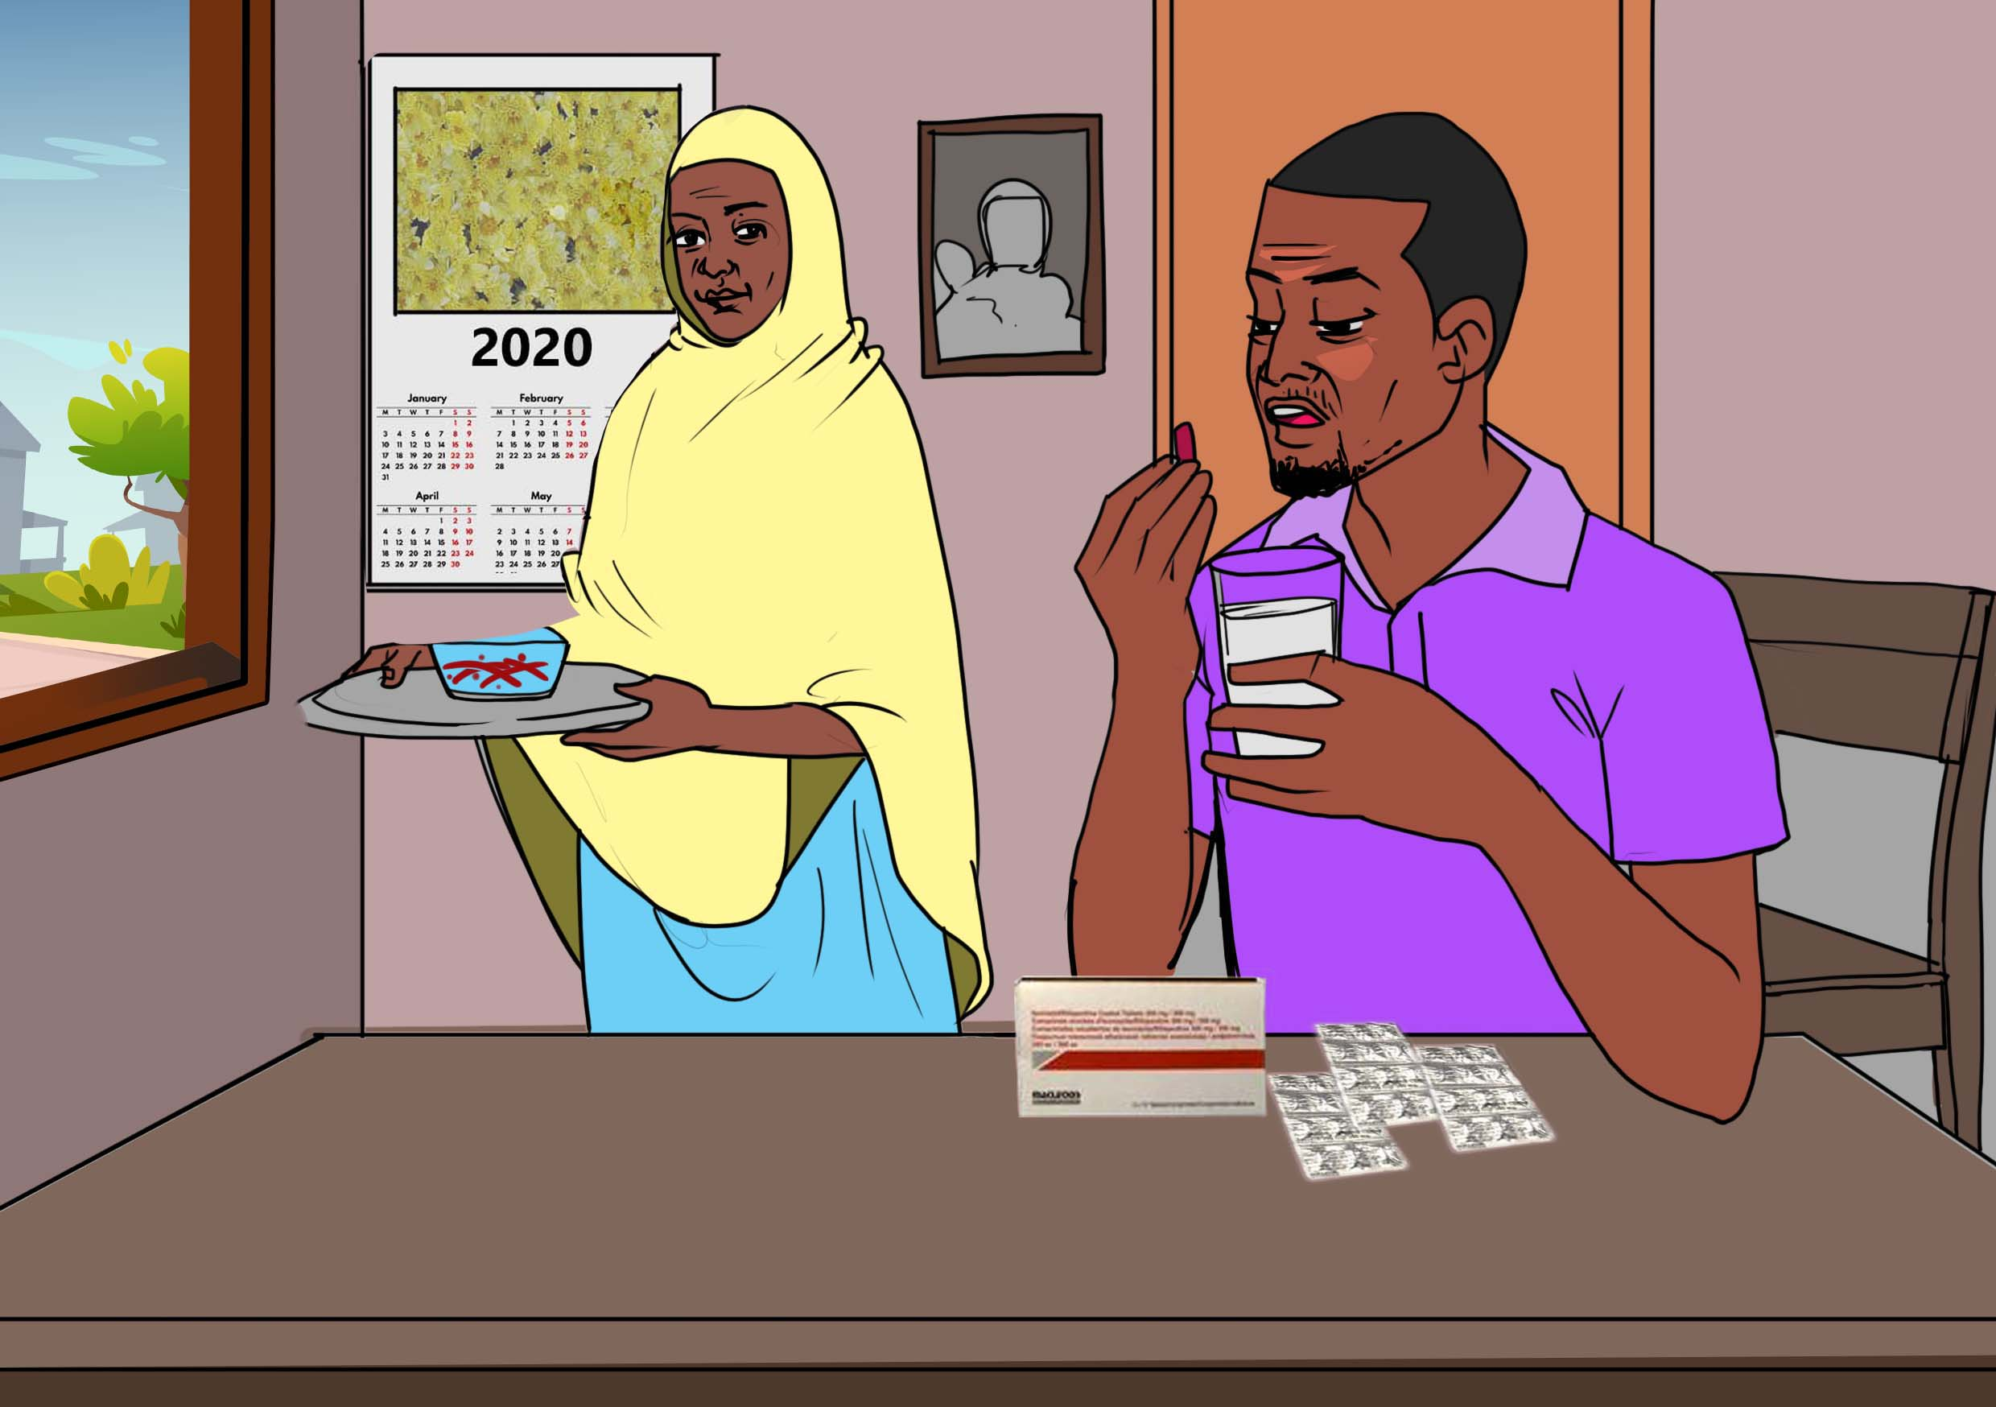
In 2020, shortly after starting the 3HP, Daud experienced a persistent mild headache, which resolved on its own in the course of treatment after a few weeks.
However, there were no clear plan from the health workers for monitoring side effects. Luckily, aside from the headaches, the 3HP short regimen was tolerable and short.
Taking 3HP once a week for 3 months is not that bad.
Discussion Points:
Malawi’s healthcare system is plagued with a shortage of healthcare workers and poorly equipped with information technologies for monitoring adverse effects.
The WHO TPT implementation handbook recommends national TPT programs to use communication technology, including SMS and video-calls, for early reporting of adverse events and prompt action by health care workers.
Discussion question: What information do you think someone should receive when starting 3HP? What would successful counselling for TB preventive treatment look like?

Slide 13
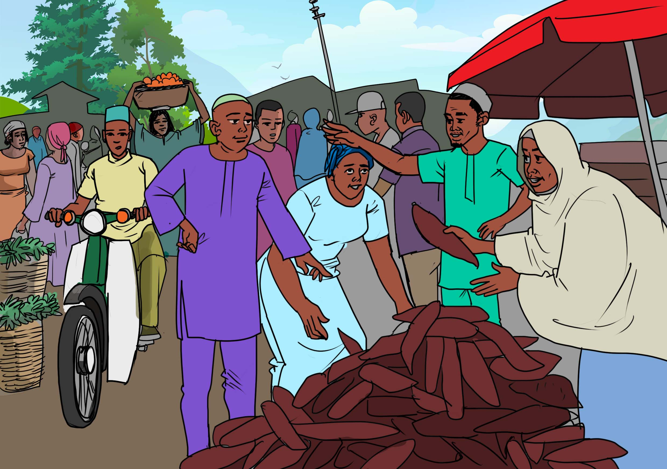
I’m so grateful that my wife and I won the fight against TB and are healthy now.
Daud and his wife were able to continue working on the farm during their treatments and generated money from cassava produce.
The income Daud earned during this time was necessary to cover the out-of-pocket payments for his and Alima’s care due to recurring transportation costs from his home to the hospital.
Discussion Points:
Short-course TB preventive therapy regimens like 3HP are better tolerated than older options like isoniazid preventive treatment. They are easier to take and have fewer side effects and enable patients generate income to cover health costs such as transport fares.

Slide 14
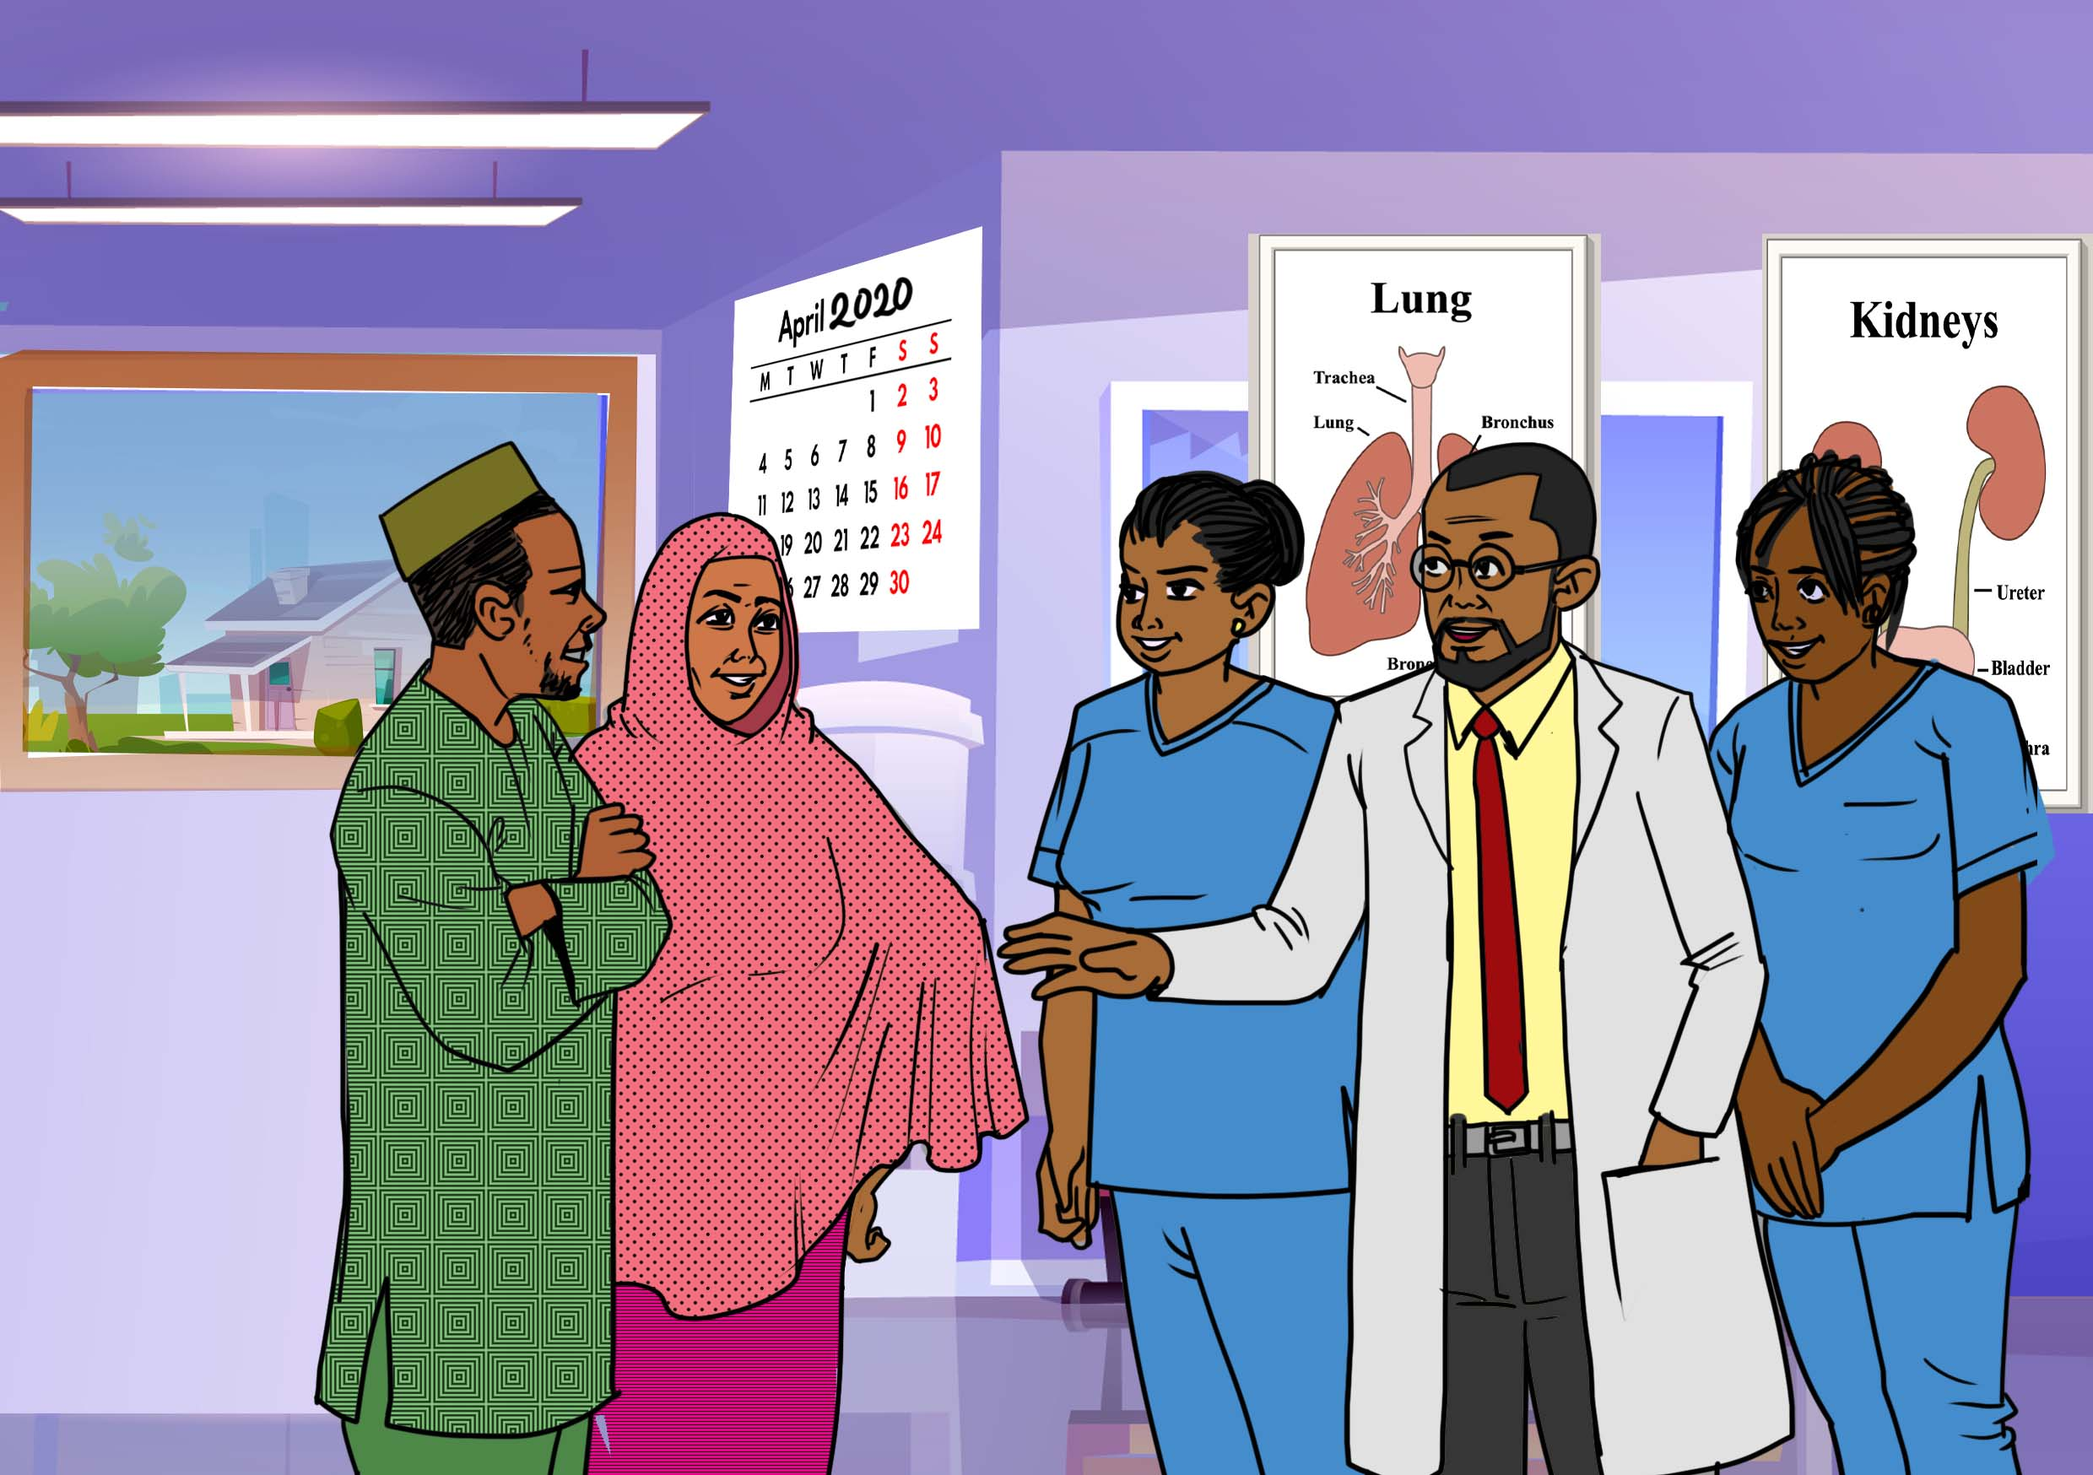
Towards the end of April 2020, Daud returned to Mangochi district hospital to receive counselling for the completion of his 12-week 3HP regimen.
Health workers at the facility were satisfied that indeed he had completed treatment successfully.
The health workers encouraged Daud and his family to live a healthy life and to educate others in the family and the neighborhood on the benefits of 3HP to prevent TB.
Thank you so much for completing your 3HP treatment. Keep yourself and your family well. It’s possible to beat TB in the households.

Slide 15
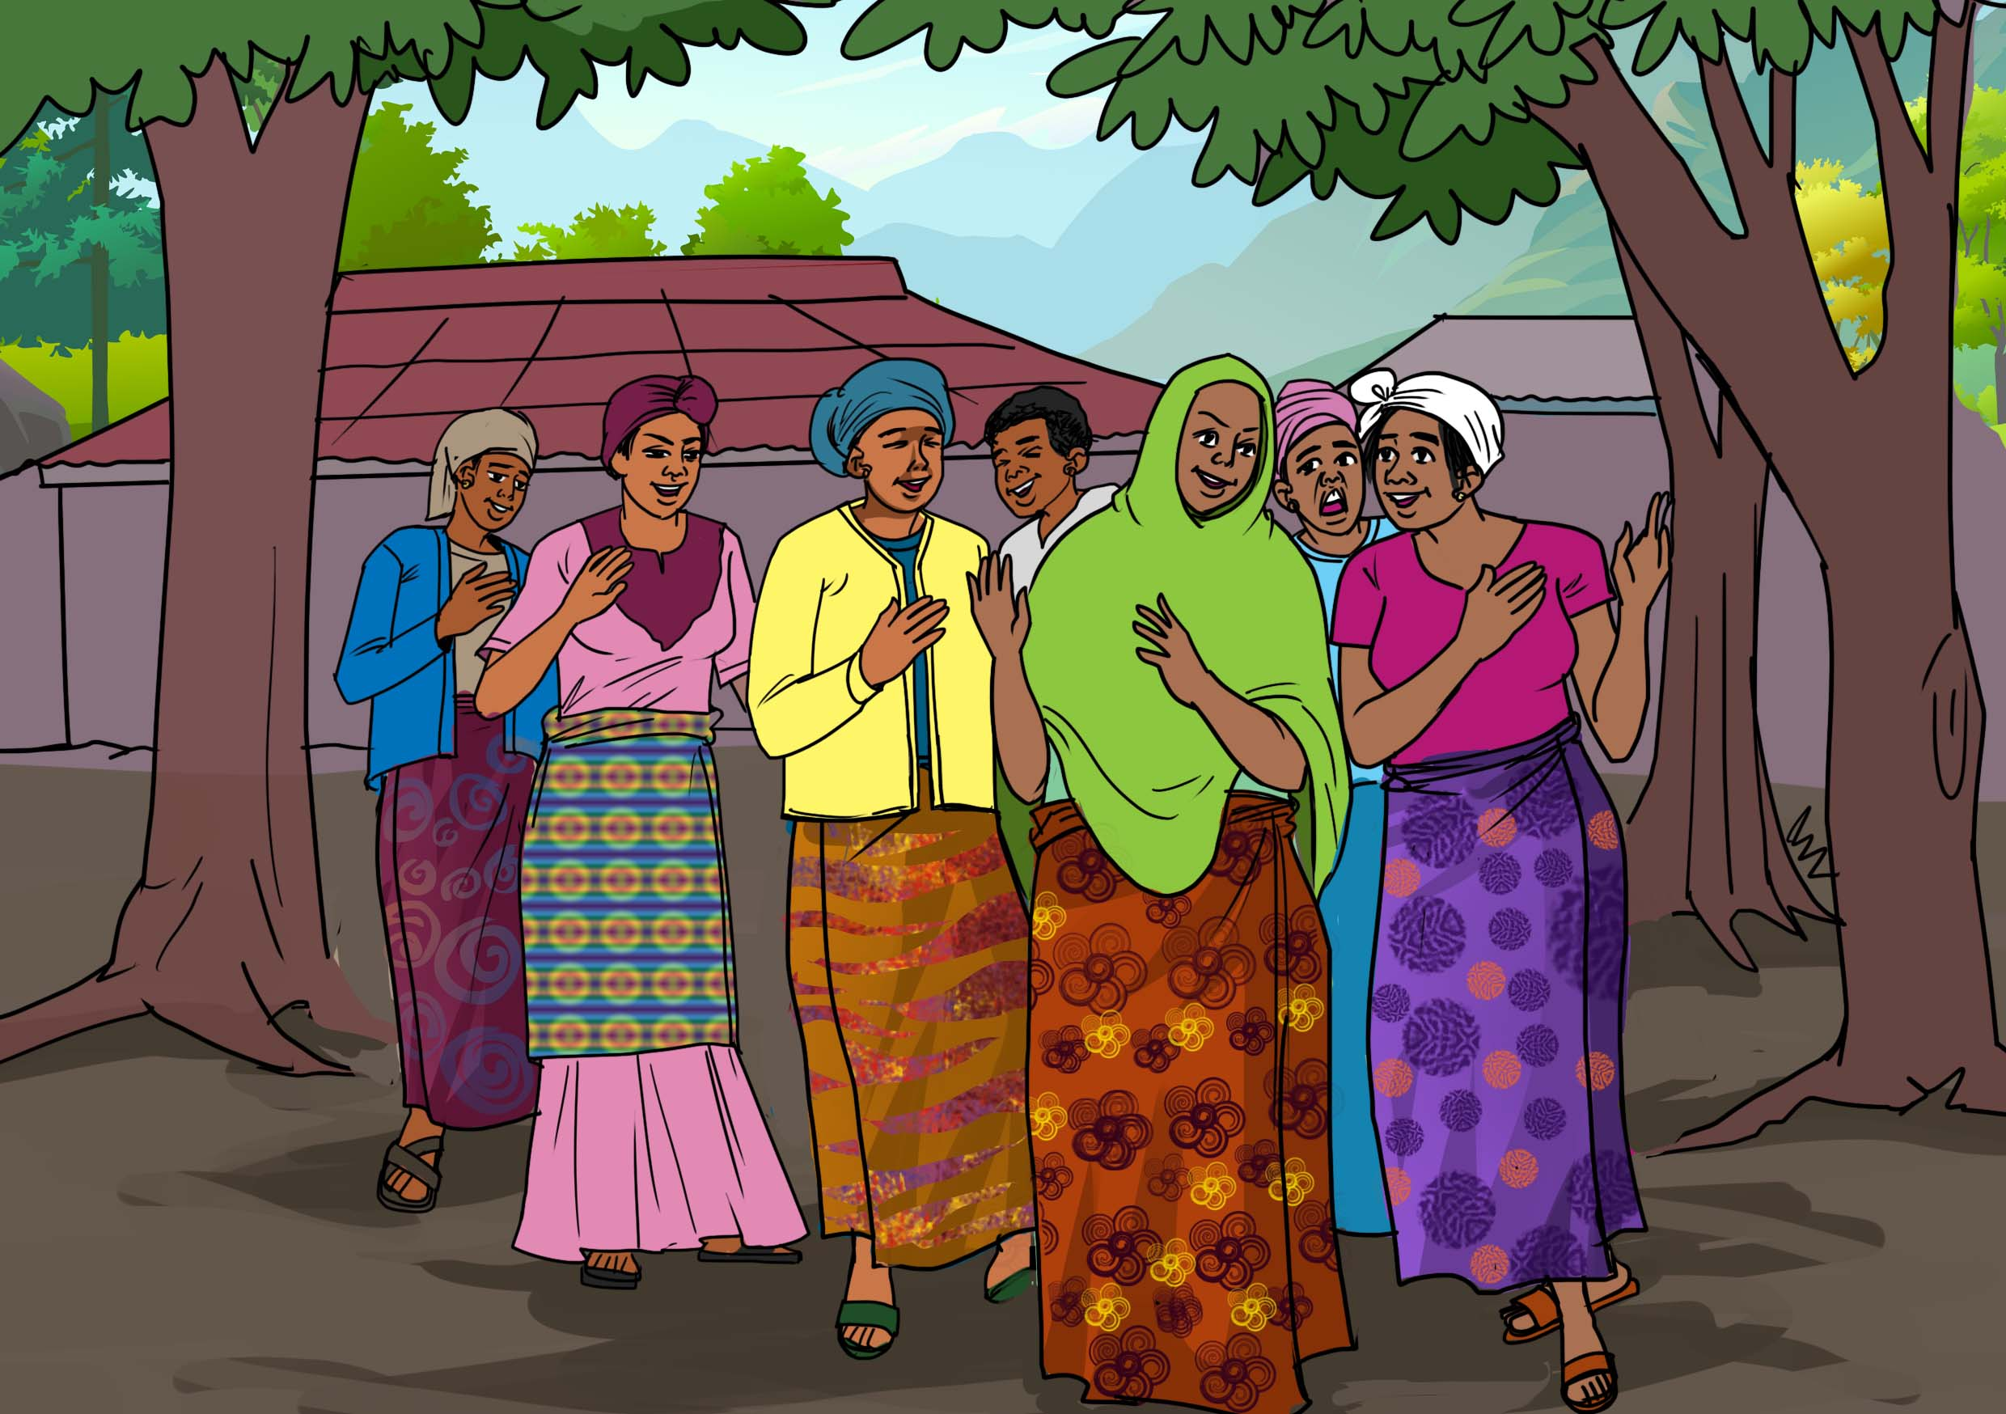

Alima now works with a women’s group in her community who work with the Coalition of Women Living with HIV (COWLHA), where she advises fellow women to encourage their husbands to embrace TPT in their households to stop TB, just like she did with Daud.
Discussion Points:
Health workers and civil society organizations should encourage people who have completed their TPT treatment successfully to engage others on the benefits of TB prevention. Former patients can even form TPT community platforms as a group of ex-TPT patients who are raising awareness to rapidly mobilize hesitant TB household contacts to initiate TPT.

Slide 16
Acknowledgments
Story: Daud and Alima Yamikani.
Narrative: Dingaan Mithi.
Illustration: Peter Olawoyin.
Project management: Lynette Mabote and Mike Frick.
Funding provided to TAG by Aurum Institute under the Unitaid-supported IMPAACT4TB project.
Special thanks to the Coalition of Women Living with HIV/AIDS, Malawi for support working with Daud and Alima.
https://www.impaact4tb.org/

