Slide 1


Ganesh Acharya
TPT in Mumbai, India
Pathways to TB preventive treatment among household contacts illustrated story series

Slide 2
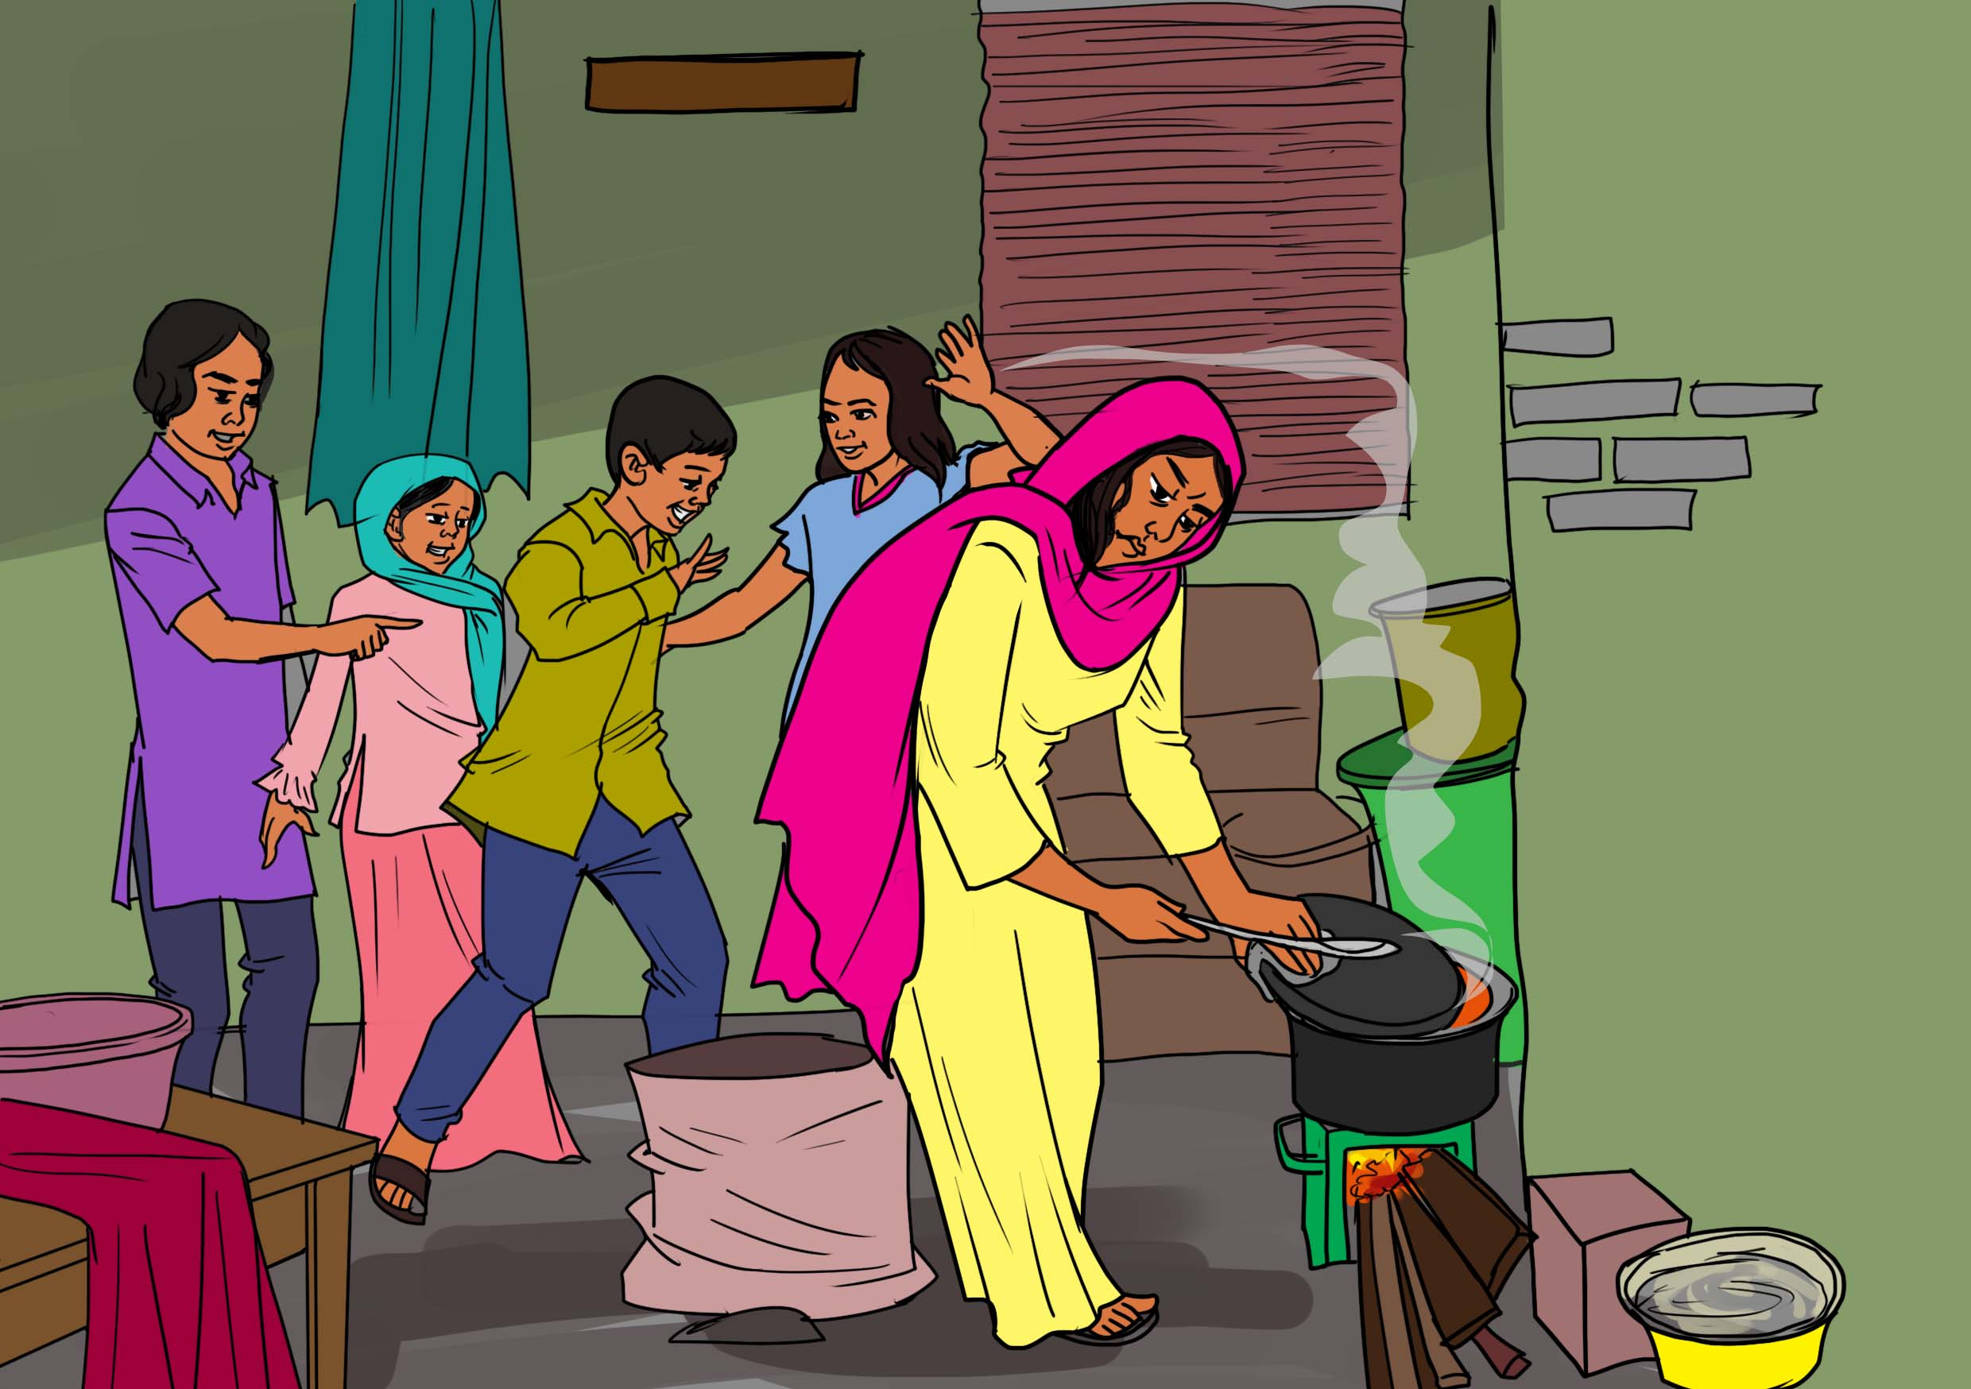
Ganesh Acharya was born in 1980 in the Southwestern Indian state of Maharashtra. He comes from a family of four – his mother is still alive, but he lost his father in the 1990s.
When his father passed away, the family went through serious financial problems based on the fact his mother had no other source of income to support the household.
He lived in the slums of Mumbai (Bombay at that time), India’s most populous city with an estimated population of 22 million, with his mother, brother, and sisters.

Slide 3
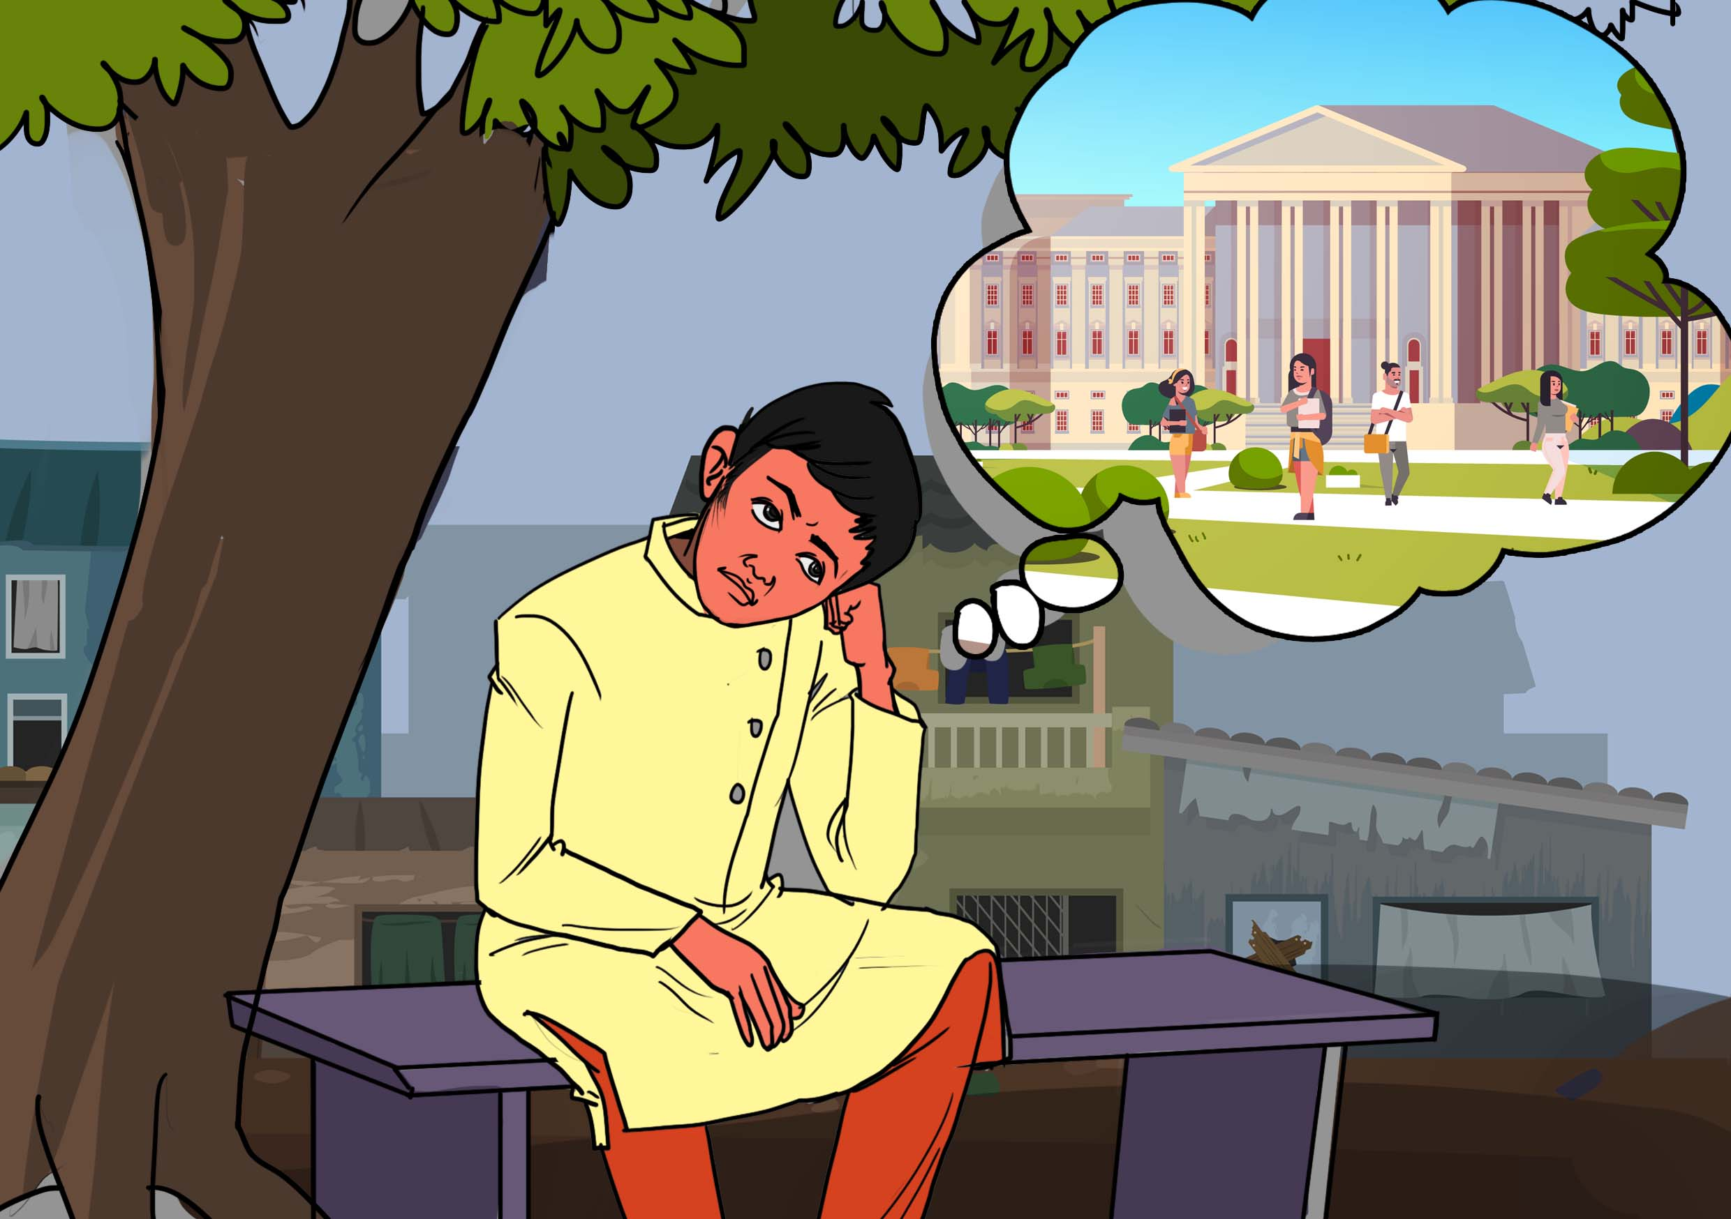
As a young man in his teens, Ganesh worked hard to finish secondary school at the Shree Ram Janaki High School. He had dreams of studying in the university.
Although Ganesh came from a female-headed household having lost his father, his mother worked hard selling food stuffs to earn income to support his studies
Notes:
Correction- Shree

Slide 4
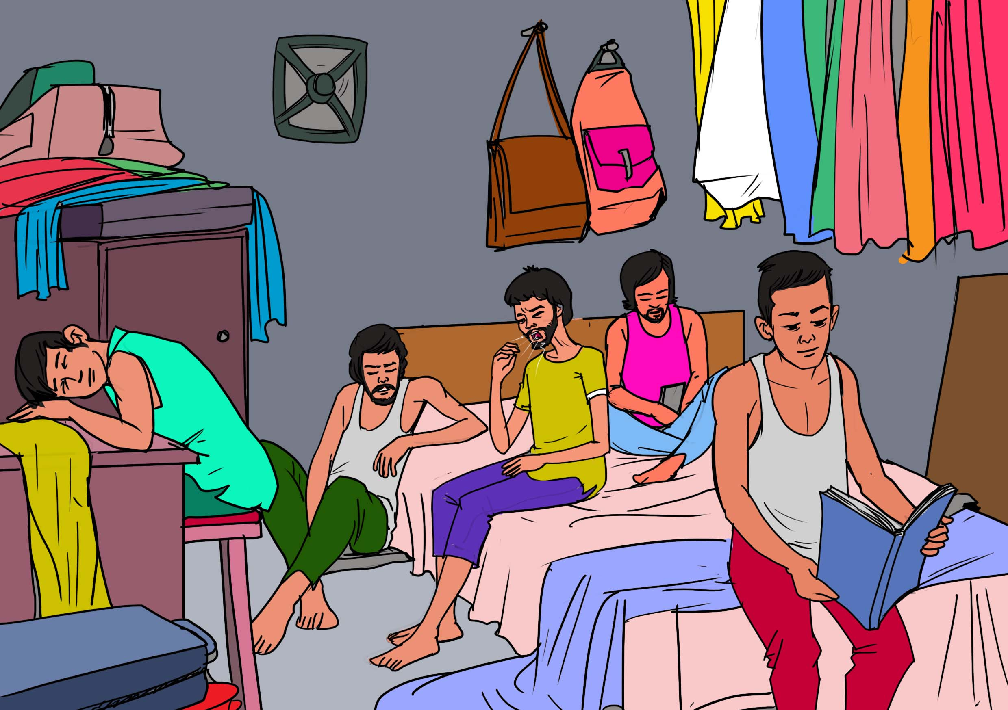
During his high school days, Ganesh lived in Govandi and King Circle slums in a small dwelling with no ventilation that he shared with friends who were incessantly coughing. He linked the coughs to tuberculosis (TB), which is very common in India.
TB is a serious public health challenge in Mumbai’s slums, with the city experiencing an explosion in population growth over the past 20 years with more slum dwellings without proper ventilation
The rapid population growth is attributed to migration from other regions in the country, driven by migrants seeking business and employment opportunities in city.
This cough won’t go away.

Slide 5
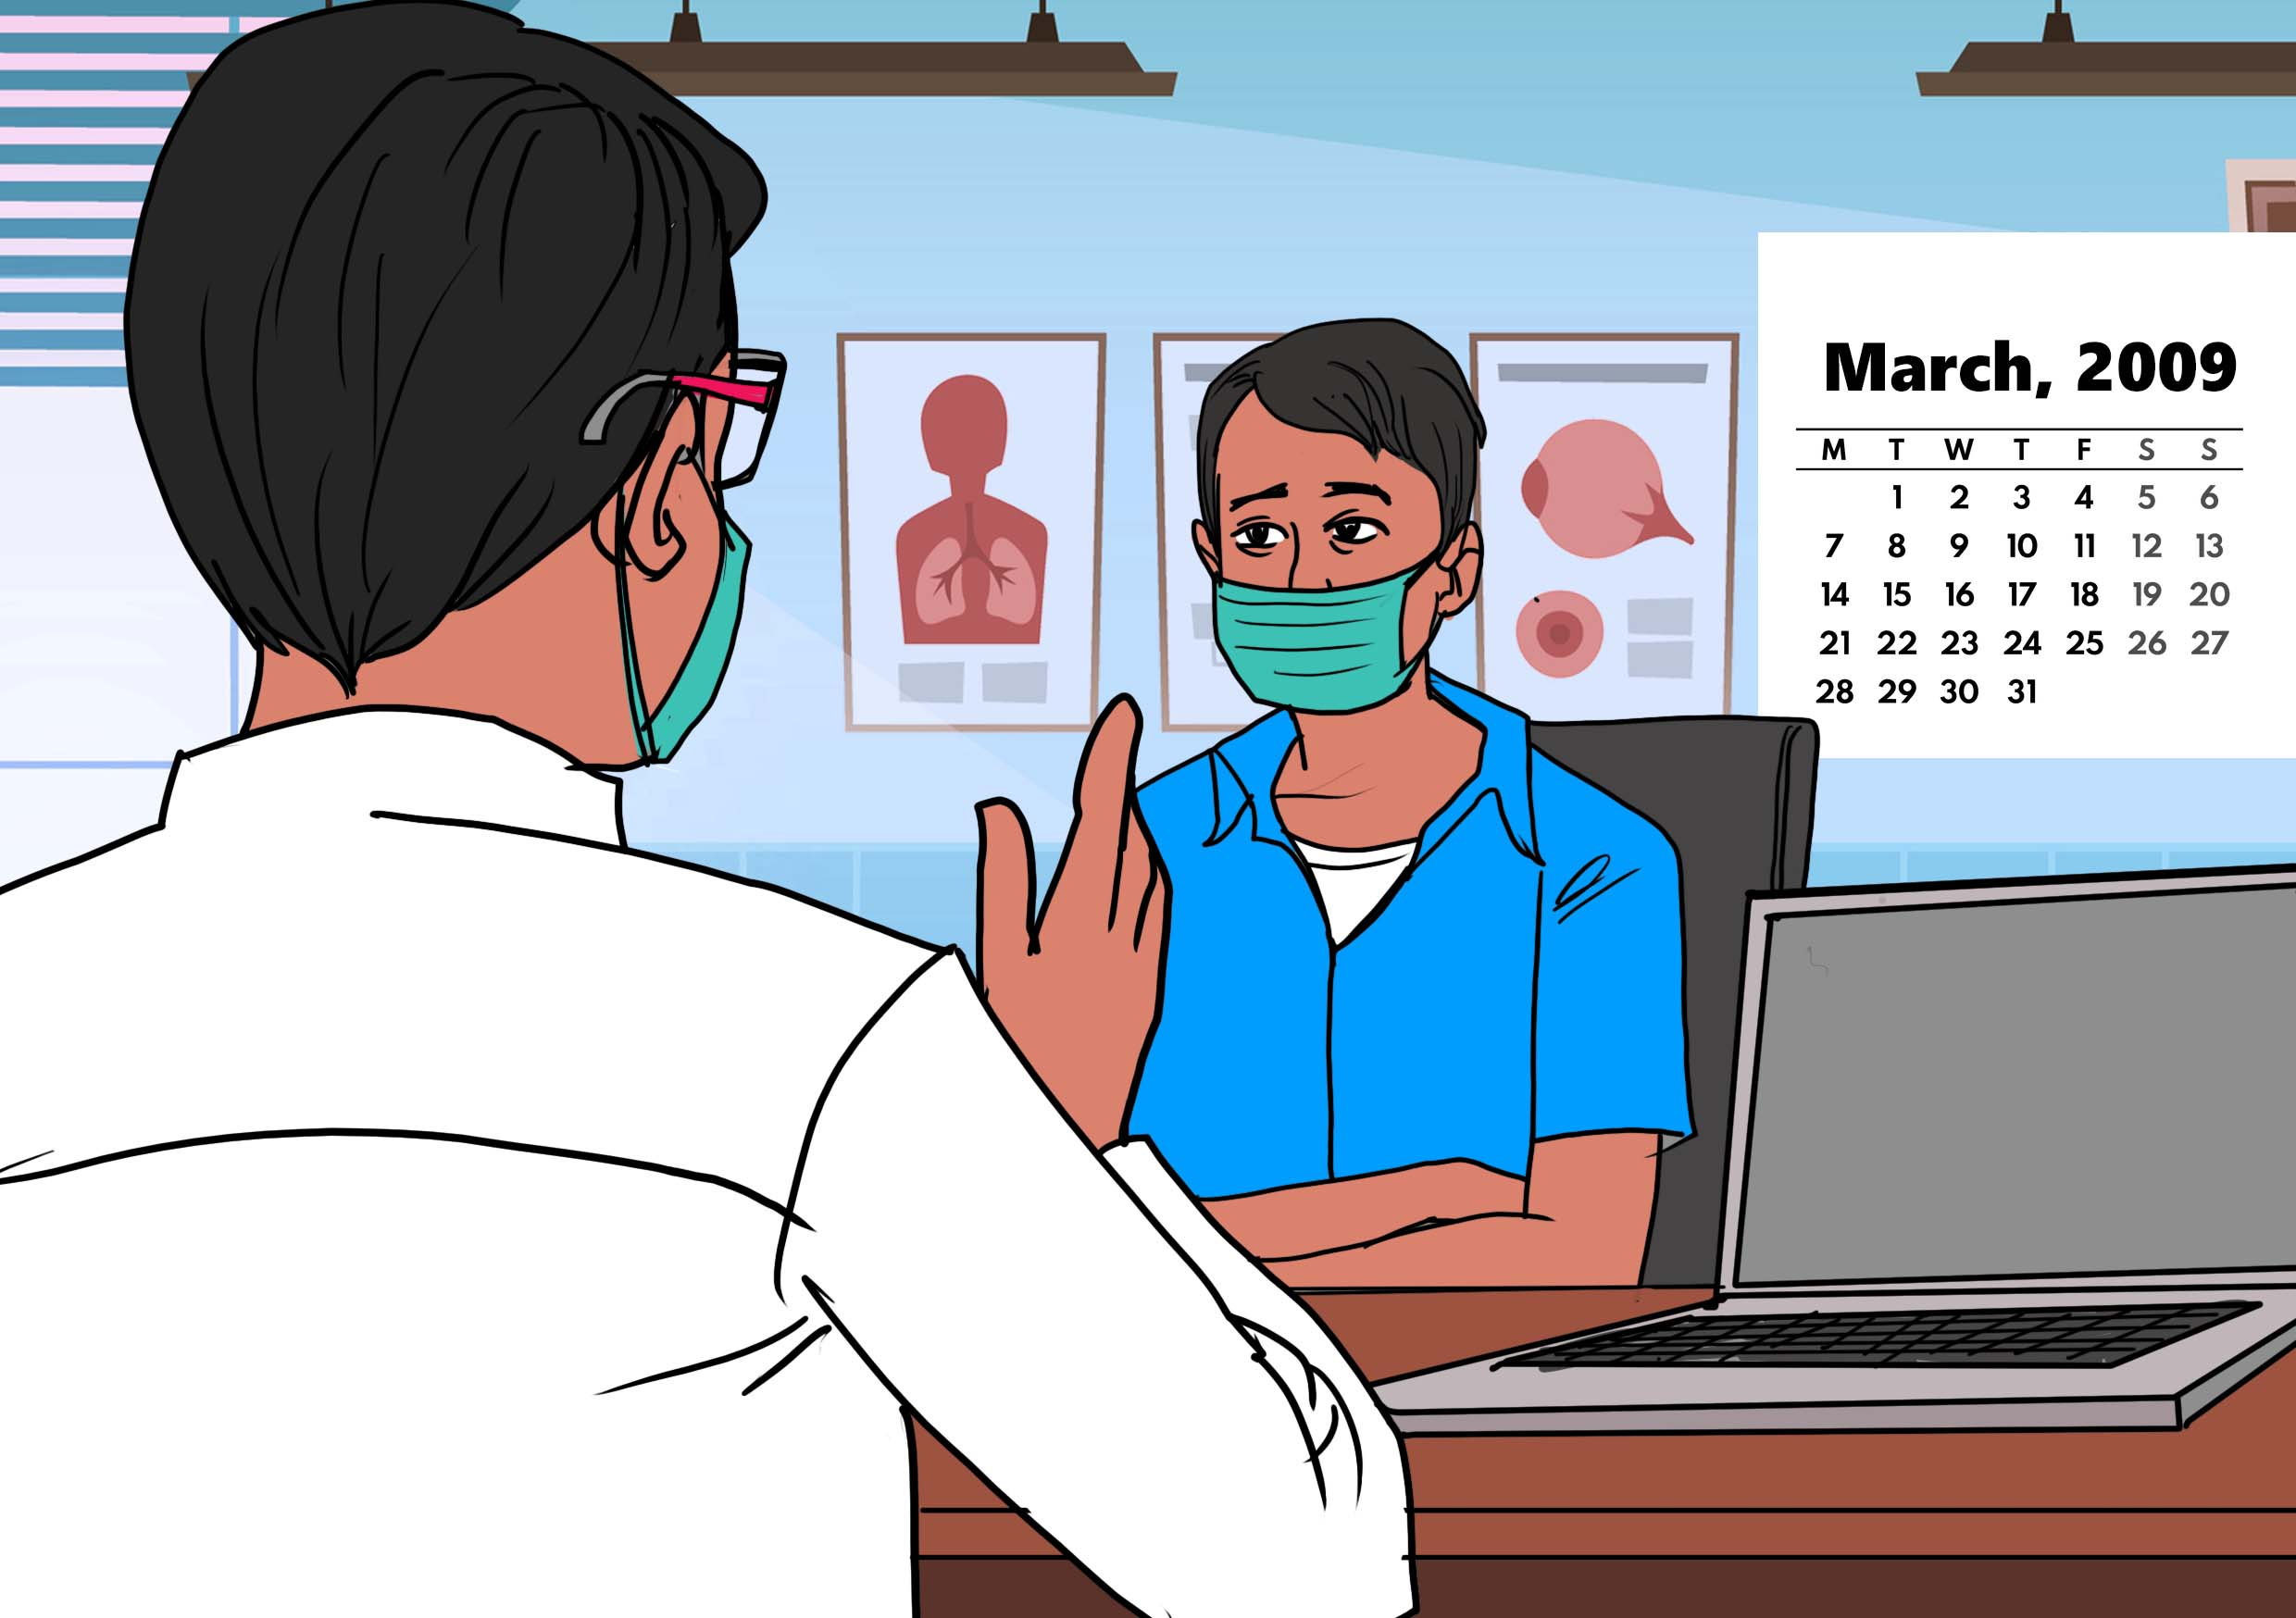
Ganesh started to feel unwell and heard about the TB work of a leading medical charity, Médecins Sans Frontières (MSF), which operates one of the largest TB clinics in Mumbai. Ganesh decided to visit the MSF clinic and got screened for TB.
Although he had no TB symptoms, health workers at the MSF clinic in Mumbai determined that he was eligible for Isoniazid Preventive Therapy (IPT) as some of the people he lived with had TB in the slums and Ganesh was living with HIV.
Based on his HIV status, the health workers at the MSF clinic determined that IPT for 36 months was the right regimen for him. TB disease progresses rapidly in people living with HIV, making TB prevention with TPT a priority in this population.
In 2009, there were no short course TB preventive therapy drugs in India like 3HP.
Discussion Points:
Before the development of short-course TPT regimens like 3HP the only option for TB preventive treatment was isoniazid preventive therapy (IPT).
IPT must be taken for very long durations, anywhere from 6 months to 36 months (what was sometimes called “lifelong IPT”).
Although IPT is very effective at preventing TB, many people struggle to take it due to the long duration, requirement of daily pill taking, and side effects.
Discussion question: Have you heard of IPT? Is it used and accepted by people in your community?

Slide 6
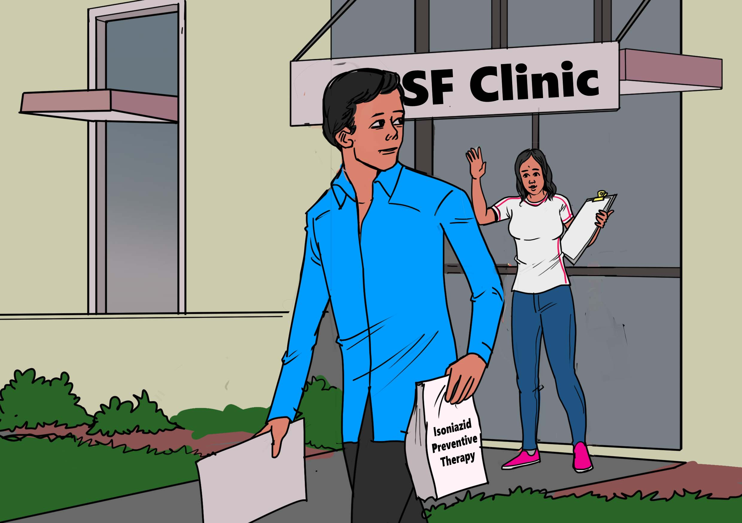
Health workers at the MSF clinic informed Ganesh that he would be initiated on a daily IPT regimen and told him to take it for 36 months.
At that time in India, there were no policies in place for shorter 6-month IPT regimens. Moreover, short-course TPT regimens used preferentially today, such as 3HP, had yet to be developed.
Ganesh understood the need to prevent TB from developing into active disease, so he quickly accepted the 36-month IPT regimen, although he had fears of side effects, including liver toxicity.
How can I sustain TB preventive treatment for 36 months?
Discussion Points:
Access to quality TB healthcare and TB preventive therapy and IPT is very challenging in slum areas. TB screening, diagnosis, prevention, and treatment are all hampered by inadequate information and a lack of access to health services.
Although now there are shorter courses of IPT – 6 months instead of 36 months – and shorter, less toxic alternative regimens such as 3HP, these better options are not yet available widely.
3HP is a short-course TPT regimen that consist of 12 doses of medicine taken once-a-week for 12 weeks. 3HP combines two TB drugs: isoniazid and rifapentine. Clinical trials have shown that 3HP is as good as IPT in preventing TB and that it has fewer side effects and can be completed in less time.
Discussion questions: What are some of the differences between 3HP and IPT? Is 3HP or are other shorter TPT regimens (1HP, 3HR) available in your community?

Slide 7

I am so proud of myself for sticking with my TB prevention treatment.
Finally, Ganesh’s dream of attending university came true and he enrolled at Dr. Ram Manohar Lohia Avadh University to study for a bachelor’s degree in political science. During this time, he continued to take his IPT regimen, although he sometimes had to take time off from college due to severe IPT side effects.
Ganesh was repeatedly worried that side effects from the prolonged IPT regimen would jeopardize his chances of completing his university education. However, he continued with his studies under duress.
Notes:
Correction- Manohar

Slide 8
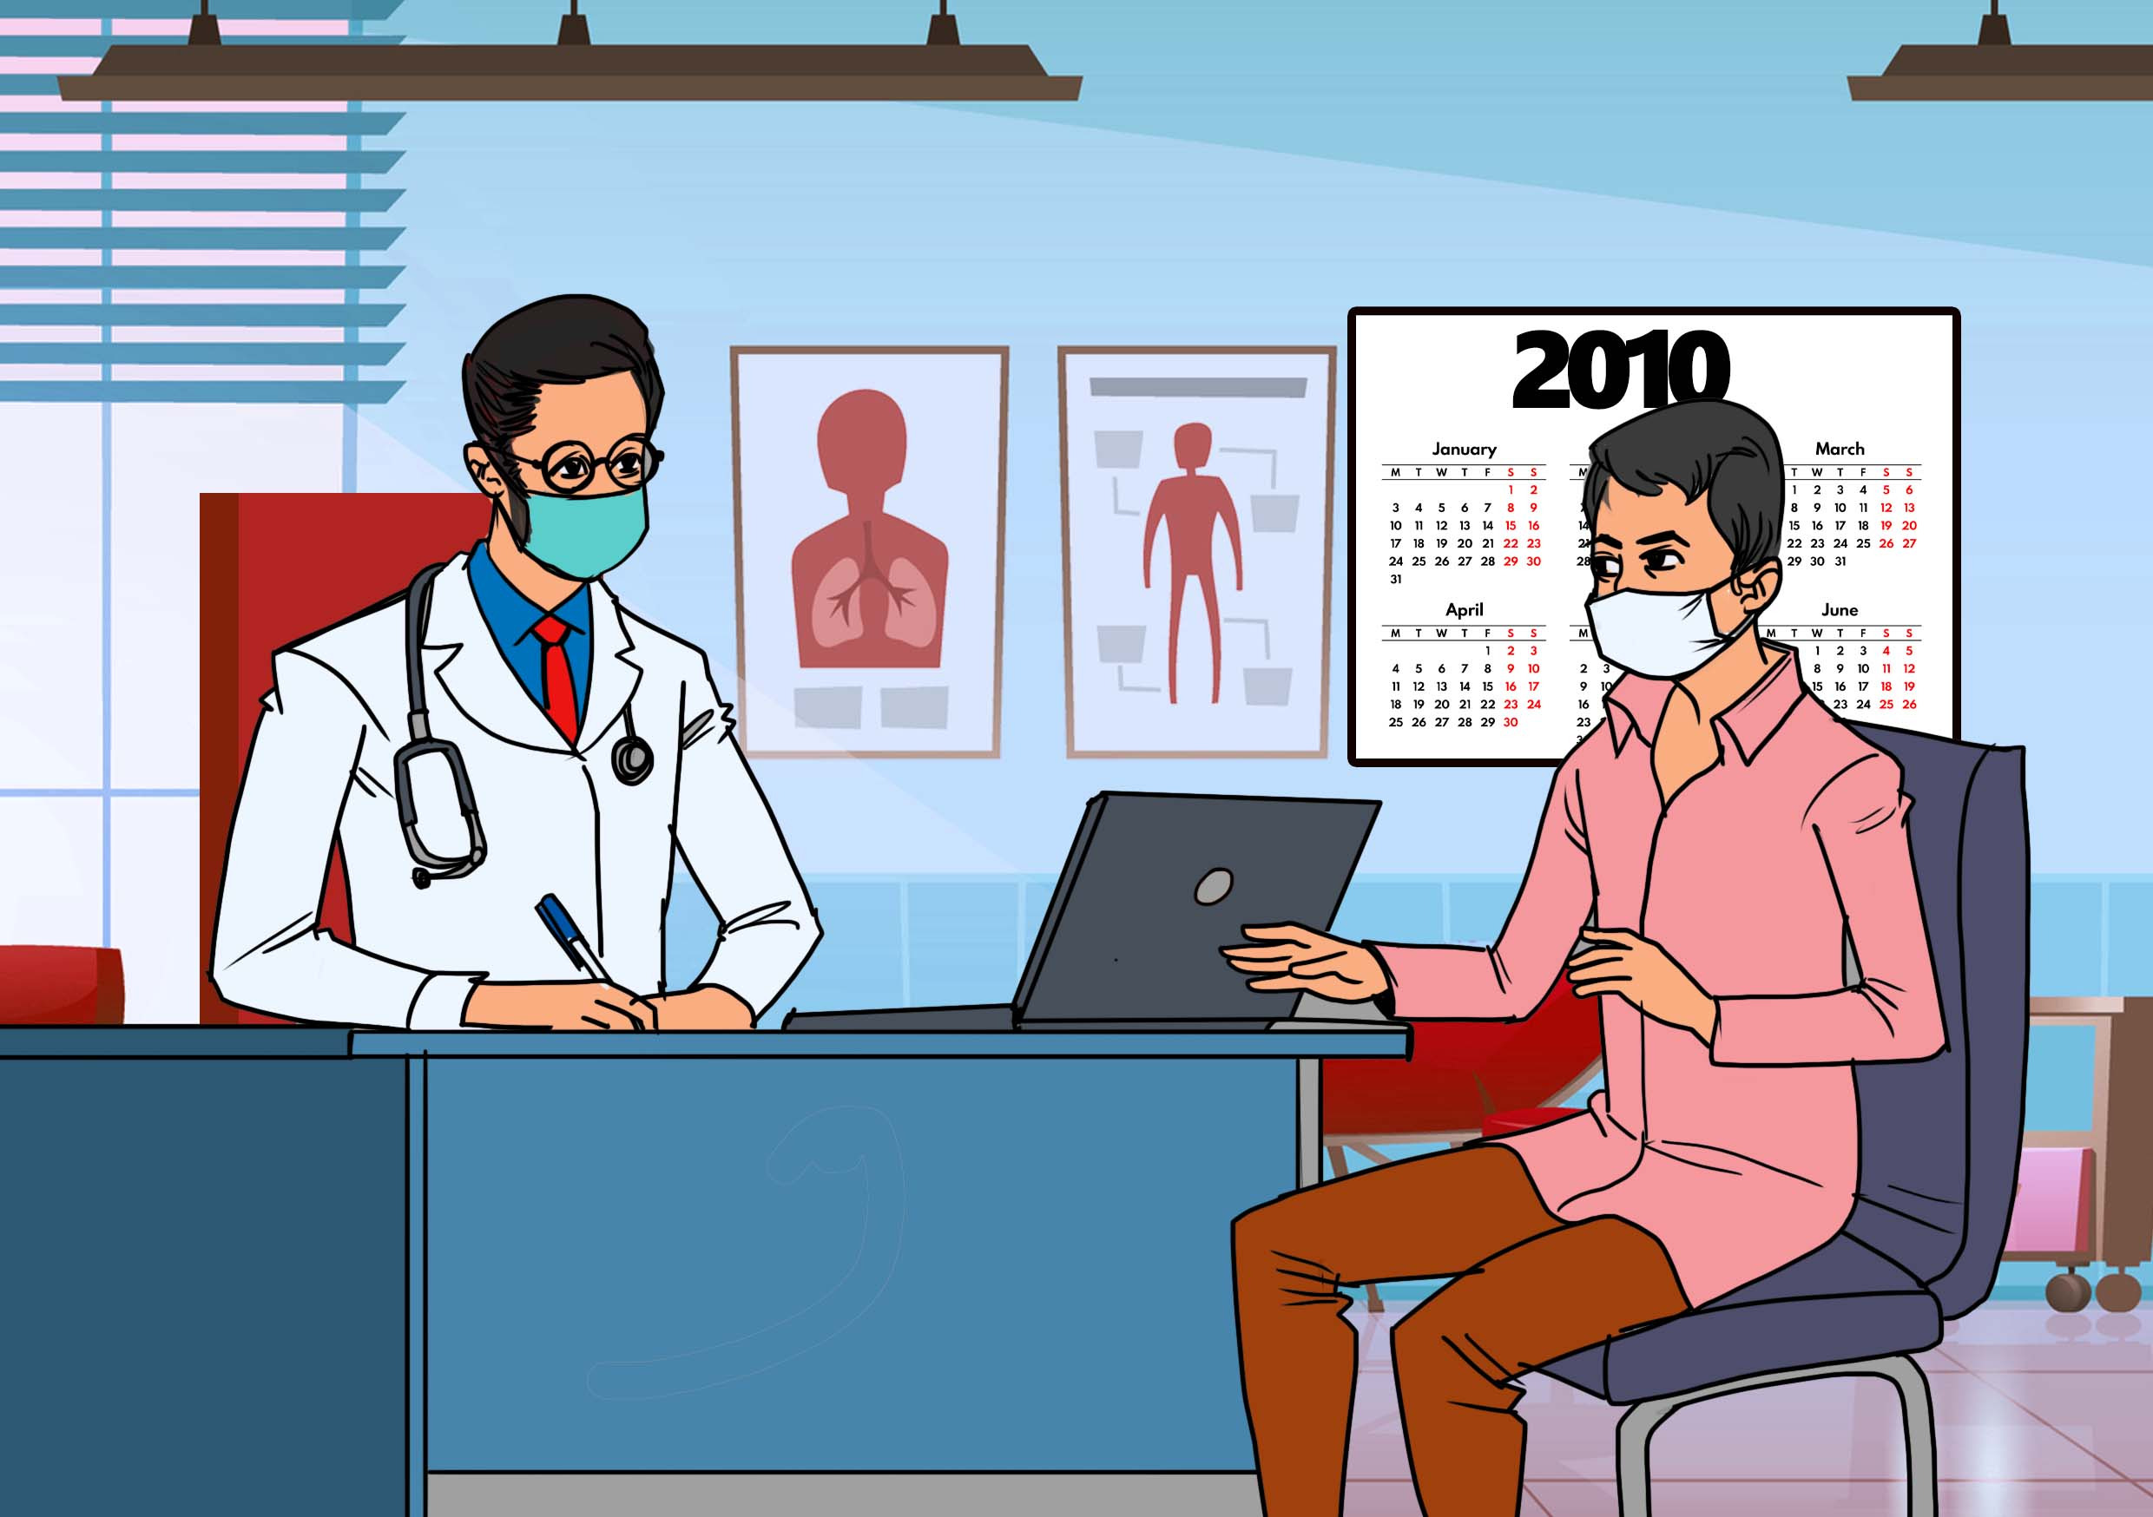
I often fee tingling or spikes in my feet and I can’t walk properly. What do you think it is?
Ganesh went back to the MSF clinic in Mumbai after experiencing numbness and tingling in his hands and feet, a symptom of IPT called peripheral neuropathy.
This feeling made his life worse as he had problems studying effectively and sometimes he lost concentration. At this point, he decided to seek a clear explanation from medical doctors at the MSF clinic to find a way to relieve the neuropathy.
He was given pyridoxine (vitamin B6) to reduce the neuropathy and told to take it with his IPT, but there were no clear follow ups due to the facility being overwhelmed by patients with TB in Mumbai.
The vitamin B6 helped Ganesh to concentrate on his studies as the tingling in his hands and feet had disappeared slightly.
Discussion Points:
In slum areas, lack of proper monitoring of side effects of IPT such as neuropathy among patients is challenging and decreases treatment completion rates.
Simple tools for managing side effects – like providing vitamin B6 to take with IPT to lessen the tingling of peripheral neuropathy – are often not provided.
Another common side effect of taking IPT is liver toxicity. This is one of the reasons for the high number of people who stop taking IPT before completing the full regimen.
People who start TPT should be counselled about common side effects, and TB programs should develop ways to track and follow side effects and adverse events among people taking TPT.
Discussion questions: What information about side effects do you think people need to know before beginning TPT?

Slide 9

This IPT treatment feels endless. I can’t afford food and books …I hope it ends soon.
The movements between his home to the MSF clinic subjected Ganesh to unreasonable financial costs given that he was not working and had no real source of income. The financial burden made continuing his IPT treatment difficult at times as he had to miss appointments.
Any patient on TB treatment needs adequate and nutritious food, which is vital in aiding treatment adherence and completion. In the case of Ganesh, he had worries that the financial costs associated with IPT would also affect his chances of completing his university education.
Discussion Points:
• Financial costs and the out-of-pocket payments are a huge barrier to patients to access treatment adequately and can lead to treatment fatigue.
Discussion question: Aside from information, what type of support should people taking TPT receive?

Slide 10
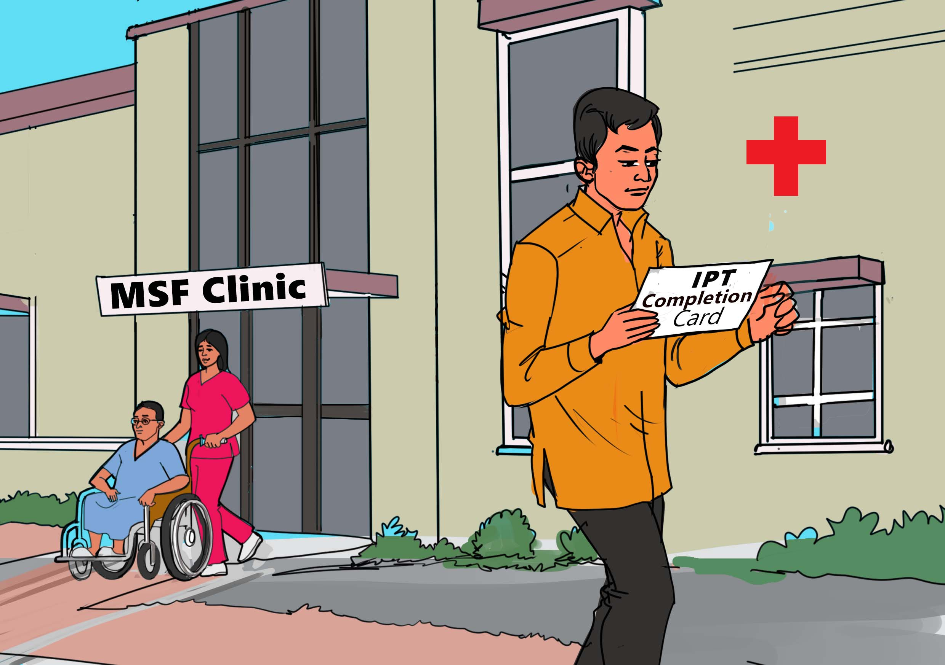
Despite the challenges and missed appointments, Ganesh persevered and completed his long IPT treatment.
Ganesh was very worried that the long IPT treatment might have damaged his liver, as he had heard this was a common side effect, although there were no any clinical signs of liver damage.
Discussion Points:
To mitigate the risk of liver toxicity and injury due to prolonged use of IPT, the World Health Organization recommended countries introduce a six-month course of daily IPT, and India adopted the shorter regimen in 2018.
Short-course regimens based on rifapentine such as 3HP have a lower risk of liver toxicity than IPT and are quickly becoming the preferred standard of care for TB preventive treatment around the world.
The Government of India’s 2021 Revised Guidelines for Programmatic Management of TB Preventive Treatment now recommend 3HP as an alternative to six-month IPT.

Slide 11
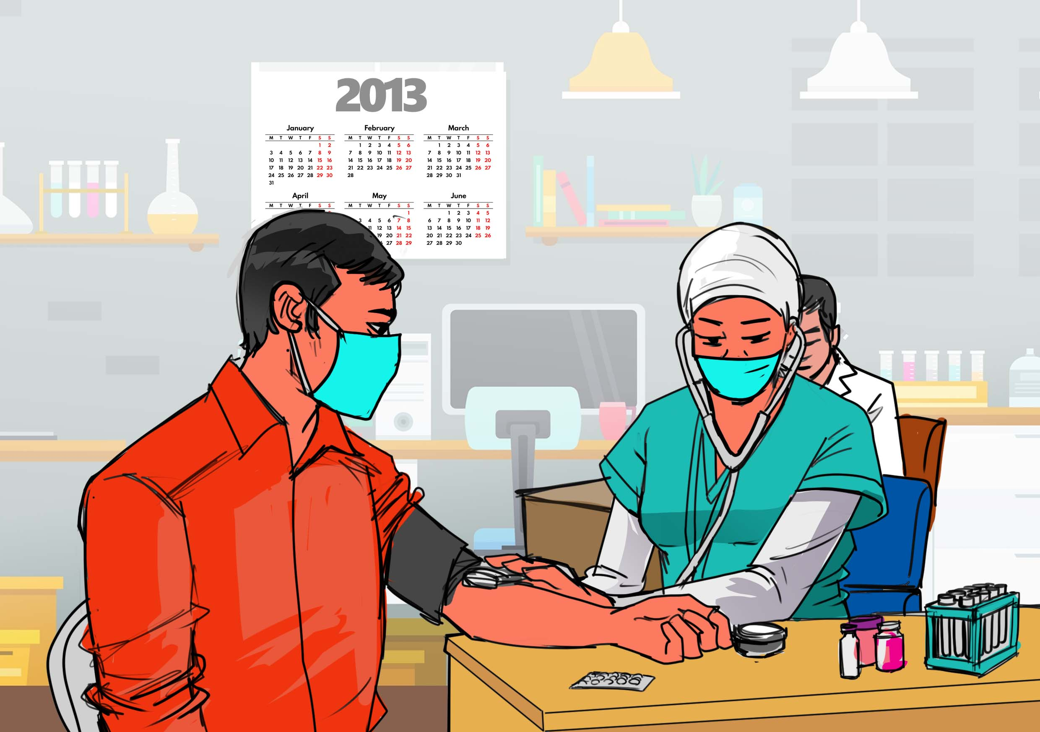
Thankfully, when Ganesh went back to the MSF clinic in Mumbai to report his treatment completion, healthcare workers also checked his liver function and found it was normal.
Your liver function is very fine, thanks for completing the IPT treatment.
Discussion Points:
Because of the risk of liver toxicity, IPT should not be given to people who drink excessive alcohol or are known to have existing liver disease. TPT regimens with less risk of liver toxicity, such as 3HP, are better options in these populations.
People who develop new symptoms of nausea, abdominal pain, or jaundice while taking IPT should stop treatment and seek medical advice promptly.

Slide 12

Ganesh successfully completed his political science degree and graduated at the Dr. Ram Manohar Lohia Avadh University in Uttar Pradesh.
Ganesh’s mother, his brother, and sisters were all delighted at his success and attended his graduation ceremony. It was one of the greatest days in the life of their family.
Notes:
Correction -Manohar

Slide 13
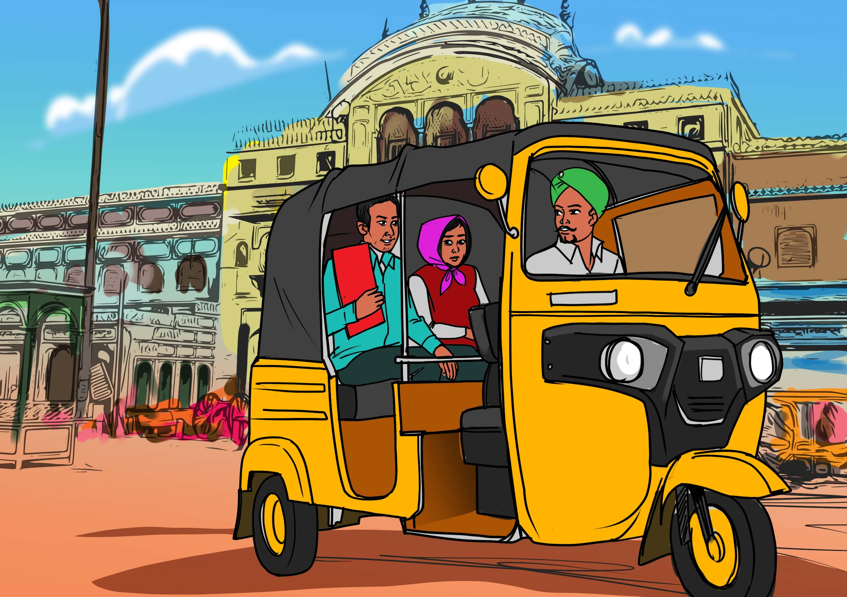
Ganesh decided to move to Mumbai to look for job opportunities. Unfortunately, his political science degree did not help him find a suitable job as he would have hoped.
Instead, he ventured into a career of development and public health. Based on his history, Ganesh believed his experiences of living with HIV and having undergone TB preventive treatment for three years would enable him become a formidable health rights advocate.
What are you planning to do in this city? Mumbai is overpopulated and has few jobs around.
Hopefully I will get a job here in the city.

Slide 14
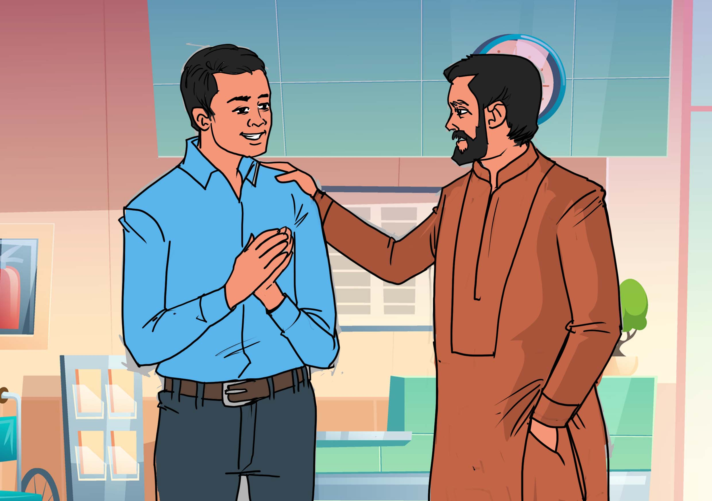
Ganesh, we were impressed with your CV. We are offering you a consultancy to help us to develop a TB community campaign
I am very thankful for this opportunity. I will do my best, sir.
Luckily, Ganesh linked up with Sathi Nepal Community Based Organization in Mumbai that offered him a small consultancy that gave him some earnings to support his mother back in the Mumbai slums.
Thereafter, he also worked for MSF and Sanjeevani PLHIV Support Group and other organizations. Ganesh had already developed passion and technical expertise in TB and HIV activism that made it easier for him to adapt to this kind of work.

Slide 15
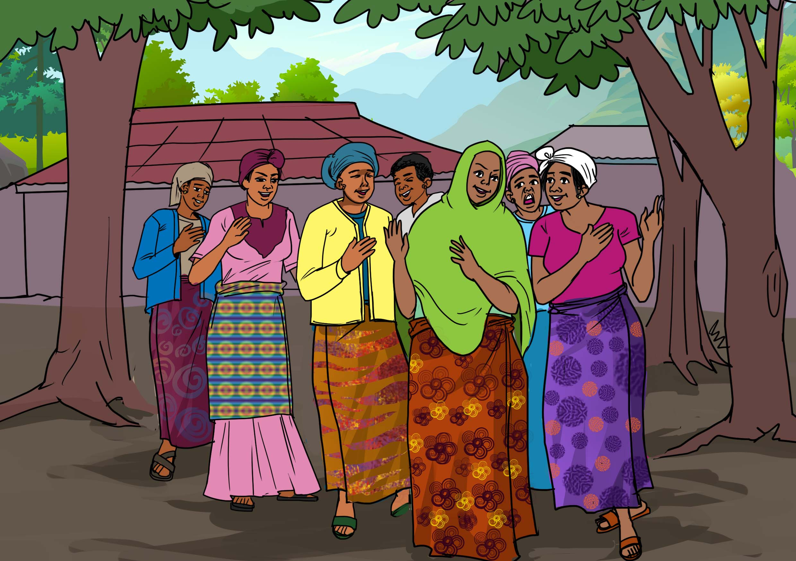
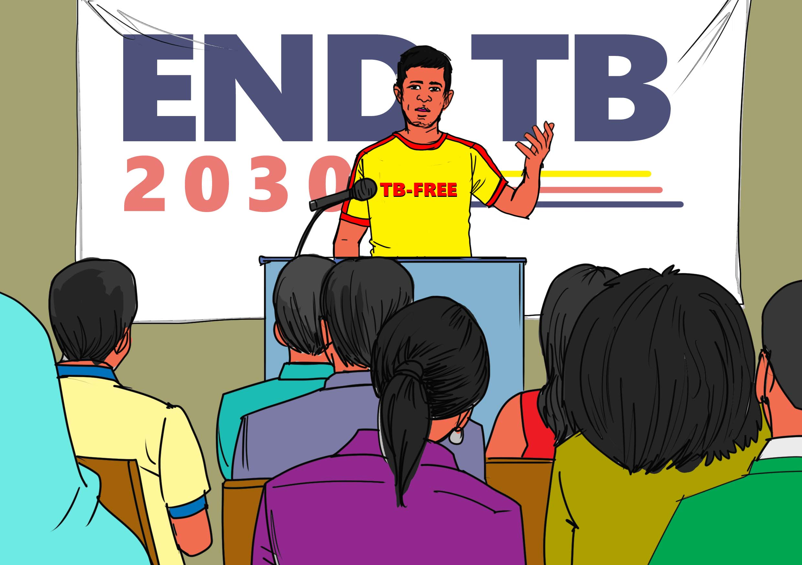
Now aged 42, Ganesh speaks at various TB related events, conferences, and seminars and is also a regular participant in international online courses in TB prevention and diagnostics. He also appears in the media regularly.
Recently, Ganesh was part of Indian HIV and TB activists who signed a letter to the Union health secretary Rajesh Bhushan and National AIDS Control Organization (NACO).
Acharya and his fellow activists observed in the letter that essential drugs for preventing opportunistic infections among PLHIV such as TB are unavailable or irregularly available in the public health sector. For instance, fluconazole, a common and cheap medication to treat fungal infections is frequently unavailable in Indian health facilities.
Learn More:
You can learn more about advocacy for TB preventive treatments like 3HP by visiting the #RightToPreventTB resource page: https://express.adobe.com/page/pc7PYUNzuztsD/.
This website has resources for advocates who want to expand access to 3HP and TPT among their communities, including fact sheets, patient video testimonials, social media graphics, and sample advocacy letters.

Slide 16
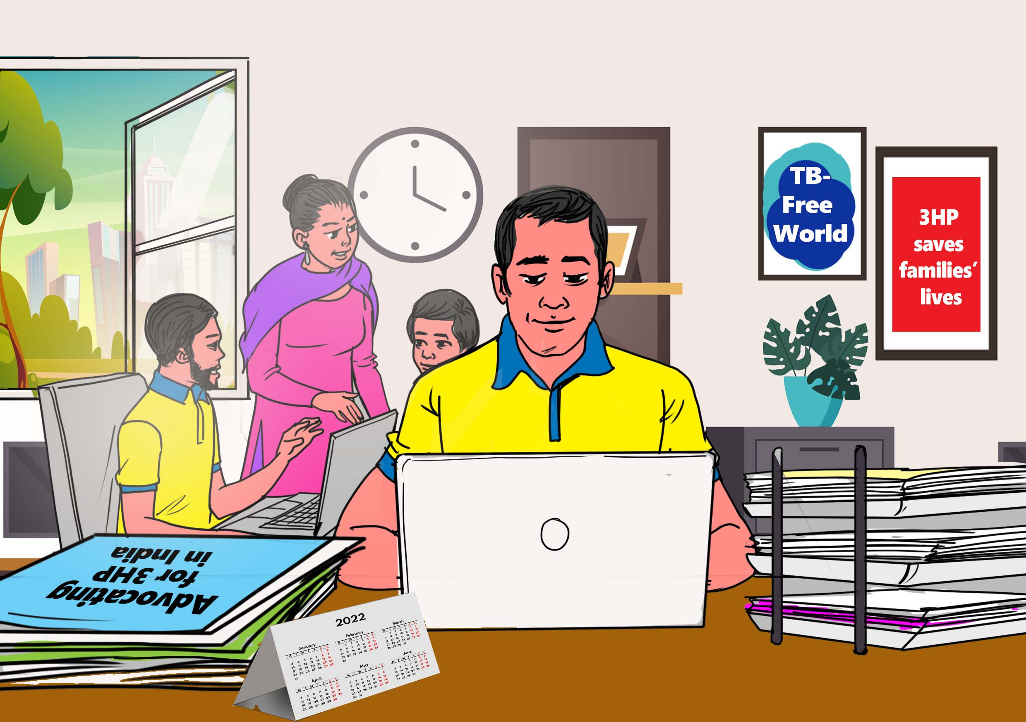
Ganesh joined a group of organizations including Treatment Action Group, MSF, Third World Network, and the Delhi Network of People Living Positively to oppose a patent application by Sanofi, the French pharmaceutical giant who claimed that 3HP was their discovery, which could have delayed the development of cheaper versions of the drug made by Indian generic manufacturers. If granted, these patent applications could have blocked access among many Indians to the shorter 3HP TPT regimen.
In the patent opposition, Ganesh and fellow activists argued that isoniazid was never patented, and the primary patents on rifapentine had long expired and Sanofi’s move was like trying to privatize two drugs that belonged in the public domain as a right of everyone.
The campaign was a success, and later on Sanofi withdrew the patent applications due to this public pressure.
Learn More:
To learn more about patents and how they affected access to medicines for TB prevention, read No Patents on Prevention! Published by the ARK Foundation of Nagaland, India, this document is a community guidebook intended to help grassroots activists understand how pharmaceutical corporations’ patenting practices impede access to crucial medicines such as rifapentine and isoniazid used in preventive treatment for TB.
You can read the guide here: https://www.treatmentactiongroup.org/publication/isoniazid-rifapentine-3hp-access-roadmap-and-patent-landscape/
Notes:
Add Third World Network

Slide 17
Acknowledgments
Story: Ganesh Acharya.
Narrative: Dingaan Mithi.
Illustration: Peter Olawoyin.
Project management: Lynette Mabote and Mike Frick.
Funding provided to TAG by Aurum Institute under the Unitaid-supported IMPAACT4TB project.
https://www.impaact4tb.org/

