Slide 1


Josephat Asande
3HP in Nairobi, Kenya
Pathways to TB preventive treatment among household contacts illustrated story series

Slide 2
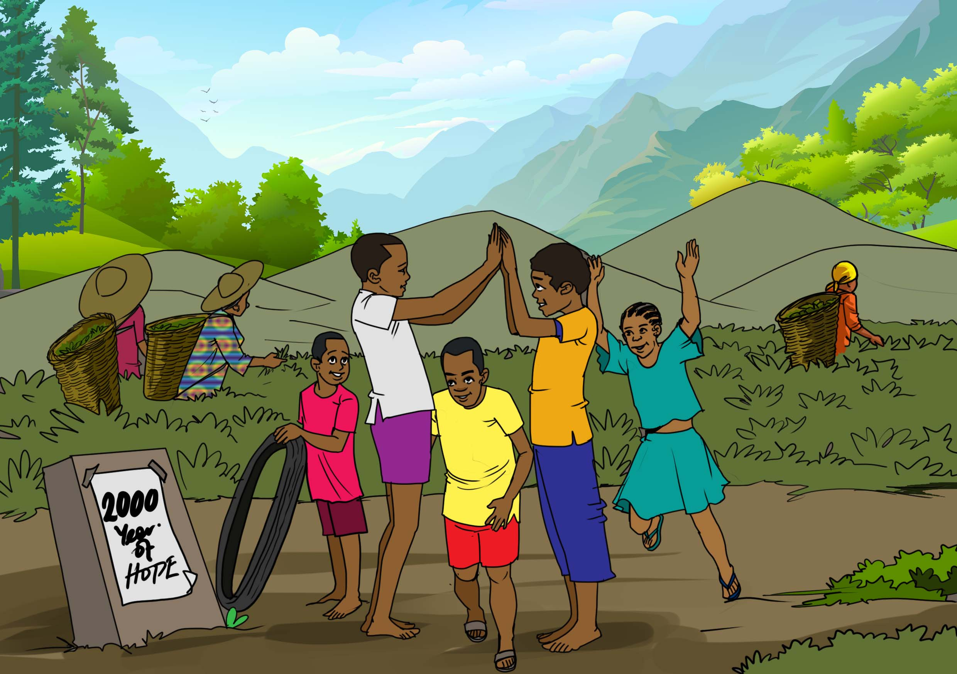
Josephat Asande grew up in Nyamira County, Kenya as a devout member of the Seventh Day Adventist Church and Kisii by tribe.
The Kisii people are an East African ethnic group and indigenous to Kisii (formerly Kisii District). They are well known for their music and traditionally play a large bass lyre called Obokano.
One of the cash crops of the county is tea and there are many tea plantations around which Josephat would frequently play with friends.

Slide 3
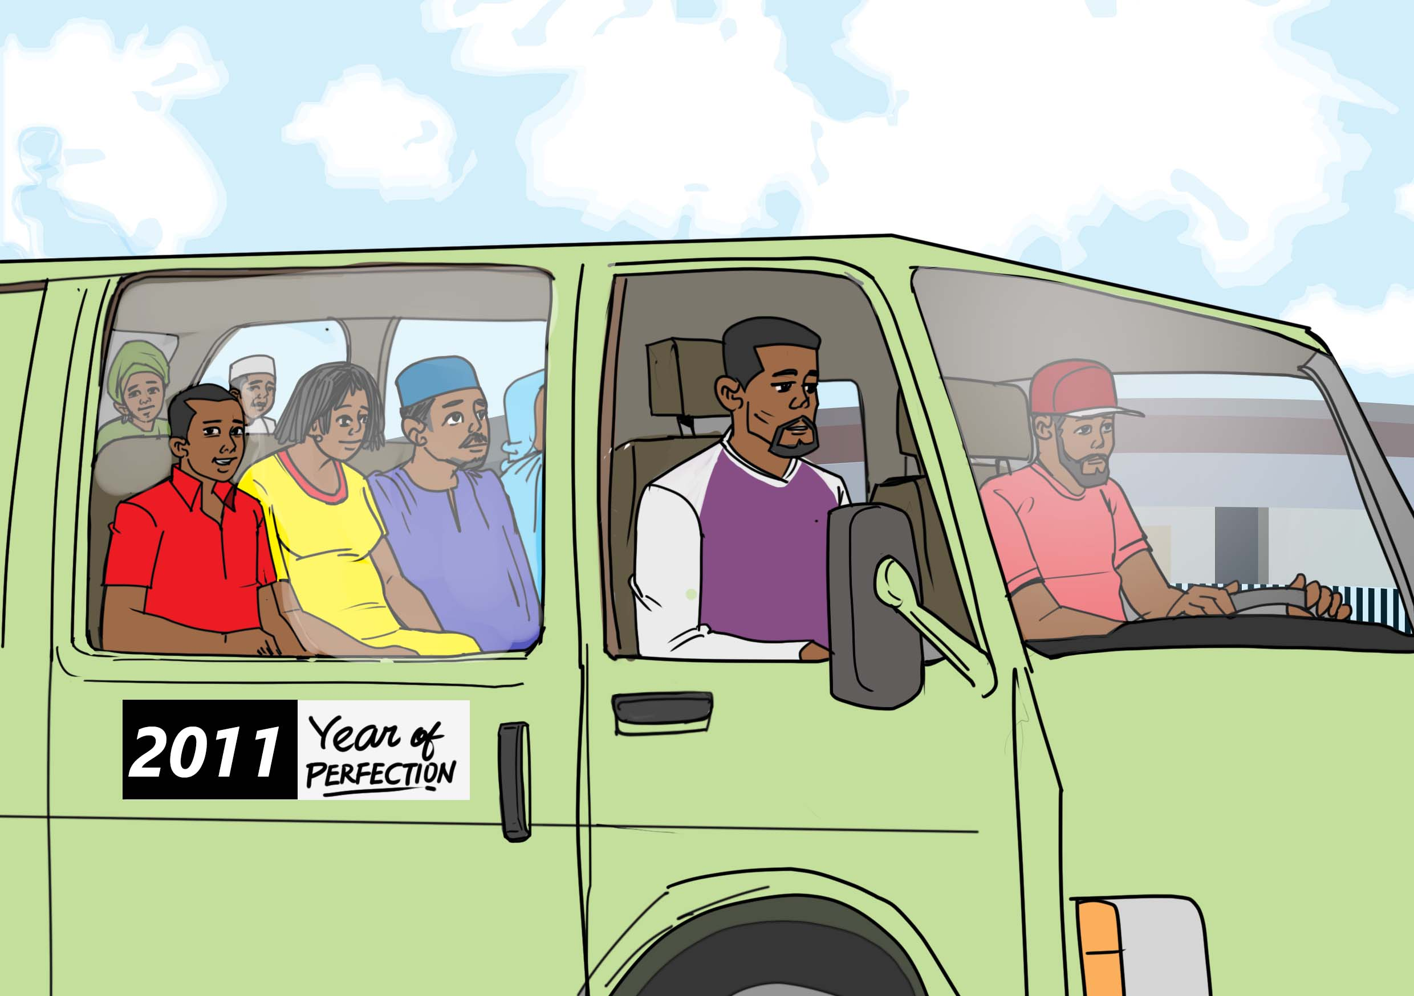
Nairobi, work opportunities…here I come!
After completing his secondary school education in Nyamira County, Josephat moved to the capital of Kenya, Nairobi, to try to find better job opportunities.

Slide 4
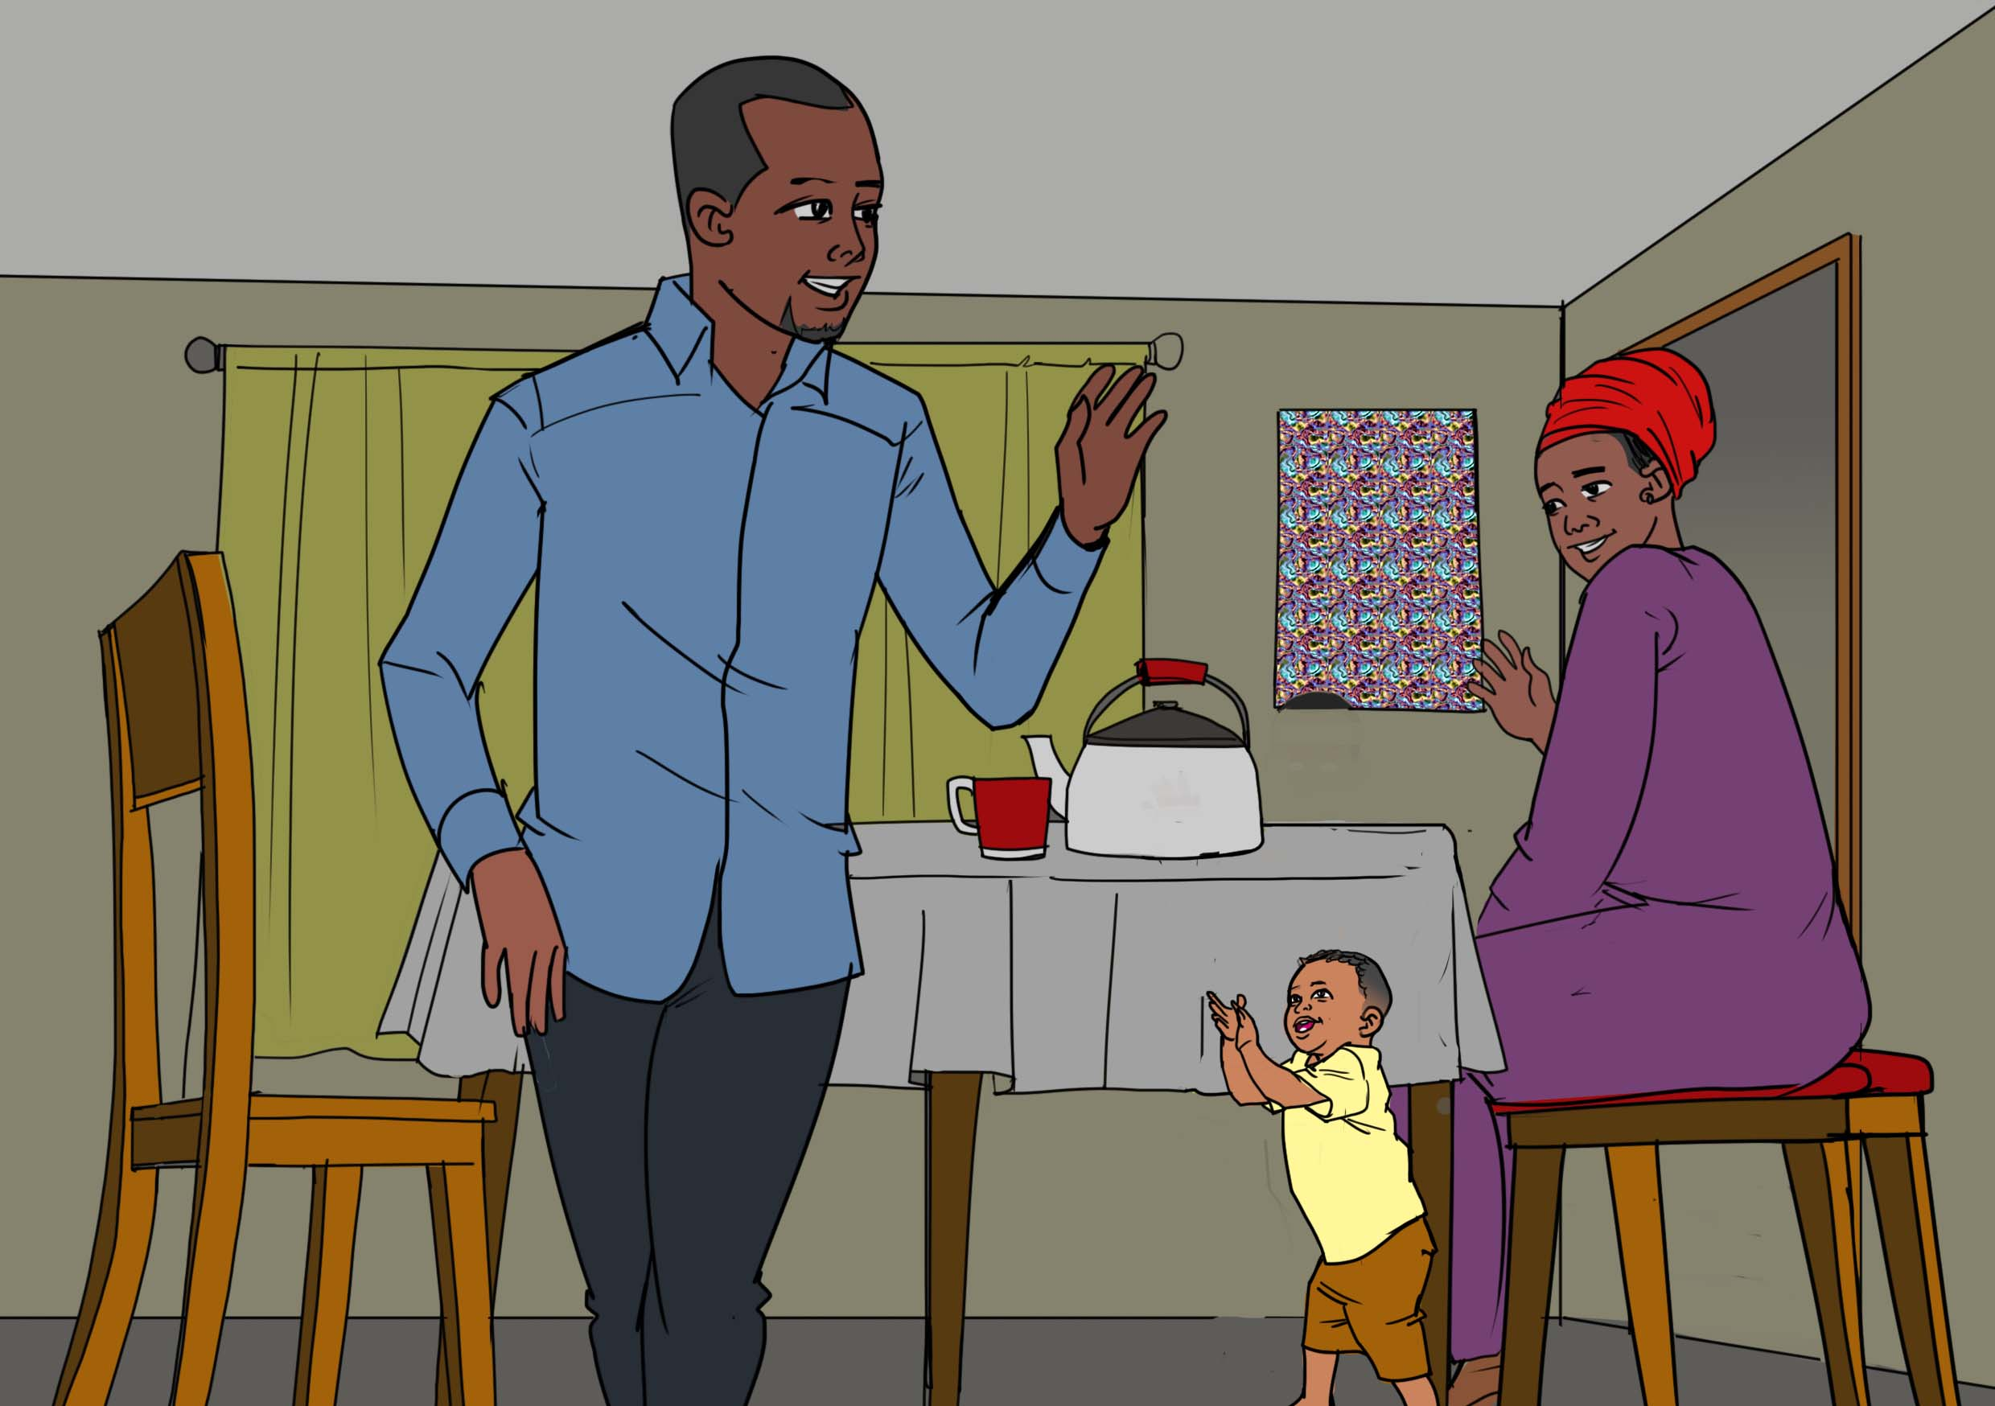
In 2014, Josephat married Zipporah. Later, Zipporah would leave Nairobi with their then 5-year-old son, Adrian, to visit their home village for some farming work. Josephat stayed in Nairobi where he was later joined by his cousin, Jackson Moyenga.

Slide 5
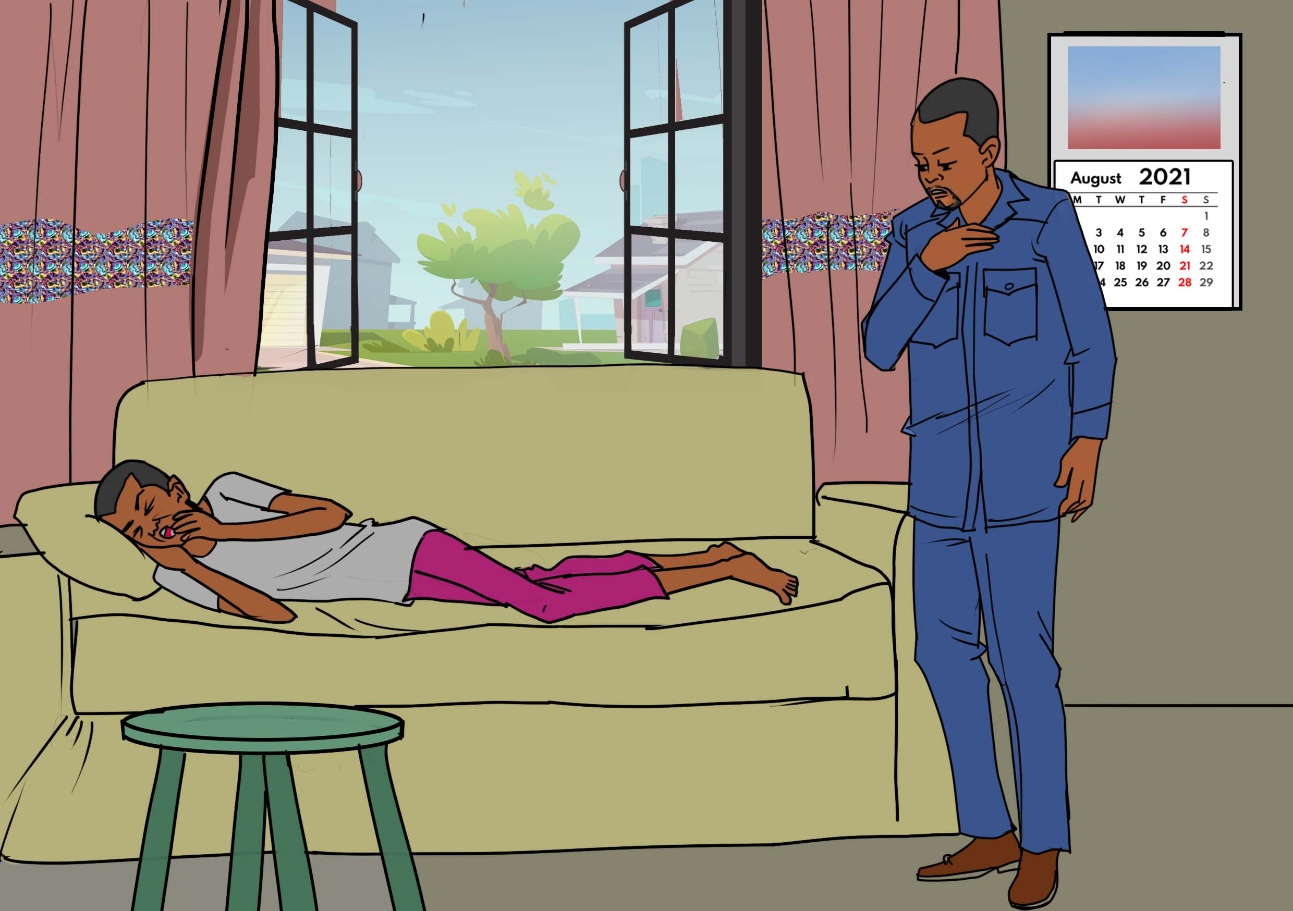
Josephat eventually found work in Nairobi as a cleaner with Clean City Cleaning Company.
While at home one afternoon in August 2021, Josephat discovered that his cousin Jackson was unwell and coughing persistently.
The coughing was making his cousin weak. In addition to the cough, Jackson was also experiencing night sweats, to such an extent that his bed was wet at times.

Slide 6
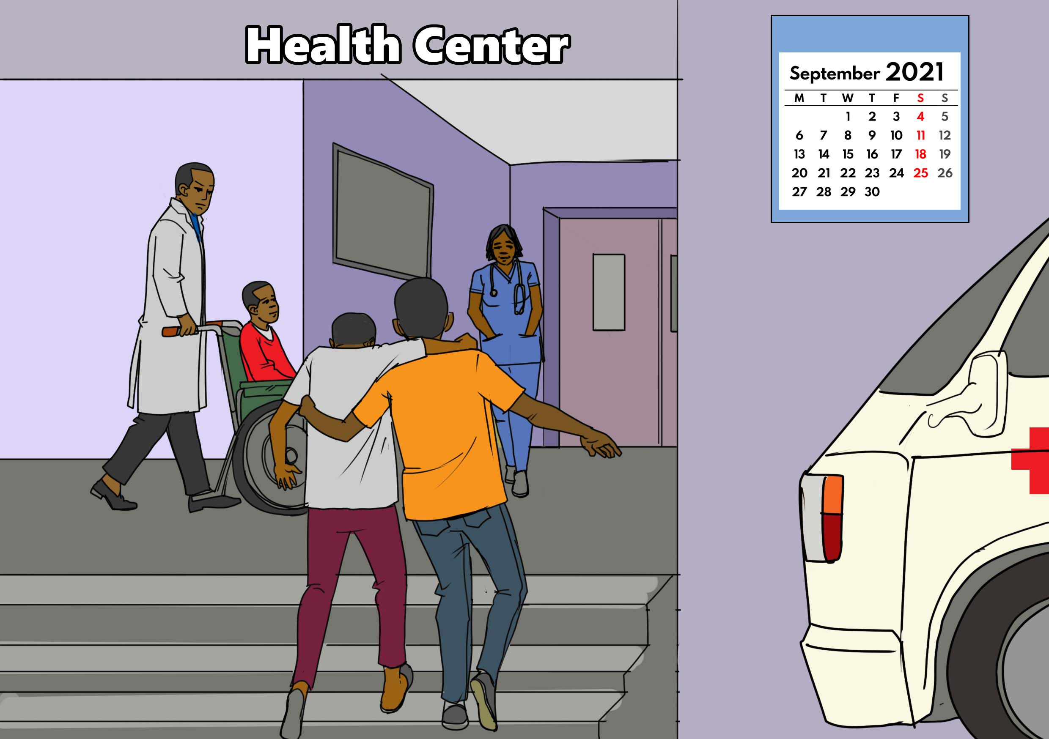
Josephat accompanied Jackson to Kangemi Health Center for diagnosis. At this point, his cousin was looking frail and struggled to walk.

Slide 7
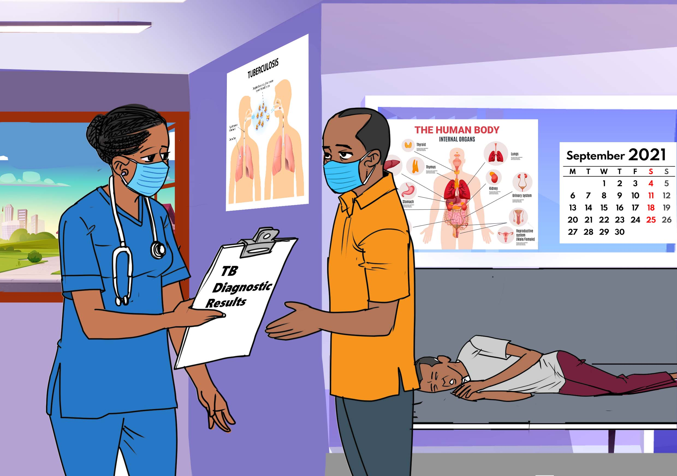
At Kangemi Health Center, Jackson was diagnosed with TB.
Josephat was worried that he may have been infected with TB, too, but at this point, his focus was on getting his cousin to full health. Luckily, his wife and son had been living outside of Nairobi, so he did not worry about them having TB.

Slide 8
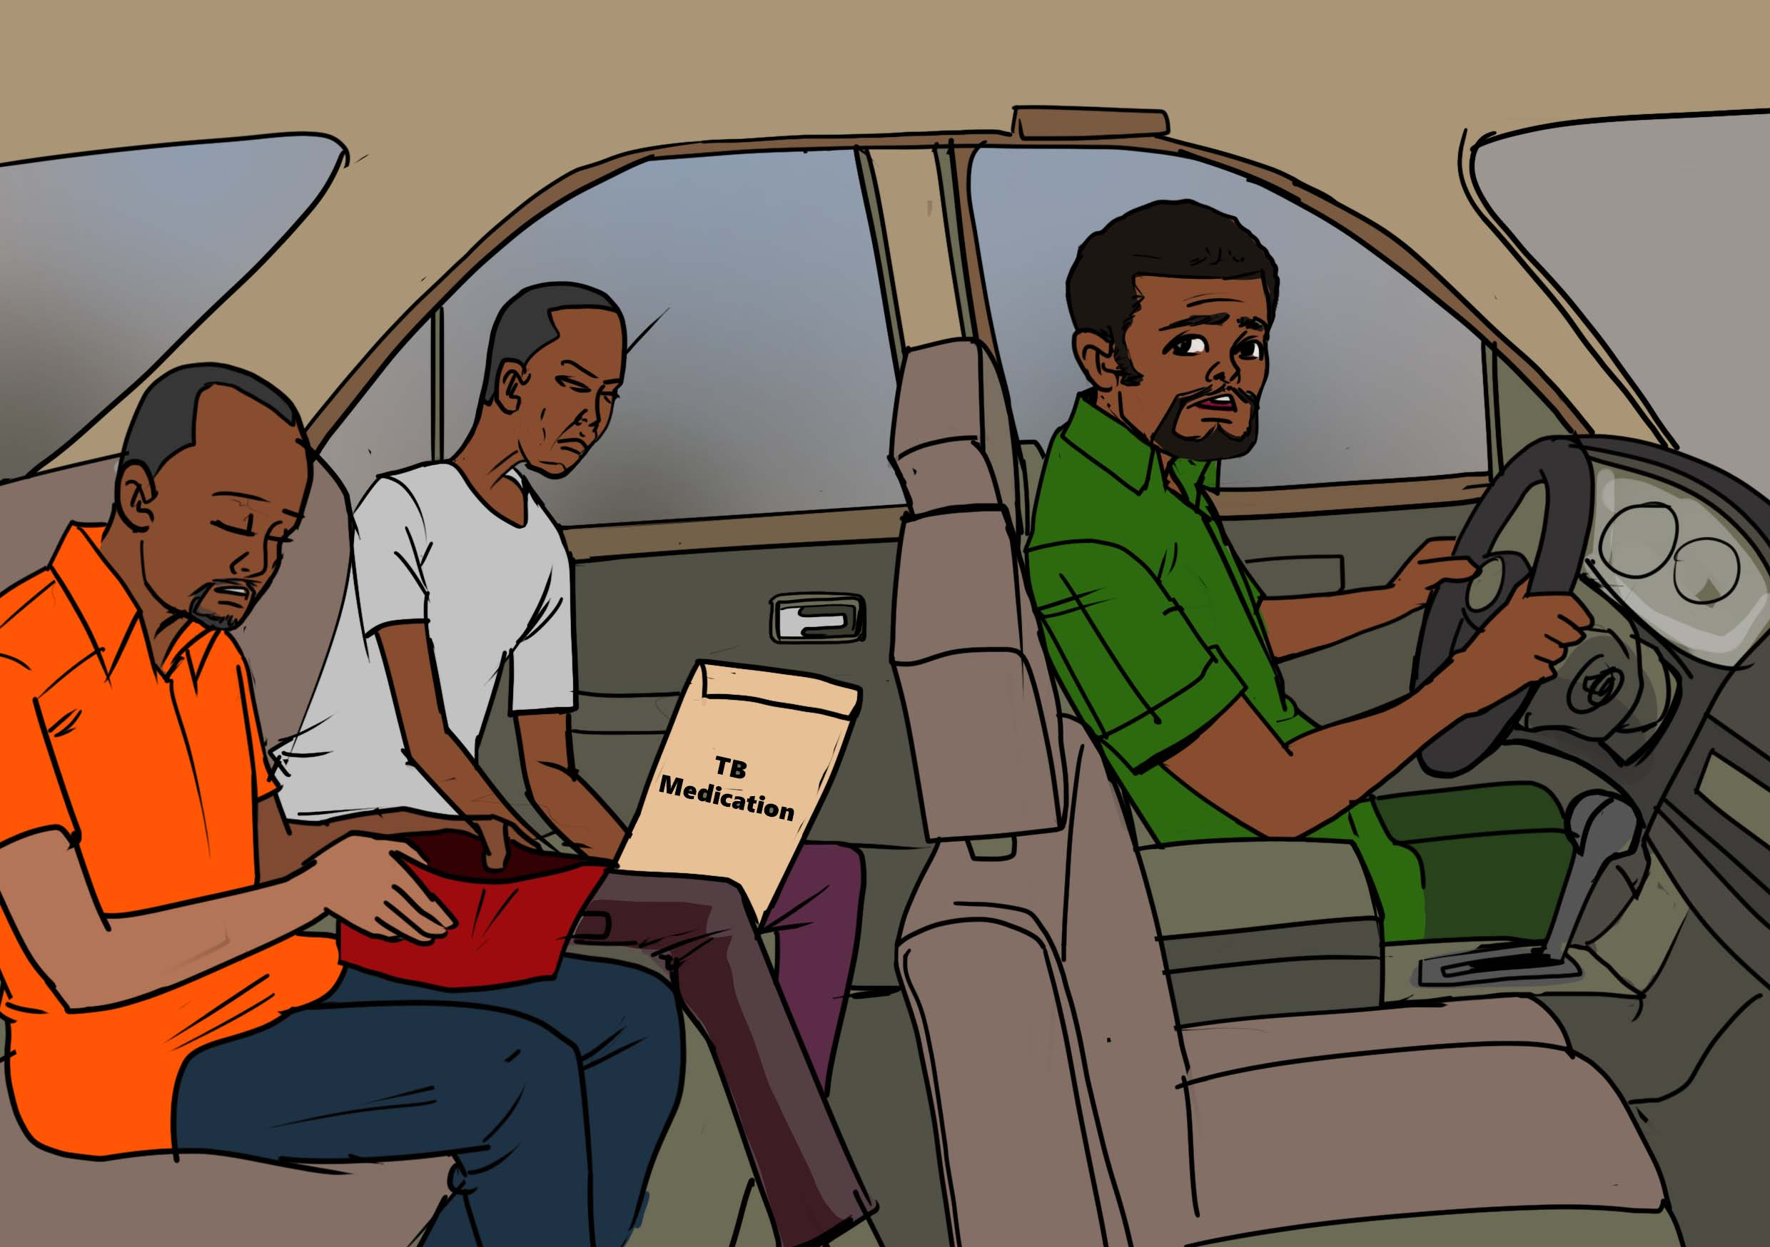
The financial costs were also a constant challenge in the family. Josephat and his cousin both had low-paying jobs, and even though the TB drugs for Jackson were free, the costs of transport and food added up quickly.
You don’t have enough money, are you serious?
Discussion Points:
Long distances to health facilities and long health facility wait times delay TB diagnosis and treatment.
Out-of-pocket payments are very common and expose people with TB and their households to financial risks. Even when diagnosis and treatment are free, people can still spend significant amounts of money on other costs such as transportation and food.
Undernutrition is a leading risk factor for TB. Food support and nutritional supplementation help people with TB get well sooner while on treatment and help people without TB lower their risk of disease.
Discussion question: What should be done to overcome the financial costs that make it difficult financially for families to cope with TB?

Slide 9
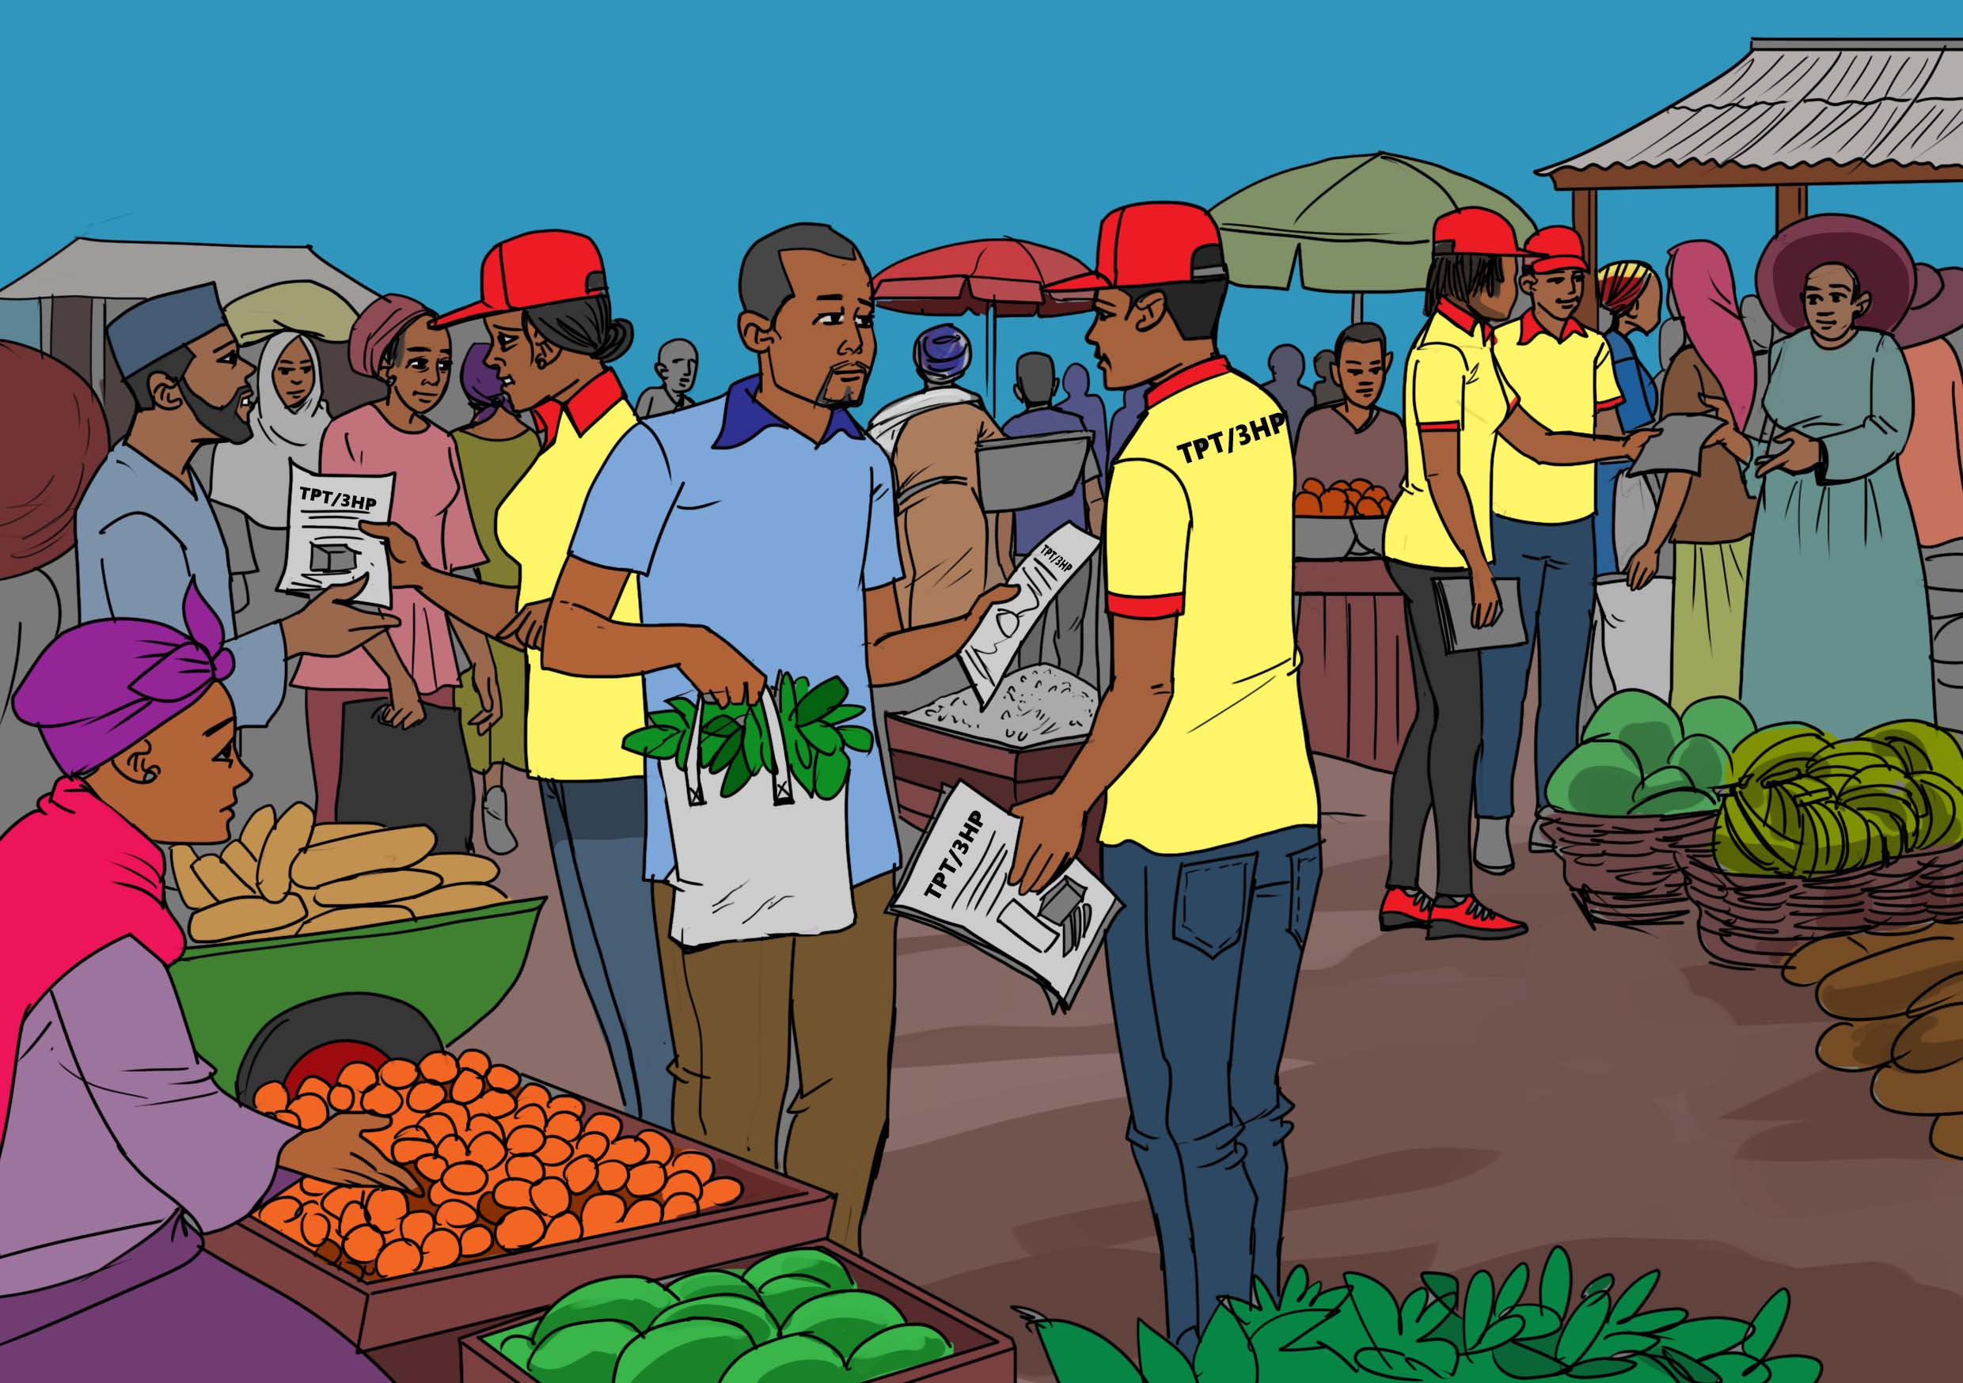
3HP is a medication that protects the whole family from contracting Tuberculosis (TB). 3HP is taken as 12 once-weekly doses of isoniazid and rifapentine to prevent TB.
Soon after Jackson started treatment, Josephat was visited by Pamoja TB Group, a community organization that raises awareness of TB preventive therapy (TPT).
The outreach workers advised him to get screened for TB and to enroll on a TPT regimen called 3HP to prevent TB.
The Pamoja TB Group members assured him that the three-month 3HP TB preventive treatment regimen had few side effects and could stop TB in his household.
Discussion Points:
Josephat was eligible to take 3HP because he was a “household contact,” or a person who lives with–or shares air with—someone who has TB disease (his cousin Jackson). Lack of awareness on TPT among household contacts means that many people exposed to TB in the home are never screened for TB or offered 3HP or other TPT regimens.
One of the concerns raised historically against the large-scale use of TPT is its potential risk of propagating drug resistance. These concerns have not been supported by evidence till date. Multiple trials have failed to find any evidence of a significant association between TB drug resistance and the use of TPT drugs like isoniazid or rifapentine. Concerns such as these have effectively deprived countless populations from the benefit of a life-saving intervention.
Discussion question: what fears or misconceptions about TPT exist in your community?

Slide 10
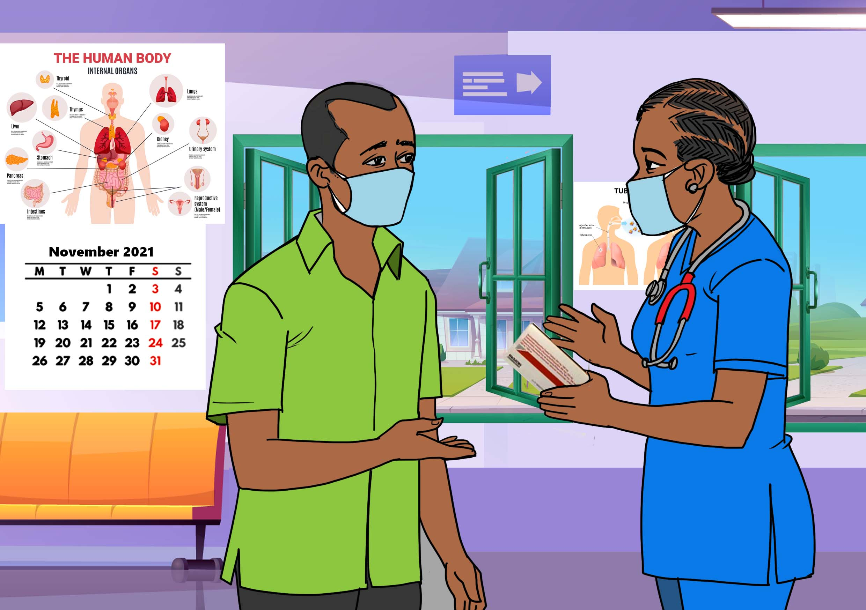
Josephat returned to Kangemi Health Center where he was screened for TB and started on TPT.
He received a prescription for the 3HP regimen with drugs made by a company called Macleods. Each pill combined the two drugs in 3HP, isoniazid and rifapentine.
In the first three weeks of taking 3HP, Josephat felt some mild chest congestion after taking 3HP. He was afraid this symptom would worsen, but the side effects soon resolved and completely disappeared.
Josephat continued to work at Clean City Cleaning Company without missing a day of work as the drugs did not make him tired or affect his physical ability to work as usual.

Slide 11
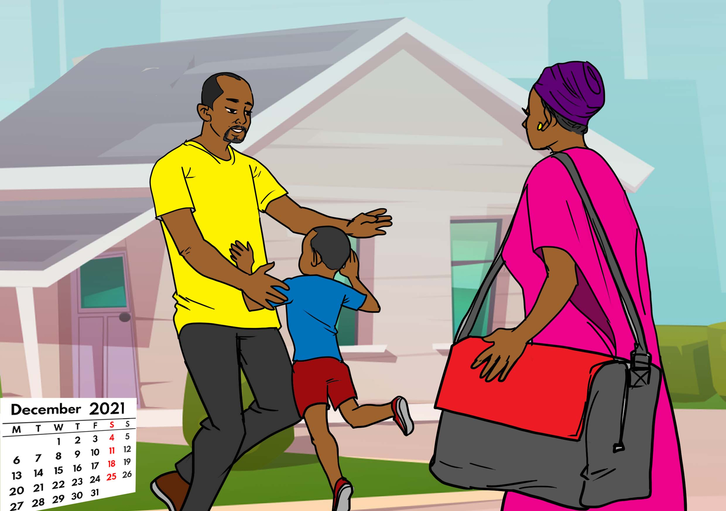
Josephat’s wife and his 5-year-old son, Adrian, returned to Nairobi. Josephat told his wife about taking TB preventive treatment. She was supportive and not negative or fearful, as others might have been, as she understood the importance of keeping TB out of their family.
Discussion Points:
Stigma and discrimination remain major problems for people affected by TB. Many people may struggle to disclose that they are taking 3HP to friends, family, or coworkers for fear of stigma and discrimination.
Discussion question: In this case, Josephat felt comfortable telling his wife he was taking 3HP. Why? What needs to happen to decrease stigma surrounding taking TB preventive treatment?

Slide 12
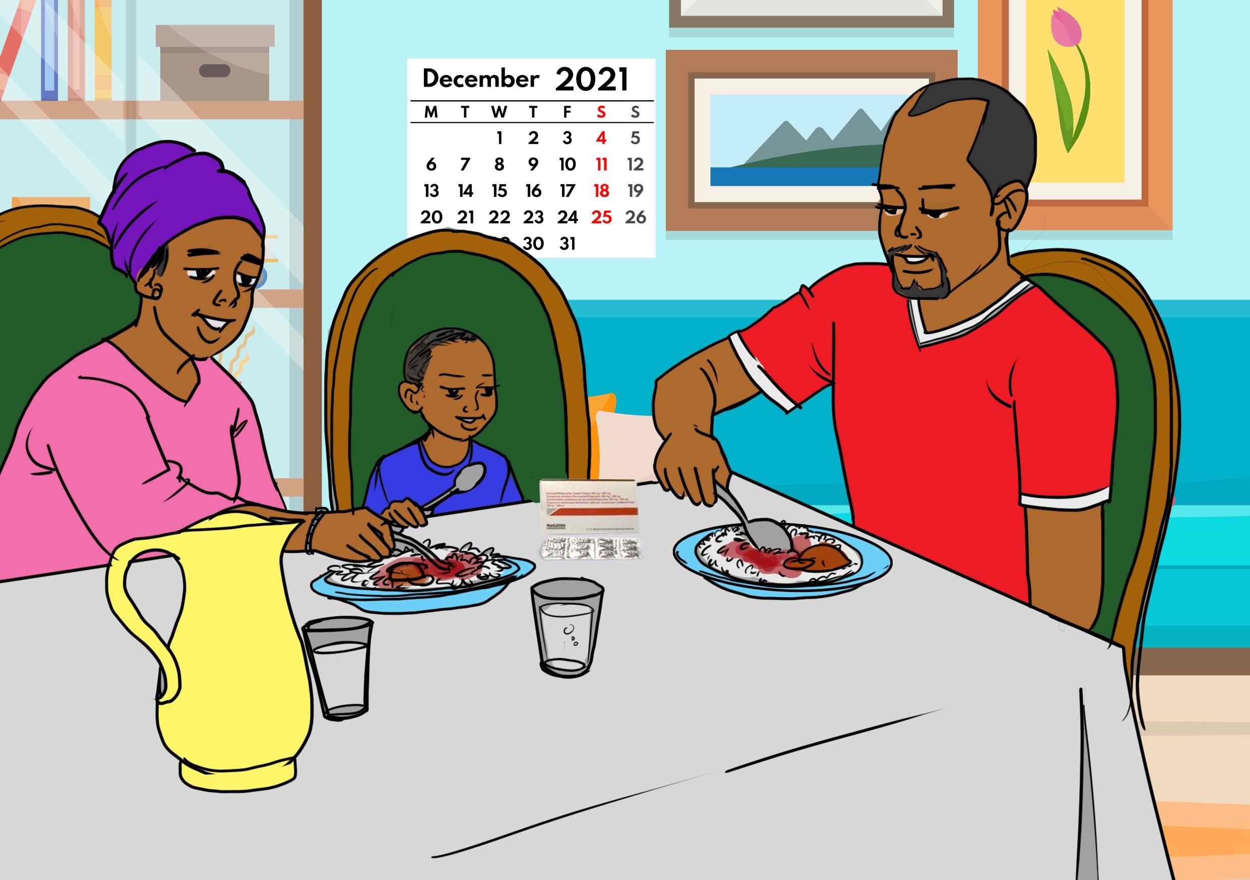
Zipporah prepared good balanced meals inform of rice and ugali (maize meal) and other dishes to help Josephat adhere to 3HP and finish in good time.
Discussion Points:
If possible, 3HP should be taken with a meal. This is because one of the two drugs in 3HP, rifapentine, works better in the body when taken together with food.
Discussion question: What are your recommendations for incorporating food support into TB preventive treatment programs?

Slide 13
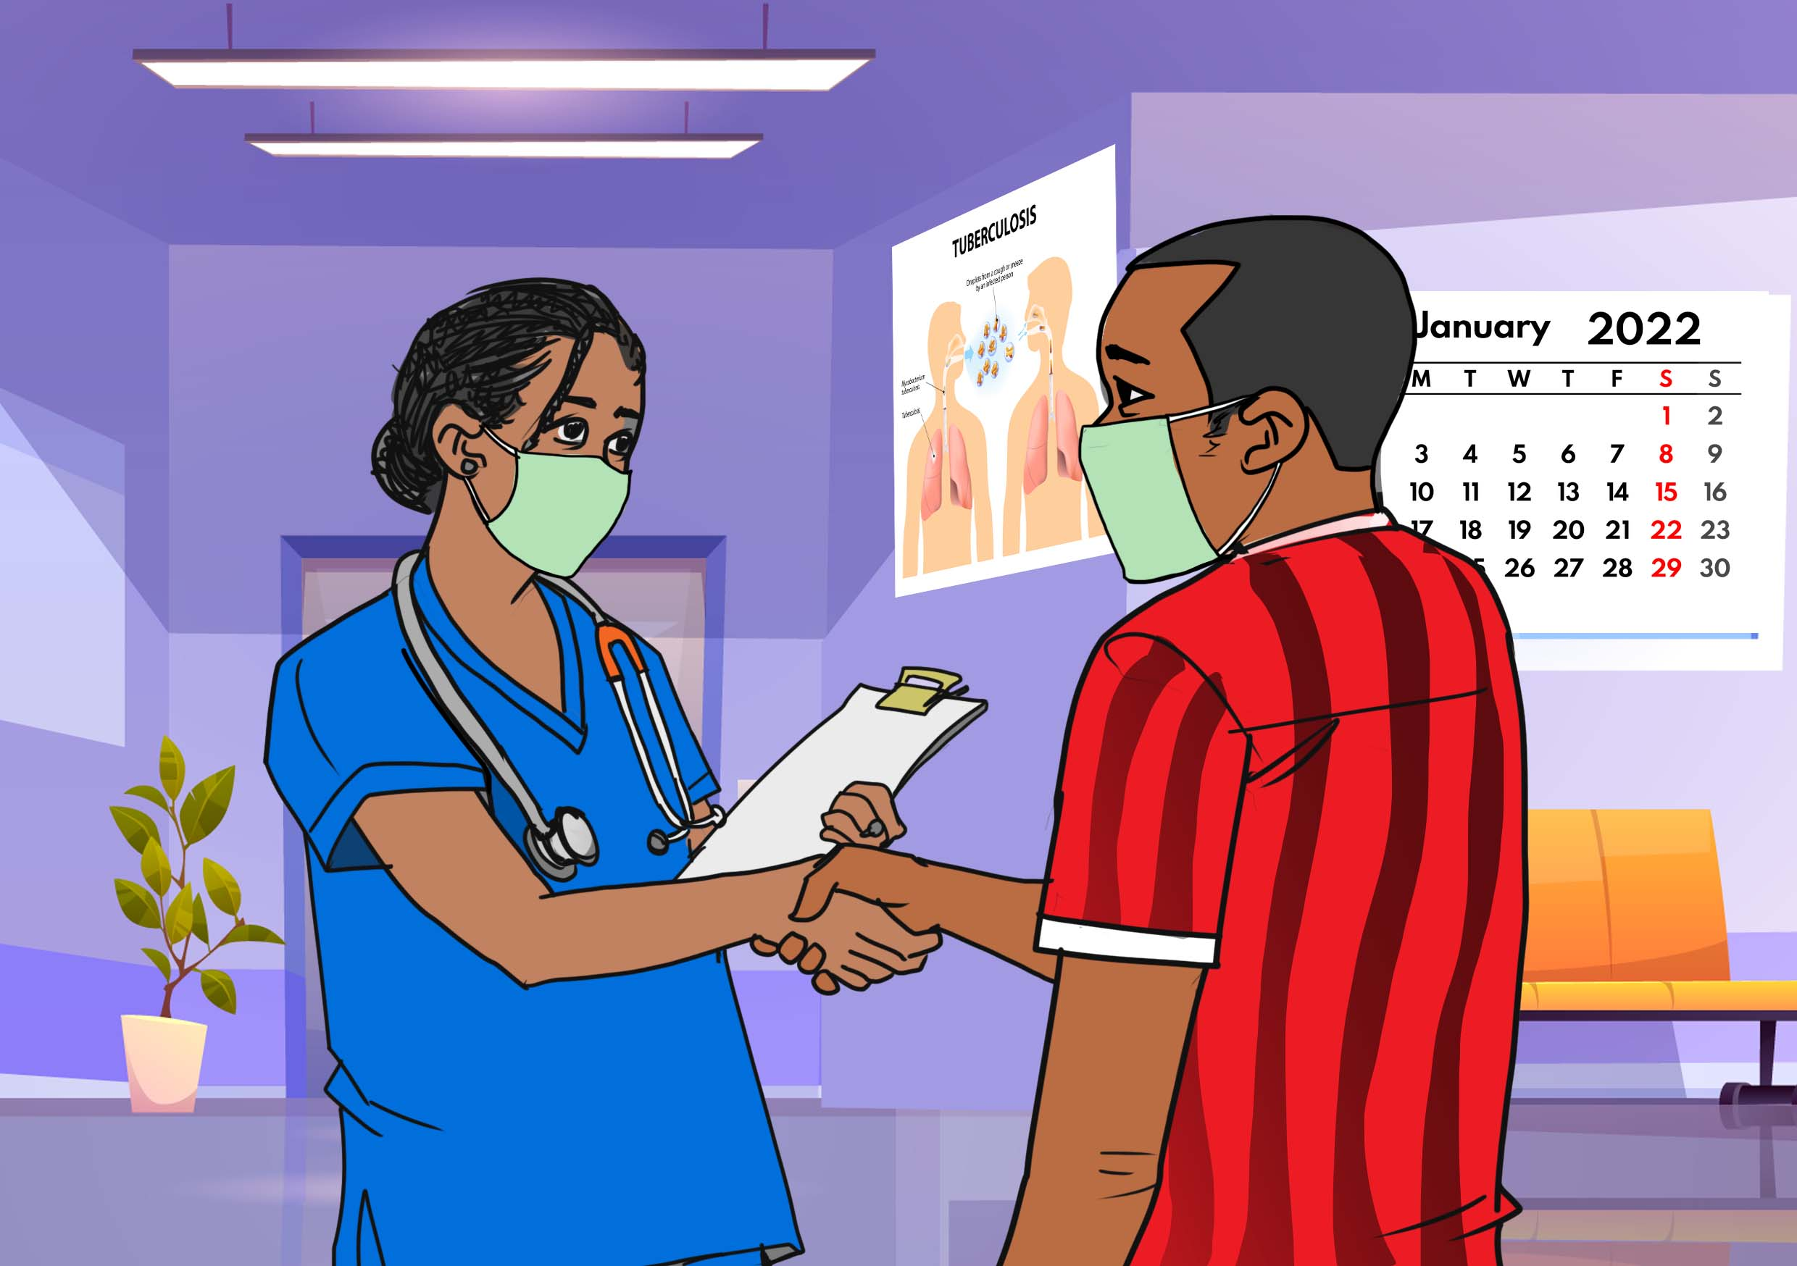
Congratulations! You’ve completed TB preventive treatment and protected yourself from TB!
After three months, in January 2022, Josephat returned to Kangemi Health Center where the health workers were satisfied that he had indeed completed his 3HP preventive treatment.
At the end of treatment, he was feeling more motivated that he would help other people like him learn about the benefits of 3HP.
Discussion Points:
It is important to monitor TPT completion both for individual care and programme management. Whether using electronic tools or paper records, there should be a record of treatment outcomes for each person who starts TPT.
TPT may be considered completed when an individual takes 80% or more of the prescribed number of doses of treatment within a certain scheduled duration of the respective TPT regimen and remains well or asymptomatic during the entire period.
For 3HP, this means completing at least 11 of 12 doses.
Discussion question: What can programmes do to encourage completion of 3HP? What support do people with 3HP need to complete treatment?

Slide 14
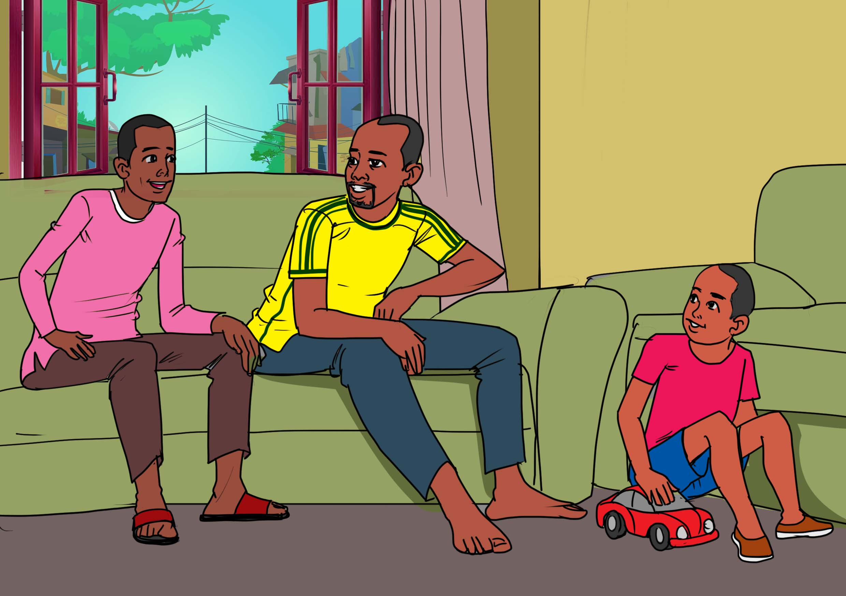
It feels so good to have completed my 3HP treatment. You look amazing too, brother Jackson.
Around the same time that Josephat finished 3HP, his cousin Jackson also completed his TB treatment using a combination of four drugs: rifampicin, isoniazid, ethambutol, and pyrazinamide.
Jackson visited Josephat’s household and discovered their happy moments are back to normal times before TB cast a dark shadow on their family.
Discussion Points:
Many household contacts who take 3HP, like Josephat, will be living together with people who are on TB treatment, like cousin Jackson.
Discussion question: What can people taking TPT and TB treatment do to support each other through treatment?

Slide 15
Acknowledgments
Story: Josephat Asande
Narrative: Dingaan Mithi.
Illustration: Peter Olawoyin.
Project management: Lynette Mabote and Mike Frick.
Funding provided to TAG by Aurum Institute under the Unitaid-supported IMPAACT4TB project.
Special thanks Pamoja TB Group and Stephen Anguva Shikoli for support working with Josephat.
https://www.impaact4tb.org/

