Slide 1
Updates for Treating Pre-Extensively Drug-Resistant TB (pre-XDR-TB):
A Shift Away from the One-Size-Fits-All approach
August 19, 2026

Slide 2
Part I: Guidelines Updates for Treating Pre-XDR-TB: A Shift Away from the One-Size-Fits-All approach
Guidelines changes
Implications for specific populations
Evidence base
Severe vs. non-severe disease
Potential implementation challenges
Priorities for community advocacy

Slide 3
Part II: Addressing Extensively Drug-Resistant TB: Treatment, Compassionate Use, and Palliative Care
Best practices for treating XDR-TB
Knowledge and evidence gaps
Pre-approval access / compassionate use
Palliative care
Advocacy priorities and strategies
@ THE SAME TIME TOMORROW: 9:00 AM EST
Separate registration required

Slide 4
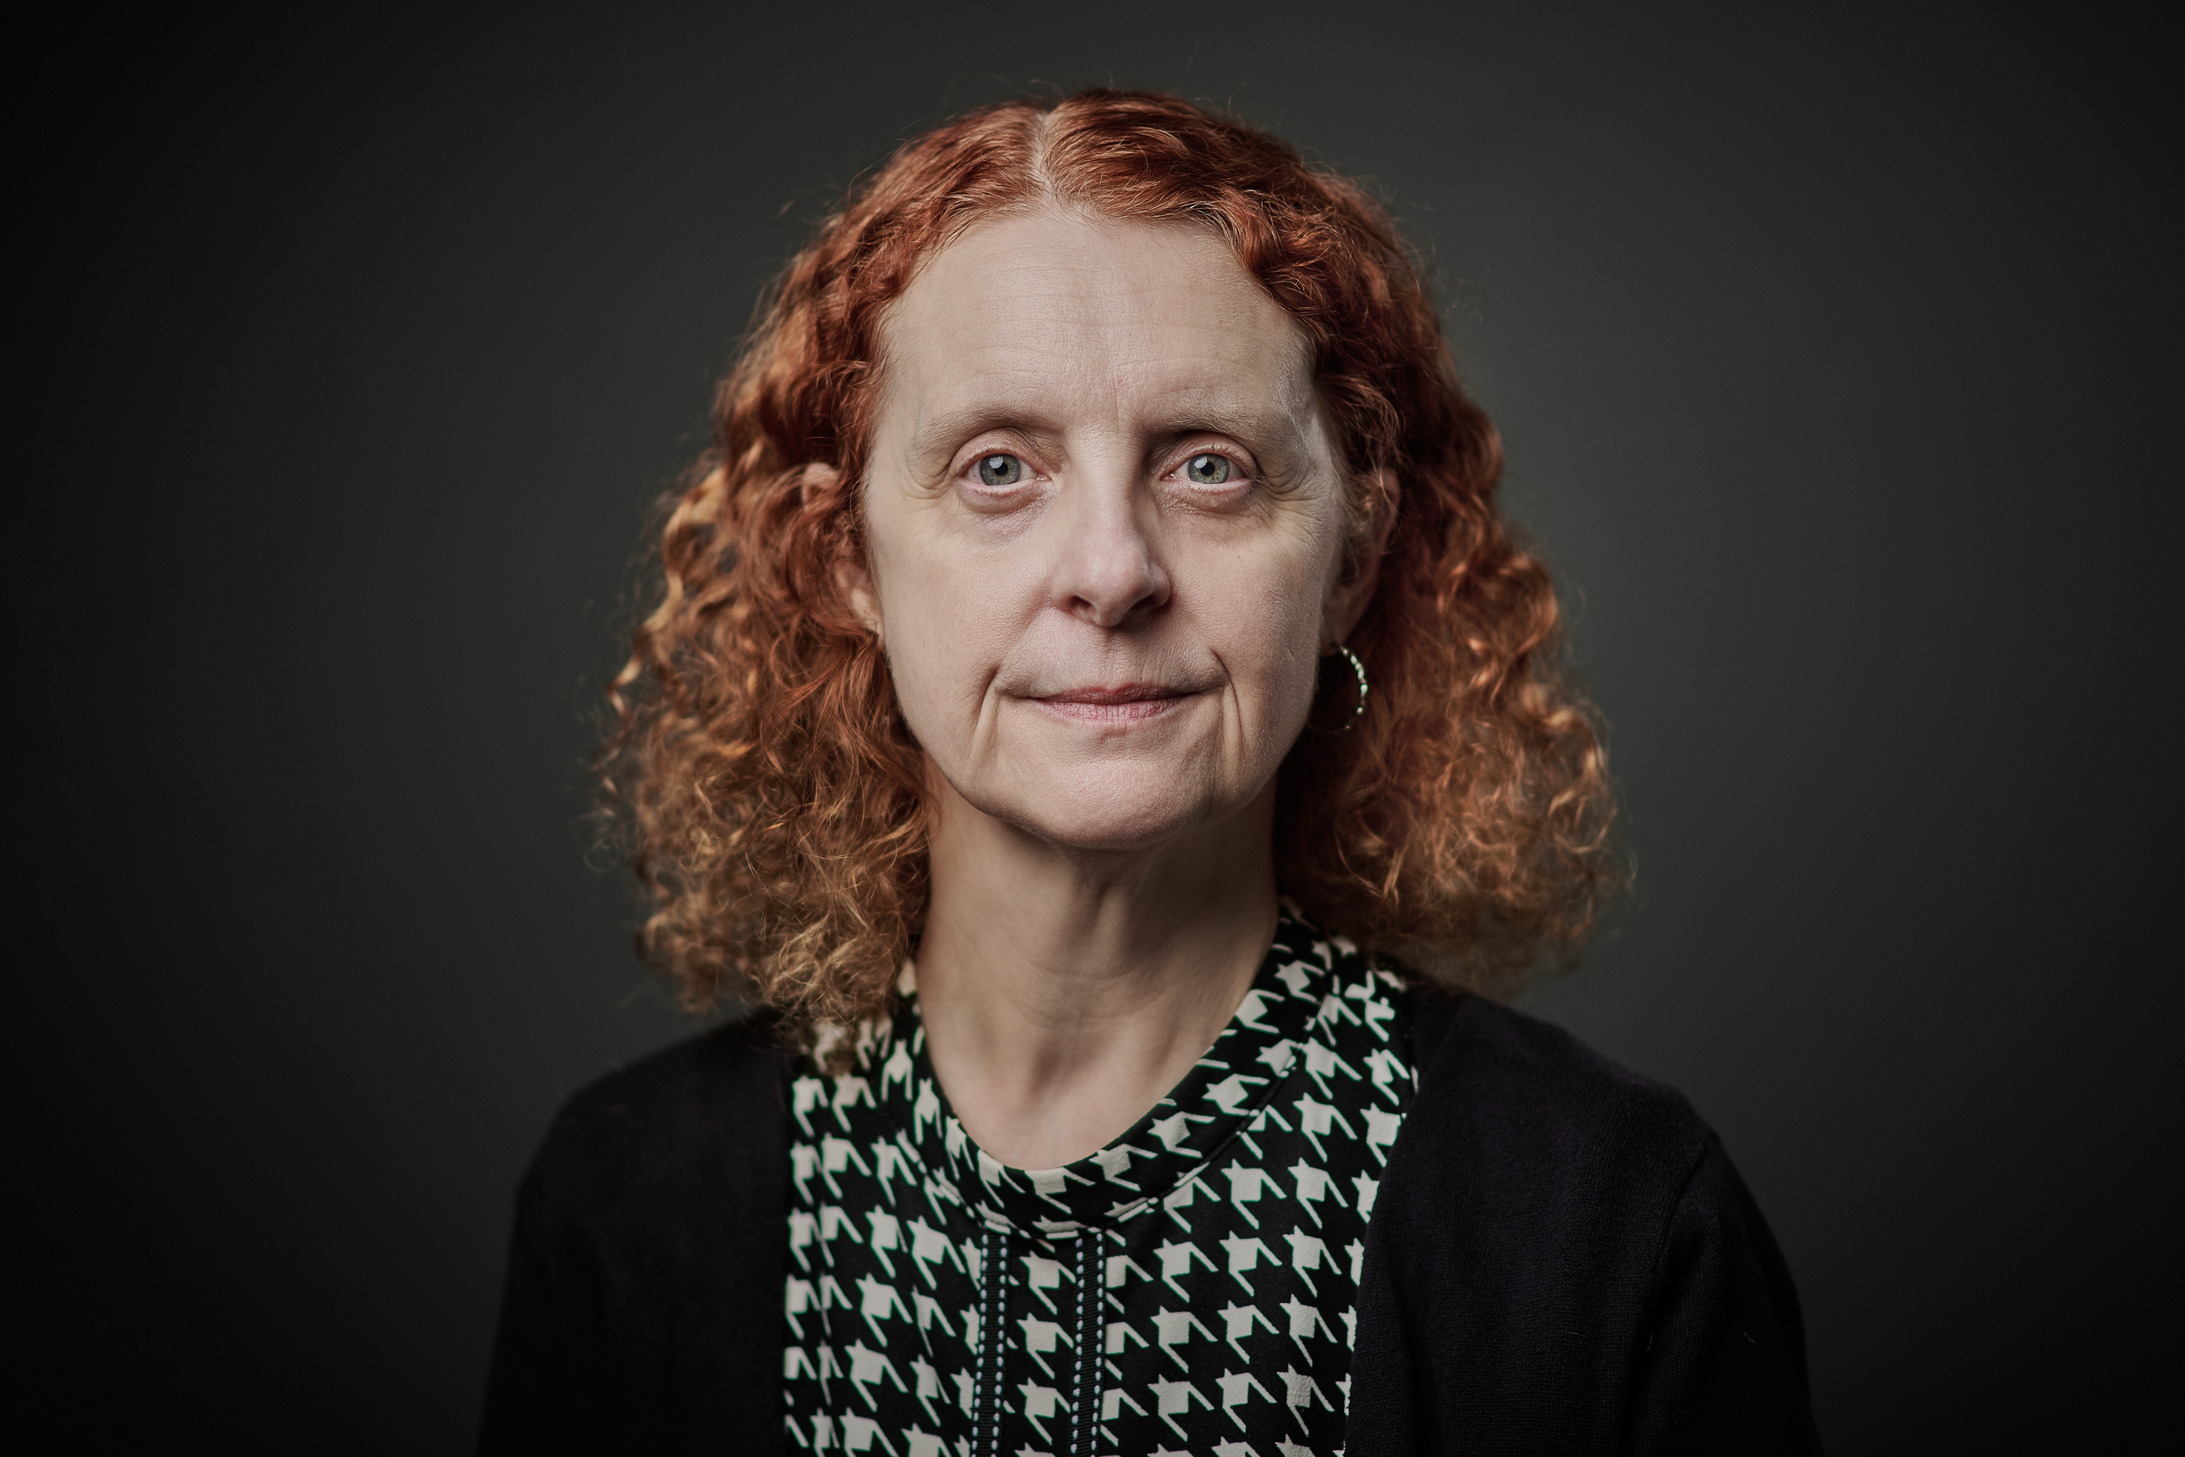
FEATURED EXPERT SPEAKER
Dr. Jennifer Furin, The BETTER Project
Jennifer Furin, MD., PhD, is an infectious diseases doctor and medical anthropologist with 30 years of experience working on drug-resistant tuberculosis (DR-TB). She is the current chair of The BETTER Project, a community of practice that is Building Experience Treating TB with Expanded Resistance. She is also an Associate Professor of Infectious Diseases at Case Western Reserve University. She specializes in the care of children, pregnant women, and people with highly resistant strains of TB.

Slide 5
NEW COMMUNITY MATERIALS ON DRUG-RESISTANT TB!
“The InSIDE Story on SIDE Effects During Treatment for Drug-Resistant Tuberculosis: What You Need to Know from Head to Toe”
This suite of materials is designed to build community treatment literacy on the side effects of medications used to treat DR-TB and to support community engagement in active drug safety monitoring and management (ADSM) initiatives.
The Resource Book
Empowers people to know the medications they are taking and to be active participants in their own care. It walks readers from "head to toe," covering the side-effects of the TB medications on each organ system and how they should be monitored and managed.
The Activity Book
Facilitates communication between people on treatment and their healthcare providers. It includes strategies and tools to help people better describe and track their symptoms and prepare for consultations with healthcare providers; and includes activities to help people feel more connected to their bodies.
The Wall Chart
A modern take on the classic anatomical posters often displayed in doctor's offices. It highlights the body parts affected by TB medications and prompts healthcare workers to ask questions about side-effects, their potential causes, and how they might be monitored and addressed.

Slide 6
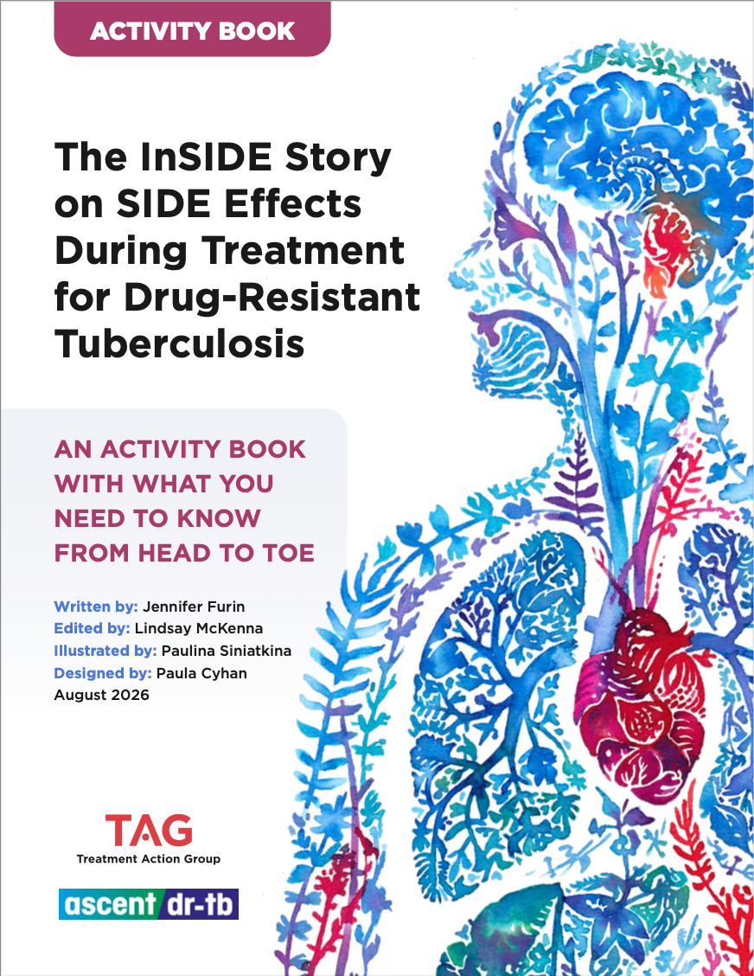
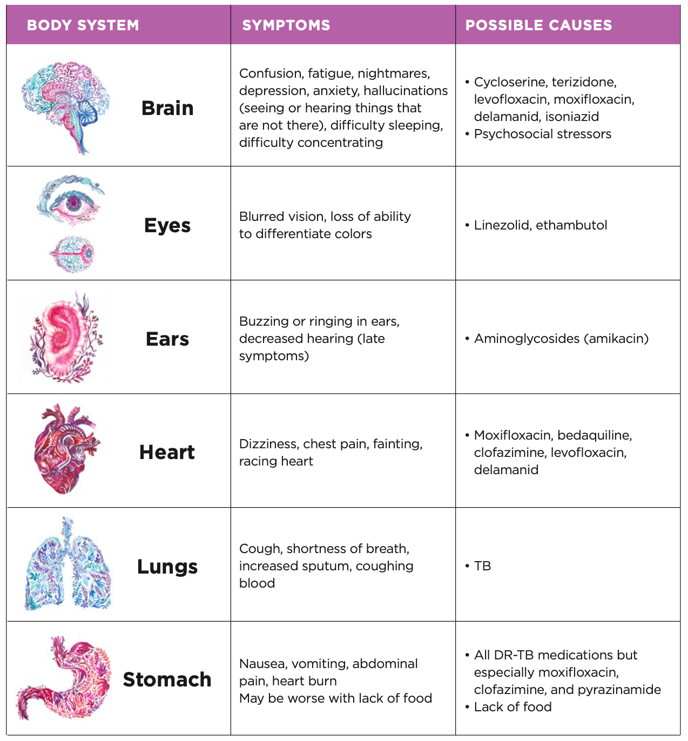
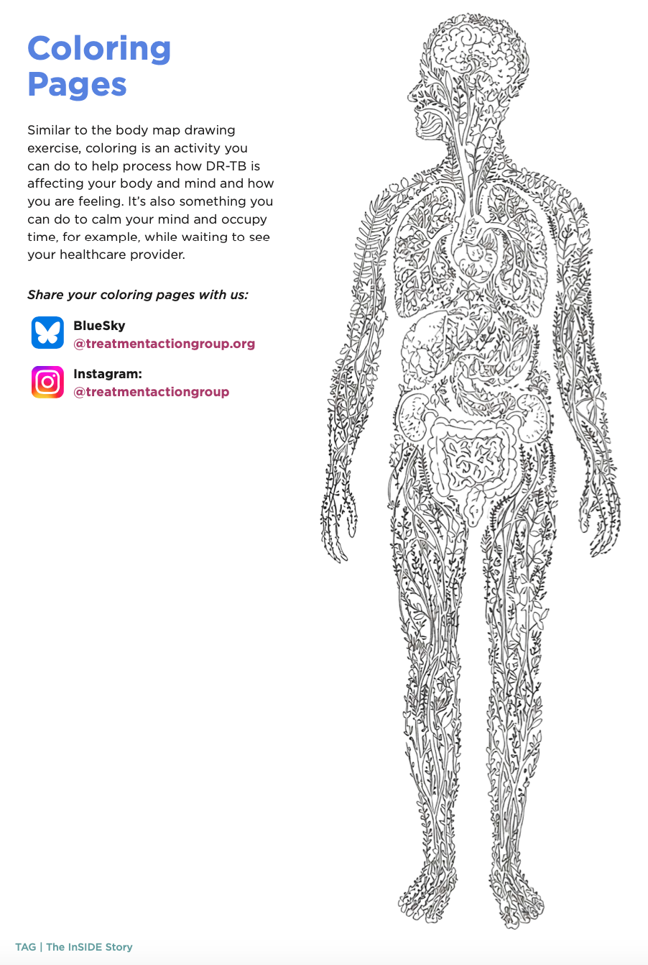
NEW COMMUNITY MATERIALS ON DRUG-RESISTANT TB!
Illustrations by Paulina Siniatkina, Artist and TB survivor
Notes:
Inspired by the idea that the body is a living ecosystem that is constantly growing, adapting, repairing, and transforming, like plants and nature.

Slide 7
COMMUNITY MATERIALS PUBLISHED IN 2025
NOW AVAILABLE IN MULTIPLE LANGUAGES
"An Activist’s Guide to Shorter Treatment for Drug-Resistant Tuberculosis" published in 2025 lays out what community advocates need to know about WHO-recommended regimens for drug-resistant TB. The Activist Guide reviews the evidence-base behind these regimens, important considerations for key populations affected by TB, the access landscape, and more. Also available in: Bahasa Indonesia, Hausa, Portuguese, Russian.
“Options for Treating Drug-Resistant Tuberculosis: Which Regimen is Right for Me?” compares key attributes, risks and benefits, and considerations related to the preferences and needs of the person undergoing treatment that should be discussed when determining which regimen to use. Also available in: Bahasa Indonesia, Portuguese, Russian, Zulu.
“Side Effects and Clinical and Laboratory-Based Monitoring of Treatment for Drug-Resistant Tuberculosis: What to Expect” walks through lab tests and clinical exams that people should expect to receive prior to treatment initiation, at regular intervals during treatment, and in response to specific problems or concerns. Also available in: Amharic, Bahasa Indonesia, Portuguese, Russian, Zulu.
“Talking with People About Your Diagnosis of Drug-Resistant Tuberculosis” is written to help people recently diagnosed with drug-resistant TB think about how to approach disclosing and discussing their diagnosis with family and other close contacts. Also available in: Amharic, Bahasa Indonesia, Portuguese, Zulu.

